Slide 1
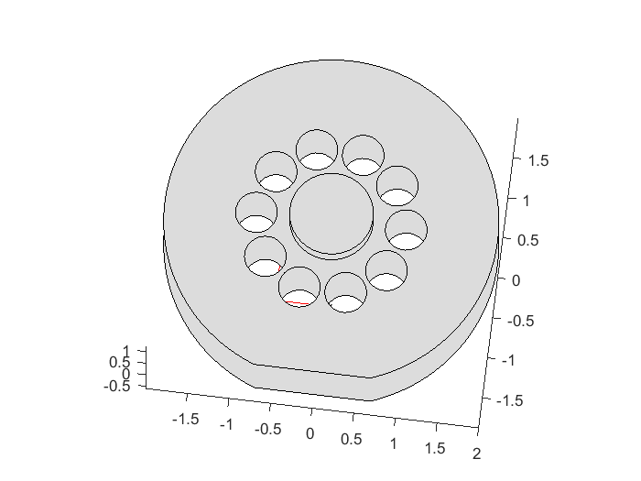

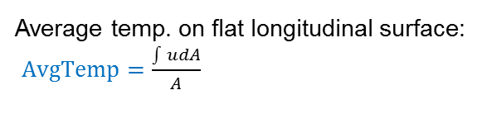



Protrusion face BC: $−\hat{n}∙c∇u+h_{c}u={h_{c}u}_{∞}$
All other faces BC: $−\hat{n}∙c∇u=0$
Holes faces BC:$−\hat{n}∙c∇u=Input$
Longitudinal face BC:$−\hat{n}∙c∇u+h_{c}u={h_{c}u}_{∞}$
and temp. spread: ${MaxMinSpread= u}_{max}−u_{min}$
Average temp. on flat longitudinal surface:
$AvgTemp=\frac{\int{udA}}{A}$
Objective: Find geometry that achieves target AvgTemp value with smallest total Input (operating cost) and smallest MaxMinSpread (temp. spread)

