Slide 1
An Evaluation of the Go Programming Language
Simon Salloum
s1347664

Slide 2
What, why and how?
What? Comparing performance of OpenMP and Go
Why? The rise of parallel computing
Why? Go vs. libraries -> general purpose vs. specificity
How? Set of benchmarks to run on clusters
4 sets of benchmarks: sequential, micro, component, suite
Different algorithms and patterns

Slide 3
Benchmarks
Sequential
Binary search, bubble sort, gcd/lcm, matrix multiplication
Micro
Broadcast, multiplex, ping, ping-pong
Component
Amicable numbers, merge sort, mandelbrot, dot product
Suite
Needleman-Wunsch (Bioinf.), SRAD (image processing), Particle Filter (medical imaging)

Slide 4
Workflow
Github
Focus on automation and incremental implementation
Issue -> Implement on dev. branch -> Push -> Merge

Slide 5
Progress
Stage 1
Sequential: implemented
Micro: implemented
Stage 2
Component: halfway through
Suite: only needs translation to Go
Experiments: stage one done

Slide 6
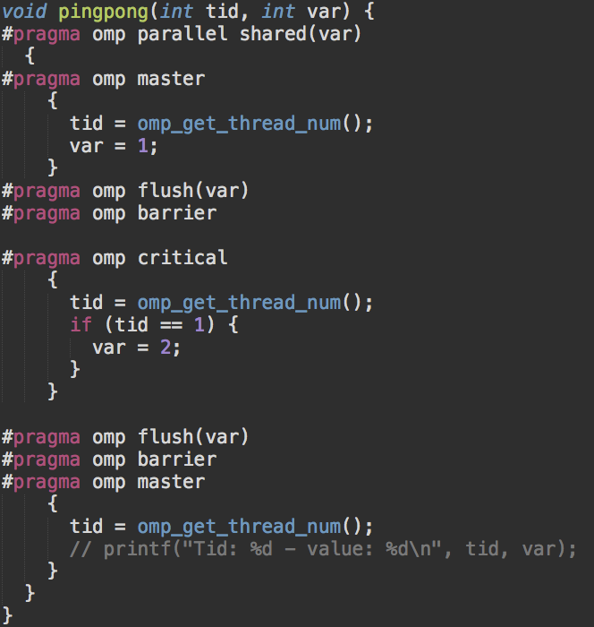
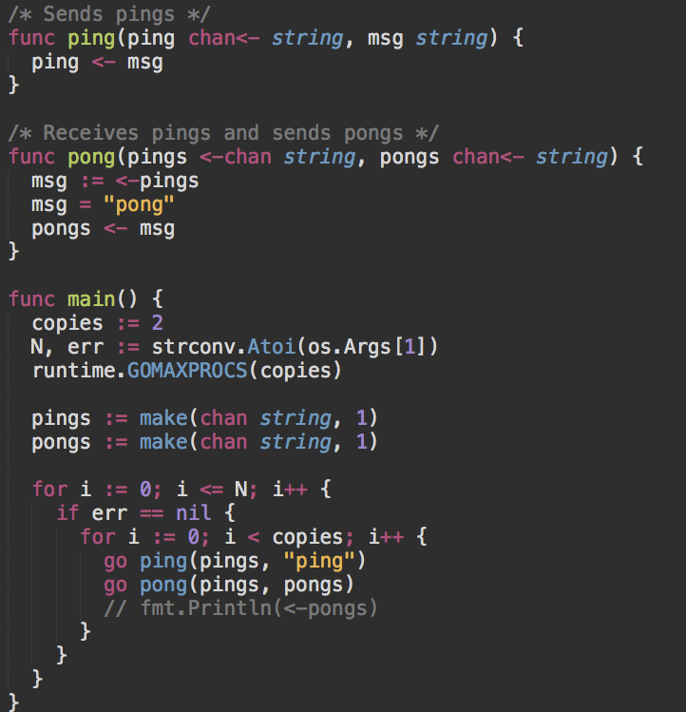
Ping-pong example

Slide 7
Next steps
https://github.com/ss1891/go-parallel-benchmarks
Github issue tracker to keep track
No deadlines, different levels of urgency
Urgent:
implement component and suite benchmarks
run second set of experiments

Slide 8
Timeline
No deadlines, but rough timeline from IRP:
July 15th: Component benchmarks implemented
August 1st: Suite algorithms implemented
August 5th: Analysis of results done
Plotting of results and writing done incrementally and concurrently with implementation

