Slide 1
Finding the prescribers a spend ranking cannot see
An analysis of Colorado Medicare Part D prescribing patterns, 2024
Caleb Edwards, M.D. · Data Analytics Bootcamp Capstone · Front Range Community College / Upright Education · August 2026
Notes:
Good morning. My name is Caleb Edwards. I spent the last several years as a general surgery resident, and I am moving into healthcare data analytics. For this capstone I took the 2024 Medicare Part D prescriber file for Colorado and asked one practical question: if a health system can only review a few hundred prescribers this year, which few hundred should it review? The short version of my answer is in the title. The list most organizations build — rank everybody by how much they spend — systematically misses about half of the prescribers who are actually unusual. I will show you why, and I will show you the 507 clinicians I would look at first. No prior knowledge of the data or the tools is needed. I will define everything as I go.

Slide 2
THE BUSINESS PROBLEM
Limited hours, thousands of prescribers
Medicare Part D is the prescription drug benefit for people on Medicare. CMS publishes, every year, what every prescriber in the country prescribed and what it cost.
Colorado, 2024
$2.74B
The decision this project supports:
Which prescriber segments should a health system prioritize for outreach, education, or further review — and on what evidence?
total Part D drug cost
19,390
prescribers
The file is public and contains no patient identifiers — no PHI.
1,177
generic drugs
Source: CMS Medicare Part D Prescribers by Provider and Drug, 2024 Colorado extract (data.cms.gov). Figures: FINDINGS.md.
Notes:
Part D is the outpatient prescription drug benefit under Medicare. It is run through private plans, and CMS publishes a public file every year showing what each prescriber prescribed and what those prescriptions cost. There is no patient identity in it — no PHI. For Colorado in 2024 that is two point seven four billion dollars, spread across roughly nineteen thousand prescribers and about eleven hundred generic drugs. Now put yourself in the seat of a population health team at a health system or a plan. You have a handful of pharmacists and maybe one medical director. You cannot review nineteen thousand people. You can review a few hundred. So the decision is: which few hundred, and what is the evidence for picking them? That is the whole project.

Slide 3
THE CHOICE BEHIND THE ANALYSIS
There are two ways to build a review list
A
Rank everyone statewide
B
Compare each prescriber to their own specialty
Sort all 19,390 prescribers by spend, or by cost per prescription, and take the top of the list.
Simple. Fast. It is what most programs do.
But an oncologist and a dentist end up on the same list. The ranking is measuring what kind of medicine you practice, not how you practice it.
Rank each prescriber only against peers in the same specialty, then flag the ones sitting above their own peer group.
Harder to build. Requires the full file.
A family practice clinician is compared to family practice, an oncologist to oncology. Case mix is held roughly constant.
This project tests whether the harder list is worth building.
Notes:
Before any data, here is the fork in the road. Option A is the list almost everyone builds. Sort all nineteen thousand prescribers by spend, take the top, go talk to those people. Easy, and defensible on its face. The problem is that an oncologist and a dentist land on the same ranking. Cancer drugs cost thousands of dollars a prescription because they are cancer drugs. So a statewide ranking mostly measures what kind of medicine somebody practices, not how they practice it. Option B compares every prescriber only to peers in their own specialty. That is more work — you need the whole file and percentiles inside every specialty. The entire analysis is a test of whether option B is worth it. Hold onto that, because everything after this is evidence one way or the other.

Slide 4
DATA AND PREPARATION
One file, 390,473 rows, and nothing thrown away
One row per prescriber, per brand, per generic drug — 22 columns covering claims, 30-day fills, day supply, drug cost, and beneficiary counts.
100% of rows are Colorado. The extract is pre-filtered, so no state filter was applied.
Ten numeric columns loaded as text and were converted to numbers. No value failed to parse.
Zero duplicate rows, and zero prescribers mapped to two different specialties or two different cities.
Every blank was left blank. Nothing was imputed, filled, or dropped — blanks in this file are CMS privacy suppressions, not errors.
Reconciliation
Measure | Raw | Cleaned
Rows | 390,473 | 390,473
Drug cost | $2.7375B | $2.7375B
Claims | 16,573,710 | 16,573,710
Prescribers | 19,390 | 19,390
Specialties | 97 | 97
390,473 in, 390,473 out. No delta to explain.
Documented in CLEANING.md — 10 steps, each with a row count before and after.
Source: CLEANING.md Steps 1–10, reproducible from the raw CSV with pandas.read_csv(..., encoding='utf-8-sig').
Notes:
The data is one CSV: three hundred ninety thousand rows, twenty-two columns. Each row is one prescriber, one drug, for the year — how many claims and what it cost. Preparation was deliberately conservative. I converted the ten numeric columns from text to numbers, and not one value failed to convert. No duplicate rows. No prescriber showing up under two specialties. The judgment call worth naming: I did not fill in blanks. In this file a blank is not a mistake — CMS blanks out any cell that would identify a small number of patients. Filling those with zero would have invented data. So the reconciliation on the right is the point of the slide. Same row count in and out, and the dollar total ties to the penny. Every number today comes back to that file.

Slide 5
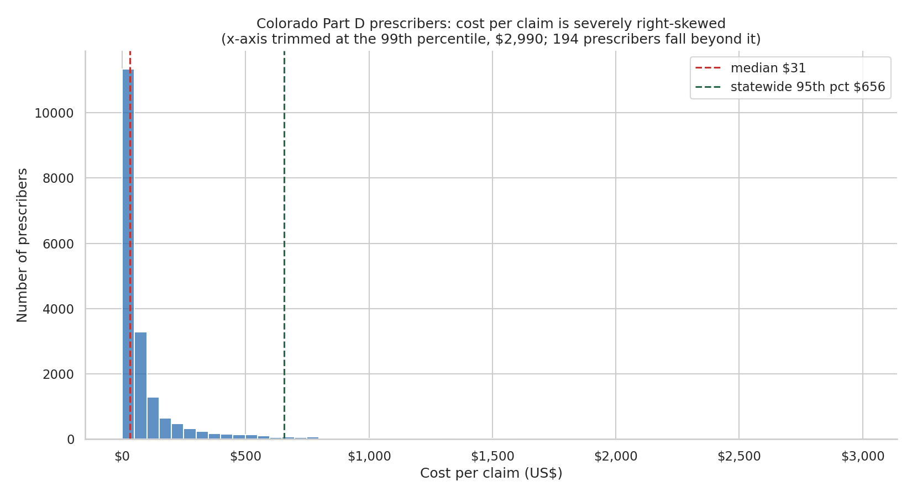
DATA AND PREPARATION
Cost per prescription, not cost per patient
Cost per patient would be the natural measure — but the patient-count column is blank on 58.9% of rows under CMS privacy suppression. It cannot be a denominator.
Claims and drug cost are complete: 0% blank. So the unit metric is cost per claim, with cost per 30-day fill as a companion.
That distribution is severely right-skewed: median $31.09, mean $193.65.
Skew that severe rules out tests that assume a normal distribution as the primary evidence — which drove the statistics on the next slides.
Chart: stage3_01_cost_per_claim_distribution.png. Blank rates: CLEANING.md Step 6. Median and mean: FINDINGS.md F1.
Notes:
One preparation decision shaped everything downstream, so it gets its own slide. The measure you would want is cost per patient. I could not compute it — the patient-count column is blank on fifty-nine percent of rows because of that privacy suppression. A denominator missing more than half the time is not a denominator. What is complete is claims and dollars, zero percent blank on both. So the unit of measure throughout is cost per prescription claim. The chart shows what that looks like. The typical prescription costs about thirty-one dollars; the average is a hundred ninety-three. When the average is six times the middle, you have a long tail of very expensive drugs pulling on it. That is why I leaned on tests that do not assume a bell curve.

Slide 6
METHODOLOGY
Four tools, one question, each layer checking the last
1
2
3
4
Excel
SQL
Python
Tableau
Aggregate tables straight from the raw extract. The fast first pass — and the tie-out that every later number is checked against.
The full 390,473-row file as system of record. Percentile window functions (NTILE) build the peer bands and identify outliers inside each specialty.
pandas and seaborn. Tests which dimension actually explains cost, ranks prescribers inside their own specialty, and produces the seven charts.
The executive layer — the prioritized segments in a form a population health director can act on, paired with a one-page memo.
Substitution, stated openly: the proposal called for regression. Regression was never covered in this curriculum, so the same question — which dimension drives cost — is answered with ANOVA, Kruskal–Wallis, and within-specialty percentile ranking.
Notes:
The pipeline is four tools, deliberately in this order. Excel first — aggregate tables straight off the raw file. That is the reference every later number gets checked against. SQL second, on the full file. This is where the peer groups get built: percentile window functions that rank each prescriber inside their own specialty. Python third, for the statistics and the charts. Tableau last, as the executive view a director would actually open. One thing I want to say plainly, because it will get asked. My proposal said regression. Regression was never taught in this program. Rather than import a library I could not explain line by line, I answered the same question with methods that were taught — analysis of variance, Kruskal-Wallis, and percentile ranking. I would rather defend a simpler method I understand completely.

Slide 7
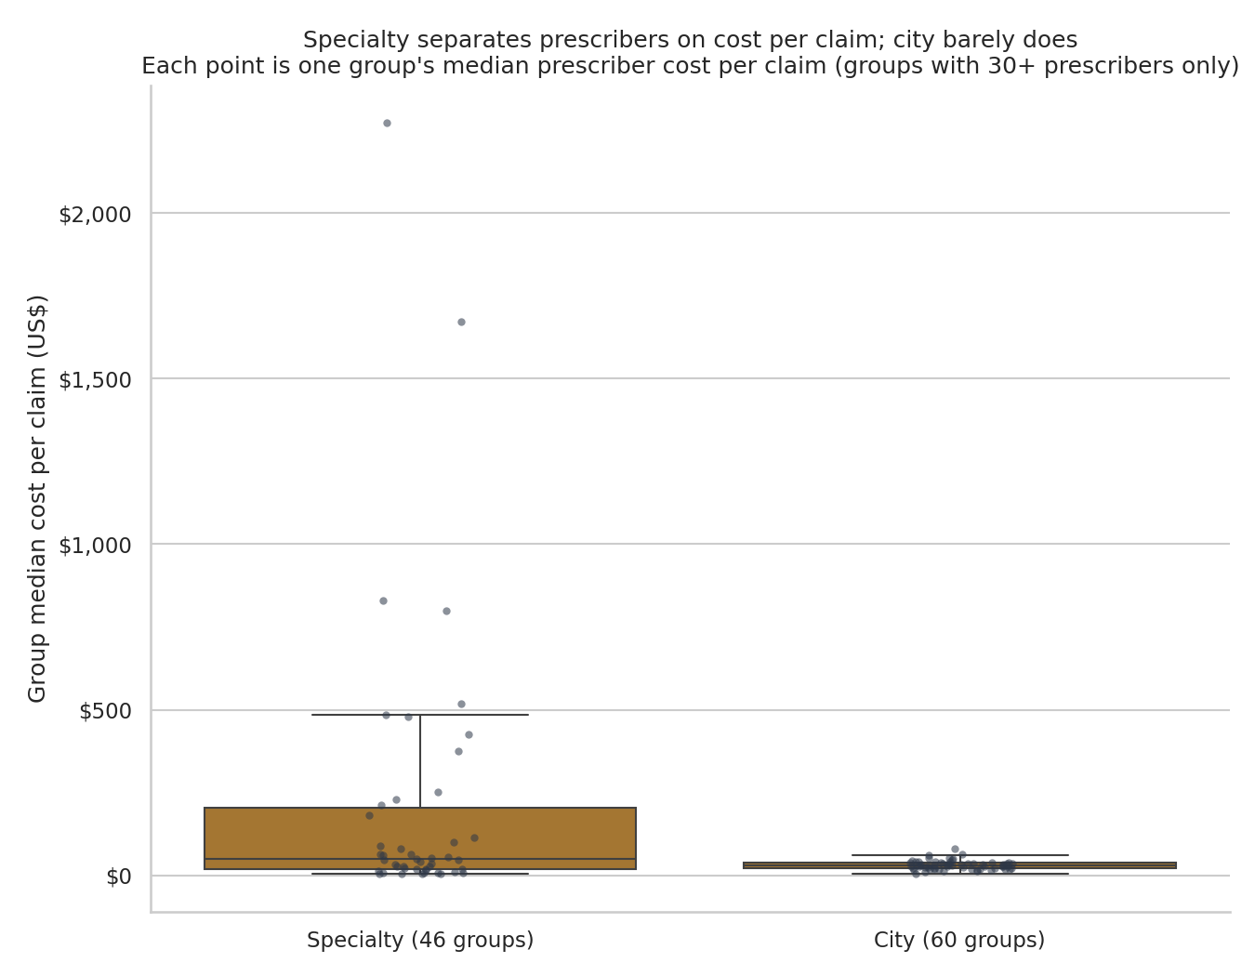
FINDING 1
Specialty drives cost. Geography barely matters.
Specialty
11.2×
spread in median cost per claim between the middle half of the 46 qualifying specialties
City
1.8×
the same spread across the 60 qualifying Colorado cities
Both dimensions are statistically significant. Only one is practically significant.
Chart: stage3_05. Kruskal–Wallis H = 8,608.94 (specialty) vs 254.96 (city), both p < 0.001. FINDINGS.md F1. City = the 60 raw CMS city strings, 28 spelling variants unnormalized (QUESTIONS.md Q1); no regional grouping was tested.
Notes:
First finding. I tested two ways of grouping prescribers — by specialty and by city — to see which one actually explains cost per prescription. Both came back statistically significant. That sounds like a result and it is not. With nineteen thousand prescribers, almost anything comes back significant. The question is how big the difference is. Specialty: the middle half of specialties differ eleven-fold on typical cost per prescription. City: one point eight fold. That is essentially noise. So city-level geography is off the table as a targeting dimension, and specialty is the one that matters. Two caveats I will own: I tested the city names as CMS published them, without normalizing twenty-eight spelling variants, and city is not the same as region — a rural-versus-urban cut might show something. I did not run it, so I am not claiming geography is empty. I want to flag the reasoning move, because it is the most important one in the project: significant is not the same as important. I reported both and let the size of the effect decide.

Slide 8
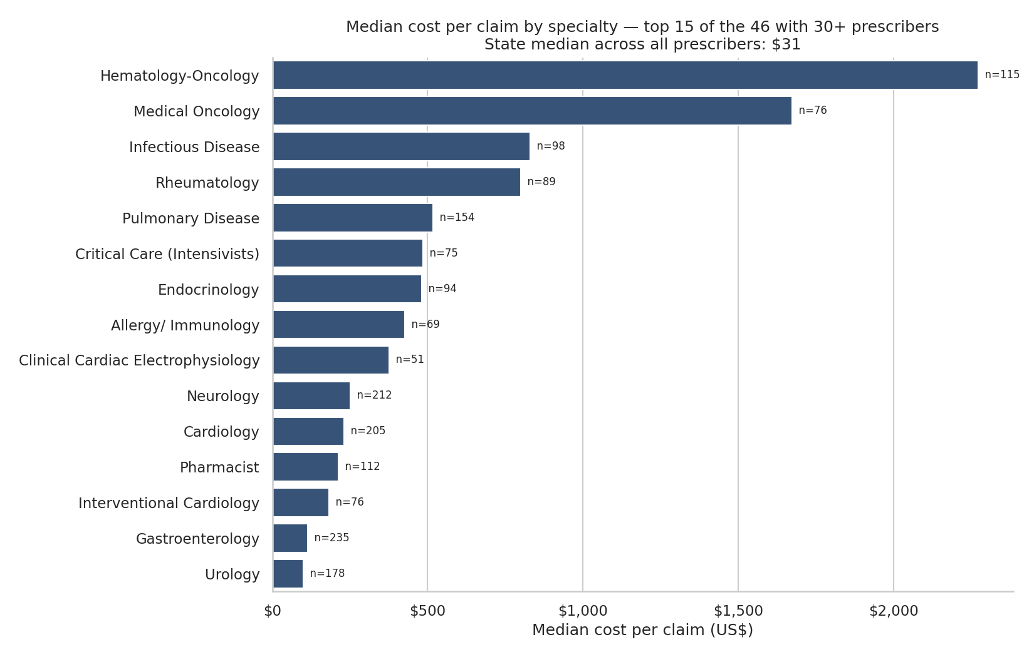
FINDING 1, CONTINUED
One list holds a $3.89 specialty and a $2,272 specialty
584×
separates the cheapest qualifying specialty from the most expensive on median cost per claim.
This is case mix, not behavior. Any ranking that ignores it is ranking specialties in disguise.
Chart: stage3_03_median_cost_per_claim_by_specialty.png. Specialties with ≥30 prescribers only. FINDINGS.md F1.
Notes:
This is the same finding, made concrete. Every bar is one specialty, sorted by the typical cost of one prescription. At the top, specialties where a single prescription runs into the thousands — oncology, pulmonary. At the bottom, a few dollars. The full range is five hundred eighty-four fold. None of that is a behavior problem. That is what treating cancer costs versus what treating a routine condition costs. One methodological note. I only included specialties with at least thirty prescribers, because a specialty with four people in it produces a median you cannot trust. That rule drops fifty-one of ninety-seven specialties, but those fifty-one hold only about three percent of the money, so I am not hiding much. The takeaway: rank statewide, and you have built a list of oncologists.

Slide 9
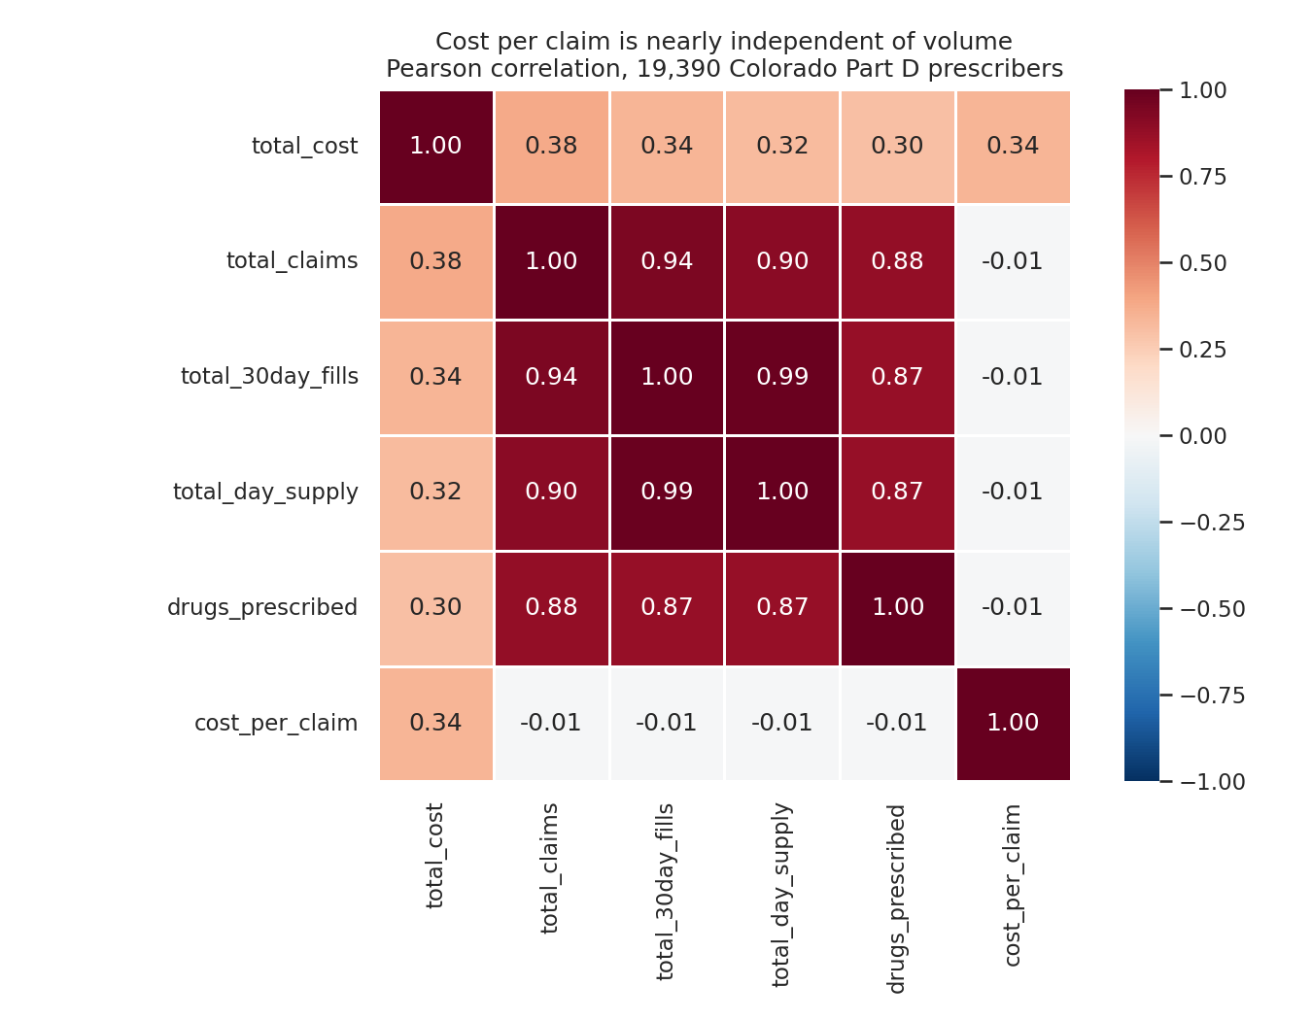
FINDING 2
Spending a lot and charging a lot are unrelated
−0.011
correlation between cost per claim and claim volume
A correlation of zero means the two measures carry no information about each other. Knowing how much a prescriber spends tells you nothing about whether their prescriptions are expensive.
So a high-spend review list and a high-unit-cost review list are not two versions of the same list. They are lists of different people.
Chart: stage3_07_prescriber_measure_correlation_heatmap.png. Pearson r, prescriber level. FINDINGS.md F4.
Notes:
Second finding, and this one surprised me. I checked whether the prescribers who spend the most are also the ones whose individual prescriptions are most expensive. The correlation is negative zero point zero one one. That is zero. Read it plainly: knowing a prescriber spent two million dollars tells you nothing about whether their prescriptions are expensive. High spend usually just means high volume — a busy clinic seeing a lot of patients. This is the justification for the whole project. If those two measures moved together, a spend ranking would be a fine shortcut and none of this would be worth doing. They do not. So a program reviewing the biggest spenders is reviewing a volume list, and it will miss everyone whose issue is price per prescription.

Slide 10
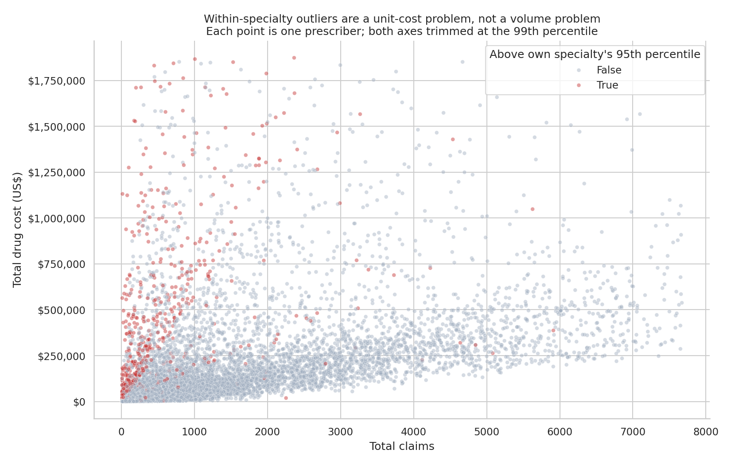
FINDING 3
Half the prescribers who stand out among peers are invisible statewide
431 flagged statewide only — high unit cost, but perfectly normal for their specialty.
498 flagged by both methods — the overlap.
467 flagged only against their own peers — 48% of the within-specialty list, and they never appear on a statewide ranking at all.
965 prescribers — 5.1% of the state — sit above their own specialty’s 95th percentile and carry 22.1% of spend.
Chart: stage3_06_within_specialty_outliers_scatter.png. FINDINGS.md F2, F3. Flag rule: cost per claim above the prescriber’s own specialty p95.
Notes:
Here is the test of that fork from earlier. I built both lists and compared them. Four hundred thirty-one prescribers show up on the statewide list only — expensive prescriptions, but completely ordinary for their field. Four hundred ninety-eight show up on both. And four hundred sixty-seven show up only when compared to their own peers. That is forty-eight percent of the within-specialty list, and a statewide ranking never surfaces them. So the statewide list is roughly half noise, and it misses about half the real signal. Altogether nine hundred sixty-five prescribers — five percent of the state — sit above their own specialty's ninety-fifth percentile and carry twenty-two percent of the money. That is a review list you could actually staff.

Slide 11
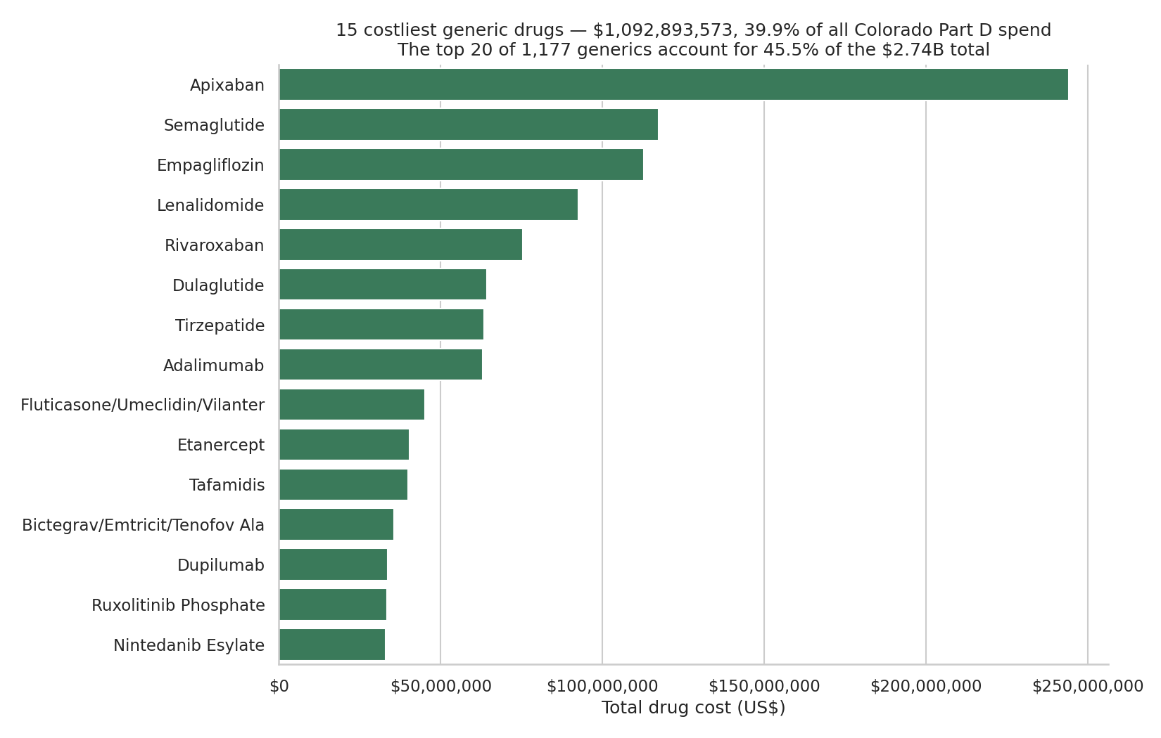
FINDING 4
The money is concentrated — 20 drugs carry 45% of it
Share of the $2.74B
Top 10 drugs
33.5%
Top 20 drugs
45.5%
Top 100 drugs
79.0%
Top 100 prescribers
18.5%
Top 10% of prescribers
71.9%
1.7% of the drug list carries nearly half of Colorado Part D spend. That is what makes a targeted review economically worth doing.
Chart: stage3_04_top15_generic_drugs_by_spend.png. Concentration figures: FINDINGS.md F5.
Notes:
One more piece before the recommendation, and this one is about feasibility rather than fairness. Colorado Part D spend is extremely concentrated. Ten drugs account for a third of two point seven four billion dollars. Twenty account for forty-five percent. Twenty out of eleven hundred — that is under two percent of the drug list holding almost half the money. The same shape holds on the prescriber side. The top ten percent of prescribers carry seventy-two percent of the spend. Why this matters: it means a targeted program is worth building. If the money were spread evenly across eleven hundred drugs and nineteen thousand prescribers, no review list would move the needle and I would be telling you to do nothing. Concentration is what makes a few hundred conversations financially meaningful.

Slide 12
RECOMMENDATION
Review these 507 clinicians first — as one cohort
Specialty | Outliers / prescribers | Spend flagged | % of specialty spend | Cost per claim (wtd)
Nurse Practitioner | 176 / 3,509 | $109.3M | 27.8% | $137
Physician Assistant | 151 / 3,010 | $106.7M | 41.6% | $147
Internal Medicine | 65 / 1,292 | $60.3M | 19.1% | $98
Family Practice | 115 / 2,288 | $41.3M | 11.7% | $73
Hematology-Oncology | 6 / 115 | $33.0M | 14.5% | $2,652
Urology | 9 / 178 | $26.7M | 53.0% | $320
Pulmonary Disease | 8 / 154 | $25.6M | 24.8% | $907
Cardiology | 11 / 205 | $24.1M | 17.9% | $272
$317.6M
is held by flagged prescribers across the top four segments — 54% of all within-specialty outlier dollars in Colorado, spread across 507 clinicians.
Second tier: Urology
Nine prescribers hold 53% of the entire specialty’s spend — the highest concentration on the list. Nine charts is a day of work.
Ranked by spend flagged — the 2024 drug cost held by prescribers above their own specialty’s 95th percentile, which is the money a peer-based review would actually be looking at.
Priority table: FINDINGS.md “Recommended priority segments”. Outlier rule: cost per claim above the prescriber’s own specialty 95th percentile. Cost per claim in this table is specialty-weighted (total cost ÷ total claims), so it runs higher than the prescriber-level medians on Finding 1.
Notes:
So who do you review? This table ranks specialties by spend flagged — the drug cost held by prescribers sitting above that specialty’s own ninety-fifth percentile. One note on the cost-per-claim column: it is specialty-weighted, total cost over total claims, which is why oncology reads higher here than the median I showed on Finding 1. My recommendation is the four highlighted rows, reviewed as one cohort of five hundred seven clinicians. Here is the reasoning, and it is the argument for the whole method. Nurse practitioners, physician assistants, internal medicine, family practice are the four cheapest segments on this list — seventy-three to a hundred forty-seven dollars a prescription. And yet their outliers hold three hundred seventeen million dollars, fifty-four percent of all outlier dollars in the state. Those people are invisible to a statewide screen. A six-hundred-dollar claim looks unremarkable next to oncology and extraordinary next to a family practice peer group whose typical claim is seventy-three dollars. Second tier is urology, for a different reason: nine prescribers hold fifty-three percent of that specialty's entire spend.

Slide 13
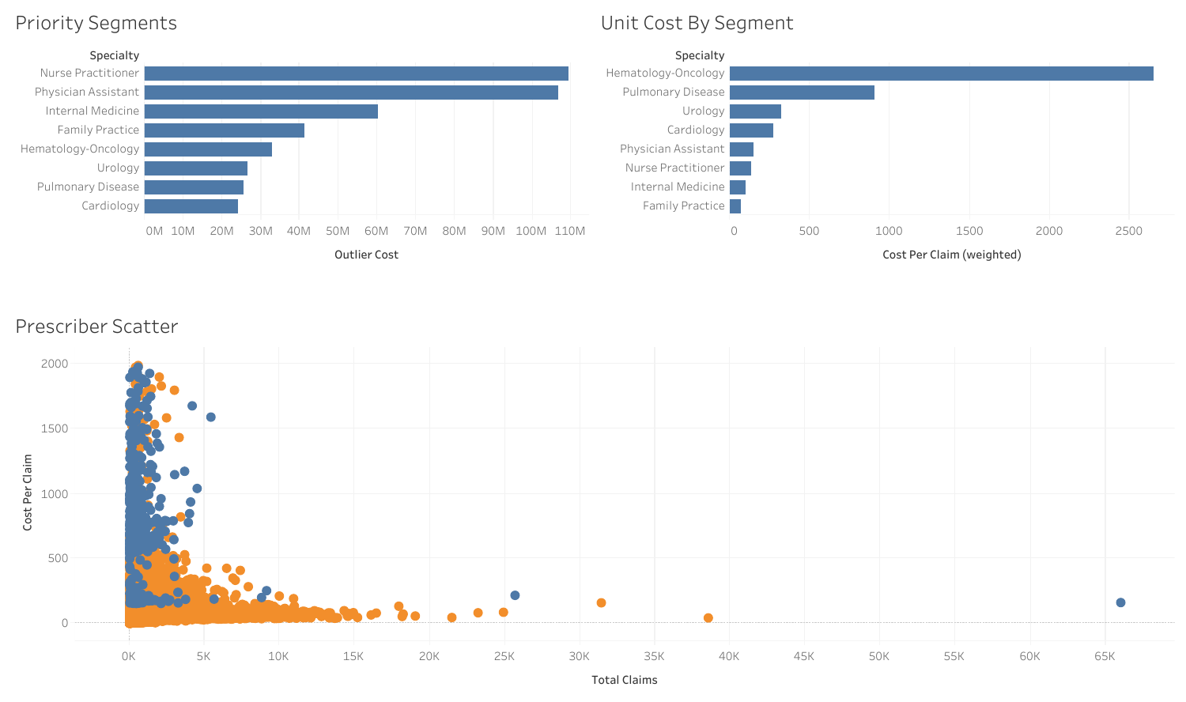
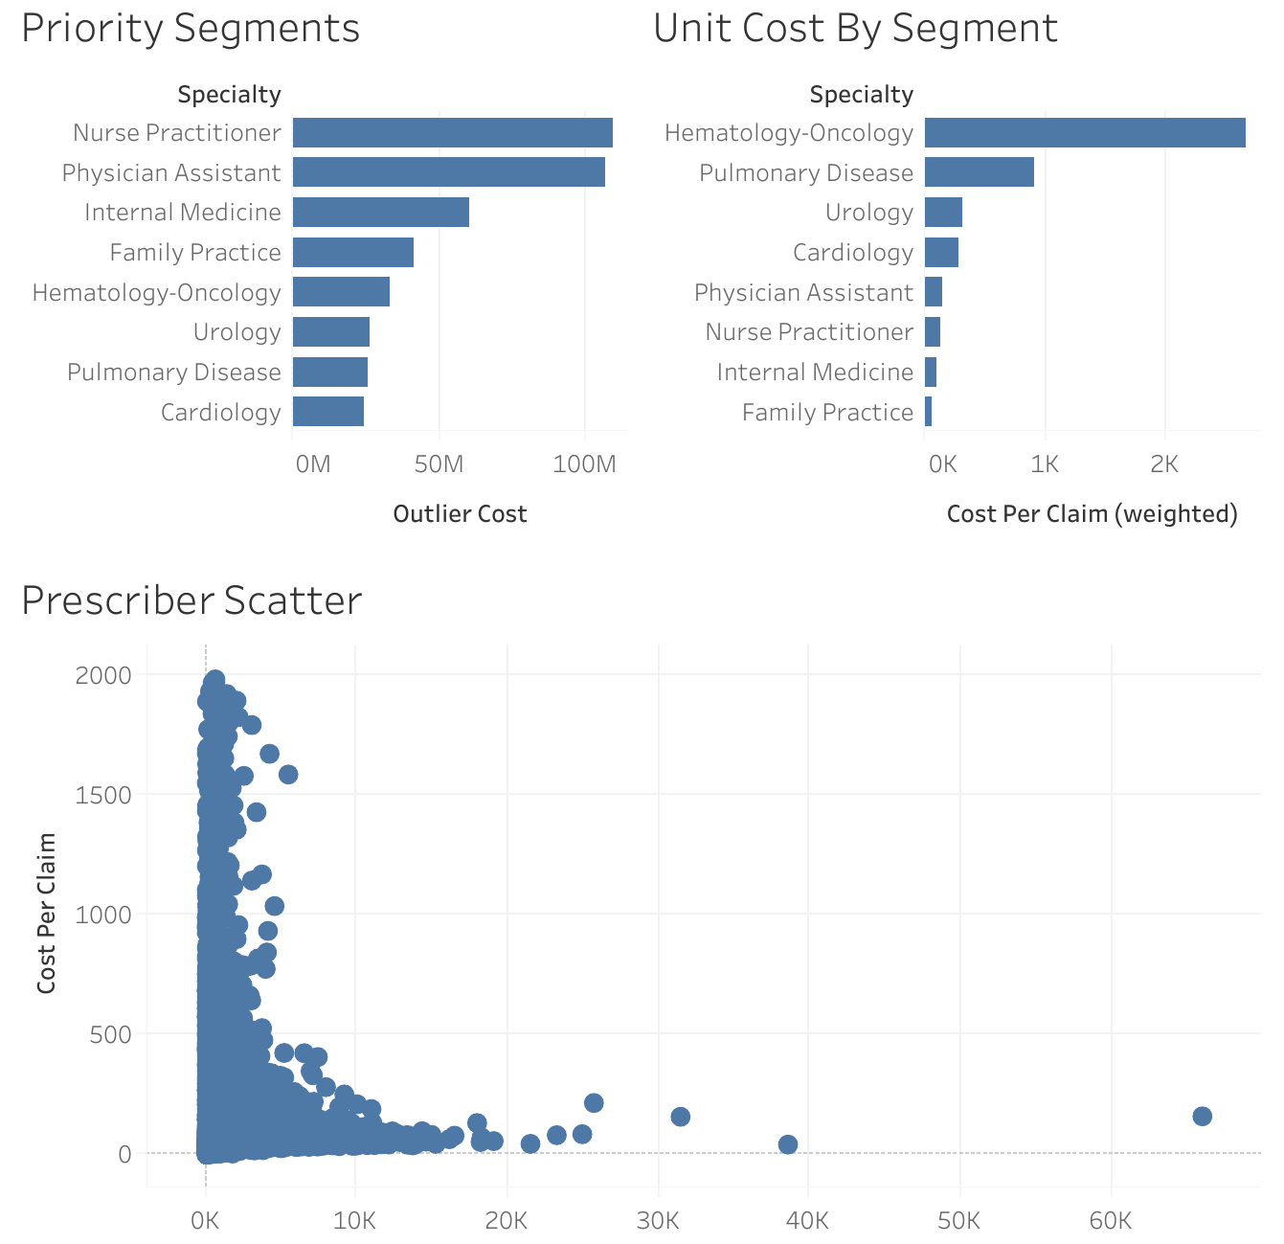
THE EXECUTIVE VIEW
The same finding, in the view a director would open
1st vs 6th
Nurse Practitioner is first on flagged spend and sixth on cost per claim. Hematology-Oncology is fifth and first.
Almost inverted. In the scatter, blue marks the 965 prescribers above their own specialty's 95th percentile.
Tableau workbook: CO Medicare Part D Dashboard.twbx, built on tableau_prescriber_segments.csv — 18,940 prescribers, 46 qualifying specialties. Figures reconcile to FINDINGS.md.
Notes:
This is the executive layer — the fourth tool, and the one a population health director would actually open.
Three worksheets and a dashboard on a prescriber-level extract of the same file: eighteen thousand nine hundred forty prescribers across forty-six specialties.
Top left is the priority ranking by flagged spend. Top right is cost per claim for those same eight segments, weighted.
Look at how differently they sort. Nurse practitioners are first on the left and sixth on the right. Hematology-oncology is fifth on the left and first on the right, by a mile. That inversion is the whole argument in one picture — the segments holding the most reviewable money are the cheap ones per prescription, and a unit-cost screen would skip right past them.
The scatter underneath is every qualifying prescriber. Blue is the nine hundred sixty-five sitting above their own specialty's ninety-fifth percentile, orange is everyone else. Notice the blue sits high on price and low on volume — that is the same point Finding 2 made with a correlation of zero.
It is interactive: clicking a specialty filters the other two panes, so I can drill into any segment live.

Slide 14
LIMITS
What this analysis does not say
1
No clinical context
2
Deprioritize the expensive specialties
The file has no diagnoses, no severity, no panel composition. An outlier here is a statistical outlier — a reason to look, never a finding of waste or wrongdoing.
Oncology, pulmonary and cardiology rank high on dollars because their drugs genuinely cost more. The residual peer-level signal is real but small, and the clinical justification is stronger.
3
Cost is gross, not net
4
One year, one state, and 51 specialties excluded
Tot_Drug_Cst is the gross point-of-sale price — what the plan, the patient and third parties paid combined, before manufacturer rebates — so cross-drug comparisons overstate the spread on rebated brands.
2024 Colorado only — no trend, no national benchmark. The ≥30-prescriber rule drops 51 of 97 specialties, covering 2.3% of prescribers and 3.0% of spend.
Source: FINDINGS.md “What these findings do not establish” and CLEANING.md Data Limitations. The 65-and-over split was built in SQL but is not reported: those columns are suppressed on 42.1% of rows (QUESTIONS.md Q9).
Notes:
I want to be careful about what I am not claiming, because this is data about real clinicians. Most important: the file has no diagnoses and no patient severity. A prescriber above their peer group is a statistical outlier, not a bad doctor. It is a reason to look at a chart. It is not a finding of waste, and it is certainly not an accusation. Second, and this is a recommendation as much as a limit: I am deliberately deprioritizing oncology, pulmonary and cardiology even though they rank high on dollars. Their drugs cost more because those drugs cost more. Spend reviewer hours where the peer gap is harder to explain. Third, the cost figure is gross rather than net — it is the point-of-sale price, everything the plan, the patient and any third party paid combined, and it is before manufacturer rebates. One more I will name if it comes up: I built the sixty-five-and-over split in SQL but I am not reporting it, because those columns are suppressed on forty-two percent of rows and reporting a difference there would have meant an imputation decision I chose not to make quietly. And fourth, this is one year, one state, and I excluded fifty-one small specialties holding three percent of the money.

Slide 15
NEXT STEPS
What I would do next
1
Run the 507-clinician cohort as a pilot
Peer-comparison letters and pharmacist outreach, then measure whether the peer gap narrows in the next data year.
2
Scope a formulary review to 20 drugs
Those twenty carry 45.5% of state spend — the cheapest structural lever available.
3
Rebuild the flag with clinical context
Diagnoses and panel composition would turn a statistical outlier into an actionable one. That data lives inside a health system, not in a public file.
4
Repeat on the 2023 file
One year cannot separate a persistent pattern from a single unusual year. Two can.
Thank you — questions welcome.
Caleb Edwards, M.D.
Notes:
Four next steps. One: run the five hundred seven as a pilot — peer-comparison letters and pharmacist outreach, then check next year's file to see whether the gap narrowed. That is a measurable intervention, not a report that sits on a shelf. Two: scope a formulary review to the top twenty drugs. Forty-five percent of the spend, twenty drugs. Three: rebuild the flag with clinical context. Diagnoses and panel data would turn a statistical outlier into an actionable one, and a health system has that internally. Four: run the same analysis on the 2023 file, because one year cannot separate a persistent pattern from an unusual year. To close where I started: the list everybody builds misses about half the prescribers who are genuinely unusual, because spend and unit cost turn out to be unrelated. Comparing people to their own specialty finds a different, smaller, more defensible list. Thank you — happy to take questions.

