Slide 1
Value vs. Growth Through Time
Do cheap stocks still beat expensive ones, and what makes them valuable?
Samantha Impellizeri · FIN 4975 — Data Analysis in Finance · Prof. Adam Aiken · Spring 2026

Slide 2
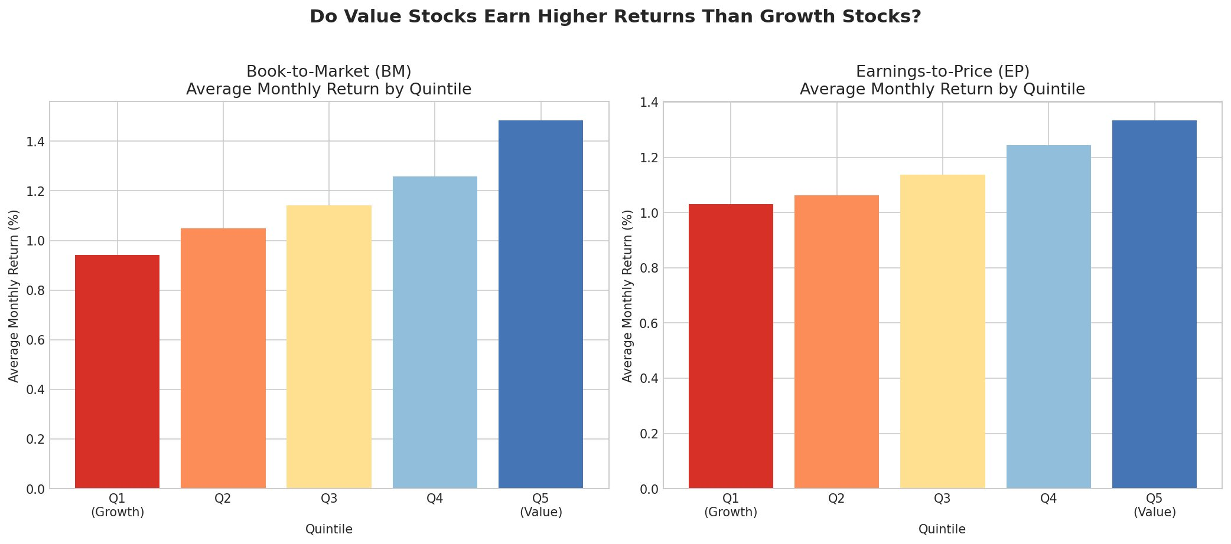
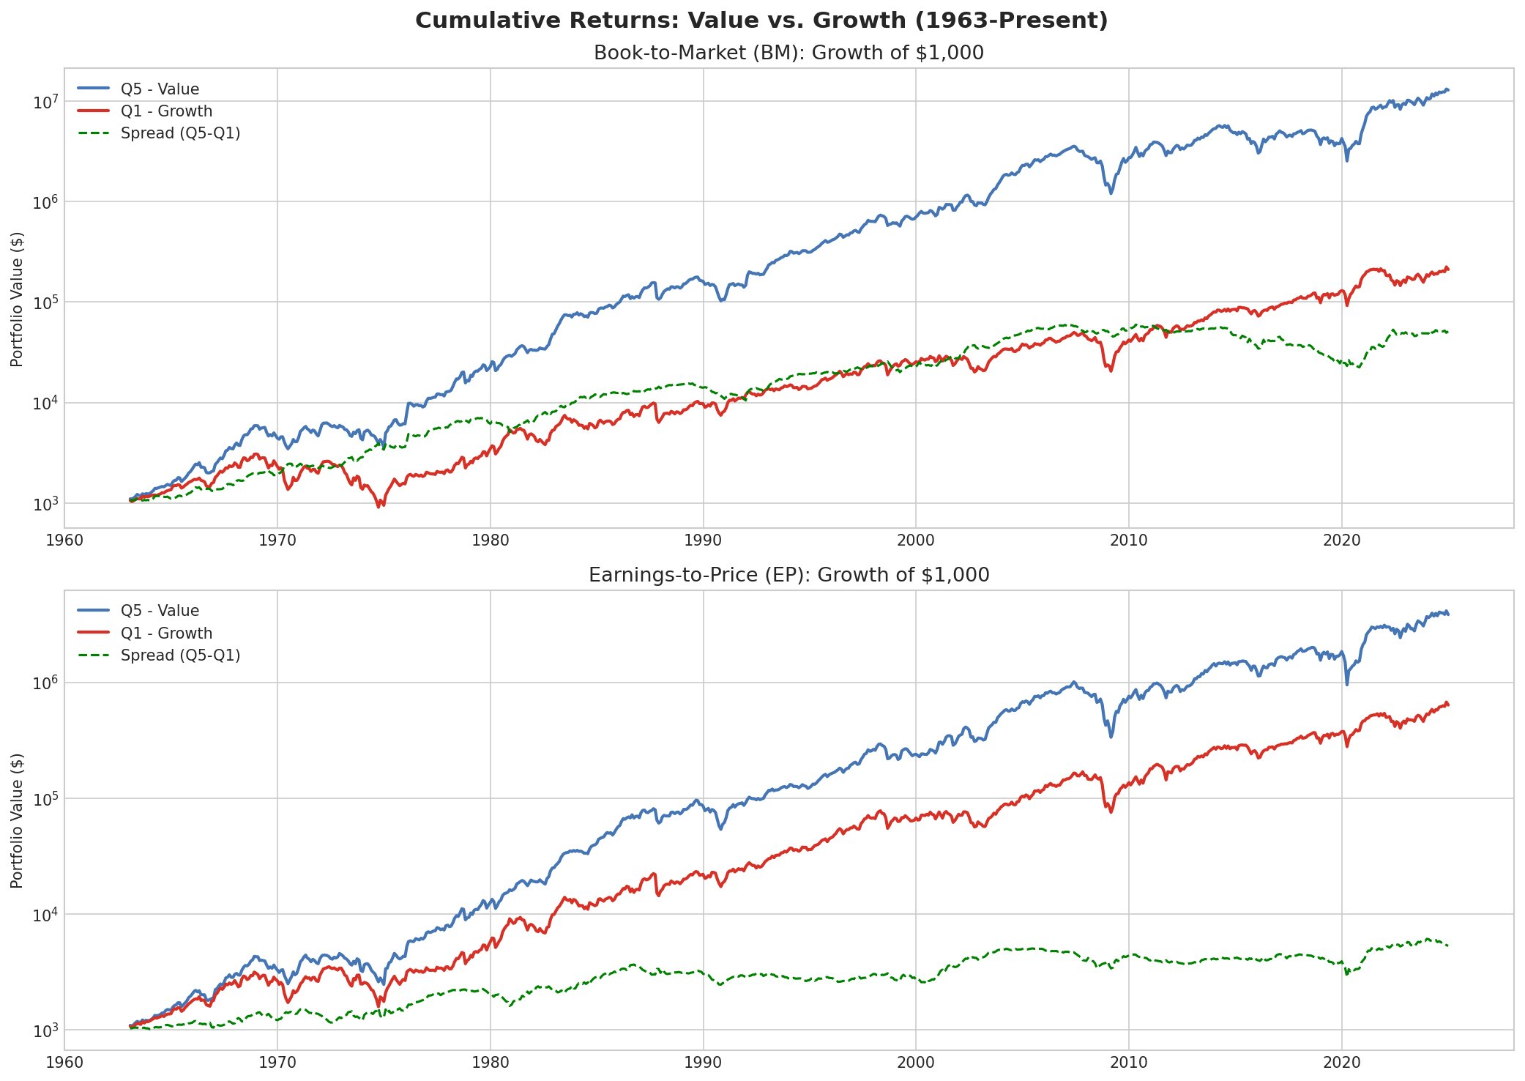
Value Has Historically Outperformed Growth
Both BM and EP: Q5 (value) consistently earns more than Q1 (growth)
$1,000 in value (blue) massively outgrew growth (red) since 1963
Key finding: Value stocks earned higher returns than growth stocks across the full sample — but has this held up recently?

Slide 3
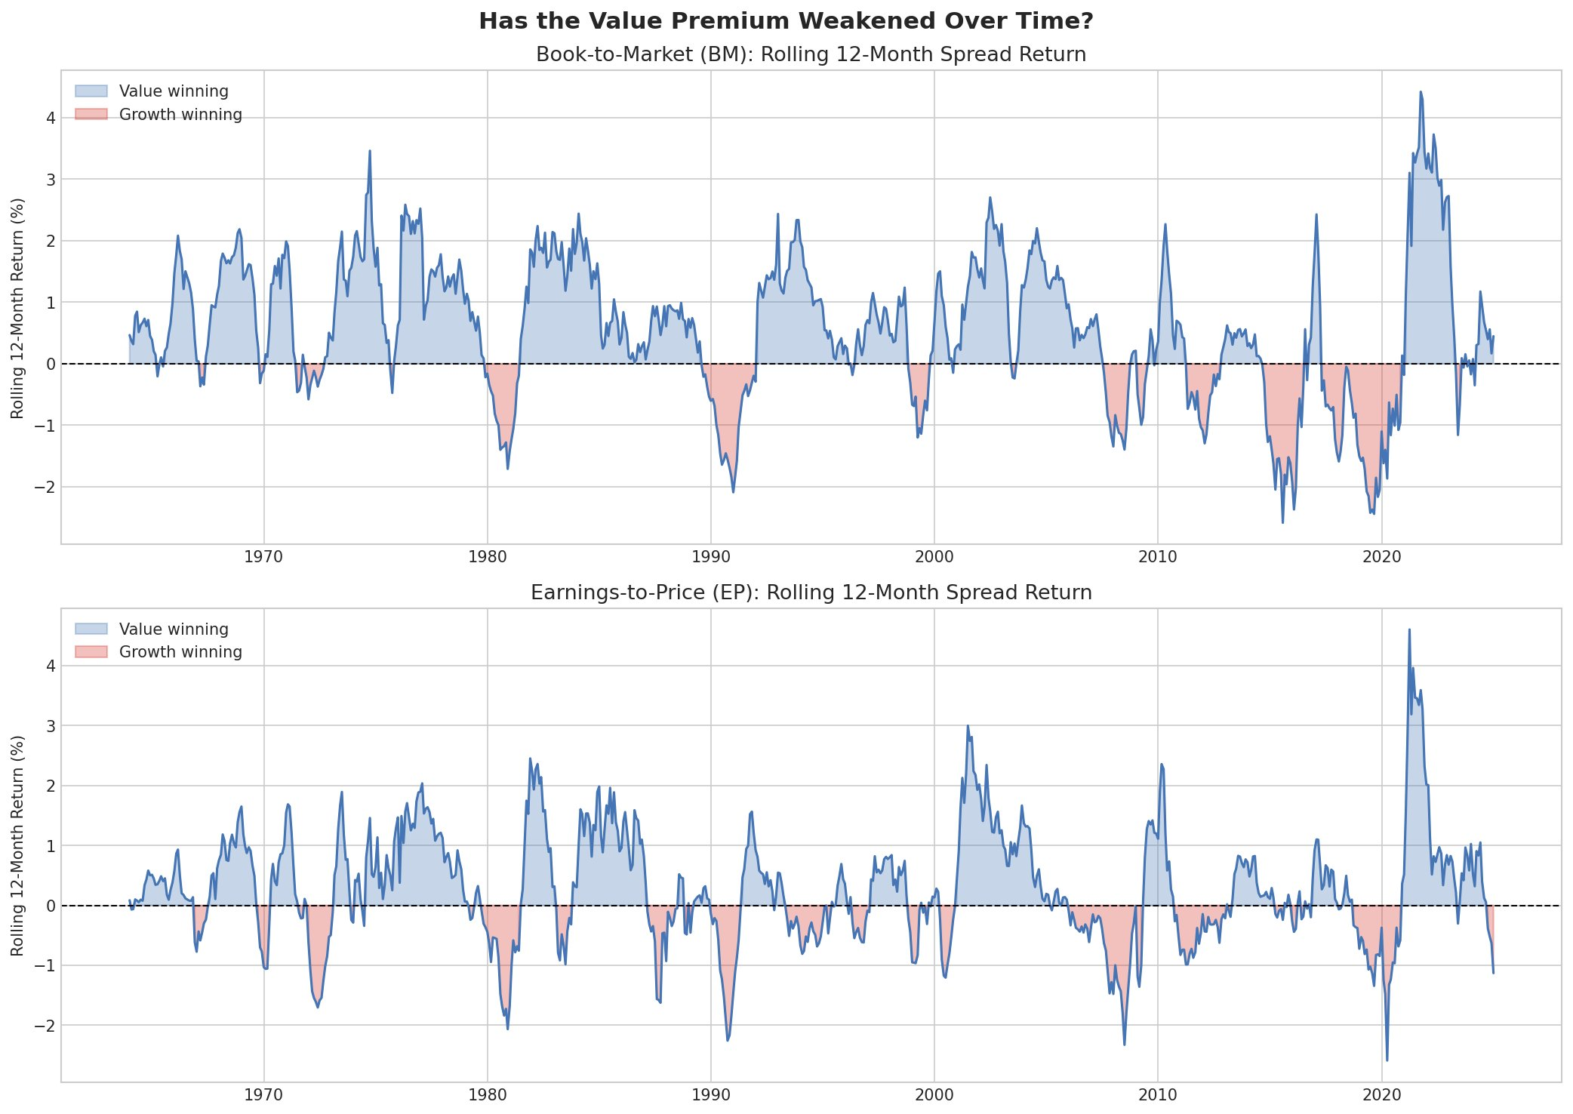
The Value Premium Has Weakened — Especially for BM
BM Time Trend Regression
t = −2.342, p = 0.019 ✓
Premium declining ~0.0013%/month
EP Time Trend Regression
t = −0.659, p = 0.510 ✗
No statistically significant decline
Blue = value winning, Pink = growth winning. Pink periods grow longer after 2007. OLS regression confirms the BM decline is statistically real (p < 0.05). EP is more stable.

Slide 4
Takeaways
1
Value works — but has weakened
Both BM and EP show value outperforming growth since 1963. But the pink periods (growth winning) have become longer and deeper since 2007.
2
How you define value matters
BM has statistically declined (p = 0.019). EP has not. Book value is less meaningful in a tech-dominated economy with intangible assets.
3
For a hedge fund today
EP is the more stable signal. BM works as a macro-timing tool — overweight value when rates rise (confirmed: t = 2.640), underweight when rates fall.
Data: Chen & Zimmermann (2022) · Fama & French (1993) · FRED

