Slide 1
Simple Groupware 0.2
User Manual

Slide 2
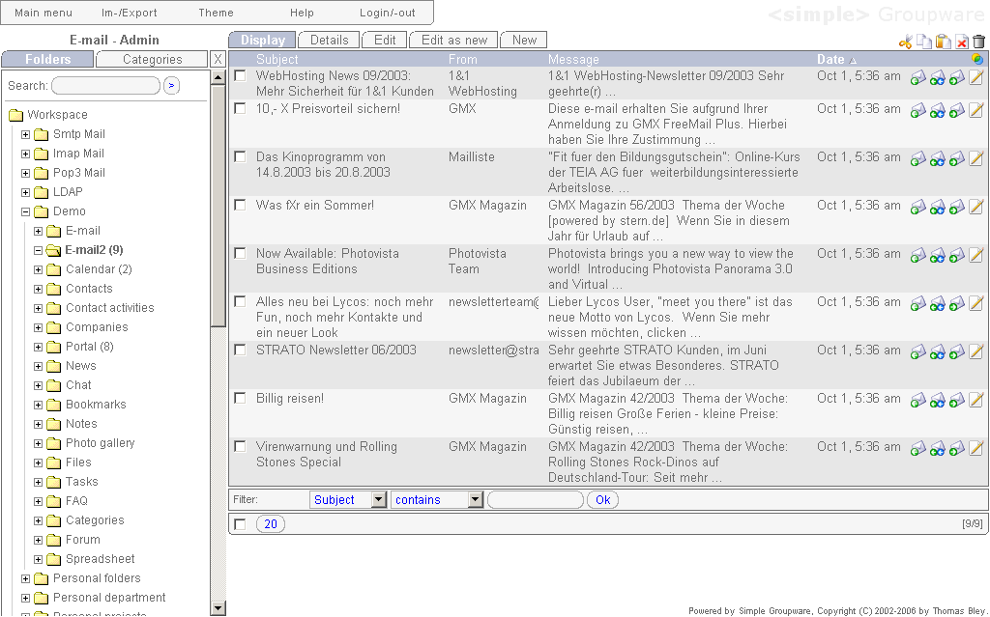
Overview

Slide 3
Sections
Main menu
Views
Buttons
Tree

Slide 4
Sections – Main menu
Print view, change password
Data im-/export (HTML, CSV, XML, Spreadsheet, etc.)
Login as another user / logout
Export data: see export tutorial
Import data: see import tutorial

Slide 5
Sections – Main menu #2
Choose another theme
Custom help page for support information

Slide 6
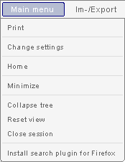
Sections – Main menu #3
Open a printable view of the current page
Change the user's password, online status

Slide 7
Sections – Main menu #4
Logout and remove all session data (orders, limits, recent views, etc.)
Reset the current view (selected order, limit, etc.)
Add Simple Groupware as search engine to Firefox

Slide 8
Sections – Main menu #5
Go to the personal home directory
Minimize the current view
Collapse all open folders

Slide 9
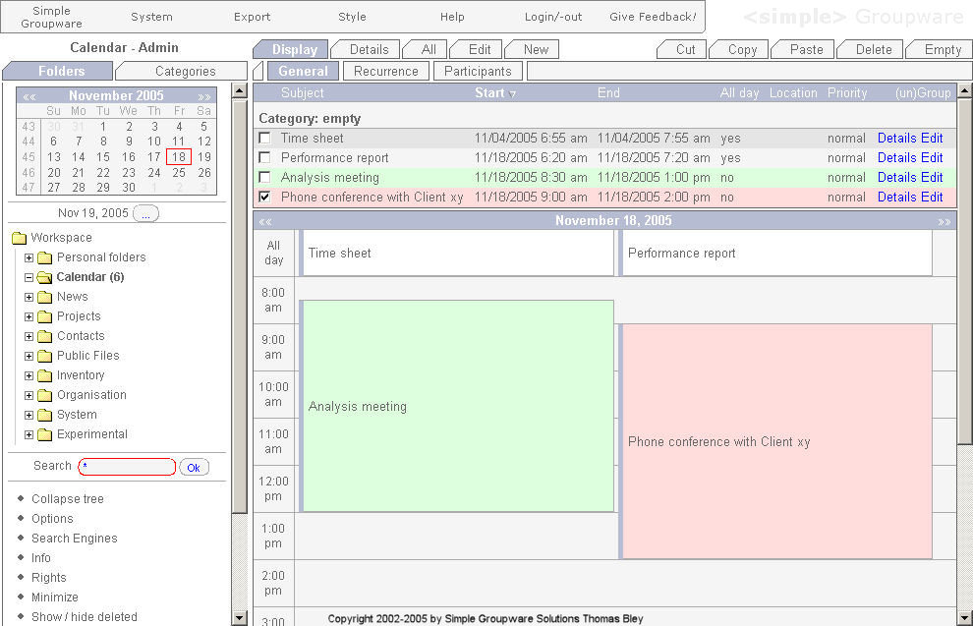
Sections #2
Tabs
Calendar
Calendar: Day

Slide 10
Navigation
    Tree (1) > Views (2) > Calendar (3, optional) > Tabs (4)
2
4
3
1

Slide 11
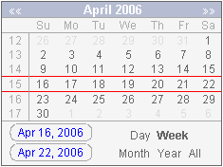
Navigation – Calendar
Previous month
Next month
Select a custom date

Slide 12
Navigation – Calendar #2
Change start of the week
Go to week #14
Go to the 14th

Slide 13
Navigation – Calendar #3
Switch to month view
Change view

Slide 14
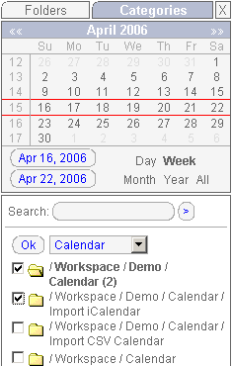
Navigation – Folder merging
1
4
2
3
Note: In the merged view, folders are read-only

Slide 15
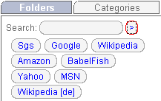
Searching
Search
assets / folders, use * as wildcard
Search in Google, Wikipedia, Amazon, etc.

Slide 16
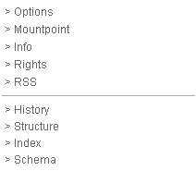
Operations
Folder options
Folder information
Subscribe to news feed

Slide 17
Operations #2
Specify a mountpoint (IMAP, iCalendar, vCard, etc., see tutorial)
Additional views

Slide 18
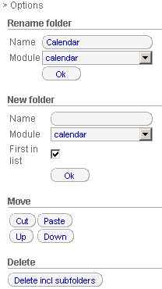
Operations – Folder options
Rename current folder
Create a new folder
Change folder position in tree

Slide 19
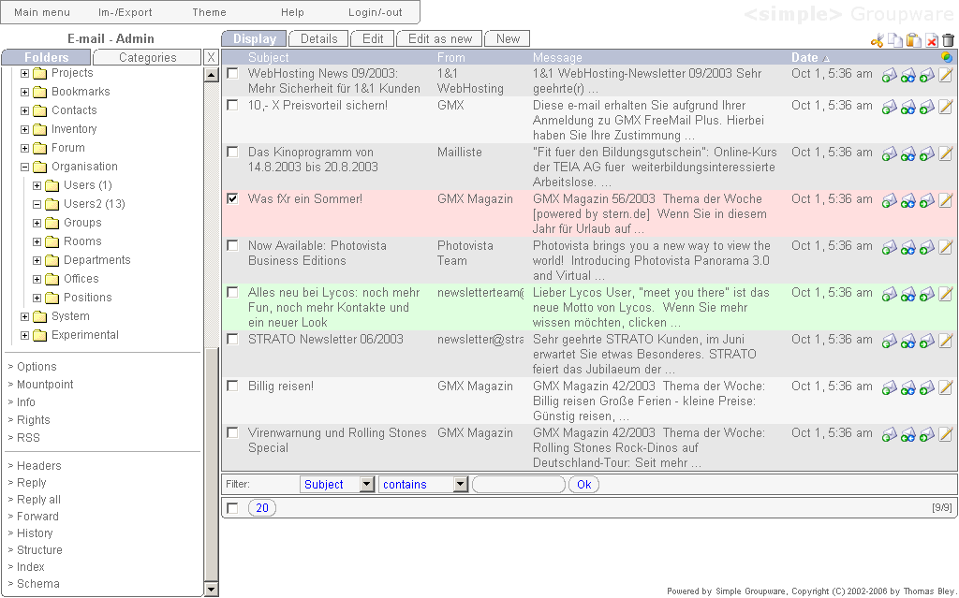
Sections – Assets
Assets
Single
Buttons
Operations

Slide 20
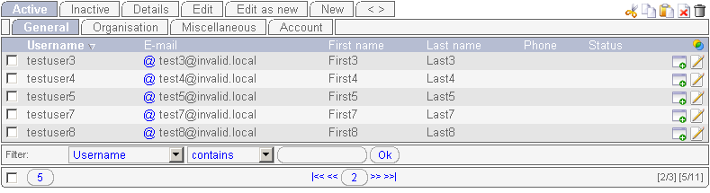
Sections – Assets #2
Buttons (cut, copy, paste, delete, empty)
Maximum assets on one page
Number of pages, assets
Change current page

Slide 21
Sections – Assets #3
Sorted by column Username
Filter assets by column, operand and value
Single buttons
(show details, edit asset)

Slide 22
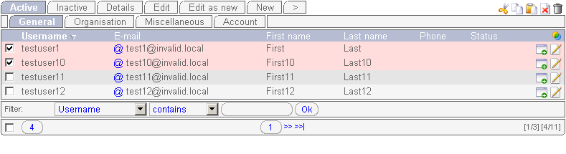
Sections – Assets #4
Views operate on selected assets
Buttons operate on selected assets
Single buttons
operate on one asset
Selected assets
Note: Buttons and views use all assets If none of them is selected.

Slide 23
Sections – Assets #5
Create new asset(s) from existing asset(s)
Edit selected asset(s)
Create new asset(s)

Slide 24
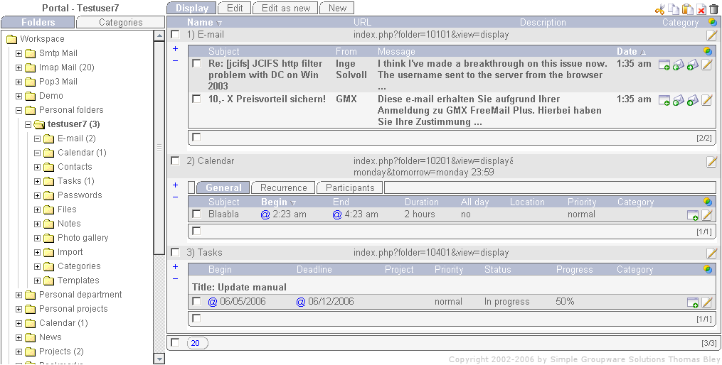
Personal home directory
E-mails
Personal folders
Calendar
Tasks

Slide 25
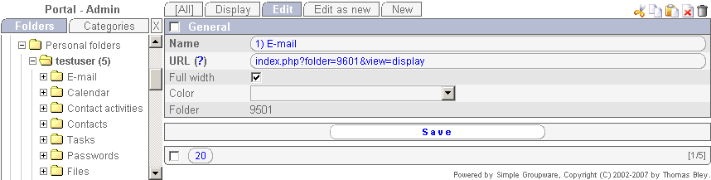
Personal home directory #2
URL
Full width for internal folders, reduced width for RSS folders
URL Syntax: index.php?folder=<number or path>&view=display
Path: e.g. /Workspace/Personal folders/testuser7/Tasks/

Slide 26
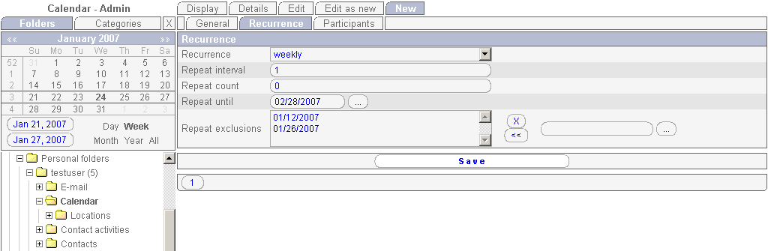
Calendar recurrences
2
3
1

Slide 27
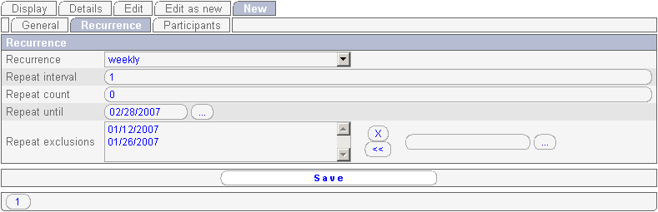
Calendar recurrences #2
Create a recurring appointment
Recur every day, week, month or year
How often the appointment is repeated, 0 means unlimited
How long the appointment will be repeated

Slide 28
Calendar recurrences #3
Create a recurring appointment
e.g. repeat the appointment every week, every second week, etc.
Don't repeat the appointment on these days

Slide 29
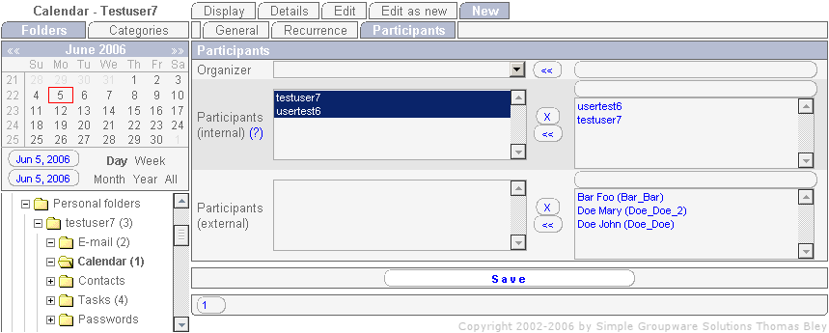
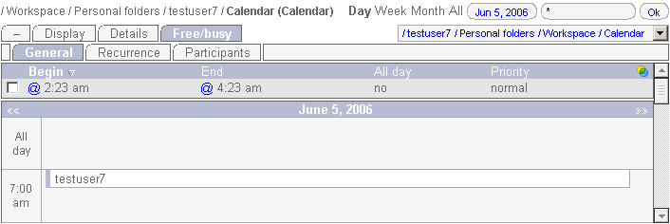
Calendar collision testing
2
3
4
5: open collision popup
1

Slide 30
Keyboard Shortcuts
Alt-c
Alt-e
Alt-r
Alt-n
Alt-x
Alt-v
Alt-a
Note: Keyboard shortcuts are available with Firefox (Alt-#),
Safari (Ctrl-#) and IE (Alt-x-Enter)

Slide 31
Keyboard Shortcuts #2
Alt-2
Alt-3
Alt-d
Alt-y
Alt-1
Alt-f
Alt-q
Alt-w
Alt-g

Slide 32
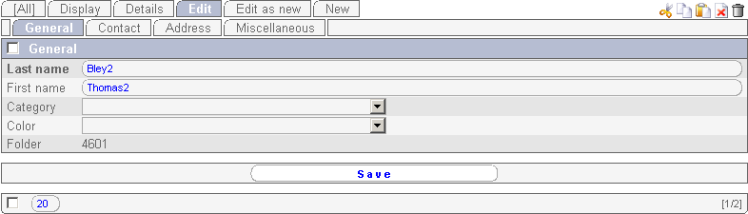
Keyboard Shortcuts #3
Alt-<
Alt-s

Slide 33
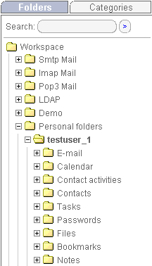
Keyboard Shortcuts #4
Alt-l
Alt-f
Alt-h
Home directory

Slide 34
Other documentation
  Desktop Integration:
  http://www.simple-groupware.de/cms/Main/DesktopIntegration
  Administration:
  http://www.simple-groupware.de/cms/Main/Administration
  Data Handlers:
  http://www.simple-groupware.de/cms/Main/DataHandlers
  Data Export:
  http://www.simple-groupware.de/cms/Main/DataExport

Slide 35
Other pages
  Homepage:
  http://www.simple-groupware.de/
  Sourceforge Homepage:
  http://sourceforge.net/projects/simplgroup/
  Contact:
  mailto:info2007@simple-groupware.de

