Slide 1
AZ-100.2 Implementing and Managing Storage

Slide 2
Course Agenda
M01: Overview of Azure Storage
L01: Azure storage accounts
L02: Data replication
L03: Azure Storage Explorer
M02: Storage Services
L01: Virtual machine storage
L02: Blob storage
L03: Azure files
L04: Structured storage
M03: Securing and Managing Storage
L01: Shared access keys
L02: Azure backup
L03: Azure File Sync

Slide 3
Course Agenda - continued
M04: Storing and Accessing Data
L01: Azure Content Delivery Network
L02: Import and Export Service
M05: Monitoring Storage
L01: Metrics and Alerts
L02: Activity Log

Slide 4
Implement and Manage Storage
Create and configure storage accounts
May include but not limited to: Configure network access to the storage account; create and configure storage account; generate shared access signature; install and use Azure Storage Explorer; manage access keys; monitor activity log by using Log Analytics; implement Azure storage replication
Import and export data to Azure
May include but not limited to: Create export from Azure job; create import into Azure job; configure and use Azure blob storage; configure Azure content delivery network (CDN) endpoints
Configure Azure files
May include but not limited to: Create Azure file share; create Azure File Sync service; create Azure sync group; troubleshoot Azure File Sync
Implement Azure backup
May include but not limited to: Configure and review backup reports; perform backup operation; create Recovery Services Vault; create and configure backup policy; perform a restore operation
Notes:
In the Welcome section of the student materials is a checklist showing where these areas are covered in the course.

Slide 5
AZ-100.2 Module 01: Overview of Azure Storage

Slide 6
Lesson 01: Azure Storage Accounts

Slide 7
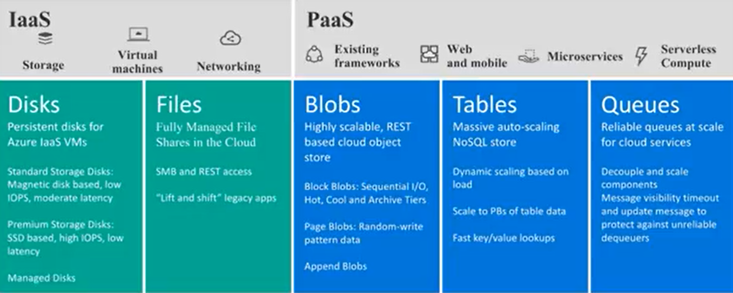
Introduction to Azure Storage
Notes:
Introduction to Azure Storage - https://www.youtube.com/watch?v=fUvQR45QaYM
✔️ In this video, Corey references an older course outline. The course outline differs slightly from what you see in this course, but the content is the same. You can ignore the course outline as described in the video.

Slide 8
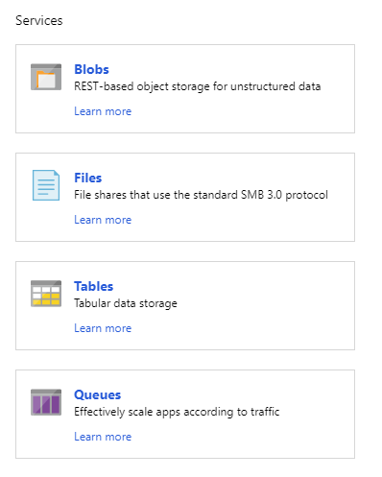
Azure Storage
A service that you can use to store files, messages, tables, and other types of information
Three categories of Azure storage:
Storage for virtual machines – Disks and File Shares
Unstructured data – Blobs and Data Lake Store
Structured data - Tables, Cosmos DB, and Azure SQL DB
Notes:
For more information, you can see:
Azure Storage - https://azure.microsoft.com/en-us/services/storage/

Slide 9
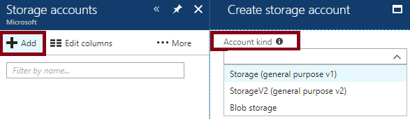
Azure Storage Accounts
Two types of Storage: General purpose and Blob storage
General purpose storage has two tiers: Standard and Premium.
Blob storage has three tiers: Hot, Cool, and Archive
Notes:
✔️ To take advantage of the new archive access tier and for the lowest price per gigabyte, it's recommended that you create new storage accounts as general-purpose v2 accounts. You can upgrade your GPv1 account to a GPv2 account using PowerShell or Azure CLI. Standard and Premium are covered on the next slide.
For more information, you can see:
Storage Account Overview - https://docs.microsoft.com/en-us/azure/storage/common/storage-account-options#overview
Upgrade a storage account to GPv2 - https://docs.microsoft.com/en-us/azure/storage/common/storage-account-options#upgrade-a-storage-account-to-gpv2

Slide 10

Standard and Premium Storage Accounts
Standard:
Backed by magnetic drives (HDD)
Lowest cost per GB
Premium:
Backed by solid state drives (SSD)
Can only be used with Azure VM disks
99.99% SLA
Notes:
✔️ It is not possible to convert a Standard storage account to Premium storage account or vice versa. You must create a new storage account with the desired type and copy data, if applicable, to a new storage account.

Slide 11
Storage Account Endpoints
Every object has a unique URL address
The storage account name forms the subdomain of that address
The subdomain and domain name forms an endpoint
Blob service: http://mystorageaccount.blob.core.windows.net
Table service: http://mystorageaccount.table.core.windows.net
Queue service: http://mystorageaccount.queue.core.windows.net
File service: http://mystorageaccount.file.core.windows.net
Notes:
✔️A Blob storage account only exposes the Blob service endpoint. And, you can also configure a custom domain name to use with your storage account.
For more information, you can see:
Storage Account Endpoints - https://docs.microsoft.com/en-us/azure/storage/common/storage-create-storage-account?toc=%2fazure%2fstorage%2fblobs%2ftoc.json#storage-account-endpoints

Slide 12
Configuring Custom Domain Names
Direct CNAME mapping
CNAME record | Target
blobs.contoso.com | contosoblobs.blob.core.windows.net
Intermediary mapping with asverify
CNAME record | Target
asverify.blobs.contoso.com | asverify.contosoblobs.blob.core.windows.net
blobs.contoso.com | contosoblobs.blob.core.windows.net
Notes:
For more information, you can see:
Configure a custom domain name for your Blob storage endpoint - https://docs.microsoft.com/en-us/azure/storage/blobs/storage-custom-domain-name

Slide 13
Storage Pricing and Billing
Storage costs
Blob storage
Data access costs
Transaction costs
Geo-Replication data transfer costs
Outbound data transfer costs
Changing the storage tier
Notes:
For more information, you can see:
Azure storage pricing - https://azure.microsoft.com/en-us/pricing/details/storage/
Pricing model for Blob storage accounts - https://azure.microsoft.com/pricing/details/storage/
Outbound data transfer charges - https://azure.microsoft.com/pricing/details/data-transfers/

Slide 14
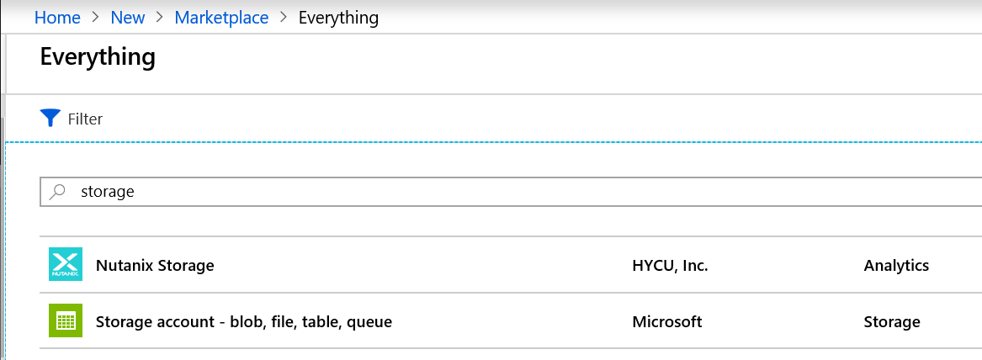
Creating Storage Accounts
Create a storage account using Azure Marketplace (Portal)
PowerShell
# Create new storage account New-AzureRMStorageAccount -ResourceName storage -Name storage2test -SkuName Standard LRS -Location 'west us'
Notes:
Creating Storage Accounts - https://www.youtube.com/watch?v=7v2ZXPX9ETs

Slide 15
Lesson 02: Data Replication

Slide 16
Planning Storage
Types of storage services
Storage design
Storage billing
Storage account management
Storage account access/tools
Notes:
Planning Storage - https://www.youtube.com/watch?v=ys2pnlkfn_E

Slide 17
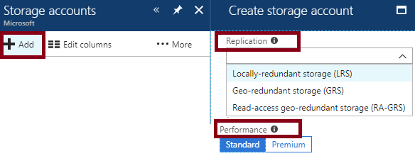
Replication Options
Replication ensures durability and high availability
Replicate your data within the same data center, across zonal data centers within the same region, and even across regions
Notes:
✔️ If you select Premium performance only LRS replication will be available.
✔️ If you create availability sets for your virtual machines, then Azure uses Zone-redundant Storage (ZRS). Read more in the next topics.
For more information, you can see:
Azure storage replication - https://docs.microsoft.com/en-us/azure/storage/common/storage-redundancy

Slide 18
Locally Redundant Storage
Replication | Copies | Strategy
Locally redundant storage (LRS) | Maintains three copies of your data. | Data is replicated three time within a single facility in a single region.
Maintains three copies of your data at a single facility
All copies of the data exist within the same region
Use if data can be easily reconstructed
Use if there are regional governance requirements
Low-cost option
Notes:
✔️ Do you think LRS is a good choice for your organization?
For more information, you can see:
Locally-redundant storage: Low-cost redundancy - https://docs.microsoft.com/en-us/azure/storage/common/storage-redundancy-lrs

Slide 19
Geo-redundant Storage
Replication | Copies | Strategy
Geo-redundant storage (GRS) | Maintains six copies of your data. | Data is replicated three times within the primary region and is also replicated three times in a secondary region hundreds of miles away from the primary region.
Read access geo-redundant storage (RA-GRS) | Maintains six copies of your data. | Data is replicated to a secondary geographic location and provides read access to your data in the secondary location.
GRS replicates your data to another data center in a secondary region, but that data is available to be read only during a failure.
RA-GRS is based on GRS and replicates data to another data center in another region. Provides read access from the secondary region, even without a failure.
Notes:
✔️ If you enable RA-GRS and your primary endpoint for the Blob service is myaccount.blob.core.windows.net, then your secondary endpoint is myaccount-secondary.blob.core.windows.net. The access keys for your storage account are the same for both the primary and secondary endpoints.
For more information, you can see:
Geo-redundant storage (Cross-regional replication for Azure Storage) - https://docs.microsoft.com/en-us/azure/storage/common/storage-redundancy-grs?toc=%2fazure%2fstorage%2fblobs%2ftoc.json
Read-access geo-redundant storage - https://docs.microsoft.com/en-us/azure/storage/common/storage-redundancy-grs?toc=%2fazure%2fstorage%2fblobs%2ftoc.json#read-access-geo-redundant-storage

Slide 20
Zone Redundant Storage
Replication | Copies | Strategy
Zone-redundant storage (ZRS) | Maintains three copies of your data. | Data is replicated three times across two to three facilities, either within a single region or across two regions.
Replicates your data across three storage clusters in a single region
Each storage cluster is physically separated from the others and resides in its own availability zone
Each availability zone, and the ZRS cluster within it, is autonomous, with separate utilities and networking capabilities
Not available in all regions
Notes:
✔️Consider ZRS for scenarios that require strong consistency, strong durability, and high availability even if an outage or natural disaster renders a zonal data center unavailable.
For more information, you can see:
Zone-redundant storage (ZRS): Highly available Azure Storage applications - https://docs.microsoft.com/en-us/azure/storage/common/storage-redundancy-zrs?toc=%2fazure%2fstorage%2fblobs%2ftoc.json
Converting to ZRS - https://docs.microsoft.com/en-us/azure/storage/common/storage-redundancy-zrs?toc=%2fazure%2fstorage%2fblobs%2ftoc.json#converting-to-zrs-replication
What are availability zones? - https://docs.microsoft.com/en-us/azure/availability-zones/az-overview

Slide 21
Replication Option Comparison
Replication Option | LRS | ZRS | GRS | RA-GRS
Node unavailability within a data center | Yes | Yes | Yes | Yes
An entire data center (zonal or non-zonal) becomes unavailable | No | Yes | Yes | Yes
A region-wide outage | No | No | Yes | Yes
Read access to your data (in a remote, geo-replicated region) for region-wide unavailability | No | No | No | Yes
Available in storage account types | GPv1, GPv2, Blob | Standard, GPv2 | GPv1, GPv2, Blob | GPv1, GPv2, Blob
Notes:
For more information, you can see:
Read-access geo-redundant storage - https://docs.microsoft.com/en-us/azure/storage/common/storage-redundancy-grs#read-access-geo-redundant-storage

Slide 22
Storage Accounts PowerShell Tasks
Task | Example
Check to see if a storage account name is available. | Get-AzureRmStorageAccountNameAvailability -Name 'mystorageaccount'
Create a storage account. | New-AzureRmStorageAccount -ResourceGroupName MyResourceGroup -AccountName mystorageaccount -Location westus -SkuName Standard_GRS
Retrieve a specific storage account or all the storage accounts in a resource group or subscription. | Get-AzureRmStorageAccount -ResourceGroupName "RG01" -AccountName "mystorageaccount"
Modify storage account properties, such as type. | Set-AzureRmStorageAccount -ResourceGroupName "MyResourceGroup" -AccountName "mystorageaccount" -Type "Standard_RAGRS"
Notes:
✔️ Be sure to try a few commands using the reference link below. You’ll need to create unique names for your own storage accounts and resource groups.
For more information, you can see:
Create a storage account - https://docs.microsoft.com/en-us/azure/storage/common/storage-powershell-guide-full#create-a-storage-account

Slide 23
Lesson 03: Azure Storage Explorer

Slide 24
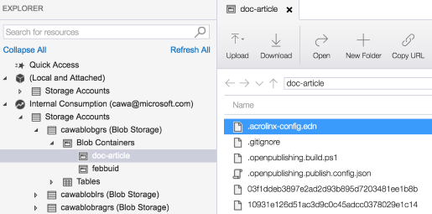
Azure Storage Explorer
Access multiple accounts and subscriptions
Create, delete, view, edit storage resources
View and edit Blob, Queue, Table, File, Cosmos DB storage and Data Lake Storage
Obtain shared access signature (SAS) keys
Available for Windows, Mac, and Linux
Notes:
For more information, you can see:
Download Azure Storage Explorer - https://azure.microsoft.com/en-us/features/storage-explorer/

Slide 25
Overview of Azure Storage Explorer
Easily manage the contents of your storage account with Azure Storage Explorer
Upload, download, and manage blobs, files, queues, tables, and Cosmos DB entities
Gain easy access to manager your virtual machine disks
Notes:
Azure Storage Explorer - https://www.youtube.com/watch?v=Me4Y4jxoer8
After watching the video try the Quickstart: Upload, download, and list blobs using Azure Storage Explorer.
Easily manage the contents of your storage account with Azure Storage Explorer. Upload, download, and manage blobs, files, queues, tables, and Cosmos DB entities. Gain easy access to manage your virtual machine disks.

Slide 26
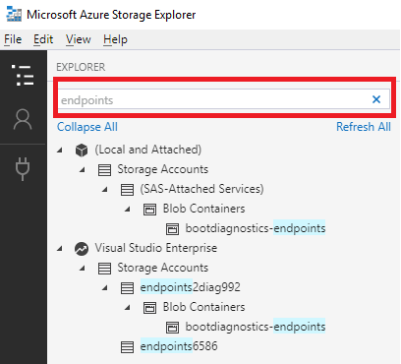
Keyword Search in Azure Storage Explorer
To find a storage resource, use the search box
As you type, the left pane displays all matching resources for the search value
For example, endpoints
Notes:
Keyword Search in Azure Storage Explorer - https://www.youtube.com/watch?v=cr5tOGyGrIQ

Slide 27
Storage Access Tools
Azure Portal
Azure Storage Explorer
Azure PowerShell
Notes:
Storage Access Tools - https://www.youtube.com/watch?v=Rcw9tVXxmKk
✔️ In the video, Corey shows how to work with the contents of an Azure storage account using a combination of various tools: the portal, Microsoft’s Azure Storage Explorer and Azure PowerShell.

Slide 28
Lab 1 A: Storage Explorer Functionality
Connect to an Azure subscription
Work with local development storage
Attach to external storage
Attach a storage account by using an SAS
Attach a service by using an SAS
Connect to an Azure Cosmos DB account by using a connection string

Slide 29
Lab 1 B: Use Storage Explorer
Create a storage account and log into Storage Explorer
Create a container and upload, download, and view blobs in a container
Manage snapshots
Notes:
For more information, you can see:
Quickstart practice - https://docs.microsoft.com/en-us/azure/storage/blobs/storage-quickstart-blobs-storage-explorer
Getting Started with Storage Explorer - https://docs.microsoft.com/en-us/azure/vs-azure-tools-storage-manage-with-storage-explorer?tabs=windows

Slide 30
AZ-100.2 Module 02: Storage Services

Slide 31
Lesson 01: Virtual Machine Storage

Slide 32
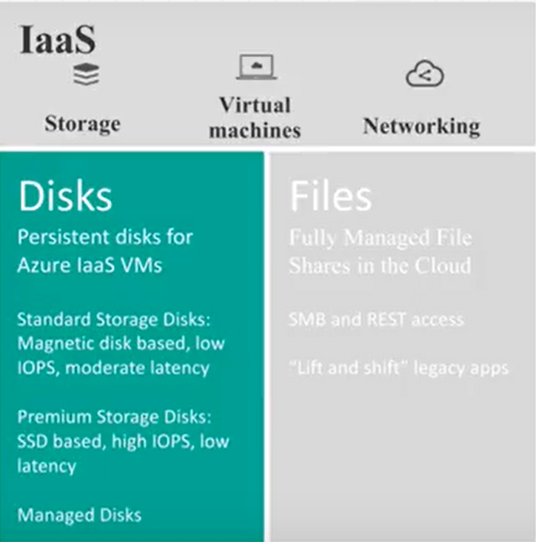
Virtual Machine Storage
Disks are how virtual machines store their VHD files
Premium or Standard storage
Managed or unmanaged
Virtual Machine disk types
Operating System disks
Temporary disk
Data disks
Notes:
Note: This default numbers in this video are accurate as of the time of the recording. Azure is constantly being updated so be sure to check the documentation if something seems out of date.
Virtual Machine Storage - https://www.youtube.com/watch?v=og_rZYBLvCs

Slide 33
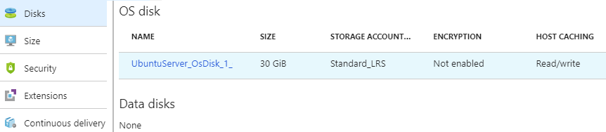
Virtual Machine Disks
Operating System Disks are SATA drives, labeled as C:
Temporary Disks provides short term storage
Data Disks are SCSI drives and depend on your virtual machine type
Notes:
✔️ Don’t store data on the temporary disk. It provides temporary storage for applications and processes and is intended to only store data such as page or swap files.
For more information, you can see:
About disk storage for Azure Windows virtual machines - https://docs.microsoft.com/en-us/azure/virtual-machines/windows/about-disks-and-vhds?toc=%2Fazure%2Fvirtual-machines%2Fwindows%2Ftoc.json

Slide 34
Premium Storage
Delivers high-performance, low-latency SSD disk support
Use for virtual machines with input/output (I/O)-intensive workloads
Two types of disks: Unmanaged and Managed
Unmanaged disks require you to manage the storage accounts and VHDs
Managed disks are maintained by Azure (recommended)
Notes:
✔ For the best performance for your application, we recommend that you migrate any VM disk that requires high IOPS to Premium Storage. If your disk does not require high IOPS, you can help limit costs by keeping it in standard Azure Storage. In standard storage, VM disk data is stored on hard disk drives (HDDs) instead of on SSDs.
For more information, you can see:
Managed disks overview - https://docs.microsoft.com/en-us/azure/virtual-machines/windows/managed-disks-overview
Premium Storage - https://docs.microsoft.com/en-us/azure/virtual-machines/windows/premium-storage
Standard Storage - https://docs.microsoft.com/en-us/azure/virtual-machines/windows/standard-storage

Slide 35
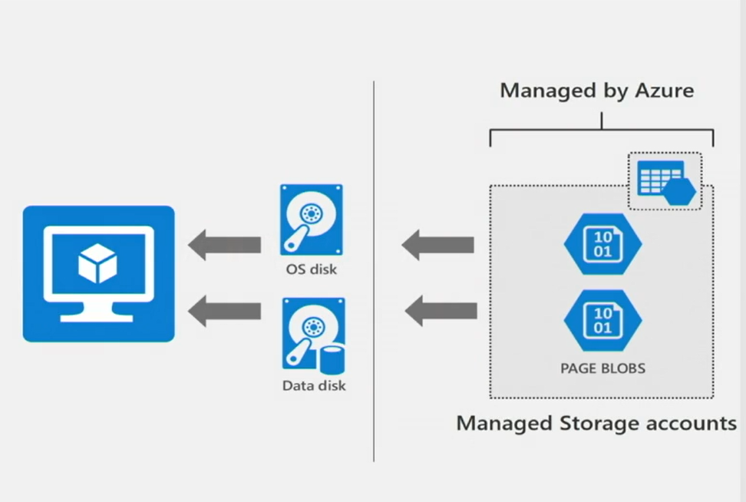
Resiliency with Managed Disks
Managed disks – abstract storage accounts from customers
Granular access control – apply Azure RBAC
Better performance - storage account limits do not apply
Scale – thousands of disks per region per subscription
Notes:
Resiliency with Managed Disks - https://channel9.msdn.com/Blogs/Azure/Managed-Disks-for-Azure-Resiliency/player
✔ Azure Managed Disks simplifies disk management for Azure IaaS VMs by managing the storage accounts associated with the VM disks. You only specify the type (Standard HDD, Standard SSD, or Premium SSD) and the size of disk you need, and Azure creates and manages the disk for you. This video covers managed disks, snapshots, and premium storage.

Slide 36
Virtual Machine Storage
Attach a data disk to a Windows VM using PowerShell
$dataDisk1 = New-AzureRmDisk -DiskName $dataDiskName -Disk $diskConfig -ResourceGroupName $rgName
$vm = Add-AzureRmVMDataDisk -VM $vm -Name $dataDiskName -CreateOption Attach -ManagedDiskId $dataDisk1.Id -Lun 1
Update-AzureRmVM -VM $vm -ResourceGroupName $rgName
Detach a data disk from a Windows virtual machine
Remove-AzureRmVMDataDisk -VM $VirtualMachine -Name "myDisk" Update-AzureRmVM -ResourceGroupName "myResourceGroup" -VM $VirtualMachine
Notes:
✔️ Can you see the advantage of completing tasks with PowerShell?
For more information, you can see:
Azure Virtual Machine PowerShell samples - https://docs.microsoft.com/en-us/azure/virtual-machines/windows/powershell-samples

Slide 37
Virtual Machine Storage
Convert a Windows virtual machine from unmanaged disks to managed disks
ConvertTo-AzureRmVMManagedDisk -ResourceGroupName $rgName -VMName $vmName
Notes:
✔️ Can you see the advantage of completing tasks with PowerShell?
For more information, you can see:
Azure Virtual Machine PowerShell samples - https://docs.microsoft.com/en-us/azure/virtual-machines/windows/powershell-samples

Slide 38
Lesson 02: Blob Storage

Slide 39
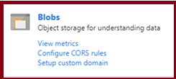
Blob Storage
Stores unstructured data in the cloud
Can store any type of text or binary data
Also referred to as object storage
Common uses:
Serving images or documents directly to a browser
Storing files for distributed access
Streaming video and audio
Storing data for backup and restore, disaster recovery, archiving
Storing data for analysis by an on-premises or Azure-hosted service
Notes:
For more information, you can see:
Azure Blob Storage - https://azure.microsoft.com/en-us/services/storage/blobs/

Slide 40
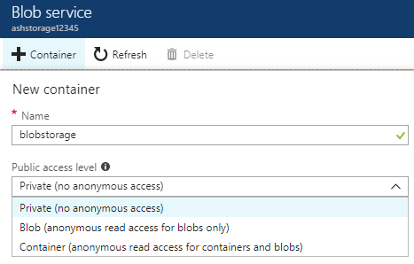
Blob Containers
All blobs must be in a container
Accounts have unlimited containers
Containers have unlimited blobs
Private blobs - no anonymous access
Blob access - anonymous public read access for blobs only
Container access - anonymous public read and list access to the entire container, including the blobs
Notes:
✔️ You can also create the Blob container with PowerShell using the New-AzureStorageContainer command.
✔️ Have you thought about how you will organize your containers?
For more information, you can see:
Create a Container - https://docs.microsoft.com/en-us/azure/storage/blobs/storage-quickstart-blobs-powershell#create-a-container

Slide 41
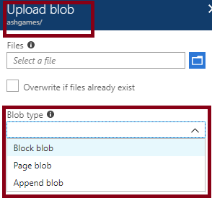
Uploading Blobs
Block blobs (default) - useful for storing text or binary files
Page blobs - More efficient for frequent read/write operations
Append blobs - useful for logging scenarios
You cannot change a blob type once it has been created
Notes:
✔️ Once the blob has been created, its type cannot be changed.
✔️ You can also upload a local file to blob storage using the PowerShell Set-AzureStorageBlobContent command.

Slide 42
Lab 2A: Blob Storage
Take a few minutes to review the Upload, download, and list blobs using the Azure portal how-to using the Azure portal
Create a container to hold block blobs
Upload and download block blobs
Next, try the Upload, download, and list blobs using Azure PowerShell to transfer files between a local disk and Azure Blob storage
Create a storage account and a container
Upload blobs to the container
List the blobs in a container
Download blobs to your local disk
Notes:
For information, you can see:
Understanding Block Blobs, Append Blobs, and Page Blobs - https://docs.microsoft.com/en-us/rest/api/storageservices/understanding-block-blobs--append-blobs--and-page-blobs

Slide 43
Lesson 03: Azure Files

Slide 44
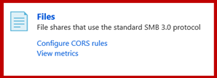
Azure Files
Managed file shares in the cloud that are accessible via SMB
Replace and supplement
Lift and shift
Azure File Sync
Shared applications
Diagnostic data
Tools and utilities
Notes:
✔️ Which of the usage cases for file shares are you most interested in?
For more information, you can see: Why Azure files are useful - https://docs.microsoft.com/en-us/azure/storage/files/storage-files-introduction#why-azure-files-is-useful

Slide 45
Azure Files Usage
Feature | Description | When to use
Azure Files | SMB interface, client libraries, and a REST interface that allows access from anywhere to stored files. | Lift and shift an application to the cloud. Store shared data across multiple virtual machines. Store development and debugging tools that need to be accessed from many virtual machines.
Azure Blobs | Client libraries and a REST interface that allows unstructured data (flat namespace) to be stored and accessed at a massive scale in block blobs. | Support streaming and random-access scenarios. Access application data from anywhere.
Azure Disks | Client libraries and a REST interface that allows data to be persistently stored and accessed from an attached virtual hard disk. | Lift and shift applications that use persistent disks. Store data that is not required to be accessed from outside the virtual machine.
Notes:
✔️ When selecting which storage feature to use, you should also consider pricing.
Take a minute to view the Azure Storage Overview pricing page.
For more information, you can see:
Comparison: Files and Blobs - https://docs.microsoft.com/en-us/azure/storage/common/storage-decide-blobs-files-disks?toc=%2fazure%2fstorage%2ffiles%2ftoc.json#comparison-files-and-blobs
Comparison: Files and Disks - https://docs.microsoft.com/en-us/azure/storage/common/storage-decide-blobs-files-disks?toc=%2fazure%2fstorage%2ffiles%2ftoc.json#comparison-files-and-disks

Slide 46

Creating File Shares
Portal
PowerShell
# Retrieve storage account and storage account key
$storageContext = New-AzureStorageContext <storage-account-name> <storage-account-key>
# Create the file share, in this case “logs”
$share = New-AzureStorageShare logs -Context $storageContext
Notes:
For more information, you can see:
Create a file share in Azure Files - https://docs.microsoft.com/en-us/azure/storage/files/storage-how-to-create-file-share#Create file share through the Portal
Create a file share through PowerShell - https://docs.microsoft.com/en-us/azure/storage/files/storage-how-to-create-file-share#create-file-share-through-powershell

Slide 47
Naming and Referencing File Shares
Must be a valid DNS name
Must start with a letter or number
Can contain only letters, numbers, and the dash (-) symbol
Cannot have multiple dash (-) symbols back to back
All letters must be lowercase
Share names must be 3 to 36 characters long
Notes:
For more information, you can see:
Naming and Referencing Shares, Directories, Files, and Metadata – https://docs.microsoft.com/en-us/rest/api/storageservices/naming-and-referencing-shares--directories--files--and-metadata

Slide 48
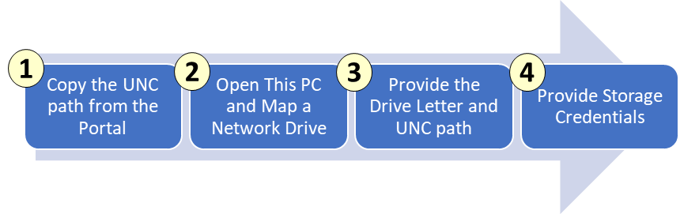
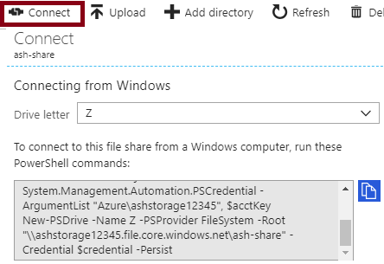
Mapping File Shares (Windows)
File Explorer
Command Line
Notes:
For more information, see: Mount the Azure file share with File Explorer - https://docs.microsoft.com/en-us/azure/storage/files/storage-how-to-use-files-windows#mount-the-azure-file-share-with-file-explorer
Mount the Azure File share with PowerShell - https://docs.microsoft.com/en-us/azure/storage/files/storage-how-to-use-files-windows#mount-the-azure-file-share-with-powershell
Mount the Azure File share with Command Prompt - https://docs.microsoft.com/en-us/azure/storage/files/storage-how-to-use-files-windows#mount-the-azure-file-share-with-command-prompt

Slide 49
Mounting File Shares (Linux)
sudo mount -t cifs //<storage-account-name>.file.core.windows.net/<share-name> <mount-point> -o vers=<smb-version>,username=<storage-account-name>,password=<storage-account-key>,dir_mode=0777,file_mode=0777,serverino
Install the cifs-utils package
Meet the SMB client requirements
Decide on the directory file chmod permissions
Create an entry in /etc/fstab to persist the mount
Notes:
For more information, you can see:
Use Azure Files with Linux - https://docs.microsoft.com/en-us/azure/storage/files/storage-how-to-use-files-linux
Create a persistent mount point for the Azure file share with /etc/fstab - https://docs.microsoft.com/en-us/azure/storage/files/storage-how-to-use-files-linux#create-a-persistent-mount-point-for-the-azure-file-share-with-etcfstab

Slide 50
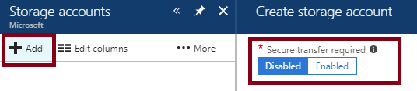
Secure Transfer Required
Only allows requests by secure connection such as HTTPs
Portal
PowerShell
Set-AzureRmStorageAccount
-Name "{StorageAccountName}"
-ResourceGroupName "{ResourceGroupName}"
-EnableHttpsTrafficOnly $True
Notes:
✔️ Because Azure storage doesn’t support HTTPs for custom domain names, this option is not applied using a custom domain name.
For more information, you can see:
Require secure transfer in Azure Storage - https://docs.microsoft.com/en-us/azure/storage/common/storage-require-secure-transfer
FAQ for Azure Files - https://docs.microsoft.com/en-us/azure/storage/files/storage-files-faq

Slide 51
Lab 2 B: Create a File Share
Create a file share in Azure Files (Portal):
Create a file share
View a file share
Upload a file
Make directories and files
PowerShell:
Create a context for your storage account and key
Create a new file share
Notes:
For more information, you can see:
Create a file share in Azure Files - https://docs.microsoft.com/en-us/azure/storage/files/storage-how-to-create-file-share#Create file share through the Portal
Create a file share through PowerShell - https://docs.microsoft.com/en-us/azure/storage/files/storage-how-to-create-file-share#create-file-share-through-powershell
Mount the Azure file share with File Explorer - https://docs.microsoft.com/en-us/azure/storage/files/storage-how-to-use-files-windows#mount-the-azure-file-share-with-file-explorer
Mount the Azure File share with PowerShell - https://docs.microsoft.com/en-us/azure/storage/files/storage-how-to-use-files-windows#mount-the-azure-file-share-with-powershell
Enable Secure Transfer with PowerShell - https://docs.microsoft.com/en-us/azure/storage/common/storage-require-secure-transfer#enable-secure-transfer-required-setting-with-powershell

Slide 52
Lesson 04: Structured Storage

Slide 53
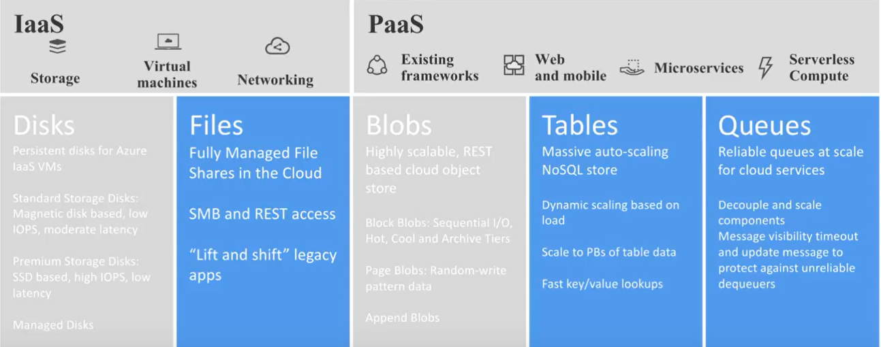
Structured Storage Overview
Structured storage makes up Azure Files in IaaS, and Tables and Queues in PaaS
Notes:
Structured Storage Overview - https://www.youtube.com/watch?v=2i9ZZ4BqRmU

Slide 54
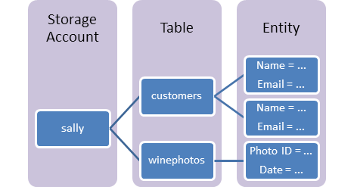
Table Storage
Store large amounts of structured data
A NoSQL key-value data store
Authenticates from inside and outside the Azure cloud.
Good for web scale applications
Store datasets for non-complex jobs, foreign keys, or stored procedures
Quickly query data using a clustered index
Notes:
✔️ You can use the Table service to store and query huge sets of structured, non-relational data, and your tables will scale as demand increases.
✔️ A NoSQL (originally referring to “non SQL” or "non-relational") database provides a mechanism for storage and retrieval of data which is modeled in means other than the tabular relations used in relational databases.
For more information, you can see:
Table storage - https://azure.microsoft.com/en-us/services/storage/tables/

Slide 55
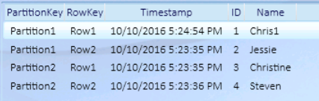
Implementing Table Storage
An entity can have up to 225 properties, including three system properties
PartitionKey and RowKey must uniquely identify every entity within a table
Azure assigns the Timestamp and it cannot be modified
Notes:
✔️ The Table service is not part of the exam objective domain but is included to complete your study of the Storage service.
For more information, you can see:
Guidelines for table design - https://docs.microsoft.com/en-us/azure/cosmos-db/table-storage-design-guide#guidelines-for-table-design

Slide 56
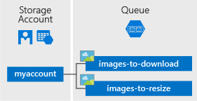
Queue Storage
Store millions of messages
Accessible from anywhere
Authenticate with HTTP or HTTPS
A message can be up to 64 KB in size
Create a backlog of work to process asynchronously.
Pass messages from an Azure web role to an Azure worker role
Notes:
✔️ The Queue service is not part of the exam objective domain but is included to complete the study of the Storage service.
For more information, you can see:
Queue Storage - https://azure.microsoft.com/en-us/services/storage/queues/

Slide 57
AZ-100.2 Module 03: Securing and Managing Storage

Slide 58
Lesson 01: Shared Access Keys

Slide 59
Storage Security Overview
Storage service encryption
Encryption in transit
Storage firewall - limit IP addresses through network security groups
Limit user access to storage accounts using RBAC
Analyze metrics and logs with Azure Monitor and Log Analytics
Storage keys
More granular security with Shared Access Signatures
Policy based signatures
Notes:
Storage Security - https://www.youtube.com/watch?v=tcMyGYp_dQM

Slide 60

Shared Access Signature (SAS)
Provides delegated access to resources
Grants access to clients without sharing your storage account keys
The account SAS delegates access to resources in one or more of the storage services: Blob, Queue, Table, or File service
The service SAS delegates access to a resource in just one of the storage services
Notes:
For more information, you can see:
What is a shared access signature? - https://docs.microsoft.com/en-us/azure/storage/common/storage-dotnet-shared-access-signature-part-1?toc=%2fazure%2fstorage%2fblobs%2ftoc.json#what-is-a-shared-access-signature
When should you use a shared access signature? - https://docs.microsoft.com/en-us/azure/storage/common/storage-dotnet-shared-access-signature-part-1?toc=%2fazure%2fstorage%2fblobs%2ftoc.json#when-should-you-use-a-shared-access-signature

Slide 61
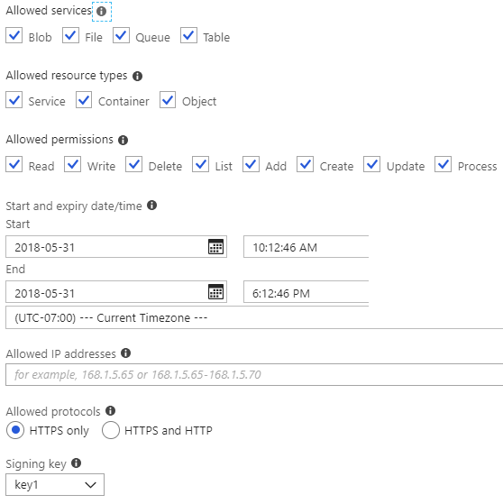
Configuring SAS Parameters
Account level SAS, full permissions
New-AzureStorageAccountSASToken
-Service Blob,File,Table,Queue
-ResourceType Service,Container,Object
-Permission "racwdlup"
Blob level SAS, full permissions
New-AzureStorageBlobSASToken
-Container "ContainerName"
-Blob "BlobName"
-Permission rwd
Notes:
✔️ Take a few minutes to access the Azure Portal. Select a Storage Account and click Shared Access Signature. Use the Information icon to step through each of the settings to learn more about what that parameter does.
For more information, you can see:
New-AzureStorageAccountSASToken- https://docs.microsoft.com/en-us/powershell/module/azure.storage/new-azurestorageaccountsastoken?view=azurermps-6.8.1
New-AzureStorageBlobSASToken- https://docs.microsoft.com/en-us/powershell/module/azure.storage/new-azurestorageblobsastoken?view=azurermps-6.8.1

Slide 62
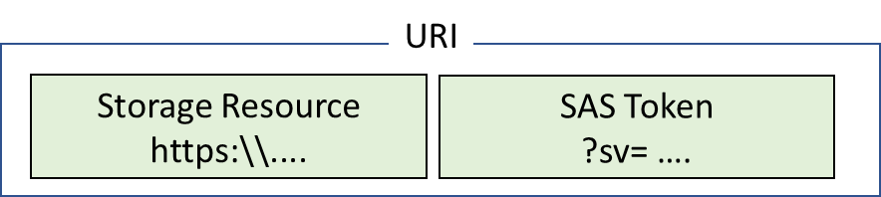
URI and SAS Parameters
A SAS is a signed URI that points to one or more storage resources
Consists of a storage resource URI and the SAS token
Includes parameters for resource URI, storage services version, services, resource types, start time, expiry time, resource, permissions, IP range, protocol, signature
Notes:
For more information, you can see:
Shared access signature parameters - https://docs.microsoft.com/en-us/azure/storage/common/storage-dotnet-shared-access-signature-part-1?toc=%2fazure%2fstorage%2fblobs%2ftoc.json#shared-access-signature-parameters
Service SAS URI example - https://docs.microsoft.com/en-us/azure/storage/common/storage-dotnet-shared-access-signature-part-1#service-sas-uri-example
Account SAS URI example - https://docs.microsoft.com/en-us/azure/storage/common/storage-dotnet-shared-access-signature-part-1#account-sas-uri-example

Slide 63
Best Practices
Always use HTTPS to create or distribute an SAS
Reference stored access policies where possible
Be careful with SAS start time
Be specific with the resource to be accessed
Notes:
For more information, you can see:
Best practices when using SAS - https://docs.microsoft.com/en-us/azure/storage/common/storage-dotnet-shared-access-signature-part-1#best-practices-when-using-sas
Configure Azure Storage Firewalls and Virtual Networks - https://docs.microsoft.com/en-us/azure/storage/common/storage-network-security

Slide 64
Lesson 02: Azure Backup

Slide 65
Azure Backup
Azure-based service used to back up and restore data in Microsoft cloud
Automatic Storage Management
Unlimited scaling
Multiple storage options
Unlimited data transfer
Data encryption
Application consistent backup
Long-term retention
Notes:
✔️ What are some of the reasons your organization might choose Azure Backup?
For more information, you can see:
Why use Azure Backup? - https://docs.microsoft.com/en-us/azure/backup/backup-introduction-to-azure-backup#why-use-azure-backup
Azure Backup Protection Support Matrix - https://docs.microsoft.com/en-us/azure/backup/backup-mabs-protection-matrix#protection-support-matrix

Slide 66
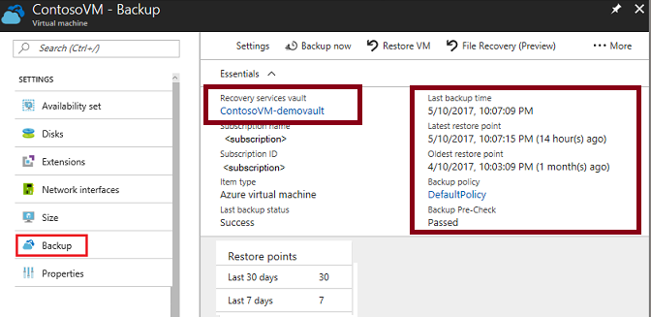
Recovery Services Vault
Storage entity in Azure that houses data
Data for virtual machines (VMs), workloads, servers, or workstations
Support for System Center DPM, Windows Server, Azure Backup Server
Up to 25 Recovery Services vaults per region
Replaces Backup vaults
Notes:
✔️ If multiple servers are protected using the same Recovery Services vault, it may be more logical to look at the Recovery Services vault. You can search for all Recovery Services vaults in the subscription and choose one from the list.
✔️ Prior to November 2017 there were Backup vaults. Now all Backup vaults have been upgraded to Recovery Services vaults.
For more information, you can see:
Managing your Recovery Services vaults in the portal - https://docs.microsoft.com/en-us/azure/backup/backup-azure-recovery-services-vault-overview

Slide 67
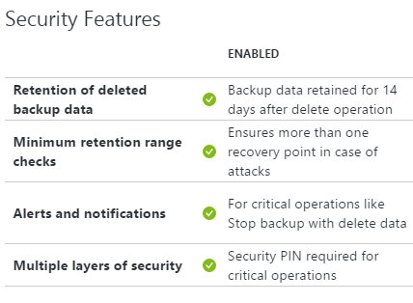
Security Features for Hybrid Backups
Prevention – Authentication to ensure validated users
Alerting – Email notifications for critical events
Recovery – Extended retention and recovery points
Notes:
✔️ Security features should not be enabled if you are using infrastructure as a service (IaaS) VM backup. These features are not yet available (as of April 2018) for IaaS VM backup, so enabling them will not have any impact.
For more information, you can see:
Security features to help protect hybrid backups that use Azure Backup - https://docs.microsoft.com/en-us/azure/backup/backup-azure-security-feature

Slide 68
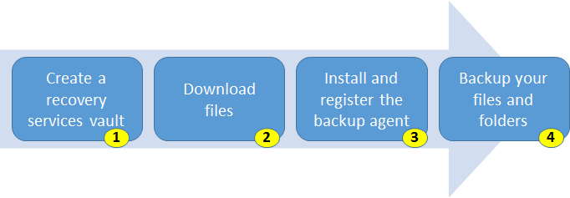
Backup Files and Folders
Create a recovery services vault in the region you store the data, and determine how you want the data replicated
Download the Backup Agent for Windows Server or Windows Client and the vault credentials
Use Azure Recovery Services to back up files and folders
Schedule the back up and do the first-time backup
Notes:
For more information, you can see:
Questions about the Backup Service - https://docs.microsoft.com/en-us/azure/backup/backup-azure-backup-faq

Slide 69
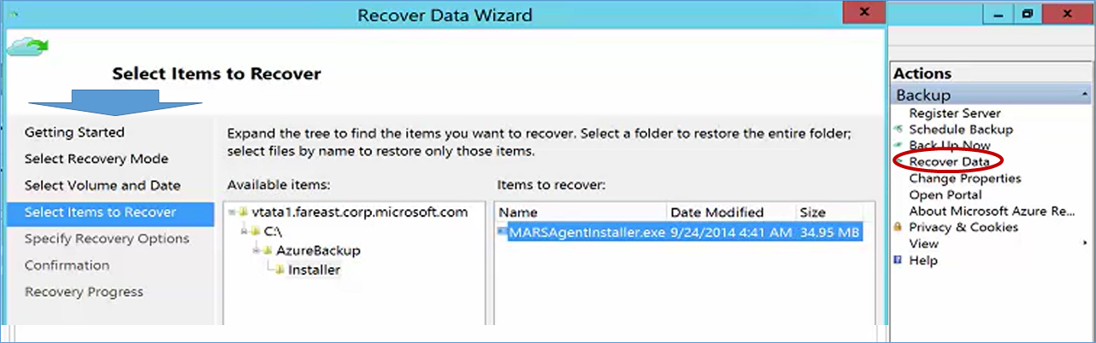
Restore Files and Folders
Select recovery mode
Select volume and date
Select items to recover
Specify recovery options

Slide 70
Backup and Recovery
Azure Backup
Service that allows you to back up and restore data
Works with on-premises or cloud-based services
Replaces on-premises or off-site backup solution
Deployment scenarios
Azure Backup agent – deploy on Windows Server in Azure and on-premises
System Center DPM – deploy in Azure and on-premises
Azure Backup Server – deploy in Azure and on-premises
Azure Backup (VM extensions) – Azure makes backup copies of your VM
Notes:
Backup and Recovery - https://www.youtube.com/watch?v=CV0FHLcRefw

Slide 71
Lesson 03: Azure File Sync

Slide 72
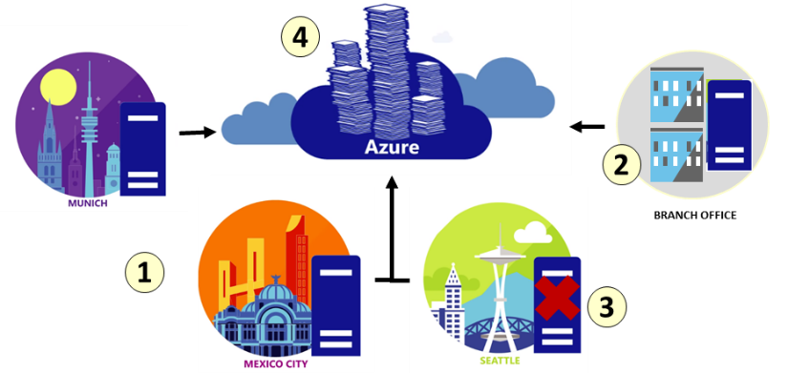
Azure File Sync
Centralize file shares in Azure Files
Lift and shift
Branch Office backups
Backup and Disaster Recovery
File Archiving
Notes:
✔ At the time of this writing Azure File Sync is in preview. Be sure to consult the documentation for any new updates.
For more information, you can see:
Planning for an Azure File Sync deployment - https://docs.microsoft.com/en-us/azure/storage/files/storage-sync-files-planning
Release notes for the Azure File Sync agent - https://docs.microsoft.com/en-us/azure/storage/files/storage-files-release-notes

Slide 73
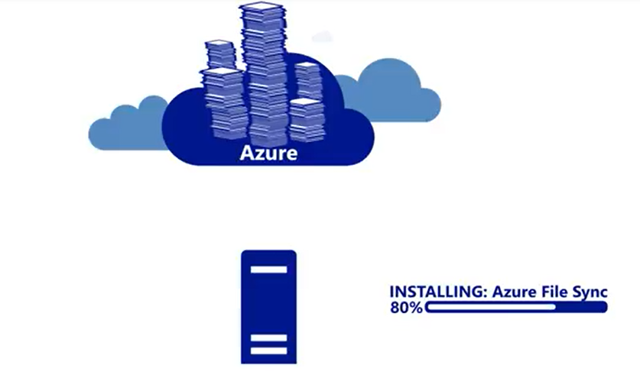
File Sync Overview
Centralize your organization's file shares in Azure Files
Azure File Sync transforms Windows Server into a quick cache of your Azure file share
Use any available protocol access your data locally, including SMB, NFS, and FTPS
Have as many caches as you need globally
Local server
Notes:
File Sync Overview - https://www.youtube.com/watch?v=Zm2w8-TRn-o

Slide 74

File Sync Service Deployment (Initial Steps)
Deploy the Storage Sync Service
Prepare Windows Server to use with Azure File Sync.
Install the Azure File Sync Agent
Register Windows Server with Storage Sync Service
Notes:
✔ Do you see in the last step why you may need multiple storage sync services? Continue to the next topic for an explanation of how files are synchronized.
For more information, you can see:
Deploy Azure File Sync - https://docs.microsoft.com/en-us/azure/storage/files/storage-sync-files-deployment-guide#deploy-the-storage-sync-service
FAQ for Azure File Sync - https://docs.microsoft.com/en-us/azure/storage/files/storage-files-faq#azure-file-sync

Slide 75
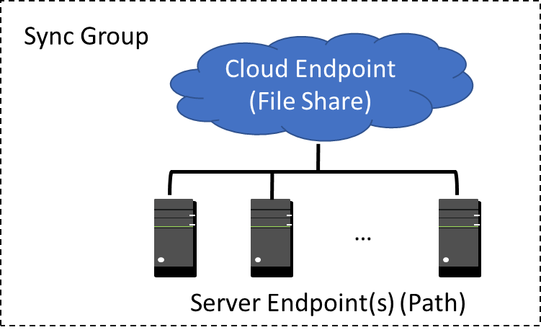
File Sync Service Deployment (Synchronization)
Sync group defines the sync topology for a set of files. Must contain at least one cloud endpoint and one server endpoint.
Server endpoint configuration includes: Registered server, Path, Cloud Tiering, and Volume Free Space
Notes:
✔ Regardless of whether cloud tiering is enabled, your Azure file share always has a complete copy of the data in the sync group.
✔ Azure File Sync moves file data and metadata exclusively over HTTPS and requires port 443 to be open outbound. Based on policies in your datacenter, branch or region, further restricting traffic over port 443 to specific domains may be desired or required.
✔ There is a lot to consider when synchronizing large amounts of files. For example, you may want to copy the server files to the Azure file share before you configure file sync. Take a few minutes to read the reference link and decide upon a strategy.
For more information, you can see:
Onboarding with Azure File Sync - https://docs.microsoft.com/en-us/azure/storage/files/storage-sync-files-deployment-guide#onboarding-with-azure-file-sync

Slide 76
Troubleshooting Azure File Sync
Agent installation and server registration
Sync group management
File synchronization
Cloud tiering
Notes:
For more information, you can see:
Troubleshoot Azure File Sync - https://docs.microsoft.com/en-us/azure/storage/files/storage-sync-files-troubleshoot
Azure Support Forum - https://social.msdn.microsoft.com/Forums/en-US/home?forum=windowsazuredata
How can we improve Azure storage? - https://feedback.azure.com/forums/217298-storage/category/180670-files

Slide 77
Hybrid Storage with Azure File Sync
Azure File Sync lets you replicate your locally stored on-premises data to Azure
Provides multi-site sync
Tier the coolest data, where the file server becomes an on-premises cache
Only the files you need are on the file server as you extend the logical drive into the cloud
Provides integrated backup and restore
Notes:
Hybrid Storage - https://www.youtube.com/watch?v=svncg5DfpP4
✔ This video reviews the File Sync process and provides another demonstration. Review the video to ensure students have learned the main points of this lesson.

Slide 78
Configure and Deploy Azure File Sync
Create a storage account
Deploy the Storage Sync Service
Create a Sync Group where you specify an Azure file share to sync with
Create a file share in the storage account
Register your on-premise or local server with the storage sync service
Configure the synchronization which involves deploying the File Sync agent
Add a server endpoint
Notes:
✔️ Remember that your storage account must be located in one of the regions in which Azure File Sync is supported.

Slide 79
Lab 3: Backup Azure File Shares
Configure a Recovery Services vault to back up Azure Files
Run an on-demand backup job to create a restore point
Restore a file or files from a restore point
Manage Backup jobs
Stop protection on Azure Files
Delete your backup data
Notes:
For more information, you can see:
Back up Azure Files - https://docs.microsoft.com/en-us/azure/backup/backup-azure-files
Questions about backing up Azure Files - https://docs.microsoft.com/en-us/azure/backup/backup-azure-files-faq
Troubleshoot problems backing up Azure Files - https://docs.microsoft.com/en-us/azure/backup/troubleshoot-azure-files

Slide 80
AZ-100.2 Module 04: Storing and Accessing Data

Slide 81
Lesson 01: Azure Content Delivery Network

Slide 82
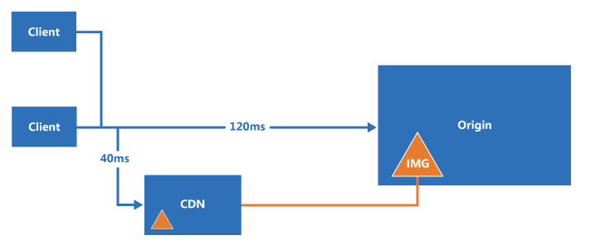
CDN Benefits
Lower latency and faster delivery of content
Reduced load on server or application
Typical uses:
Delivering static resources for client apps
Delivering public static and shared content to devices
Serving static content websites
Streaming video files to clients on demand
Supporting IoT solutions
Notes:
✔️ CDN provides a faster, more responsive user experience. Do you think your organization would be interested in this feature?
✔️ Use the following link to review some of the challenges with deploying CDN including security, deployment, versioning, and testing.
For more information, you can see:
Best practices for using content delivery networks (CDNs) - https://docs.microsoft.com/en-us/azure/architecture/best-practices/cdn?toc=%2Fazure%2Fcdn%2Ftoc.json

Slide 83
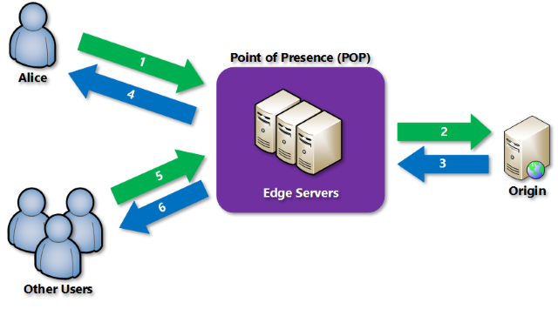
How CDN Works
User requests a file
Edge server requests file from origin
Origin returns the file to the edge server
Edge server caches the file and returns the file to the original requestor
Additional user requests the same file
Edge server returns the file from the cache
Notes:
✔️ After you enable CDN access to a storage account, all publicly available objects are eligible for CDN edge caching. If you modify an object that's currently cached in the CDN, the updated content will not be available via CDN until CDN refreshes its content after the time-to-live period for the cached content expires.
For more information, you can see:
Overview of the Azure Content Delivery Network - https://docs.microsoft.com/en-us/azure/cdn/cdn-overview
Azure CDN POP locations by region - https://docs.microsoft.com/en-us/azure/cdn/cdn-pop-locations

Slide 84
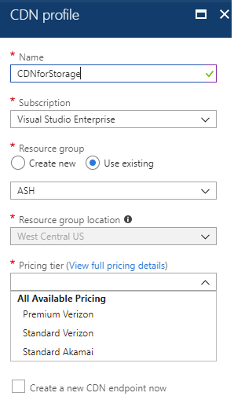
CDN Profiles
A CDN profile is a collection of CDN endpoints with the same pricing tier and provider (origin)
Can create multiple profiles to organize endpoints
Up to eight profiles per subscription
Subscription pricing tiers:
Premium Verizon
Standard Verizon
Standard Akamai
Notes:
✔️ Can you think of different scenarios that would require different CDN profiles?
For more information, you can see:
CDN Pricing - https://azure.microsoft.com/en-us/pricing/details/cdn/

Slide 85
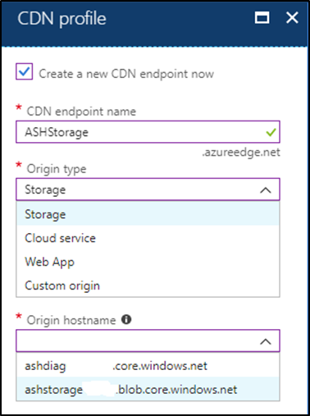
CDN Endpoints
Origin types: Storage, Cloud Service, Web App, and Custom origin
The CDN endpoint for this storage example: ASHStorage.azureedge.net/…
Add custom domain mapping to your CDN endpoint and enable custom domain HTTPS
Additional CDN features for your delivery, such as compression, query string, and geo filtering
Notes:
✔️ Because it takes time for the registration to propagate, the endpoint isn't immediately available for use. For Azure CDN from Akamai profiles, propagation usually completes within one minute. For Azure CDN from Verizon profiles, propagation usually completes within 90 minutes, but in some cases can take longer. Be sure to review the Troubleshooting pages reference link.
For more information, you can see:
Create a new CDN endpoint - https://docs.microsoft.com/en-us/azure/cdn/cdn-create-new-endpoint#create-a-new-cdn-endpoint
Troubleshooting CDN endpoints returning 404 statuses - https://docs.microsoft.com/en-us/azure/cdn/cdn-troubleshoot-endpoint

Slide 86
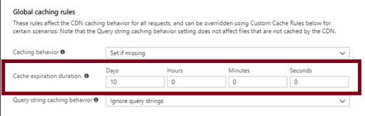
CDN Time-to-Live (Default Caching)
Blob content can be cached in Azure CDN until its TTL elapses
If there aren’t any Cache-directive headers, the Cache Expiration Duration controls the endpoint caching
TTL is configured as days, hours, minutes, and seconds
Notes:
For more information, you can see:
Cache-directive Headers - https://docs.microsoft.com/en-us/azure/cdn/cdn-how-caching-works#cache-directive-headers
Control Azure CDN caching behavior with caching rules - https://docs.microsoft.com/en-us/azure/cdn/cdn-caching-rules

Slide 87
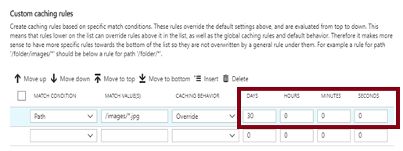
CDN Time-to-Live (Caching)
Override the global caching rules with custom caching rules
Caching rules based on specific match conditions
Evaluated in order, top to down

Slide 88
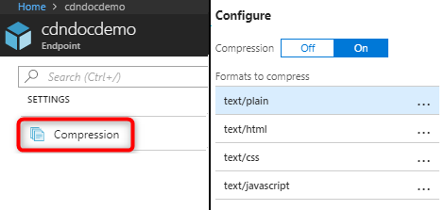
CDN Compression
Improve file transfer speed and increase page-load performance
Reduce bandwidth costs and provide a more responsive experience
Enable compression on the origin server or on the CDN edge servers
Specify which MIME formats are compressed
Notes:
✔️Although it is possible, it is not recommended to apply compression to compressed formats. For example, ZIP, MP3, MP4, or JPG.
For more information, you can see:
Premium tier compression - https://docs.microsoft.com/en-us/azure/cdn/cdn-improve-performance#premium-tier
Compression behavior tables - https://docs.microsoft.com/en-us/azure/cdn/cdn-improve-performance#compression-behavior-tables
Troubleshooting CDN file compression - https://docs.microsoft.com/en-us/azure/cdn/cdn-troubleshoot-compression

Slide 89
Optimize Your Content Delivery
Optimize CDN on the backend to improve performance based on the scenario
General web delivery
General media streaming
Video on demand media streaming
Large file download (preferred for anything greater than 10 Mb)
Object chunking for large file downloads
Prefetch for improving large file delivery
Notes:
Optimize Your Content Delivery - https://channel9.msdn.com/Shows/Azure-Friday/Optimize-Your-Content-Delivery-with-Azure-CDN/player

Slide 90
Lab 4: Optimize Your Content Delivery
Enable Azure CDN
Create a new CDN profile
Create a new CDN endpoint
Create Caching Rules
Access the azure CDN caching rules page
Set global caching rules
Set custom caching rules
Notes:
For more information, you can see:
Troubleshooting CDN endpoints returning 404 statuses - https://docs.microsoft.com/en-us/azure/cdn/cdn-troubleshoot-endpoint
How caching works – https://docs.microsoft.com/en-us/azure/cdn/cdn-how-caching-works
Control Azure CDN caching behavior – https://docs.microsoft.com/en-us/azure/cdn/cdn-caching-rules

Slide 91
Lesson 02: Import and Export Service

Slide 92
Import and Export Service
Import/transfer large amounts of data to Azure Blob storage and Azure Files
Export/transfer data from Azure storage to hard disk drives
Migrating data to the cloud
Content distribution
Backup
Data recovery
Notes:
✔ Only 2.5” SSD or 2.5" or 3.5" SATA II or III internal HDD are supported for use with the Import/Export service.
For more information, you can see:
Import/Export Prerequisites - https://docs.microsoft.com/en-us/azure/storage/common/storage-import-export-service#prerequisites
Azure Import and Export Service - https://azure.microsoft.com/en-us/documentation/articles/storage-import-export-service/
Import/Export Pricing - https://azure.microsoft.com/en-us/pricing/details/storage-import-export/

Slide 93
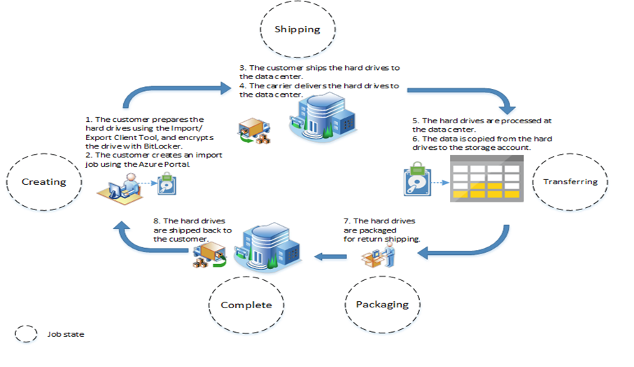
Import Jobs Process
Automatic Storage Management
Unlimited data transfer
Data encryption
Unlimited scaling
Multiple storage options
Long-term retention
Application consistent backup
Notes:
For more information, you can see:
Inside an import job - https://docs.microsoft.com/en-us/azure/storage/common/storage-import-export-service#inside-an-import-job

Slide 94
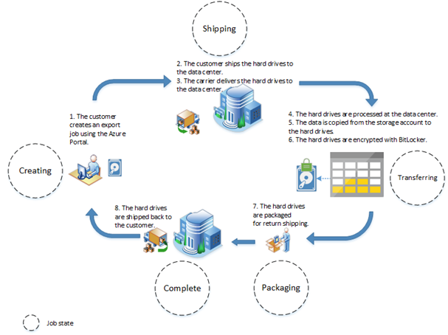
Export Jobs
Notes:
For more information, you can see:
Inside an export job - https://docs.microsoft.com/en-us/azure/storage/common/storage-import-export-service#inside-an-export-job

Slide 95
Azure Import/Export Tool
Install and set up the Azure Import/Export Tool
Prepare your hard drives for a job where you import data from your drives to Azure Blob Storage
Review the status of a job with Copy Log Files
Repair an import job
Repair an export job
Troubleshoot the Azure Import/Export Tool
Notes:
✔ This practice involves a fairly lengthy process and in a real-world use case you would package an import job to the appropriate media in order to ship it to an Azure data center. Even if you don’t attempt this practice, it’s worth reading through the documentation.
✔ If you decide to try this practice, you’ll need one or more empty 2.5-inch or 3.5-inch SATAII or III or SSD hard drives connected to the copy machine.
For more information, you can see:
Using the Azure Import/Export Tool - https://docs.microsoft.com/en-us/azure/storage/common/storage-import-export-tool-how-to?toc=%2fazure%2fstorage%2fblobs%2ftoc.json

Slide 96
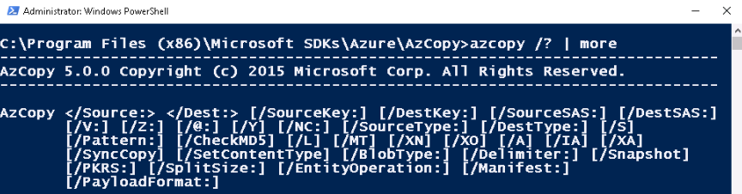
AzCopy
Command-line utility for transferring data
Designed for copying data to/from Microsoft Azure Blob, File, and Table storage
Notes:
✔Take a few minutes to download the tool and try a few simple transfer examples.
For more information, you can see:
Download and install AzCopy on Windows - https://docs.microsoft.com/en-us/azure/storage/common/storage-use-azcopy#download-and-install-azcopy-on-windows

Slide 97
Lesson 03: Data Box

Slide 98
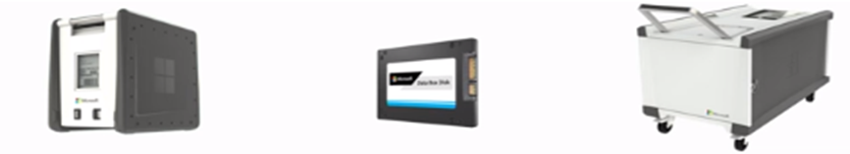
Offline: Data Box Products
Data Box
Bulk migration to Azure when a network isn’t an option
Capacity: 100 TB
Weight: ~ 50 lbs.
Secure, ruggedized appliance
Data Box Disk
Best for projects that require a smaller form factor
Capacity: 8 TB ea.
Secure, ruggedized USB drives orderable in packs of 5 (up to 40 TB)
Data Box Heavy
Same service as Data Box, but targeted to petabyte-sized datasets
Capacity: 1 PB
Weight: 500+ lbs.
Secure, ruggedized appliance
Notes:
For more information, you can see:
Azure Data Box Products - https://azure.microsoft.com/en-us/services/storage/databox/
Azure Data Box - https://docs.microsoft.com/en-us/azure/databox-family/
Ignite 2018 Azure Data Box Family - https://azure.microsoft.com/en-us/resources/videos/ignite-2018-the-new-additions-to-the-azure-data-box-family/

Slide 99
Offline: Use Cases
One-time migration
Moving data from offline tapes to archival data in Azure cool storage
Moving a media library from offline tapes into Azure to create an online media library
Migrating your VM farm, SQL server, and applications to Azure
Moving historical data to Azure for in-depth analysis and reporting using HDInsight
Moving backup data to Azure for offsite storage
Incremental transfer
Periodic uploads
Notes:
For more information, you can see:
Use Cases (Data Box Heavy) - https://docs.microsoft.com/en-us/azure/databox/data-box-heavy-overview#use-cases
Case Study: Azure Data Box | Oceaneering Intl - https://www.youtube.com/watch?time_continue=61&v=y0nGRHw3Zqc

Slide 100
Offline: Product Selection
Speed and time
Security
Product | Network Interfaces
Data Box Disk | USB 3.0 connection
Data Box | 1 Gbps or 10 Gbps network interfaces
Data Box Heavy | High performance 40 Gbps network interfaces
Product | Physical security | Encryption
Data Box Disk | The disks are tamper-resistant and support secure update capability. | The data is secured with AES 128-bit encryption.
Data Box | Rugged device casing secured by tamper-resistant screws and tamper-evident stickers | The data is secured with AES 256-bit encryption.
Data Box Heavy | Rugged device casing secured by tamper-resistant screws and tamper-evident stickers | The data is secured with AES 256-bit encryption.
Notes:
✔️ Once your data is uploaded to Azure, the disks on the device are wiped clean, in accordance with NIST 800-88r1 standards.

Slide 101
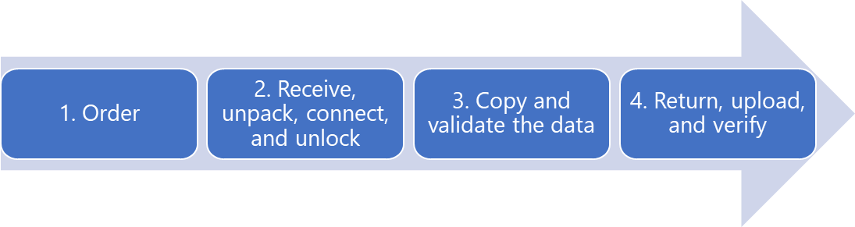
Offline: Implementation Workflow
Order
Receive, unpack, connect, and unlock
Copy and validate the data
Return, upload, verify.
Device disks are securely erased as per the NIST guidelines
Notes:
✔️ Take a few minutes to review each link. The links are for Data Box, there are similar pages for Data Box Disk and Data Box Heavy.
✔️ Throughout this process, you are notified via email on all status changes.
For more information, you can see:
QuickStart: Deploy Azure Data Box using the Azure portal - https://docs.microsoft.com/en-us/azure/databox/data-box-quickstart-portal

Slide 102


Online: Data Box Products
Data Box Gateway
Virtual network transfer appliance, runs on your choice of hardware
Device provisioned in our hypervisor
Supports storage gateway, SMB, NFS, Azure blob, and files
Data Box Edge
Manages uploads to Azure and can pre-process data prior to upload
Local cache capacity: ~12 TB
Includes Data Box Gateway and Azure IoT Edge
Notes:
For more information, you can see:
What is Azure Data Box Gateway? - https://docs.microsoft.com/en-us/azure/databox-online/data-box-gateway-overview
What is Azure Data Box Edge? - https://docs.microsoft.com/en-us/azure/databox-online/data-box-edge-overview

Slide 103
Online: Data Box Gateway
A virtual device based on a virtual machine
Provisioned in your virtualized environment or hypervisor
Write data using the NFS and SMB protocols
Transfer to Azure block blob, page blob, or Azure Files.
Use cases:
Cloud Archival
Data Aggregation
Integration with on-premises workloads
Benefits:
Easy data transfer with high performance
Fast access and limited bandwidth usage
Notes:
For more information, you can see:
Data Box Gateway - https://docs.microsoft.com/en-us/azure/databox-online/data-box-gateway-overview

Slide 104
Online: Data Box Edge
Physical device supplied by Microsoft
Write data using the NFS and SMB protocols
Has all the gateway capabilities of Data Box Gateway
Also equipped with AI-enabled edge computing capabilities that can analyze, process, or filter data
Use cases:
Preprocess data
Inference Azure Machine Learning
Transfer data over network to Azure
Notes:
✔️ Data Box Edge has many of the same benefits of Data Box Gateway.
For more information, you can see:
Data Box Edge - https://docs.microsoft.com/en-us/azure/databox-online/data-box-edge-overview

Slide 105
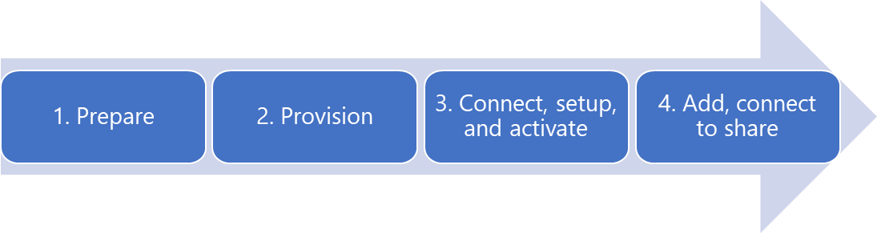
Online: Implementation Workflow
Prepare
Provision. Hyper-V or VMware
Connect, setup, and activate
Add, connect to the share
Notes:
✔️ Be sure to view the documentation for each step,
✔️ The steps for Data Box Edge are different. Use the reference link to walk through those tutorials.
For more information, you can see:
Tutorial: Prepare to deploy Azure Data Box Edge - https://docs.microsoft.com/en-us/azure/databox-online/data-box-edge-deploy-prep

Slide 106
AZ-100.2 Module 05: Monitoring Storage

Slide 107
Lesson 01: Metrics and Alerts

Slide 108
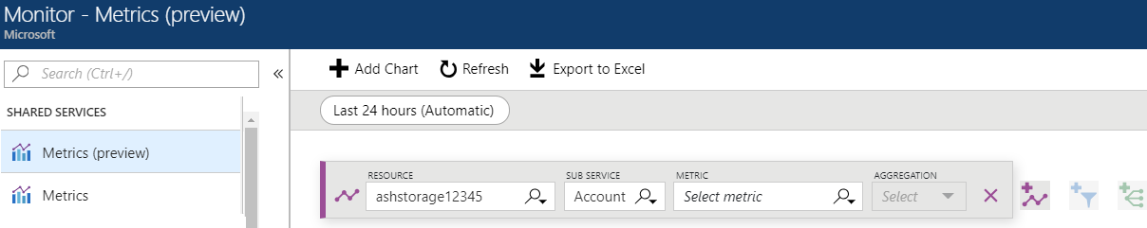
Monitor Metrics
Azure Monitor provides unified user interfaces for monitoring across different Azure services
Azure Storage integrates Azure Monitor by sending metric data to the Azure Monitor platform
Access metrics with: portal, Monitor APIs, OMS, and Event Hubs
Notes:
✔ Take a minute to locate the Monitor service and then Metrics on the Shared Services blade.
For more information, you can see:
Azure Storage metrics in Azure Monitor - https://docs.microsoft.com/en-us/azure/storage/common/storage-metrics-in-azure-monitor?toc=%2fazure%2fstorage%2fblobs%2ftoc.json
Monitoring Azure applications and resources - https://docs.microsoft.com/en-us/azure/monitoring-and-diagnostics/monitoring-overview

Slide 109
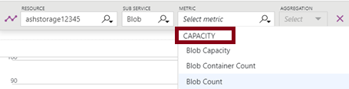
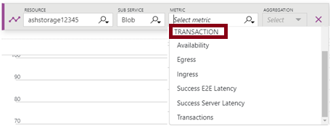
Capacity and Transaction Metrics
Capacity metrics values are sent every hour and refreshed daily
Transaction metrics are sent every minute for both account and service level
Notes:
✔ Take few minutes to read about the Capacity and Transaction metrics and create a few metric graphs in the Azure portal.
For more information, you can see:
Capacity Metrics - https://docs.microsoft.com/en-us/azure/storage/common/storage-metrics-in-azure-monitor?toc=%2fazure%2fstorage%2fblobs%2ftoc.json#capacity-metrics
Transaction Metrics - https://docs.microsoft.com/en-us/azure/storage/common/storage-metrics-in-azure-monitor?toc=%2fazure%2fstorage%2fblobs%2ftoc.json#transaction-metrics

Slide 110
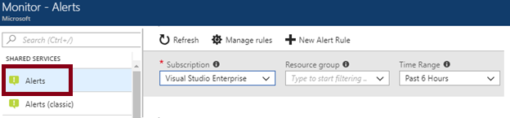
Azure Monitor Alerts
Better notification system
Unified authoring experience
Log Analytics alerts display in Azure portal
Separation of Fired Alerts and Alert Rules
Improved workflow
Notes:
For more information, you can see:
The new alerts experience in Azure Monitor - https://docs.microsoft.com/en-us/azure/monitoring-and-diagnostics/monitoring-overview-unified-alerts

Slide 111
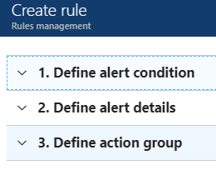
Alert Rules
Define alert conditions: Target selection, Alert criteria, and Alert logic
Define alert details: Alert rule name, description, and severity (0 to 4)
Define action group: notify your team via email and text messages or automate actions using webhooks and runbooks.
Notes:
✔ Take a few minutes to create an alert rule and look at the options.

Slide 112
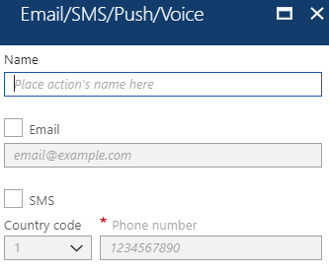
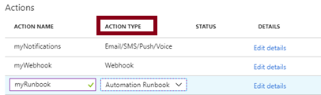
Action Groups
Configure a list of actions to take when an alert is triggered
Email/SMS/Push/Voice
Logic App
Webhook
IT Service Management
Automation Runbook
Notes:
✔ Take a few minutes to create an action group using the link below.
For more information, you can see:
Create an action group by using the Azure portal - https://docs.microsoft.com/en-us/azure/monitoring-and-diagnostics/monitoring-action-groups#create-an-action-group-by-using-the-azure-portal
Action specific information - https://docs.microsoft.com/en-us/azure/monitoring-and-diagnostics/monitoring-action-groups#action-specific-information
Rate limiting for Voice, SMS, emails, Azure App push notifications and webhook posts - https://docs.microsoft.com/en-us/azure/monitoring-and-diagnostics/monitoring-alerts-rate-limiting

Slide 113

Signal Types and Metrics
Signal types:
Metric
Activity log
Application Insights
Logs
Enable newer metric alerts:
Improved latency
Multi-dimensional metrics support
Combined monitoring for multiple metrics
Metrics from Logs
Notes:
For more information, you can see:
Alert rule terminology - https://docs.microsoft.com/en-us/azure/monitoring-and-diagnostics/monitoring-overview-unified-alerts#alert-rules-terminology

Slide 114
Monitoring Storage
Enable monitoring for a new or existing storage account
Aggregate metrics
Per-API metrics
Logs
Not supported for Premium storage accounts
Metrics and logs are stored in the same storage account
Metrics can be displayed in the Monitoring lens
Metric-based alerts
Delivered through email
Routed to a Webhook
Notes:
Video file: https://www.youtube.com/watch?v=oBhbrTQNrLc

