Slide 1
AZ-100.3 Deploying and Managing Virtual Machines

Slide 2
Course Agenda
M01: Introduction to Virtual Machines
L01: Azure Virtual Machines: Course Overview
L02: Planning Considerations
M02: Creating Virtual Machines
L01: Overview of Virtual Machine Creation Process
L02: Creating Virtual Machines in the Azure Portal
L03: Creating Virtual Machines (PowerShell)
L04: Creating Virtual Machines using ARM Templates
M03: Deploying Virtual Machine Images
L01: Deploying Custom Images
L02: Deploying Linux Virtual Machines

Slide 3
Course Agenda (continued)
M04: Configuring Virtual Machines
L01: Overview of Virtual Machine Configuration
L02: Virtual Machines Networking
L03: Virtual Machine Storage
M05: Configuring Availability and Extensibility
L01: Virtual Machine Availability
L02: Virtual Machine Scalability
L03: Applying Virtual Machine Extensions
M06: Managing and Monitoring Virtual Machines
L01: Backup and Restore
L02: Monitoring Virtual Machines

Slide 4
AZ-100.3 Module 01: Introduction to Virtual Machines

Slide 5
Lesson 01: Azure Virtual Machines: Course Overview

Slide 6
Course Introduction
Planning virtual machines
Creating virtual machines
Configuring virtual machines
Configuring virtual machine storage
Managing virtual machines
Notes:
In this video (@5:30) the SAP HANA link has changed. SAP HANA (Large Instances) overview and architecture on Azure - https://docs.microsoft.com/en-us/azure/virtual-machines/workloads/sap/hana-overview-architecture
Course Introduction - https://docs.microsoft.com/en-us/azure/virtual-machines/workloads/sap/hana-overview-architecture

Slide 7
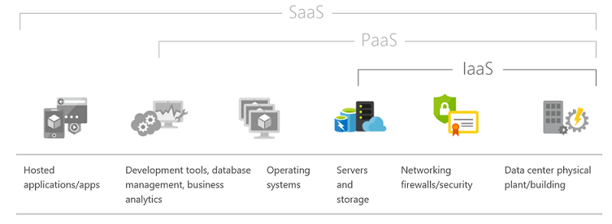
IaaS Cloud Services
Test and development
Website hosting
Storage, backup, and recovery
Web apps
High-performance computing
Big data analysis
Notes:
✔️What advantages do you think IaaS has over other business models? Read the reference link to learn more.
For more information, you can see:
Infrastructure as a Service - https://azure.microsoft.com/en-us/overview/what-is-iaas/

Slide 8
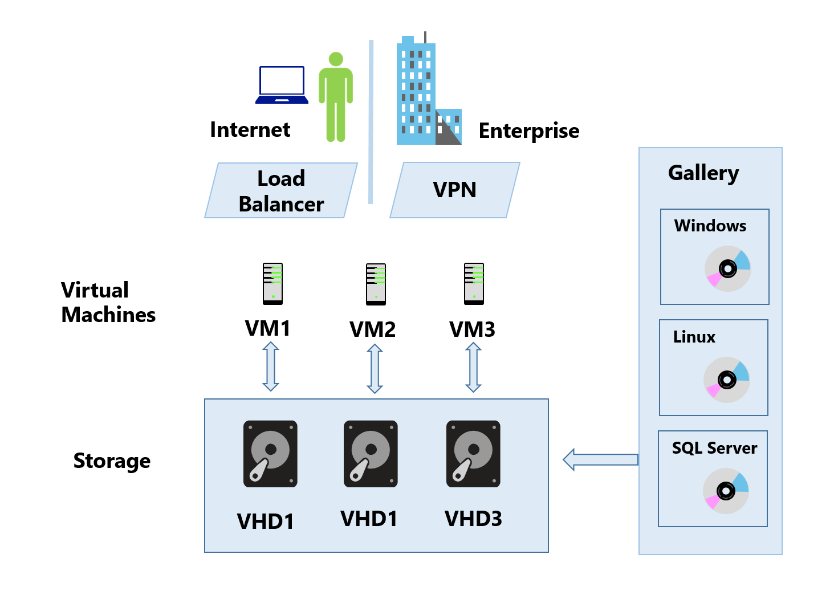
Virtual Machines
On-demand, scalable computing resources
Test and Development
Running applications in the cloud
Extending your data center to the cloud
Disaster recovery
Notes:
✔️ Which of these scenarios are you most interested in?
For more information, you can see:
Overview of Windows virtual machines in Azure - https://docs.microsoft.com/en-us/azure/virtual-machines/windows/overview?toc=%2Fazure%2Fvirtual-machines%2Fwindows%2Ftoc.json

Slide 9
On-Premises vs Azure Virtual Machines
Characteristic | On-Premises Hyper-V | Azure
Console access available to virtual machine | Yes | No
Support for Generation 2 Hyper-V VM features | Yes | No
Support for VHDX file format | Yes | No
Upgrade Guest OD | Yes | Not supported
Requires ownership and control of physical hardware | Yes | No
Run anti-virus on virtual machines | Yes | Yes
Support for more than one virtual network adapter | Yes | Generally not, depends on VM size
Notes:
✔️ This video compares what you may already know about on-premises virtual machines with virtual machines in the cloud. Can you see the differences and similarities?

Slide 10
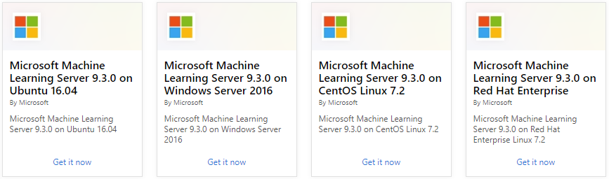
Supported Operating Systems
Windows Server includes many common products, requires a license, doesn’t support OS upgrades
Linux distributions are supported, upgrade of the OS is supported
Notes:
For more information, you can see:
Microsoft server software support for Microsoft Azure virtual machines - https://support.microsoft.com/en-us/help/2721672/microsoft-server-software-support-for-microsoft-azure-virtual-machines
Linux on distributions endorsed by Azure - https://docs.microsoft.com/en-us/azure/virtual-machines/linux/endorsed-distros#supported-distributions–versions.

Slide 11
Lesson 02: Planning Considerations

Slide 12
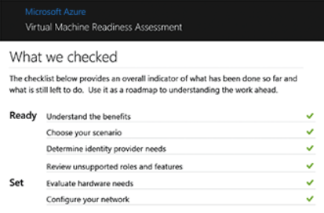
Virtual Machine Readiness Assessment
High-level checklist and a detailed report.
Highlights areas which are ready to move and areas which may need additional configuration or design changes
Offers expert guidance and advice tailored to your environment
Notes:
For more information, you can see:
Virtual Machines Readiness Assessment tool - https://azure.microsoft.com/en-us/downloads/vm-readiness-assessment

Slide 13
Virtual Machine Optimization Assessment
Prioritized recommendations across six focus areas including security and compliance, performance and scalability, and availability and business continuity
Improvements we suggest and why they’re worth considering
Which specific components of your environment are affected
Troubleshooting tips
Step-by-step tune up instructions
Best practice guidance
Notes:
For more information, you can see:
Microsoft Azure Virtual Machine Optimization Assessment - https://azure.microsoft.com/en-us/downloads/vm-optimization-assessment/

Slide 14
Virtual Machine Sizes
VM Type | Sizes | Description
General Purpose | B, Dsv3, Dv3, DSv2, Dv2, Av2 | Balanced CPU-to-memory ratio. Ideal for testing and development, small to medium databases, and low to medium traffic web servers.
Compute Optimized | Fsv2, Fs, F | High CPU-to-memory ratio. Good for medium traffic web servers, network appliances, batch processes, and application servers.
Memory Optimized | Esv3, Ev3, M, GS, G, DSv2, Dv2 | High memory-to-CPU ratio. Great for relational database servers, medium to large caches, and in-memory analytics.
Storage Optimized | Ls | High disk throughput and IO. Ideal for Big Data, SQL, and NoSQL databases.
GPU | NV, NC, NCv2, NCv3, ND | Specialized virtual machines targeted for heavy graphic rendering and video editing, as well as model training and inferencing (ND) with deep learning. Available with single or multiple GPUs.
High Performance Compute | H | Our fastest and most powerful CPU virtual machines with optional high-throughput network interfaces (RDMA).
Notes:
✔️ Be sure to read about each of the virtual machine types. Focus less on the specifications and more on the general usage scenarios for the different types of machines. Is there a group of machines you find particularly interesting?
For more information, you can see:
Sizes for Windows virtual machines in Azure - https://docs.microsoft.com/en-us/azure/virtual-machines/windows/sizes?toc=%2Fazure%2Fvirtual-machines%2Fwindows%2Ftoc.json#size-tables
Sizes for Linux virtual machines in Azure - https://docs.microsoft.com/en-us/azure/virtual-machines/linux/sizes?toc=%2fazure%2fvirtual-machines%2flinux%2ftoc.json
VM Sizes - https://azure.microsoft.com/en-us/documentation/articles/virtual-machines-windows-sizes/#size-tables

Slide 15
Design Considerations
The names of your application resources
The location where the resources are stored
The size of the VM
The maximum number of VMs that can be created
The operating system that the VM runs
Notes:
✔️ Can you think of any other things to consider before creating a virtual machine? How about pricing (next topic)?
For more information, you can see:
What do I need to think about before creating a VM? - https://docs.microsoft.com/en-us/azure/virtual-machines/windows/overview#what-do-i-need-to-think-about-before-creating-a-vm

Slide 16
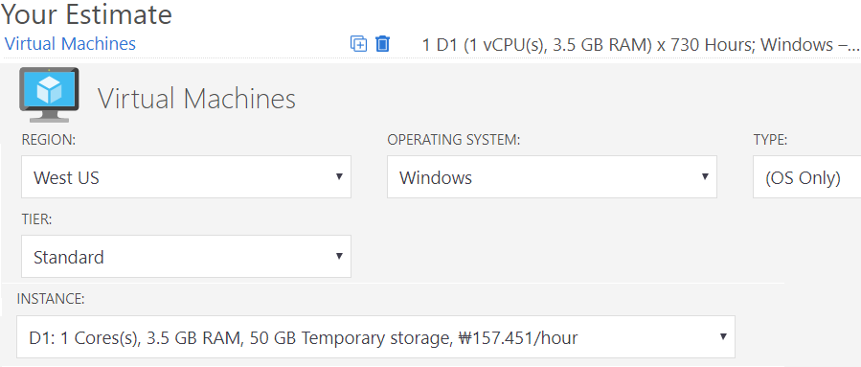
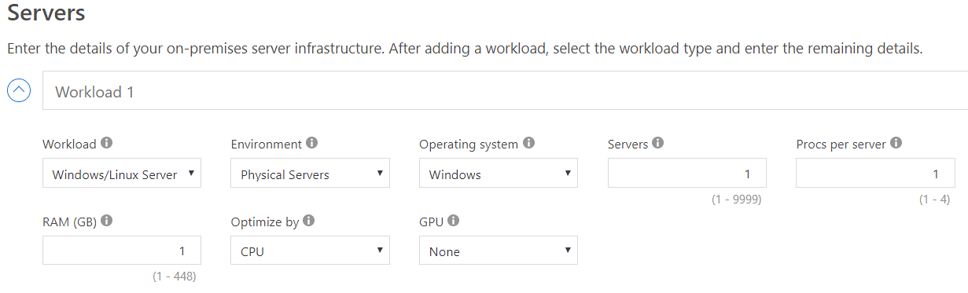
Virtual Machine Pricing Tools
Pricing Calculator
Total Cost of Ownership (TCO) Calculator
Notes:
✔️ Take a few minutes to experiment with the pricing tools.
For more information, you can see:
Linux Virtual Machines Pricing - https://azure.microsoft.com/en-us/pricing/details/virtual-machines/linux/
Windows Virtual Machines Pricing - https://azure.microsoft.com/en-us/pricing/details/virtual-machines/windows/
Online Pricing Calculator - https://azure.microsoft.com/en-us/pricing/calculator/
TCO Calculator - https://azure.microsoft.com/en-us/pricing/tco/calculator/

Slide 17
AZ-100.3 Module 02: Creating Virtual Machines

Slide 18
Lesson 01: Overview of Virtual Machine Creation Process

Slide 19
Creating Virtual Machines
Tools for deploying virtual machines
Creating and managing virtual machine images
Azure portal, PowerShell, CLI, Visual studio, ARM templates
Linux Virtual machines
Endorsed versus non-endorsed distributions
New Virtual machines – key decision points
Images (custom or Azure marketplace)
Licensing
Storage
VM Size
Networking configuration
Notes:
Creating Virtual Machines - https://www.youtube.com/embed/1WtG7yFVqbI

Slide 20
Lesson 02: Creating Virtual Machines in the Azure Portal

Slide 21
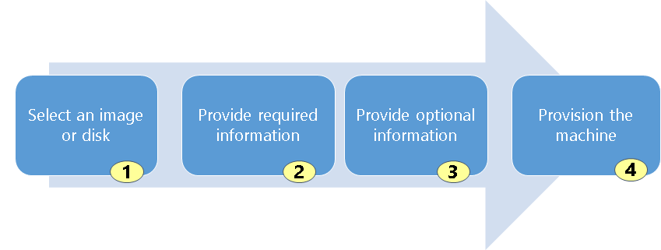
Creating Virtual Machines (Portal)
Select an Market place image or VHD disk
Provide required information such as host name, user name, and password for the new virtual machine
Provide optional information like domain membership, virtual networks, storage account, cloud service, and availability set
Provision the machine
Notes:
For more information, you can see:
How do I create my first machine? - https://docs.microsoft.com/en-us/azure/virtual-machines/windows/overview#how-do-i-create-my-first-vm

Slide 22
Creating Virtual Machines
Tools for deploying virtual machines
Azure portal
PowerShell
CLI
Visual Studio
ARM templates
Notes:
Creating Virtual Machines - https://www.youtube.com/embed/r-F-lAcioiI

Slide 23
Lab 2A: Create a Windows Virtual Machine
Create a virtual machine
Connect to a virtual machine
Install a Web Server
Open port 80 for web traffic
Test the IIS welcome page.
✔️ Once your virtual machine is running take some time to navigate and explore the different settings. To reduce costs, always stop your virtual machine when it is not in use.
Notes:
Create a Windows VM - https://docs.microsoft.com/en-us/azure/virtual-machines/windows/quick-create-portal
✔️ Once your virtual machine is running take some time to navigate and explore the different settings. To reduce costs, always stop your virtual machine when it is not in use.

Slide 24
Lesson 03: Creating Virtual Machines (PowerShell)

Slide 25
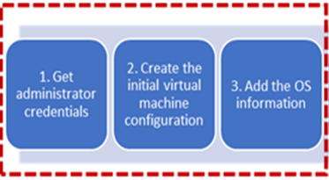
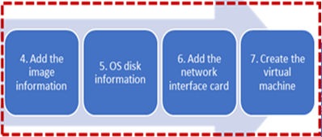
Virtual Machine Example (Part 1)
# 1. Set the admin username and pwd
$cred = Get-Credential
# 2. Create the initial configuration
$vm = New-AzureRmVMConfig -VMName myVM
-VMSize Standard_D1
# 3. Add the OS information
$vm = Set-AzureRmVMOperatingSystem `
-VM $vm `
-Windows `
-ComputerName myVM `
-Credential $cred `
-ProvisionVMAgent `
-EnableAutoUpdate
Notes:
✔️ In the next video, Corey will go through all the virtual network PowerShell commands. For these topic pages we are just taking the defaults.

Slide 26
Virtual Machine Example (Part 2)
# 4. Add the image information
$vm = Set-AzureRmVMSourceImage -VM $vm -PublisherName MicrosoftWindowsServer -Offer WindowsServer -Skus 2016-Datacenter -Version latest
# 5. Add the OS settings
$vm = Set-AzureRmVMOSDisk -VM $vm -Name myOsDisk -DiskSizeInGB 128 -CreateOption FromImage -Caching ReadWrite
# 6. Add the NIC
$vm = Add-AzureRmVMNetworkInterface -VM $vm –Id $nic.Id
# 7. Create the VM
New-AzureRmVM -ResourceGroupName myResourceGroupVM -Location EastUS -VM $vm
Notes:
For more information, you can see:
Sample PowerShell Script - https://docs.microsoft.com/en-us/azure/virtual-machines/scripts/virtual-machines-windows-powershell-sample-create-vm#sample-script
Common PowerShell commands for creating and managing Azure Virtual Machines - https://docs.microsoft.com/en-us/azure/virtual-machines/windows/ps-common-ref

Slide 27
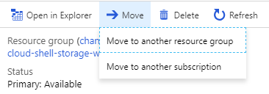
Moving Virtual Machines Between Resource Groups
Get-AzureRMResource -ResourceGroupName <sourceResourceGroupName> | Format-table -Property ResourceId
Move-AzureRmResource -DestinationResourceGroupName "<myDestinationResourceGroup>" -ResourceId <myResourceId,myResourceId,myResourceId>
Move-AzureRmResource -DestinationSubscriptionId "<myDestinationSubscriptionID>" -DestinationResourceGroupName "<myDestinationResourceGroup>" -ResourceId <myResourceId,myResourceId,myResourceId>
Notes:
For more information, see:
Use the portal to move a VM to another resource group – https://docs.microsoft.com/en-us/azure/virtual-machines/windows/move-vm#use-powershell-to-move-a-vm

Slide 28
Create a VM using PowerShell
# Create a VM with New-AzureRMVM. Name the resources. New-AzureRmVm `
-ResourceGroupName "myResourceGroup" `
-Name “MyVM” `
-Location “East US” `
-VirtualNetworkName "myVnet" `
-SubnetName "mySubnet" `
-SecurityGroupName "myNetworkSecurityGroup" `
-PublicIpAddressName "myPublicIpAddress" `
-OpenPorts 80,3389
Notes:
Create a VM using PowerShell - https://www.youtube.com/embed/JS90kU0ybmw

Slide 29
Lesson 04: Creating Virtual Machines using ARM Templates

Slide 30
Resource Manager Templates
Element name | Required | Description
$schema | Yes | Location of the JSON schema file that describes the version of the template language. Use the URL shown in the preceding example.
contentVersion | Yes | Version of the template (such as 1.0.0.0). You can provide any value for this element. Use this value to document significant changes in your template. When deploying resources using the template, this value can be used to make sure that the right template is being used.
parameters | No | Values that are provided when deployment is executed to customize resource deployment.
variables | No | Values that are used as JSON fragments in the template to simplify template language expressions.
functions | No | User-defined functions that are available within the template.
resources | Yes | Resource types that are deployed or updated in a resource group.
outputs | No | Values that are returned after deployment.
Notes:
✔️ Review the reference link for the details on how parameters, variables, outputs, and resources are defined.
For more information, you can see:
Understand the structure and syntax of Azure Resource Manager Templates - https://docs.microsoft.com/en-us/azure/azure-resource-manager/resource-group-authoring-templates#template-limits

Slide 31
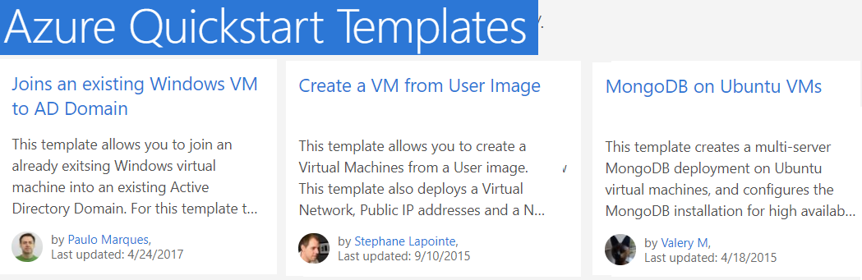
ARM Process
Azure provides many QuickStart templates. As much as possible, you should make use of these templates.
Values for the ARM template are provided in a JSON parameters file. You can standardize and reuse the templates.
Use the Portal, PowerShell, or the CLI to deploy the template.
Notes:
✔️ Don't forget to properly secure any username and password parameters that are included in the JSON files.
✔️ Take a minute to look through the QuickStart templates. Are there any you are interested in?
For more information, you can see:
Azure QuickStart templates - https://azure.microsoft.com/en-us/resources/templates/

Slide 32
Create a VM using ARM
Create a template file (JSON) to deploy required resources
Deployment options
Quickstart template on GitHub – allows you to take any JSON file, correctly structured and syntactically correct and feed it into the portal
Azure Marketplace – in reality, a wizard for JSON-based deployments
Deploy ARM templates directly from Visual Studio code
Supply a parameters file that contains the parameter values to the template
Notes:
Create a VM using ARM - https://www.youtube.com/embed/MkPruUHiv5o

Slide 33
Lab 2B: Creating Virtual Machines (Template)
Create template
Deploy template
Notes:
Create and deploy your first Azure Resource Manager template - https://docs.microsoft.com/en-us/azure/azure-resource-manager/resource-manager-create-first-template
✔️ If you have time and interest, try some of the other tasks in this tutorial.
For more information, you can see:
Troubleshoot common Azure deployment errors with Azure Resource Manager - https://docs.microsoft.com/en-us/azure/azure-resource-manager/resource-manager-common-deployment-errors

Slide 34
AZ-100.3 Module 03: Deploying Virtual Machine Images

Slide 35
Lesson 01: Deploying Custom Images

Slide 36
Create and Manage Virtual Machine Images
Image types
Virtual machine image
OS image
Image source
Azure Marketplace
VM Depot
Custom image
Image you create and upload for use in Azure
Notes:
Creating and Managing VM Images - https://www.youtube.com/embed/v7GH8IeSo7c

Slide 37
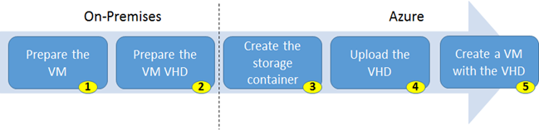
Virtual Machines (Custom Images)
Identify the VM, ensure everything is installed, and run Sysprep
Only use Generation 1 VHD virtual machines
Create a storage account for the VM image.
Use Add-AzureRmVhd to upload the image
Create a VM using the uploaded VHD
Notes:
✔️ When preparing your VHD be sure to remove any guest virtualization tools and agents. Also, ensure the VM is configured to pull its IP address and DNS settings from DHCP. This ensures that the server obtains an IP address within the virtual network when it starts up.
For more information, you can see:
Upload a specialized VHD - https://docs.microsoft.com/en-us/azure/virtual-machines/windows/create-vm-specialized#option-2-upload-a-specialized-vhd

Slide 38
Creating and Managing Virtual Machine Images (Part 1)
Upload custom machine image to serve as the base for a new Azure VM image
Install any required apps, data or settings into the image
Turn on remote management and remote desktop
Run sysprep on the virtual machine
Prepare the VHD file for upload
Upload the new VHD into an Azure storage container
Notes:
Creating and Managing VM Images (Part 1) - https://www.youtube.com/embed/LyX_liuh3Wc
This is a two-part video which continues in the next topic. If you want to try this yourself the script can be found on GitHub - https://github.com/MicrosoftDocs/azure-docs/blob/master/articles/virtual-machines/scripts/virtual-machines-windows-powershell-upload-generalized-script.md.

Slide 39
Creating and Managing Virtual Machine Images (Part 2)
Convert new VHD to an image and build the new VM
Use PowerShell to create the VM using the Azure Resource Manager
Supply all the resources needed, such as networks, subnet, storage groups
Create a resource group to isolate all the components
Create the virtual machine
# Create the VM `
New-AzureRMVM -ResourceGroupName $ResourceGroupName ` -Location $LocationName -VM $VirtualMachine -Verbose
Notes:
Creating and Managing VM Images (Part 2) - https://www.youtube.com/embed/MjnJ-D92gMo
If you want to try this yourself the script can be found on GitHub - https://github.com/MicrosoftDocs/azure-docs/blob/master/articles/virtual-machines/scripts/virtual-machines-windows-powershell-upload-generalized-script.md.

Slide 40
Lab 3A: Create a Custom Image
Sysprep and generalize VMs
Create a custom image
Create a VM from a custom image
List all the images in your subscription
Delete an image
✔️ To complete the example in this tutorial, you must have an existing virtual machine.
Notes:
Create a Custom Image - https://docs.microsoft.com/en-us/azure/virtual-machines/windows/tutorial-custom-images

Slide 41
Lesson 02: Deploying Linux Virtual Machines

Slide 42
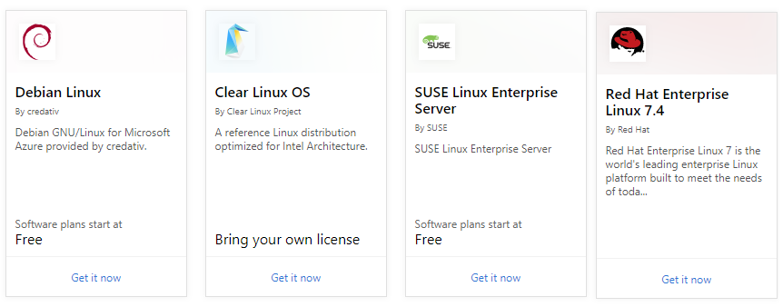
Linux Virtual Machines
Hundreds of community-built images in the Azure Marketplace
Linux has the same deployment options as for Windows VMs
Manage Linux VMs with many popular open-source DevOps tools
Notes:
✔️ Take a few minutes to look through the Marketplace at the Linux distributions. Are there any you are interested in?
For more information, you can see:
Linux virtual machines and open technologies - https://azure.microsoft.com/en-us/services/virtual-machines/linux-and-open/
Linux virtual machines (Documentation) - https://docs.microsoft.com/en-us/azure/virtual-machines/linux/

Slide 43
Deploying Linux Virtual Machines
Add an Ubuntu server from the Azure Marketplace
Configure settings in the Azure portal and create
Allow inbound rule SSH (TCP/22)
Connect to the running instance of the Linux VM through an SSH session
Notes:
Deploying Linux VMs - https://www.youtube.com/embed/k7mPJhRVXoA

Slide 44
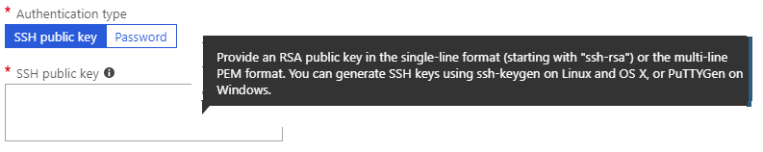
Connecting to Linux VMs
Authenticate with a SSH public key or password
SSH is an encrypted connection protocol that allows secure logins over unsecured connections
There are public and private keys – what is the difference?
Notes:
✔️ Azure currently requires at least a 2048-bit key length and the SSH-RSA format for public and private keys.
For more information, you can see:
How to use SSH keys with Windows on Azure - https://docs.microsoft.com/en-us/azure/virtual-machines/linux/ssh-from-windows#overview-of-ssh-and-keys

Slide 45
Creating SSH Keys
Create SSH keys with ssh-keygen
If you can run a command shell such as Bash for Windows or GitBash (or Bash in Azure Cloud Shell), create an SSH key pair using the ssh-keygen command.
Create SSH keys with PuTTYgen
If you prefer to use a GUI-based tool to create SSH keys, you can use the PuTTYgen key generator. The steps to use PuTTYgen are shown in this video.
Notes:
Creating SSH Keys - https://www.youtube.com/embed/dVYU6I_Hpo4
For more information, you can see:
Create SSH keys with PuTTYgen - https://docs.microsoft.com/en-us/azure/virtual-machines/linux/ssh-from-windows#create-ssh-keys-with-puttygen

Slide 46
Lab 3B: Advanced Azure Virtual Machine and Compute
Configure a virtual machine scale set
Notes:
Microsoft Online Labs - https://www.microsoft.com/handsonlabs/SelfPacedLabs

Slide 47
AZ-100.3 Module 04: Configuring Virtual Machines

Slide 48
Lesson 01: Overview of Virtual Machine Configuration

Slide 49
Configuring Virtual Machines Azure Portal Powershell CLI
Notes:
https://www.youtube.com/embed/nJYw54Rxdgg
✔️ This video is a comprehensive overview of the topics in Modules 4 and 5

Slide 50
Lesson 02: Virtual Machines Networking

Slide 51
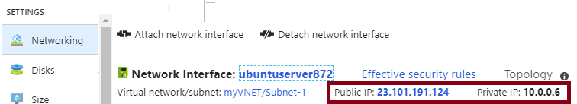
Virtual Machine IP Addressing
Public IP addresses allow Azure resources to communicate with external clients and are assigned directly at the virtual network interface card of the VM.
Private IP addresses are used by VMs in the virtual network to communicate with other VMs in the same virtual network or an on-premises network through a VPN gateway or ExpressRoute connection.
Notes:
Take a minute to locate the VM IP information.

Slide 52
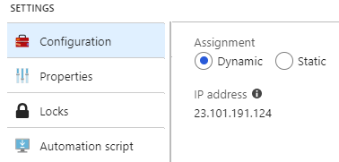
Dynamic and Static Addressing
Dynamic IP addresses are allocated when you start (or create) a resource and released when you stop (or delete) the resource. This means the IP address can change.
Static IP addresses do not change. In this case an IP address is assigned immediately. It is released only when you delete the resource or change its allocation method to dynamic.
Notes:
✔️ Private IP addresses can also be dynamic or static. Take time to look at the assignment method in the Portal. Read more at the reference link. Which type of IP allocation will you use? Does it depend on the virtual machine role?
For more information, you can see:
Public IP addresses - https://docs.microsoft.com/en-us/azure/virtual-network/virtual-network-ip-addresses-overview-arm#public-ip-addresses
Private IP addresses - https://docs.microsoft.com/en-us/azure/virtual-network/virtual-network-ip-addresses-overview-arm#private-ip-addresses

Slide 53
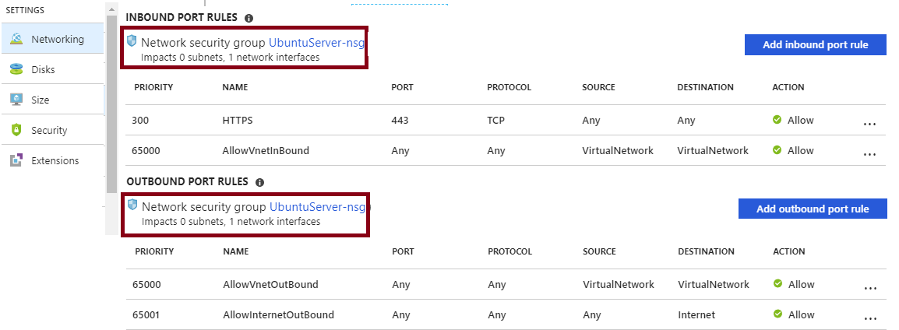
Network Security Groups (NSGs)
NSGs provide network isolation for Azure resources
Rules specify whether traffic is approved or denied
Provide a network experience that is like an on-premises network
Notes:
✔️ Remember there is a separate course on Networking.
For more information, you can see:
Network Security Groups - https://docs.microsoft.com/en-us/azure/virtual-network/security-overview#network-security-groups

Slide 54
LAB 4A: Network Security Groups
Create the NSG-FrontEnd NSG
Create rules in an existing NSG
Associate the NSG to the FrontEnd subnet
Create the NSG-BackEnd NSG
Notes:
For more information, see:
Network Security – https://docs.microsoft.com/en-us/azure/virtual-network/security-overview

Slide 55
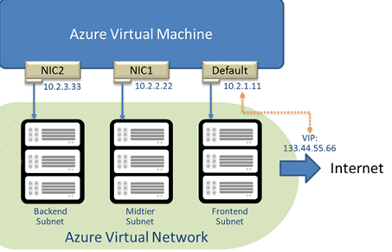
Adding Network Interfaces
Virtual machines can have multiple virtual network interface cards (NICs) attached to them
For example, a NIC for the backend subnet
Different VM sizes support a varying number of NICs
Notes:
For more information, you can see:
Create and manage a Windows virtual machine that has multiple NIC - https://docs.microsoft.com/en-us/azure/virtual-machines/windows/multiple-nics?toc=%2fazure%2fvirtual-network%2ftoc.json#add-a-nic-to-an-existing-vm

Slide 56
Lab 4B: VMs with Multiple NICs
Create a virtual machine VM with multiple NICs
Add a NIC to an existing VM
Notes:
VMs with Multiple NICs - https://docs.microsoft.com/en-us/azure/virtual-machines/windows/multiple-nics?toc=/azure/virtual-network/toc.json#create-a-vm-with-multiple-nics
For more information, see:
Add network interfaces to or remove network interfaces from virtual machines – https://docs.microsoft.com/en-us/azure/virtual-network/virtual-network-network-interface-vm

Slide 57
Lesson 03: Virtual Machine Storage

Slide 58
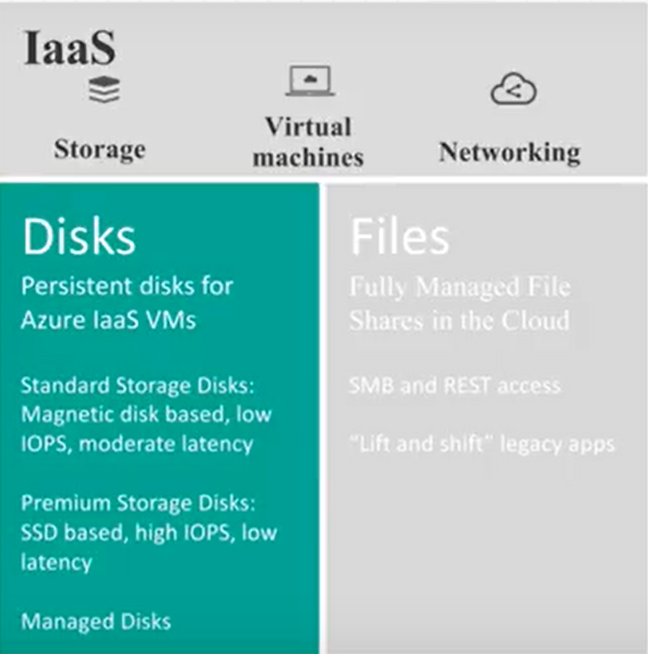
Virtual Machine Storage
Disks are how virtual machines store their VHD files
Premium or Standard storage
Managed or unmanaged
Virtual Machine disk types
Operating System disks
Temporary disk
Data disks
Notes:
Note: This default numbers in this video are accurate as of the time of the recording. Azure is constantly being updated so be sure to check the documentation if something seems out of date.
Virtual Machine Storage - https://www.youtube.com/watch?v=og_rZYBLvCs

Slide 59
Virtual Machine Storage
Several ways to implement virtual machine storage
Storage configuration can be either managed or unmanaged
For VMs using unmanaged disks, you must manage the storage accounts
For VMs using managed disks, the storage account is set automatically
Notes:
VM Storage Demonstration - https://www.youtube.com/embed/sKg5Hz1tSmQ

Slide 60
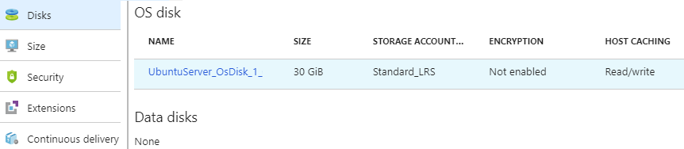
Virtual Machine Disks
Operating System Disks are SATA drives, labeled as C:
Temporary Disks provides short term storage
Data Disks are SCSI drives and depend on your virtual machine type
Notes:
✔️ Don’t store data on the temporary disk. It provides temporary storage for applications and processes and is intended to only store data such as page or swap files.
For more information, you can see:
About disk storage for Azure Windows virtual machines - https://docs.microsoft.com/en-us/azure/virtual-machines/windows/about-disks-and-vhds?toc=%2Fazure%2Fvirtual-machines%2Fwindows%2Ftoc.json

Slide 61
Premium Storage
Delivers high-performance, low-latency SSD disk support
Use for virtual machines with input/output (I/O)-intensive workloads
Two types of disks: Unmanaged and Managed
Unmanaged disks require you to manage the storage accounts and VHDs
Managed disks are maintained by Azure (recommended)
Notes:
✔ For the best performance for your application, we recommend that you migrate any VM disk that requires high IOPS to Premium Storage. If your disk does not require high IOPS, you can help limit costs by keeping it in standard Azure Storage. In standard storage, VM disk data is stored on hard disk drives (HDDs) instead of on SSDs.
For more information, you can see:
Managed disks overview - https://docs.microsoft.com/en-us/azure/virtual-machines/windows/managed-disks-overview
Premium Storage - https://docs.microsoft.com/en-us/azure/virtual-machines/windows/premium-storage
Standard Storage - https://docs.microsoft.com/en-us/azure/virtual-machines/windows/standard-storage

Slide 62
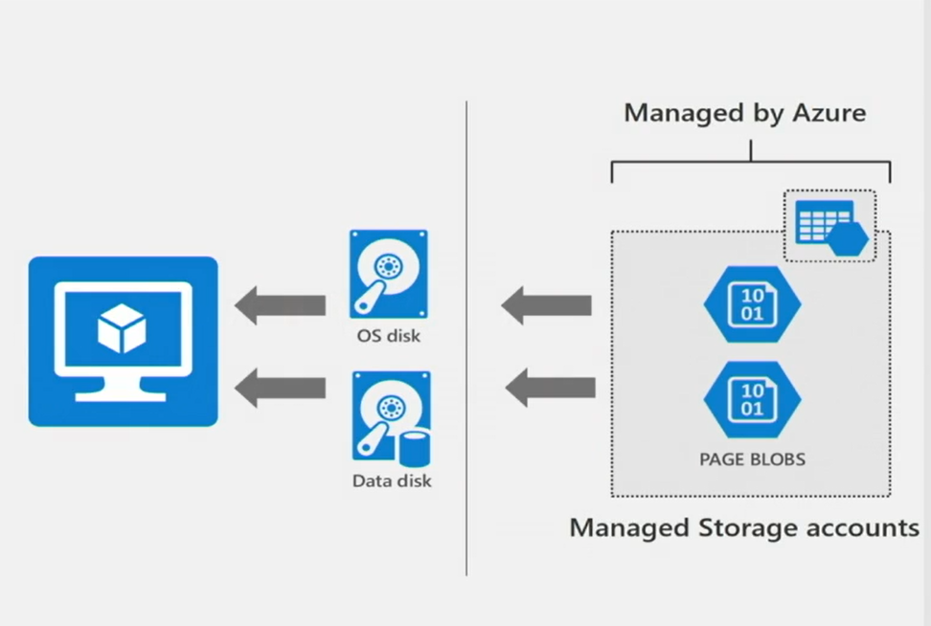
Resiliency with Managed Disks
Managed disks – abstract storage accounts from customers
Granular access control – apply Azure RBAC
Better performance - storage account limits do not apply
Scale – thousands of disks per region per subscription
Notes:
Resiliency with Managed Disks - https://channel9.msdn.com/Blogs/Azure/Managed-Disks-for-Azure-Resiliency/player
✔ Azure Managed Disks simplifies disk management for Azure IaaS VMs by managing the storage accounts associated with the VM disks. You only specify the type (Standard HDD, Standard SSD, or Premium SSD) and the size of disk you need, and Azure creates and manages the disk for you. This video covers managed disks, snapshots, and premium storage.

Slide 63
Attach and Detach Disks
Attach additional data disks to existing VMS
Number of data disks determined by the class or type of VM you deploy
Understand your workload and how many disks you think you’ll need
Helps in sizing and choosing the correct size of VM when you deploy it
Notes:
Attach and Detach Disks - https://www.youtube.com/embed/LXblaftKoxM

Slide 64
Upload Custom Disks
Upload and attach a local VHD file on the local system to a VM running in Azure
Create a storage account and a container to upload the VHD file
To upload the VHD, use PowerShell (Add-AzureRMVhd)
Create the new managed disk based on the uploaded VHD
Notes:
Upload Custom Disks - https://www.youtube.com/watch?v=uG1wVoc7oVQ

Slide 65
Migrating from Managed Disks
Convert an unmanaged disk to a managed disk
Need to power off the virtual machine during the operation
Consider downtime and availability of applications
Notes:
Migrating from Managed Disks - https://www.youtube.com/watch?v=hXCBMQlPfR8

Slide 66
Lab 4C: Virtual Machine Storage
Attach a data disk to a Windows VM using PowerShell
Detach a data disk from a Windows virtual machine
Convert Azure managed disks storage from standard to premium, and vice versa
Convert a Windows virtual machine from unmanaged disks to managed disks.
Notes:
✔️Can you see the advantage of completing tasks with PowerShell?

Slide 67
AZ-100.3 Module 05: Configuring Availability and Extensibility

Slide 68
Lesson 01: Virtual Machine Availability

Slide 69
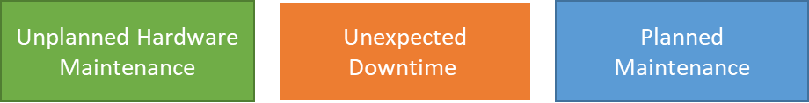
Maintenance vs. Downtime
When the platform predicts a failure, it will issue an unplanned hardware maintenance event. Action: Live migration.
Unexpected Downtime is when the a virtual machine fails unexpectedly. Action: Automatically migrate (heal).
Planned Maintenance events are periodic updates made to the Azure platform. Action: No action.
Notes:
✔️ To reduce the impact of downtime due to one or more of these events, we recommend placing multiple virtual machines into an availability set (next topic).
For more information, you can see:
Manage the availability of Windows virtual machines in Azure - https://docs.microsoft.com/en-us/azure/virtual-machines/windows/manage-availability

Slide 70
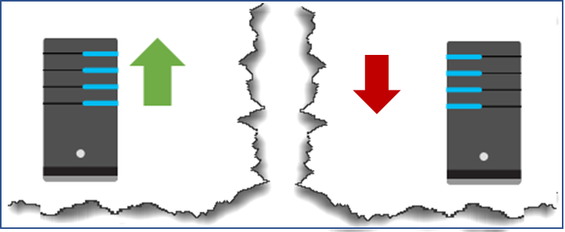
Availability Sets
Two or more instances in a set, 99.95% uptime
Configure multiple virtual machines in an Availability Set
Configure each application tier into separate Availability Sets
Combine a Load Balancer with Availability Sets
Use managed disks with the virtual machines
Notes:
✔️ You can create a virtual machine and an availability set at the same time. Or you create an availability set and then add virtual machines to it. This is a matter of personal preference.
For more information, you can see:
SLA for Virtual Machines - https://azure.microsoft.com/en-us/support/legal/sla/virtual-machines/v1_8/

Slide 71
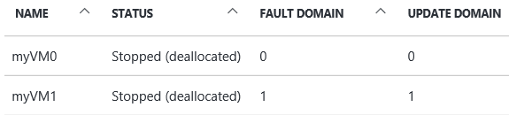
Update and Fault Domains
Update domains lets Azure to perform incremental or rolling upgrades across a deployment. During planned maintenance, only one update domain is rebooted at a time.
Fault Domains are a group of virtual machines that share a common set of hardware, switches, that share a single point of failure. VMs in an availability set are placed in at least two fault domains
Notes:
✔️ Placing your virtual machines into an availability set does not protect your application from operating system or application-specific failures, it does limit the impact of potential physical hardware failures, network outages, or power interruptions. Can you see why this important and how this is implemented?
For more information, you can see:
Configure multiple virtual machines in an availability set for redundancy - https://docs.microsoft.com/en-us/azure/virtual-machines/windows/manage-availability?toc=%2Fazure%2Fvirtual-machines%2Fwindows%2Ftoc.json#configure-multiple-virtual-machines-in-an-availability-set-for-redundancy

Slide 72
Creating Availability Sets
End to end highly available solution
Redundancy at every level
Always specify an availability set when creating more than one virtual machine for the same purpose
Notes:
Create Availability Sets - https://www.youtube.com/embed/Lh4hrWE07nY

Slide 73
Lab 5A: Deploying a Highly Available VM
Create and deploy highly available virtual machines with Azure PowerShell

Slide 74
Lesson 02: Virtual Machine Scalability

Slide 75
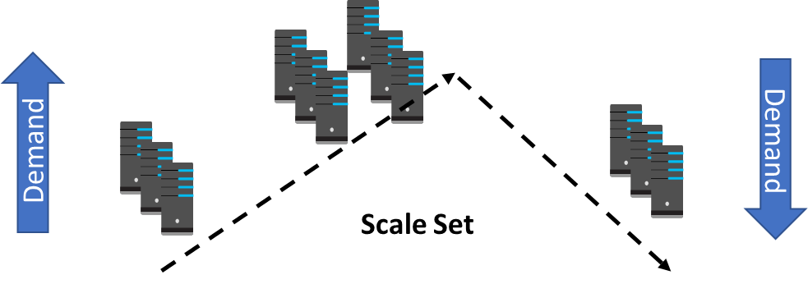
Scale Sets
Scale sets deploy a set of identical VMs
No pre-provisioning of VMs is required
As demand goes up VMs are added, as demand goes down VM are removed
The process can be manual, automated, or a combination of both
Notes:
✔️ Do you see the difference between virtual machines and scale sets? Read the link to learn more.
For more information, you can see:
Why use virtual machine scale sets? - https://docs.microsoft.com/en-us/azure/virtual-machine-scale-sets/overview#why-use-virtual-machine-scale-sets
Differences between virtual machines and scale sets - https://docs.microsoft.com/en-us/azure/virtual-machine-scale-sets/overview#differences-between-virtual-machines-and-scale-sets

Slide 76
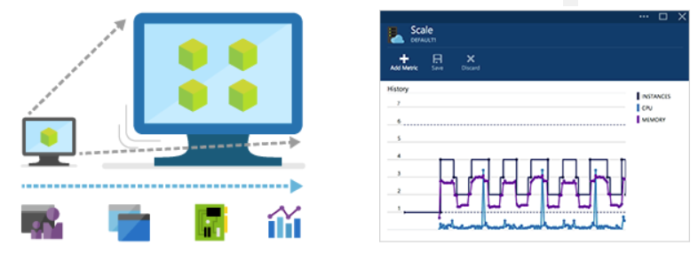
Autoscale
Define rules to automatically adjust capacity
Scale out (increase) the number of VMs in the set
Scale in (reduce) the number of VMs in the set
Schedule events to increase or decrease at a fixed time
Reduces monitoring and optimizes performance
Notes:
✔️ Autoscale minimizes the number of unnecessary VM instances that run your application when demand is low, while customers continue to receive an acceptable level of performance as demand grows and additional VM instances are automatically added.
For more information, you can see:
Azure Autoscale - https://azure.microsoft.com/en-us/features/autoscale/

Slide 77
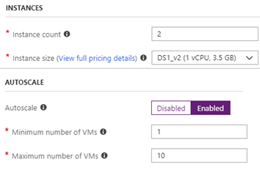
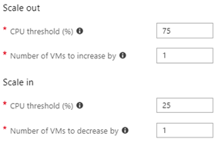
Implementing Autoscale
Define a minimum, maximum, and default number of VM instances
Create simple scale sets with scale out and scale in parameters
Notes:
Take a look in the portal at the basic autoscale parameters.
For more information, you can see:
Best Practices for Autoscale - https://docs.microsoft.com/en-us/azure/monitoring-and-diagnostics/insights-autoscale-best-practices

Slide 78
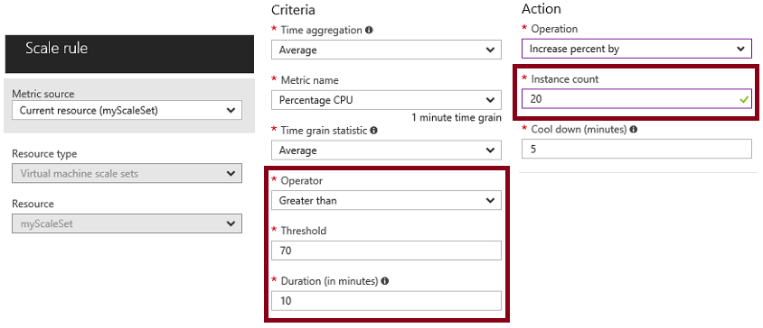
Autoscale Example (Advanced)
Define a scaling criteria with metrics and rules
Set the action operation for increasing instance counts
Notes:
For more information, you can see:
Create a rule to automatically scale out - https://docs.microsoft.com/en-us/azure/virtual-machine-scale-sets/virtual-machine-scale-sets-autoscale-portal#create-a-rule-to-automatically-scale-out

Slide 79
Creating Scale Sets
Use Scale sets to reliably deploy and update at large scale
Deploy a group of virtual machines with the same configuration
Allow Azure to bring additional machines online or remove them
Based on the load or other criteria you have established
Notes:
Scale Sets - https://www.youtube.com/embed/IhYRZ8ny6b0

Slide 80
Lab 5B: Scale Sets
Create a virtual machine scale set.
Connect to a VM in the scale set.
✔️ Use the reference links for PowerShell and the CLI.
Notes:
For more information, you can see:
QuickStart: Create a virtual machine scale set in the Azure portal - https://docs.microsoft.com/en-us/azure/virtual-machine-scale-sets/quick-create-portal
QuickStart: Create a virtual machine scale set with the Azure CLI 2.0 – https://docs.microsoft.com/en-us/azure/virtual-machine-scale-sets/quick-create-cli
QuickStart: Create a virtual machine scale set with Azure PowerShell - https://docs.microsoft.com/en-us/azure/virtual-machine-scale-sets/quick-create-powershell

Slide 81
Lab 5C: Autoscale
Create a rule to automatically scale out.
Create a rule to automatically scale in.
Define autoscale instance limits.
Monitor number of instances in a scale set.
Autoscale based on a schedule
✔️ Use the reference links for PowerShell and the CLI.
Notes:
For more information, you can see:
Automatically scale a virtual machine scale set in the Azure portal - https://docs.microsoft.com/en-us/azure/virtual-machine-scale-sets/virtual-machine-scale-sets-autoscale-portal
Tutorial: Automatically scale a virtual machine scale set with Azure PowerShell - https://docs.microsoft.com/en-us/azure/virtual-machine-scale-sets/tutorial-autoscale-powershell
Tutorial: Automatically scale a virtual machine scale set with the Azure CLI 2.0 - https://docs.microsoft.com/en-us/azure/virtual-machine-scale-sets/tutorial-autoscale-cli

Slide 82
Lesson 03: Applying Virtual Machine Extensions

Slide 83
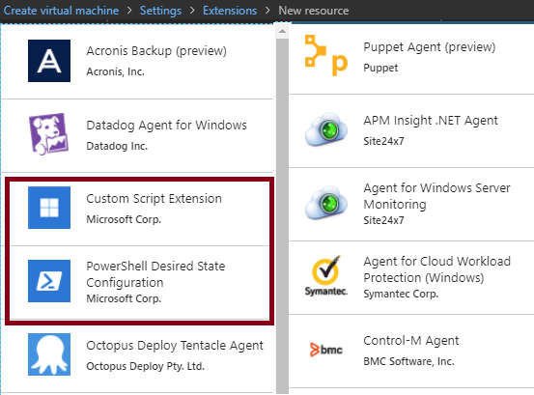
Virtual Machine Extensions
Extensions are small applications that provide post-deployment VM configuration and automation tasks
Managed with Azure CLI, PowerShell, Azure Resource Manager templates, and the Azure portal
Bundled with a new VM deployment or run against any existing system
Different for Windows and Linux machines.
Notes:
✔️VM extensions can be applied to an existing VM through the Azure portal. Select the VM in the portal, then choose Extensions. Take a minute to see what extensions are available for your virtual machine. Do any of the extensions sound interesting to you?
For more information, you can see:
Virtual machine extensions and features for Windows - https://docs.microsoft.com/en-us/azure/virtual-machines/extensions/features-windows?toc=%2Fazure%2Fvirtual-machines%2Fwindows%2Ftoc.json
Virtual machine extensions and features for Linux - https://docs.microsoft.com/en-us/azure/virtual-machines/extensions/features-linux

Slide 84
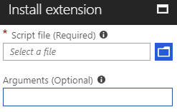
Custom Script Extensions
Extension scripts can be simple or complex
Timeout - Extensions have 90 minutes to run
Dependencies – Double check to ensure availability
Failure events - Account for any errors that might occur
Sensitive data - Protect/encrypt sensitive information
Notes:
✔ Can you think of any custom script extensions that you might want to create?
For more information, you can see:
Get started with Azure PowerShell - https://docs.microsoft.com/en-us/powershell/azure/get-started-azureps?view=azurermps-6.2.0

Slide 85
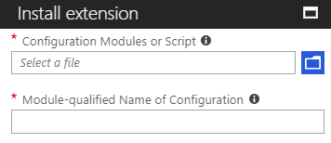
Desired State Configuration (DSC)
DSC enables deploying and managing configurations
Provide the URL for the Zip file package defining the DSC configuration
Define the configuration example and the function, “Module\Function”
Notes:
✔ Use DSC when the Custom Script extension will not work for your application.
For more information, you can see:
Introduction to the Azure Desired State Configuration extension handler - https://docs.microsoft.com/en-us/azure/virtual-machines/extensions/dsc-overview

Slide 86
Implementing DSC
Configuration block(s) have a name
Node blocks define the computers or VMs that you are configuring
Resource block(s) configure the resource and it’s properties
There are many built-in configuration resources
configuration IISInstall
{
Node “localhost”
{
WindowsFeature IIS
{
Ensure = “Present”
Name = “Web-Server”
}
}
}
Notes:
✔️ The Windows PowerShell DSC comes with a set of built-in configuration resources. For example, File Resource, Log Resource, and User Resource. Use the reference link to view the resources that are available to you. Are there any resources that you might be interested in? Take a few minutes to discuss the resources and configuration parameters.
For more information, you can see:
Built-In Windows PowerShell Desired State Configuration Resources - https://docs.microsoft.com/en-us/powershell/dsc/builtinresource

Slide 87
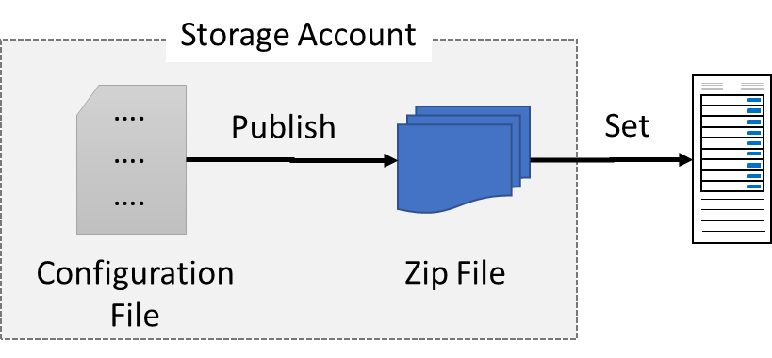
Deploying DSC
Create the configuration file
Publish the configuration file to create the ZIP file
Set the VMs to run
Notes:
✔️ Be sure to watch Corey’s video to see these steps in action. If you have time, try it for yourself. The next topic shows the code implementation.

Slide 88
DSC Code Example
# variables
$rg = “vms”
$location = “eastus”
$vmName = “vm1”
$storagename = “scriptstore”
# Publish the configuration script into the user storage
Publish-AzureRmVMDscConfiguration -ConfigurationPath .\webserverinstall.ps1
-ResourceGroupName $rg -StorageAccountName $storagename –force
# Set the VM to run the DSC Configuration
Set-AzureRmVMDscConfiguration -Version 1.1 -ResourceGroupName $rg -VMName $vmName -ArchiveStorageAccountName $storageaccount -ArchiveBlobName webserverinstall.ps1.zip -AutoUpdate: $true -ConfigurationName “IISInstall”
Notes:
For more information, you can see:
DSC extension PowerShell cmdlets - https://docs.microsoft.com/en-us/azure/virtual-machines/extensions/dsc-overview#dsc-extension-powershell-cmdlets
Publish-AzureRmVMDscConfiguration - https://docs.microsoft.com/en-us/powershell/module/azurerm.compute/publish-azurermvmdscconfiguration?view=azurermps-6.2.0
Set-AzureRmVMDscExtension - https://docs.microsoft.com/en-us/powershell/module/azurerm.compute/set-azurermvmdscextension?view=azurermps-6.2.0

Slide 89
DSC and Custom Scripts
Use built-in tools to include automation at the virtual machine level
Virtual machine extensions
Custom script extensions
Use desired state configuration (DSC) to deploy, manage, and maintain configuration data
Use DSC when a custom script will not work for your application
Notes:
DSC and Custom Scripts - https://www.youtube.com/embed/dw_EE8cUfEU

Slide 90
Lab 5 D: Custom Script Extensions
Use the Custom Script Extension to install IIS
Create a VM that uses the Custom Script Extension
View a running IIS site after the extension is applied
Notes:
✔️ Notice this tutorial uses a different PowerShell command. Use the reference link to learn more.
For more information, you can see:
DSC extension PowerShell cmdlets - https://docs.microsoft.com/en-us/azure/virtual-machines/extensions/dsc-overview#dsc-extension-powershell-cmdlets
Publish-AzureRmVMDscConfiguration - https://docs.microsoft.com/en-us/powershell/module/azurerm.compute/publish-azurermvmdscconfiguration?view=azurermps-6.2.0
Set-AzureRmVMDscExtension - https://docs.microsoft.com/en-us/powershell/module/azurerm.compute/set-azurermvmdscextension?view=azurermps-6.2.0

Slide 91
AZ-100.3 Module 06: Managing and Monitoring Virtual Machines

Slide 92
Lesson 01: Backup and Restore

Slide 93
Managing Virtual Machines
Common VM management tasks
Moving a VM
Resizing a VM
Downloading a VM template
Enabling remote management
Notes:
Managing Virtual Machines - https://www.youtube.com/embed/uo7Mfq9Vibk

Slide 94
Virtual Machine Backups
Managed snapshots provide a quick and simple option for backing up VMs that use Managed Disks
Azure Backup supports application-consistent backups for both Windows and Linux VMs
Azure Site Recovery protects your VMs from a major disaster scenario when a whole region experiences an outage
Notes:
The Migrate Servers to Azure course provides detailed information on Azure Site Recovery.
✔️ Have you tried any of these backup methods? Do you have a backup plan?
For more information, you can see:
About site recovery - https://docs.microsoft.com/en-us/azure/site-recovery/site-recovery-overview
Replicate an Azure VM to another Azure region - https://docs.microsoft.com/en-us/azure/site-recovery/azure-to-azure-quickstart

Slide 95
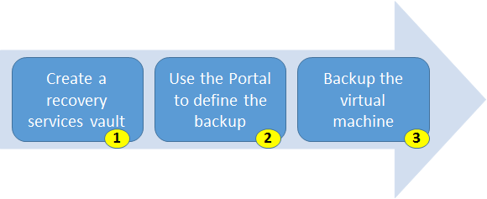
Backup Virtual Machines
Use a Recovery Services vault in the region where you want to store the data To backup your files and folders. Also determine how you want your storage replicated.
Take snapshots (recovery points) of your data at defined intervals. These snapshots are stored in recovery services vaults.
For the Backup extension to work, the Azure VM Agent must be installed on the Azure virtual machine.
Notes:
For more information, you can see:
Backing up Virtual Machines - https://azure.microsoft.com/en-us/documentation/articles/backup-azure-vms-first-look-arm/
Plan your VM backup infrastructure in Azure - https://docs.microsoft.com/en-us/azure/backup/backup-azure-vms-introduction

Slide 96
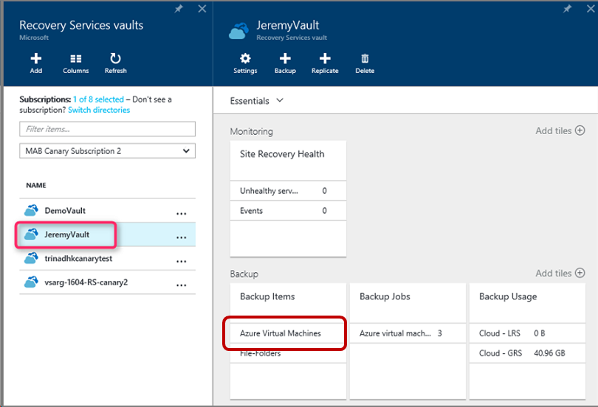
Restore Virtual Machine
Once you trigger the restore operation, the Backup service creates a job for tracking the restore operation.
The Backup service also creates and temporarily displays notifications, so you monitor how the backup is proceeding.
Notes:
For more information, you can see:
Use the Azure portal to restore virtual machines - https://docs.microsoft.com/en-us/azure/backup/backup-azure-arm-restore-vms

Slide 97
Lab 6A: Virtual Machine Backup and Restore
Create a backup
Recover a file
Notes:
VM Backup and Restore - https://docs.microsoft.com/en-us/azure/virtual-machines/windows/tutorial-backup-vms

Slide 98
Lesson 02: Monitoring Virtual Machines

Slide 99
Monitoring Virtual Machines
Monitoring is available for VMs running the Windows and Linux operating systems
Implemented as Agent VM extension
Metrics, diagnostics and log data
Displayed in Azure portal (metrics and boot diagnostics)
Configurable in the Azure portal and programmatically
Stored in Azure storage (tables and blobs)
Alerts
Metric, condition, threshold, and period-based
Email notifications and Webhook support
Notes:
Monitoring VMs - https://www.youtube.com/embed/uK6K_w75Fjk

Slide 100
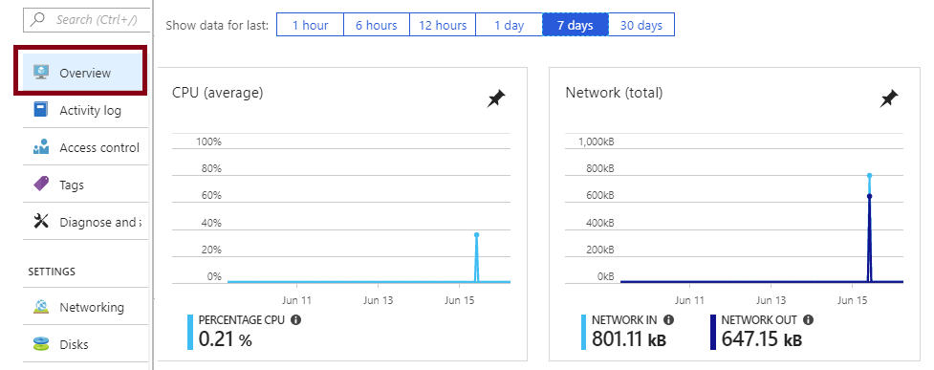
Monitoring
The Overview screen of the Azure portal shows CPU, Network, Disk bytes, and Disk operations. You can also show the data for different periods of time.
The Monitoring section provides access to Metrics, Diagnostic settings, Advisor recommendations, and Diagram.
Notes:
✔️Take a few minutes to navigate the Overview page and the Monitoring section to see what is available for your virtual machine.
For more information, you can see:
How to monitor virtual machines in Azure - https://docs.microsoft.com/en-us/azure/virtual-machines/windows/monitor

Slide 101


Diagnostic Settings
The VM’s Diagnostic setting blade is different for Windows and Linux machines.
On Windows machines you have access to Performance counters, Logs, Crash dumps, Sinks, and Agent.
On Linux machines your choices are Metrics, Syslog, and Agent.
Notes:
✔️The diagnostics settings can't be updated when the virtual machine isn't running.
For more information, you can see:
Overview of metrics in Microsoft Azure - https://docs.microsoft.com/en-us/azure/monitoring-and-diagnostics/monitoring-overview-metrics

Slide 102
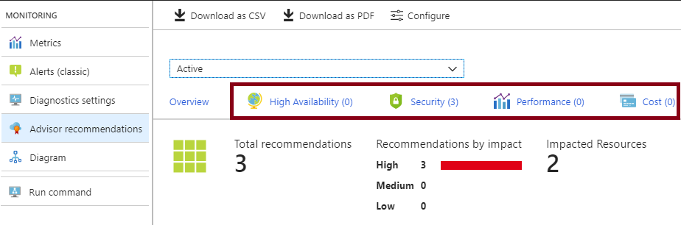
Advisor Recommendations
High Availability recommendations helps you ensure and improve the continuity of your business-critical applications.
Security recommendations to detect threats and vulnerabilities that might lead to security breaches.
Performance recommendations to improve the speed of your applications.
Cost recommendations to optimize and reduce your overall Azure spending.
Notes:
For more information, you can see:
Introduction to Azure Advisor - https://docs.microsoft.com/en-us/azure/advisor/advisor-overview

Slide 103
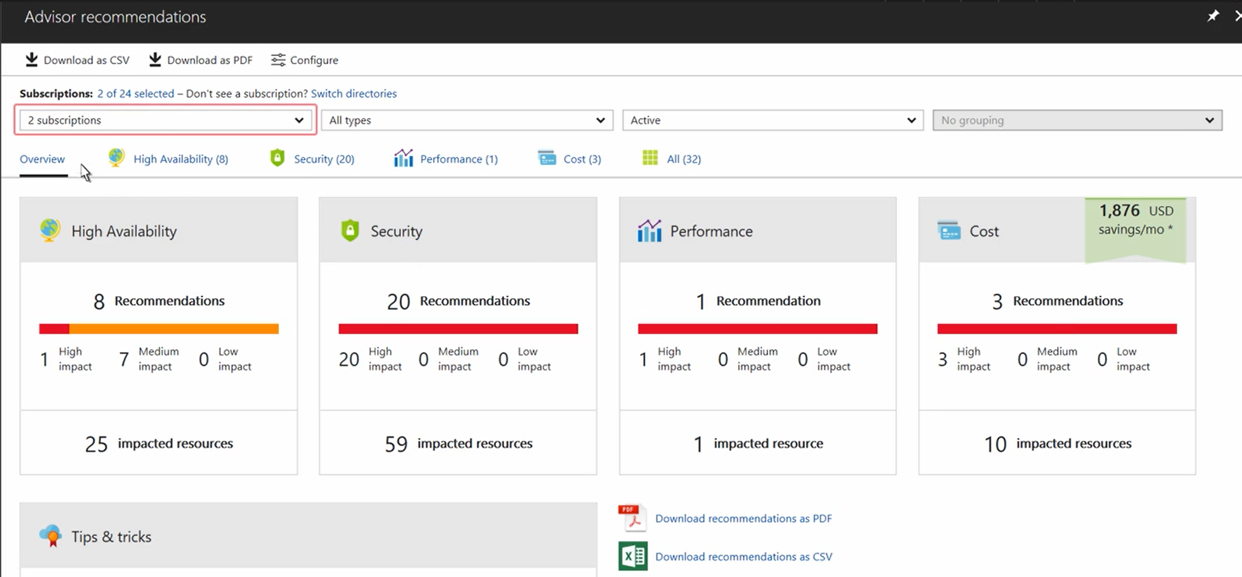
Azure Advisor
Notes:
Azure Advisor - https://channel9.msdn.com/Blogs/Azure/Azure-Advisor-your-personalized-guide-to-optimal-resource-configuration/player

Slide 104
Lab 6B: Advisor Recommendations
Get recommendation details and implement a solution.
Filter advisor recommendations.
Postpone or dismiss recommendations.
Exclude subscriptions or resource groups.
Configure the utilization rules.
Download your recommendations.
Notes:
✔ Notice this tutorial uses a different PowerShell command. Use the reference link to learn more.

