Slide 1


Singularity Hyperautomation Use Cases
Shawn Stugart
Staff Technical Content Developer
Notes:
Welcome to SentinelOne Singularity Hyperautomation technical deep-dive.
In this training course will discuss Hyperautomation capabilities, component, integrations with 3rd party tools, various use cases, and workflows in detail.
Basically, Hyperautomation is designed for SentinelOne users to enhance their speed and efficiency during their day-to-day Security Operations tasks like Alert Investigation, Incident Response, Threat Hunting, and taking quick actions when it comes to Alert Mitigation and Remediation.

Slide 2
Agenda
Hyperautomation Use Cases
01
02
03
04
Hyperautomation Overview
Fundamentals of Hyperautomation
Workflow Use Cases
Hands-On Lab

Slide 3
Safe Harbor
This presentation contains forward-looking statements of SentinelOne, Inc. (“SentinelOne” or the “Company”), within the meaning of Section 27A of the Securities Act of 1933, as amended, and Section 21E of the Securities Exchange Act of 1934, as amended, which statements involve risks and uncertainties, including statements regarding our future growth, and future financial and operating performance, competition and our competitive position, technological capabilities and strategic relationships, future product releases or capabilities, business strategy and our ability to execute our business plans, the COVID-19 pandemic, our reputation and performance in the market, general market trends, outstanding shares, market growth, and our objectives are forward-looking statements.
The words “believe,” “may,” “will,” “potentially,” “estimate,” “continue,” “anticipate,” “intend,” “could,” “would,” “project,” “target,” “plan,” “expect,” or the negative of these terms and similar expressions are intended to identify forward-looking statements. However, not all forward-looking statements contain these identifying words. Forward-looking statements should not be read as a guarantee of future performance or results and will not necessarily be accurate indications of the times at, or by, which such performance or results will be achieved, if at all.
Forward-looking statements are based on information available at the time those statements are made and/or management’s good faith beliefs and assumptions as of that time with respect to future events, and are subject to risks and uncertainties that could cause actual performance or results to differ materially from those expressed in or suggested by the forward looking statements. In light of these risks and uncertainties, the forward-looking events and circumstances discussed in this presentation may not occur and actual results could differ materially from those anticipated or implied in the forward-looking statements. These risks and uncertainties are described in greater detail under the headings “Risk Factors” and “Management’s Discussion and Analysis of Financial Condition and Results of Operations” in the filings we make with the Securities and Exchange Commission (“SEC”) from time to time, which are available on our website at www.investors.SentinelOne.com and on the SEC’s website at www.sec.gov.
Notes:
Presenter Notes
This document, like many corporate presentations, contains statements about SentinelOne's future (like expected growth, financial performance, and product plans). These are called "forward-looking statements.“
These are just predictions, not guarantees. Words like "expect," "potential," "intend," and "will" signal these future-focused statements.
Actual results could be very different. These statements are based on current beliefs and assumptions, but they are subject to various risks and uncertainties (like market changes, competition, etc.).
Don't rely on them completely. You should not assume these predictions will definitely happen.

Slide 4

Speaker
Shawn Stugart
Staff Technical Content Developer
SentinelOne | shawn.stugart@sentinelone.com

Slide 5
Hyperautomation Overview
Hyperautomation Use Cases
Notes:
Hyperautomation Release
Hyperautomation became part of S1 Singularity product suite after the acquisition of Stride Security, announced during OneCon in October 2024.
Official SOC Press was released on 21st October 2024.
09th February 2025 Hyperautomation was ready to launch with Purple Console version S-25.1.1

Slide 6
Analyst Overload
Respondents to a recent 451 Research study indicated on average they are unable to investigate 43% of alerts in a typical day, and about one in five (19%) are unable to investigate more than 75% of alerts.
Notes:
451 Research Report: https://www.sentinelone.com/resources/reports/451-research-report-hyperautomation-combines-automation-with-ai/

Slide 7






SOC Challenges
Inefficient Processes
Low-Fidelity Security Signals
Siloed Tools
Notes:
The reasons so many alerts go uninvestigated include high volumes of low-fidelity security signals; inadequate, siloed analytical tools; and inefficient, time-consuming response processes.
Singularity Hyperautomation is built to help security teams with some of their most pressing challenges:
High Alert Volume - Long alert queues requires thousands of investigation hours.
Manual Processes - When it comes to investigations or security operating processes, analysts are faced with a ton of manual and tedious workflows that take up a lot of time, distracting teams from their most critical tasks.
Tool Complexity - Orchestrating in the SOC is difficult with many different tools, people, and processes in place. This isn't made any easier if the tools themselves are complex to manage, not well-integrated with one another, and limits security teams on what they want to achieve.

Slide 8
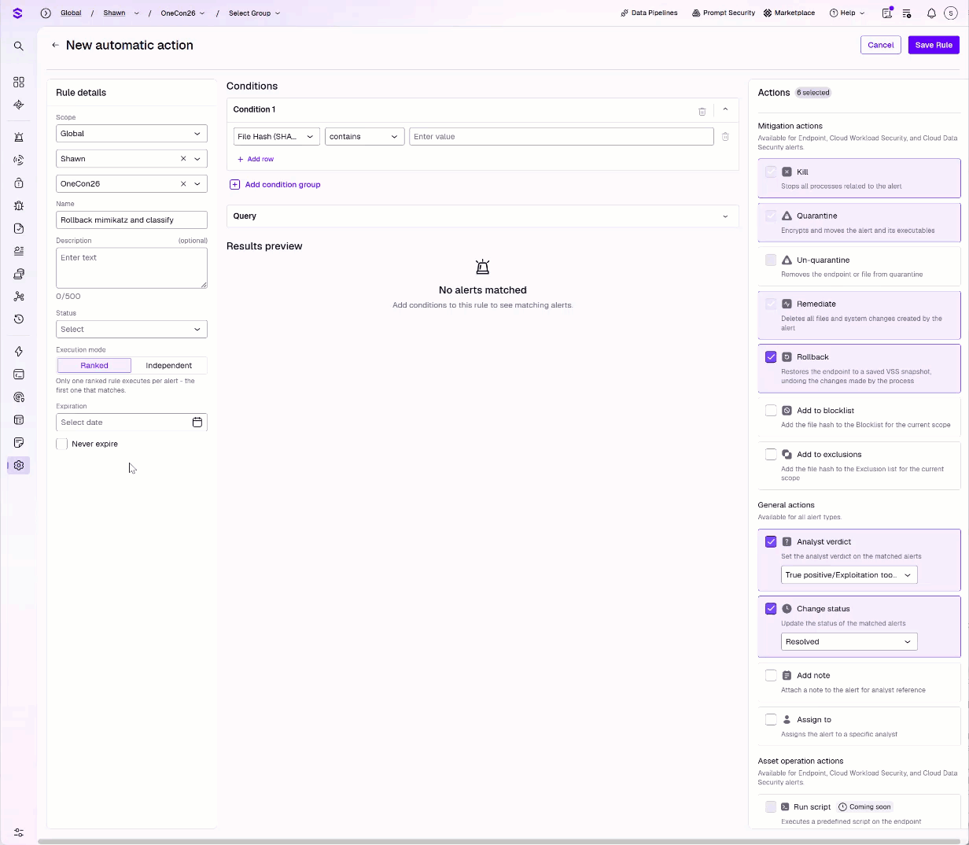
Automatic Actions
SOAR
Notes:
Upcoming “Automatic Actions” is more SOAR-like. Specific to security use cases and mostly involve case management-type actions.
Ranked Execution Mode (Priority-Based)
In Ranked mode, rules are organized in a strict top-down hierarchy (a sequential list) and evaluated in order of their priority. When an alert is generated, the rule engine evaluates it against the rules sequentially, starting from Rank 1. As soon as the alert meets the criteria of a specific rule, the associated action is executed, and the evaluation stops
Independent Execution Mode (Parallel-Based)
In Independent mode, rules exist outside of a hierarchy and are evaluated in parallel. When an alert is generated, the engine evaluates it against all active independent rules simultaneously. If an alert matches the criteria of multiple independent rules, all of those matching rules will fire their respective actions.
Note: This isn’t retroactive. Existing alerts already sitting in your open queue—regardless of how long they have been there or whether they perfectly match the rule's criteria—will not be processed or updated by the newly enabled rule. The rule will only trigger on new incoming alerts that enter the console triage queue from that moment forward.
Note: Ensure that your rules in Independent mode do not have conflicting actions—such as assigning the same alert to two different owners—as this can lead to race conditions where the final assigned state is unpredictable

Slide 9

Hyperautomation
“Hyperautomation is a business-driven, disciplined approach that organizations use to rapidly identify, vet and automate as many business and IT processes as possible״.
- Gartner
Notes:
Natural progression from SOAR, which was generally harder to automate, had fewer available triggers, and was/is often limited to security uses cases. Note the Gartner definition includes “business and IT processes”
In simpler terms, Hyperautomation is about scaling your automation efforts across the entire organization,
ensuring that you can automate not just isolated tasks, but entire workflows and processes.

Slide 10








The Singularity Difference
The Value of the Singularity Platform
Endpoint Threat Mitigation
Identity and Access
Email Security
Network Response
Automate quarantine, kill, and rollback actions.
Handle access blocks, 2FA, and JIT provisioning.
Extract and enrich observables, analyze content.
Block malicious domains, URLs, and IPs.
Ticketing and Reporting
Exposure Management
Threat Hunting and Response
Alert Triage and Enrichment
Automate ticket creation, escalation, and reporting.
Analyze, prioritize, mitigate, and remediate exposures.
Enable triage, threat hunting, and posture management.
Automate triage, correlation, and enrichment
Notes:
Note that these are also by and large security-based hyperautomation use cases. One of the defining characteristics of hyperautomation is its ability to integrate beyond the traditional security toolsets.
Identity and Access Management
Secure, efficient management of user and machine access to systems and data is another highly repetitive task that has traditionally required substantial human involvement. This includes provisioning and de-provisioning user and machine identities, employing classic behavioral analytics to determine potential suspicious activities, and then taking actions such as disabling accounts and forcing password resets. Hyperautomation can take outputs from pattern-detecting AI/ML models and correlate them with additional data and signals such as threat intelligence and attacker tactics to determine the degree of risk. For example, AI models could detect behavioral anomalies such as accounts downloading large quantities of data from organizational systems or impossible login scenarios. The account in question may be placed on a watch list, and an agent could automatically force a password reset or disable the account when access is determined to be of high risk and potentially the result of a compromised account.
Threat Hunting and Response
Threat hunting could also benefit from hyperautomation, which can aid in searching for advanced threats as well as indicators of potential threats. Hyperautomation could help by correlating signals from AI models that identify potential or actual threats with data from multiple sources, including threat intelligence, indicators of compromise, news feeds, operational systems (security and observability data) and user/entity behavior analytics. Agents can automate data collection, including preserving potential forensic data related to suspicious activities by saving it in immutable storage.For example, AI models may detect a subtle anomaly in network traffic, which when correlated with threat intelligence data indicates a potential nation-state attack. Personnel can be notified of the potential threat while agents automatically collect and preserve data from potentially affected systems for later analysis and use.
What I’ve tried to do is select workflow examples for our use case walkthrough that highlight these functionalities.
Endpoint Threat Mitigation
"Automate actions like quarantine, rollback, or killing malicious processes to stop threats fast. For example, isolate a compromised device in seconds."
Identity and Access
"Streamline access blocks, 2FA prompts, and JIT provisioning to secure accounts. Suspend compromised users automatically."
Email Security
"Analyze and enrich email threats like phishing to reduce manual work. For instance, flag suspicious links for investigation."
Network Response
"Block malicious domains, IPs, and URLs automatically to contain threats. For example, stop traffic to known bad actors instantly."
Ticketing and Reporting
"Create and sync tickets across systems, track escalations, and auto-generate reports. For instance, log an incident in ServiceNow immediately."
Exposure Management
"Identify, prioritize, and fix vulnerabilities and misconfigurations. For example, patch critical CVEs without delay.“ Maybe note that, originally, our CNS used its own mechanism for auto-mitigating misconfigurations. That’s now part of HA.
Threat Hunting and Response
"Enable proactive workflows like insider threat hunting and cloud posture management. Spot and stop unusual admin behavior early."
Alert Management
"Automate triage, enrichment, and correlation to focus on critical alerts. For example, link related alerts into one investigation.“ For example, Carter says the S1 SOC’s major use case for HA is adding context to threats. They create a Jira ticket, then add details from various sources.

Slide 11
Fundamentals of Hyperautomation
Hyperautomation Use Cases

Slide 12
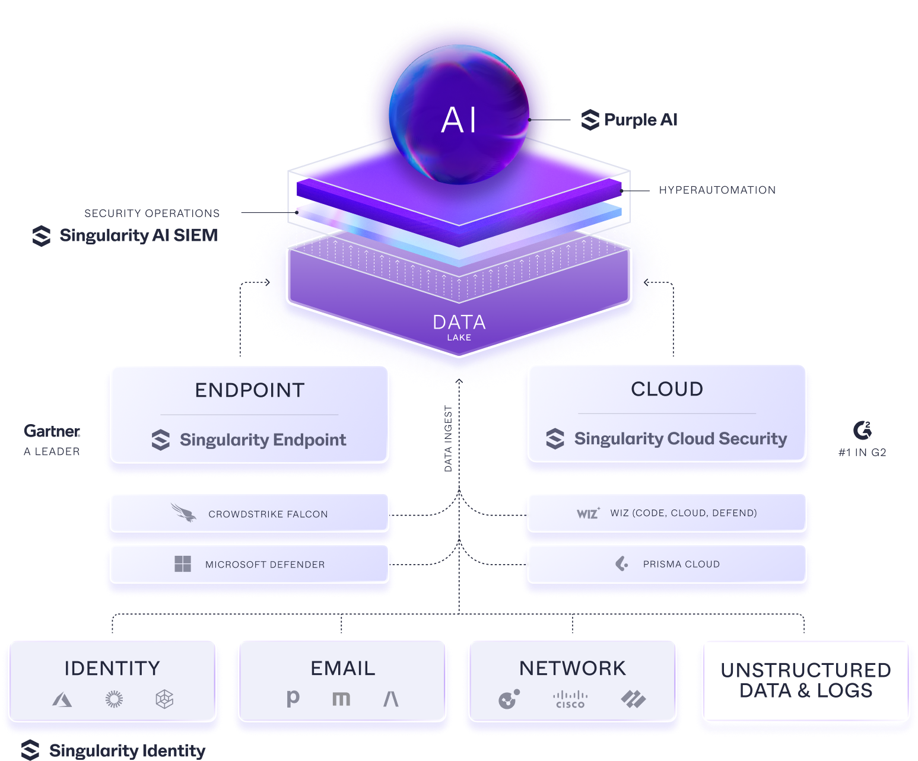
Singularity Platform
The strongest aspect of our solution is the unified platform providing protection and visibility into the endpoint, cloud environments, Identity and Active Directory, as well third- party log sources that AI SIEM can ingest.
Notes:
Attendees may have already seen this architecture slide. Focus on the Hyperautomation layer.

Slide 13








Preparing for Hyperautomation
Optimize Continuously
Identify Processes
Integrate Tools
Automate Tasks
Notes:
Want to emphasize the importance of defining your processes and outcomes first. It doesn’t help to automate chaos—you’re just making chaos more quickly.
HA process is usually presented as Infinity Loop…
There are a few core principles that drive successful Hyperautomation.
First, you need to Identify Processes—understanding what tasks are ripe for automation within your organization.
Next is the Automation of Tasks, where you implement the automation solutions that streamline these processes.
Integration plays a crucial role here—Integrating Tools allows you to connect various platforms and technologies, ensuring that your automated workflows are seamless.
Finally, it’s important to Optimize Continuously. Hyperautomation isn’t a one-time project; it’s an ongoing effort to refine and improve your processes as your organization evolves.
We built Singularity Hyperautomation to connect and integrate all of your SOC tools in one place and help accelerate response to threats, so teams can work smarter, faster, and more efficiently.
Traditional security automation is inefficient and fragmented, often requiring manual intervention and rigid workflows. But with Hyperautomation, SentinelOne uses seamless cross-platform integration and a no-code canvas to optimize and accelerate security operations.

Slide 14
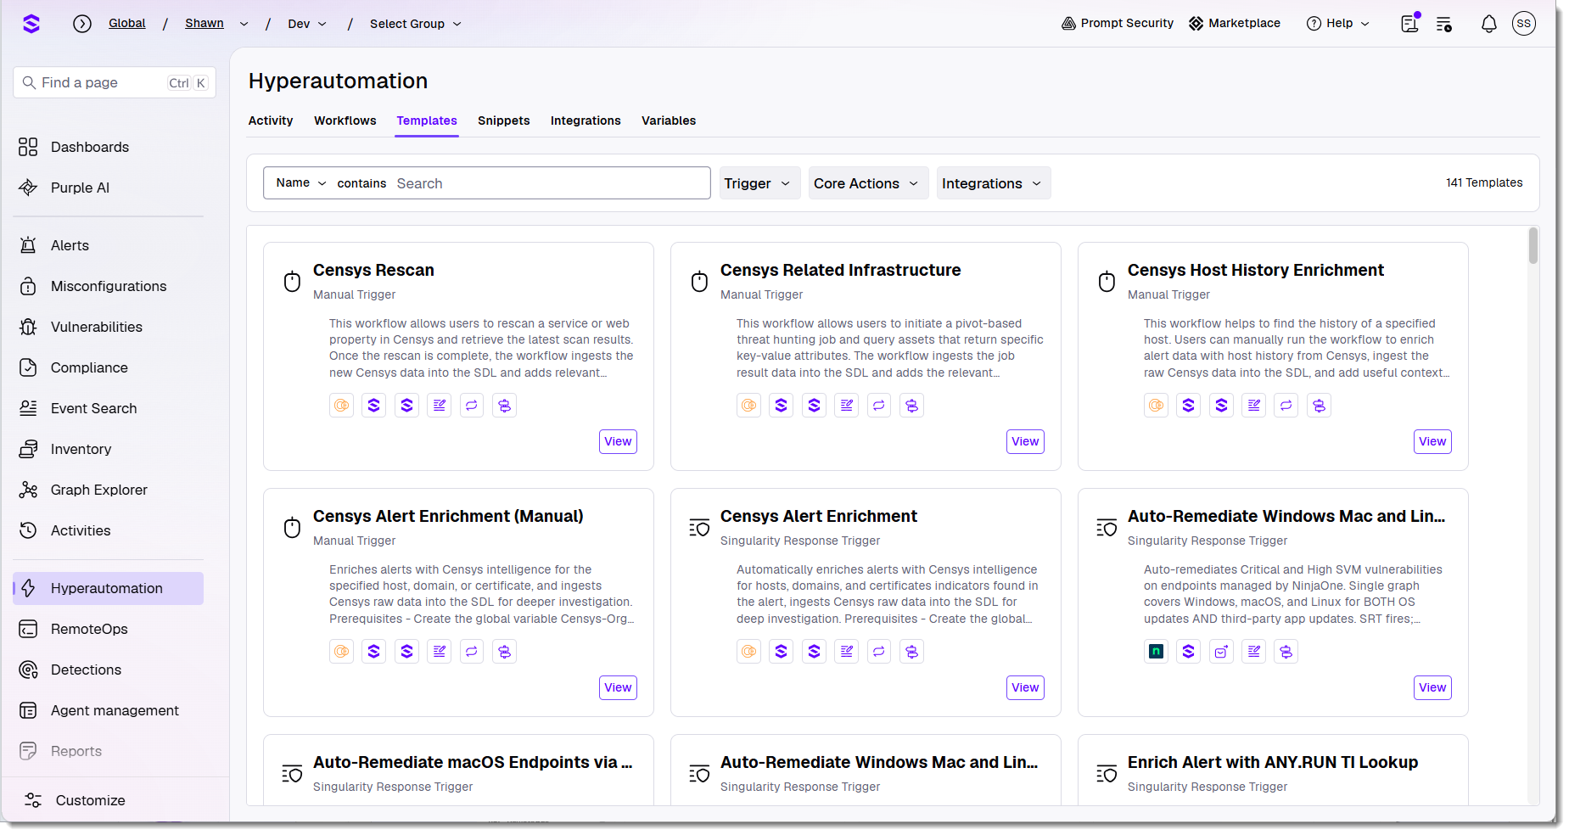
Getting Started with Hyperautomation Templates
Notes:
A workflow defines one or more actions in a process you’d like to automate.
Hyperautomation templates in Singularity™ Hyperautomation are pre-built, expert-designed workflow blueprints that help organizations quickly automate common security and IT processes. These templates address frequent use cases—such as endpoint incident response, suspicious user activity, and cloud threat remediation—by providing ready-made sequences of triggers and actions that can be customized to fit specific needs. They are accessible directly within the Hyperautomation platform, allowing users to review, use, and adapt them as starting points for building their own automated workflows. This accelerates deployment, ensures best practices, and lowers the barrier to entry for teams looking to automate and scale their operations without writing code.
Selecting Use this template copies the logic into a customizable workflow.
Example: 5 new templates that leverage LLM actions in Hyperautomation.

Slide 15
Demo
Working with Templates
Notes:
Use Enrich Alert with VirusTotal as an example. Walk through basic logic, pointing out elements we’ll be speaking to:
Always starts with a trigger. Note the conditions of the trigger.
Different actions, linked together on the workflow Canvas
Actions requiring configuration marked with an exclamation
Variable
Functions
Conditional branching
VT integration (we’ll look at this more closely in the Integrations section)
Integration to write results to alert notes

Slide 16
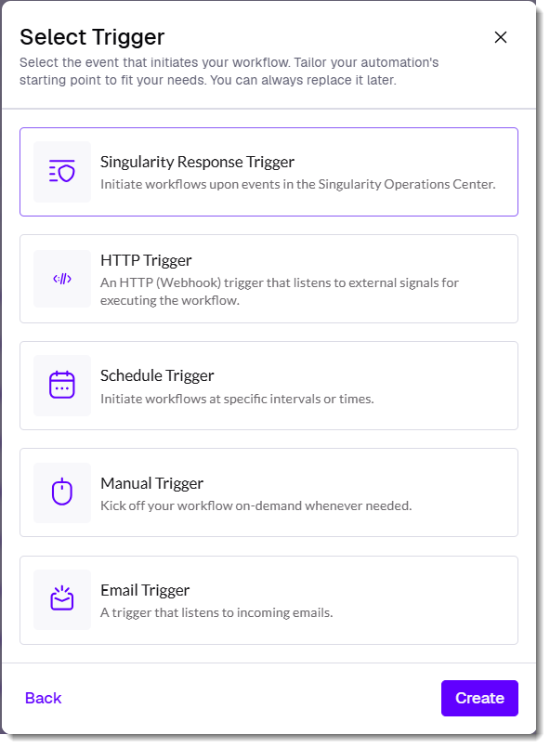
Triggers
Workflow Triggers
Workflows activate automatically based on real-time events, on a schedule, or on demand.
They can respond to SentinelOne alerts and exposures, integrate with third-party tools via webhooks, process incoming emails, run on predefined schedules, or be triggered manually for immediate action.
Notes:
We’ll be looking more deeply at the Singularity Response Trigger logic in the Simple Workflow demo
Singularity Response Triggers fire off of:
Alerts
Misconfigurations
Vulnerabilities
Activity (Activity log events)
Note that the Singularity Response Trigger can be configurated to Run Automatically or Run on Demand (we’ll see that on the next slide, as part of the analyst’s workflow). Also note that you’re not configuring an integration for viewing the exposures related to the Singularity Response Trigger. Instead, the workflow has access to the exposures within the scope of the workflow. Other actions using S1 APIs require a specific integration and connection.
We can design workflows to run automatically or be run on demand, based on real-time event triggers. These triggers are flexible to suit your needs, and can respond to SentinelOne alerts and exposures, integrate with third-party tools via webhooks, process incoming emails, run on predefined schedules, or be initiated manually for immediate action.
Workflow Triggers
Workflows can be set into motion with a variety of trigger options, ensuring they activate exactly when and how you need them.
Respond to Alerts and Exposures from the platform
Workflows can run automatically in response to SentinelOne Alerts and Exposures. Define specific attributes and conditions to trigger workflows, enabling immediate responses to security incidents.
Start workflows via Webhooks from 3rd-party tools
Webhooks allow integration with external systems. For example, workflows can be triggered by events from tools like Slack, Jira, or other platforms that send webhook notifications.
Trigger actions with Emails for automated responses
Emails can act as triggers for workflows in response to new messages. Use this to analyze suspicious email content, such as extracting potentially malicious URLs or sending attachments for sandbox analysis.
Automate tasks using Schedules
Scheduled triggers ensure workflows run at predefined times, making them ideal for automating recurring tasks like generating reports or performing regular system checks.
Use Manual triggers for on-demand workflows
Manual triggers provide flexibility for tasks initiated by users. These are useful for processes such as onboarding/offboarding or enriching threat intelligence as needed.

Slide 17
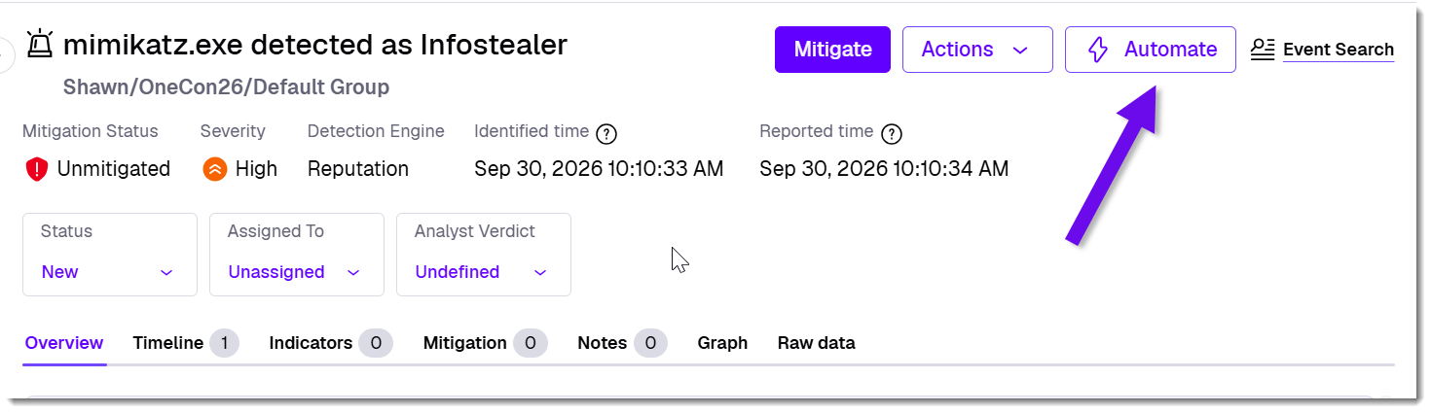
Running a Workflow from Triage
Notes:
Triage section of Ops Center includes
Alerts
Misconfigurations
Vulnerabilities
Only workflows that are set up with a trigger type that can be initiated from an Alert—such as a "Manual Trigger" or a trigger explicitly designed to respond to alert events—will appear as options to run.

Slide 18
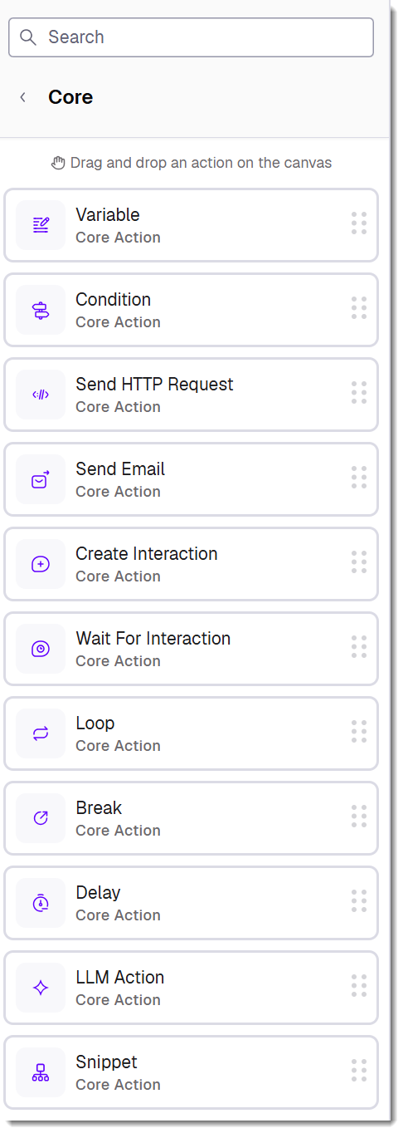
Overview of
Core Actions
Adding Actions
Easily build workflows by dragging actions onto the canvas. Send HTTP requests, and emails, control logic with conditions, loops, and delays, and manage data flow using variables.
Notes:
At the simplest level, a workflow is a trigger and one or more actions.
Provide an overview of each type of core action. We’ll look at variables in more detail coming up.
Delay example: you may run a PowerQuery as part of automated threat hunting. If it’s long running, you can periodically check the status via query ID and continue when it is “finished”
Loop example: pagination, collect forensic details from a list of endpoints identified in a threat, use network control to block each IP associated with an IoC, etc.
Building workflows begins with adding the right actions. The platform provides a variety of essential and advanced actions that can be easily added using a straightforward drag-and-drop interface.
Send HTTP requests, Emails, and SQL queries
Core actions include sending HTTP requests to interact with APIs, sending emails for notifications, and executing SQL queries to retrieve or manipulate data.
Control workflow logic with conditions, loops, and delays
Workflow controls such as conditions, loops, and delays let you handle different scenarios, manage repetitive tasks, and adjust the timing of actions.
Manage data flow using variables
Variables allow you to store, update, and share data between actions within a workflow, making it easy to manage information.

Slide 19
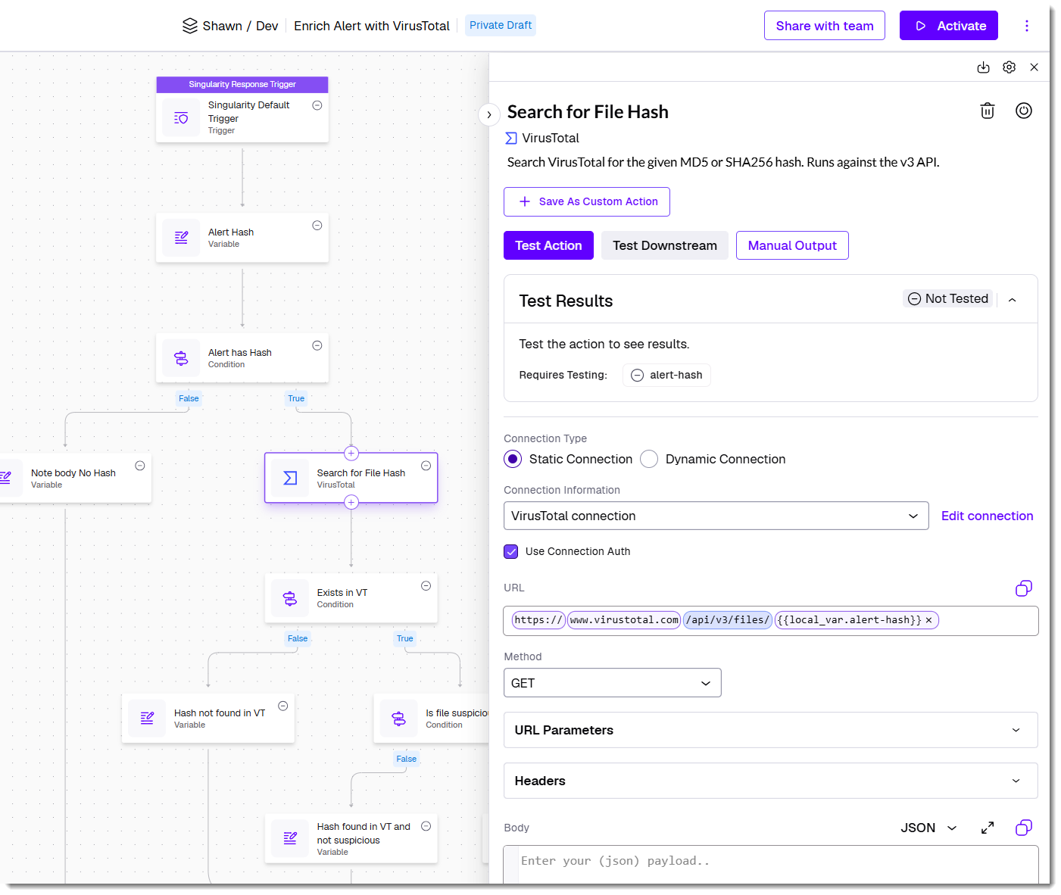
Configuring Actions
The Action Inspector
Once added to a workflow, actions are configured using the Action Inspector, which appears on the right panel. Key parameters are highlighted for easy setup, and changes auto-save.
Testing actions is essential to ensure proper execution, a process covered coming up.
Notes:
For some configurations, you’ll enter or select exact values. For example, I can select the integration/connection to use for an operation. In other cases, your config will depend on previous data available earlier in the workflow. We’ll talk about working with these references a little later

Slide 20
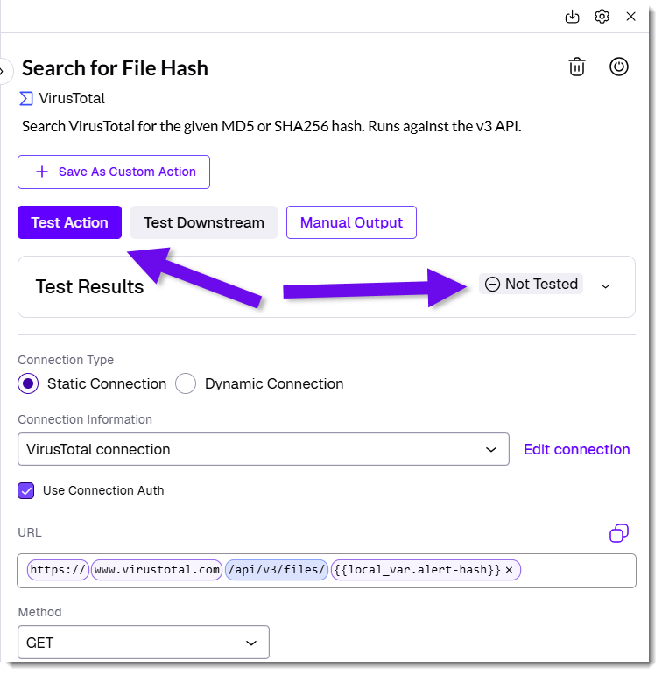
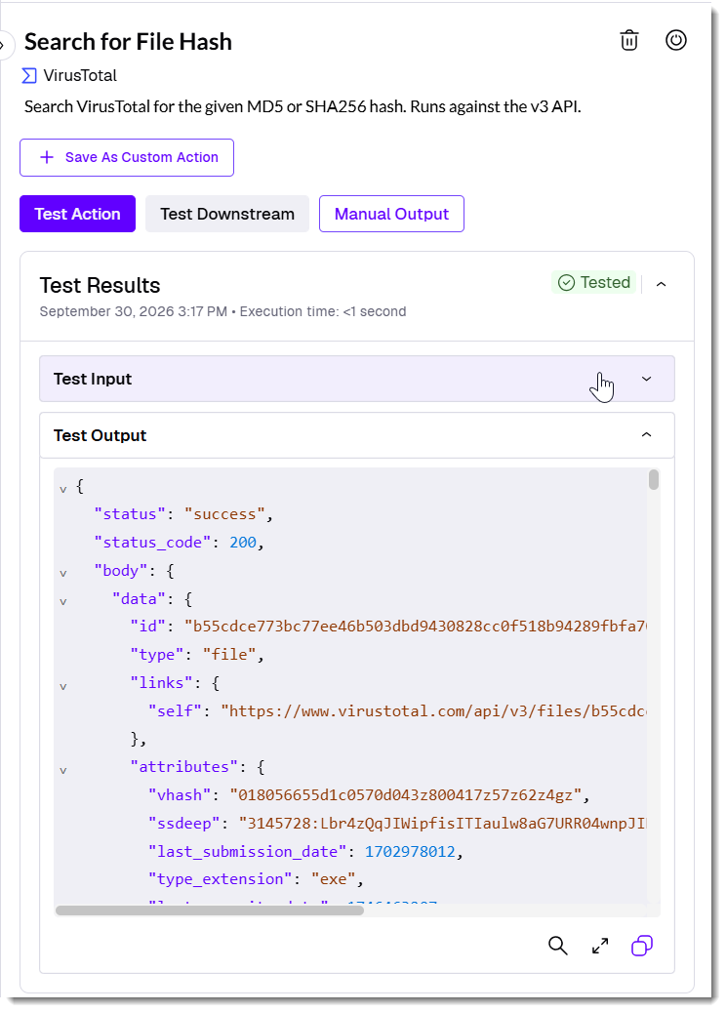
Testing As You Go
Testing actions ensures they function correctly and produce the expected output.
Run tests directly in the Action Inspector to validate configurations, debug errors, and understand output structures. Use realistic sample data or manually simulate outputs to refine workflows before execution.
Notes:
We didn’t see results in our simple email workflow until we tested them. Testing the trigger fetched the critical alert, and testing the send email action sent the email.

Slide 21
Demo
A Simple Workflow
Notes:
Demo
+ create Singularity Trigger for new, high-severity alert
+ send me an email
+ test both the trigger and the Send Email action and verify the results. Note, we’ll talk more about testing your actions shortly.
What if I didn’t have a new, high-severity alert handy to test this workflow? Can use synthetic/manual output.
+ Copy the alert JSON and paste it into Manual output, then rerun both the trigger and action.

Slide 22
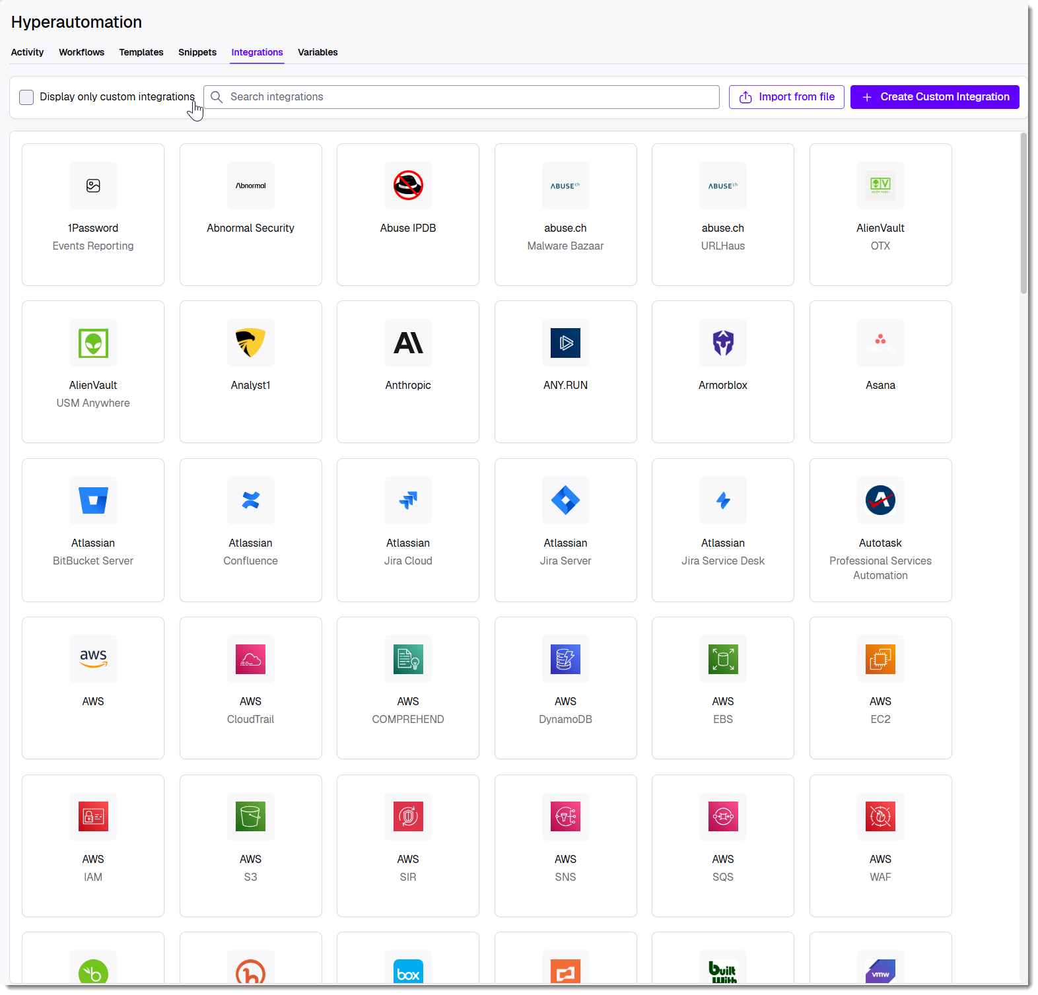
Integrations
Integrations connect workflows to third-party tools, acting as a container for both actions and connections.
Each integration is tied to a specific vendor and product.
Hyperautomation includes 150+ pre-built integrations, supports no-code API connections, and allows users to create custom integrations.
Notes:
Integration is the ability to connect a wide library of cloud-based applications into the Singularity platform—and your workflow—eliminates the silo-ing of relevant data from security and IT sources across your ecosystem and helps automate response and remediation.
This no-code access to available APIs enables you to leverage all first- and third-party data and get peer-driven insights to add context to your automation and decision-making.
Built directly into the SentinelOne platform, Hyperautomation integrates seamlessly into analyst workflows, where automations are intelligently suggested during investigations. Native integration with Singularity’s endpoint, cloud, and identity capabilities means that not only can security teams automate the remediation of threats across multiple attack surfaces, but all first-party and third-party data in Singularity can be leveraged to rapidly respond to incidents with more context and less complexity.

Slide 23
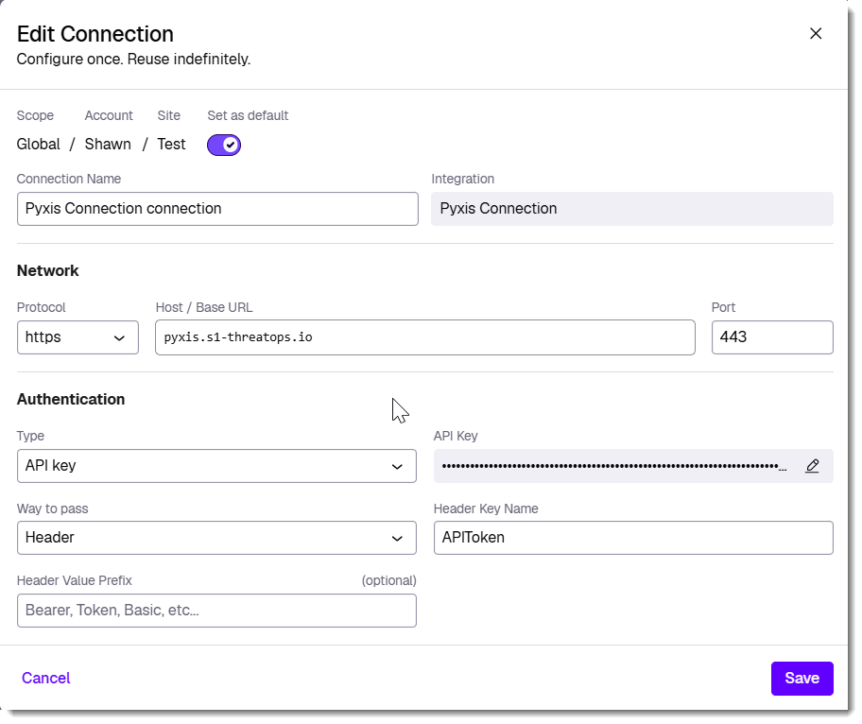
Integration Connections
Connections enable secure interaction with external systems by managing host details, authentication, and protocols.
Each integration supports multiple connections, allowing flexibility across environments. With built-in support for OAuth 2.0, API keys, and other authentication methods, connections are configured once and reused across workflows while ensuring security and privacy.

Slide 24
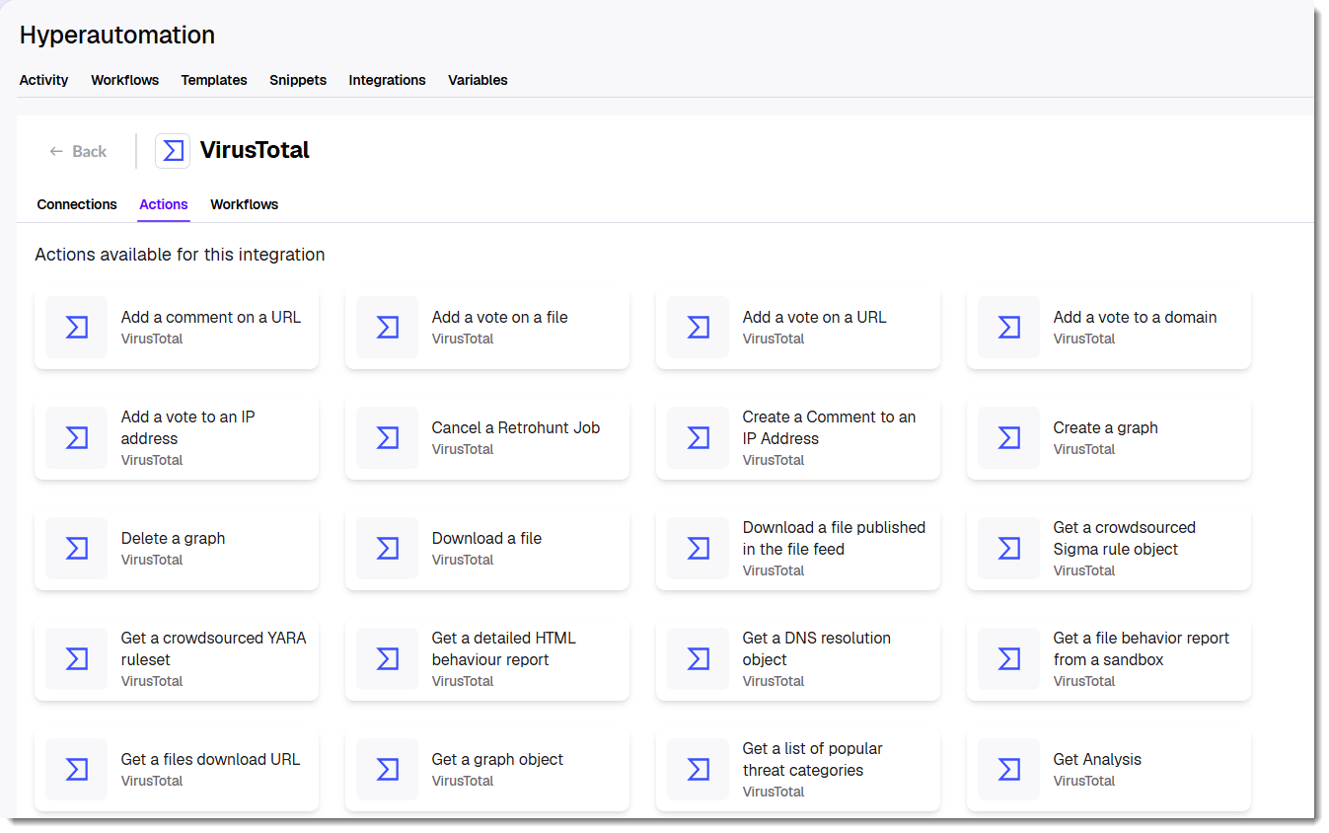
Integration Actions
Pre-configured actions are designed for seamless interaction with third-party tools.
Each integration includes built-in actions tailored to its platform, supporting operations like data retrieval, incident management, and automation tasks.
Users can also create custom actions to extend functionality and adapt workflows to specific needs.
Notes:
Note that you can save an action as a custom action. For example, you might create an action for a particular HTTP request and save it as a custom action so you don’t have to rebuild it from scratch if you want to use it again in another workflow.

Slide 25
Demo
Configuring Integrations
Notes:
Demo VirusTotal integration. We saw the template example earlier.
Demo GraphQL integration. Used for interacting with Unified Alert Management and XSPM (extended Security Posture Management) in the console.

Slide 26
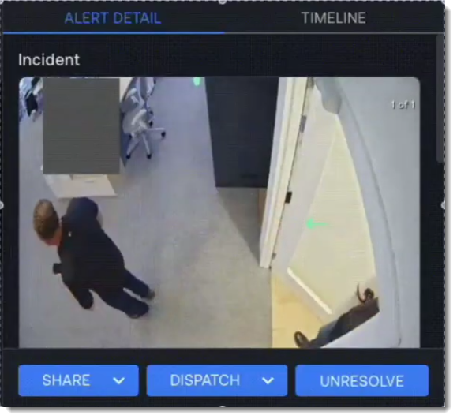
Custom Integrations
You can create custom integrations to any SaaS application for which you have an API key.
Once you create an integration, it will appear at the top of the Integrations page along with the other platforms you have configured.
Notes:
Example of S1’s smart camera integration for detecting tailgating.
Might demo a custom integration from https://www.freepublicapis.com/, like Hacker News
Note that we’ll be using custom integrations for the Long Running Query use case coming up

Slide 27
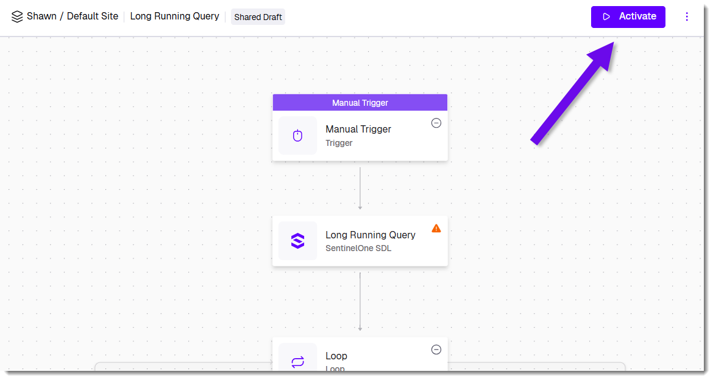
Activating A Workflow
Activate workflows to make them operational, allowing them to respond to triggers and execute tasks as configured in real time.

Slide 28
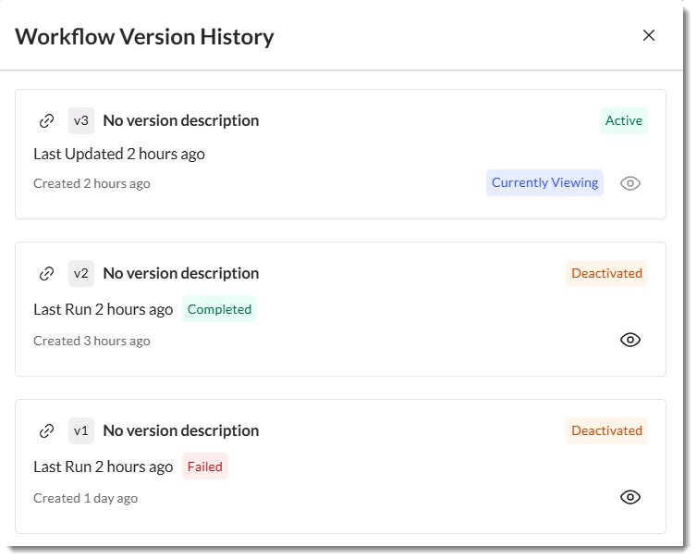
Workflow Versions
Workflows support versioning to track changes and ensure stability. Editing an active workflow creates a draft version without affecting operations.
Only one version can be active at a time, while previous versions remain accessible for rollback. Activating a new version deactivates the current one, ensuring controlled updates.
Notes:
Docs don’t say if there’s a cap on the number of versions kept for rollback or review.

Slide 29
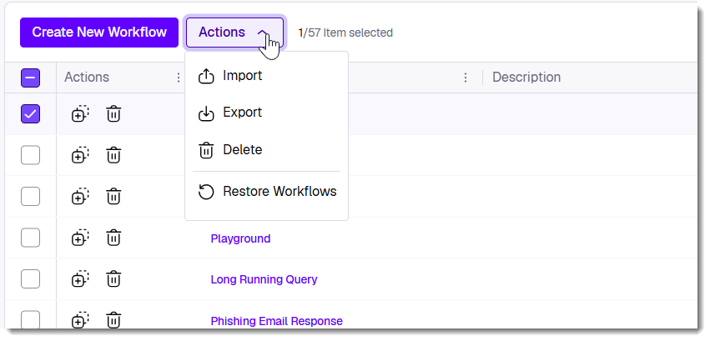

Workflow Export/Import
A workflow can be exported in the UI or via API as JSON and imported to other scopes. You can also export and import multiple workflows simultaneously as a ZIP file.
The sample workflows demonstrated later in this presentation can be downloaded here:
https://github.com/simplescripter/OneCon26
Notes:
https://github.com/simplescripter/OneCon26
A note on scoping of workflows:
Workflows created at a specific scope (e.g., Account) are only visible and usable within that scope. They do not propagate to Sites or Groups below the Account.
There are ongoing discussions and plans to improve manageability, especially for MSSPs and organizations that want to share workflows across multiple accounts or sites. However, as of now, sharing or propagating workflows from Account to Site (or from Global to Account/Site) is not natively supported; each workflow must be created or imported at the specific scope where it is needed
Other elements with this non-inheritance behavior include integrations, connections, RemoteOps scripts, Console configuration settings, and Locations.

Slide 30
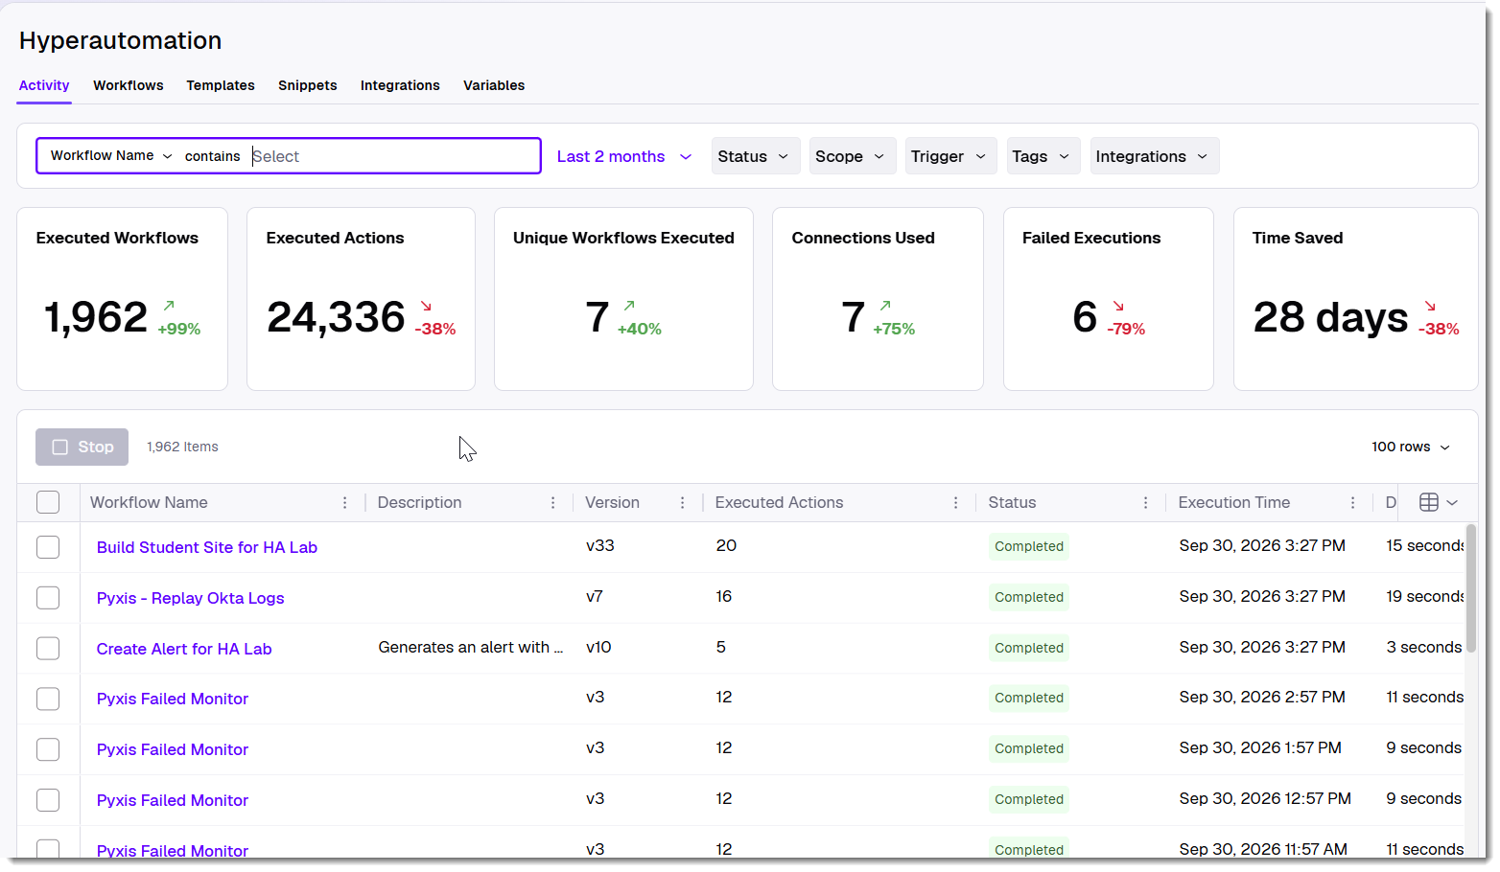
Workflow Activity
The Activity page tracks all recent workflow executions, displaying key details like workflow name, version, trigger type, and execution status.
Workflows can be filtered and sorted, with statuses including running, completed, or failed, ensuring clear visibility into operational workflows.

Slide 31
Demo
Workflow Admin Tasks

Slide 32
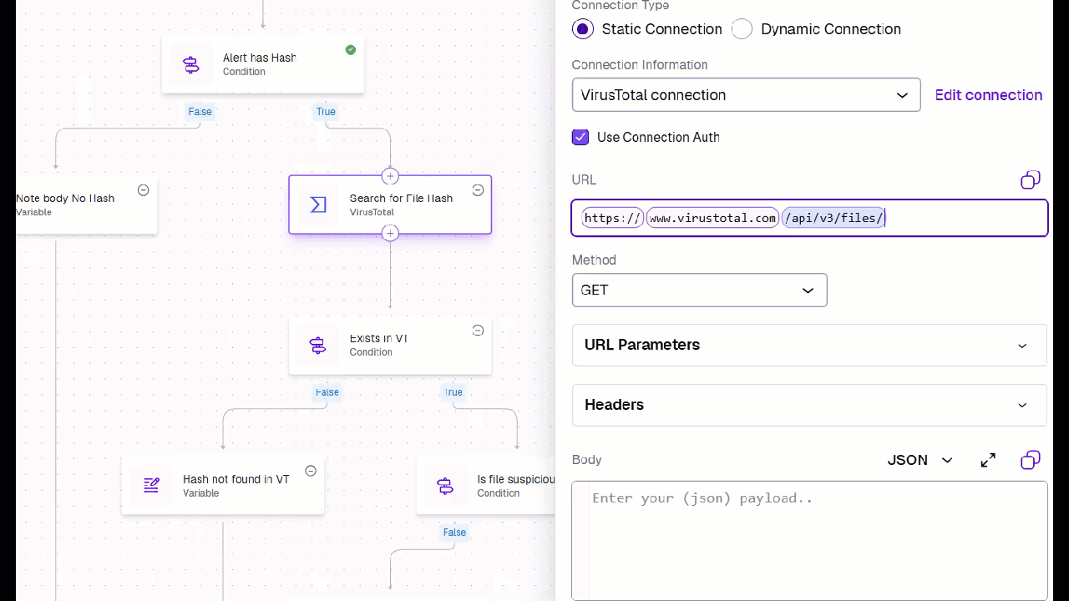
Configuring Actions - References
Actions can dynamically reference outputs from earlier steps, ensuring seamless data flow.
The Action Inspector supports auto-complete and fuzzy search for easy selection of prior action results.
Testing actions helps confirm their output schema, making references more accurate and reliable.
Notes:
Consider using https://jsonpathfinder.com/ to view JSON path structure
Also note that you can click an element in the returned JSON to copy the entire JSON path to your clipboard.
Return to the original email workflow to pull some details into the message and re-test it.

Slide 33
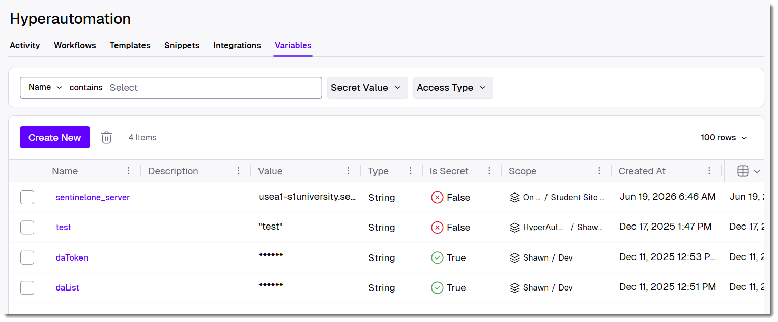
Variables
Store and share data across workflows using global variables. These variables persist beyond a single execution, enabling seamless data reuse between workflows for consistent automation and streamlined operations.
Notes:
Variables enable your Actions to dynamically reference output from earlier steps, ensuring seamless data flow. The Workflow Inspector supports auto-complete and "fuzzy" search for easy selection of prior action results.
Note: Variables are local by default. For variables to be accessible by other workflows as well, you must set them to be global.
The Variables page tracks your saved global variables. Variables store and share data both within workflows (local) and across workflows (global). These variables persist beyond a single execution, enabling great flexibility and seamless data reuse between workflows for consistent automation and streamlined operations. Variables empower advanced use of HA by defining key-value pairs to be used in Workflows, with an option to sanitize values of a given variable when inspecting executions (for example, a password or a token).
Define an empty array as []

Slide 34
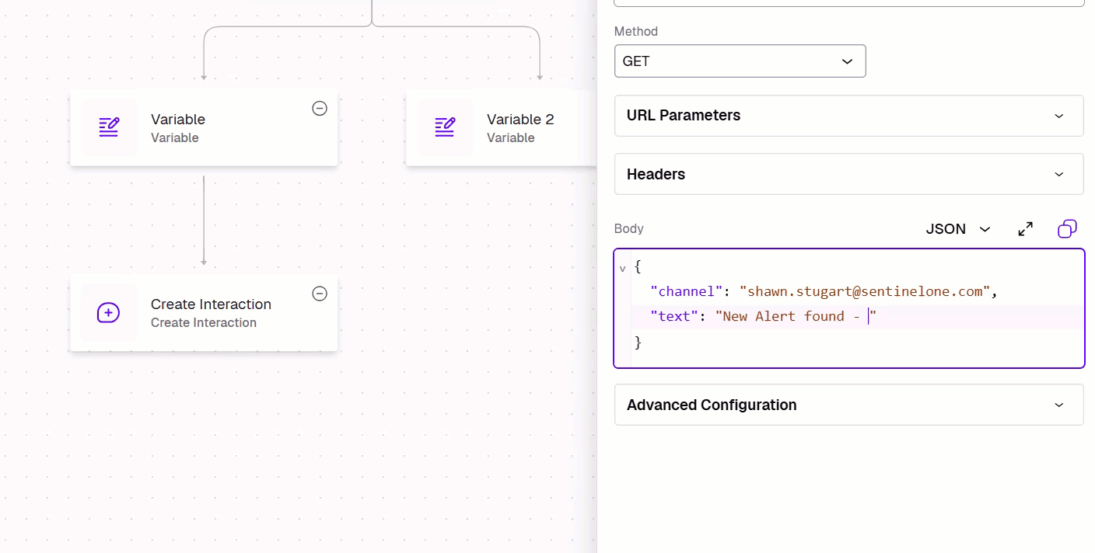
Functions
Functions are part of Actions Configuration.
Functions enable input manipulation and formatting within action configurations.
https://community.sentinelone.com/s/article/000010854
Notes:
Open https://community.sentinelone.com/s/article/000010854 and talk through some examples. We’ll see several different uses for functions in the use cases section of the session, coming up next.
For Function.JQ and an introduction to JQ, see https://www.digitalocean.com/community/tutorials/how-to-transform-json-data-with-jq
Useful tool is https://jqplay.org

Slide 35
Workflow Use Cases
Hyperautomation Use Cases

Slide 36
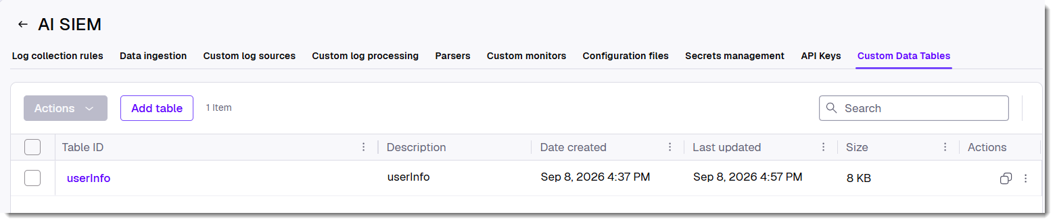
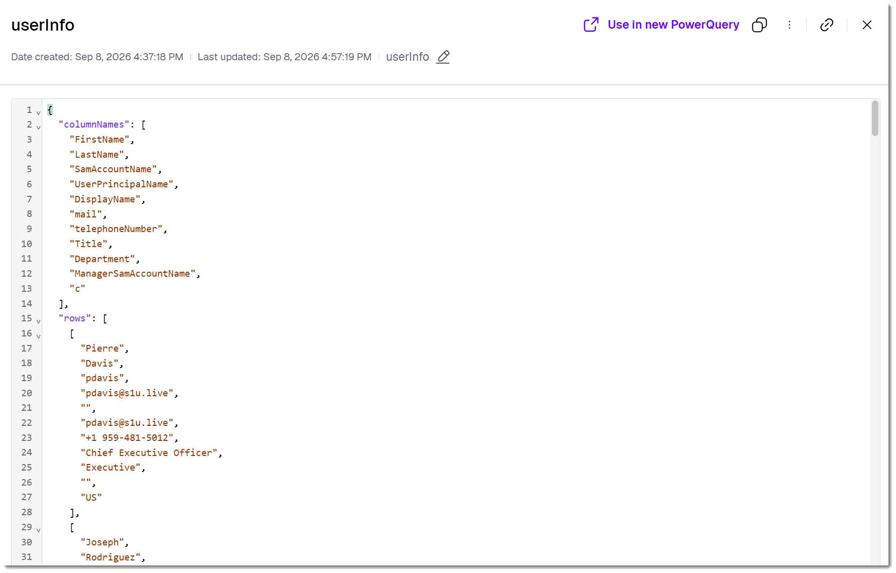
Introduction to Custom Data Tables
Notes:
A compelling use case for Hyperautomation in AI SIEM is the creation and maintenance of data tables in the Singularity Data Lake. Data tables are JSON- or CSV-formatted configuration files that contain details about objects such as users, assets, or software that might be missing from the raw logs themselves. The file(s) can be used as lookup tables that you reference within a PowerQuery to enrich the results with human-meaningful context. For example, an analyst might join PowerQuery results to a user information data table to add useful details about users, such as manager names, phone numbers, email addresses, office locations, and employment status. Likewise, an asset data table might include useful details about protected assets not contained in your log data, like OS builds, physical locations, serial numbers, and so on.
This context could be created manually, but it's more likely you'll automate the periodic collection of the attributes of interest by pulling from sources such as Active Directory, HR databases, Change and Configuration Management DBs, and so on. The files are then imported into the custom data tables data store in AI SIEM.
A few constraints to note: Each data table can be up to 150 MB in size. If you intend to use the table with scheduled rules, the table should not exceed 10,000 rows. JSON file names don't require an extension, but CSV files must include the .csv extension.

Slide 37
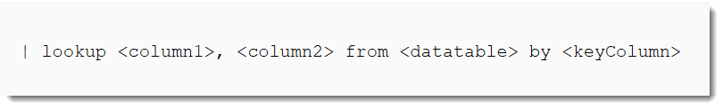
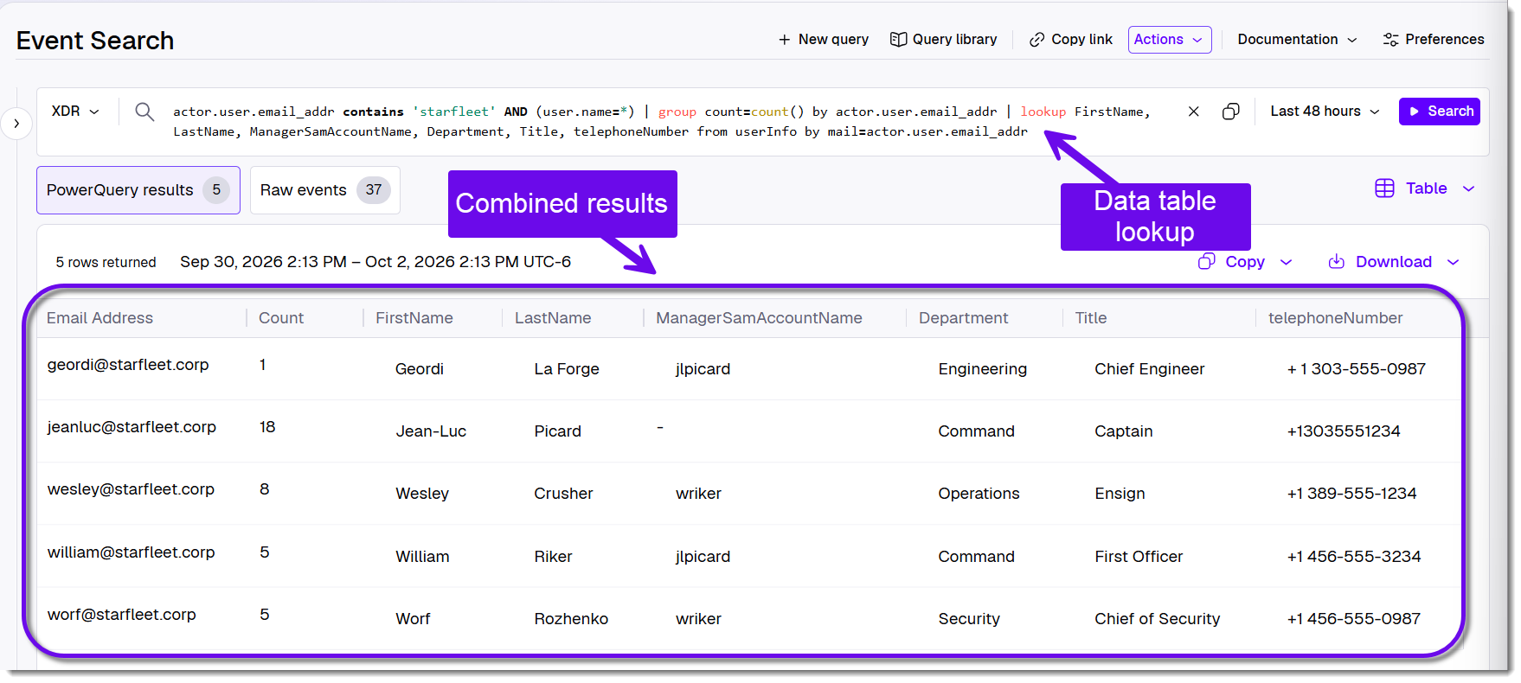
Join results to the data table with the lookup command
Notes:
After you've added a data table, you can then use the PowerQuery lookup command to specify columns from a data table and join them to your query. Lookup pulls one or more columns from the table defined after the from parameter. The by parameter identifies the key on which to join values.

Slide 38
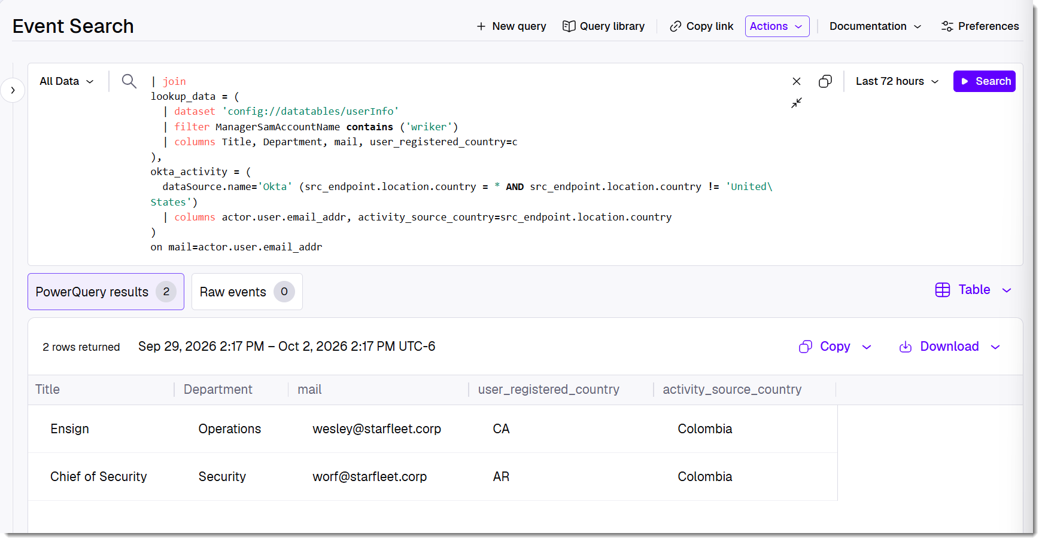
Join results to the data table with the lookup command
Notes:
Note: When the data table is a left-side join as above, you need to select All Data.
Whereas the lookup command always treats the lookup table as the right table, dataset lets you bring the table in from the left, and the join returns all rows from the lookup table. Note that you must set | columns to use a lookup table column in the on clause of the join.
Above example: Give me all users with the manager William Riker in the data table. Of those, pull the user’s Title, Department, email address, and registered country.
Second table, grab Okta events where the source country exists and is not US
Group the events by user and source activity country, and count them
Join the 2 tables on user’s email

Slide 39
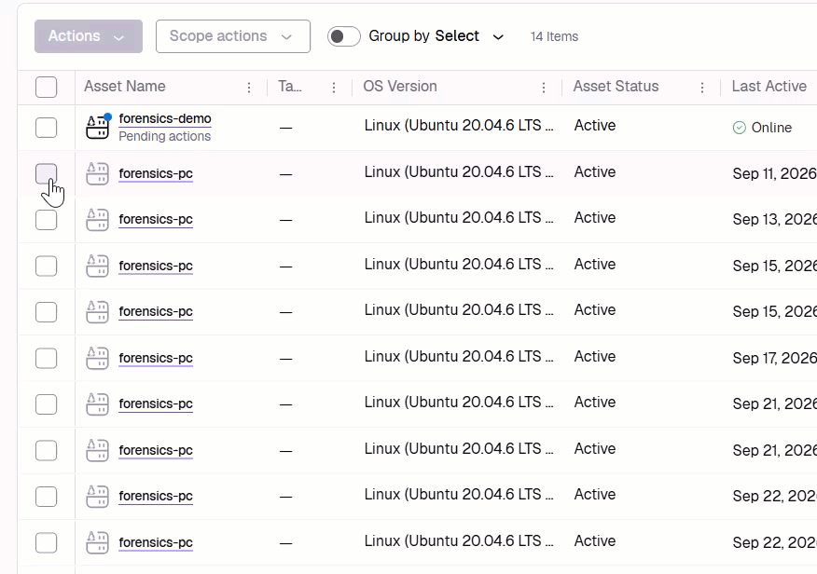
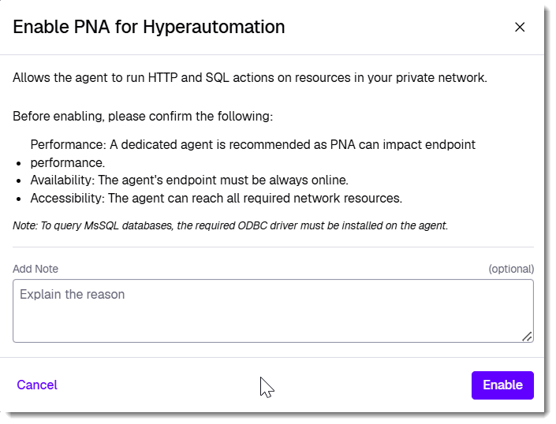
Introduction to Private Network Access (PNA)
Notes:
Private Network Access is a Singularity Hyperautomation feature that lets the Hyperautomation platform securely trigger HTTP requests and SQL queries against resources sitting inside your private network (on-prem, a private cloud VPC, or any network not directly internet-reachable). It works through a dedicated Linux Agent (version 25.2.1+) that establishes an outbound secure connection from inside your network out to the Hyperautomation platform — nothing is opened inbound. When a workflow triggers an HTTP or SQL action targeting that private network, Hyperautomation sends the command down that existing tunnel to the agent, the agent executes it locally against the target resource, and the result is returned the same way.

Slide 40
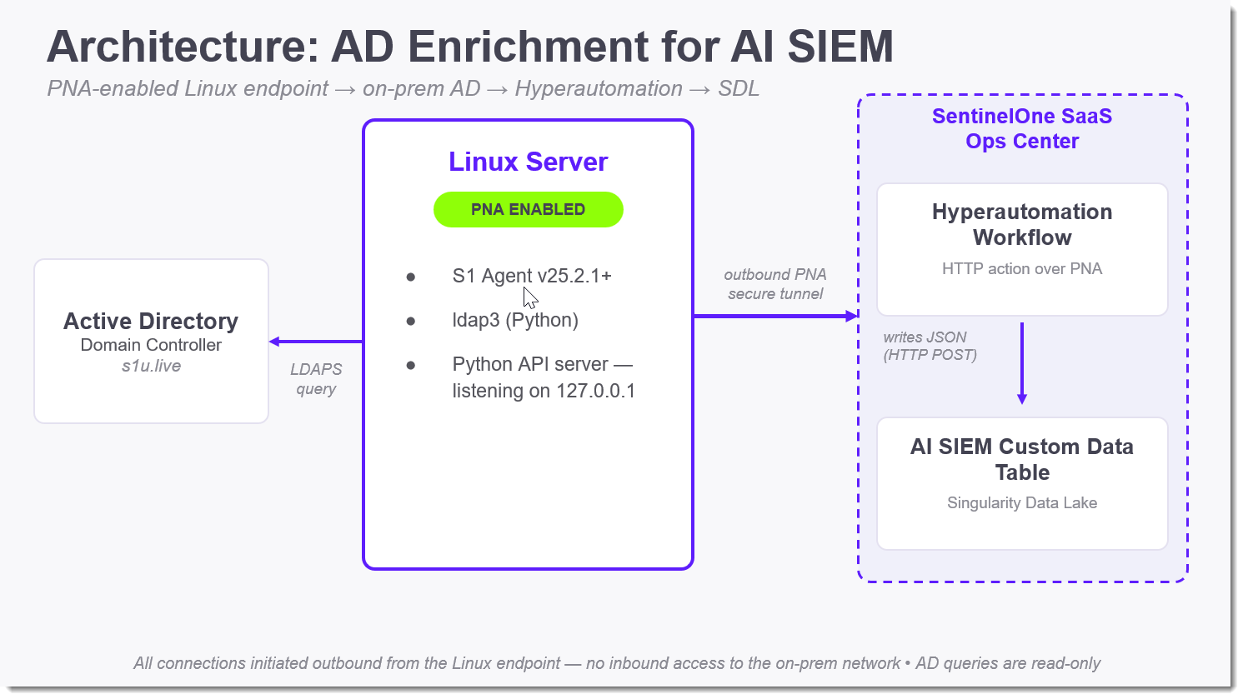
Architecture to Pull AD Details via Hyperautomation & PNA
Notes:
A PNA-enabled Linux server sits at the center of the flow: it runs the S1 Agent with Private Network Access enabled, uses ldap3 to run read-only LDAPS queries against the on-prem Active Directory domain controller, and exposes that data through a local Python API.
The Linux server then reaches out over an outbound-only PNA tunnel to SentinelOne's SaaS console — nothing is ever initiated from the cloud side back into the on-prem network.
On the cloud side, a scheduled Hyperautomation workflow calls that API over PNA, transforms the response into the required schema, and writes it as JSON into an AI SIEM Custom Data Table in Singularity Data Lake, making the AD data available to enrich SIEM queries.

Slide 41
Demo
Using PNA to Pull AD Data into AI SIEM
Notes:
S1U/Shawn/Student Site ha-13309: Pull AD Info to Data Table workflow. Requires HA PNA Data Tables Demo Skytap environment running. Make sure Windows Server 2016 is also running! https://cloud.skytap.com/configurations/222257376?section=vms&sort=name&thumbnails=shown

Slide 42
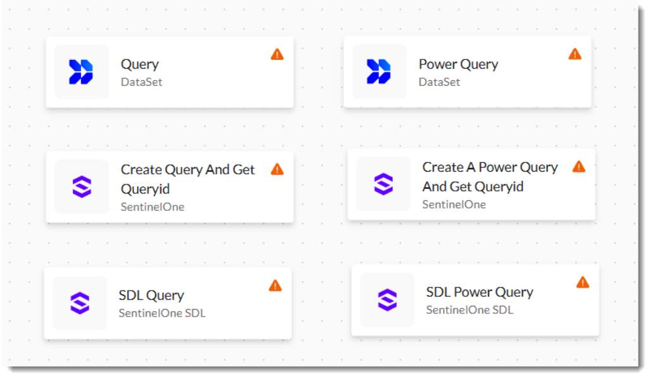
Searching AI SIEM Using Hyperautomation
Traditional Actions
Notes:
Searching the Singularity Data Lake using Hyperautomation builds the foundation for your more mature automation and orchestration efforts throughout the platform. Example use cases include:
Scheduled threat hunts: Proactively running PowerQueries on a schedule or on demand to hunt for hidden threats.
Complex detections: Using an automated SDL search to do a "deep dive" on a particular asset and identifying geo-based anomalies and other suspicious IP patterns.
Context enrichments: Triggering search(es) based on a unified alert, querying for related events, and enriching the alert with additional findings.
Custom reporting outside of the console: Supplementing console reporting functionality with information pulled from the data lake.
Responding to console configuration change events: Taking action based on console configurations logged in the Activity data feed.
The six actions in the screenshot above don't cover all Hyperautomation search functionality; there are many more actions for customizing search queries and working with the results. But typically, these are the core Hyperautomation search actions you'll encounter and use most often in your workflows.
Note that the actions are from three different integrations: DataSet, SentinelOne, and SentinelOne SDL.
The DataSet actions use the legacy DataSet/Scalyr API and are not recommended for new workflows. Although the API supports SentinelOne Query Language version 2 (S1QL 2.0), the query runs synchronously: if the query takes more than 60 seconds, the connection will time out and be dropped.
Similarly, the SentinelOne actions also use a legacy API and should not be implemented for newer workflows. These actions are limited to the S1QL 1.0 query language, and the query results can return only Deep Visibility telemetry data, not full SDL logs.
Although the SentinelOne SDL Hyperautomation actions use a different URL, it's effectively just the same synchronous API call used by the DataSet actions described above.

Slide 43
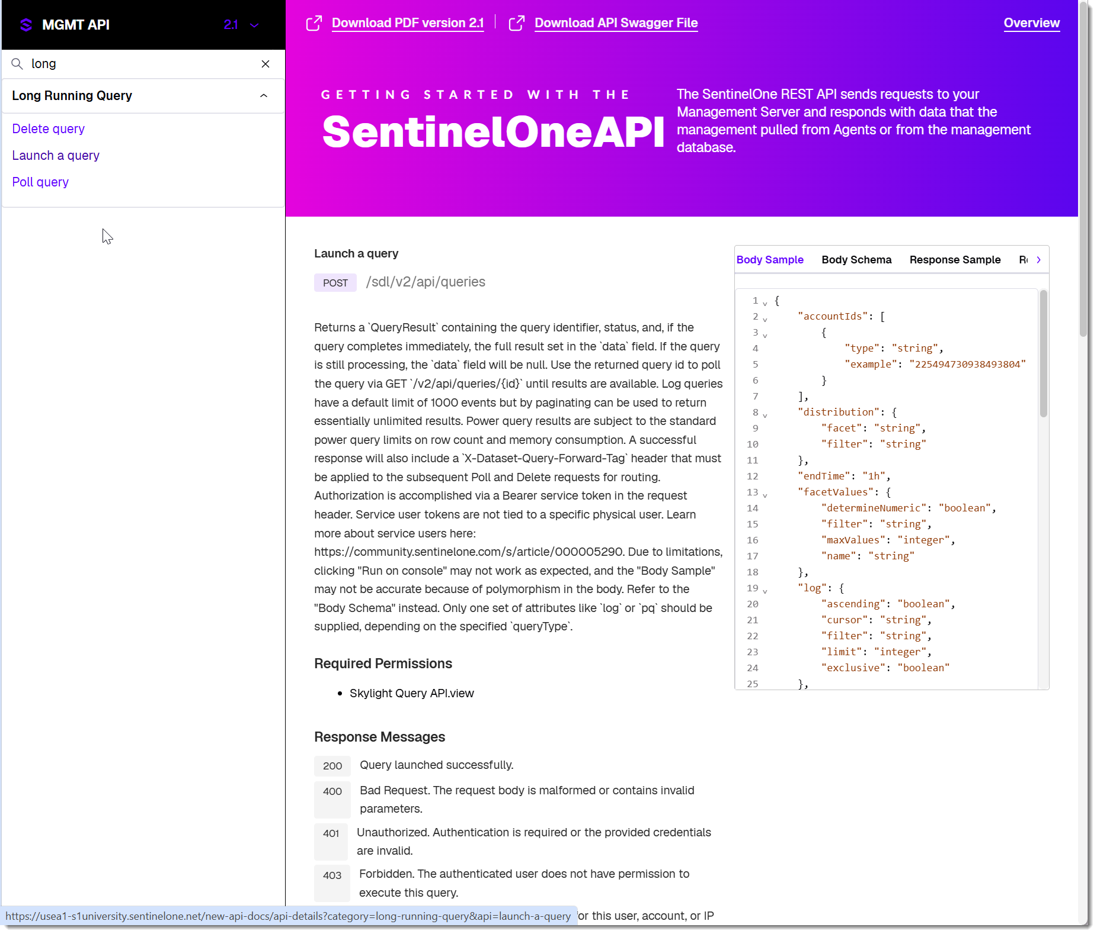
Introduction to Long-Running Queries
Asynchronous
Single API Endpoint
Streamlined Resource Management
* Recommended for all Singularity Data Lake query scenarios, although the older APIs remain in place for backward compatibility
Notes:
SentinelOne has introduced Long-Running Queries (LRQs) to optimize your interactions with the underlying data lake search functionality. These Long-Running Queries have several key benefits:
Asynchronous operation: LRQs are chunked into steps and processed by the backend without interrupting or blocking the API call, so they don't have the potential to time out like synchronous APIs can.
A single API endpoint for both Event Search and PowerQuery operations. Rather than using separate endpoints for Event Search and PowerQuery calls, both operations use the same endpoint path: https://<yourConsole>.sentinelone.net/sdl/v2/api/queries. The parameters you include define the type of query and its logic.
Streamlined resource management. The query and its results are cached by the platform for only a short window—30 seconds after the last ping—and the results and resources can easily be deleted via the API to free up resources immediately.

Slide 44
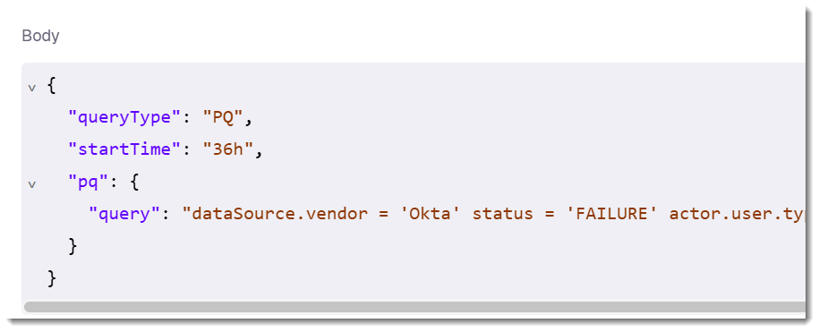
LRQ Requirements
1. Configure an Integration
2. Configure the Query body
3. Handle and Transform the Results
4. Iterate and Act on Data
Notes:
Beyond the API operations themselves, there are some fundamentals you'll need to take care of in order to work with LRQs in Hyperautomation.
1. Configure your Integration – To interact with the Singularity Data Lake, you must configure an authenticated integration.
a. Create a service user with permissions to read the data lake logs and grab the service token to use for authentication.
b. Connection: Create a connection in Hyperautomation using the generated token and your specific console URL.
2. Configure the query body – With the integration connected, you'll use the query body within the action to configure your search.
a. queryType: either LOG for ordinary Event Searches or PQ for PowerQueries
b. Time Range: You must specify a startTime value (for example, "24h") and optionally an endTime to scope your search
c. Dynamic Inputs: As always, you can inject values from previous workflow steps directly into the query string using curly brackets (for example, endpoint.name = '{{trigger.data.assetName}}').
3. Handle and Transform Query Results – Loop until the query is complete and collect the results.
a. To handle queries of any length runtime, you'll need to create a Loop action with a one-second delay and a "ping" operation (a status check on the query ID) that iterates until the results are complete. For standard Event Search queries that return more than 1,000 results, you can implement cursor-based pagination to fetch them all. See the Hyperautomation Advanced Topics course for pagination details and examples.
b. PowerQueries output data in separate "columns" and "values" arrays. Use the built-in JQ() and MAP_TABLE() functions to combine the results into a human-readable collection of JSON objects. We'll use these functions in the upcoming demonstration.
4. Iterate and Act on Data – Once the search data is collected and formatted, you can automate actions based on the results, such as:
a. Looping: Use the Loop action to iterate through the rows of results (for example, a list of malicious IPs found by the query) to perform actions on each item individually.
b. Alerting and Enrichment: You can use the results to enrich existing alerts. For example, a workflow can trigger on a new alert, run a PowerQuery to find related network activity, and write those results back into the original alert as a Note using the SentinelOne integration.
c. Reporting: You can format the PowerQuery results into a string or table and send them via the Send Email action or post them to a Slack channel.

Slide 45
Demo
Long Running Queries in Hyperautomation
Notes:
S1U/Shawn/Student Site ha-13309: Pull AD Info to Data Table workflow. Requires HA PNA Data Tables Demo Skytap environment running. Make sure Windows Server 2016 is also running! https://cloud.skytap.com/configurations/222257376?section=vms&sort=name&thumbnails=shown

Slide 46
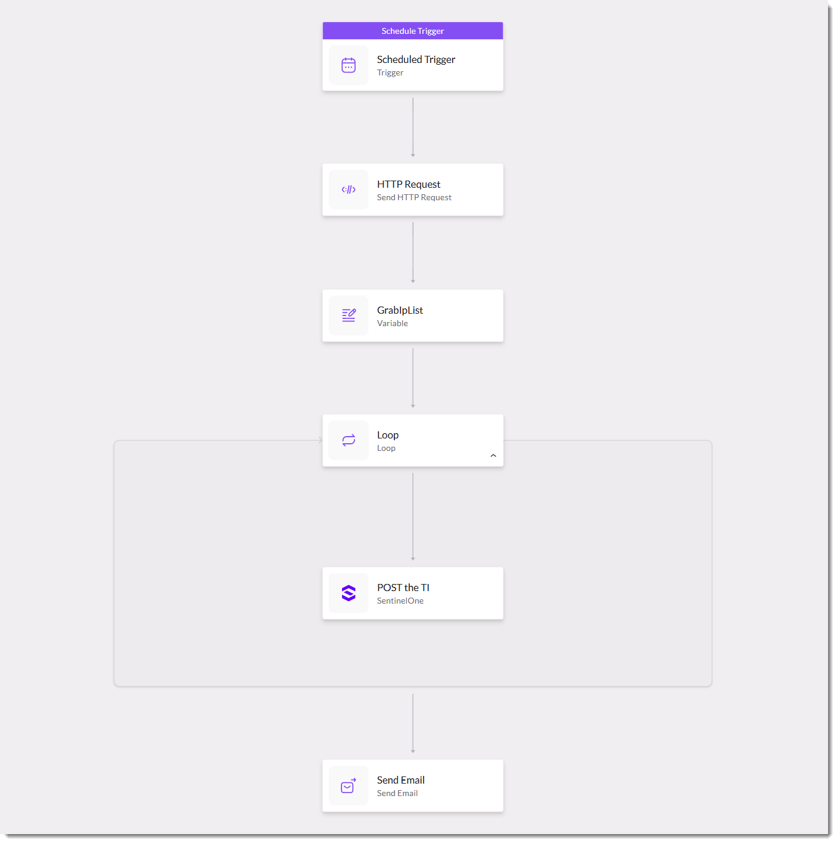
Updating Custom Threat Intelligence
This TOR Exit Nodes Inbound workflow imports public threat intel into the SentinelOne platform on a regular cadence.
Notes:
The TOR Exit Nodes Inbound workflow can be found in the S1U console/Training:
https://usea1-s1university.sentinelone.net/hyperautomation/workflow/6f0a4ac2-faa8-41dd-a8ea-7f2a5a87cf18/3bd369f1-2062-44eb-92ca-70fe2790149a?_scopeId=1706608756432300879&_scopeLevel=account&_categoryId=hyperautomation
In demo, you can certainly iterate through a few loops to write the threat intel to the database. You could then use the API Hub with the Get IOCs endpoint to show that the IOC was written to the database. But remember, it can take up to 25 minutes before the new threat intel becomes active and surfaces as TI events in the data lake and/or Alert enrichments, so you can’t really show that side of things.

Slide 47
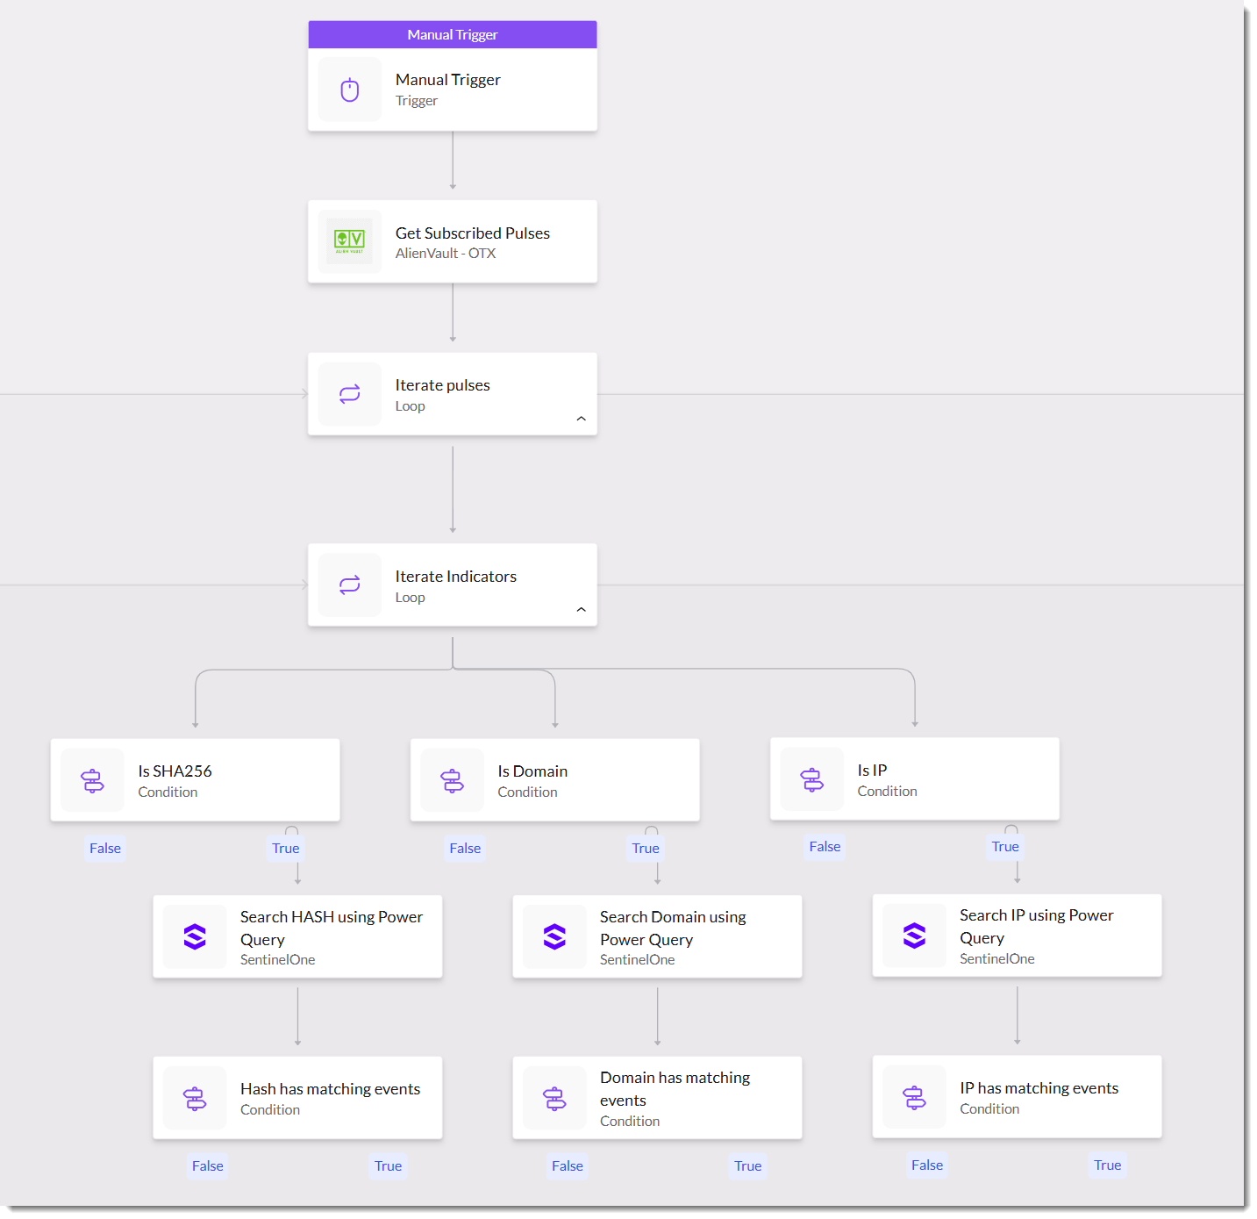
Threat Hunting
This Automated Threat Hunting with AlienVault workflow searches the Singularity Data Lake for IoCs pulled dynamically from AlienVault Pulse subscriptions.
Notes:
The Automated Threat Hunting with Alienvault workflow can be found in the S1U console/Training:
https://usea1-s1university.sentinelone.net/hyperautomation/workflow/c43784dc-f497-4014-bd76-8f0809e2727c/b162a956-c4db-405a-895f-d06997037c9c?_scopeId=1706608756432300879&_scopeLevel=account&_categoryId=hyperautomation
Note that when dealing with results in a loop, the special item term is a reference to the data returned within the current iteration (in other words, “item” isn’t a reference to a key in the JSON itself; it’s used by Hyperautomation as a special term).

Slide 48
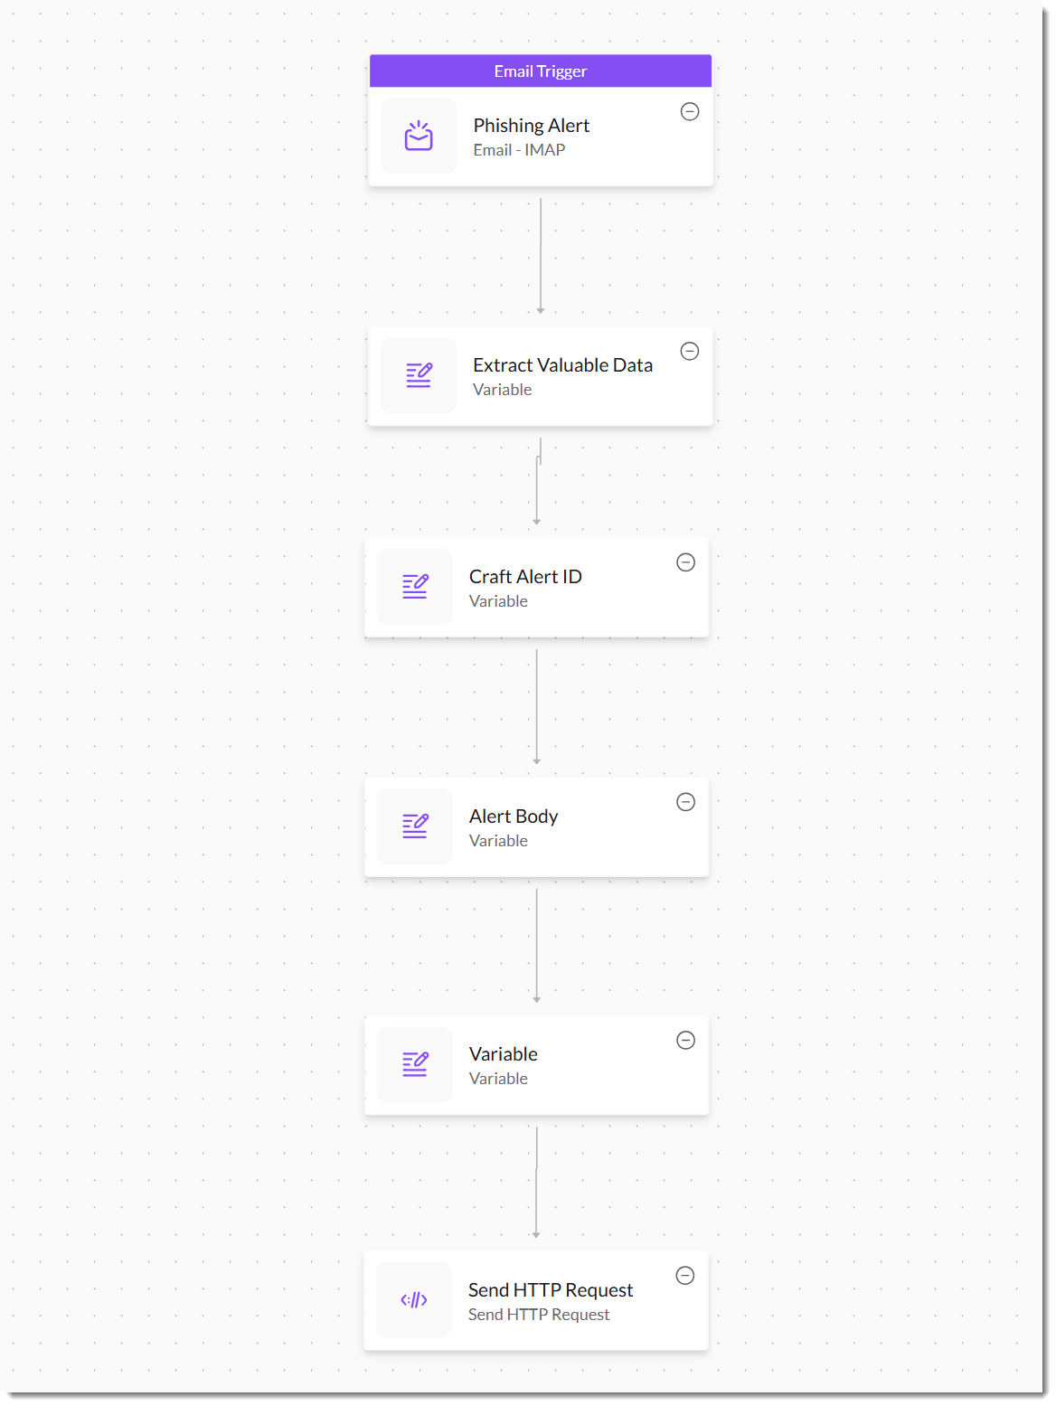
Create Ops Center Alerts for Phishing Attempts
This Phishing Alert workflow monitors a phishing inbox and generates a SentinelOne alert populated with the relevant details.
Notes:
The Phishing Email Response workflow can be found in the Purple console/Shawn:
https://usea1-purple.sentinelone.net/hyperautomation/workflow/71728677-c8da-4bbf-bd88-d6cb0ea4c2a6/0bac0969-b1ac-4688-abda-e50ad8eb1304?_scopeId=2122153722974915716&_scopeLevel=account&_categoryId=hyperautomation
Unified Alert Management Ingest API: https://community.sentinelone.com/s/article/000009322
Function.ACCESS_LIST_ITEM accesses a list item at a specific index
Function.BASE64_DECODE_AS_BYTES: Converts a Base64 string to its byte sequence
_______________________________________________________________________________________________
regex breakdown for <(?P<url>https?:\/\/[^>\s]+)>
< > literal opening and closing brackets
( ) create a capture group
?P<url> assigns the name “url” to the capture group
https? matches both http and https
:\/\/ matches :// (escaping the forward slashes)
[ ] define a character set
^ at the start of the set means "match any character not in this set“
> means do not match the closing angle bracket.
\s means do not match any whitespace character
+ means match the preceding character (or character set) one or more times

Slide 49
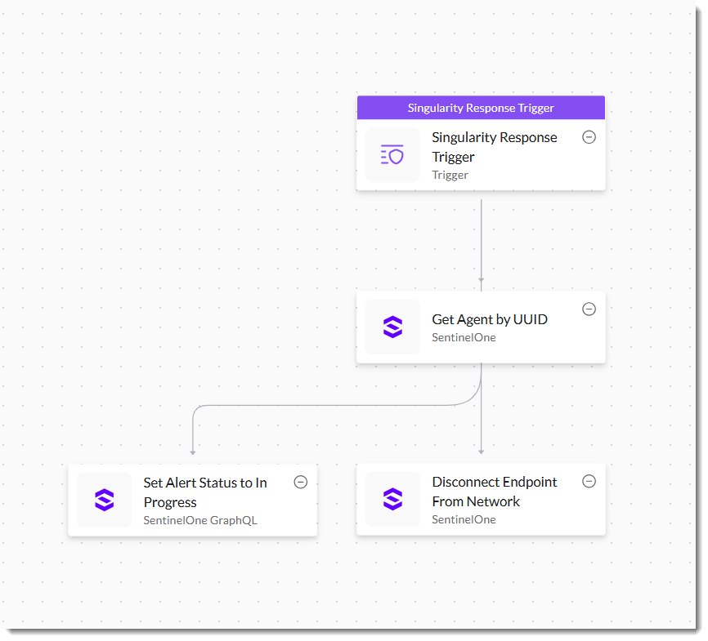
Automatically Quarantine a Compromised Endpoint
This Quarantine Sandbox Endpoint Automatically workflow isolates an endpoint from the network if it shows signs of Windows Sandbox abuse.
Notes:
The Quarantine Sandbox Endpoint Automatically workflow can be found in the S1U console/Training:
Overview Windows Sandbox abuse behavior (next slide)
Talk through Quarantine Sandbox Endpoint Automatically workflow
Quarantine Sandbox Endpoint Automatically should be disabled so that it doesn’t trigger automatically
Show workflow
Show Detections and talk through the Windows Sandbox Abuse Detection rule
Show the triggered Windows Sandbox Abuse Detection alert
Return to the workflow for walkthrough
Skip ahead to Disconnect Endpoint from Network
Show API
Show schema
Filter requirements: “ One of these filter arguments must be supplied: ids, groupIds, filterId.”
Problem is, the “id” field in the alert is the alert ID, not the agent ID. And I don’t want to filter on groupID (that would impact all members of the group). What I want is to identify the endpoint specifically by its UUID, but that’s not what the API is looking for…
Return to Get Agent by UUID block
Consider showing the new alertWithRawIndicators GraphQL API. It also contains the agent ID
Validate that the endpoint has been isolated
Take the endpoint out of network quarantine to prepare for the next demo

Slide 50
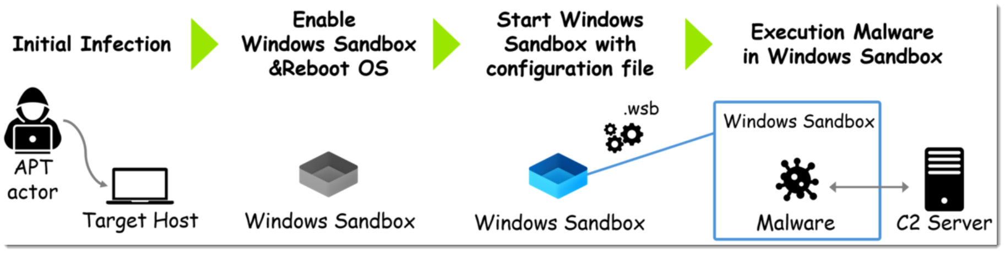
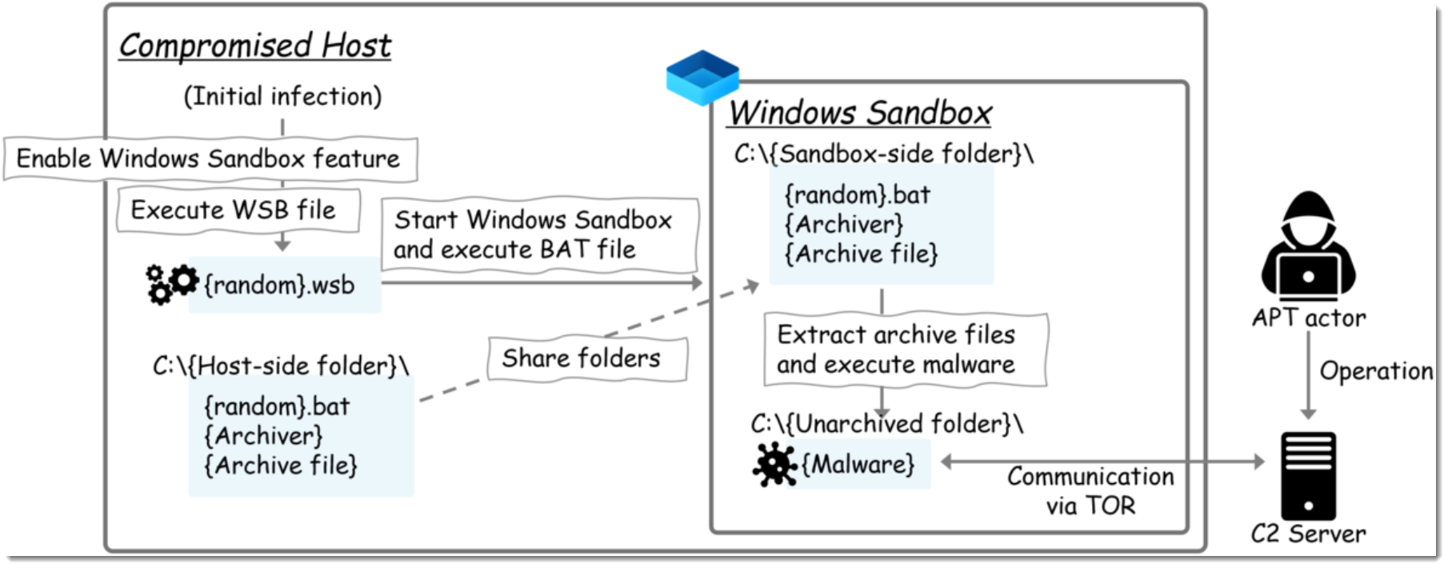
Windows Sandbox Abuse
Source: https://blog-en.itochuci.co.jp/entry/2025/03/12/140000
Notes:
From ITOCHU, a Japanese cybersecurity research company

Slide 51
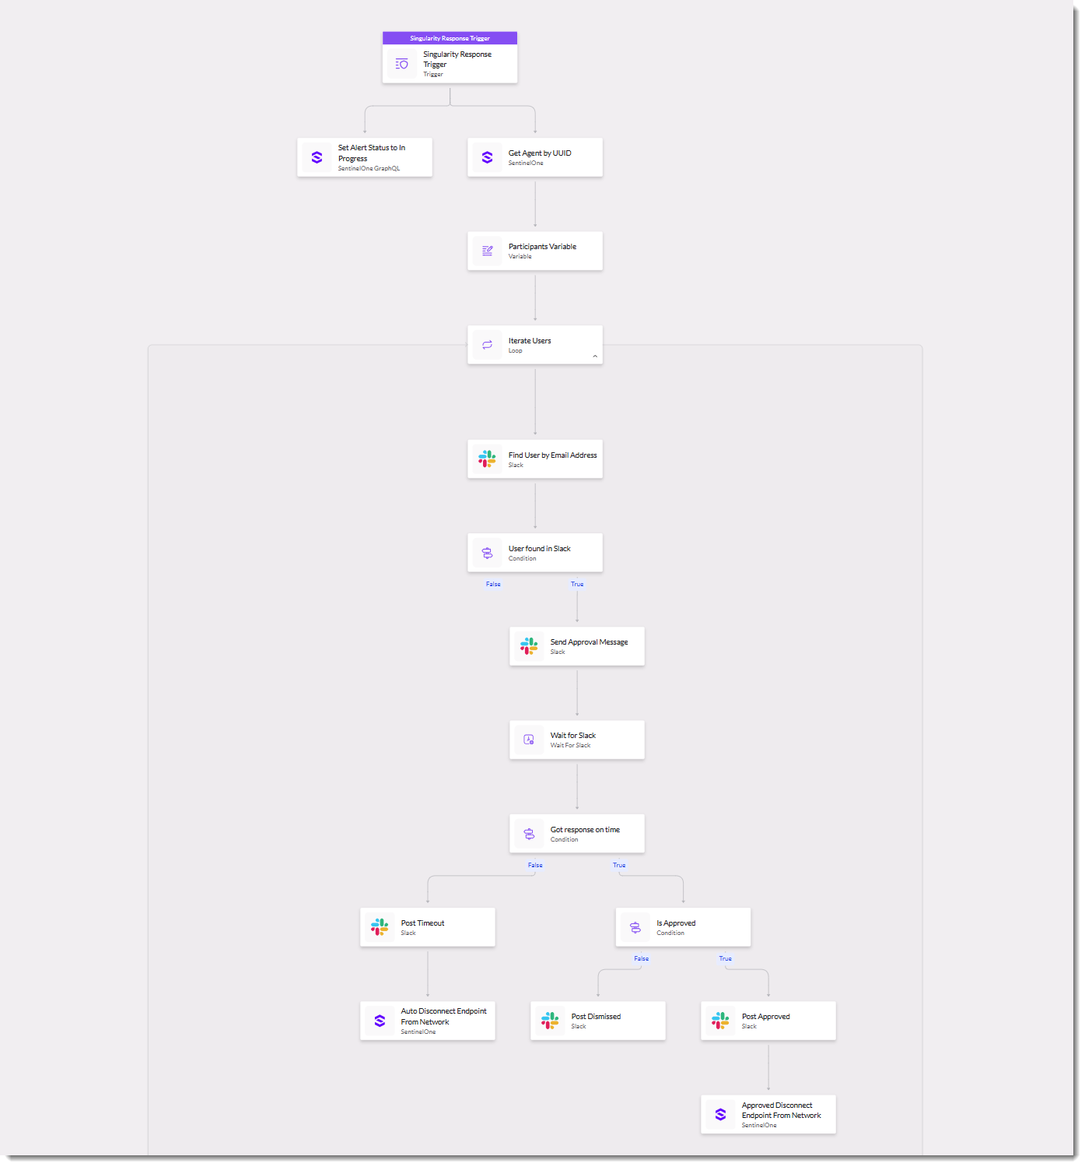
Prompt Analyst to Quarantine a Compromised Endpoint
This Quarantine Sandbox Endpoint workflow builds on the previous use case by prompting the analyst in Slack to approve or disapprove the quarantine operation.
Notes:
The Quarantine Sandbox Endpoint workflow can be found in the S1U console/Training:
https://usea1-s1university.sentinelone.net/hyperautomation/workflow/ab4c0a85-4836-4cd7-80d9-75477e0b24a4/035671c0-5fed-43cb-ad0a-493611e6d6b6?_scopeId=1706608756432300879&_scopeLevel=account&_categoryId=hyperautomation

Slide 52
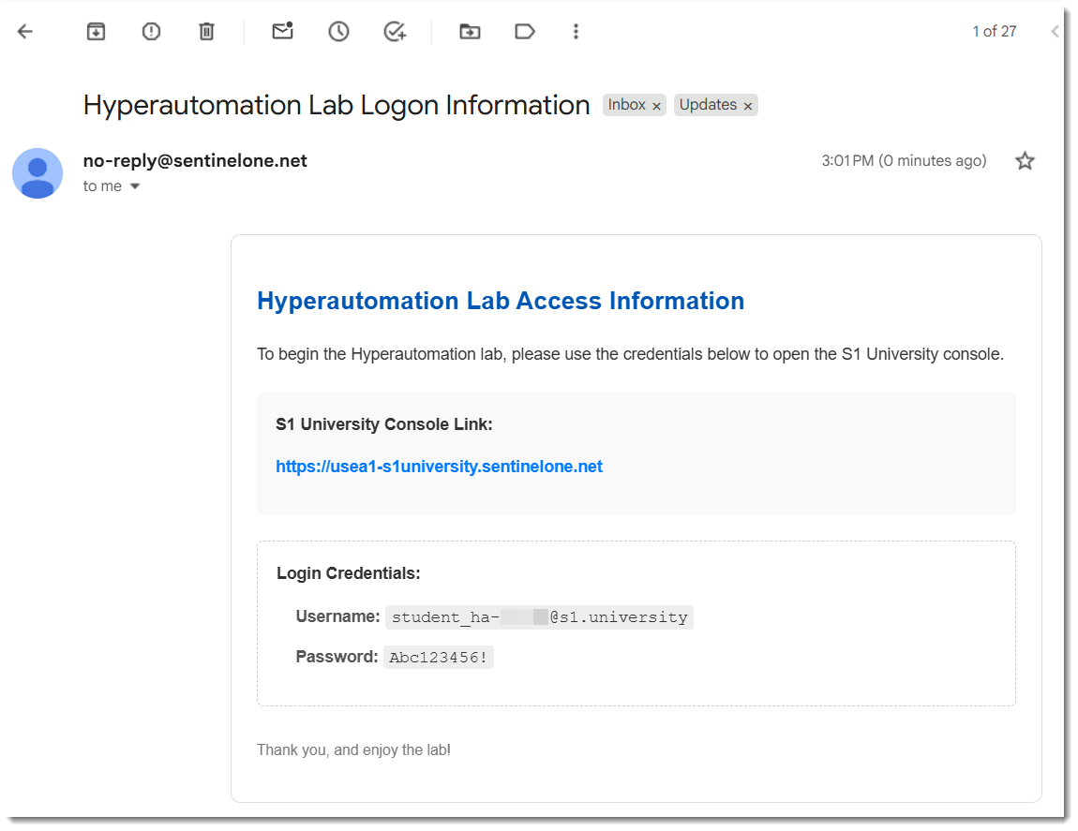
Email for Lab
Notes:
Spend a few minutes here talking them through the process:
https://usea1-s1university.sentinelone.net
Check your email for logon information.
You will have to enroll in 2FA using an authenticator app
Switch to Ops Center
You’re an Admin in your site. You can explore the Hyperautomation feature and create your own workflows. You cannot see my workflows at the Account level; workflows created at a specific scope (e.g., Account) are only visible and usable within that scope. They do not propagate to Sites or Groups below the Account.

Slide 53
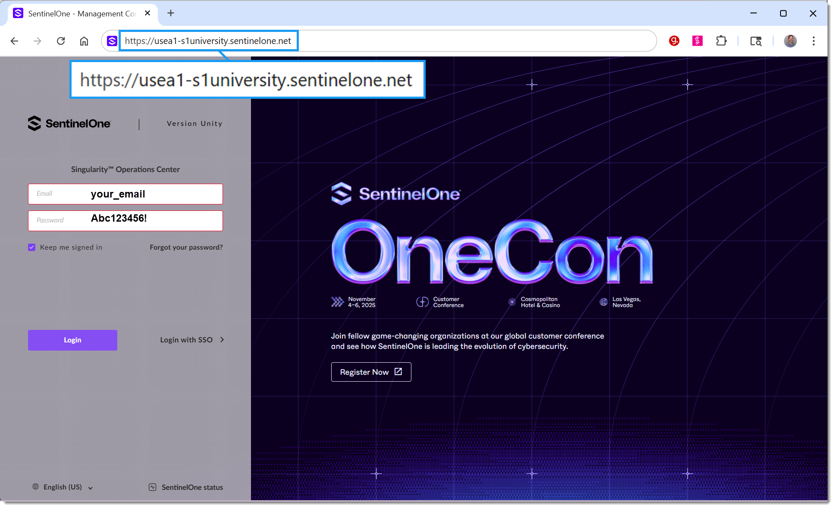
Notes:
Spend a few minutes here talking them through the process:
https://usea1-s1university.sentinelone.net
Check your email for logon information.
You will have to enroll in 2FA using an authenticator app
Switch to Ops Center
You’re an Admin in your site. You can explore the Hyperautomation feature and create your own workflows. You cannot see my workflows at the Account level; workflows created at a specific scope (e.g., Account) are only visible and usable within that scope. They do not propagate to Sites or Groups below the Account.

Slide 54
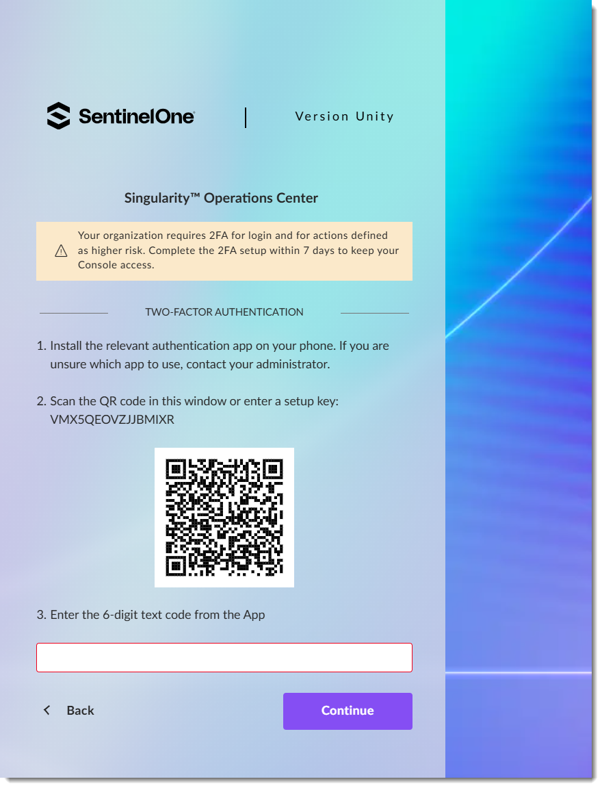
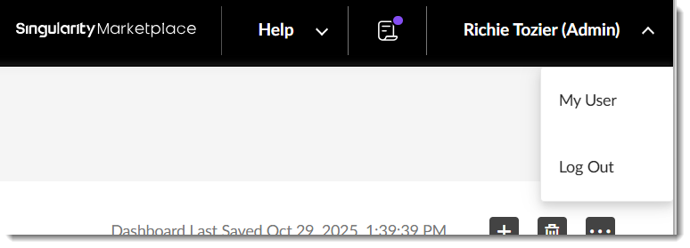
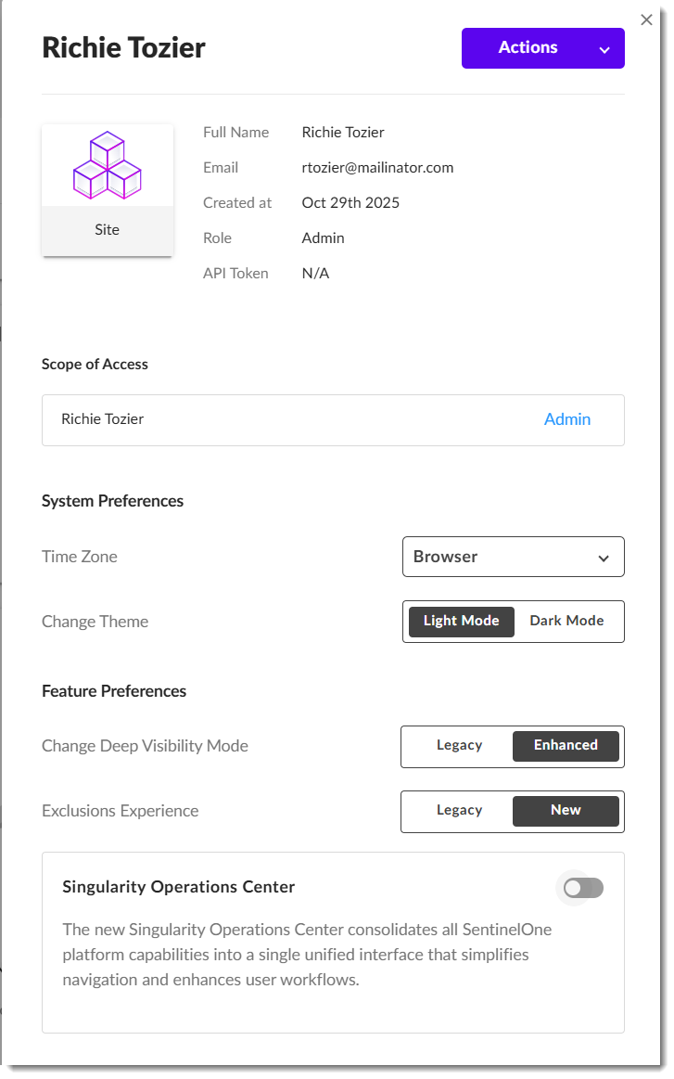

Slide 55
Hands-On Lab
Hyperautomation Use Cases

Slide 56
Thank You

