Slide 1
Memory Management in Android Apps
-Simsun

Slide 2
Heap Size
Device dependent
16 to 48 MB
getMemoryClass()
largeHead = true (> =3.0)

Slide 3
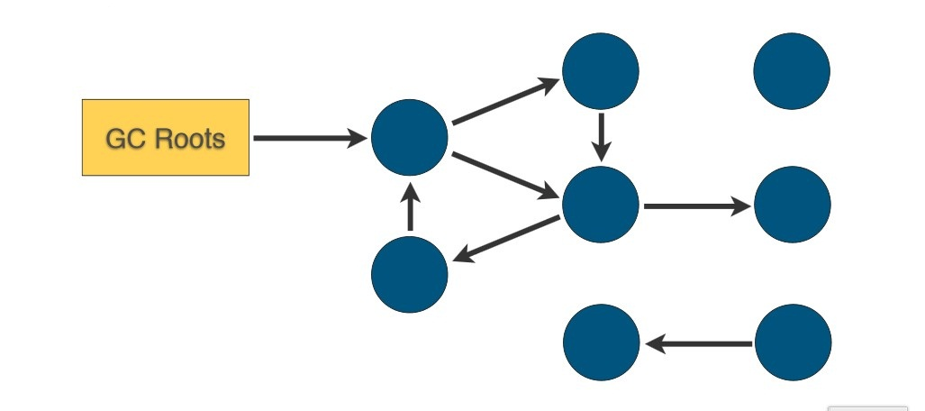
Garbage Collector

Slide 4
GC cost
< 2.3
Whole world stoped
Full heap collection
Take long time (> 100ms)
>= 2.3
Concurrent
Partial collection
Fast, low time costing

Slide 5
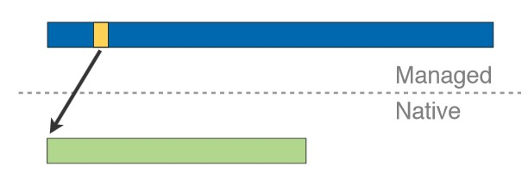
Bitmaps
Native memory (out side dalvik heap)
Call recycle() or wait for finalizer
< 3.0

Slide 6
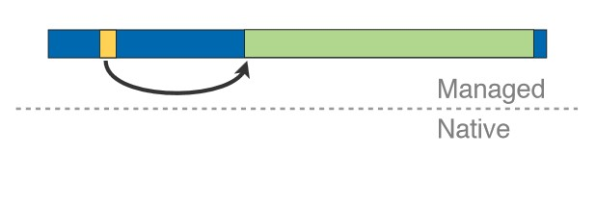
Bitmap (2)
>=3.0 system
Freed by GC
Concurrent GCs

Slide 7
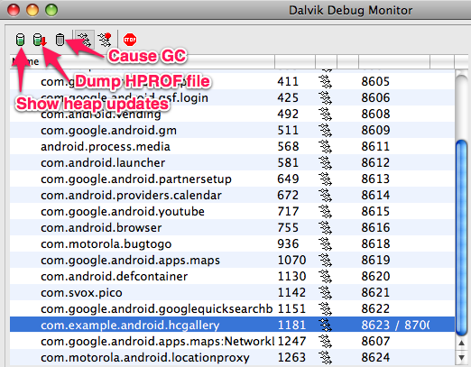
Memory Analyze
Heap Dumps
DDMS
In code dumpHprofdata()
Analyze
MAT (Memory Analyzer)

Slide 8
Memory Leak
GC is not the god
Long lifecycle reference will cause leak
Activity
Context
View
Drawable
Callback (this)
handler

Slide 9


Memory Leak (2)
Webview

Slide 10
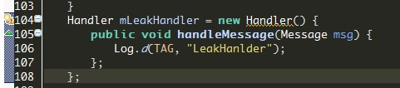
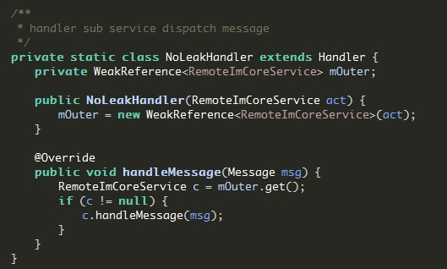
Memory Leak (3)
Non-static inner class (runable)

Slide 11
Memory Leak (4)
Context
ApplicationContext
Caches
Cursor
Strict Mode

Slide 12
Reference
http://www.eclipse.org/mat/
http://android-developers.blogspot.com/2011/03/memory-analysis-for-android.html

Slide 13
Thank you & Let’s Talk

