Slide 1
AGENTIC RL · DEEP RESEARCH
LiteResearcher
A Scalable Agentic RL Training Framework for Deep Research Agents
arXiv:2604.17931 · github.com/simplex-ai-inc/LiteResearcher
Zhejiang University · Simplex AI · HKPU
1 / 30

Slide 2
PAPER INFORMATION
Authors, links & one-line summary
AUTHORS
RESOURCES
Wanli Li¹², Bince Qu¹², Bo Pan¹, Jianyu Zhang¹, Zheng Liu³, Pan Zhang², Wei Chen¹, Bo Zhang¹²
Paper · arXiv:2604.17931
Code · github.com/simplex-ai-inc/LiteResearcher
Weights · huggingface.co/simplex-ai-inc/LiteResearcher-4B
Venue · Preprint, under review
¹ Zhejiang University ² Simplex AI ³ The Hong Kong Polytechnic University
TL;DR
A virtual world that mirrors live web search but isolates its noise lets a tiny 4B model match or beat 8× larger open-source and commercial agents on deep-research benchmarks.
LiteResearcher · Presentation
2 / 30

Slide 3
AGENDA
What we will cover today
01
Problem & prior approaches
02
Method overview
Why scaling Agentic RL for deep research is hard
The 3-pillar LiteResearcher pipeline
03
Pillar 1 · Data × Corpus
04
Pillar 2 · Local tool environment
Co-construct synthetic data and local corpus
32M-page virtual web at <0.2 s latency
05
Pillar 3 · Curriculum RL
06
Main results
On-policy GRPO + difficulty filtering
GAIA, Xbench, BrowseComp, HLE, …
07
Ablations
08
Behavior analysis · appendix
Cost, data, on/off-policy, two-stage, RL vs SFT
Four mechanisms behind the Sim2Real gain
LiteResearcher · Presentation
3 / 30

Slide 4
01 · PROBLEM
Why scaling Agentic RL for Deep Research is hard
“
RL has delivered sustained gains for closed-world reasoners; Agentic RL for deep research has not. Why?
A · DATA BOTTLENECK
B · ENVIRONMENT BOTTLENECK
Hand-crafted synthetic data
Real-web RL dependency
Over-engineered task templates that do not elicit the diverse atomic search skills used in the real world — cross-verification, enumeration, statistics, …
Live-internet rollouts inject high variance and prohibitive cost into RL training, capping the number of stable updates and the scale of training data.
LiteResearcher · Presentation
4 / 30

Slide 5
01 · PRIOR APPROACHES
Three families, three trade-offs
WEBTHINKER · KIMI-RESEARCHER
SEARCH-R1 · SEARCH-O1
ZEROSEARCH
Online RL
Local retrieval
Simulated search
Live internet · high realism
Wikipedia-scale corpus
LLM-mimicked search engine
STRENGTHS
STRENGTHS
STRENGTHS
+ Realistic interactions
+ Cheap, fast, deterministic
+ Fully controllable
+ Unbounded knowledge
LIMITATIONS
LIMITATIONS
LIMITATIONS
− Narrow, homogeneous
− No page-level fidelity
− Non-deterministic reward
− Misses real-web dynamics
− Hallucinated documents
− Cost grows with steps
− Caps the search-skill ceiling
− Limited transfer to real web
− Variance bottlenecks scale
LiteResearcher · Presentation
5 / 30

Slide 6
01 · THESIS
Mirror the web, isolate the noise
OUR ARGUMENT
Scaling Agentic RL for Deep Research requires a twin architecture:
OUTCOME
LiteResearcher-4B
A 4B model that scales like a 30B+ one
Mirroring
Local environment behaves like the live web — same page-level fidelity, same retrieval distributions, same browse dynamics.
71.3%
GAIA
Isolation
Training is decoupled from the real internet — no rate limits, no API cost, no non-deterministic reward, no rollout variance.
78.0%
Xbench-DS
83.1%
Frames
LiteResearcher · Presentation
6 / 30

Slide 7
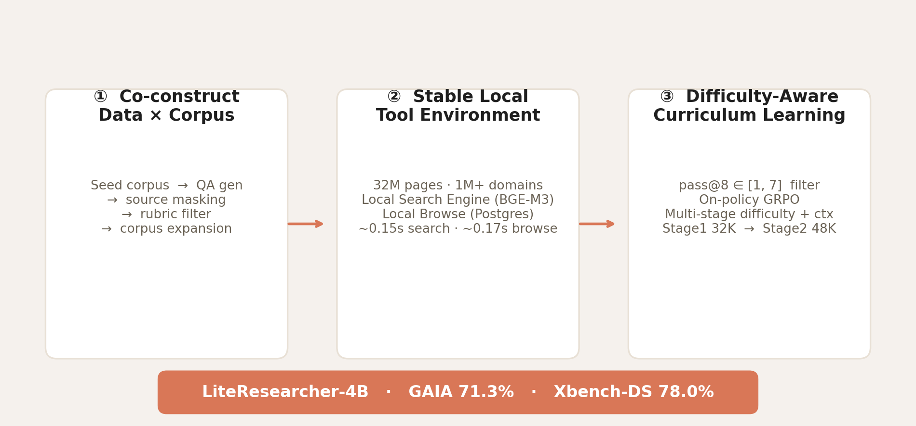
02 · METHOD OVERVIEW
Three pillars of the LiteResearcher pipeline
LiteResearcher · Presentation
7 / 30

Slide 8
03 · PILLAR 1
Co-construct training data and local corpus
WHY CO-CONSTRUCTION
Tasks and corpus evolve together so that every synthetic query is answerable by browsing the local environment — no shortcut, no leak.
STEP 01
STEP 02
STEP 03
STEP 04
Seed Corpus
Source Masking
Rubric Filtering
Corpus Expansion
Wikipedia + BBC News → structured QA
Delete the source page so the answer is non-trivial
7-criteria LLM filter (independence, verifiability, ...)
Fetch related web pages → enrich the local pool
LiteResearcher · Presentation
8 / 30

Slide 9
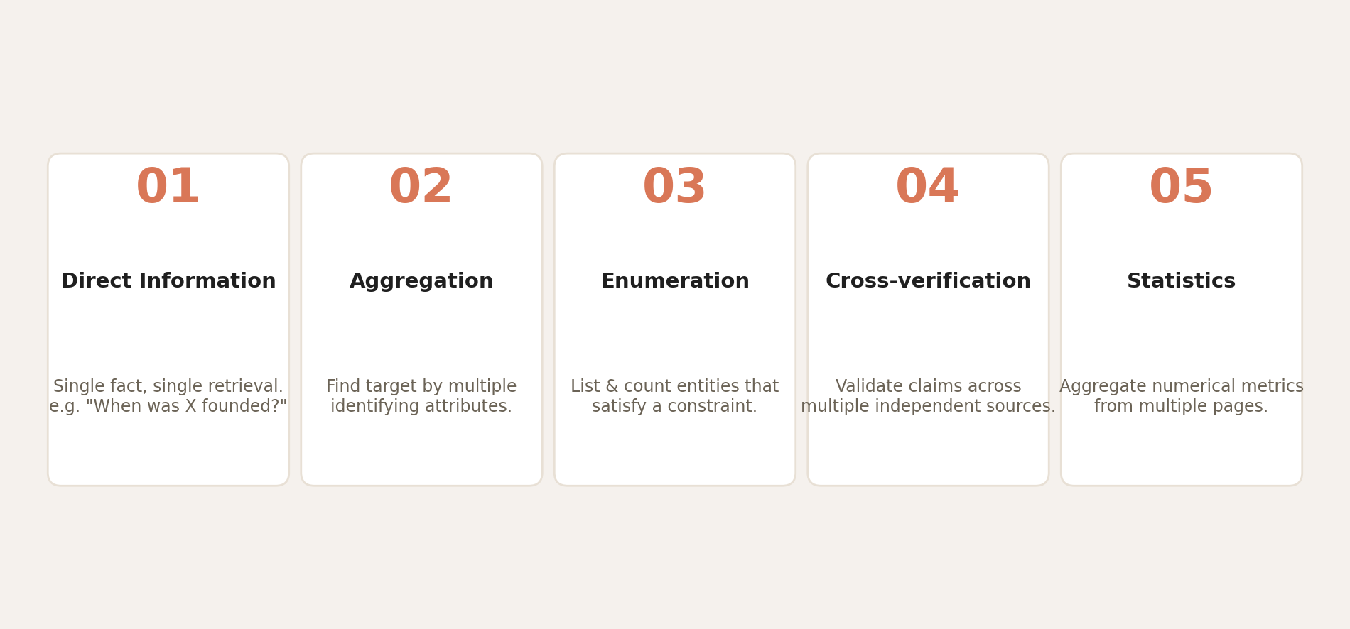
03 · PILLAR 1
Five atomic search capabilities
The taxonomy of skills our data must elicit
LiteResearcher · Presentation
9 / 30

Slide 10
04 · PILLAR 2
Stable local tool environment
THE VIRTUAL WEB
32 M
1 M+
73.2 M
pages
domains
tool calls over full RL run
INDEX · RETRIEVE
STORE · SERVE
Local Search Engine
Local Browse Tool
BGE-M3 hybrid dense + sparse Milvus index · DiskANN on disk ~0.15 s / query (≈ 10× faster than online)
Full Markdown content in PostgreSQL Keyed by URL · tuned for 1,000 concurrent conn. ~0.17 s / page (≈ 46× faster than Jina Reader)
LiteResearcher · Presentation
10 / 30

Slide 11
05 · PILLAR 3
Difficulty-aware curriculum learning
THE PROBLEM · TRAINING SATURATION
ON-POLICY GRPO
When too easy → no gradient. When too hard → no signal. Single-stage RL plateaus at the model's current difficulty band.
The training objective
J(θ) = E [ (1/K) Σ min ( rᵢ·Aᵢ ,
clip(rᵢ, 1-ε_lo, 1+ε_hi)·Aᵢ ) ]
THE FIX · TWO LEVERS
rᵢ(θ) = π_θ(oᵢ|q) / π_old(oᵢ|q)
Difficulty filter
Before each stage: K=8 rollouts per query, keep only those with correct-count c ∈ [1, 7]. Discard trivial and impossible.
· No KL penalty
· No entropy regularizer
· Strictly on-policy: each rollout used once
Multi-stage curriculum
Each stage → increase task difficulty + context length (Stage 1 = 32K → Stage 2 = 48K, with harder data mix).
LiteResearcher · Presentation
11 / 30

Slide 12
06
EXPERIMENTS
Main results & ablations
8 benchmarks · ablations on data, environment, on/off-policy, multi-stage, SFT-only
LiteResearcher · Presentation
12 / 30

Slide 13
06 · SETUP
Training recipe at a glance
RL TRAINING CONFIGURATION
Base model
Qwen3-4B-Thinking-2507
Cold-start SFT
trajectories distilled from Tongyi DeepResearch
Batch size
global 128 · 8 rollouts per query · on-policy
Learning rate
1 × 10⁻⁶ (constant)
Loss
GRPO · no KL · no entropy regularizer
Context length
Stage 1 = 32 K → Stage 2 = 48 K
Eval tools
Serper for search · Jina Reader for browse (online APIs)
Benchmarks
GAIA · Xbench-DS · BrowseComp · HLE · Frames · WebWalker · Seal-0
LiteResearcher · Presentation
13 / 30

Slide 14
06 · MAIN RESULTS
8 benchmarks · 4B model · open-source SOTA
Model
Size
GAIA
Xbench-DS
Frames
BrowseComp
Claude-4.5-Sonnet
—
71.2
66.0
80.7
—
OpenAI GPT-5-high
—
—
77.8
—
—
GLM-4.6
—
71.9
70.0
—
—
DeepSeek-V3.2
—
—
—
80.2
—
Tongyi DeepResearch
30B
70.9
75.0
—
—
WebSailor
30B
53.2
53.3
—
—
AgentCPM-Explore
4B
63.9
70.0
—
—
LiteResearcher (ours)
4B
71.3
78.0
83.1
32.5
All scores in %. LiteResearcher-4B matches or exceeds models 8× its size and most commercial systems.
4 B beats 30 B · open-source SOTA on GAIA · Xbench · Frames · zero marginal cost during training
LiteResearcher · Presentation
14 / 30

Slide 15
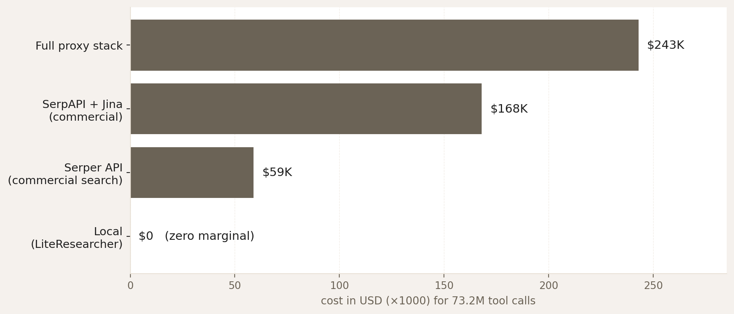
07 · ABLATION
Local vs. live internet — cost & latency
TOTAL TOOL CALLS
73.2 M
45.8 M search + 27.4 M browse over the full RL run
SPEED-UP
10× faster search 46× faster browse
Throughput is what makes scalable on-policy RL feasible.
LiteResearcher · Presentation
15 / 30

Slide 16
07 · ABLATION
Effect of our synthetic data
DOES SCALING INFORMATION SOURCES PAY OFF?
Training data
GAIA
Xbench-DS
Multi-hop data only
58.7
66.3
Multi-hop + our synthetic
66.8
71.0
INTERPRETATION
Adding our synthetic data lifts both benchmarks by +8.1 / +4.7 points. A scaled-and-filtered information source covers the long-tail of search patterns that hand-crafted multi-hop data misses.
LiteResearcher · Presentation
16 / 30

Slide 17
07 · ABLATION
On-policy vs. off-policy GRPO
SETUP
GAIA VALIDATION ACCURACY
Off-policy variant: each rollout batch (256) is split into 4 mini-batches and consumed in 4 successive updates. On-policy: each rollout batch is consumed in a single update and discarded.
Off-policy
66.8 %
On-policy
68.9 %
RESULT
Off-policy gains reward earlier but eventually declines. On-policy keeps improving — higher final GAIA validation.
Multiple updates per batch → policy lag → trajectory mismatch → ceiling drops.
LiteResearcher · Presentation
17 / 30

Slide 18
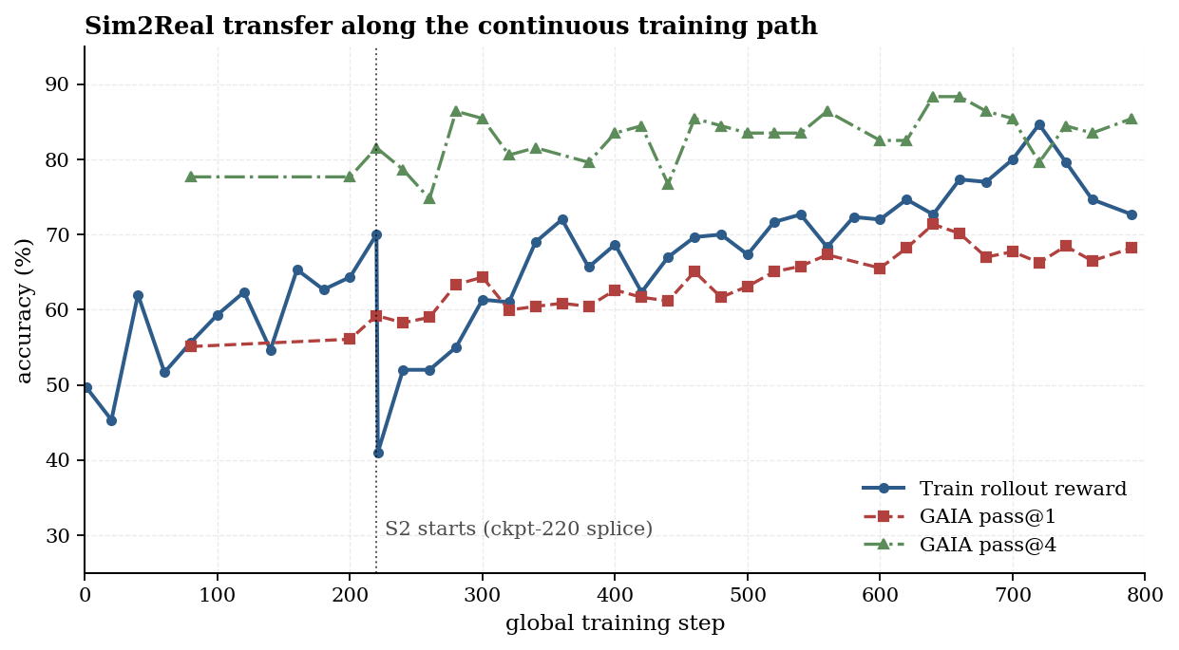
07 · ABLATION
Effectiveness of multi-stage training
GAIA · EMA-SMOOTHED
Stage 1 plateau
64.7 %
at ~step 220
Stage 2 end
68.3 %
+3.6 pts
Stage 2 lifts the plateau by raising difficulty + context length.
LiteResearcher · Presentation
18 / 30

Slide 19
07 · ABLATION
Contribution of RL over SFT
SFT TEACHER · TONGYI DEEPRESEARCH (30B)
TEACHER (30B)
SFT ONLY (4B)
+ RL (4B, OURS)
70.9 %
55.6 %
71.3 %
where the teacher caps
−15.3 pts vs teacher
+15.7 pts over SFT
The primary performance driver is the RL framework — not teacher distillation.
LiteResearcher · Presentation
19 / 30

Slide 20
APPENDIX · BEHAVIOR ANALYSIS
08
Why does the policy improve?
A behavior-level autopsy of 41 checkpoints across
S1 (steps 0-220) → S2 (steps 0-570), spliced at step 220.
30 metrics · 300 traj/step · GAIA every 20 steps
LiteResearcher · Presentation
20 / 30

Slide 21
APPENDIX · BEHAVIOR
What changed about the model's behavior?
MOTIVATION
ANALYSIS SETUP
The aggregate reward curve goes up — but what does the policy
actually do differently at step 790 vs step 0?
We log 30 per-trajectory behavior signals at every
checkpoint, then look for monotone shifts that correlate
with the GAIA accuracy gain.
Goal: isolate causal patterns from incidental noise.
Checkpoints sampled
41
Train rollouts per ckpt
300 trajectories
GAIA-eval rollouts per ckpt
412 tasks × pass@1, pass@4
Behavior metrics extracted
30 per trajectory
Splice point
step 220 — S1 end → S2 start
Total trajectories analyzed
~ 24,000
LiteResearcher · Presentation
21 / 30

Slide 22
APPENDIX · BEHAVIOR
What we measured at the outcome level
OBSERVATION
Train reward and GAIA
evaluation co-improve
through both stages.
S1 saturates near
step 220 — S2 lifts
the plateau without
regression.
→ Sim2Real transfer
is sustained.
LiteResearcher · Presentation
22 / 30

Slide 23
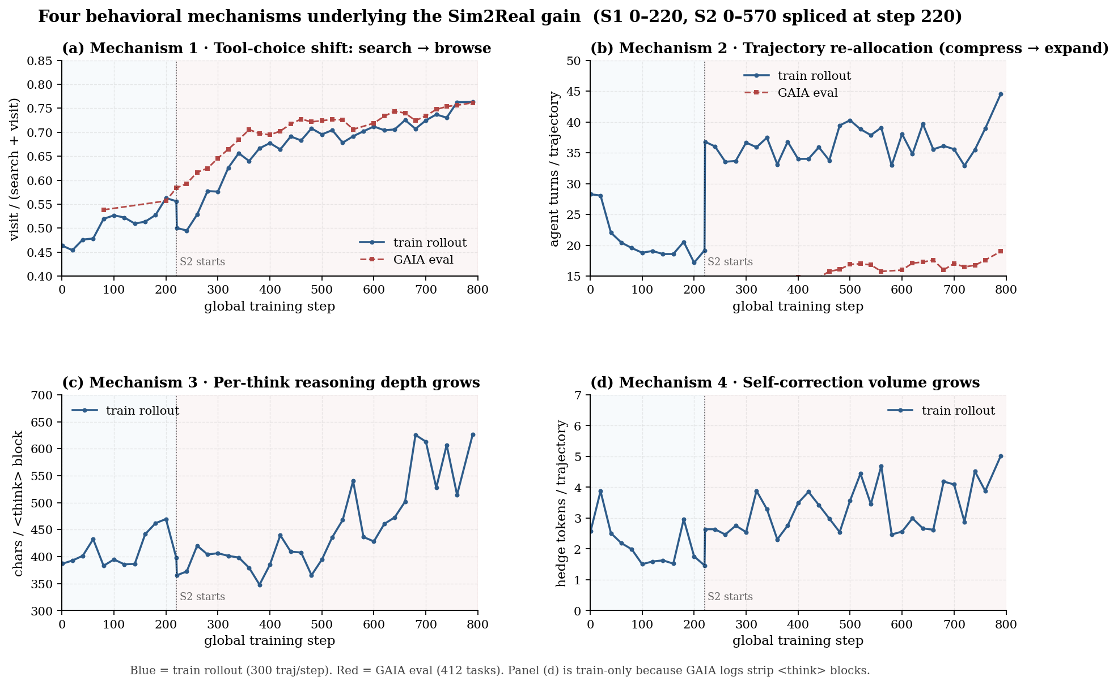
APPENDIX · BEHAVIOR
Four mechanisms behind the gain
THE FOUR LEVERS
M1
Tool-choice shift
search → browse
0.46 → 0.76
M2
Trajectory re-alloc
compress → expand
28 → 19 → 45
M3
Per-think depth
richer reasoning blocks
387 → 626 chars
M4
Self-correction
more hedge volume
1.5 → 5.0 tokens
LiteResearcher · Presentation
23 / 30

Slide 24
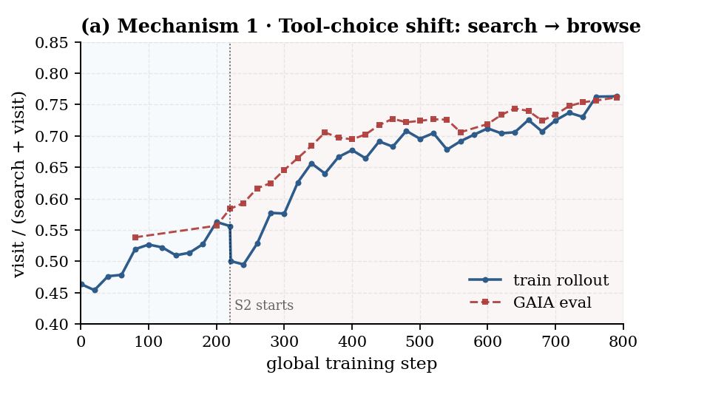
M1 · TOOL-CHOICE SHIFT
From keyword search to deep browse
browse / (search + browse)
step 0
0.46
step 220
0.56
step 460
0.72
step 790
0.76
INTERPRETATION
Policy stops treating search as the answer
and starts using it as a pointer toward
evidence — which it then opens and reads.
LiteResearcher · Presentation
24 / 30

Slide 25
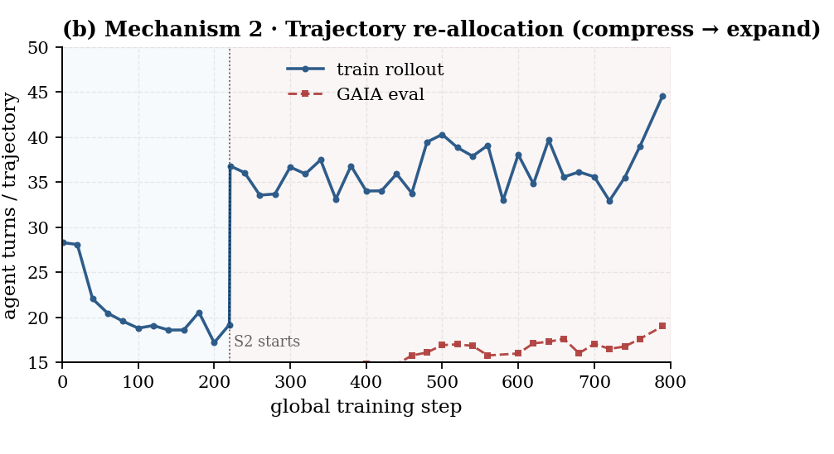
M2 · TRAJECTORY RE-ALLOCATION
Compress, then expand into harder problems
agent turns / trajectory
28 → 19 → 45
S1 start · S1 end · S2 end
Phase A · S1 (0→220)
Policy learns to compress —
fewer wasted turns per task.
Phase B · S2 (220→790)
Same policy meets harder tasks
and an enlarged 48k context — it
re-invests the budget for depth.
LiteResearcher · Presentation
25 / 30

Slide 26
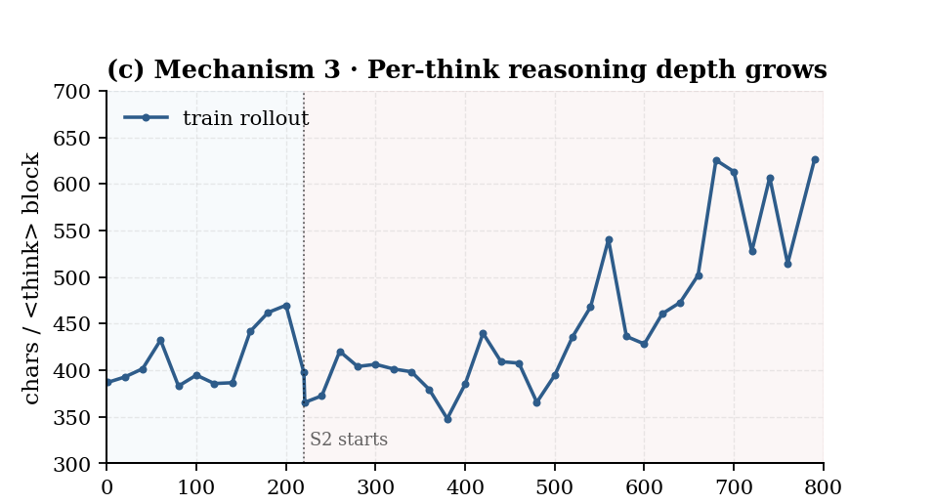
M3 · PER-THINK DEPTH
Each reasoning block carries more content
chars / <think> block
387 → 626
≈ +62 % per reasoning block
WHY DEPTH, NOT FREQUENCY?
Number of <think> blocks per turn
stays flat — what grows is the
content inside each block.
The policy reasons more carefully,
not more often.
LiteResearcher · Presentation
26 / 30

Slide 27
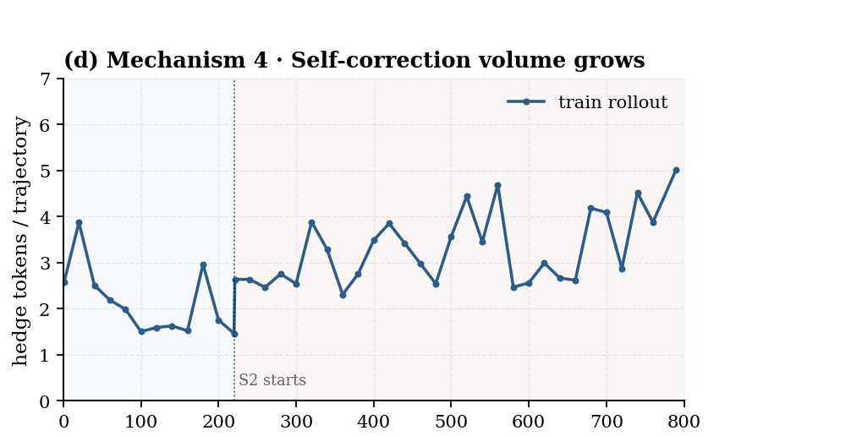
M4 · SELF-CORRECTION VOLUME
More hedging and verification moves
hedge tokens / trajectory
1.5 → 5.0
"wait / verify / actually / let me check"
HONEST FRAMING
Hedges per token barely changes —
the trajectory simply gets longer
and contains more verification.
Self-correction is a volume effect,
driven by the expanded budget.
LiteResearcher · Presentation
27 / 30

Slide 28
APPENDIX · BEHAVIOR
Candidates we ruled out — for transparency
RULED OUT BY THE DATA
CAUSAL CHAIN
Answer-length growth
Confounded with task difficulty in S2
M1
Tool-choice
Tool calls per turn
Stable across both stages — no shift
search → browse
Think frequency per turn
Flat — the depth, not the count, grows
M2
Re-allocation
expand budget
Hedge density (per token)
Almost unchanged — only volume grows
·
More evidence
Vocabulary diversity
No monotone trend across checkpoints
per trajectory
M3+M4
Deeper reason &
Error/retry rate
Drops in S1, rebounds in S2 — non-monotone
self-correction
→
GAIA +9 pts
(60 → 69)
LiteResearcher · Presentation
28 / 30

Slide 29
09 · TAKEAWAYS
Three things to remember
01
Local environments are enough.
A 32 M-page Wikipedia mirror + a lightweight browse tool replaces $59 K-$243 K of commercial APIs, gives 10×/46× speed-ups, and unlocks the trajectory volume needed for on-policy RL at scale.
02
Simple-but-scalable beats clever-but-fragile.
Atomic-capability synthesis, on-policy GRPO, and a 2-stage curriculum — each individually familiar — combine to lift a 4 B model past 30 B teachers and most commercial systems.
03
The gain has a behavioral signature.
Two structural mechanisms (tool-choice shift, trajectory re-allocation) act first; depth and self-correction emerge as their downstream effect. Sim2Real is sustained because the behavior, not just the score, transfers.
LiteResearcher · Presentation
29 / 30

Slide 30
Thank you
Questions & discussion welcome.
PAPER
CODE
MODEL
arXiv : 2604.17931
github.com/wanli/LiteResearcher
hf.co/litereresearcher-4b
Wanli Lee · with thanks to all co-authors and reviewers

