Slide 1


Let her $ave so she can be $afe
Prototype concepts to empower women to be financially secured
Presented by: Mervyn, Krupa and Emilie

Slide 2


What are the problems?
$ Women Financial Independence $
Women are informally employed to perform tasks which do not return $$
Women tend to give (spend on others/family) and not save for herself
Women are at risk financially in the event of accidents and sudden loss of main source of income (e.g., husband)

Slide 3
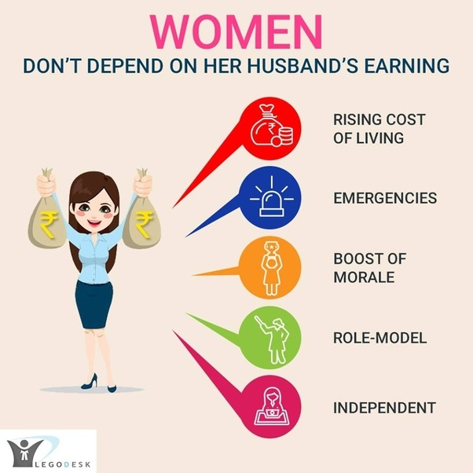

What are we trying to solve?
Encourage women in low paying and informal employment or full-time housewives manging household finances in developing countries to starting a habit of $aving on her own.
Help women get access to formal financial institutions and their services
Provide an indicator of financial credentials to back them up for future entrepreneurship.
Create her self-confidence and build a supportive community around her.

Slide 4




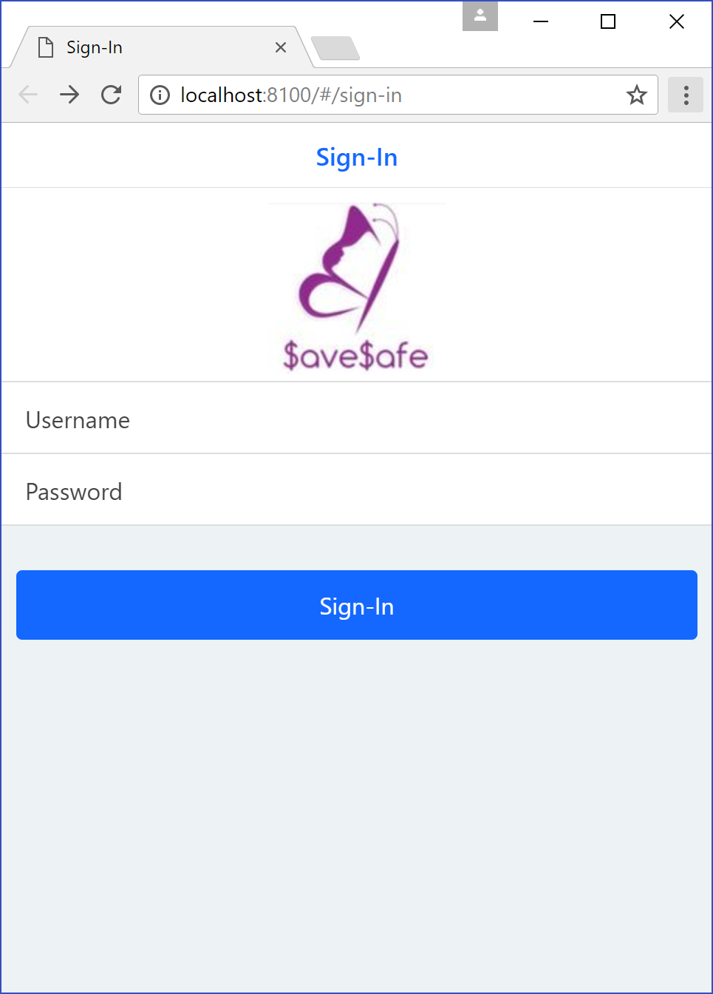


How does $ave$afe App work?
Features
Account Registration
Link bank account
Create bank account (via bank)
Financial Planning
Set up saving goals
Track achievements
Assist/Encourage users to save
Financial Analysis
*$ave Index – Measuring the user’s ability to save
Rewards System
Grant leaders in the savings board additional reward points
Grant users reward points for collectively saving with other family members / friends

Slide 5
Apps functionality (F) and Mechanics (M)
Our proprietary $aving Index
Primary data depency – User’s account balance
Two indices:
% change of daily balance across a period of base days (configurable)
% change of increment in the daily balance across the same period
Benefits:
Encourage consistent savings - detect spikes in the account balance if a user attempts to cheat the rewards system
Potentially can be used by microfinancing companies to assess the credit worthiness / financial savviness for loans

Slide 6
Thank you

Slide 7
S
3rd party records
W
Technology developments (APIs, algorithms to calculate Average Increment Savings)
O
T
Bank can develop same solutions
Target women
Heavily regulated financial sectors with high confidentiality
Technological pioneers for banking sectors on community supports
Family’s objections to women’s role
Competitors from microfinance and other NGOs
Can partnership with microfinance sectors for further entrepreneurship program
Raise awareness of women’s role in family and help her to achieve her financial solution.
Partnership with Banks to promote online banking services to wider community

Slide 8
Data Analytics Model
Person 1 |  | Best Case |  | (R_save >0 && TAG_save == R_save)
Date | TAG_save | V_balance | R_balance in bank | R_save | (R_save >0 && TAG_save == R_save) | R_propensity_save
1/01/2017 | $ - | $300 | 50
31/01/2017 | $ 10 | $310 | $ 60 | $ 10 | CONGRATS, YOU HIT YOUR GOAL | 20.00%
1/02/2017 | $ 21 | $331 | $ 81 | $ 21 | CONGRATS, YOU HIT YOUR GOAL | 35.00%
28/02/2017 | $ 18 | $349 | $ 99 | $ 18 | CONGRATS, YOU HIT YOUR GOAL | 22.22%
1/03/2017 | $ 44 | $393 | $ 143 | $ 44 | CONGRATS, YOU HIT YOUR GOAL | 44.44%
31/03/2017 | $ 31 | $424 | $ 174 | $ 31 | CONGRATS, YOU HIT YOUR GOAL | 21.68%
1/11/2018 | $ 28 | $1,548 | $ 1,298 | $ 28 | CONGRATS, YOU HIT YOUR GOAL | 2.20%
30/11/2018 | $ 35 | $1,583 | $ 1,333 | $ 35 | CONGRATS, YOU HIT YOUR GOAL | 2.70%
1/12/2018 | $ 29 | $1,612 | $ 1,362 | $ 29 | CONGRATS, YOU HIT YOUR GOAL | 2.18%
31/12/2018 | $ 30 | $1,642 | $ 1,392 | $ 30 | CONGRATS, YOU HIT YOUR GOAL | 2.20%
1/01/2019 | $ 11 | $1,653 | $ 1,403 | $ 11 | CONGRATS, YOU HIT YOUR GOAL | 0.79%

Slide 9
 | Initial Save | YearToDate Save | $ave$afe Ratio
Person 1 | 50 | 1403 | 360.77%
Person 2 | 20 | 121 | 191.85%
Person 3 | 500 | 876 | 56.73%
Person 4 | 1000 | 944 | -5.76%

Slide 12
Thank you for your attention and patience!
Please let us know if you have any questions

