Slide 1


Let her $ave so she can be $afe
Prototype concepts to empower women to be financially secured
Presented by: Mervyn, Krupa and Emilie

Slide 2


What is the problems?
$ Women Financial Independence $
Women take care a lot of unpaid undervalued unknown roles
Women have different approach to $$$ than men: $$$ is the mean to reach the end goal, not the goal itself.
Women’s nature: love to give, scare to receive.
Statistically, women live longer than men => not enough saving for retirement

Slide 3
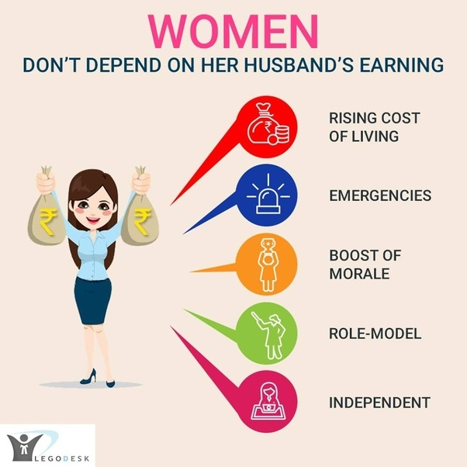

What are we trying to solve?
Get women in low paying jobs or full-time housewives in developing countries starting a habit of $aving on her own.
Help them to set up bank accounts and financial records in case she needs.
Help more women learning about digital $aving platform.
Potentially create her self-confidence and build supportive community around her.

Slide 4
How does the Game App work?
Demonstration by Mervyn and Krupa .

Slide 5
Apps functionality (F) and Mechanics (M)

Slide 6
S
3rd party records
W
Technology developments (APIs, algorithms to calculate Average Increment Savings)
O
T
Bank can develop same solutions
Target women
Heavily regulated financial sectors with high confidentiality
Technological pioneers for banking sectors on community supports
Family’s objections to women’s role
Competitors from microfinance and other NGOs
Can partnership with microfinance sectors for further entrepreneurship program
Raise awareness of women’s role in family and help her to achieve her financial solution.
Partnership with Banks to promote online banking services to wider community

Slide 7
Data Analytics Model
Person 1 |  | Best Case |  | (R_save >0 && TAG_save == R_save)
Date | TAG_save | V_balance | R_balance in bank | R_save | (R_save >0 && TAG_save == R_save) | R_propensity_save
1/01/2017 | $ - | $300 | 50
31/01/2017 | $ 10 | $310 | $ 60 | $ 10 | CONGRATS, YOU HIT YOUR GOAL | 20.00%
1/02/2017 | $ 21 | $331 | $ 81 | $ 21 | CONGRATS, YOU HIT YOUR GOAL | 35.00%
28/02/2017 | $ 18 | $349 | $ 99 | $ 18 | CONGRATS, YOU HIT YOUR GOAL | 22.22%
1/03/2017 | $ 44 | $393 | $ 143 | $ 44 | CONGRATS, YOU HIT YOUR GOAL | 44.44%
31/03/2017 | $ 31 | $424 | $ 174 | $ 31 | CONGRATS, YOU HIT YOUR GOAL | 21.68%
1/11/2018 | $ 28 | $1,548 | $ 1,298 | $ 28 | CONGRATS, YOU HIT YOUR GOAL | 2.20%
30/11/2018 | $ 35 | $1,583 | $ 1,333 | $ 35 | CONGRATS, YOU HIT YOUR GOAL | 2.70%
1/12/2018 | $ 29 | $1,612 | $ 1,362 | $ 29 | CONGRATS, YOU HIT YOUR GOAL | 2.18%
31/12/2018 | $ 30 | $1,642 | $ 1,392 | $ 30 | CONGRATS, YOU HIT YOUR GOAL | 2.20%
1/01/2019 | $ 11 | $1,653 | $ 1,403 | $ 11 | CONGRATS, YOU HIT YOUR GOAL | 0.79%

Slide 8
 | Initial Save | YearToDate Save | $ave$afe Ratio
Person 1 | 50 | 1403 | 360.77%
Person 2 | 20 | 121 | 191.85%
Person 3 | 500 | 876 | 56.73%
Person 4 | 1000 | 944 | -5.76%

Slide 11
Thank you for your attention and patience!
Please let us know if you have any questions

