Slide 1
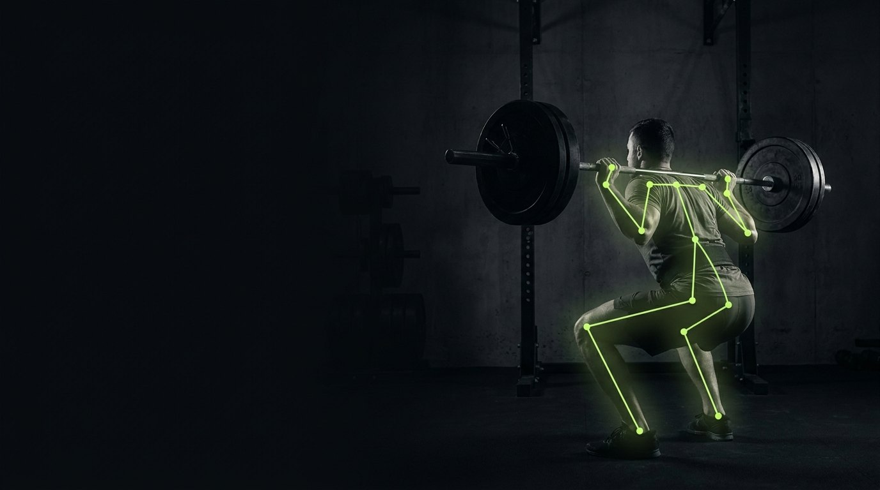

RepMint
A personal trainer,
living in your camera.
Real-time rep counting, spoken coaching, AI plans — nothing but a phone.
AI MVP CHALLENGE · TEAM REPMINT
Notes:
SPEAKER 1 — 45s. Hook: ask who has filmed their own set to check form. 'We built the coach that watches instead.' One-breath team intro, then to the problem.

Slide 2
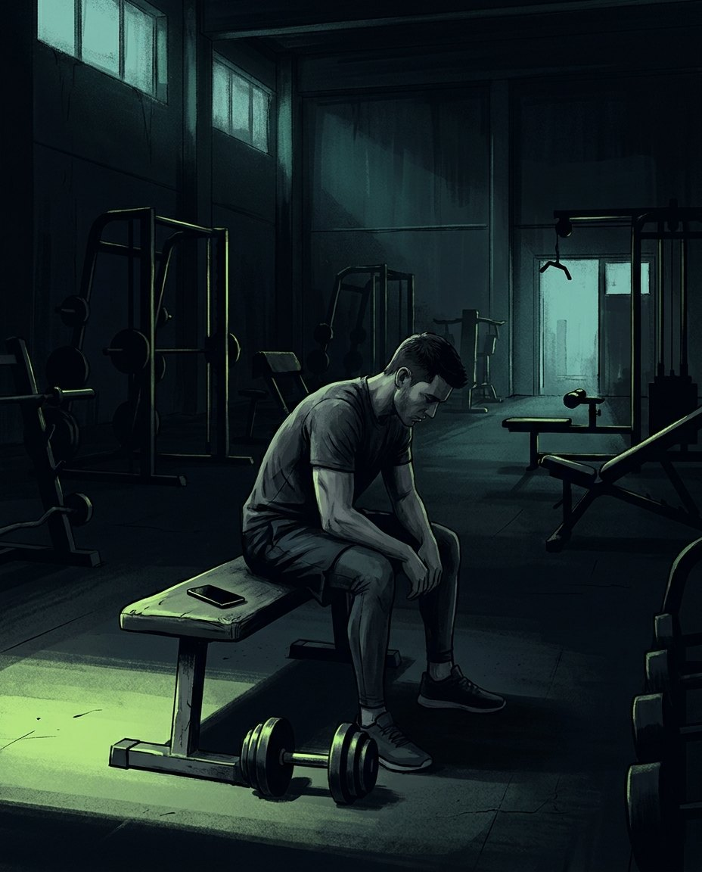
PROBLEM
Training alone is guesswork.
€50–80
per personal-training session — out of reach for most students and young professionals
4 in 5
gym-goers train with no feedback at all: no rep quality, no form check, no plan logic
0
fitness apps that can actually SEE you — they log what you type, not what you do
RepMint
2
Notes:
SPEAKER 1 — 60s. The pain is concrete: coaching is expensive, mirrors cost 2000 euros, and every app is blind — it trusts whatever you type. Bad form means plateaus and dropouts. The moment of pain: mid-set, no one watching, 'was that rep even right?'

Slide 3
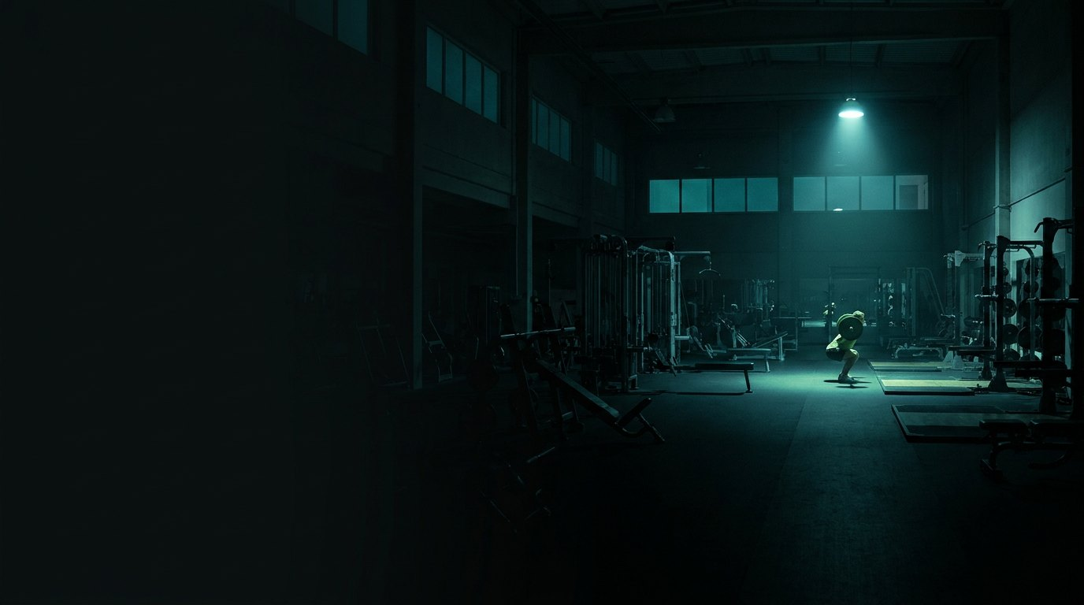
Nobody is watching.
And form is the first thing that breaks.
Notes:
SPEAKER 1 — 10s beat. Say the line, pause two seconds, click. This is the pivot from problem to answer.

Slide 4
NABC
Need · Approach · Benefits · Competition
Need
Approach
Affordable, real-time form guidance for people who train without a coach — feedback in the set, not after it.
33-point pose AI runs on-device in the browser. Honest rep counting, spoken cues, AI plans, and social accountability — no hardware, no install.
Benefits
Competition
A coach that sees, speaks, plans, and remembers — for the price of a coffee, not a PT. Video never leaves the phone.
Freeletics & Fitbod plan but can't see you. Tempo/Tonal mirrors see you for €2,000+ of hardware. PTs see you but don't scale. We're the only camera-native software coach.
RepMint
4
Notes:
SPEAKER 1 — 60s. Walk N-A-B-C clockwise. Land the competition line hard: apps are blind, mirrors are expensive, trainers don't scale — we are the only one that is camera-native AND software-only.

Slide 5
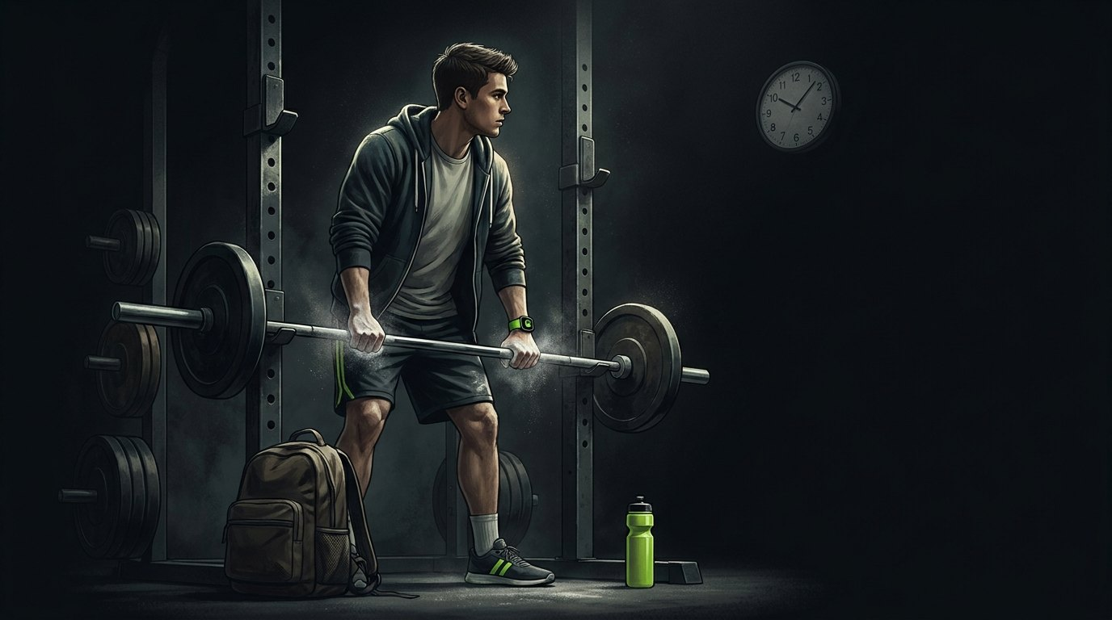
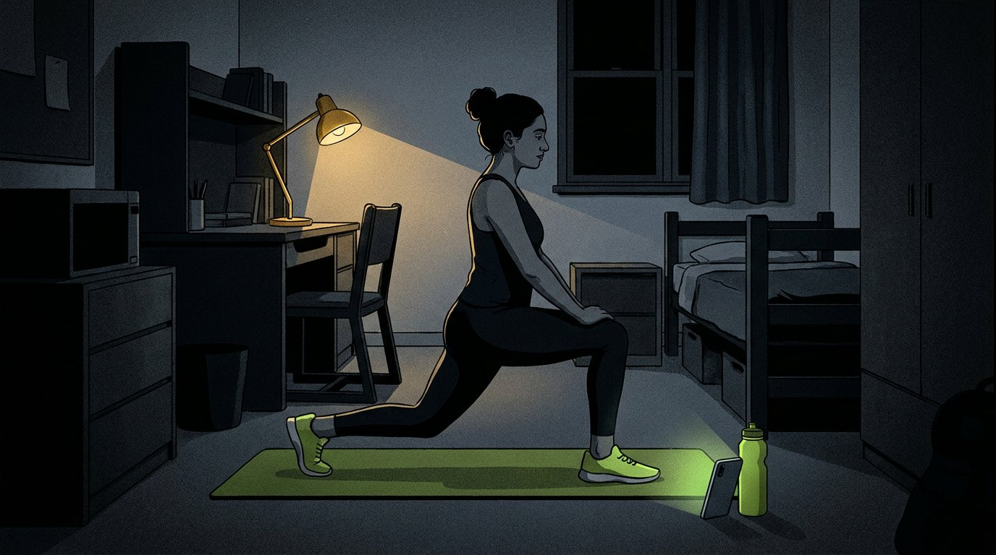
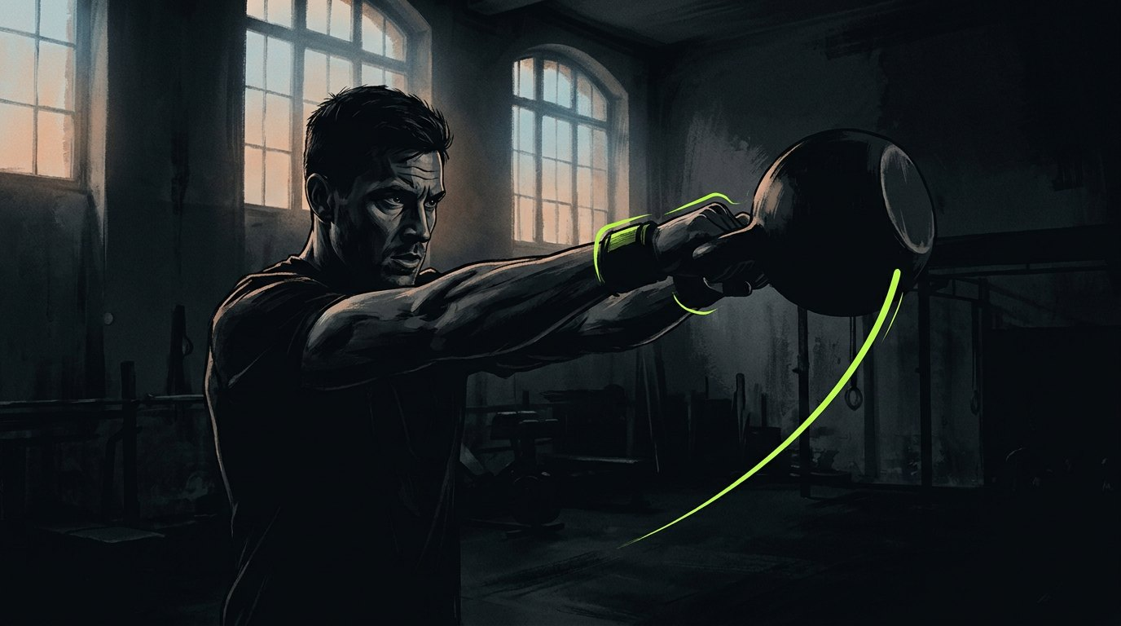
PERSONAS
Three people, one missing coach.
Mateo, 26 — the optimizer
Priya, 22 — the home beginner
Lukas, 29 — the streak-keeper
Trains in fixed 45–75 min windows between classes. Abandons anything with more than two decisions.
Dorm room, no equipment, would never build a workout from a blank screen. Afraid of doing it wrong.
Ex-athlete, checks his streak every morning. Busy weeks kill momentum and the habit with it.
Est. duration on everything, a sanctioned 20-min short version, week-over-week data.
Ready-made room workouts, plain-language cues, on-device camera privacy, 'you did it right' feedback.
A legit 15-min minimum session, one calendar for everything, weekly competitions with friends.
RepMint
5
Notes:
SPEAKER 2 — 50s. Real personas from our UX sprint. One line each: Mateo wants efficiency, Priya wants safety and privacy, Lukas wants accountability. Every feature in the demo maps back to one of these three.

Slide 6
JUMP START
Idea to deployed product in three weeks.
Week 1 — See
Week 2 — Think
Week 3 — Feel
Camera engine: 33-landmark pose tracking in the browser, honest rep counting, per-rep quality scoring, 115-exercise registry with per-movement form checks.
Full platform: AI weekly plans + one-off day workouts, coach chat with long-term memory, history, insights, workout builder — Supabase backend with RLS on every table.
Realtime voice coaching, community (friends, shared workouts, weekly competitions), design system, hardening pass — deployed on Vercel.
Shipped: 45+ production deployments · 13 database migrations · 115 exercises with custom AI-illustrated muscle maps · live at repmint.vercel.app
RepMint
6
Notes:
SPEAKER 2 — 45s. The jump start: we didn't spend three weeks on slides. See-Think-Feel arc. Point at the proof strip: forty-plus deployments, eleven migrations — this is a real product, and you can open it right now.

Slide 7





SOLUTION
One coach. Five superpowers.
It sees
It speaks
It thinks
On-device pose AI at 30fps. Only full range-of-motion reps count — half-reps don't fool it. Depth, tempo, time-under-tension, velocity-loss fatigue.
A natural realtime voice in your ear during the set: one cue at a time, human trainer energy, ~300ms latency. Silent when it should be.
AI weekly plans around your real life, one-off day workouts on demand, and a chat coach grounded in your actual training data.
It connects
It protects
Friends, shared workouts, and week-long competitions on reps, sets, sessions, or minutes — accountability built in.
Video never leaves the device. Pose runs in the browser; only your numbers sync. Privacy is architecture, not a policy page.
RepMint
7
Notes:
SPEAKER 2 — 60s. Five verbs: sees, speaks, thinks, connects, protects. The AI is NOT decorative (professor's canvas question 4): without the vision model there is no product — a form can't count your reps.

Slide 8
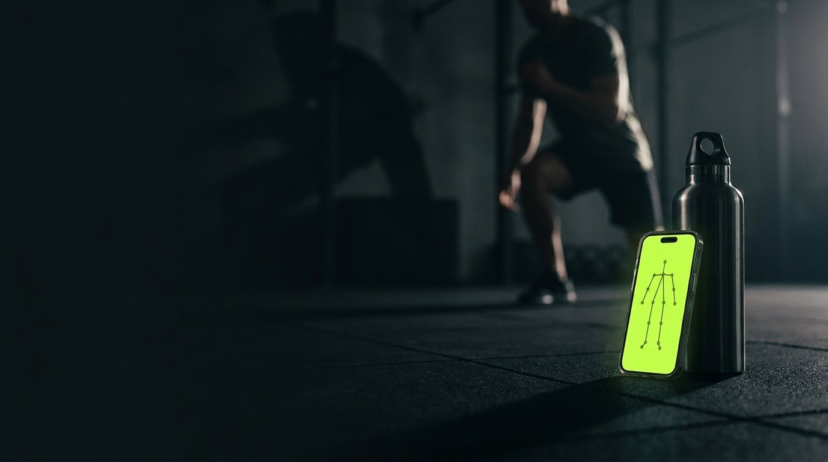
Enough slides.
Live demo · repmint.vercel.app
Notes:
SPEAKER 2 hands off with exactly this line; SPEAKER 3 walks to the demo machine while it's on screen. 5 seconds, then the run-of-show slide.

Slide 9
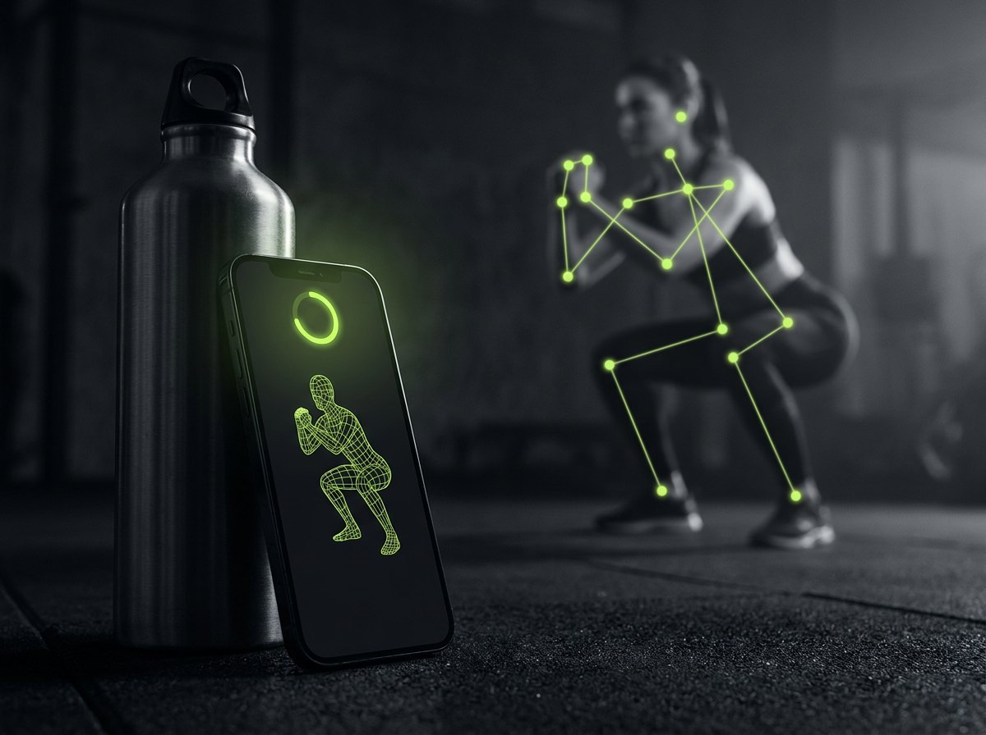

LIVE DEMO
Watch it count. Hear it coach.
1
Prop the phone, raise a hand — 3·2·1, the set starts hands-free
2
Squats live on stage: honest reps, depth %, one spoken cue at a time
3
Ask the AI for a workout: "chest and triceps, 30 minutes" — saved in seconds
Deployed & open —
try it during Q&A
4
Coach chat: "did the pause trick work?" — answers from real session data
5
Community: live leaderboard in this week's competition
repmint.vercel.app
RepMint
9
Notes:
SPEAKER 3 — 3.5 min LIVE DEMO. Backup video ready on desktop. Order: train flow first (biggest wow), then AI workout builder, then coach chat grounded answer, then competitions leaderboard. If wifi dies: switch to backup video without commentary break.

Slide 10
BUSINESS VALUE
The coach that scales like software.
Freemium, camera-first
$6.8B
fitness app market, growing double-digit annually
Free
Camera coach, rep counting, starter workouts — the hook that shows the magic in 30 seconds.
~€0.05
our AI cost per active training day — 99% gross margin on €9.99
Premium · €9.99/mo
AI plans & day workouts, realtime voice, insights & load trends, competitions.
Later · B2B
K-factor
competitions require friends — the product invites for us
White-label for gym chains and university sports programs — every member gets a coach.
RepMint
10
Notes:
SPEAKER 4 — 60s. Business logic: free tier demonstrates magic instantly (camera counts your reps in 30 seconds), premium unlocks the brain and the voice. Unit economics: pose runs on the user's device = zero inference cost for the core loop; AI calls cost cents. Social layer is the acquisition engine.

Slide 11



ARCHITECTURE
Heavy where it matters, light everywhere else.
Phone / browser
Supabase
AI providers
Next.js 15 static app (Vercel CDN)
Postgres + row-level security on every table
OpenRouter → any LLM (user-selectable model)
MediaPipe pose — 33 landmarks, 30fps, fully on-device
Auth (email + magic link)
Gemini fallback chain
Rep engine + form scoring (deterministic logic)
Edge functions: ai-coach, generate-plan, tts, realtime-token…
OpenAI Realtime — voice over WebRTC
WebRTC audio ← realtime voice
Only numbers & text stored — never media
Keys live server-side only
Video NEVER uploaded
RepMint
11
Notes:
SPEAKER 4 — 45s. One architectural idea to remember: the heavy AI (vision) runs on the USER'S device — that's what makes it private AND free to scale. The cloud only does what must be shared: data, auth, and language models. Every table has row-level security.

Slide 12
RELIABILITY & CONTROLS
Built to be trusted, not just demoed.
Hallucinated exercises
Plans validate against a 115-slug allowlist — the model cannot invent a movement; outputs are clamped and re-asked once on invalid JSON.
Provider outages
Every AI call has a fallback chain: OpenRouter → Gemini; realtime voice → TTS → on-device speech. The workout never goes silent.
Data leakage
Row-level security on every table; the leaderboard is a guarded aggregate function — raw sessions stay private even from friends.
Overreach
Coach declines off-topic and medical questions; 'coaching guidance, not medical advice' on every chat; claim-safe copy throughout.
Runaway voice
The realtime agent physically cannot self-trigger: no microphone attached, turn-detection off, speaks only queued cues, session closes after the final line.
RepMint
12
Notes:
SPEAKER 4 (or 5) — 45s. This is the professor's 'Reliability, Risk and Controls' block, answered concretely. Pick two rows to say out loud (hallucinated exercises + runaway voice) and let them read the rest.

Slide 13
FUTURE WORK & CONCLUSIONS
What's next — and what we proved.
Next
What we proved
Wearables: Strava sync + heart-rate for effort-aware coaching
Exercise form video library + camera-position guides
Workout marketplace: creators publish, athletes follow
B2B pilots: gym chains & university sport programs
Native companion for Apple Watch
AI is necessary here, not decorative — no camera, no product
The full loop works today: see → coach → plan → remember → compete
Deployed, secured, and demo-able by anyone in this room right now
A smaller working MVP with evidence
beats an ambitious fake demo.
RepMint
13
Notes:
SPEAKER 4 (or 5) — 40s. Close on the professor's own principle: a smaller working MVP with evidence beats an ambitious fake demo. Ours works — you just watched it.

Slide 14
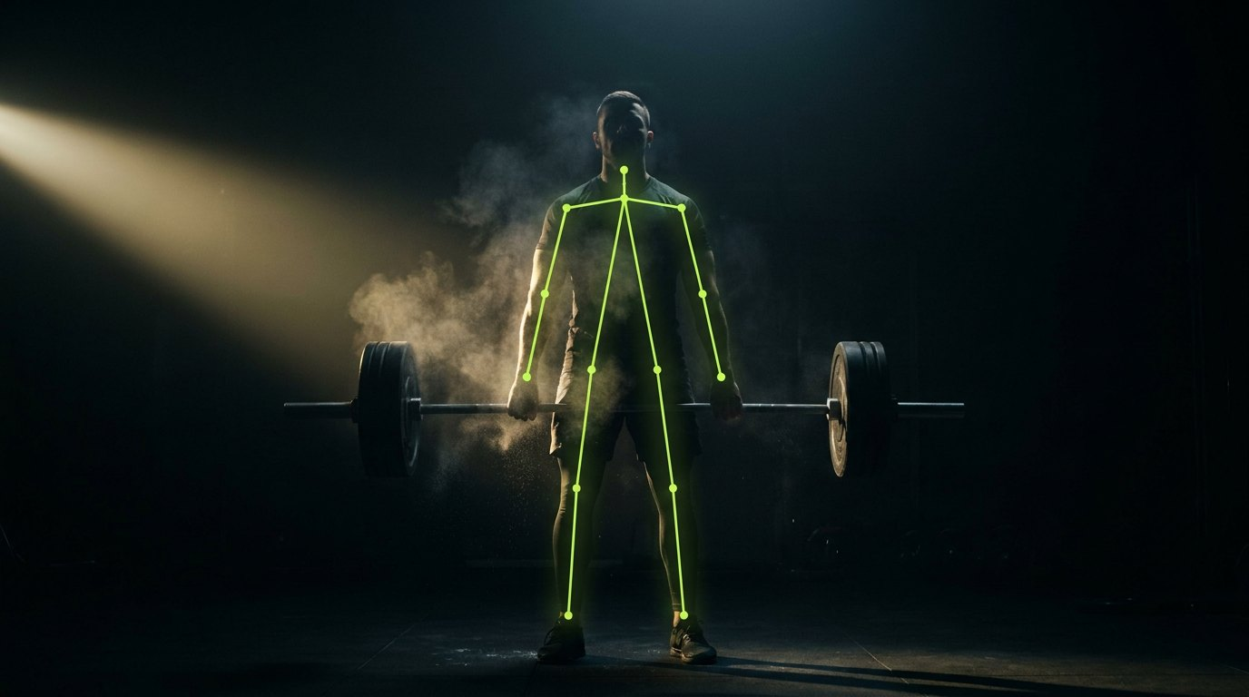
RepMint
Stop guessing. Start counting.
repmint.vercel.app · github.com/simplyYK/repmint
Notes:
ALL — 10s. 'We're Team RepMint. Scan it, train with it, ask us anything.' Stand for Q&A.

