Slide 1


ERROR 404
CASE STUDY 1
AeroGuard SENTINEL
Uncertainty-aware fleet prognostics
and automated maintenance triage
ROUND 1 / IDEA SUBMISSION
Notes:
Opening: AeroGuard SENTINEL estimates remaining life, rehearses maintenance choices and creates evidence-backed work orders. Team ERROR 404 submits this design for Case Study 1. The name self-healing refers to the maintenance workflow, not autonomous physical repair.
Sources and attribution:
Round 1 design proposal. Demonstration values are illustrative. No benchmark performance or business savings have been measured by ERROR 404.

Slide 2


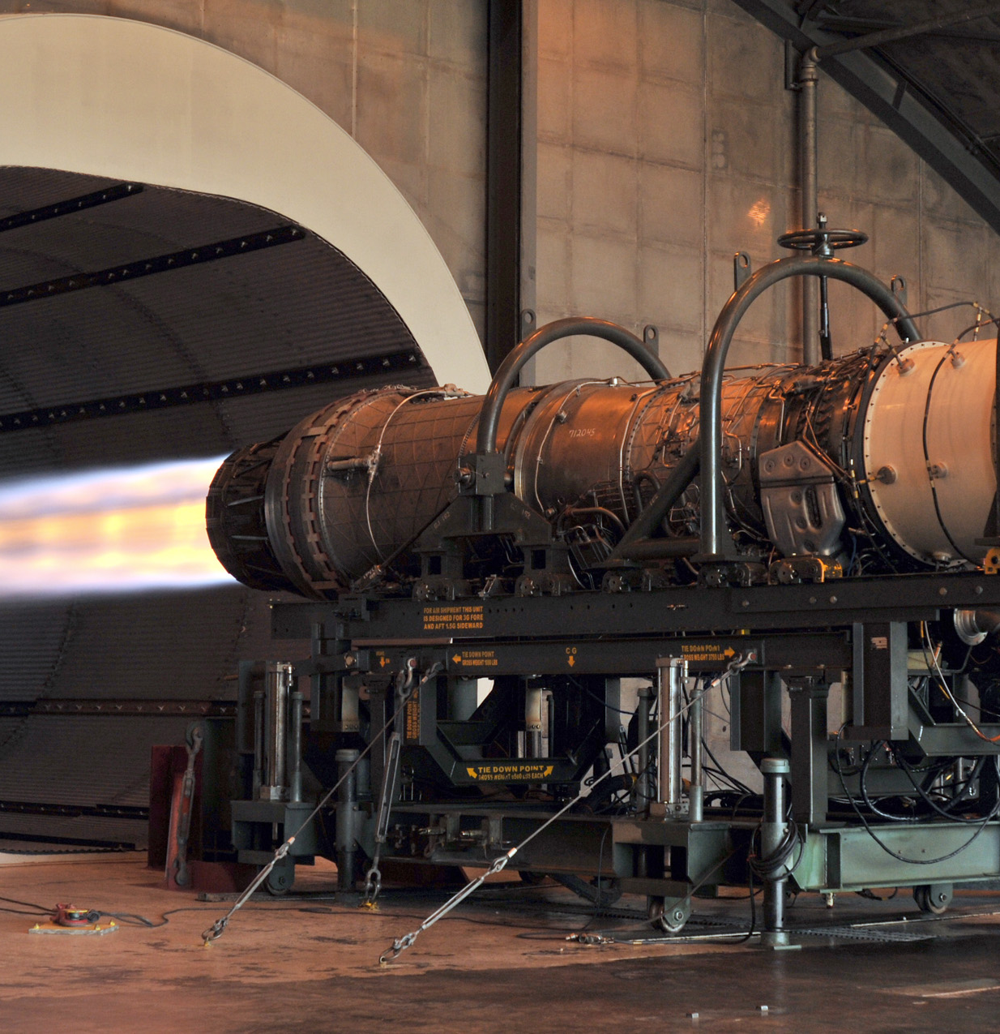
AeroGuard SENTINEL
ERROR 404 / CASE STUDY 1 / ROUND 1
Fleet prognostics that turns uncertain remaining life into a maintenance decision
01 ENGINE DATA
02 FEATURES
03 PROGNOSTICS
04 DECISION TWIN
05 TRIAGE + ORDER
C-MAPSS FD001–FD004
21 sensors + 3 settings
Regime-aware scaling
Causal rolling trends
Isolation Forest +
LightGBM RUL quantiles
Compare service slots
Risk + capacity rules
Python FSM, no LLM
Work order + audit trail
SIGNATURE FEATURE / MAINTENANCE DECISION TWIN
Example: median RUL 30 cycles, estimated range 6–54. Which service slot should the fleet choose?
+4 cycles: preferred inspection
+12 cycles: escalate depot delay
+20 cycles: reject deferral
AUTONOMOUS TRIAGE
DELIVERY + PROOF
ENGINE SENSOR
SIGNATURE
NORMAL: q50 > 50, no persistent alert.
WATCH: q50 ≤ 50 or persistent anomaly.
PLANNED: q50 ≤ 30 cycles.
URGENT: q10 ≤ 10 cycles, override.
EXCEPTION: bad data / unknown regime.
Use persistence + recovery hysteresis.
One open order per engine. Include sensor
evidence, due cycle and model version.
FD001: full demo. FD002: extension.
FD003/004: broader validation.
Track RMSE + NASA asymmetric score,
interval coverage, lead time, false alerts.
Drift flags review. New labelled histories
enable retraining with promotion gates.
Demo: delay a slot, raise an order, replay
an event, inject an outage, retrain.
Engine-disjoint split.
FD002/004: k = 6 regimes.
Scale within regime.
Past-only trends + EWMA.
RUL: q10 / q50 / q90.
SHAP explains features.
STACK Python / LightGBM / scikit-learn / Streamlit / SQLite / MLflow
Notes:
Round 1 one-page idea submission, following the cover. PROBLEM: fixed intervals can waste useful life while reactive repairs interrupt operations. NOVELTY: a lightweight decision simulator turns RUL uncertainty into capacity-aware service priorities, with deterministic triage and idempotent auditable work orders. The simulator is not a physics digital twin. EXAMPLE: q10=6, q50=30, q90=54, no safety buffer. A +4-cycle slot precedes the conservative estimate, +12 and +20 do not. This does not establish a per-engine failure probability. Set and validate a safety buffer. DATA: freeze engine-disjoint splits before fitting clustering and scaling. Use training-only regime statistics and past-only windows. Validate constants per subset. A RUL cap is a modeling assumption, not an imbalance remedy. MODEL: compare Random Forest baseline and LightGBM quantiles using held-out engines. Measure interval coverage/width and quantile crossing. Isolation Forest flags persistent abnormality, not exact fault initiation. SHAP explains influence, not diagnosed component failure. POLICY: evaluate data exceptions first, keep urgent uncertainty visible to human review, then urgent/planned/watch/normal. Persist non-urgent evidence, require recovery hysteresis, never close an order just because a prediction rebounds. Store unique event ID, engine ID, severity, due cycle, feature evidence and model version. RETRAINING: drift initiates investigation, completed labelled trajectories enable supervised retraining. Compare challengers on fixed validation engines with RMSE, PHM08 asymmetric score, interval coverage and late-life safety gates, keeping official test data locked. Record promotion and rollback in MLflow. C-MAPSS does not contain repair outcomes, service capacity or costs, so these are scenario assumptions and simulated outcomes. FD001 is the full-demo commitment, FD002 an extension, FD003/FD004 further validation. NASA score penalizes RUL overestimation more heavily. References inform the proposal and do not imply measured team results. The N-CMAPSS repository uses a different benchmark and is optional sequence-model inspiration. Use no LLM. Repository reuse must respect licenses and disclose attribution.
Sources and attribution:
https://www.nasa.gov/intelligent-systems-division/discovery-and-systems-health/pcoe/pcoe-data-set-repository/
https://scikit-learn.org/stable/auto_examples/ensemble/plot_gradient_boosting_quantile.html
https://pmc.ncbi.nlm.nih.gov/articles/PMC12615660/
https://github.com/DArmandoSalinas/predictive-maintenance-rul
https://github.com/devwithmohit/predictive-maintenance-manufacturing-system
https://github.com/Adithya-Thonse/N-CMAPSS_DL
Round 1 design proposal. Demonstration values are illustrative. No benchmark performance or business savings have been measured by ERROR 404.
Replacement photo: F100 F-15 engine undergoing a diagnostic ground run, U.S. Air Force / public domain, via https://commons.wikimedia.org/wiki/File:F100_F-15_engine.JPG . Illustrative engine photograph, not a C-MAPSS engine record. Removed on-slide footer disclosures remain documented in these notes.

