Slide 1



Anatomy of Creative Commons Licenses
By K. M. Ehrig-Page
This work is licensed under a Creative Commons Attribution 4.0 International License
Notes:
“Anatomy of Creative Commons Licenses”. A presentation by K. M. Ehrig-Page.

Slide 2
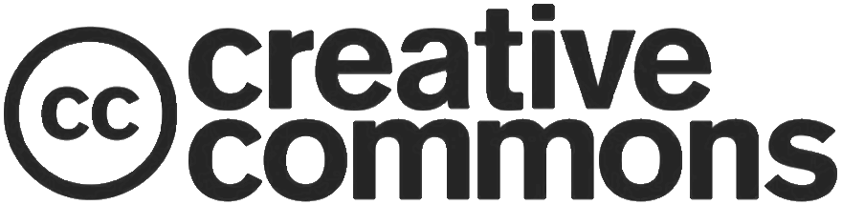
Introduction
What is Creative Commons (CC)?
Three layers of the CC licenses
Four license elements and their icons
Six Creative Commons licenses
CC licenses affect on copyright exceptions and limitations
CC licenses affect on works in the public domain
Notes:
In this presentation we will explore the anatomy of Creative Commons licenses through coming to understand six key areas. These areas are:
What is Creative Commons (CC)?
Three layers of the CC licenses
Four license elements and their icons
Six Creative Commons licenses
CC licenses affect on copyright exceptions and limitations AND FINALLY
CC licenses affect on works in the public domain

Slide 3

What is Creative Commons (CC)?
An organization
Free legal tools
A culture
Notes:
Academia is built on the free exchange of knowledge; a teacher does not charge a student every time they impart advice (apart from through their wages). Libraries do not usually levy a charge when a student accesses its resources. Fees, though, have been levied in certain areas- particularly within the field of higher education- that has lead to less shared knowledge within the “commons”, or the shared public space and has created a business out of scholarship. So what is Creative Commons? In order to lead to a greater flow of ideas, Creative Commons (an organization and a set of legal tools) was set up to encourage the FREE exchange of knowledge. In the following slides we will delve into what the Creative Commons licenses are and how they can help you when applied to your work.

Slide 4
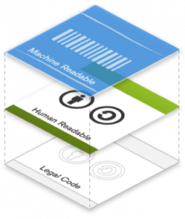
Three layers of the CC licenses
Notes:
The foundation of Creative Commons licenses is that they are built on legal code that is enforceable in the courts of most countries. The human readable layer (also known as the common deeds) avoids legalese in order that everyone can understand them and most importantly, use them. Following that there is a layer that can be interpreted easily by machines.

Slide 5




Four license elements and their icons
Attribution – “BY”
ShareAlike – “SA”
NonCommercial – “NC”
NoDerivatives – “ND”
Notes:
As already mentioned, Creative Commons is an organization and a set of legal tools. The Creative Commons suite contains four license elements. These are: Attribution or BY, ShareAlike or SA, NonCommercial or NC and NoDerivatives or ND. BY: All licenses contain the attribution element.
SA: Adaptations must be licensed under the same license.
NC: NonCommercial requires that it Is only used for non-commercial purposes
ND: NoDerivatives means adaptations of the work cannot be shared.

Slide 6





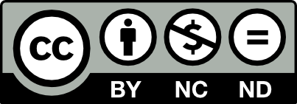
Six Creative Commons licenses
Attribution license or “CC BY”
Attribution-ShareAlike license or “BY SA”
Attribution-NonCommercial license or “BY NC”
Attribution-NonCommercial-ShareAlike license or “BY NC-SA”
Attribution-NoDerivatives license or “BY ND”
Attribution-NonCommercial-NoDerivatives license or “BY NC-ND”
Notes:
These license elements combine to form 6 licenses, which are as follows:
- The Attribution license or “CC BY”, requires the author attribution though the use of the author’s work can be for anything e.g. commercial or non-commercial.
The Attribution-ShareAlike license or “BY-SA” allows use for any purpose as long as attribution is given and adaptations are shared under the same or compatible license. This type of license is also known as copyleft where derivative works are distributed under the same terms.
The Attribution-NonCommercial license or “BY-NC” permits non-commercial reuse with attribution given.
The Attribution-NonCommercial-ShareAlike license or “BY-NC-SA” permits non-commercial reuse with attribution given when adaptations are licensed under the same or compatible creative commons license.
The Attribution-NoDerivatives license or “BY-ND” means that the author must be credited and the work can be used for any purpose as long as it is not adapted.
The Attribution-NonCommercial-NoDerivatives license or “BY-NC-ND” requires attribution of the author/ creator and that only unadapted versions of the work can be used in a non-commercial setting. This is the most restrictive of the six licenses.

Slide 7
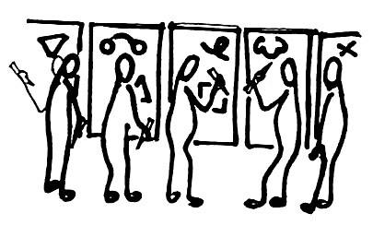
CC licenses affect on
copyright exceptions and limitations
Fair Use
Freedom of Expression
Public Domain
Notes:
The CC licenses affect creative works whose reuse could be considered to be “fair use” or “fair dealing”, as well as some other limitations depending on the jurisdiction. “Fair Use”, or “Fair Dealing”, promotes freedom of expression and allows for the use of copyrighted work in certain circumstances, such as when reporting the news, providing comment or critique of a creative work and also when used in education. The four factors for considering fair use, as contained in section 107 of the Copyright Act, are as follows:
1. Purpose and character of the use
2. Nature of the copyrighted work
3. Amount used in relation to the whole copyrighted work
4. Effect of the use upon the potential market or value of the copyrighted work

Slide 8


CC licenses affect on works in the public domain
CC0
(pronounced “CC Zero”)
Public Domain Mark
Notes:
Creative Commons has the CC0 [CC Zero], public domain dedication tool that allows authors to renounce their own copyright and allow any members of the public to use their work; authors therefore take a “no rights reserved” approach and release their work into the public domain. However, some jurisdictions prevent work being dedicated to the public domain so other legal tools must be utilized in these circumstances.
Like the CC licenses, CC0 (read “CC Zero”) uses the three-layer design—legal code then being both human readable and machine readable.
The Public Domain Mark signifies that the work is free of all copyright restriction, however it carries no legal weight and is therefore not based on legal code.

Slide 9

Notes:
And finally, to conclude, if a university or school program did not have to worry about a budget in order to acquire the course text, think of the uses that those extra funds could be used for, such as with going on more field trips. If a student did not have course texts to buy, think of how student enrollment would be effected if they did not have to contend with as high a level of debt as they do, on average, now face.
Creative Commons license have an anatomy that is designed to be flexible and this flexibility of their anatomy leads to a more dynamic knowledge landscape for creators, students and researchers to draw from. Creative Commons licenses therefore enable people to gain access to high quality resources so that we all benefit from this exchange of ideas.

Slide 10
Bibliography
Commons, Creative. "3.1 License Design and Terminology." 3.1 License Design and Terminology | Creative Commons Certificate for Educators and Librarians. Accessed July 09, 2019. https://certificates.creativecommons.org/cccertedu/chapter/3-1-license-design-and-terminology/. CC BY 4.0 [Core text]
Commons, Creative. "3.3 License Types." 3.3 License Types | Creative Commons Certificate for Educators and Librarians. Accessed July 09, 2019. https://certificates.creativecommons.org/cccertedu/chapter/3-3-license-types/. CC BY 4.0 [Core text]
"Copyleft." Wikipedia. July 02, 2019. Accessed July 09, 2019. https://en.wikipedia.org/wiki/Copyleft. CC BY-SA 4.0
"First practical use" by For Inspiration Only, CC BY-NC-SA 2.0
Martin. "Leaves - Subtle Patterns | Free Textures for Your next Web Project | Toptal." Subtle Patterns. August 29, 2018. Accessed June 13, 2019. https://www.toptal.com/designers/subtlepatterns/leaves/. CC BY-SA 3.0 [Slides’ background]

