Slide 1
Understand the data, generate output and create a learning set to gain new knowledge
Understand the data and generate output by his own
Machining Leaning using deep leaning algorithms
Artificial Intelligence
Inspired from human brain neurons. By connecting them create a network. Adopted in Deep leaning
Computer science that deals with understanding, interpretation and manipulate human language
Machine Learning
Deep Learning
Neural Networks
Natural Language Processing
Neural Networks
Natural Language Understanding
Natural Language Generation
Study of scientific methods and algorithms
Data Science

Slide 2
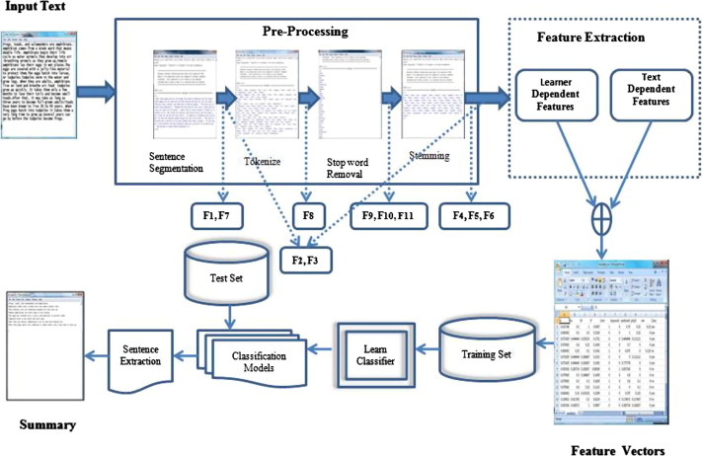
Steps for Extractive Text Summarization

Slide 3
Extractive vs Abstractive
Extractive summarization
Copying parts/sentences of the source text and then combine those part/sentences together to render a summary.
Importance of sentence is based on linguistic and statistical features.
Extractive is easy to implement but not quite accurate.
Abstractive summarization
These methods try to first understand the text and then rephrase it in a shorter manner, using possibly different words
For perfect abstractive summary, the model has to first truly understand the document and then try to express that understanding in short possibly using new words and phrases.
Much harder than extractive.
Has complex capabilities like generalization, paraphrasing and incorporating real-world knowledge.
Abstractive is complex but gives more human like summary.

Slide 4
Steps for Abstractive Text Summarization
CNN dataset
Data Cleaning using Regex , remove stop word, lemmatization, Vectorization – NLTK
Fasttext (facebook)
Dataset
Start
1. Read Data files
2. Data processing
3. Word Embedding
TensorFlow (Bidirectional Encoder Decoder )
4. Model Development
End
If we have scope to improve
5. Train Model
ROGUE
8. Compare Results
7. Summary generation for input set
6. Test Model

Slide 5
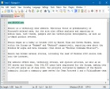
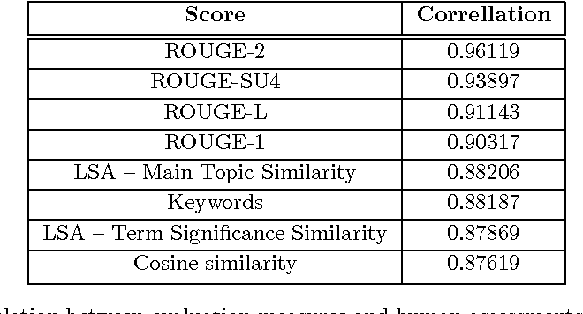
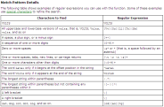
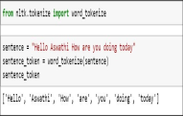
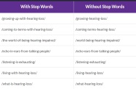
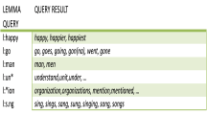
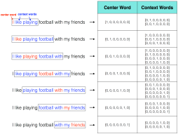
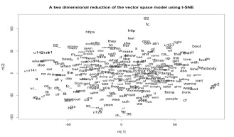

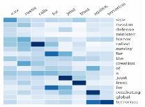

Training data set OR single document for summary prediction
…….
ROUGE Scores
* Performed only in training cycle
Data Cleaning
Tokenization
Remove stop words
Lemmatization
ROUGE
Evaluation
Data Pre-processing layer
Word Embedding Model
(Fast Text pre–trained)
Predicted Abstract Summary (Output)
Word Embedding layer
Source Embedding
Y₁
Y₄
Y_{n}
…….
Y₂
Y₃
x₁
x₂
x₃
x₄
x_{n}
Dense Layer (Output Layer)
Context Vector
LSTM Cell
LSTM Cell
LSTM Cell
LSTM Cell
…….
LSTM Cell
Encoder
Beam search Layer
Decoder
LSTM Cell
LSTM Cell
LSTM Cell
LSTM Cell
…….
LSTM Cell
LSTM Cell
LSTM Cell
LSTM Cell
LSTM Cell
….
LSTM Cell
h_{n}
h₄
h₃
h₂
…….
h₁
α₃
Throughput Vector
α₄
α₂
α_{n}
α₁

