Slide 1
OPEN BANKING APP

Slide 2
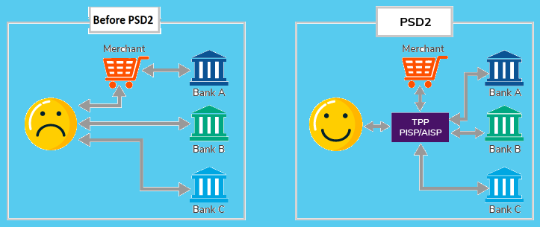
What is Open banking AND PSD2 ?
Jul 13
Jan16
Q3 16
Mar 17
Open banking is the practice of sharing financial information electronically, securely, and only under conditions that customers approve of. Application programming interfaces (APIs) allow third-parties to access financial information efficiently, which promotes the development of new apps and services. Ideally, open banking should result in a better experience for consumers.
PSD2
EC published proposals
PSD2
Come into force in Europe
First RTS on SCA
Discussion paper published
Final draft RTS
On SCA by the EC
Nov 17
Jan18
Mar 18
Mar 19
Sep 19
RTS Adoption
On SCA by EC
PSD2
Adopt in member domestic now
RTS on SCA
Published in EU Official Journal
Test Period
On SCA begins
Deadline
Of RTS on SCA
Open banking has the potential to reshape the competitive landscape and consumer experience of the banking industry.
PSD2 focuses on making data more accessible payments faster and stronger user authentication. PSD2 also standardise the way data is accessed through open banking, through the creation of open API. Directive will provide consumers with greater transparency of costs and protection from charges as they can now compare products across participants and face reduced lability from fraudulent payments.
PSD2 changes traditional banking giving it a modern, more technical outlook by opening up the backing relationship to TPPs laying a legal foundation towards standardizing Open banking
In simpler terms, PSD2 is the regulation that allows projects such as Open Banking to take place. Having that regulation will ensure the market is fair and competitive, but also safe and secure.

Slide 3
Benefits for stake-holders
Large National Banks
Retail or Small Businesses
Consumers
Large national Banks that offer the full range of financial services, can leverage their brands and customer bases to partner with other firms and offer new, innovative services.
Demands & Offers: Meet dramatically evolving consumers demands and offer more choice to the customers.
Cost Management: Manage escalating costs of launching new digital services at scale.
Transparency: Meet regulatory requirement to provide higher transparency for reporting data.
Compete: Offer innovative products and services, thereby helping banks to compete with Fintechs.
Revenue: Develop strategies to monetize customer data to generate new revenue streams.
Account Switching: Small and mid-sized financial service providers have higher profile online and can better attract new customers thanks to simplified account switching and other functionality.
Safe & Seamless: Less red tape with useful digital services delivered seamlessly and safely.
Insight: Aggregation of payroll, auditing, accounting and more for easier and deeper operational insight.
Rates & Timelines: Faster adjudication of loans, auto financing and mortgages with potentially lower rates.
Automation: Cash flows, invoices and assets can automated.
Overview: Account aggregation for a 360 degree financial picture.
Safe & Security: Secure use of third-party financial service apps (no need to share login information).
Comparison: Easy financial product comparisons.
Personalized financial product offerings.
Alert: Account transaction notifications to alert of potential fraud or mistaken transactions.
Reduced charges: Lower fees, no chargebacks and decreased number of frauds.
Services and Settlements: Tailored services and Real-time transaction settlements.

Slide 4
Implications of using Open Banking
Payment implications
Impact
Possible scenarios
Implications for banks
POSITIVE
Revenue from new
Products and services
Opportunity to gain market share from other banks
Provide technology/ platform services to other banks ( e.g. API management
Low/ medium positive impact
Third parties fail to gain market share
Fintechs serve as financial managers
Bank retain customer trust, control of customer data, and role as financial anchor
Best-case scenario
Attackers offer integrated payments and financial management; leverage customer data to improve risk pricing and cross-selling
Bank solidify role as trusted adviser; gain market share
Revenue implications
Impact
Possible scenarios
Implications for banks
NEGATIVE
Decrease revenue due to competitive pricing
Loss of market share to AISP/PISP
Fewer customer interactions, fewer opportunities for cross-selling
Highly negative impact
Bank retain accounts and transactions but third party control financial managers
Banks lose customer touch points; cede role as financial anchor
Worst case scenario
Closed-loop solutions emerge; third parties provide liquidity for all transactions
Banks reduced to pure balance-sheet providers; current account transactions limited to incoming salary and outgoing payments to transaction accounts

Slide 5
Proof of concept for open banking use case
POC Mobile Application has been developed for the Open Banking use case - Digital Payment system
Key Features Include:
Registration and Access
Accounts Aggregation
Financial Management
Mobile Application compatible with both Android and iOS devices
Leverages the Open Banking APIs available on public sandbox
Secured Authentication using OTP via SMS
Hosted on AWS Cloud
Technologies used: React-Native, Java/J2EE, Restful API, Twilio, Spring-Boot, Lombok, JavaScript, GitHub, Cloud Oracle

Slide 6
Use cases - Open banking - POC
Registration and Access:
Register in accordance with compliance and know your customer (KYC).
Secured way of account activation and access.
Registration and Access
Opt of Open banking
Consent Management
Accounts Aggregation
Financial Management
Accounts Aggregation:
Brings together bank accounts, credit cards, investments, savings and borrowing.
Tailored view of transactions also capability of switching of accounts.
Open Banking
Financial Management:
It gives users insight into their spending and helps them plan for the future.
Help to budget, find the best deals for the products and services that suit appropriately.
Consent Management:
Securely share the account information.
Ensure accessing transactions and processing online payments take place with the consent of the respective PSU (Payment Service User).
Control on layers of data to share or keep private

Slide 7
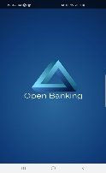






Technical architecture of Mobile App
Presentation Layer
Service Layer
API Layer
(Open Bank Project Sandbox)
REST Service
Authentication Service
Client API
Banks
Authorization Service
User Management
Rest API
Calls
Accounts
SMS Service
Customer
Cards Management
Card Processor Service
Repo
Cards
Payment Management
Transaction Service
Transactions
Transaction Management
Utilities
Exception

Slide 8
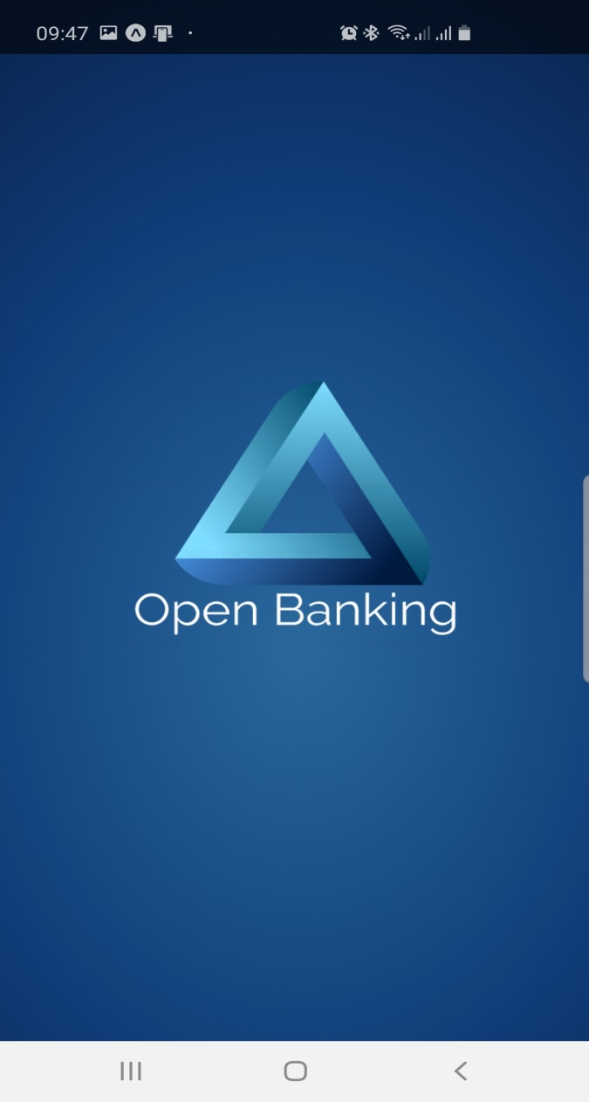
DEMO - Application flows
User Registration
Registration with all mandatory details.
Add Card
Adding existing bank account cards like credit, debit.
Bank Consent and OTP authentication to add card.
View Detailed Transactions
View list of cards with sliding option.
OTP authentication to activate the account.
Defaulting selected card and switching around cards.
Detailed transaction view of the selected card from the slider.
Application Features
Screens to overview the application features.
Dashboard & Widgets
Categorized overview of transaction across accounts on expenditure.
Add card widget, another option to add card navigation.
Make Payment
Make transaction with selected card.
Based on the transaction amount and type of transaction
Profile
Capture customer identity document and details.
Once the documents are approved from backend freeze the files at customer end.

Slide 9
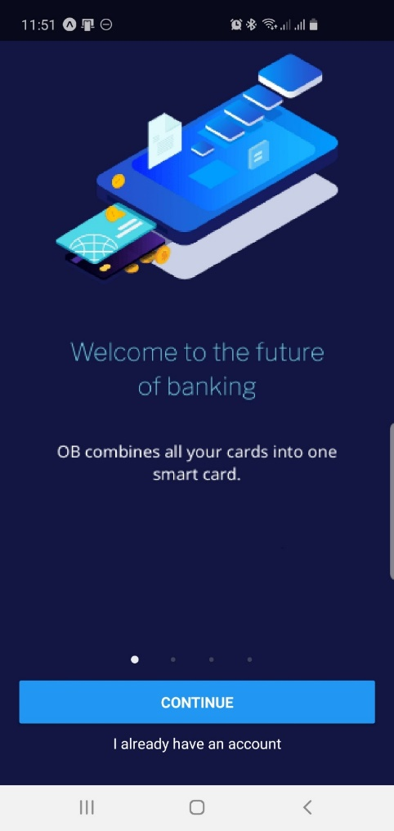
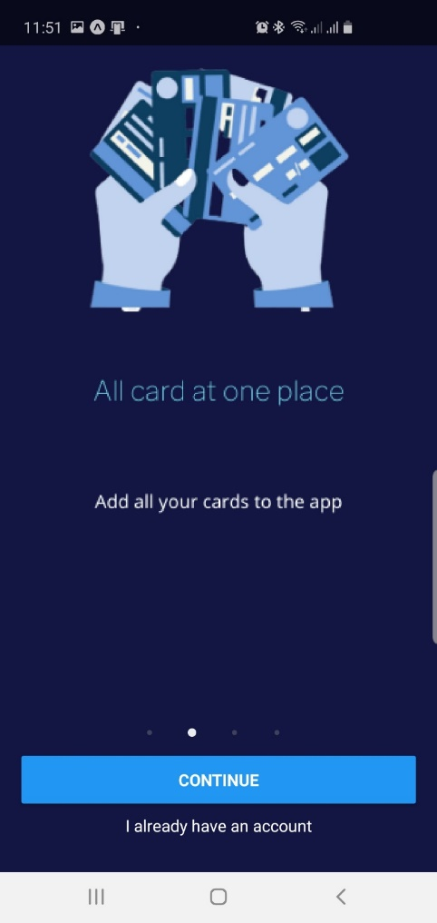
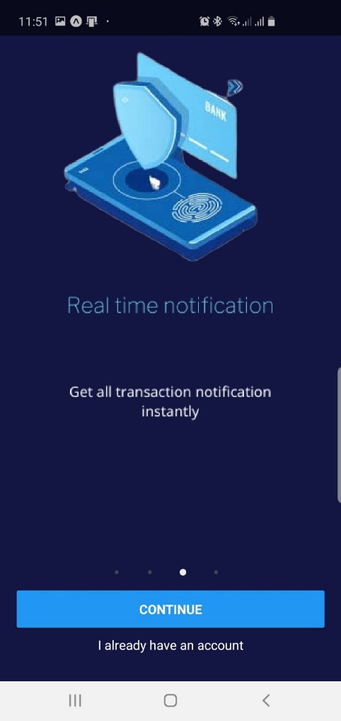
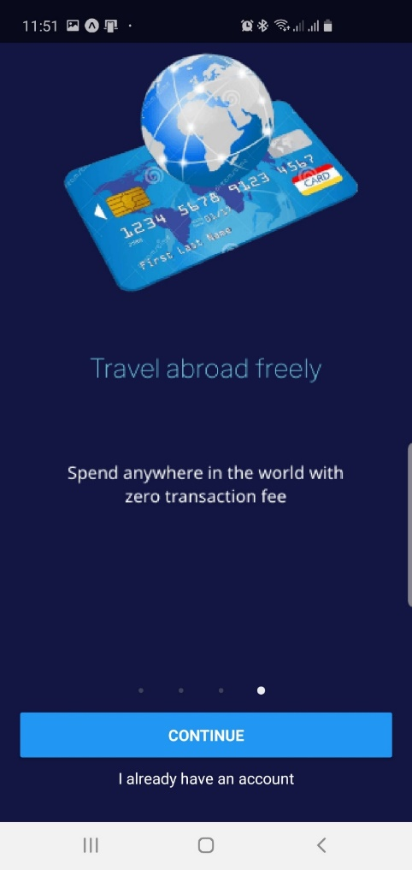
Application features
1. Smart Card
2 . Cards at once place
3 . Real time notification
3 . Travel across borders

Slide 10
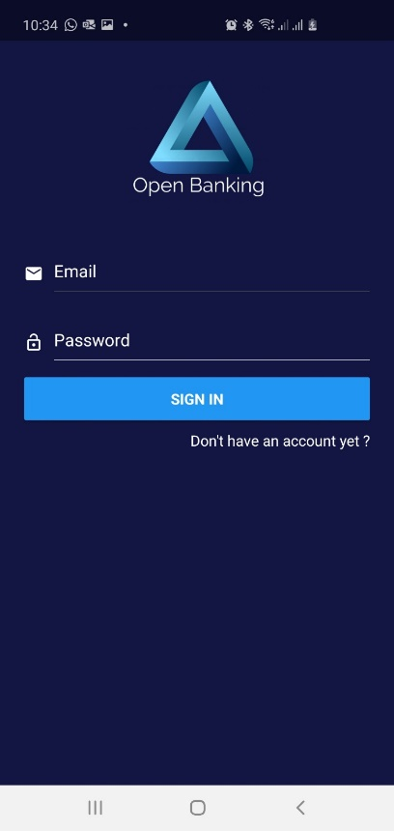
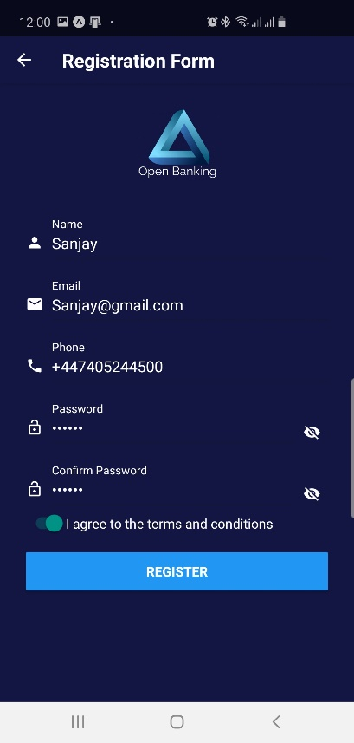
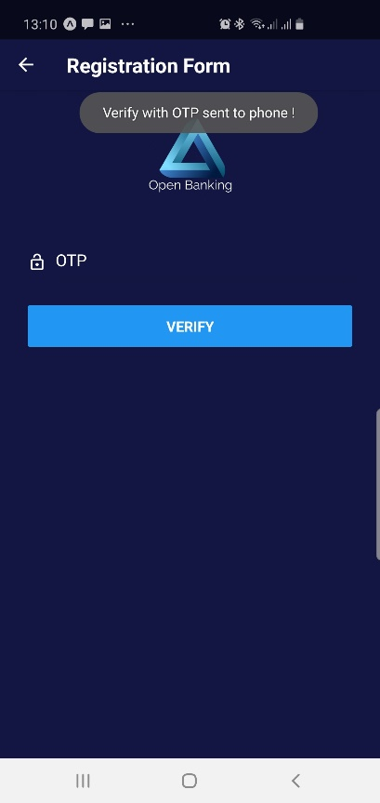
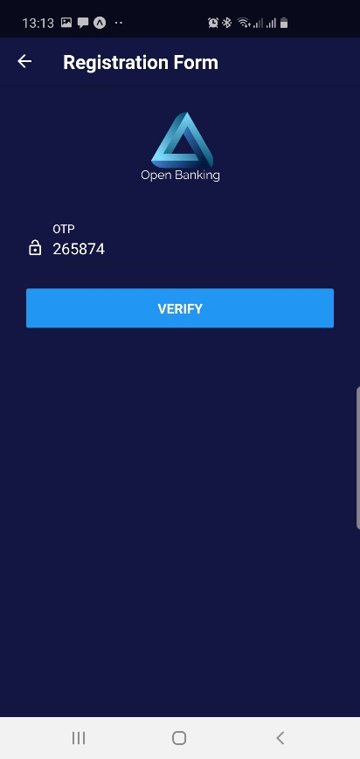
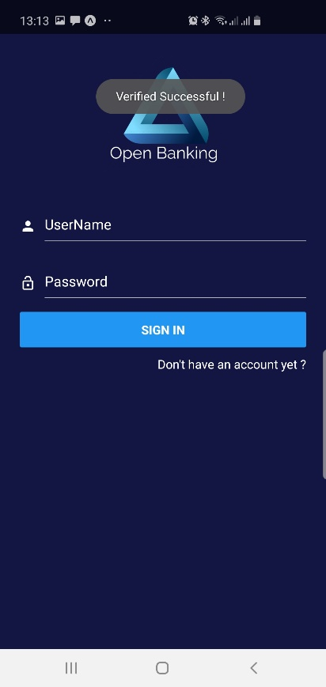
User registration
1. Login screen
Navigate to Register Page
Provide all information
Enter received OTP and verify
OTP verified and redirected
2 . User Information
3 . Registration Successful
3 . Registration Successful
3 . Registration Successful

Slide 11
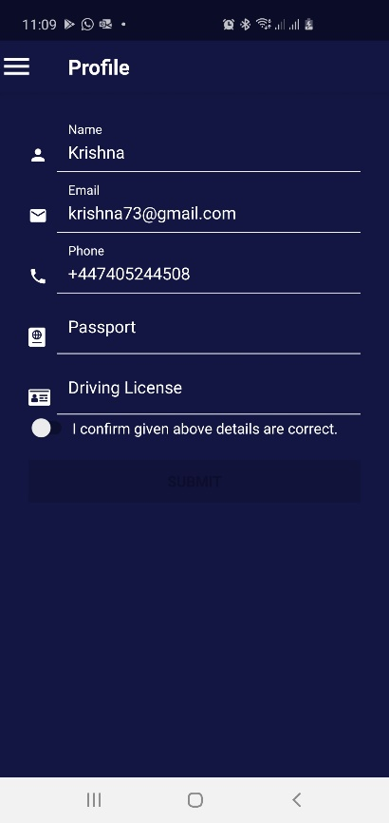
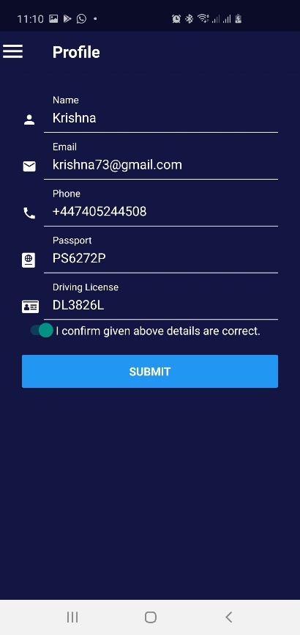
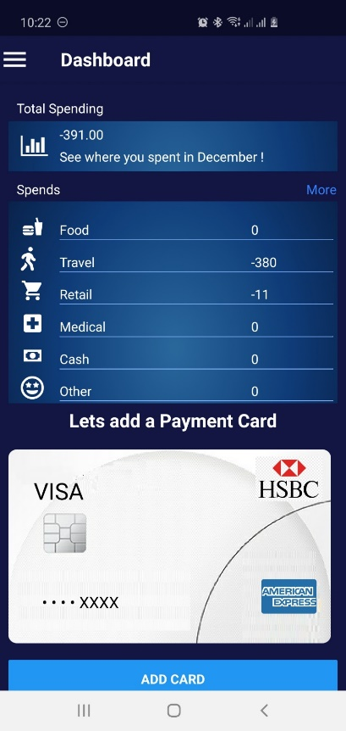
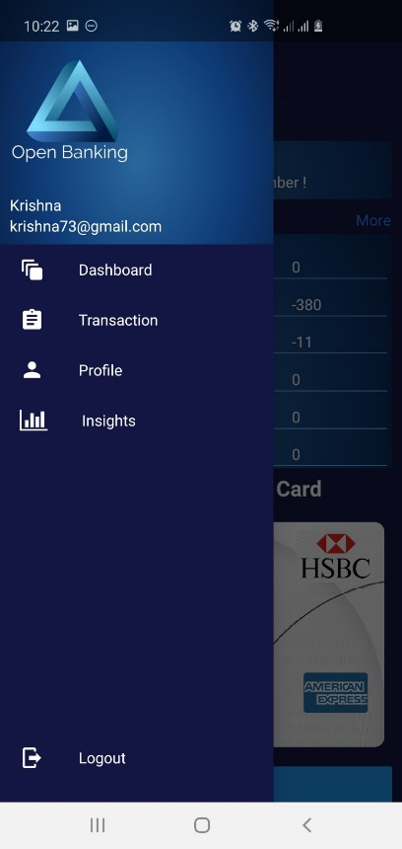
Profile
For first time login redirects to Profile page
Profile page can be accessed from menu
Provide all information
1. Login screen
2 . User Information
3 . Update KYC information
3 . Successful profile update redirect to dashboard
5. Navigation menu for Profile page

Slide 12
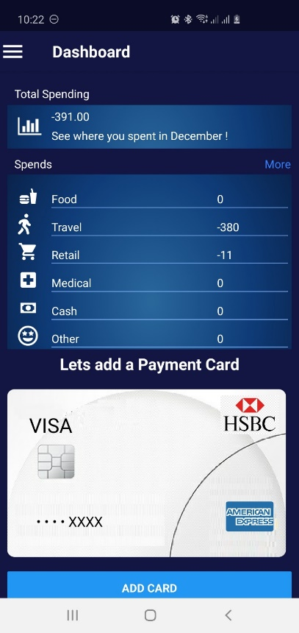
Dashboard
Login menu to login to the application
Side Menu can be accessed from any Screen
Select “Dashboard” to navigate to Dashboard
1. Login Screen
2. Side Menu Screen
2. Dashboard Screen with Add Card

Slide 13
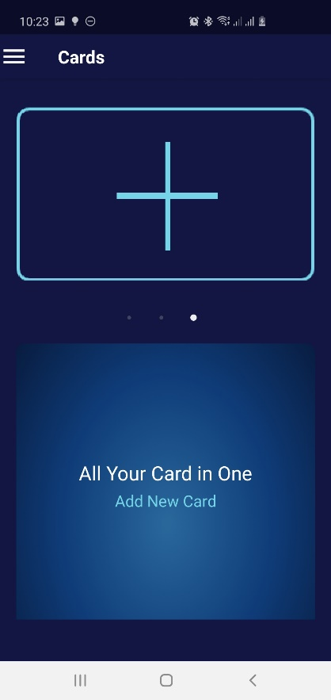
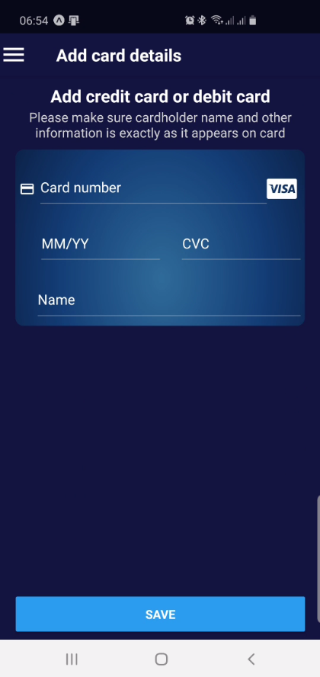
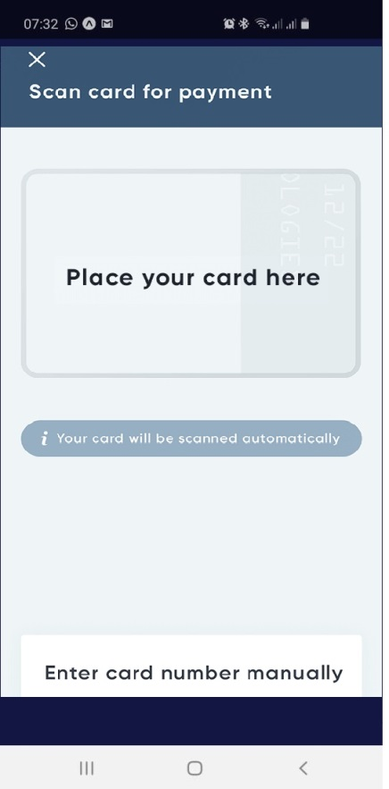
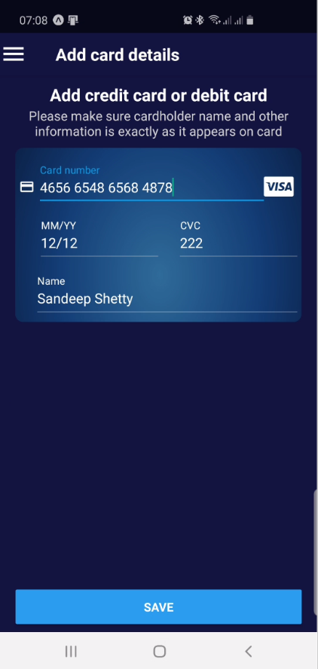
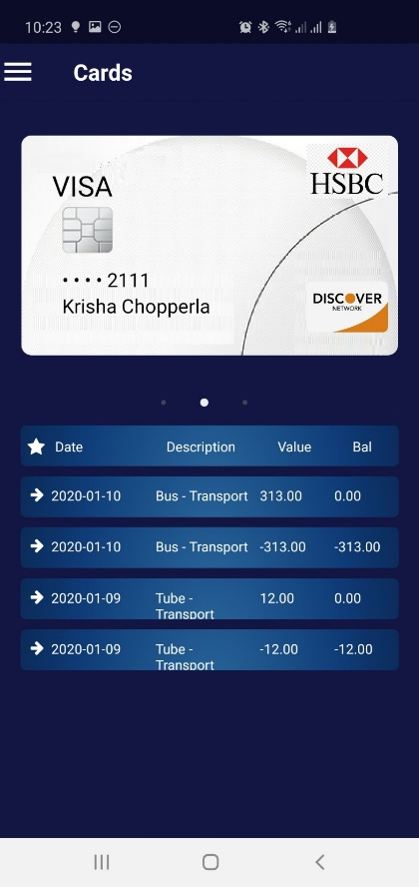
Add card
Add Card navigation widget in the Cards View
This appears when user select “Camera” option to Card info
Card is saved if authentication is successful
Manual Entry option to add a card
Display captured info
1. Add card widget
1. Card Details
2 Camera capture card info
3.Display Entered Card Info Details
4 . Registration Successful

Slide 14


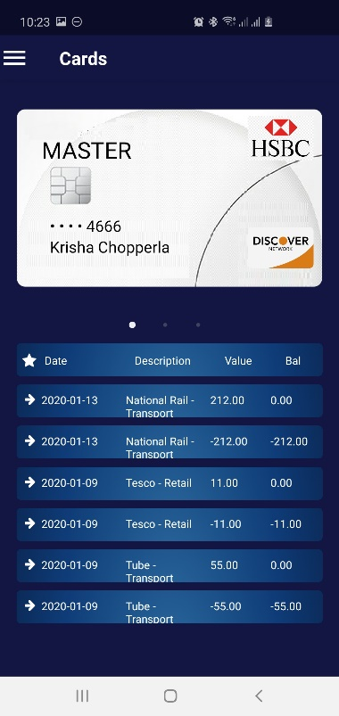

View detailed transactions
Default Screen After Login
Display all registered card
Display all transactions pf registered class
1. Login Screen
2. Side Menu Screen
3. All Cards Screen With swiper
4. Swipe through with transactions
Open up Side Menu

Slide 15
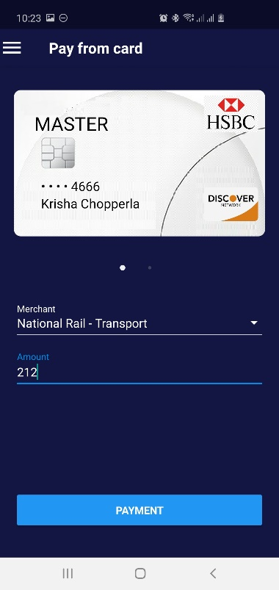
Make transactions
Default Screen After Login
Make Transaction
Display all transactions pf registered cards
1. Login Screen
2. Side Menu Screen
Make Transaction Screen
4. All Transaction Screen
Open up Side Menu

Slide 16
What’s next ?
Retail Use Cases
Opportunities
Account Aggregation
Link all accounts; track expenses; set and plan savings goals; self-administration
Peer-to-peer payment service
Peer-to-peer payment service
Consumer-to-business payments
Consumer-to-business payments
Products Cross – Selling
Identity leads for lending products
Banking Products
Non-Banking Products
Identity leads for insurance and utilities offers
Lifestyle offerings
Enable payments & service beyond regular payments; adding alternate methods
Identification and authentication service
Provide digital identity, e.g. For secure login to tax department
Corporate Use Cases
Opportunities
Balance sheet simulation
Balance sheet/P&L simulation across accounts
Multi-account management
Improve multi-account aggregation & management
Integrated cash management
Cash pooling/liquidity management across accounts
Enhanced risk scoring
Use multi-account data to enhance risk scoring

Slide 17
APPENDIX
Technical Enrichments to the POC
Elaborate Use cases

