Slide 1
SeqTrainer
`
From Promoter Model Training
to Annotated SBOL Designs
A concise teaching deck for using SeqTrainer annotation features, exporting GenBank/SBOL outputs, validating design files, and visualizing results in SBOL Canvas or GenBank viewers.
Training notebooks
Promoter annotation
SBOL export
Canvas visualization

Slide 2
Learning outcomes
By the end of this guide, students should know what each SeqTrainer artifact is for.
1
Set up SeqTrainer from the official repository
2
Retrain or rerun notebooks responsibly
Clone SynBioDex/SeqTrainer, install extras, and work from the main branch used by the university lab.
Edit hyperparameters while preserving validation/test separation and benchmark provenance.
3
Run promoter annotation
4
Export and inspect results
Use a GenBank file, checkpoint, and benchmark manifest to produce computational predicted promoters.
Read annotated GenBank, predictions CSV, annotation manifest, SBOL3, and SBOL2/RDF outputs.
5
Validate and visualize
Use SBOL Validator and SBOL Canvas for standards checks and visual inspection.

Slide 3
Official setup: start from SynBioDex main
Use this as the first practical cell or terminal block in a university lab handout.
# 1) Clone the official repository
git clone https://github.com/SynBioDex/SeqTrainer.git
cd SeqTrainer
# 2) Work from the course-approved main branch
git checkout main
git pull origin main
# 3) Create an isolated Python environment
python -m venv .venv
source .venv/bin/activate # Windows: .venv\Scripts\activate
# 4) Install SeqTrainer locally
python -m pip install --upgrade pip
python -m pip install -e ".[annotation,dev]"
Teaching instruction
Ask students to confirm that `seqtrainer --help` works before running any annotation command. This catches most path and environment errors early.
If annotation is not merged yet
Use the exact branch specified by the instructor or PR. The slide commands should still be taught as the intended SynBioDex main workflow after merge.

Slide 4
Overall workflow: one biological question
How do we move from a promoter model to predicted promoter features in a plasmid?
1
Retrain / run notebook
2
Save benchmark evidence
3
Annotate GenBank
4
Export results
5
Validate + visualize
CNN-v2, DNABERT2, or another supported model workflow
checkpoint + manifest + validation-selected threshold
scan plasmid windows on one or both strands
GenBank, CSV, manifest, SBOL3, SBOL2/RDF
SBOL Validator → SBOL Canvas or GenBank viewer
Central rule
Do not treat every high-scoring window as a confirmed promoter. SeqTrainer adds computational predicted promoter features that require biological interpretation and, ideally, experimental validation.

Slide 5
Part A : Retrain or rerun a model notebook
Training creates the checkpoint and manifest needed later for annotation.
# From the official SeqTrainer checkout
cd SeqTrainer
# Start notebooks
jupyter lab
# Open the course notebook under notebooks/
# Example naming pattern:
# notebooks/.../cnn_v2_*.ipynb
# notebooks/.../dnabert2_*.ipynb
Notebook teaching flow
1. Load the shared dataset
2. Preprocess sequences
3. Train or load the model
4. Evaluate on validation
5. Select threshold from validation
6. Report held-out test metrics
7. Save checkpoint and manifest
Annotation should begin only after a model run has a checkpoint and a manifest that records the training/evaluation settings.

Slide 6
What can students safely edit in notebooks?
Use validation performance to guide training changes, not repeated test-set trial-and-error.
1
Learning rate
2
Epochs
3
Batch size
Controls how strongly model weights update. Too high can destabilize training; too low may learn slowly.
Number of full passes through the training data. More epochs can overfit.
Affects memory use and optimization noise. Large models may require smaller batches.
4
Dropout / regularization
5
Threshold policy
6
Random seed
Reduces overfitting by discouraging fragile learned patterns.
Should be selected on validation metrics such as MCC, then frozen for test and annotation.
Record it so another student can reproduce the run.

Slide 7
Benchmark outputs that annotation needs
A training notebook is useful only if it leaves auditable artifacts.
checkpoint
model weights used for inference
manifest.json
model family, threshold, dataset and run metadata
metrics.csv/json
validation and test performance summary
predictions.csv
row-level probabilities and predicted labels
history.csv
training curve if model was trained
The benchmark manifest connects model training to annotation. It prevents the annotation step from becoming a disconnected one-off prediction script.

Slide 8
Part B : Prepare the annotation input
The annotation command starts from an existing GenBank DNA record.
Input file
Model evidence
Output folder
A GenBank file such as `pAN1717_cyan.gb` or any course-provided plasmid record. Existing features should be preserved rather than overwritten.
A checkpoint and benchmark manifest from a completed model run. These define the predictor and threshold provenance.
Use a clean folder such as `outputs/annotations/` so the GenBank, CSV, manifest and SBOL files stay together.
mkdir -p outputs/annotations
# Recommended project structure
inputs/
plasmid.gb
outputs/
benchmarks/
model_run/manifest.json
model_run/checkpoints/best_model.pt
annotations/

Slide 9
Annotation smoke test: confirm the pipeline works
The dummy predictor is for file writing and workflow checks only. It is not a biological model.
seqtrainer annotate promoters inputs/plasmid.gb \
--model-family dummy \
--threshold 0.80 \
--window-size 300 \
--step-size 25 \
--scan-both-strands \
--output outputs/annotations/plasmid_dummy_annotated.gb \
--predictions-csv outputs/annotations/plasmid_dummy_predictions.csv \
--manifest outputs/annotations/plasmid_dummy_manifest.json \
--clean-output
Use this first
Run this before using a real checkpoint. It checks that SeqTrainer can read the GenBank file, generate windows, write features, export the CSV, and record a manifest.
Do not report dummy results
The dummy predictor is not trained. It should never be used as biological evidence.

Slide 10
Real annotation command: checkpoint + manifest
Replace the paths with the model run produced by your course notebook.
seqtrainer annotate promoters inputs/plasmid.gb \
--model-family dnabert2 \
--checkpoint outputs/benchmarks/dnabert2_run/checkpoints/best_model.pt \
--benchmark-manifest outputs/benchmarks/dnabert2_run/manifest.json \
--output outputs/annotations/plasmid_dnabert2_annotated.gb \
--predictions-csv outputs/annotations/plasmid_dnabert2_predictions.csv \
--manifest outputs/annotations/plasmid_dnabert2_manifest.json \
--sbol-output outputs/annotations/plasmid_dnabert2.nt \
--sbol2-output outputs/annotations/plasmid_dnabert2_sbol2.rdf
Model family choices
`dnabert2` and `cnn_v2` require compatible checkpoints. Keep model family, checkpoint and manifest from the same benchmark run.
SBOL outputs
Use SBOL3 `.nt` as the standards-oriented machine-readable export. Use SBOL2/RDF `.rdf` for SBOL Canvas compatibility when required.

Slide 11
Editable annotation parameters
These settings change how SeqTrainer scans the input DNA.
1
--window-size
2
--step-size
Length of sequence shown to the model at once. Keep compatible with training length.
Distance between neighboring windows. Smaller step = denser scan and more runtime.
3
--threshold
4
--scan-both-strands
Probability cutoff. Prefer the validation-selected value stored in the benchmark manifest.
Scores forward and reverse-complement orientation. Useful for plasmids with features on both strands.
5
--clean-output
6
--open-output-folder
Removes the target output files before a fresh run. Avoids confusing stale files.
Convenience option for local teaching demos when supported.

Slide 12
What SeqTrainer does internally
This is the scientific core of the annotation workflow.
GenBank
record
sliding
windows
model
score
threshold
filter
merge
regions
predicted
promoters
window_start, window_end, strand, score, threshold_pass,
merged_region_id, overlaps_existing_feature, circular_boundary
Every scanned window is saved in the predictions CSV, so students can inspect both positive and negative windows instead of relying only on the final GenBank file.

Slide 13
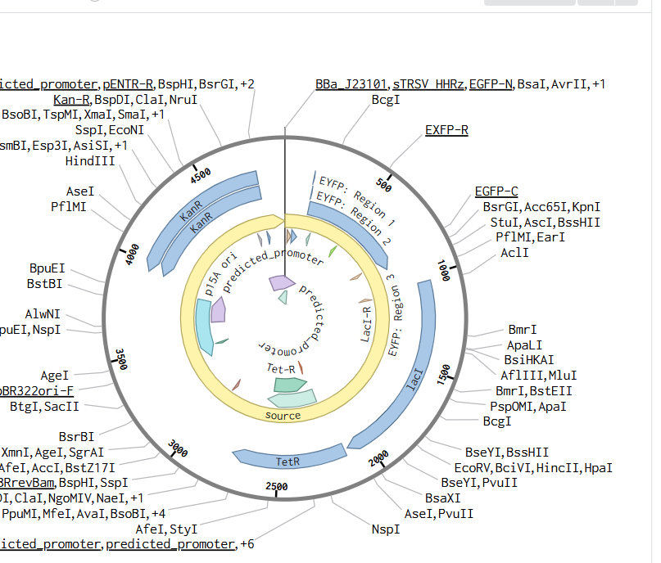
Output 1 : Annotated GenBank
Use this for sequence-level inspection in GenBank-compatible viewers.
What changes?
Existing features remain in the record. SeqTrainer appends additional computational features labelled as predicted promoters.
What not to claim
A predicted promoter is not a confirmed biological part. Treat it as a model-derived candidate region.
# Open in Benchling, SnapGene, ApE, Geneious, or another GenBank viewer
outputs/annotations/plasmid_dnabert2_annotated.gb
Example visual inspection of predicted_promoter features in a sequence viewer / SBOL Canvas-style map.

Slide 14
Output 2 : Predictions CSV and annotation manifest
These are the files that make the annotation auditable.
predictions.csv
annotation_manifest.json
One row per scanned window. Use it to inspect coordinates, strand, score, threshold result, overlap status, region ID, and sequence.
Records input/output paths, model family, checkpoint, benchmark manifest, threshold source, window settings, circular topology, warnings and timestamp.
python - <<'PY'
import pandas as pd
df = pd.read_csv('outputs/annotations/plasmid_dnabert2_predictions.csv')
print(df.sort_values('score', ascending=False).head(10))
PY
python -m json.tool \
outputs/annotations/plasmid_dnabert2_manifest.json | head -80

Slide 15
Output 3 : SBOL export
Use SBOL when the design needs to move into standards-oriented synthetic-biology tools.
SBOL3 .nt
SBOL2 .rdf
Machine-readable representation of the sequence, mapped features, predicted promoter features and inference provenance. Use it for standards-oriented exchange and archiving.
Compatibility export for tools that expect SBOL2 RDF/XML, especially SBOL Canvas workflows that do not directly consume the SBOL3 N-Triples file.
# Typical SeqTrainer annotation command already creates both:
--sbol-output outputs/annotations/plasmid_dnabert2.nt \
--sbol2-output outputs/annotations/plasmid_dnabert2_sbol2.rdf
SBOL validation checks file structure and standards compliance. It does not prove that the predicted promoter is biologically active.

Slide 16
Validate the SBOL file when required
Use the official SBOL Validator before opening or sharing designs.
Web workflow
What to save
1. Open validator.sbolstandard.org
2. Upload the SBOL output file
3. Select the relevant SBOL version / conversion option
4. Save validation messages and converted files with your run outputs
• SBOL3 .nt
• SBOL2 .rdf compatibility file
• validation report or messages
• annotation manifest
• original GenBank input
outputs/annotations/
plasmid_dnabert2_annotated.gb
plasmid_dnabert2_predictions.csv
plasmid_dnabert2_manifest.json
plasmid_dnabert2.nt
plasmid_dnabert2_sbol2.rdf
sbol_validation_report.txt

Slide 17
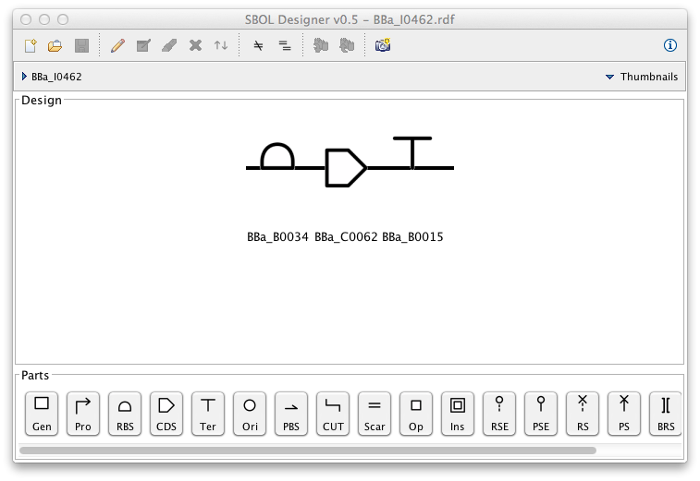
Visualize in SBOL Canvas
Use the Canvas-compatible SBOL2/RDF output for visual inspection.
Canvas handoff
1. Open sbolcanvas.org
2. File → Import
3. Upload `plasmid_dnabert2_sbol2.rdf`
4. Inspect predicted_promoter features
5. Save/export visual design if needed
Important
Open the SBOL2 `.rdf` compatibility export in Canvas. Keep the SBOL3 `.nt` file as the canonical standards-oriented machine-readable output unless the tool explicitly supports it.

Slide 18
Use Seq Design Buddy as a workflow signpost
The website should explain the handoff; it should not run the model or store files.
What it should do for students
What it should not do
• Explain which SeqTrainer command to run
• Distinguish GenBank, CSV, manifest, SBOL3 and SBOL2 outputs
• Link to official SeqTrainer, SBOL Validator and SBOL Canvas pages
• Provide copyable commands and glossary terms
• Upload biological files
• Run DNABERT2/CNN jobs
• Claim validation results
• Store model outputs
• Replace official SeqTrainer documentation
Recommended route label
SeqTrainer annotation → SBOL validation → SBOL Canvas visualization → optional GenBank viewer inspection

Slide 19
Academic checklist before reporting results
1
Repository is SynBioDex/SeqTrainer, main branch or course-approved branch.
2
Notebook changes are recorded: seed, learning rate, epochs, model family and split paths.
3
Threshold is selected from validation, not the held-out test set.
4
Checkpoint and benchmark manifest are from the same run.
5
Annotation output distinguishes predicted_promoter from confirmed biological parts.
6
Predictions CSV and manifest are submitted with the GenBank/SBOL files.
7
SBOL Validator messages are saved when SBOL is used.
8
SBOL Canvas visualization is interpreted as visual inspection, not biological validation.

Slide 20
Suggested university practical session
A 2-hour teaching plan.
1
0–20 min: Setup
2
20–45 min: Notebook review
3
45–75 min: Annotation
Clone SynBioDex/SeqTrainer, install extras, run `seqtrainer --help`.
Open the course notebook and identify hyperparameters, metrics and output artifacts.
Run dummy annotation, then real model annotation if a checkpoint is supplied.
4
75–100 min: Inspect outputs
5
100–115 min: SBOL
6
115–120 min: Discussion
Open GenBank, predictions CSV and manifest. Explain score, threshold and strand.
Export/validate SBOL files and explain SBOL3 vs SBOL2/RDF roles.
Why prediction is not biological validation; what wet-lab follow-up would be needed?

Slide 21
Source notes for instructors
SeqTrainer repository
https://github.com/SynBioDex/SeqTrainer
SBOL standard website
https://sbolstandard.org/
SBOL Visual glyphs
https://sbolstandard.org/visual-glyphs/
SBOL Validator
https://validator.sbolstandard.org/
SBOL Canvas
https://sbolcanvas.org/
SBOL Canvas repository
https://github.com/SynBioDex/SBOLCanvas

Slide 22
Thank you
Key message
Questions and discussion
SeqTrainer annotations are traceable computational hypotheses. SBOL and Canvas help exchange and inspect them; experiments validate them.
Suggested discussion prompt: How would you experimentally validate a computationally predicted promoter region?

