Slide 1
Predictive Model for Income Classification
Leveraging Machine Learning for Socio-Economic Analysis

Slide 2
Problem Statement
The objective of this machine learning task is to construct a predictive model for classifying individuals
based on whether their income exceeds a specified threshold of $50,000. The provided dataset
encompasses a variety of demographic, socio-economic, and employment-related features for a diverse
group of individuals. The goal is to leverage this information to create a classification model that
effectively discerns between individuals with incomes above and below the $50,000 limit.
Dataset: Overview of demographic, socio-economic, and employment-related features.

Slide 3
Dataset Description
Demographic Information
Employment Details
Financial Information
Migration and Residence Details
Family and Veteran Status

Slide 4
Target Variable
Definition of the target variable: Income Above $50,000
Binary classification indicating income level.

Slide 5
Methodology
Machine learning is a branch of artificial intelligence that involves training algorithms to learn patterns and make predictions from data.
In this project, I have used machine learning techniques to construct a predictive model for income classification.

Slide 6
Challenges
Handling missing data and outliers
Dealing with categorical variables
Identifying relevant features
Balancing the dataset

Slide 7
Deliverables
Trained machine learning model
Evaluation metrics and analysis
Documentation on feature importance and model insights

Slide 8
Handling Missing Data
Dataset is containing fields with ‘?’ I have replaced initially with Nan values
# Replace '?' with NaN
train_data.replace('?', np.nan, inplace=True)
test_data.replace('?', np.nan, inplace=True)
Since there are so many null values I replaced with Mode and Median.
train_data[col].fillna(mode_val, inplace=True) for object data type
train_data[col].fillna(median_val, inplace=True) For non object data type.
# Replace '?' with NaN
train_data.replace('?', np.nan, inplace=True)
test_data.replace('?', np.nan, inplace=True)

Slide 9
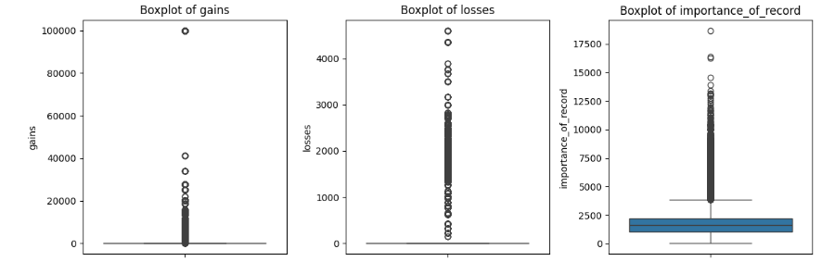
Handling Outliers using Box plots

Slide 10
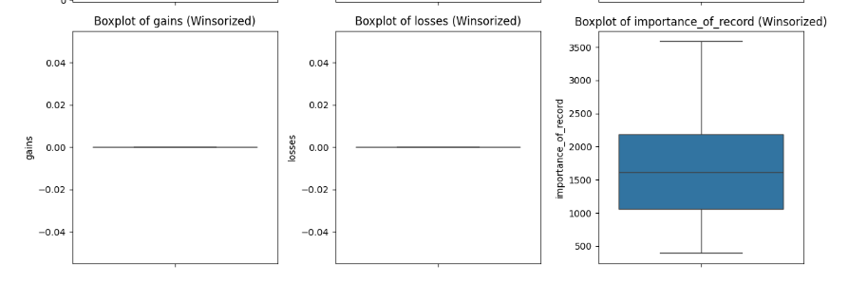
Winsorization to handle outliers
Winsorization to handle outliers

Slide 11
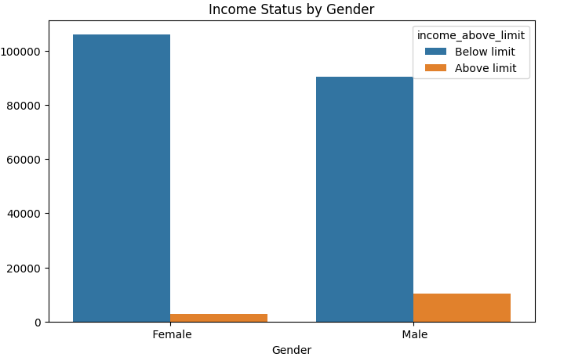
EDA

Slide 12
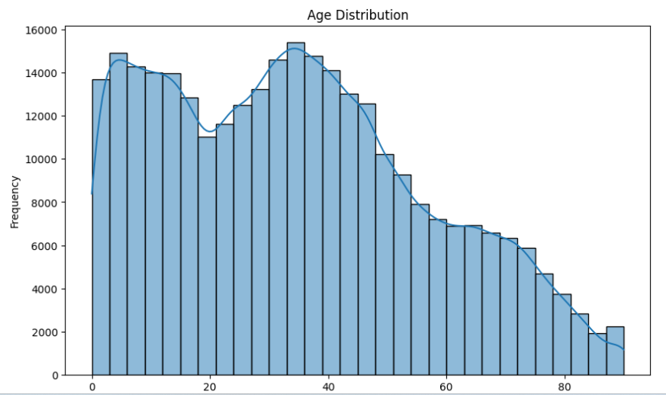

Slide 13
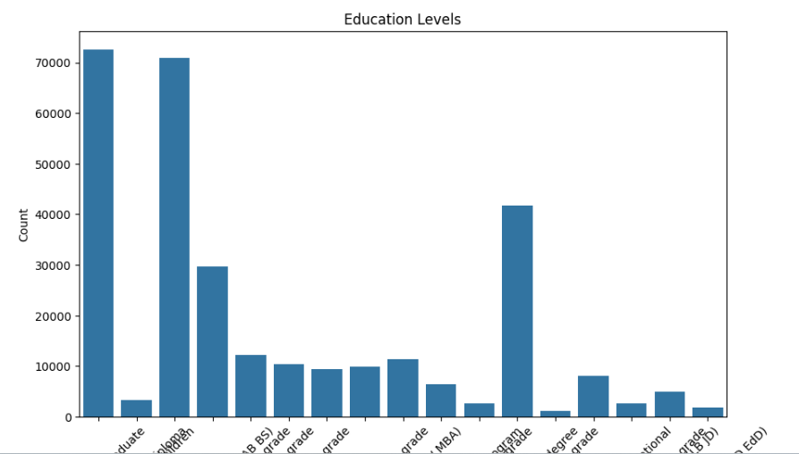
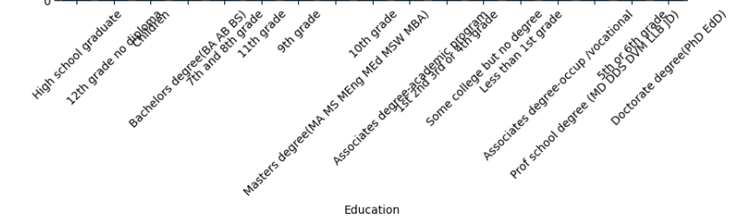

Slide 14
Dealing with Categorical Variables
Utilization of the pd.get_dummies() function from the pandas library.
pd.get_dummies() is used to one-hot encode categorical variables.
Usage of the drop_first=True parameter to prevent multicollinearity and reduce the number of columns.
data_encoded = pd.get_dummies(combined_data, columns=categorical_variables, drop_first=True)
Label Encoding is applied to ensure all categorical variables are encoded numerically.
Iteration over each categorical column and encoding its values using LabelEncoder.
Replacement of categorical values with their encoded numerical counterparts in the feature matrix.

Slide 15
Data Preparation
Separation of features (X) and target variable (y) from the dataset
Initialization of the RandomForestClassifier with parameters: n_estimators=100, random_state=42
from sklearn.ensemble import RandomForestClassifier
rf_classifier = RandomForestClassifier(n_estimators=100, random_state=42)

Slide 16
Displaying Feature Importances
Creation of a DataFrame to display feature importances
Sorting the Data Frame by importance in descending order
Displaying the top N features contributing to income predictions (top_features = 10 in this case)
import pandas as pd
top_features = 10
feature_importance_df = pd.DataFrame({'Feature': X.columns, 'Importance': feature_importances})
feature_importance_df = feature_importance_df.sort_values(by='Importance', ascending=False)
print(f"Top {top_features} features contributing to income predictions:")
print(feature_importance_df.head(top_features))

Slide 17
Top 10 features contributing to income predictions:
+-------------------------------+------------+
| Feature | Importance |
+-------------------------------+------------+
| ID | 0.570617 |
| importance_of_record | 0.042897 |
| importance_of_record_winsorized| 0.039517 |
| age | 0.028444 |
| age_winsorized | 0.026667 |

Slide 18
| occupation_code | 0.015219 |
| stocks_status | 0.013984 |
| industry_code | 0.012808 |
| working_week_per_year | 0.010479 |
| gains | 0.010202 |
Features listed along with their corresponding importance scores.
Importance scores represent the relative importance of each feature in predicting income levels.
+-------------------------------+------------+

Slide 19
Balancing the Dataset
Imbalanced datasets can lead to biased model predictions, especially in classification tasks where one class is significantly more prevalent than the other.
Balancing the dataset ensures that the model learns from an equal representation of both classes, improving its ability to generalize and make accurate predictions.

Slide 20
Random Under-Sampling:
Random under-sampling is a technique used to balance imbalanced datasets by randomly removing samples from the majority class.
It aims to reduce the class imbalance by equalizing the number of samples in each class.

Slide 21
Initialization of RandomUnderSampler:
undersampler = RandomUnderSampler(random_state=42)
Resampling the dataset using RandomUnderSampler:
X_resampled, y_resampled = undersampler.fit_resample(X, y)
Class distribution after random undersampling:
0 102784
1 102784
Name: income_above_limit_Below limit, dtype: int64

Slide 22
Evaluation Criteria
Metrics: Accuracy, Precision, Recall, F1 Score
Emphasis on predicting income above $50,000

Slide 23
Model Evaluation Metrics
Classification Report:
precision recall f1-score support
0 0.89 0.93 0.91 20564
1 0.96 0.94 0.95 39293
accuracy 0.94 59857
macro avg 0.93 0.94 0.93 59857
weighted avg 0.94 0.94 0.94 59857
Accuracy: 0.9367
Precision: 0.9632
Recall: 0.9395
F1 Score: 0.9512

Slide 24
RandomForestClassifier:
A popular ensemble learning method based on decision trees.
Capable of handling both classification and regression tasks.
Utilizes multiple decision trees to improve predictive accuracy and prevent overfitting.
A feature selection technique provided by the sklearn.feature_selection module.
Allows selecting features based on importance scores computed by a specified estimator.
In this project, I have used RandomForestClassifier as the estimator for feature selection.
Feature selection is the process of identifying the most relevant features from a dataset.
RandomForestClassifier can be used to determine the importance of each feature in predicting the target variable.
Features with higher importance scores are considered more influential in the classification process.
SelectFromModel will then select the top-ranked features based on their importance scores, helping to improve model performance and reduce computational complexity.

Slide 25
Feature Importance
Training the RandomForestClassifier to determine feature importance
rf_classifier.fit(X, y)
feature_importances = rf_classifier.feature_importances_

Slide 26
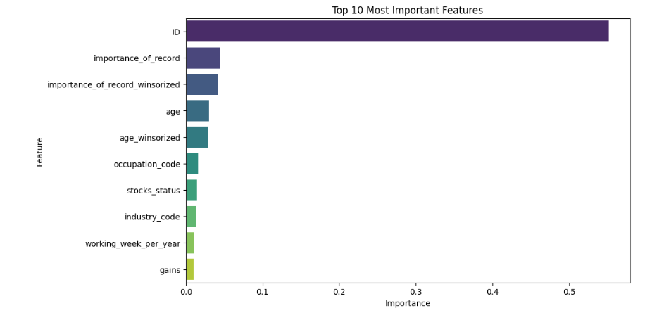

Slide 27
Flask APP
we'll explore a Flask application that predicts income based on demographic and socio-economic features. Let's dive into the code and see how it works."
Opening the Flask App File:
"First, we import necessary libraries such as Flask and joblib for loading the trained model."
Loading the Trained Model:
"We load the trained random forest classifier and the top 10 important features from the saved model file using joblib."

Slide 28
Flask App (Cont..)
Creating Routes:
"The Flask app has two routes: the home route, which renders the index.html template, and the predict route, which handles the prediction."
Home Route:
"The home route renders the index.html template, passing the top 10 important features to the template for user input."
Predict Route:
"The predict route retrieves user input from the form, creates a DataFrame with the input data, and makes a prediction using the loaded model."

Slide 29
Flask app(Cont..)
Rendering the Result:
"The predicted income, along with an explanation, is rendered in the result.html template based on the prediction."
Explanation of Predicted Income:
"If the predicted income is 'True,' it means that the predicted income is above the threshold, while 'False' indicates that the predicted income is below the threshold."
Conclusion:
"And that's how the Flask app predicts income based on demographic and socio-economic features. Feel free to explore the code further and customize it for your own projects!"

Slide 30
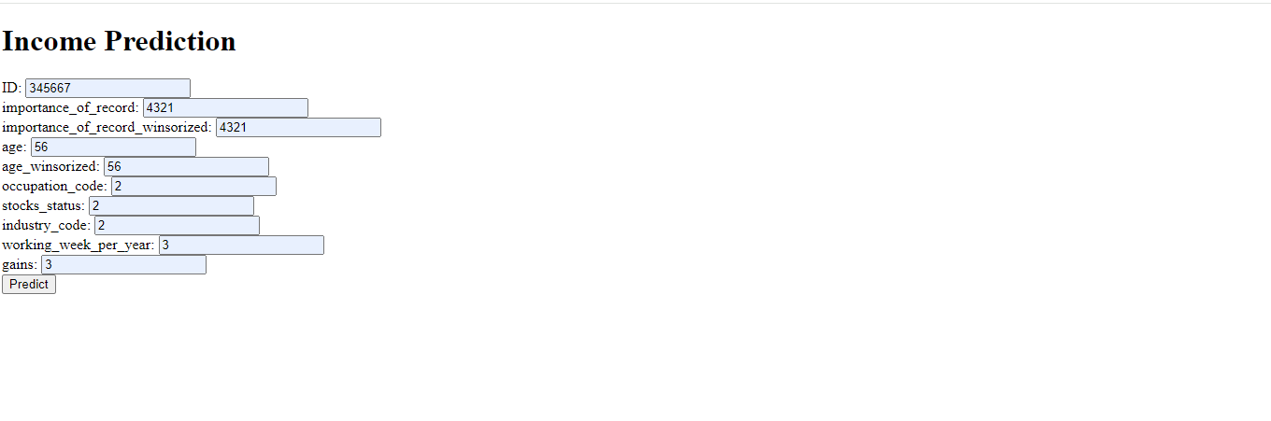

Slide 31
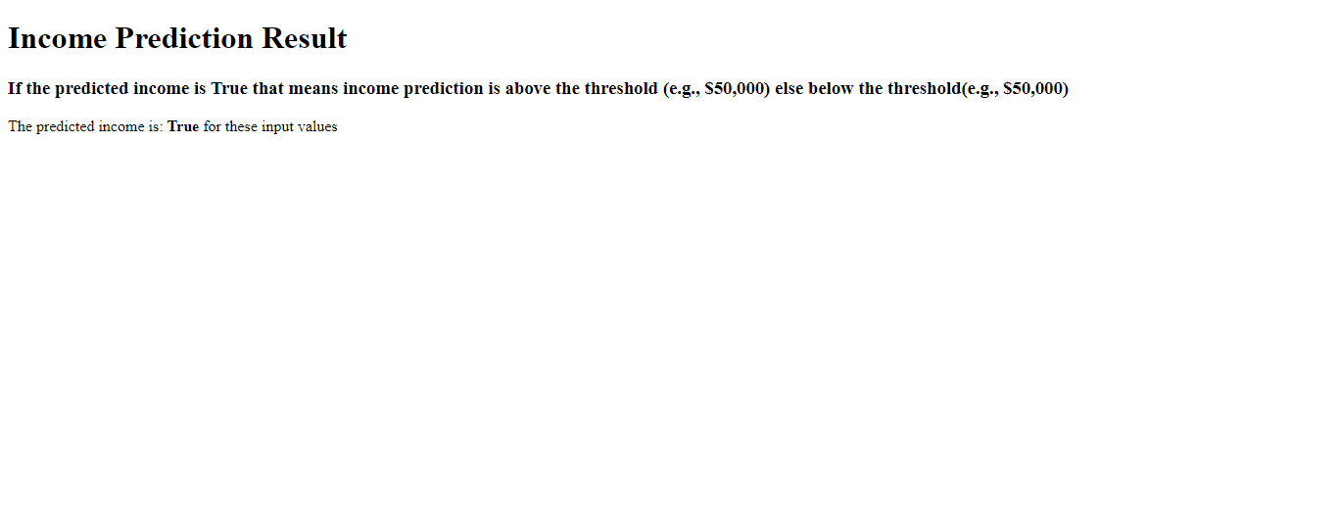

Slide 32
Summary
I have conducted a feature importance analysis using Random Forest Classifier to identify the most influential features for income classification.
The analysis revealed the top features that contribute significantly to predicting income levels above the specified threshold.
The insights gained from feature importance analysis can be utilized for:
Refining the machine learning model by focusing on the most relevant features.
Guiding decision-making processes in various domains such as finance, social services, and policy planning.
Identifying areas for further investigation or data collection to improve model accuracy.

Slide 33


