Slide 1



A dive into the Effects of Air Quality
Compiled and Presented by:
Kristian, Logan, Christina, & Rob

Slide 2
Insert Brief explanation of AQI since it will be prevalent throughout presentation

Slide 3
Our Question
Is there any Correlation between a States Temperature and its Air Quality
How Do the different types of energy consumption methods effect the air quality
Does a states air quality effect the rate of hospitalization or death due to asthma

Slide 4
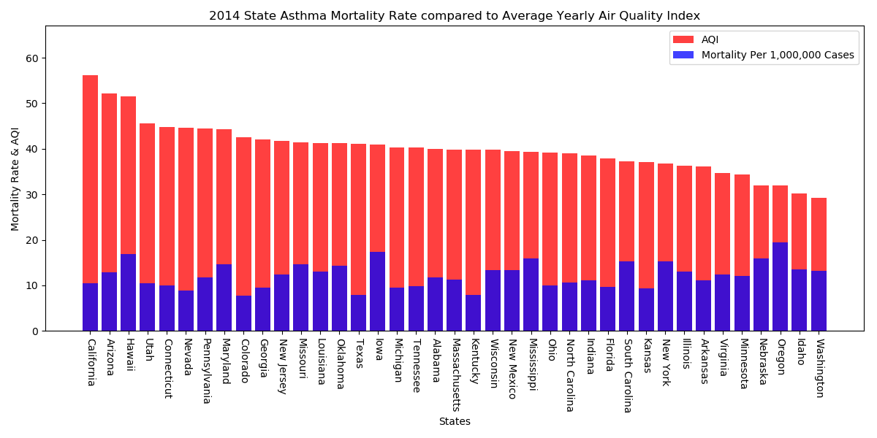

Slide 5
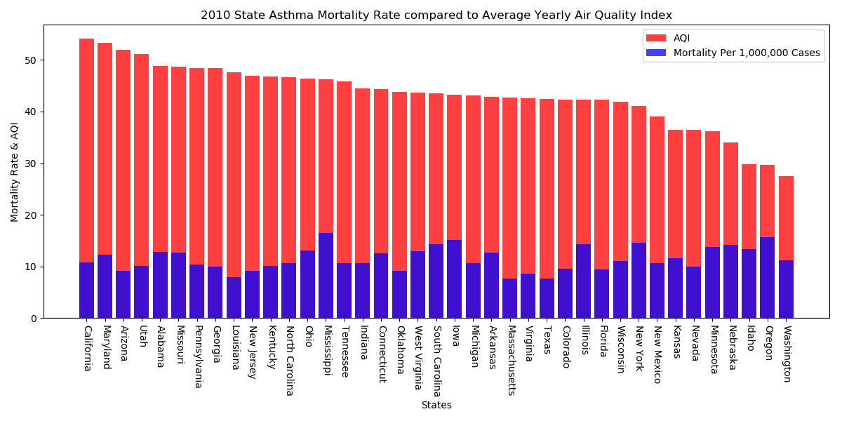
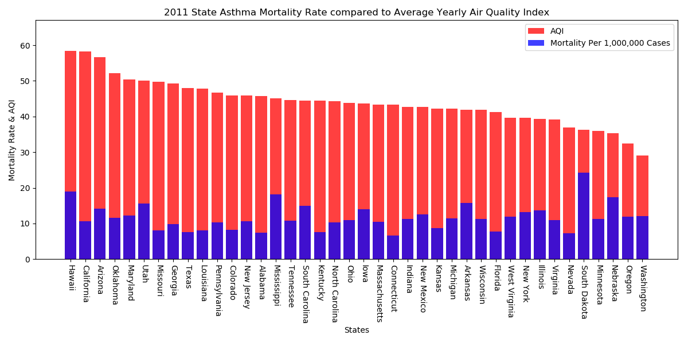
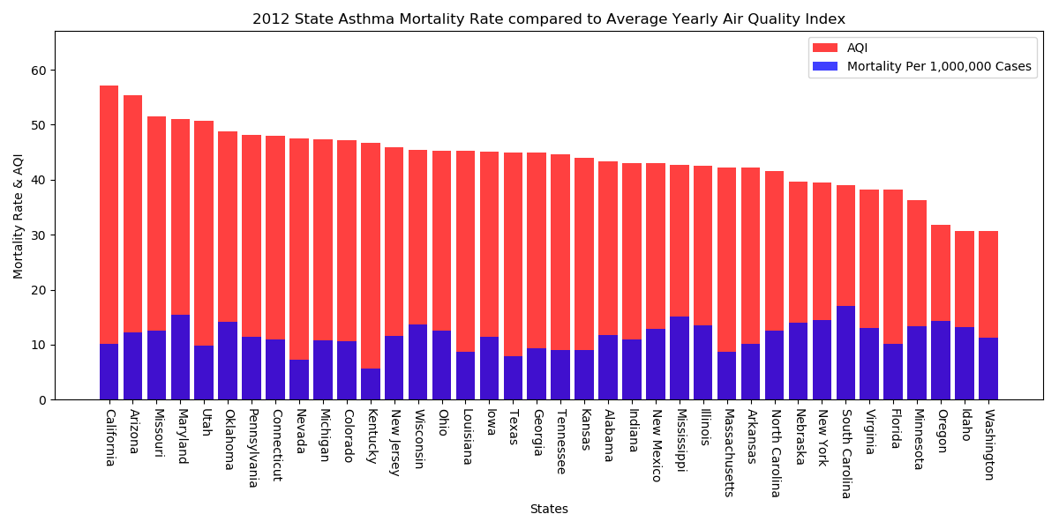
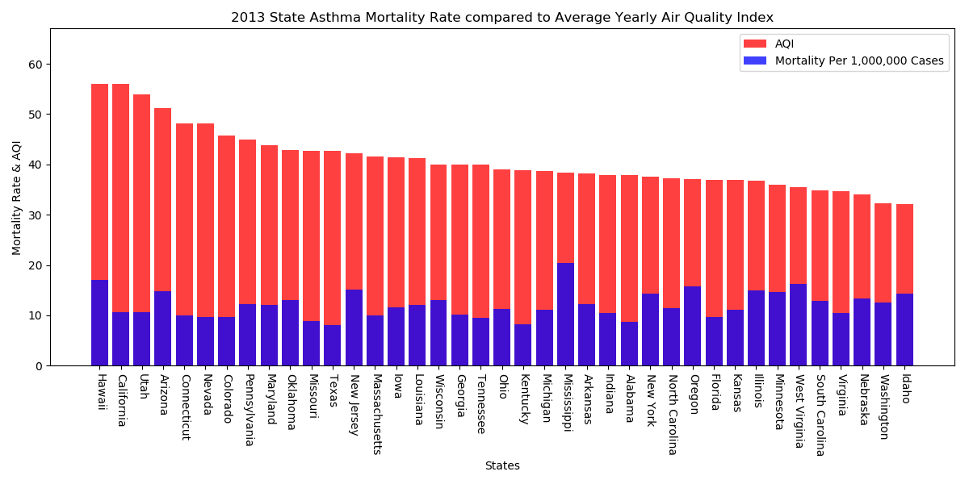
Air Quality Index Compared to Asthma Mortality Rate
Notes:
Hypothesis:
Results:
Data Limitations:

Slide 6
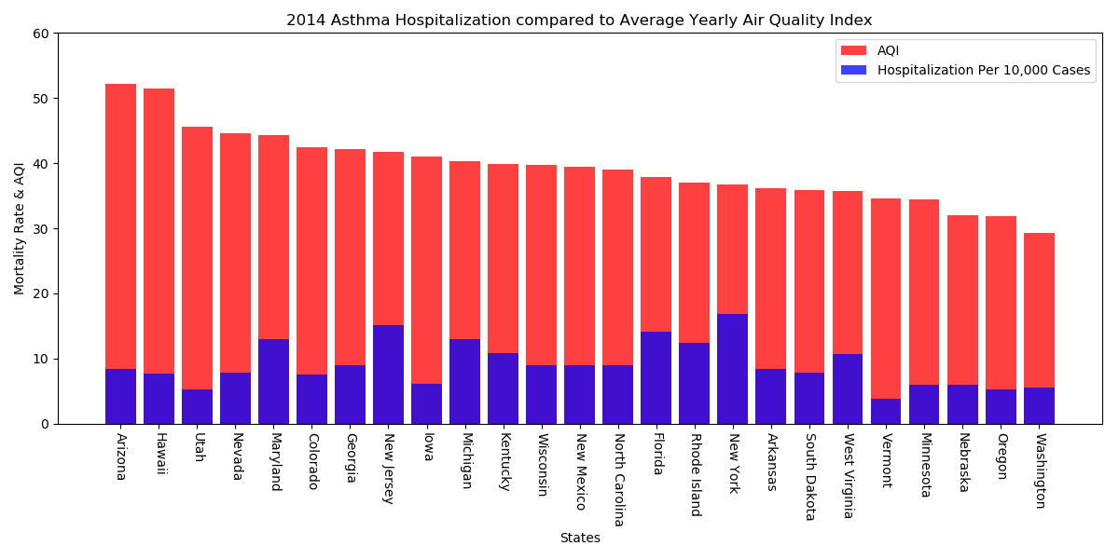

Slide 7
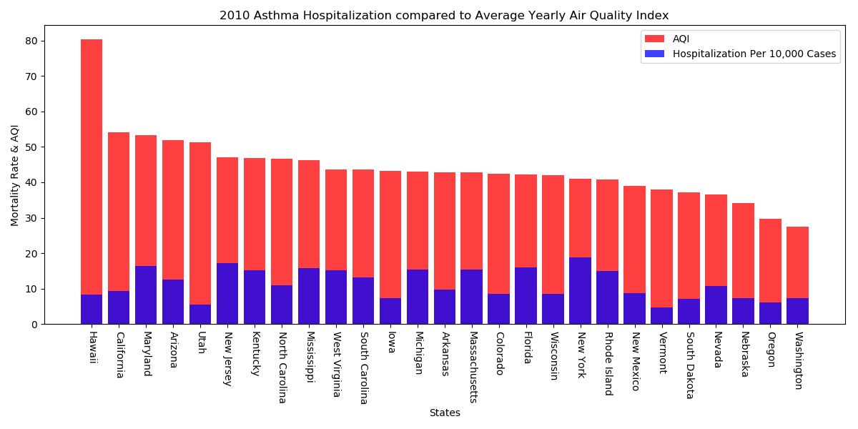
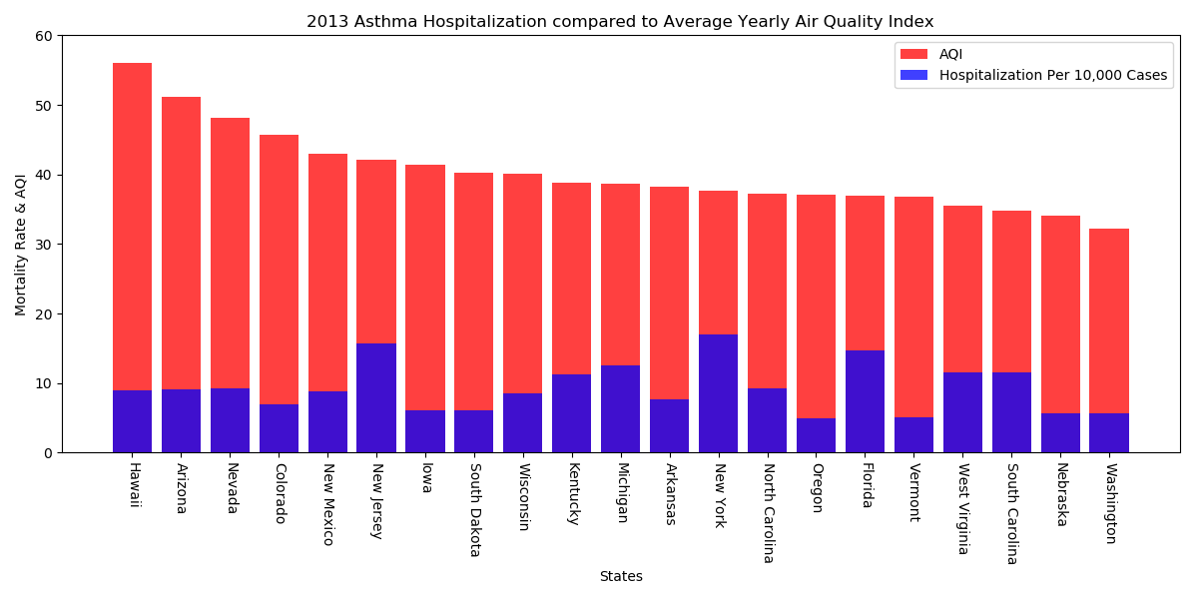
Air Quality Index compared to Asthma Hospitalization
Notes:
Hypothesis:
Results:
Data Limitations:

Slide 8
Questions

