Slide 1



A dive into the Effects of Air Quality
Compiled and Presented by:
Kristian, Logan, Christina, & Rob

Slide 2
EPA calculates the AQI by five major air pollutants: ground-level ozone, particle pollution (also known as particulate matter), carbon monoxide, sulfur dioxide, and nitrogen dioxide

Slide 3
Our Question
How the air quality has changed in America over the past 30 years
How Do the different types of energy consumption methods effect the air quality
Does a states air quality effect the rate of hospitalization or death due to asthma

Slide 4
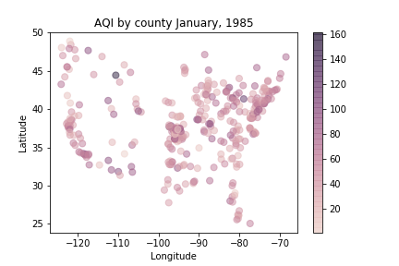

Slide 5
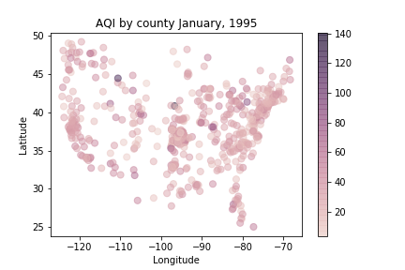

Slide 6
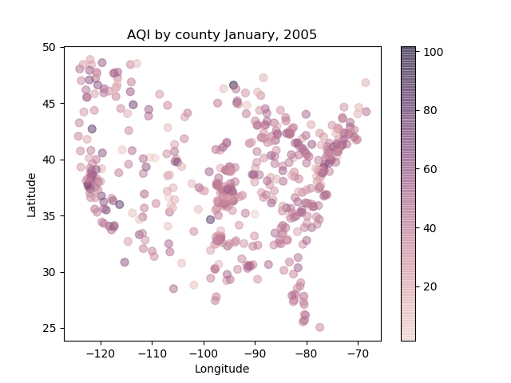

Slide 7
American Energy Consumption

Slide 8
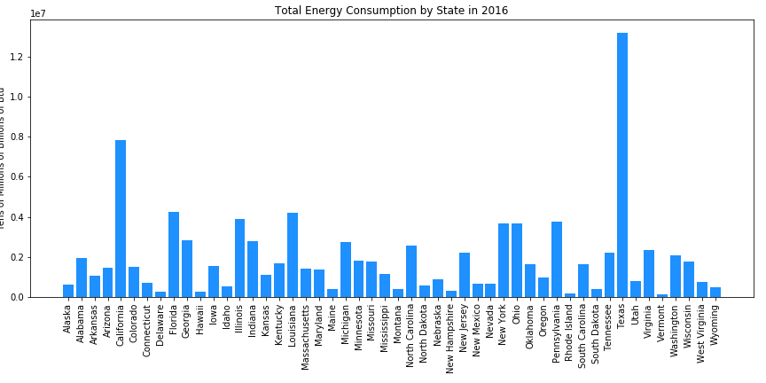

Slide 9
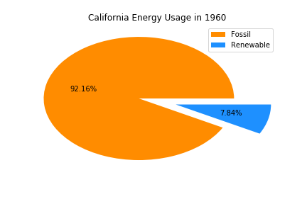
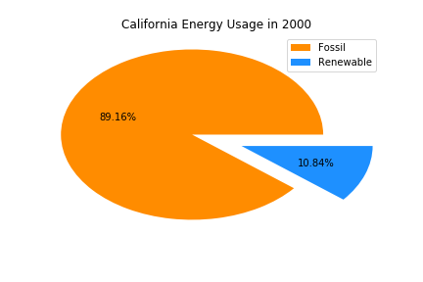
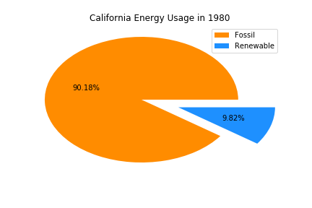
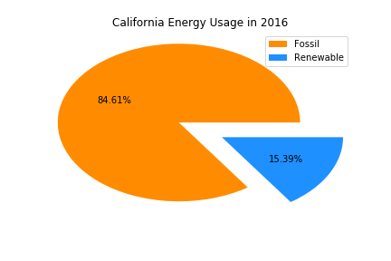
C A L I f o r n I a

Slide 10
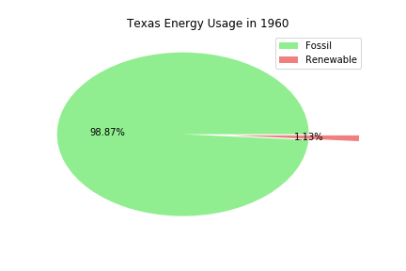


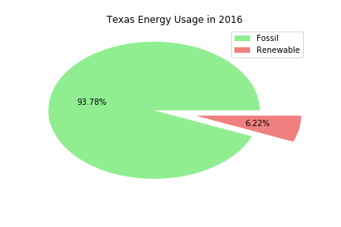
T e x a s

Slide 11
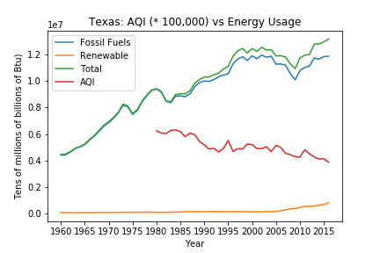
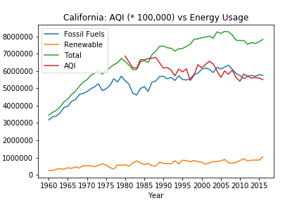
Texas vs California since 1960

Slide 12
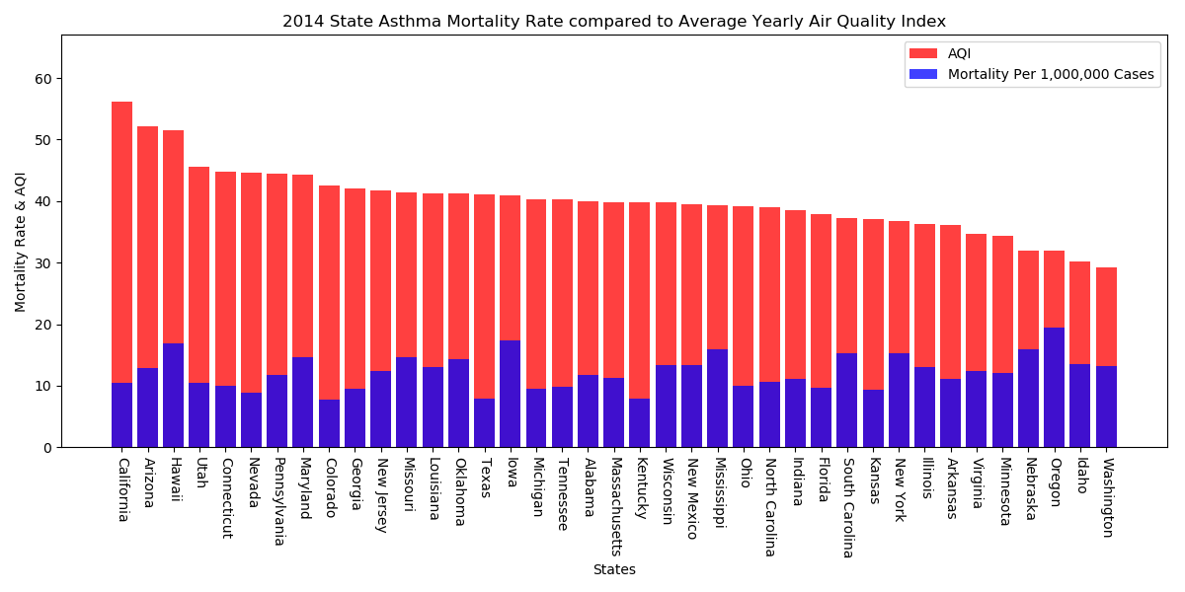

Slide 13
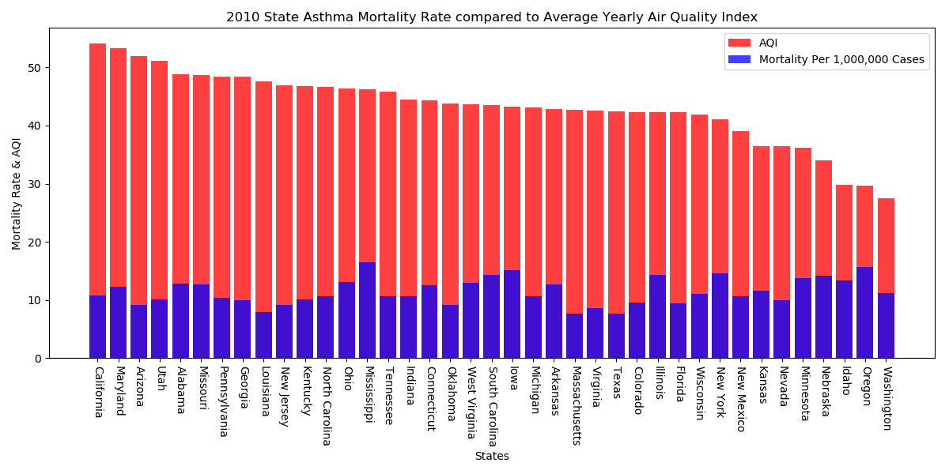
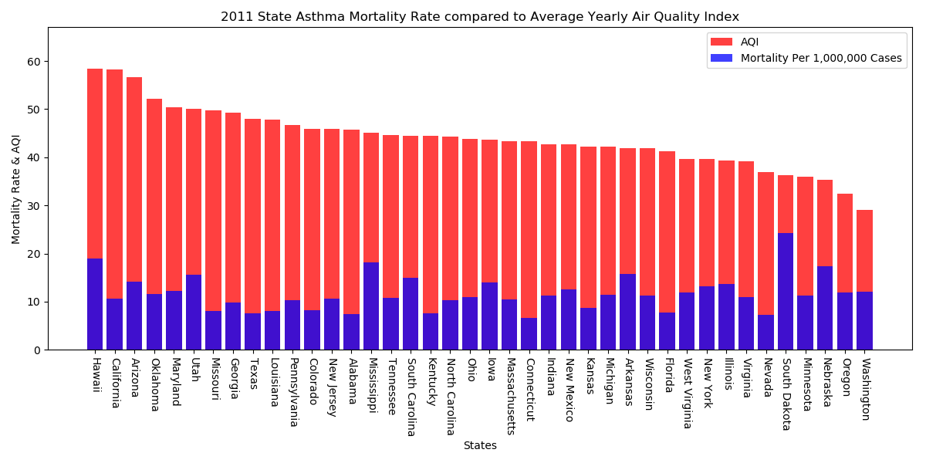
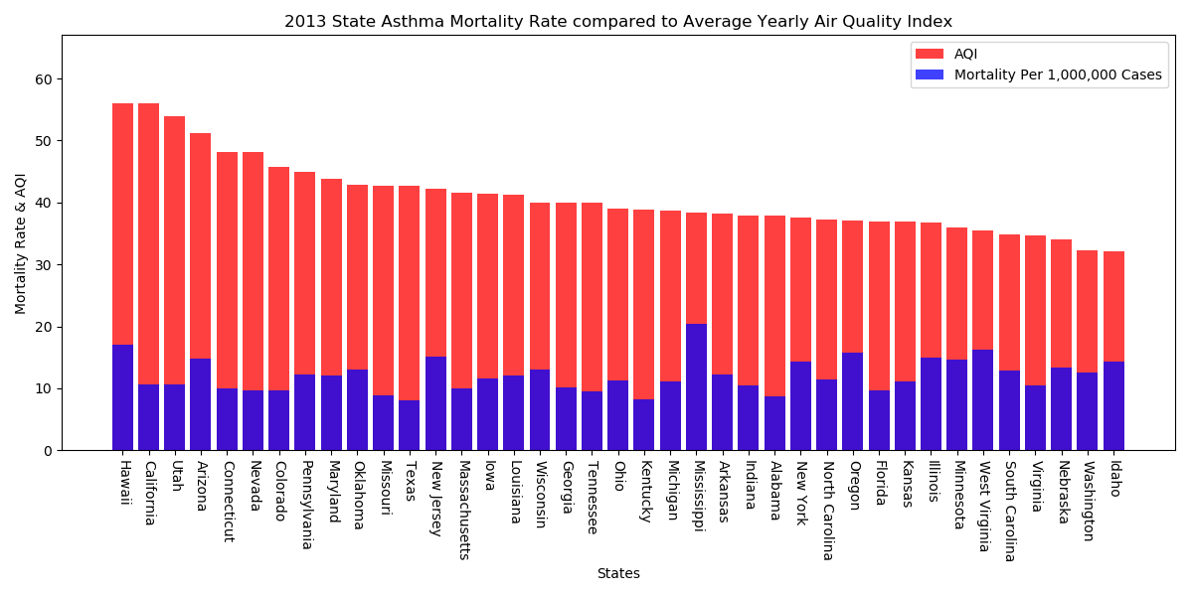
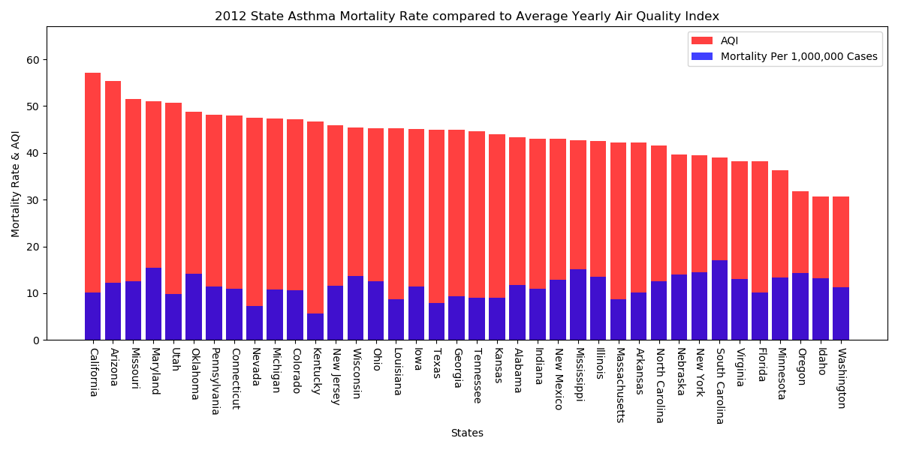
Air Quality Index Compared to Asthma Mortality Rate
Notes:
Hypothesis:
Results:
Data Limitations:

Slide 14
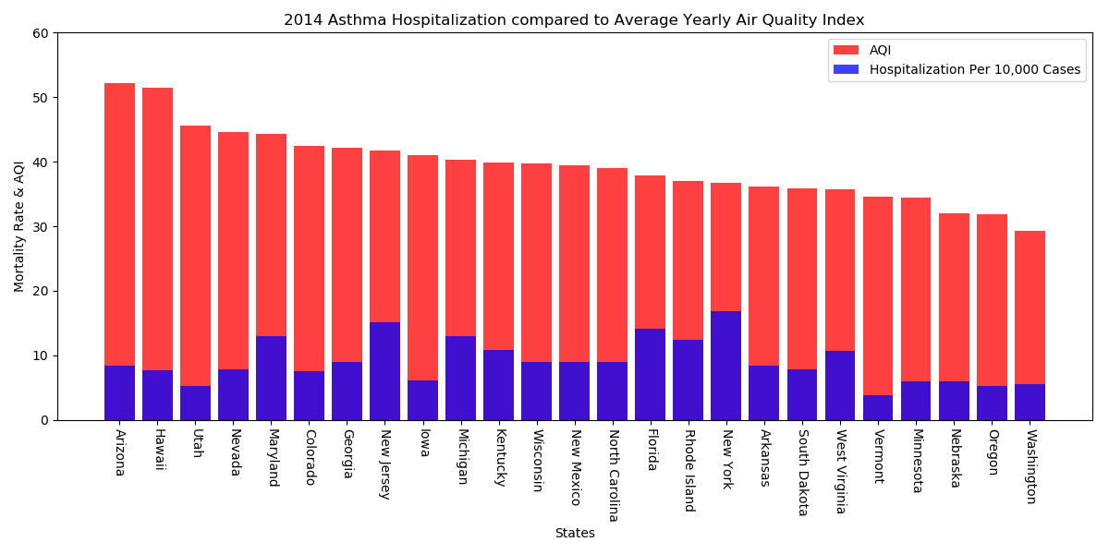

Slide 15
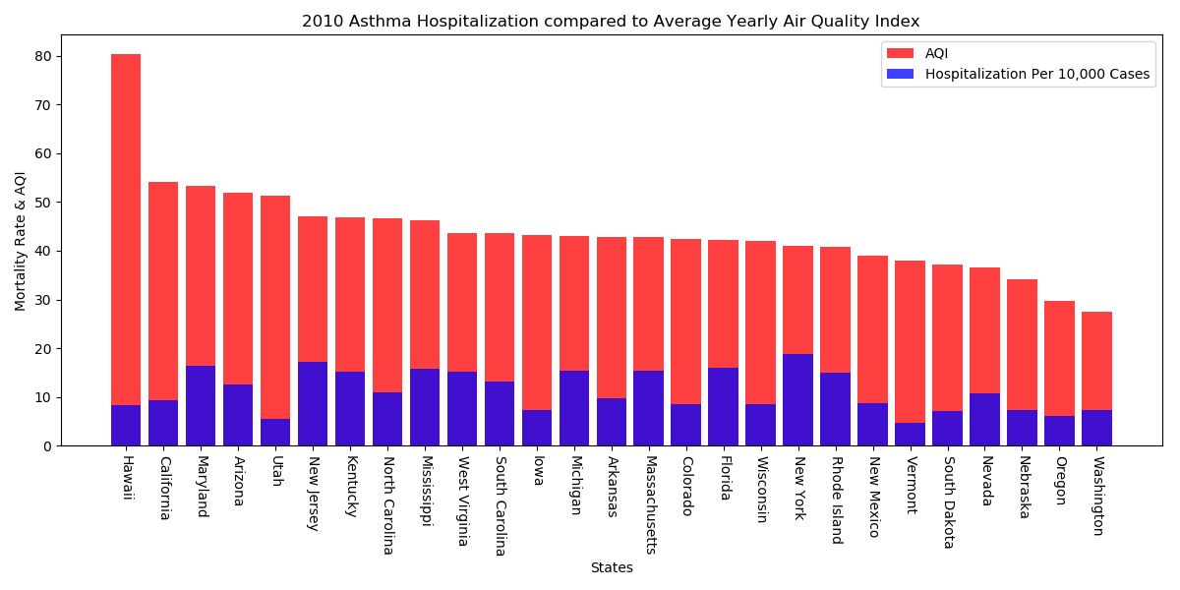
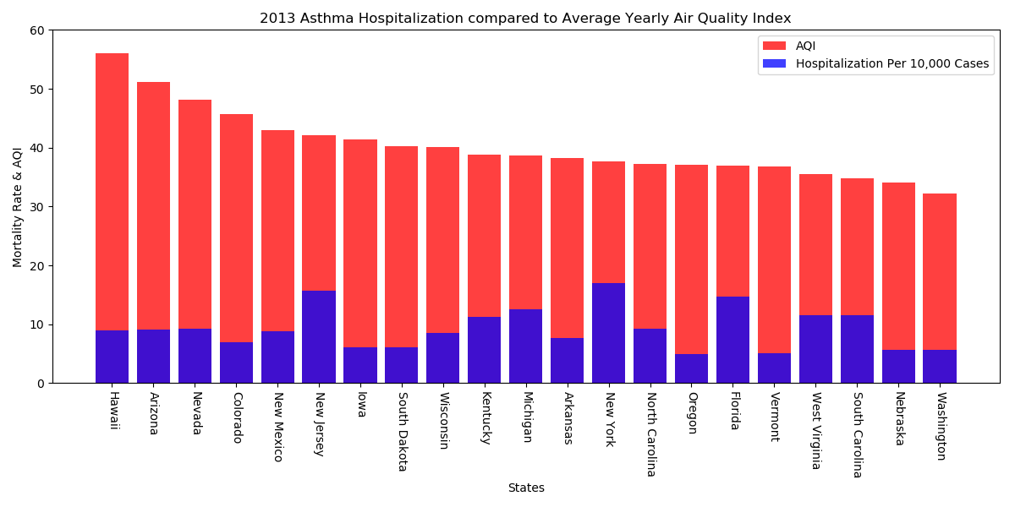
Air Quality Index compared to Asthma Hospitalization
Notes:
Hypothesis:
Results:
Data Limitations:

Slide 16
Questions

