Slide 1
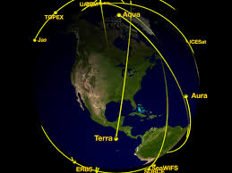
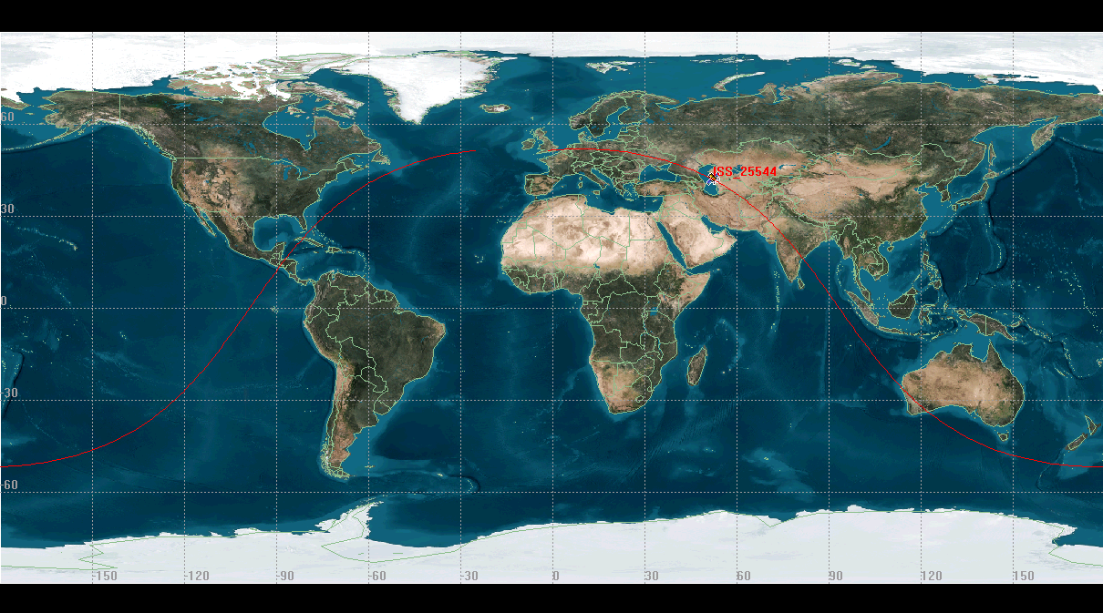
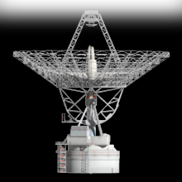

Satellite Details:
Name
Round trip time
Altitude
Any other data from satelite
Ground Station Details
Name
Coordinates
Altitude
Min horizon
Antennas and frequency

Slide 2
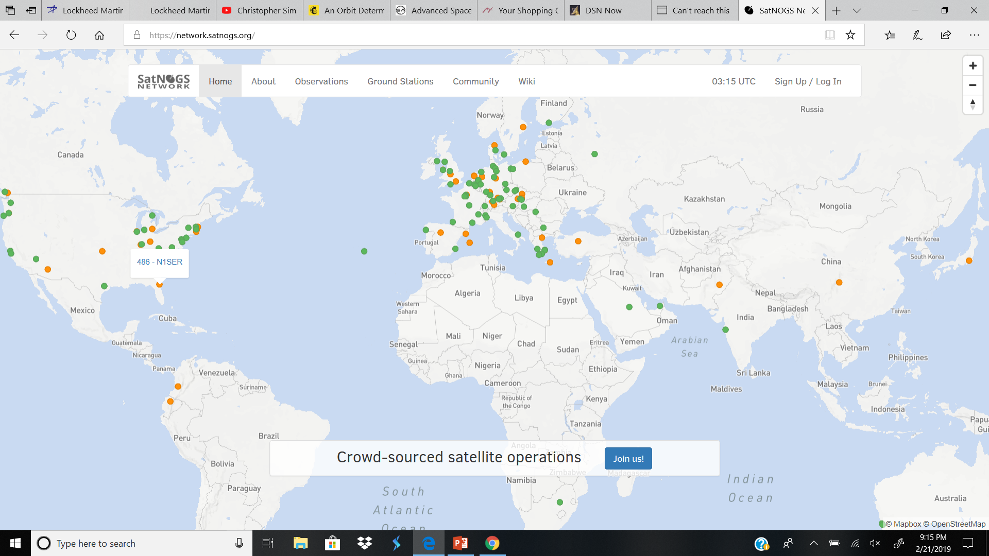
All Satelites and Ground Stations
List of Satelites:
List of Ground Stations:

