Slide 1

Silos are for farmers
Julian Simpson
The Build Doctor
http://www.flickr.com/photos/eqqman/142532682/

Slide 2
Visit
http://bit.ly/devopsqcon
for links and notes

Slide 3


About:
1. Introduction
2. Advice
3. Questions?
http://www.flickr.com/photos/voght/2258089069/
Notes:
* do the check on the particpants
* summary is
** The IT industry is broken
** We’re caught up in silos
** We’re failing to deliver because of it
** And some people don’t even enjoy their work

Slide 4
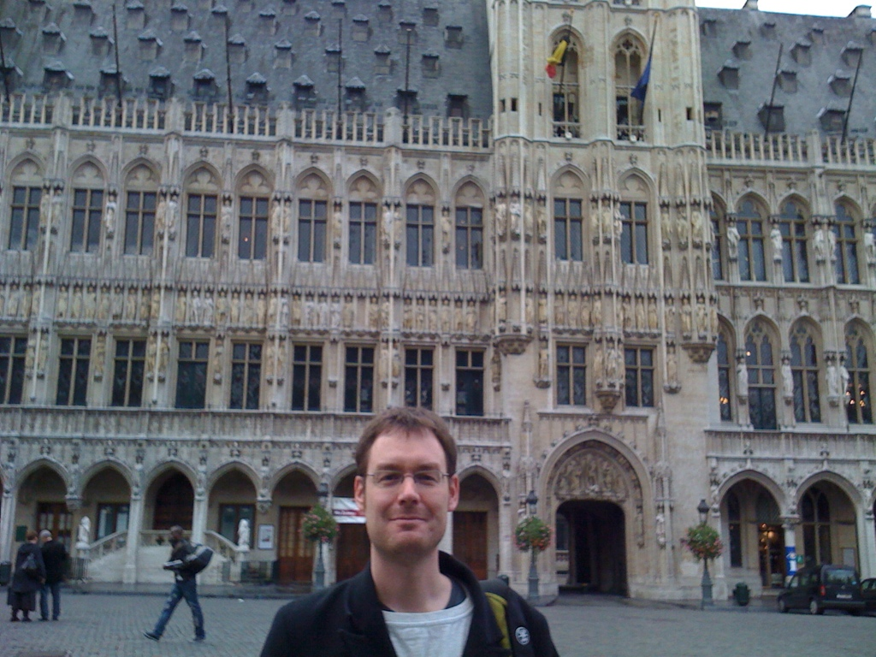
Me
Notes:
Entered IT Industry in 1991. First task: rolling up cables to exacting standards of fastidious boss
Brief foray as screwdriver and TCP fix-er
Solaris Admin
build and release manager
blogger at build-doctor.com

Slide 5
Conflict

Slide 6
“Don't waste my time, buddy. You're just a dogsbody sysadmin; I write the software and you merely service it. So just shut up with your petty concerns and do as I say, OK?”
Taken from http://serverfault.com/questions/16698/what-do-you-wish-developers-would-do-differently

Slide 7
"The Fuckup Fairy is a developer
who has only been on the project
for 6 months or so ...... This touched off The Pontificator.
The Pontificator is another developer ..."
Taken from alt.sysadmin.recovery

Slide 8
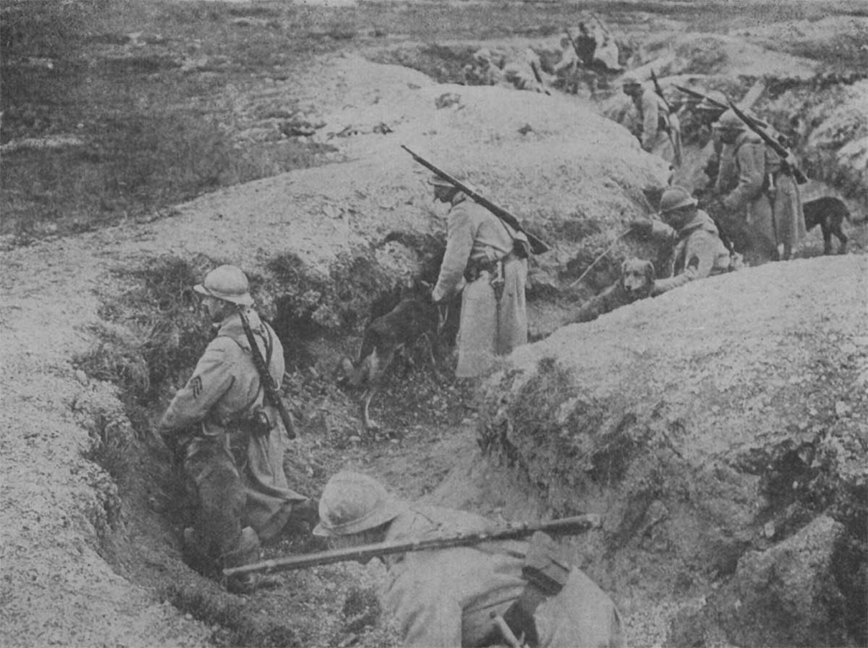
It shouldn’t have to be like this
http://www.flickr.com/photos/angells60640/3411660099/
Notes:
Example: sequence 2001-2004
Impact: we certainly delivered late
Bad devs, who the ops team didn't help, but chose to get pissed off at
Good ops team, but attitude poor in retrospect
Vicious cycle of passive aggression, political needling
Social group theory
Entire department collocated in room but argued over email and IM
Who gives out these incentives? Sociopaths? Sociopaths do well in organisations

Slide 9
“That brings me to Dennis Ritchie. Our collaboration has been a thing of beauty” --Ken Thompson
Notes:
Do you think these guys argued about who did the deployments
Most teams seem to have an adversarial approach "we just need to get this past the operations" "damn developers keep dumping crap on us"
Does an adversarial approach work well in many situations, even in legal?
Collaboration is key to all working in organisations
Yet we pass work around as if we were assembling TV's
We're passing up effecting collabotation to score points

Slide 10
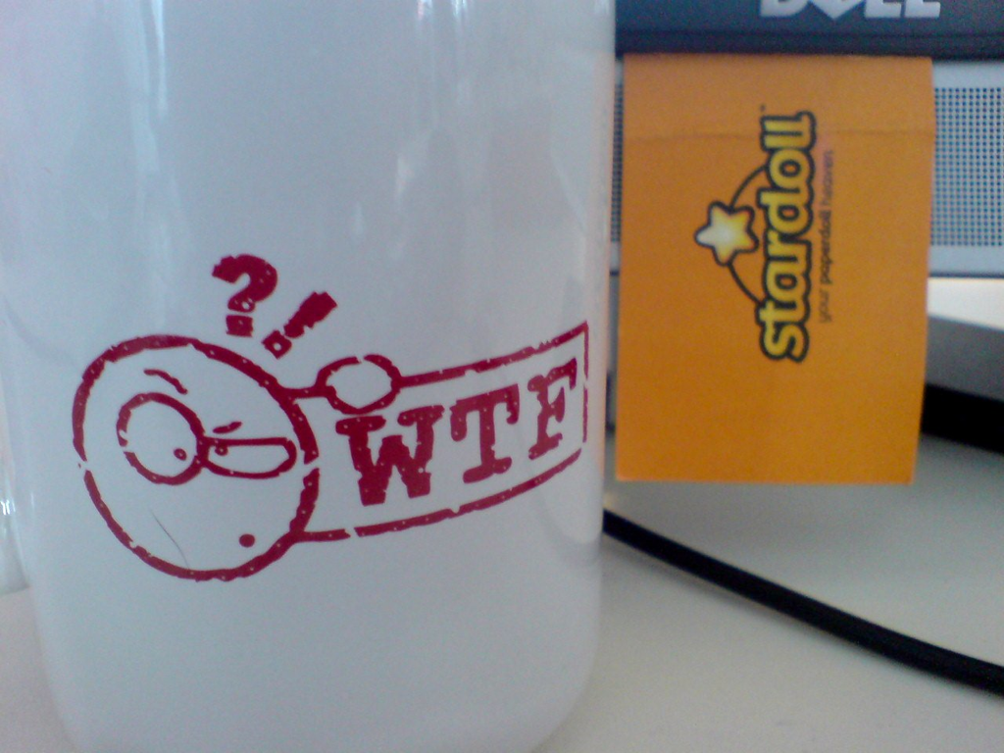
Some developers aren’t very good
http://www.flickr.com/photos/schmilblick/2629823009/
Notes:
There's no need for me to cite examples of underskilled developers when the DailyWTF does it so well.
Worked with many, many developers who were out of their league but had incentives to stay in the game
You won't get co-operation with someone who doesn't feel equal to the other party
Most of us don't know how to hire good developers
Warning signs: won't pair, prefer to work alone, talking loud, but delivering little

Slide 11
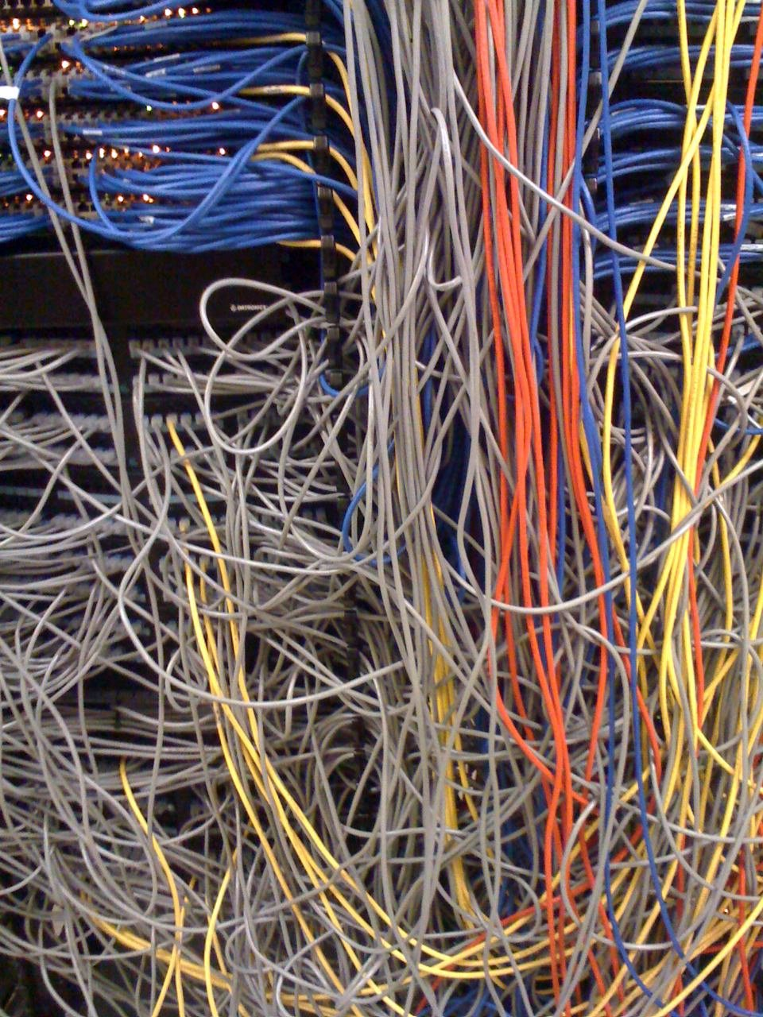
Nor some systems administrators
http://www.flickr.com/photos/alq666/2248613780/in/photostream
Notes:
Exact same problem with sysadmins
Sometimes harder to document, but go to pub with sysadmins: the stories are there
We don't know how to hire them either
Warning signs, everything is a security risk, excessive caution, failing to use sudo or SSH pubkey

Slide 12

Some people want to hide
http://www.flickr.com/photos/wbaiv/3236672907/
Notes:
If people aren't just conditioned to make meetings, plan 'catch-ups', telephone calls, write email
Then they are using the organisation to hide - policy is my favourite

Slide 13

Advice
http://www.flickr.com/photos/quinnanya/3457792408/
Notes:
People,
Process
Technology

Slide 14
People
Notes:
Why people?
Gerald Weinburg’s Second law of consulting “No matter how it looks at first, it’s always a people problem.”

Slide 15
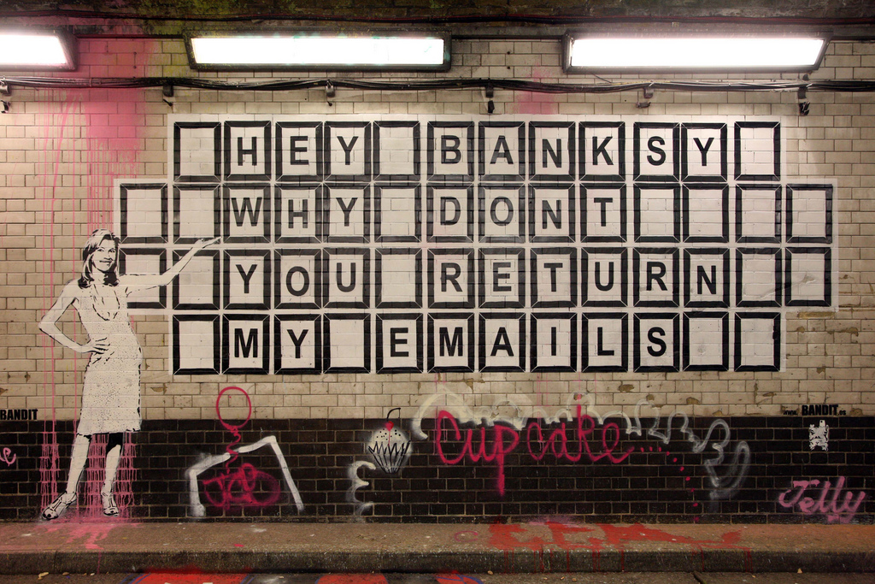
Don’t use email. Just don’t.
http://www.flickr.com/photos/brunogirin/2484786902/
Notes:
We know that email removes most of the communication.
One study at UCLA indicated that up to 93 percent of communication effectiveness is determined by nonverbal cues. Another study indicated that the impact of a performance was determined 7 percent by the words used, 38 percent by voice quality, and 55 percent by the nonverbal communication.
And we’re really, really bad at writing them, too. Stop!

Slide 16
Respect everyone
Notes:
They may not share your views, but that doesn’t stop them being valuable
Sysadmins and developers have different skills, but there’s no excuse to disrespect anybody because of their career path

Slide 17

Have lunch with the people on the other side of the wall
http://www.flickr.com/photos/balakov/1614997917/
Notes:
It's a meeting with a purpose
You might learn something

Slide 18

Discuss your problems
with other groups.
http://www.flickr.com/photos/clairity/154640125/
Notes:
Part of theme of engaging early with sysadmins
Sysadmins love problem solving
Usually don't like being presented with a problem and solution

Slide 19
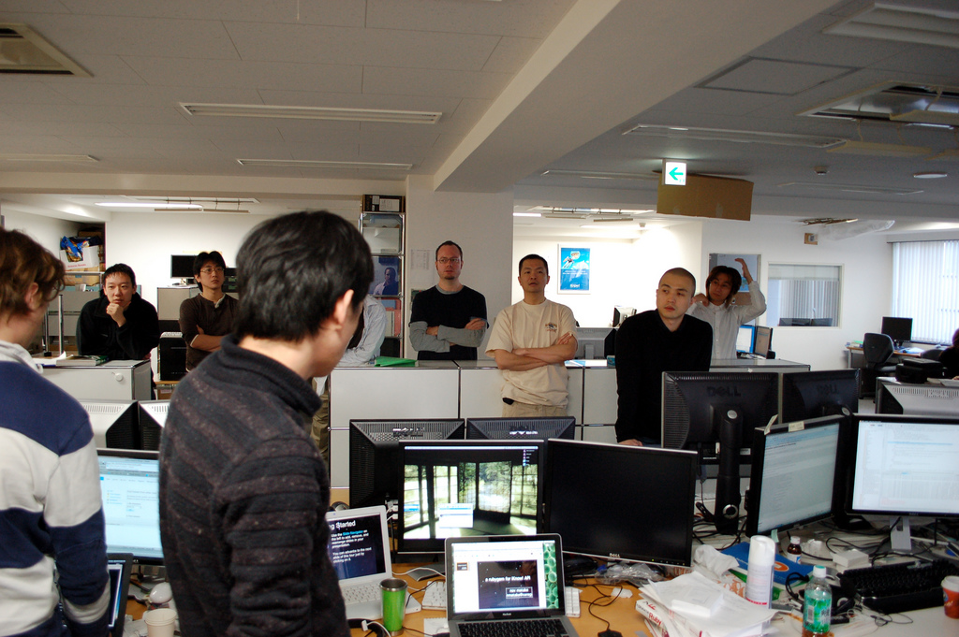
Invite everyone to stand-ups ...
... and retrospectives
http://www.flickr.com/photos/kimtaro/3393958979/
Notes:
It's that whole team thing. Can be boring, but better to overcommunicate.

Slide 20

Co-locate the sysadmins and developers
http://www.flickr.com/photos/parap/4355237522/
Notes:
Nonverbal communication again
Face-to-face is only way to overcome communication barriers
Further the distance, less the effort
Different building might as well be in a different city

Slide 21
Process

Slide 22
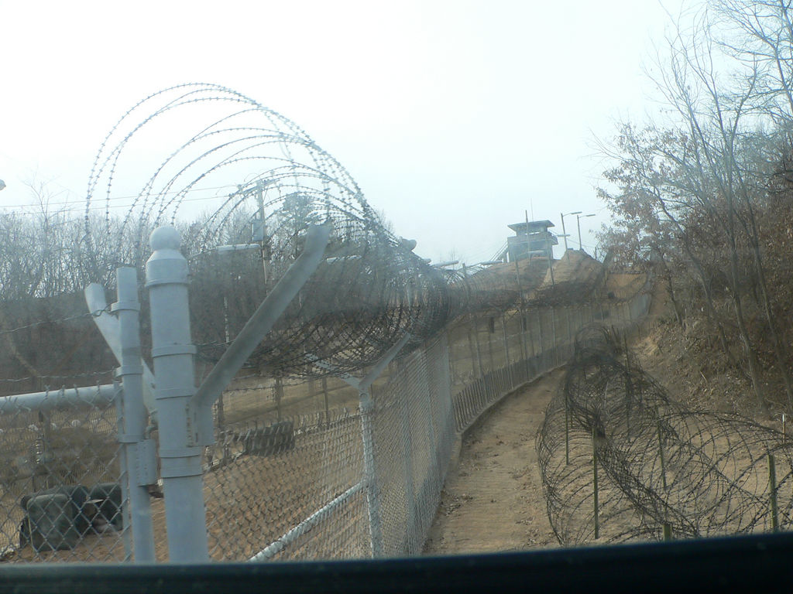
There should be no code ownership
outside business code, either
http://www.flickr.com/photos/nagy/4658629/
Notes:
Collective code ownership is a good rule. Reduces bus factor and onboarding and allows us to plow forward with development
But why do we stop there?
We slow down when the release and build scripts are owned by 1 person.
Pure Theory of Contstraints to
Often people who maintain these aren’t be best coders in the room
Who wants that?

Slide 23
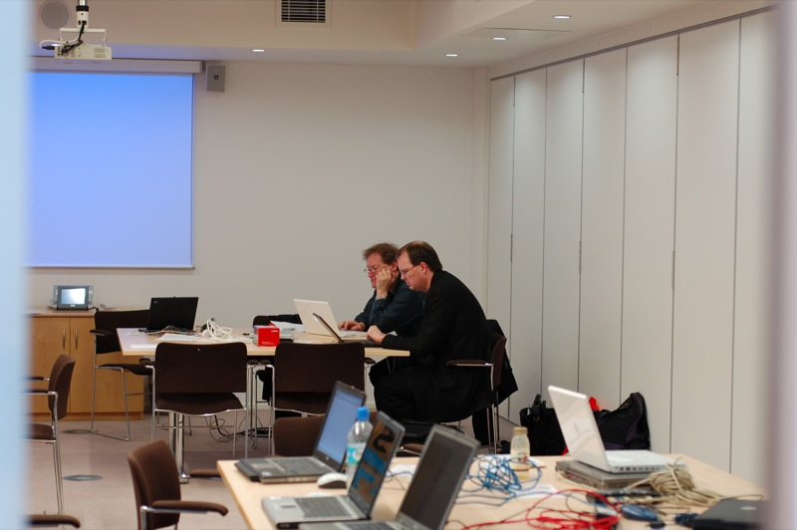
Pair with your sysadmin
http://www.flickr.com/photos/adewale_oshineye/306143949/
Notes:
This won't feel natural at first
Harder. because of lack of tools (pairing with vi can be hard)
Great, safe way to learn
Paiting with DBA

Slide 24

It’s done when the code is in production
http://www.flickr.com/photos/mar1lyn84/2911863640/
Notes:
You're faking it unless you count them as done when they are in production
This gives incentive to help the deploy effort

Slide 25
Tools

Slide 26
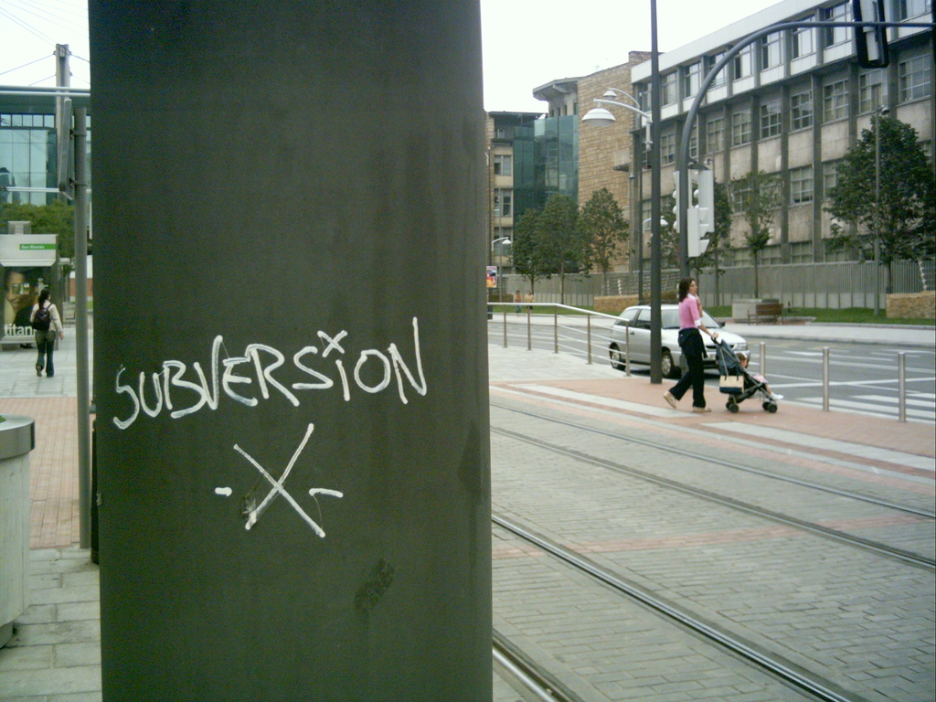
Teach your sysadmins to use version control
http://www.flickr.com/photos/daquellamanera/70740020/
Notes:
An operations job is about tracking and controlling change. Why wouldn't you?
I suspect the answer is cultural - it's seen as a developer
But we’re all developers
Don't use fancy vendor tools, don't use CVS either

Slide 27
Help your developers write performant code
Help developers with managing their dev environment
(like SSH public keys)
Notes:
Why watch someone flounder?
Some sysadmins don't use SSH properly. Those who do, do well. Help developers become more fluent on the systems that you manage. They'll only thank you.

Slide 28

Run your deploy scripts via CIUse continuous deployment
http://www.flickr.com/photos/clofresh/3384877145/
Notes:
Knowing that your code is undeployable should focus the mind. I've done this, and it helped the testing no end, and it helped derisk the prod deploys
Continuous deployment might not be 50 days to prod
But why not 50 a day to a test server?
CD needs adapting for some domains
But you can take the principles

Slide 29
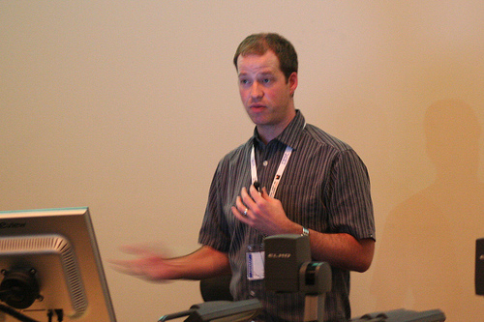
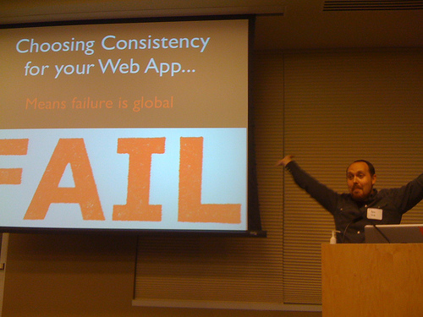
http://www.flickr.com/photos/varrqnuht/2228454518/
Use Puppet or Chef
http://www.flickr.com/photos/34526794@N00/4164784445/
Notes:
You don't need to choose one or the other
You need to get good at modelling your systems
And then the choice of tool should come second
Remember this is a VI vs Emacs/Ruby vs Python - you should be focusing on automating well - the other guys are the ones telling the CTO that installing stuff by hand is cool

Slide 30
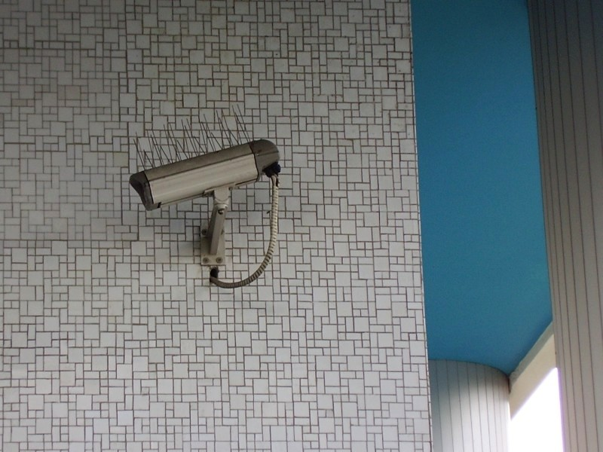
Synthesize monitoring and CI
Test monitoring in dev environment
http://www.flickr.com/photos/34997655@N02/3914526029/
Notes:
Big visible state of your build: fine. What about your build infrastructure?
@auxesis compares the two
Don't you want to know? What about production? Is that broken?
It's easy to write plugins to monitoring systems.

Slide 31

OS Packages are your friend
http://www.flickr.com/photos/avlxyz/3014317179/
Notes:
OS packages contain useful metadata
It means you can match up your application and its native dependencies
Doesn't help developers all that much but it helps sysadmins a boatload
Development help in delivering these can be a godsend to devs, and likely to make you a hero
Tripwire effect
"how often do you ask the sysadmin what they want? - or do you just show up and ask them to deploy something?

Slide 32
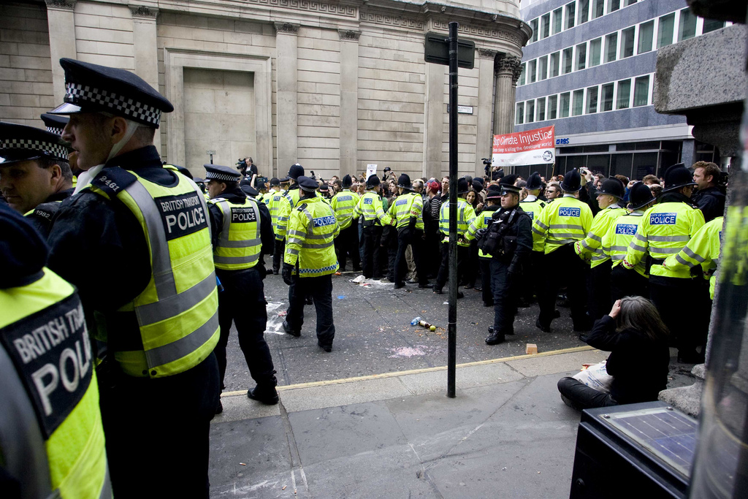
Separate binaries and configuration
http://www.flickr.com/photos/kashklick/3406964390/
Notes:
What works for your desktop and your very first single-node test environment may not work for all environments
This will hurt everyone unless you head it off at the pass
Seems obvious but I've had people fight me on it

Slide 33
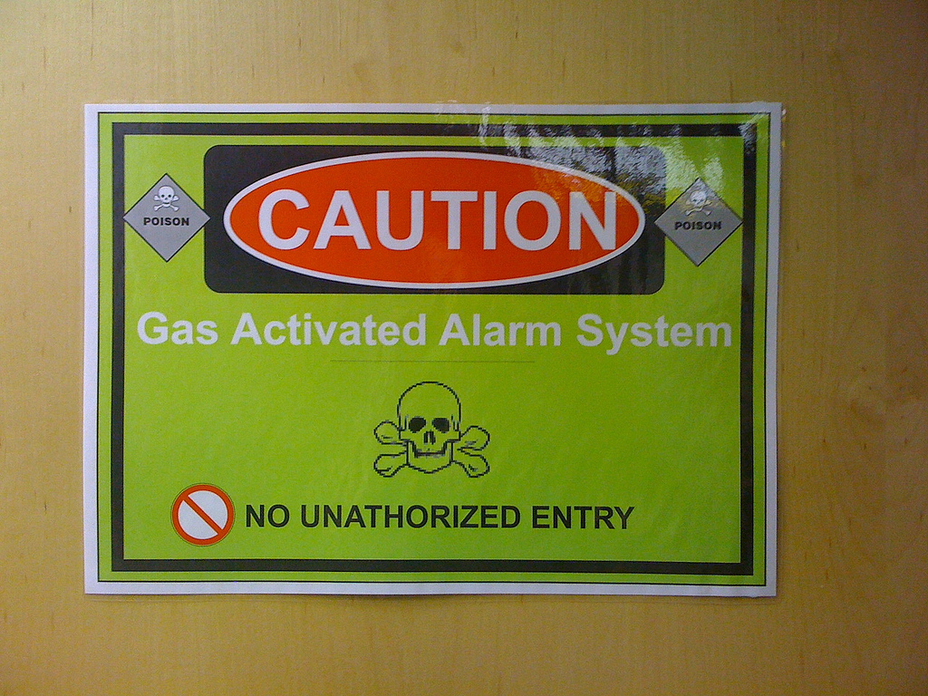
Harden systems immediately
and enable logging
for tuning security configuration
http://www.flickr.com/photos/kdga/3811644033/
Notes:
Making development systems too easy to deploy to causes deployment problems down the line.
Make development a little more like production and gradually roll it out.
YouDevise have UAT at the production facility

Slide 34
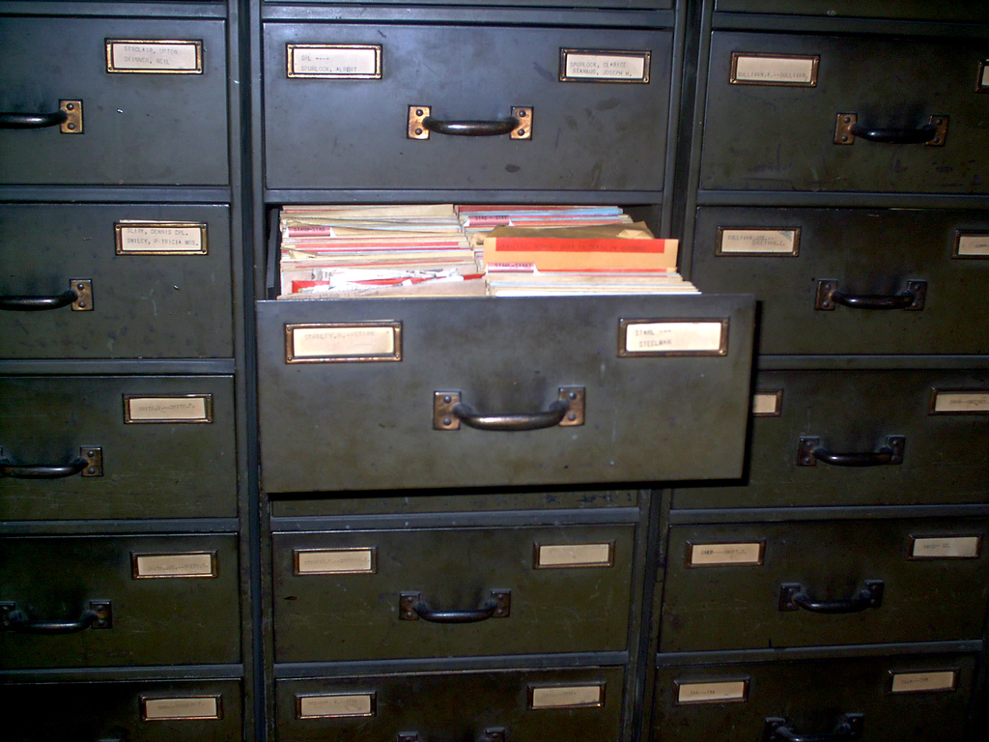
Give developers access to production logs and data
http://www.flickr.com/photos/misterdna/49841409/
Notes:
Feedback loop. If you can't see what your code does in production, how can you improve?

Slide 35
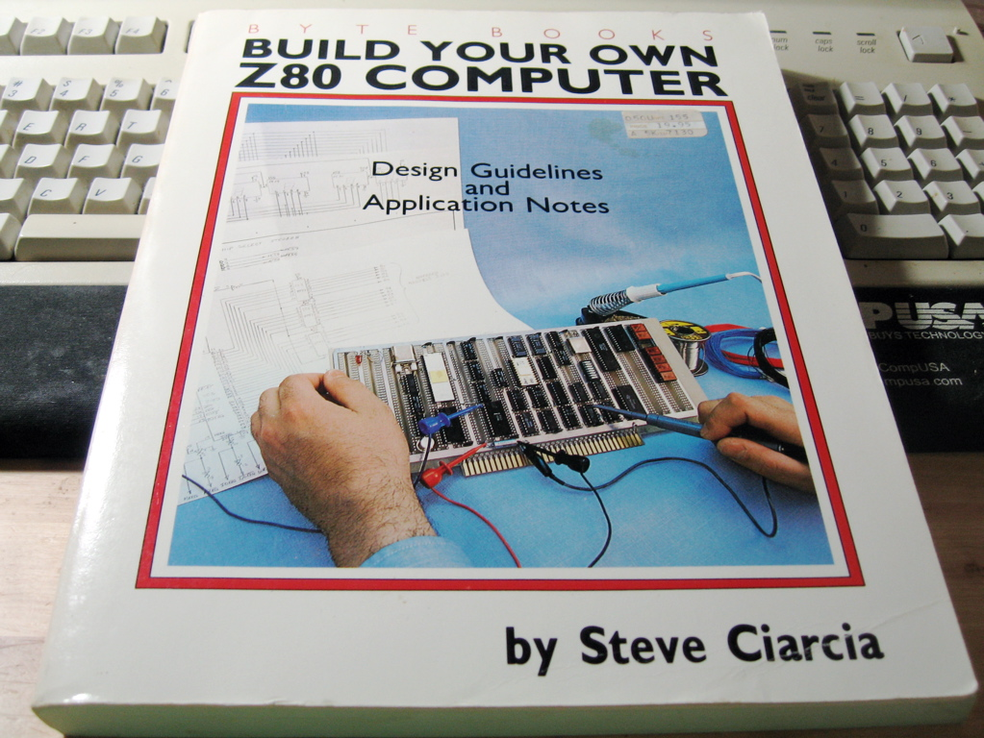
Re-create the developer environment often
http://www.flickr.com/photos/mrbill/159064314/
Notes:
Little tweaks here and there go unoticed. REbuilding frequently forces us to have a process. rebuilding any system is possible these days with puppet.

Slide 36

Questions?
http://www.flickr.com/photos/erikcharlton/2303709058/

Slide 37
Thank you!
More at:
http://build-doctor.com
http://twitter.com/builddoctor

