Slide 1

Welcome to StudyBuddy
Probiere es aus!
Try it yourself!
StudyBuddy
Exams are coming!
Already have a study
partner?
Find one with
StudyBuddy!
StudyBuddy

Slide 2
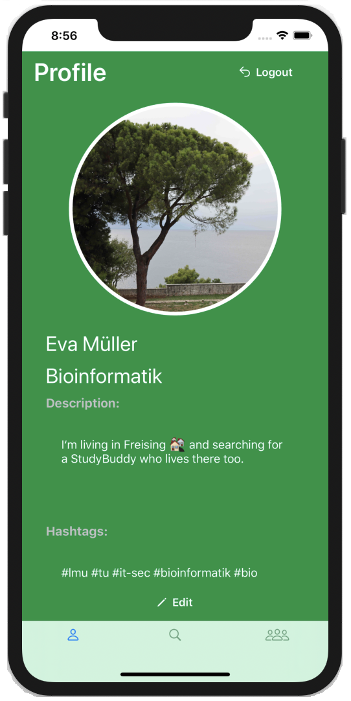
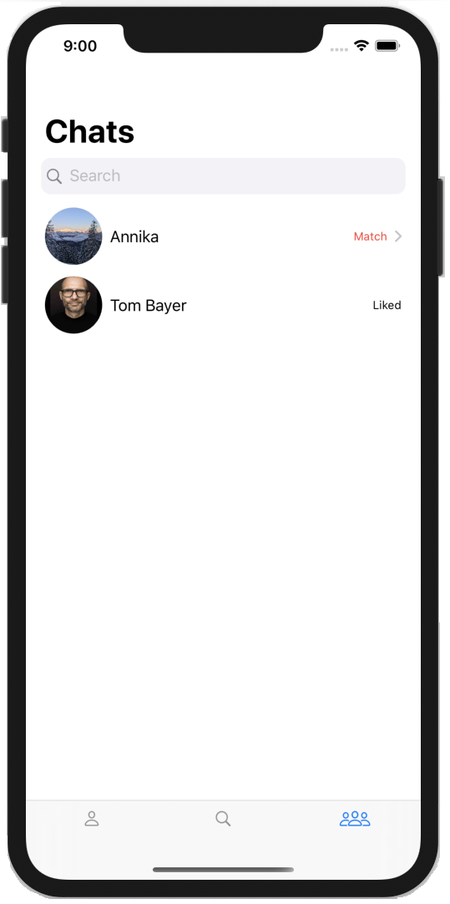
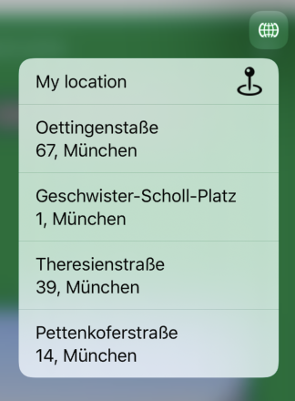

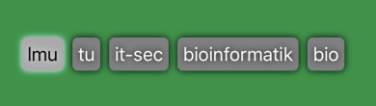
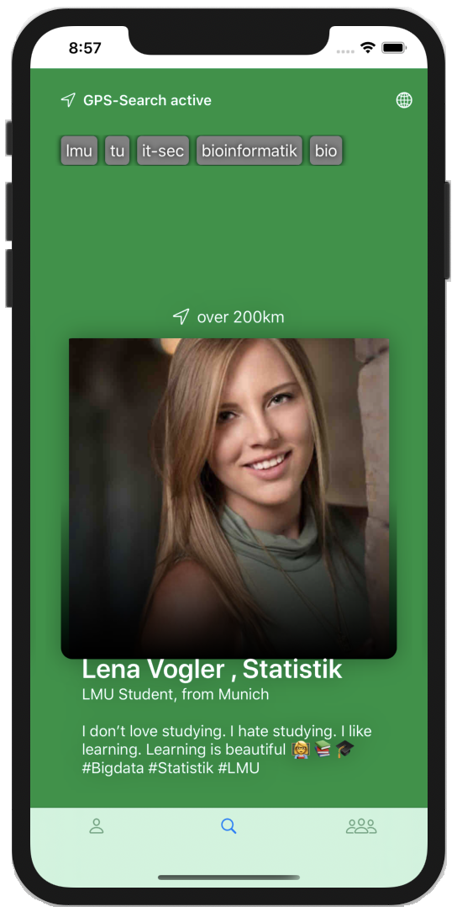
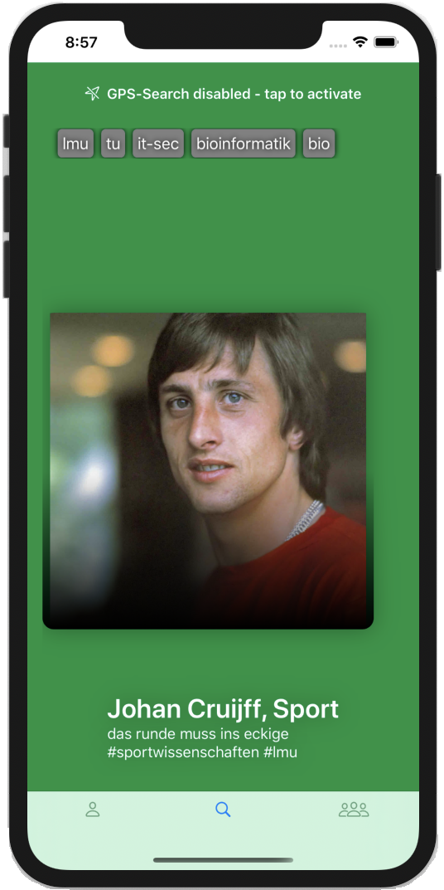
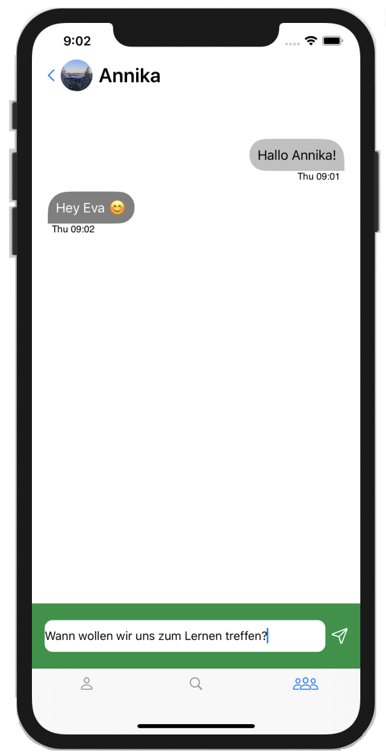




Create your profile
Change
your location
to a different place
When you
have a
Match
–
Let‘s chat!
Use # to filter
#LMU
Search for a StudyBuddy
Find a place to
study, get
motivated and
graduate your
exam!
double-tap to like
with GPS-location
or without GPS-location

