Slide 1
Customer Segmentation
using RFM Analysis & K-Means Clustering
Data Mining Project
Author: Naqash Amjad
University: [ IMSciences / MSDS ]
Course: Data Mining

Slide 2
Project Overview & Motivation
❓ The Problem
💡 Why It Matters
🔬 Our Approach
A UK online retailer has 1M+ transactions but no customer labels. We need to discover natural groups from pure transaction history — no supervision required.
Personalised marketing, targeted retention, and smarter budget allocation all depend on knowing which customers are valuable, loyal, at-risk, or dormant.
RFM feature engineering + K-Means clustering, following the full CRISP-DM lifecycle from business understanding through deployment-ready segment profiles.
Framework: CRISP-DM · Dataset: UCI Online Retail II · Language: Python / scikit-learn

Slide 3
Dataset
UCI Machine Learning Repository — Online Retail II
1,067,371
43
2 Years
Total Transactions
Countries
Dec 2009 – Dec 2011
Key Columns
Data Quirks
Column | Description
Invoice | Unique transaction ID (prefix 'C' = cancellation)
CustomerID | Unique customer identifier (has nulls)
InvoiceDate | Timestamp of the transaction
Quantity | Units purchased (negatives exist)
Price | Unit price in GBP (negatives exist)
Country | Customer's country
C-prefix invoices = cancellations
~23% of rows have null CustomerID
Negative Quantity & Price values exist
Duplicate rows present

Slide 4
Data Preprocessing Pipeline
1
Remove Null Customer IDs
Final Clean
Dataset
243,007 rows removed — cannot assign spending without an ID
2
Remove Cancelled Transactions
779,425
19,494 rows removed — C-prefix invoices flagged as returns
rows
3
Remove Non-Positive Qty & Price
Negative and zero values are erroneous data entries
from 1,067,371 raw
4
Remove Duplicate Rows
34,335 exact duplicates removed
5
Engineer TotalPrice Column
TotalPrice = Quantity × Price → ready for RFM aggregation

Slide 5
RFM Feature Engineering
Feature | Definition | Reference
Recency (R) | Days since last purchase | Ref: 10 Dec 2011
Frequency (F) | Count of distinct invoices | Per customer
Monetary (M) | Total spending (£) | Sum of TotalPrice
Transformations Applied
📐 log1p Transform
🚫 IQR Outlier Removal
⚖️ StandardScaler Norm.
Applied to R, F, M to reduce right-skew towards a more normal distribution
877 extreme customers removed; bounds per feature using 1.5 × IQR rule
Zero mean, unit variance — ensures K-Means treats each dimension equally
Final dataset: 5,001 customers with clean, normalised RFM features

Slide 6
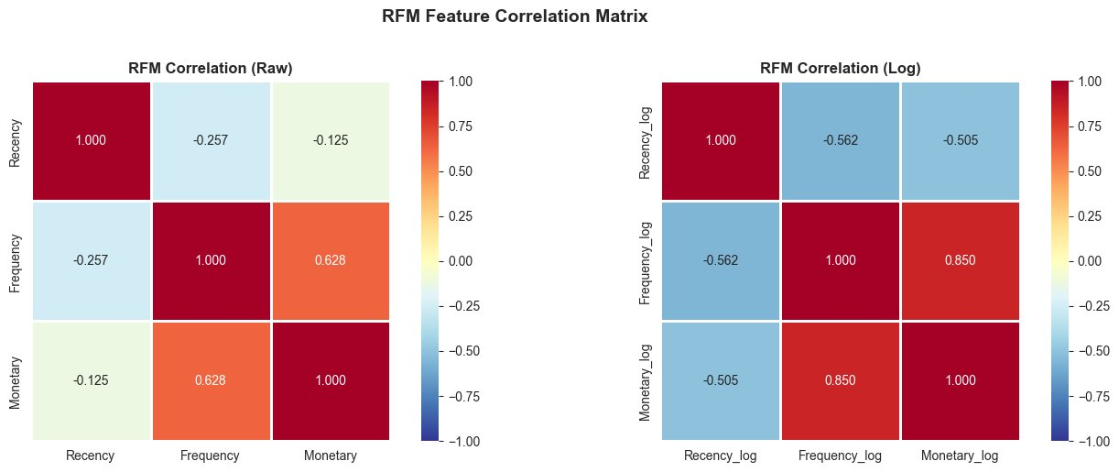
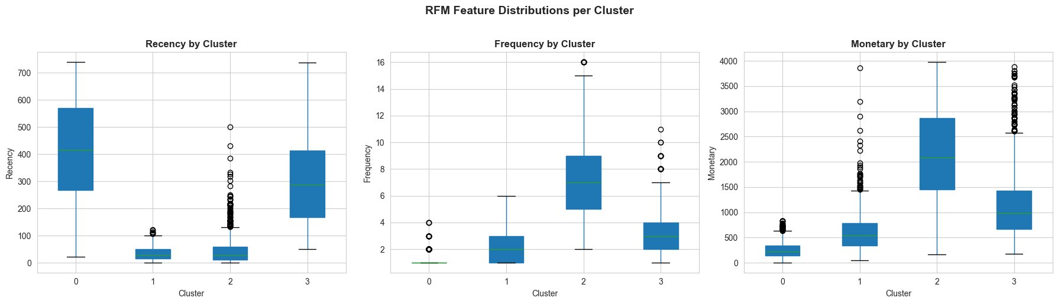
Exploratory Data Analysis
Key Findings
1
Raw RFM features are heavily right-skewed. log1p transform successfully normalised all three distributions.
2
Frequency & Monetary are moderately correlated (r = 0.63 raw, 0.85 log). Recency is largely independent.
3
UK dominates (>90% of customers). Germany and France are the next largest markets.

Slide 7
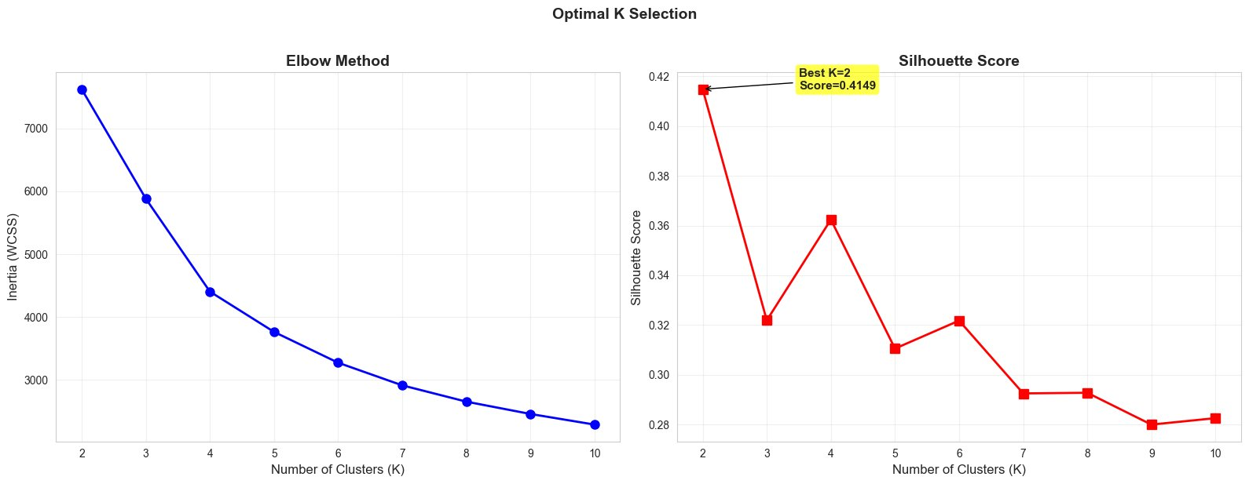
Choosing K: Elbow Method & Silhouette Analysis
K | Inertia | Silhouette
2 | 7,620 | 0.4149
3 | 5,870 | 0.3216
4 | 4,400 | 0.3624
5 | 3,780 | 0.3140
6 | 3,300 | 0.3216
7 | 2,930 | 0.2885
8 | 2,660 | 0.2895
9 | 2,480 | 0.2800
10 | 2,330 | 0.2820
Why K = 4? K=2 peaks at silhouette 0.4149 but yields only two vague groups. K=4 delivers four distinct, business-interpretable segments (Champions, Loyal, At-Risk, Hibernating) with a silhouette of 0.3624 — the next local maximum after K=2.

Slide 8
Experimentation — 12 Model Configurations
Scaler | IQR Removal | K | Silhouette | Notes
StandardScaler | No | 3 | 0.3080
StandardScaler | Yes | 4 | 0.3624 | ★ Final Model
StandardScaler | Yes | 5 | 0.3140
MinMaxScaler | No | 3 | 0.3200
MinMaxScaler | No | 4 | 0.3510
MinMaxScaler | Yes | 3 | 0.3620
MinMaxScaler | Yes | 4 | 0.3944 | Highest silhouette
MinMaxScaler | Yes | 5 | 0.3380
RobustScaler | No | 3 | 0.3150
RobustScaler | No | 4 | 0.3500
RobustScaler | Yes | 4 | 0.3610
RobustScaler | Yes | 5 | 0.3290
MinMaxScaler+IQR+K=4 achieves the highest silhouette (0.3944), but StandardScaler+IQR+K=4 is chosen as the principled default for log-transformed data — delivering consistent, interpretable results.

Slide 9
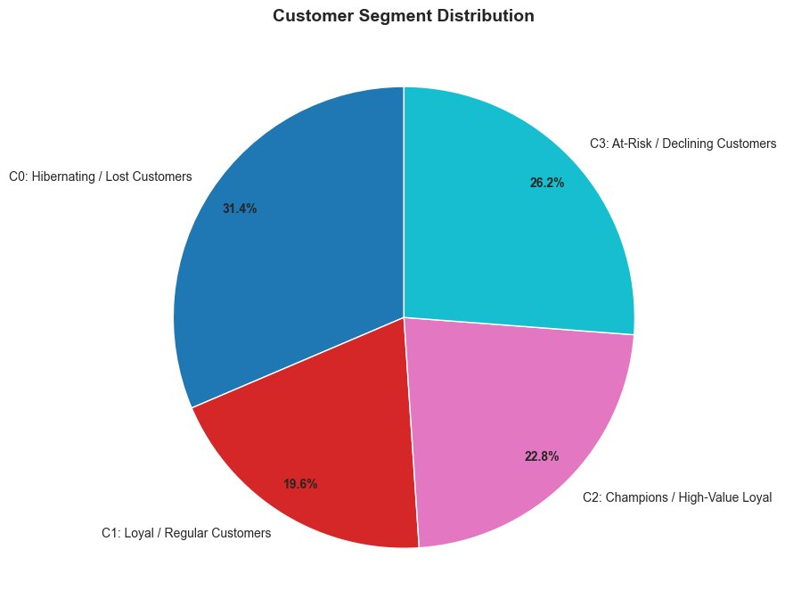
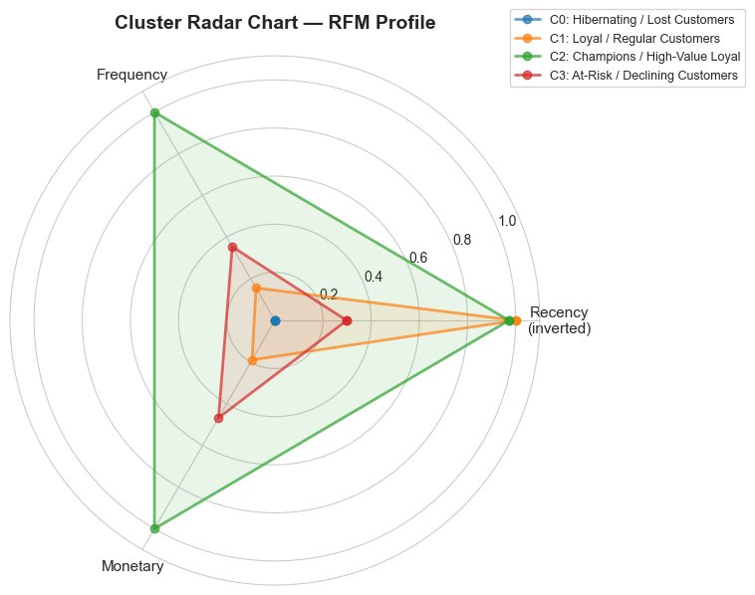
Final Cluster Profiles
Cluster | Label | Size (n) | Avg Recency | Avg Frequency | Avg Monetary
C0 | Hibernating / Lost | 1,571 (31.4%) | 415 days | 1.2 | £247
C1 | Loyal / Regular | 982 (19.6%) | 35 days | 2.2 | £613
C2 | Champions | 1,138 (22.8%) | 45 days | 7.7 | £2,180
C3 | At-Risk / Declining | 1,310 (26.2%) | 301 days | 3.5 | £1,151
Label assignment: rank-based composite scoring on R (inverted), F, and M across clusters.

Slide 10
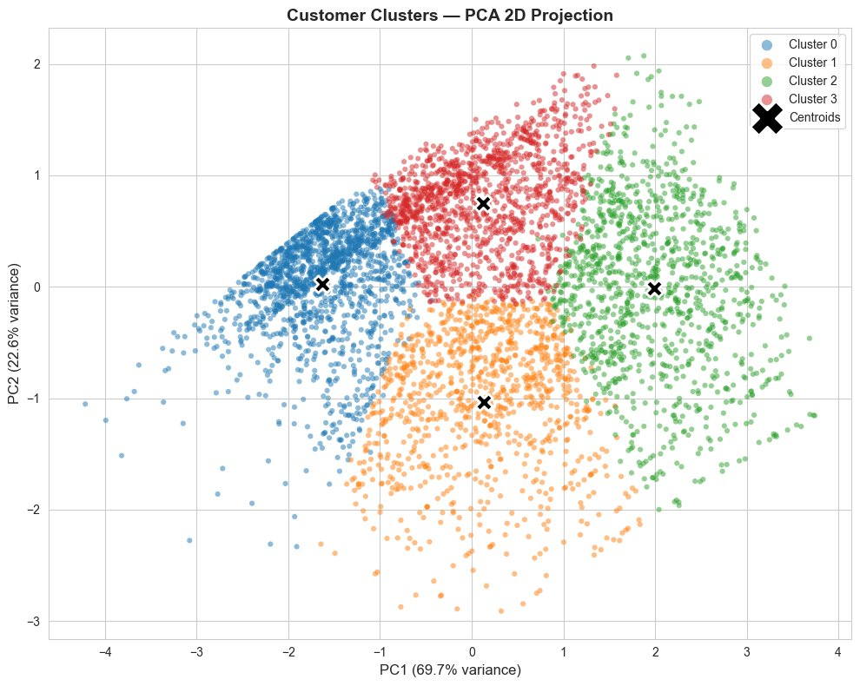
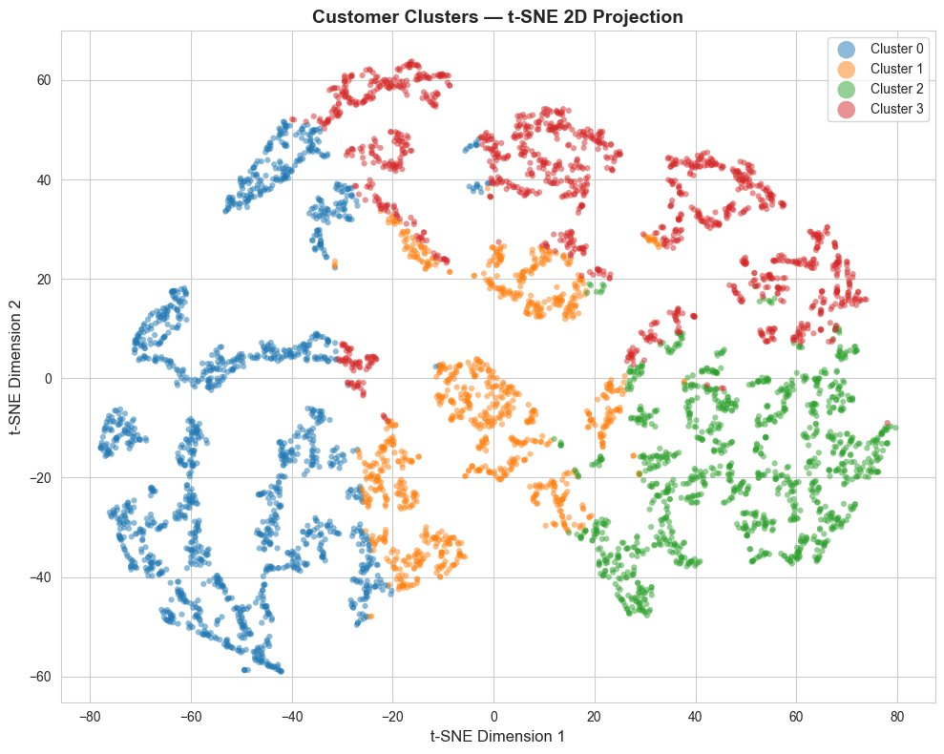
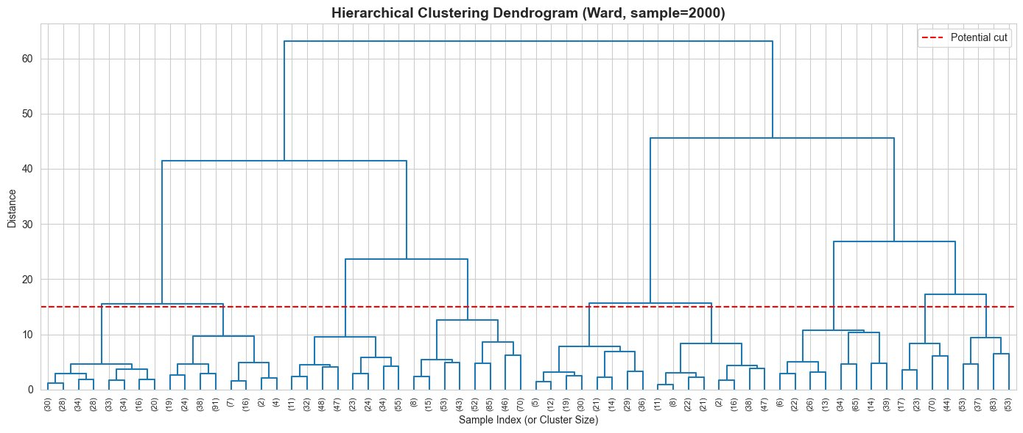
Cluster Visualisations
PCA 2D Projection (69.7% + 22.6% variance explained)
t-SNE 2D Projection (non-linear, cluster topology)
RFM Radar Chart
Hierarchical Dendrogram (Ward linkage, n=2000 sample)

Slide 11
Business Strategies per Segment
🏆 Champions (C2)
⭐ Loyal / Regular (C1)
Invite to exclusive VIP / loyalty tier programmes
Personalised product recommendations and early access
Encourage referrals — these customers are your advocates
Bundle offers and volume discounts to increase basket size
Loyalty emails with personalised thank-you messages
Birthday and anniversary discounts to deepen relationship
⚠️ At-Risk (C3)
💤 Hibernating / Lost (C0)
Win-back campaigns with time-limited discount codes
Customer satisfaction surveys to understand churn drivers
Targeted re-engagement emails referencing past purchases
Low-cost re-engagement emails based on purchase history
Test small incentive to gauge residual interest
Accept a portion will not return — focus budget elsewhere

Slide 12
Conclusion
1
5,001 customers successfully segmented into 4 clear, interpretable groups via K-Means on RFM features.
2
Final model (StandardScaler + IQR removal + K=4) achieves Silhouette Score = 0.3624.
3
End-to-end CRISP-DM workflow followed: from raw data through cleaning, EDA, modelling, and evaluation.
4
Each segment maps to concrete, actionable marketing and retention strategies.
"Segmentation turns transaction data into strategy."

