Slide 1

Lottery Draw Engine Presented By : Simpy Surbhi

Slide 2
Purpose
This guide has been created to capture below point:
Requirement Details
Flow Diagram
Application Screenshot
Solution Algorithm

Slide 3
Requirement
Step 1: User Input data store in Database(including User Name, Email Id, Phone Number, Lottery Number, Lucky Number, Grid Number)
Step 2: Generate Lottery Result (Lottery Number and Lucky Number) and store in Database.
Step 3: Map User Input data and Lottery Result
Step 4: Get User rank through step 3

Slide 4
Rule Game Rules
Players can play up to 5 Grids
For each "grid" the player chooses 7 numbers from 1 to 49 and one lucky number between 1 and 10.
Every Saturday a draw is organized to draw the 7 winning numbers and the lucky number and to find the winners.
At the end, each winner is assigned a rank as shown:
Rang | Résultat
1 | 5 numéros + numéro chance
2 | 5 numéros sans numéro chance
3 | 4 numéros + numéro chance
3 | 4 numéros sans numéro chance
4 | 3 numéros + numéro chance
4 | 3 numéros sans numéro chance
5 | 2 numéros + numéro chance
5 | 2 numéros sans numéro chance
6 | 1 numéro + numéro chance
6 | aucun numéro + numéro chance

Slide 5
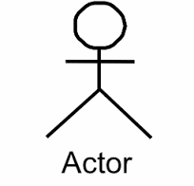
Flow Diagram
DB(Table Members)
process
Delete Previous Data
store
Input User Data
Show Success Message
DB(Table Result)
Process
Mapping
Delete Previous Data and store new generated number
Generate Result
Generate Lottery and Lucky Number
DB(Table members)
DB(Table Result)
Read
Mapping Lottery Number and Lucky Number
Show Result
Show Result

Slide 6
Technologies
PHP
JavaScript
HTML
CSS
Bootstrap
PhpMyAdmin

Slide 7
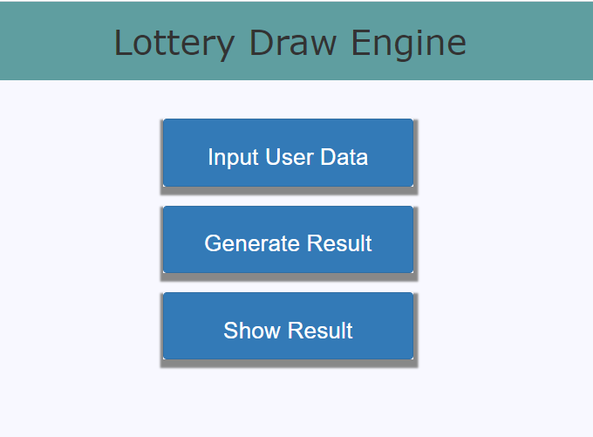
Home Page

Slide 8
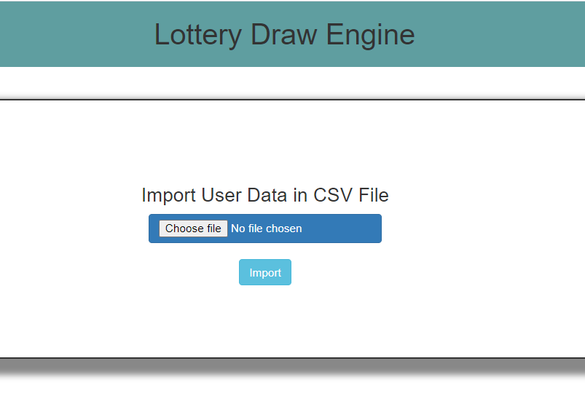
Input User Data Page

Slide 9
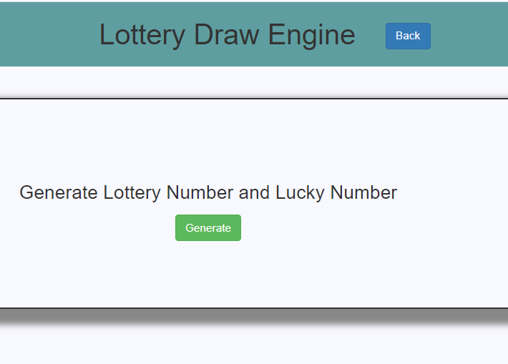
Generate Result Page

Slide 10
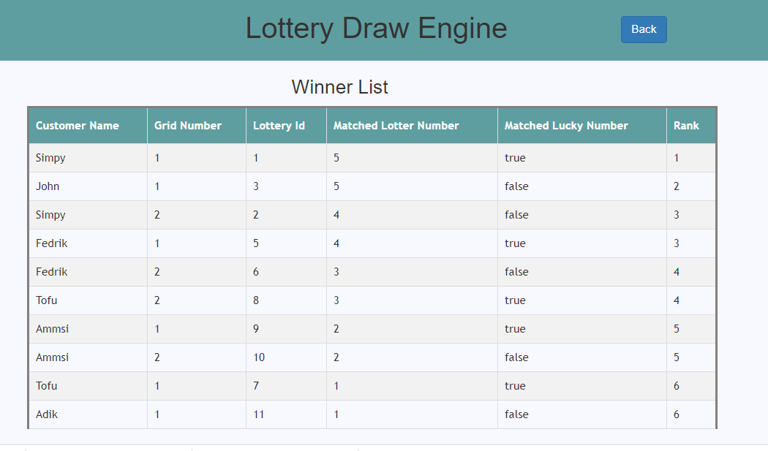
Winner List

Slide 11
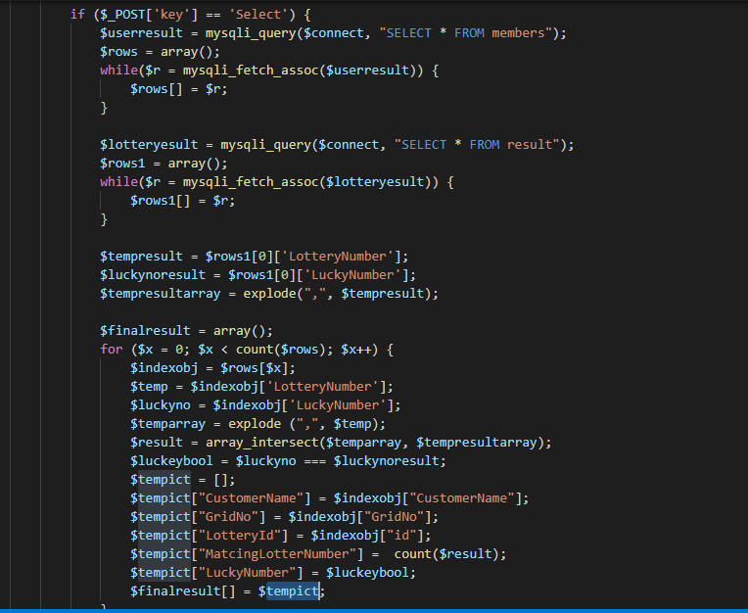
Solution

Slide 12
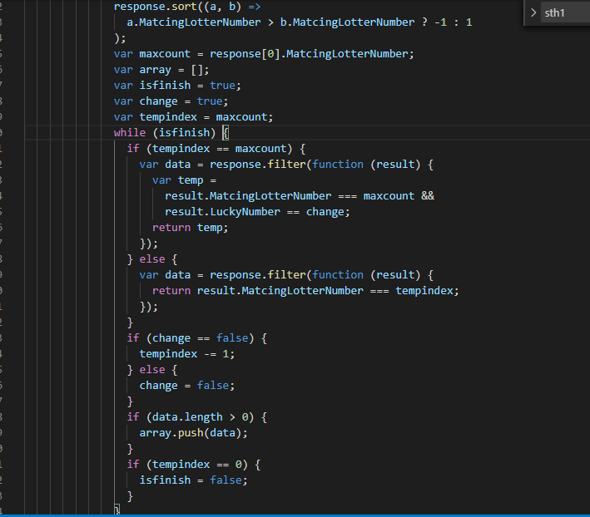
Solution

Slide 13
Thank You

