Slide 1
Structured Prediction for Language and Other Discrete Data 11-763
Introductory Lecture
Taylor Berg-Kirkpatrick and Bhiksha Raj
Slides adapted from
Chris Dyer, William Cohen, and Noah Smith

Slide 2
Course Information
Course website (link might not work yet): http://structuredprediction.cs.cmu.edu
Piazza: should have gotten email!
Canvas: check your email soon!
TAs:
Chaitanya Ahuja
Simral Chaudhary
Shubham Tripathy

Slide 3
Course Requirements
Prerequisites:
Upper division algorithms (dynamic programming)
Strong background in machine learning (e.g. 701)
Strong programming skills
Work and Grading:
5 Assignments (mostly coding, some written)
Will turn in assignments on Canvas

Slide 4

The Book
Linguistic Structure Prediction
Available in electronic form (free at CMU) and print form.

Slide 5
Other Announcements
Course Contacts:
Website: slides, readings, assignments
Piazza: announcements, discussion forum
Canvas: turning in assignments
Enrollment:
We’ll try to take everyone who meets the requirements
Late day policy:
5 late day quota to use whenever you like
Subtract 25% credit for every additional day after quota

Slide 6
A Little Bit of History

Slide 7
A Little Bit of History
1935: Zipf’s law
1940s & 1950s: empiricism: Shannon, Weaver, Harris, Yngve

Slide 8
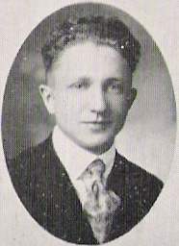
George Kingsley Zipf, 1935
Heavy tail in word distributions

Slide 9
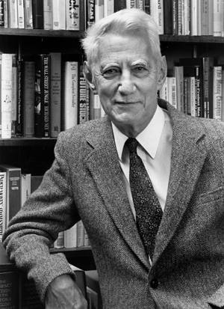
Claude Shannon, 1948
Father of information theory
Entropy: a mathematical measure of uncertainty
Information can be encoded digitally; questions include how to encode information efficiently and reliably.
Huge impact on speech recognition (and space exploration and digital media invention and …)

Slide 10
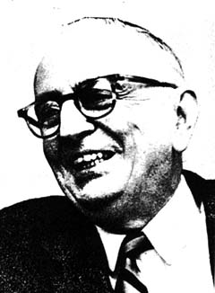
Warren Weaver, 1949
“One naturally wonders if the problem of translation could conceivably be treated as a problem in cryptography. When I look at an article in Russian, I say: 'This is really written in English, but it has been coded in some strange symbols. I will now proceed to decode.”

Slide 11
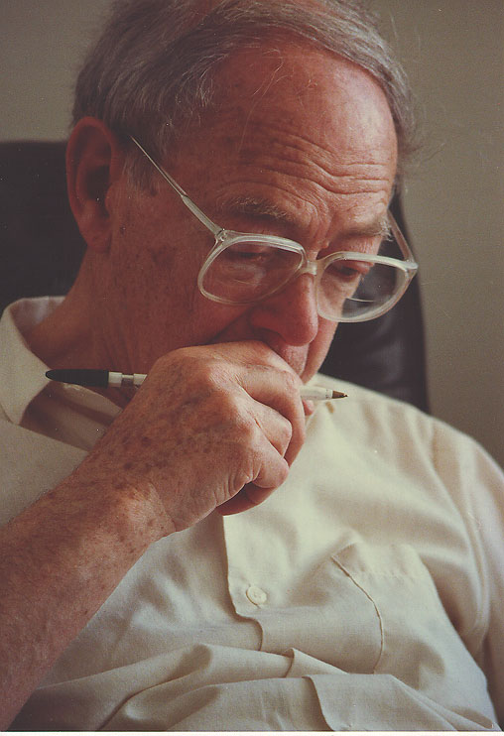
Zellig Harris, 1940s and forward
Centrality of data for linguistic analysis
Transformations (a step toward computational models of language)
Heavy use of mathematics in linguistics

Slide 12
Victor Yngve, 1958
Early computational linguist
Showed “depth limit” of human sentence processing - restricted left branching (but not right)
Early programming language, COMIT, for linguists (influenced SNOBOL)
Random sentence generation (in the 1950s)

Slide 13
A Little Bit of History
1935: Zipf’s law
1940s & 1950s: empiricism: Shannon, Weaver, Harris, Yngve
1960-1985: rationalism/representations/formalisms/syntax/unapplied AI
1962: ACL (then MTACL) begins
1964-6: ALPAC report, MT winter, Bar-Hillel leaves the field
1980: ICML begins
~1985: statistical and information theoretic methods catch hold again in NLP, in part due to their success in ASR
This has continued unabated for 25+ years, with help from Moore’s Law-type phenomena
1986: LTI founded (then called “CMT”)
1993: “Very Large Corpora” workshops start at ACL
1996: EMNLP conference starts
~1997: Lafferty and Rosenfeld start teaching “Language and Statistics” at CMU
1998-early 2000s: Internet boom, commercial language technologies becoming viable
~2003: MLD founded (then called “CALD”)
2004: Cohen starts teaching “Information Extraction”
2006: Smith starts teaching “Language and Statistics 2”
2011: Cohen and Smith start teaching “Structured Prediction”

Slide 14
What is Structured Prediction?

Slide 15
What is Structured Prediction?
Having observed some information (input) …
Binary classification: predict a coin toss (given some information)
Multi-class: predict which side of a die (given some information)
Structured prediction: choose among a very large number of complex outcomes.
Large means “exponential in the size of the input.”

Slide 16
E.g., (Part of Speech) Tagging
adjective, verb
proper noun, noun, verb
noun, verb
Bill directed plays about English kings
noun, verb
proper noun, plural proper noun, adjective
preposition, particle

Slide 17
E.g., Segmentation into Words
第二阶段的奥运会体育比赛门票与残奥会开闭幕式门票的预订工作已经结束,现在进入门票分配阶段。在此期间,我们不再接受新的门票预订申请。

Slide 18
E.g., Segmentation within Words
uygarlaştıramadıklarımızdanmışsınızcasına
“(behaving) as if you are among those whom we could not civilize”

Slide 19
E.g., Segmentation and Tagging
Britain sent warships across the English Channel Monday to rescue Britons stranded by Eyjafjallajökull 's volcanic ash cloud
geopolitical entity
geographic feature
time
cultural/ethnic group
geographic feature

Slide 20
E.g., Trees
Britain sent warships across the English Channel
Monday to rescue Britons stranded by
Eyjafjallajökull 's volcanic ash cloud

Slide 21
E.g., Predicate-Argument Structures
Britain sent warships across the English Channel
Monday to rescue Britons stranded by
Eyjafjallajökull 's volcanic ash cloud
sender
sent thing/rescuer
place sent
time
rescued thing/ stranded thing
stranding thing

Slide 22
E.g., Alignments
Mr President , Noah's ark was filled not with
Noahs Arche war nicht voller
production factors , but with living creatures .
Produktionsfaktoren , sondern Geschöpfe .

Slide 23
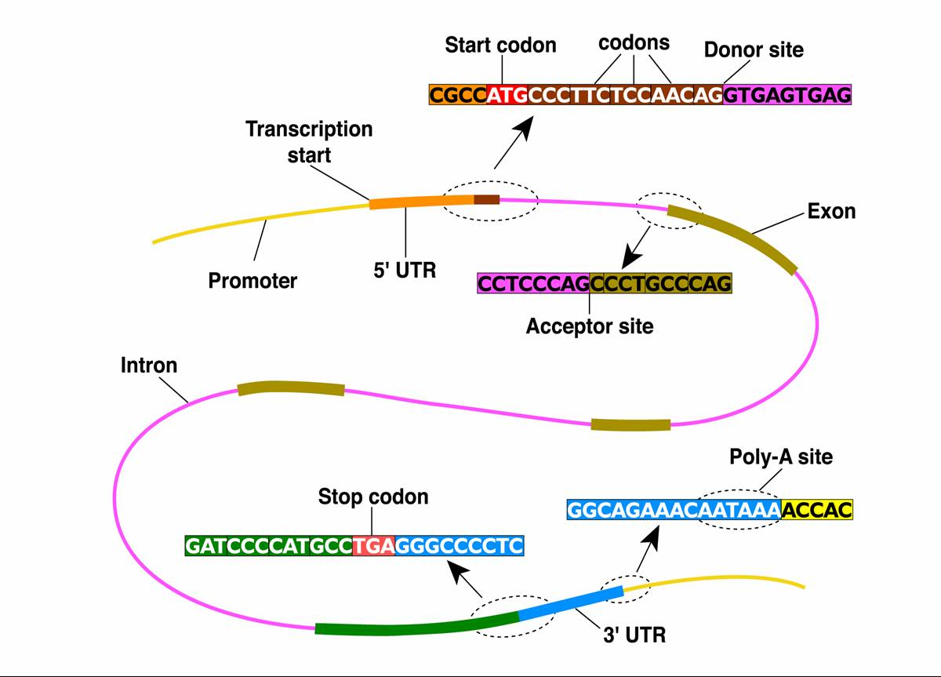
Gene Finding and Analysis
Slide due to E. Xing
Notes:
Input: the long stringy thing is a DNA sequence (long sequence of {CGAT} base pairs)
In the body: this gets converted into proteins
ML Task: segmentation and labeling – what does this DNA do? What is the coding/what is the non-coding part? What are the regulatory parts?

Slide 24
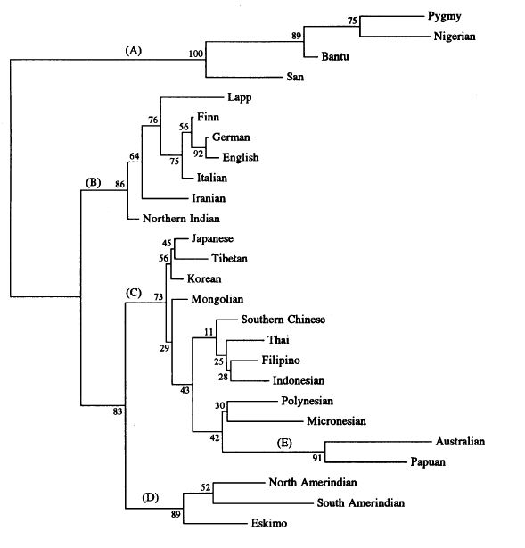
Phylogenetic Relationships
Time
Notes:
Task: infer ancestry from current distribution of species (languages, …) Challenge: unsupervised or – at best semisupervised (we know how Latin changed into Spanish, French, and Italian, maybe use this as supervision?)

Slide 25
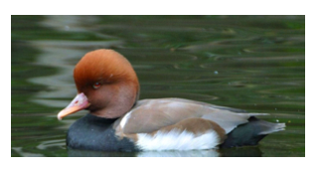
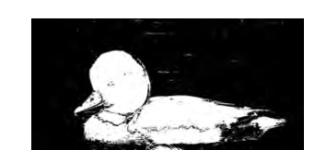

Image Segmentation
from Nowozin and Lampert (2010)

Slide 26
Implications of “Going Structured”
All aspects of training and testing become more complex:
Designing a model
Prediction algorithms (once you have a model)
Learning your model from data
Measuring “error” of a prediction
Machine learning helps with “mental hygiene”!
Principles that will help you explain and understand your methods
Generic optimization algorithms
Formal guarantees (sometimes)
Baselines when you’re tackling a new problem

Slide 27
The Structured Prediction Way
Formally define the inputs and outputs.
Identify a scoring function over input-output pairs, and an algorithm that can find the maximum-scoring output given an input.
Determine what data can be used to learn to predict outputs from inputs, and apply a learning algorithm to tune the parameters of the scoring function.
Evaluate the model on an objective criterion measured on unseen test data.
Notes:
Defining the function requires an understanding of the phenomena that serve as clues to the relationship between the input and the output, as well as the phenomena that make prediction challenging.
Ideally, input-output pairs are available and in large numbers, but often they are not. Chapter 3 discusses techniques for the case where input-output pairs are available, and chapter 4 discusses techniques for the case where they are not.

Slide 28
Topics
Inference (ch. 2, 5)
Learning from Complete Data (ch. 3)
Learning from Incomplete Data (ch. 4)

Slide 29
SPFLODD and Other Classes
Algos. | SPFLODD
parsing | inference
learning, briefly | learning, in-depth
some overlap!
Algorithms for NLP
Machine Learning
Probabilistic Graphical Models
Language and Statistics
prerequisite
Information Extraction
PGM | SPFLODD
theory | application
relational data | structural data
some overlap!
SPFLODD
L&S | SPFLODD
estimation | learning
sequences, a bit on trees | general discrete structures
some overlap!
Language and Statistics 2

Slide 30
Homework for Thursday
Read LSP, preface and chapter 1.

