Slide 1

DROWSINESS DETECTION SYSTEM
Bhakti Dwivedi 21
Simran Gupta 26
Vaishnavi Kadam 32
Department of Computer Science and Technology
Usha Mittal Institute of Technology for Women
SNDT Women’s University, Santacruz(w), Mumbai

Slide 2
OUTLINE OF TOPICS
Introduction
Problem Statement
Literature Survey
Existing System
Proposed System
Algorithm
Architecture
Workflow
Hardware and Software Requirements
Implementation
Future Work
Conclusion

Slide 3
INTRODUCTION
Driver fatigue is a major factor in vehicle accidents, with 1,200 deaths and 76,000 injuries annually. To counter its effects, technologies must be developed to detect and avoid drowsiness at the wheel.
Drowsiness detection is a safety technology that can prevent accidents caused by drivers and watchmen, and help students stay alert and focus on their studies.
This project "drowsiness detection" is based on concepts of artificial intelligence and lies in the fields of computer vision and machine learning. The algorithms used in the project are based on deep learning concepts, which mimic the human brain's activity and enable it to "learn" from massive amounts of data.
Drowsiness detection systems use cameras, sensors, or wearable devices to monitor the driver's eye movements, head position, and facial expressions. They also use data from other sources, such as the vehicle's onboard systems, to detect changes in driving patterns. If drowsiness is detected, the system may provide an alert to encourage the driver to take a break and rest.

Slide 4
PROBLEM STATEMENT
While engaging in tasks that require constant concentration, like driving a car, studying online being drowsy might be risky. Driving when sleepy increases drowsiness, which increases the risk of accidents. The main challenge is detecting the user's condition and deciding whether or not they are drowsy. The primary idea of this project is to create a deep learning-based alert system i.e. drowsiness detection system. The objective is to create a tool that can accurately assess whether or not a user is sleepy. The concept majorly impacts the automotive industry, improving driving safety and reducing the number of fatalities brought on by drowsy driving.

Slide 5
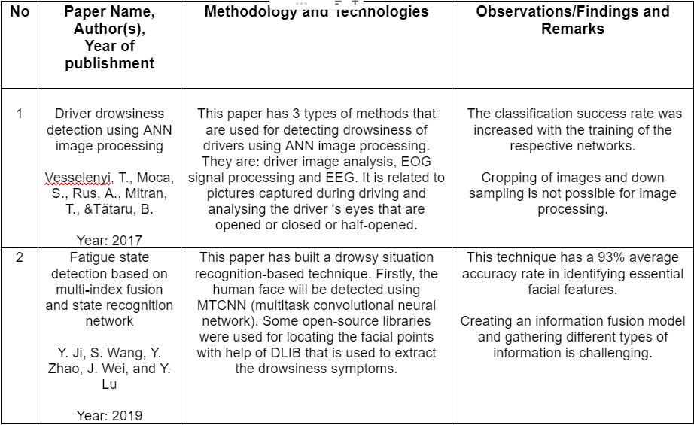
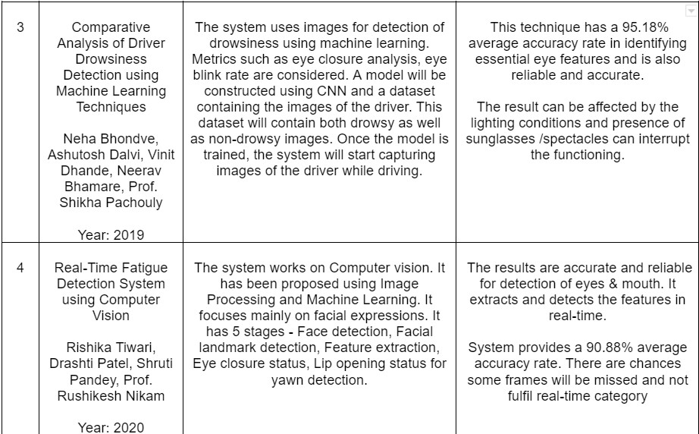
LITERATURE SURVEY

Slide 6
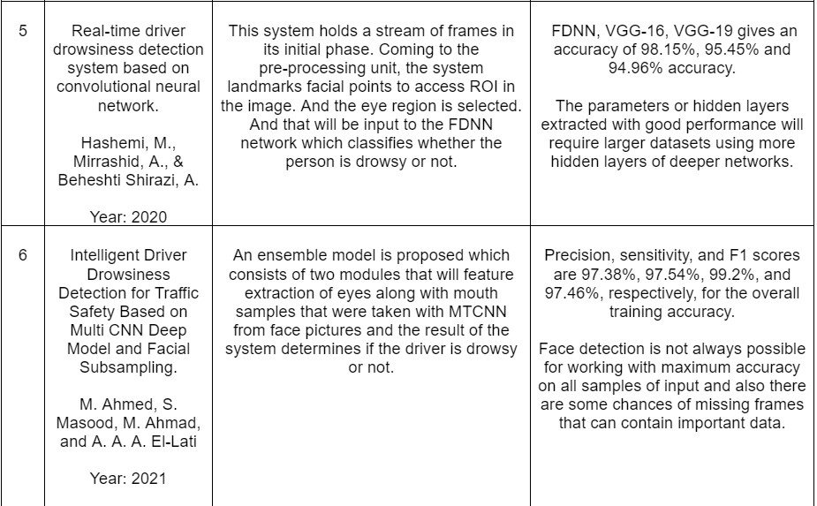
LITERATURE SURVEY

Slide 7
EXISTING SYSTEM
Steering Wheel Sensors
.
Facial Expression Analysis
.
Heart Rate Monitors
.
Eye- Tracking Systems
EEG Systems
Smart-phone based system

Slide 8
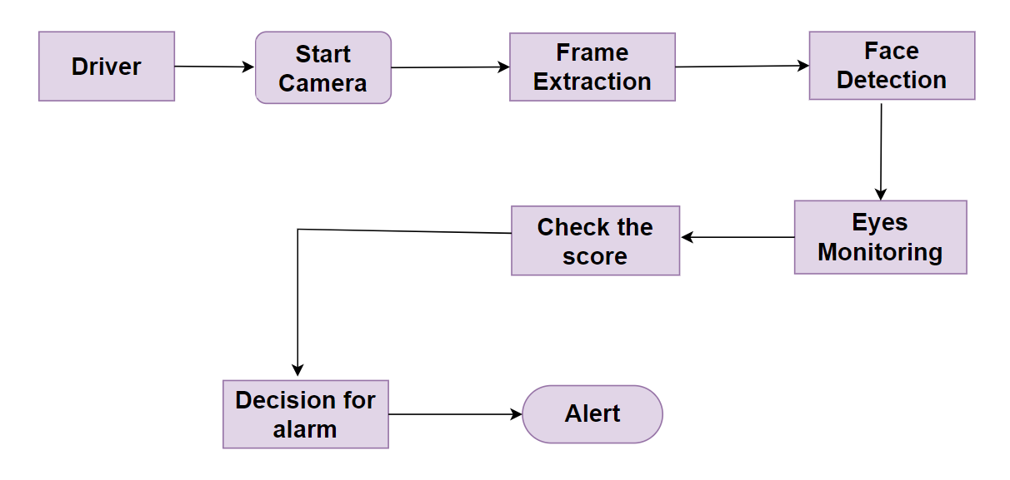
PROPOSED SYSTEM

Slide 9
ALGORITHM
STEP 4: The score increments/decrements based on eye state. If both eyes are closed increment the score, and if opened decrement the score.The system will determine whether there are any signs of drowsiness in the closed state of eyes for continuous frames.
STEP 5: If eyes are closed for score greater than 16 and any unwanted object detected then the system will sound an alarm using the play sound library to alert the user, else more frames to process.
STEP 3: A frame is displayed, capturing the face and the eyes are monitored. If it gives 1 then eye is open because 1 is assigned to open and 0 for closed.
STEP 1: In the first step, the video is extracted through a webcam using openCV and then the video is divided into frames.
STEP 2: Process of conversion of image to grayscale has been held for faster processing using open CV. After converting into grayscale, it will check the eyes are opened/closed.

Slide 10
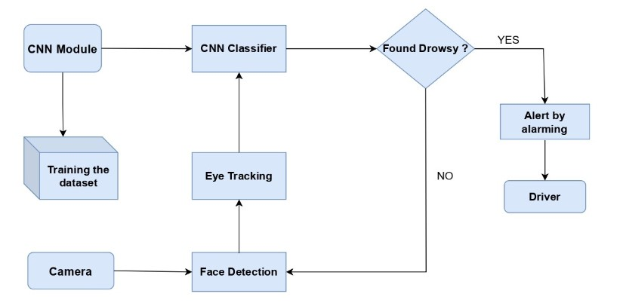
ARCHITECTURE

Slide 11
HARDWARE AND SOFTWARE REQUIREMENTS
1. System Processor: Pentium IV processor or higher.
2. RAM: Minimum 64 MB primary memory
3. Hard disk: Minimum 1 GB hard disk space.
4. Display: SVGA Monitor
5. Key board: Windows compatible.
6. Web Camera.
1. Coding Language: Python
2. Operating System: Windows 7 or above
3. Libraries Used: Keras, OpenCV, Numpy, Playsound, Pygame.
4. Tool: VsCode and Jupyter Notebook.
5. Web Technologies: HTML, CSS

Slide 12
IMPLEMENTATION

Slide 13
FUTURE SCOPE
The future scope of drowsiness detection systems is quite promising, as there is a growing need for these systems in various industries, including transportation, healthcare, and aviation.
With the advancements in technology, these systems are becoming more sophisticated and accurate, making them more reliable for detecting drowsiness in individuals.
In the future, these systems could be integrated with other safety features, such as lane departure warning systems and automatic emergency braking, to create a more comprehensive safety package for vehicles.
Additionally, these systems could be used to monitor patients in healthcare settings to detect early signs of fatigue or sleep disorders.
As technology continues to advance, these systems will become more accurate, reliable, and widespread, improving safety and productivity in many areas of life.

Slide 14
FUTURE SCOPE
1. Integration with AI and machine learning: As these systems continue to collect data on drowsiness, they may be able to use AI and machine learning algorithms to improve their accuracy and reliability. This could lead to more effective early warning systems that can alert drivers or workers to take a break before they become too fatigued.
2.Wearable technology: Wearable devices such as smartwatches and fitness trackers could be integrated with drowsiness detection systems, allowing individuals to monitor their own drowsiness levels in real-time. This could be particularly useful for individuals who work in high-risk jobs, such as pilots or truck drivers.
3. Expansion into new industries: As the technology behind drowsiness detection systems continues to improve, we may see these systems being used in new industries, such as construction or manufacturing. This could help to reduce the number of accidents and injuries caused by worker fatigue.
4. Integration with autonomous vehicles: Drowsiness detection systems could play a critical role in ensuring the safety of passengers in autonomous vehicles. These systems could monitor the driver's drowsiness levels and alert the vehicle's control system to take over if the driver becomes too fatigued to drive safely.

Slide 15
APPLICATIONS
Transportation Safety: One of the most critical applications of drowsiness detection systems is in the transportation industry, particularly in long-haul trucking and commercial driving. Drowsy driving is a significant cause of accidents, and a drowsiness detection system can help detect signs of driver fatigue and alert the driver to take necessary breaks.
Workplace Safety: Drowsiness detection systems can be used in workplaces where employees need to work for extended periods, such as in manufacturing plants or in the healthcare industry. These systems can detect signs of fatigue and alert workers to take necessary breaks, reducing the risk of accidents and errors.
Medical Monitoring: Drowsiness detection systems can also be used in medical settings to monitor patients' sleep patterns and detect signs of sleep disorders such as sleep apnea.
Consumer Electronics: Drowsiness detection systems can also be integrated into consumer electronics such as smartphones, smartwatches, and fitness trackers, to monitor users' sleep patterns and provide recommendations for improving sleep quality.

Slide 16
CONCLUSION
Drowsiness detection systems are an important technology for promoting safety and preventing accidents caused by drowsiness. These systems use various sensors and algorithms to detect signs of drowsiness such as changes in eye movement and blinking patterns, changes in head posture. Overall, drowsiness detection systems have shown promising results in detecting drowsiness and alerting users to take a break or change their working behavior. They have the potential to significantly reduce the number of accidents caused by drowsy driving, which is a major contributor to road accidents worldwide. However, it is important to note that drowsiness detection systems are not foolproof and may not detect all instances of drowsiness or fatigue. Additionally, these systems may be affected by various factors such as lighting conditions, weather, and individual differences in behavior. Therefore, while drowsiness detection systems can be a valuable tool for promoting work safety, they should be used in conjunction with other strategies for preventing drowsy driving and working, such as getting enough sleep, taking breaks during long shifts, etc.

Slide 17
THANK YOU!

