Slide 1
ChatGPT Reddit
Text Mining
Sakshi Mehta
Simran Padam
Jenika Shah
Vani Shankar

Slide 2
Overview
In this project, we perform text mining of Reddit comments on ChatGPT
We attempt topic modelling to uncover the underlying themes in the text documents
For Sentiment Analysis, VADER SentimentIntensityAnalyzer is applied to generate sentiment scores on the comments
Using sentiment scores as ground truth, text classification methodologies such as Logistic regression, Naive Bayes are used with the aim to compare different modelling techniques
Accuracy, Precision and Recall score are used as model performance metrics
Github link for the project: https://github.com/simran-padam/chatgpt-reddit-ads-project1.git

Slide 3
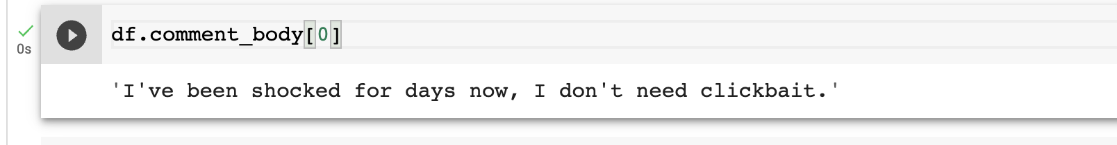
Data set summary
Columns Information
comment_id | The comment id
comment_parent_id | The comment's id which the current comment is replied to.
comment_body | The comment
subreddit | The community/subreddit name of the comment
In this data*, we have 52,414 rows and 4 columns
There are 4 Subreddits:
r/ChatGPT
r/technology
r/Futurology
r/dataisbeautiful
Sample text (or comment) from the table:
*Source: https://www.kaggle.com/code/mdbodruzzamansifat/clustering-topic-modeling-and-sentiment-analysis/input

Slide 4
Data Preprocessing
In NLP tasks, data preprocessing is required to perform any analyses.
Preprocessing on the reddit comments is carried out to :
Remove Stopwords and punctuations
Lower casing the words
Lemmatization : more sophisticated version of stemming. It reduces each word to its proper base form, that is, a word that we can find in a dictionary
Tokenization : separating a piece of text into smaller units called tokens

Slide 5
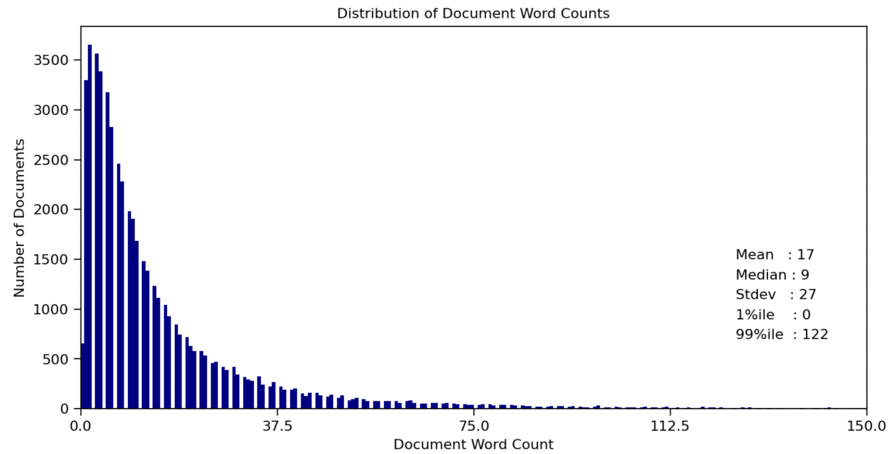
Topic Modelling
Topic modelling is a technique used to uncover the underlying topics or themes within a large text corpus. It is an unsupervised machine learning technique that identifies latent topics based on patterns of word usage within documents.

Slide 6
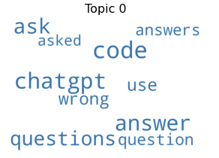
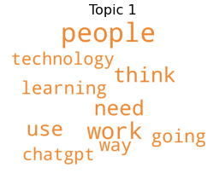
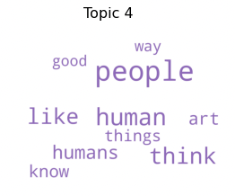
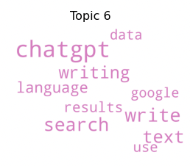
Topic Modelling (cont’d)
ChatGPT Q&A
Use Case
Humanlike
Advanced Search Engine

Slide 7
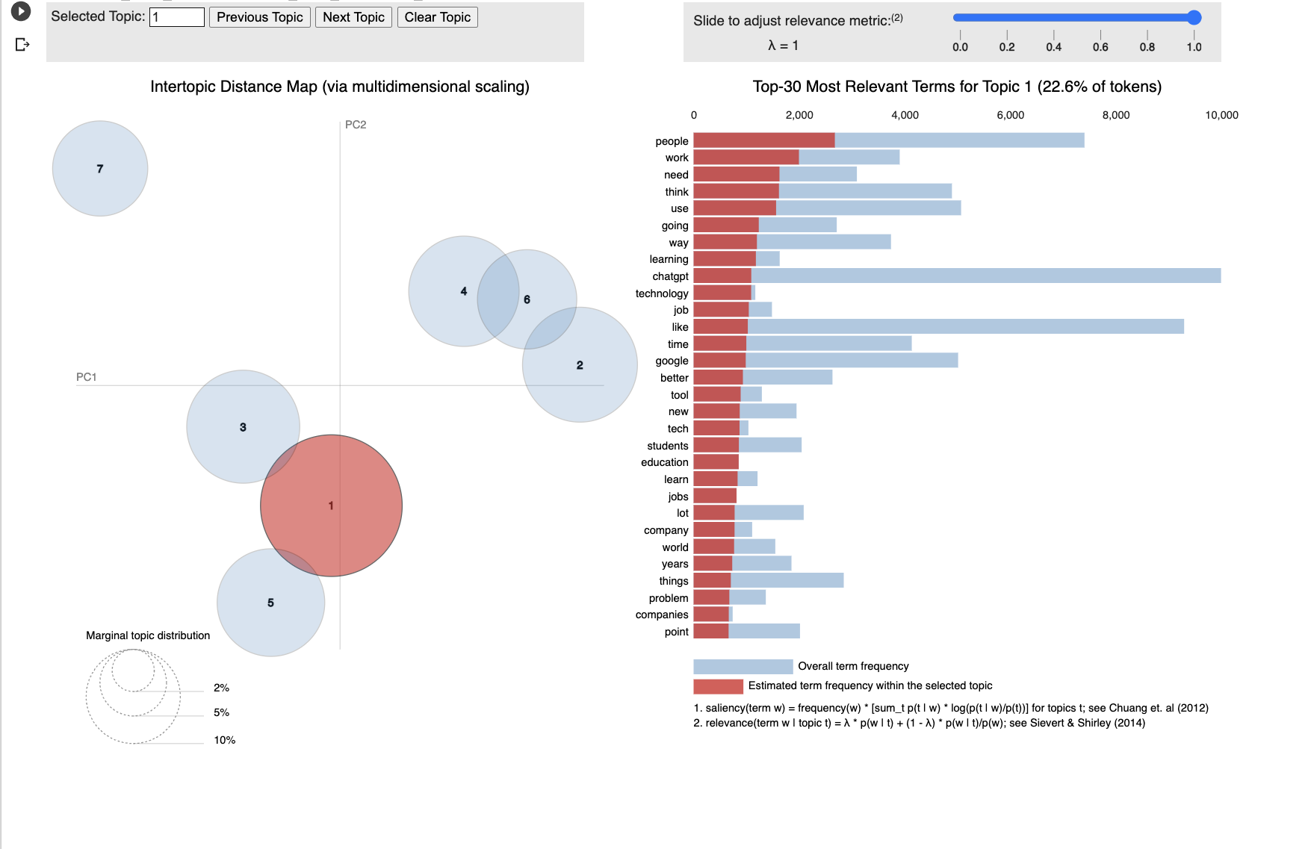
Each bubble represents a topic. The larger the bubble, the higher percentage of the number of comments in the corpus is about that topic.
Blue bars represent the overall frequency of each word in the corpus. If no topic is selected, the blue bars of the most frequently used words will be displayed.
Red bars give the estimated number of times a given term was generated by a given topic. As you can see from the image above, there are about 10,000 of the word ‘chatgpt’, and this term is used about 1,000 times within topic 1. The word with the longest red bar is the word that is used the most by the tweets belonging to that topic.
The further the bubbles are away from each other, the more different they are.

Slide 8
Valence Aware Dictionary and sEntiment Reasoner (VADER)
Valence Aware Dictionary and sEntiment Reasoner, commonly known as VADER, is a rule-based sentiment analysis tool that uses a lexicon of words and their associated sentiment scores to determine the overall sentiment of a piece of text
Purpose
Classify our comments as positive or neutral/negative, observe larger trends and help in creating our test and training sets based on classification
Using SentimentIntensityAnalyzer from NLTK library, we
Calculated the sentiment score for each comment
Used score to label given comment as ‘positive’, ‘negative’, or ‘neutral’
Group the data based on this sentiment label and subreddit
Training vs test set: X = comment, Y = sentiment label
Notes:
compound corresponds to the sum of the valence score of each word in the lexicon and determines the degree of the sentiment rather than the actual value as opposed to the previous ones. Its value is between -1 (most extreme negative sentiment) and +1 (most extreme positive sentiment). Using the compound score can be enough to determine the underlying sentiment of a text, because for:
a positive sentiment, compound ≥ 0.05
a negative sentiment, compound ≤ -0.05
a neutral sentiment, the compound is between ]-0.05, 0.05[

Slide 9
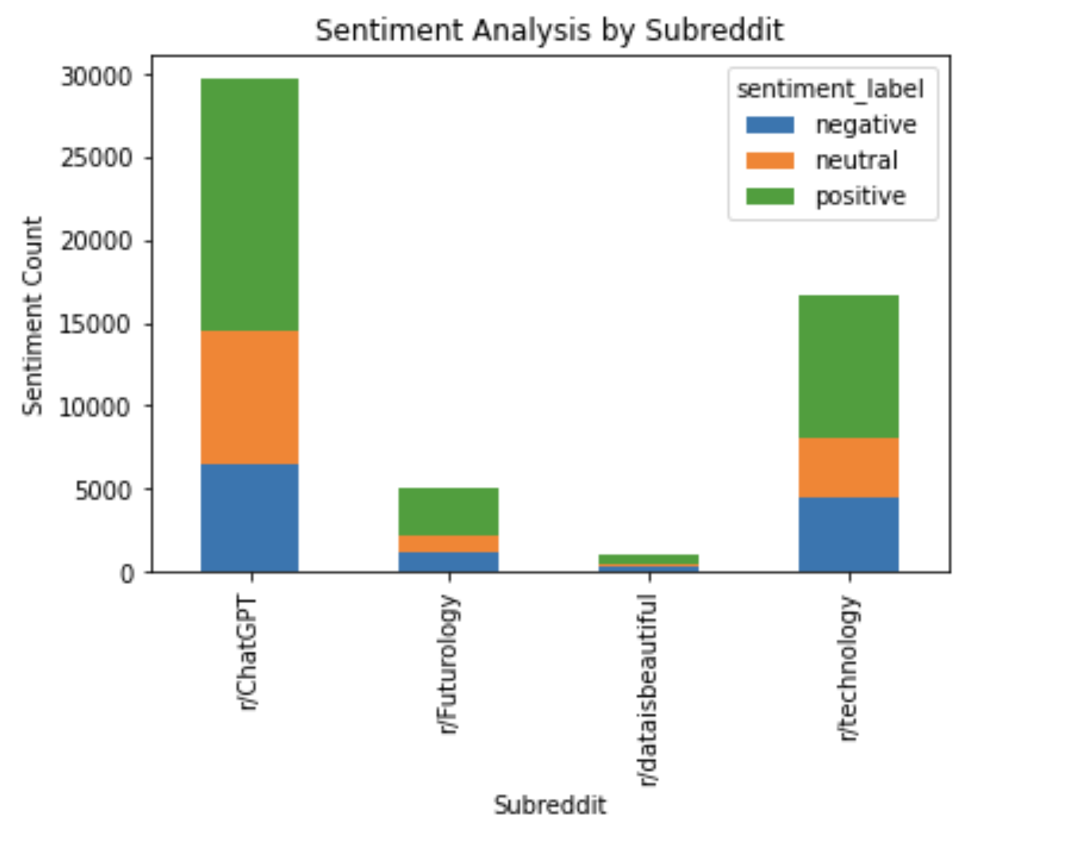
Valence Aware Dictionary and sEntiment Reasoner (VADER) (cont’d)
Quick Observations
r/ChatGPT is the most popular subreddit amongst the chosen ones
Positive comments tend to be the majority amongst chosen subreddits
Total counts across all subreddits
Positive: 52%
Neutral: 24%
Negative: 24%

Slide 10
Text Classification
Two approaches are followed - Binary and Multiclass Classification
Obtained sentiment scores have 3 categories: Positive (52%), Neutral (24%) and Negative (24%)
In Binary Classification, neutral and negative classes are combined as one class (48%), making it a balanced classification problem
In Multiclass classification, three classes are used as-is
Logistic regression and Naive Bayesian classification techniques are explored

Slide 11
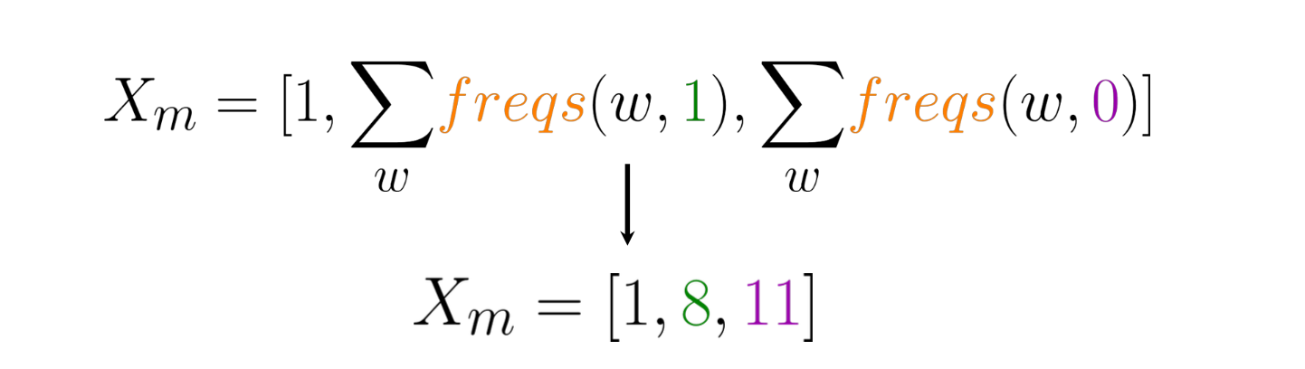
Logistic regression
Set of unique words is the vocabulary
Count each time each word appears in either class
Feature vector is in the form of
Feature vector for the entire dataset is created and logistic regression algorithm is implemented for predictions

Slide 12
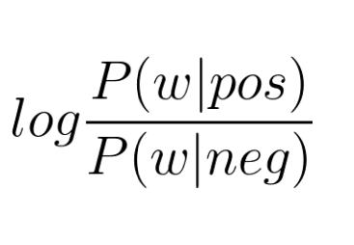
Naive Bayes
P(word|class) is calculated
Laplacian smoothing is used to treat P(word|class) = 0
Log prior is estimated using log(number of positive cases/ number of negative cases). Log prior is 0 when classes are balanced
Log likelihood is calculated using
Score = Log prior + Log likelihood
Score > 0 is positive and negative otherwise

Slide 13
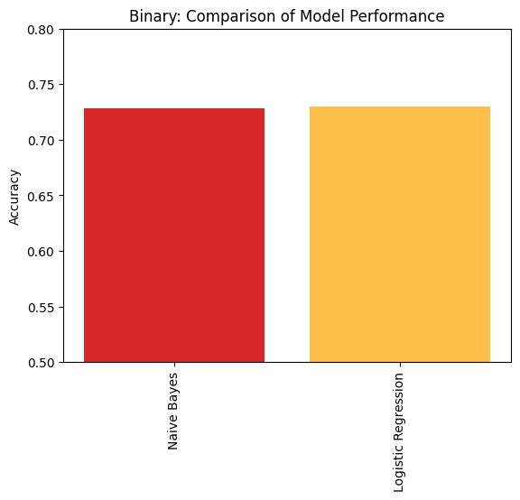
Binary Classification
In binary classification, two classes (positive and negative) were used as target variable.
Both models produced comparable results in terms of their accuracy, but to gain a more comprehensive understanding of their performance, we also evaluated their precision and recall metrics.
 | Naive Bayes | Logistic Regression
Accuracy | 0.728 | 0.730
Precision | 0.738 | 0.732
Recall | 0.723 | 0.728

Slide 14
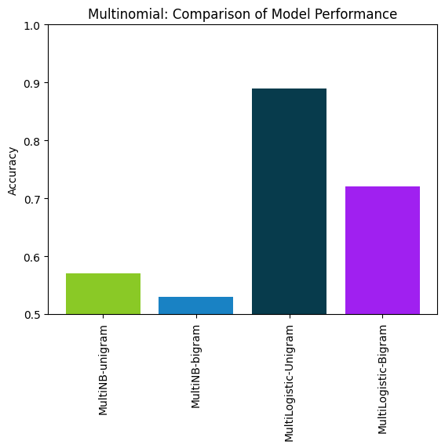
Multiclass Classification
Three classes (positive, neutral and negative) were used as target variable
TfidfVectorizer was used to obtain 1-gram and 2-gram words of vector with max_df= 0.9
Using scikit-learn, multinomial logistic and naive bayes techniques were used

Slide 15
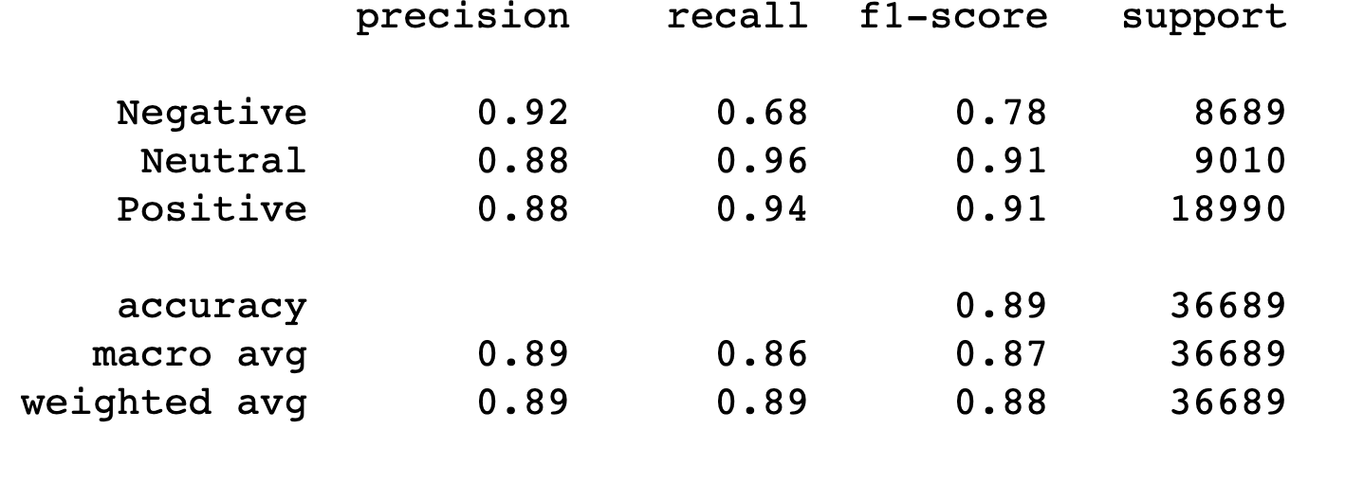
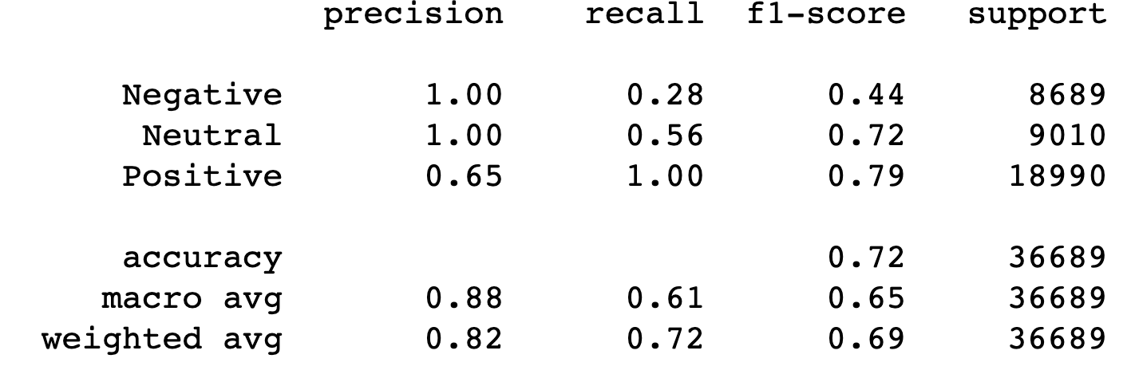
Multiclass Classification (cont’d)
Unigram
Bigram

Slide 16
Conclusion + Possible Further Explorations
Conclusion
In case of Binary, both the models give similar results. However, in case of Multiclass, better results were given by Logistic model
Further Explorations
Attempt Deep Learning methods such as Neural networks to see if it results in improved model performance
Sentiment Analysis: Be able to include more subreddits (such as those from other industries) that could possibly have more negative comments in order to get a better understanding over overall opinion on ChatGPT

Slide 17
References
Natural language processing. Coursera. (n.d.). Retrieved March 23, 2023, from https://www.coursera.org/specializations/natural-language-processing
Clustering, topic modeling and sentiment analysis. Kaggle. Retrieved March 23, 2023, from https://www.kaggle.com/code/mdbodruzzamansifat/clustering-topic-modeling-and-sentiment-analysis/input
Ageron. (n.d.). Ageron/HandsOn-ML2: A series of Jupyter notebooks that Walk you through the fundamentals of machine learning and deep learning in python using Scikit-learn, keras and tensorflow 2. GitHub. Retrieved March 23, 2023, from https://github.com/ageron/handson-ml2

