Slide 1
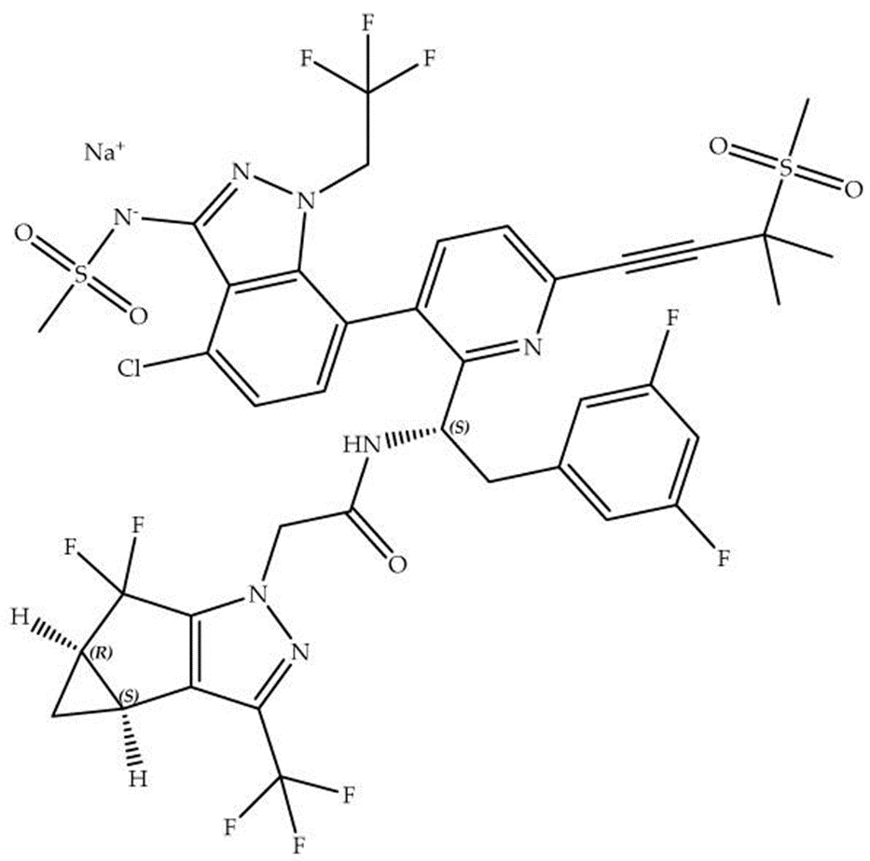






"Lenacapavir: The Future of HIV Prevention Begins Here”
The increasing prevalence of multi-drug resistance (MDR) in human immunodeficiency virus (HIV) remains the major obstacle in the fight against the infection.
Among the most promising therapies for the treatment of HIV infections, Lenacapavir is a first-in-class inhibitor of HIV capsid function specifically designed to treat MDR HIV infection. This drug has been approved by the U.S. Food and Drug Administration (FDA) under the brand name Sunlenca for the treatment of HIV.
Mode of action: Lenacapavir disrupts the capsid-mediated nuclear uptake of preintegration complexes and inhibits virion production, preventing viral replication at both early and late stages of the HIV lifecycle.
Dosage: Due to its high potency, low clearance, and slow-release properties, lenacapavir can be administered as a long-acting treatment: either subcutaneously every six months or orally on a weekly basis.
Trials: The Purpose 1 trial showed 100% Lenacapavir efficacy in preventing HIV in cisgender women in Uganda and South Africa.
In the Purpose 2 trial, lenacapavir demonstrated a 99.9% efficacy rate and a 96% reduction in HIV cases.
This innovation holds promise for enhancing patient outcomes and simplifying long-term HIV management
Capsid protein
Nucleocapsid
Human Immunodeficiency Virus (HIV)
Lenacapavir
Notes:
Lenacapavir: A Novel Capsid Inhibitor in HIV-1 Treatment and Capsid Inhibitors Drugs

Slide 2
DAROBACTIN D22: A breakthrough antibiotic against drug-resistant bacteria
In the fight against increasing rates of antimicrobial resistance (AMR), a promising chemical scaffold has emerged: Darobactin D22 originally discovered from the entomopathogenic bacterium Photorhabdus khanii. This innovative compound is proving to be a game-changer in the fight against drug-resistant Gram-negative pathogens, such as Escherichia. coli and Pseudomonas aeruginosa, that have long evaded traditional antibiotics.
Mode of action- Darobactins are post-translationally modified peptides. They target and inhibit the transmembrane protein BamA in the periplasm of the bacteria. Inhibition of this outer membrane protein by darobactin results in insufficient folding and insertion of proteins into the outer membrane, eventually leading to cell death. BamA is considered a favorable and exciting new antibacterial target as it is conserved across bacterial species but is absent in humans.
Trials- Pre-clinical trials have been conducted in zebrafish embryos and mice. D22 remarkably reduced P. aeruginosa and E. coli infections in mice models as effectively as existing antibiotics.
“A promising starting point to guide the translation of Darobactins into an innovative solution to fight antimicrobial resistance”
Carbapenems
Fluoroquinolones
Penicillin
Polymyxins
Resistance
Darobactin D22
E.coli
P.seudomonas

Slide 3
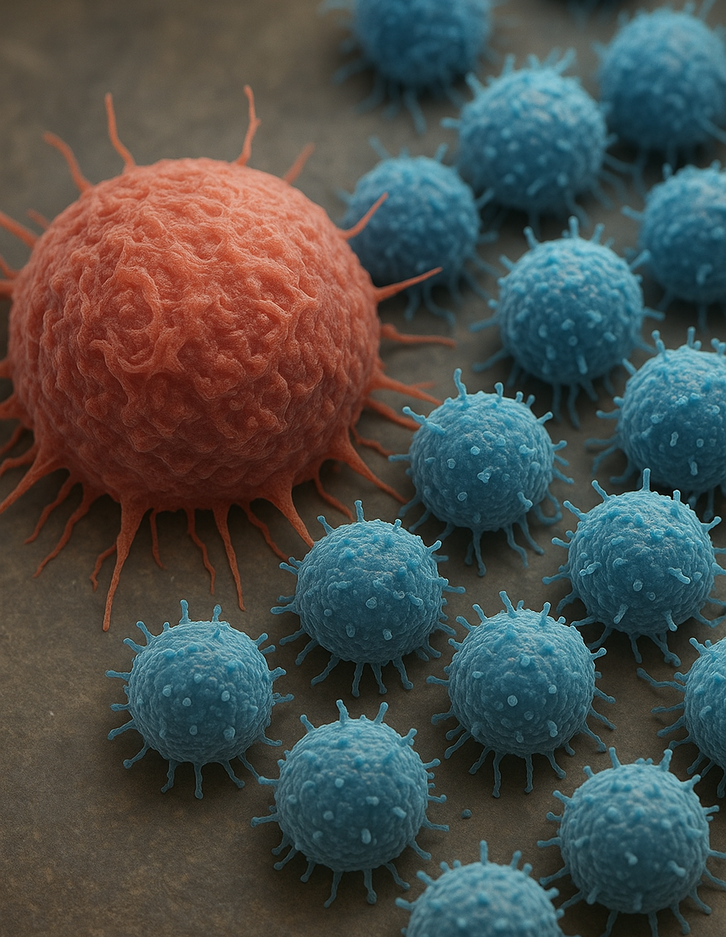
The placenta and cancer—one sustains life, the other threatens it. Yet beneath the surface, they share a surprising set of biological behaviors.
The placenta, though temporary, exhibits some of the most aggressive physiological behaviors seen in human biology—yet it does so in a precisely regulated and non-pathological manner. Interestingly, many of these behaviors mimic the hallmarks of cancer. Understanding how the placenta turns these tumor-like traits on and off at specific times could help us decode how to suppress similar pathways in cancer.
Here’s where the overlap becomes fascinating:
Angiogenesis Just like tumors, the placenta induces new blood vessel formation (via VEGF and other pathways) to support the fetus. But again, it does so with spatial and temporal precision.
Invasive Growth Trophoblast cells of the placenta invade the maternal endometrium to establish nutrient exchange. This invasion is highly controlled and ends once proper placental function is established—unlike cancer, which exhibits unchecked invasion of tissues.
Immune Evasion The placenta evades the maternal immune system to avoid rejection of the fetus (which is genetically half-foreign). It uses mechanisms like HLA-G expression, Treg cell recruitment, and cytokine modulation—mechanisms also exploited by tumors to avoid immune surveillance.
Epigenetic Plasticity Both trophoblast and cancer cells demonstrate epigenetic reprogramming, changes in DNA methylation, and histone modifications—critical for regulating genes linked to invasion, growth, and immune response.
The knowledge about the similarities could offer biomimetic models to study tumor progression and immune tolerance. Most importantly, it reinforces the idea that cancer is not always a foreign behavior—but a distorted version of biological processes meant to support life.
Notes:
Costanzo V, et al. Exploring the links between cancer and placenta development. Open Biol. 2018;8(6):180081.
https://www.the-scientist.com/how-can-the-placenta-help-us-understand-cancer-73007

