Slide 1
Machine Comprehension Question-Answering on SQUAD 2.0
CS4248 Project
Group G09:
Dolly Agarwal (A0228490B)
Lim Wei Quan Ernest (A0201835M)
Rashi Sharma (A0228492X)
Rohit Jain (A0228500R)
Simran Aggarwal (A0228520M)
Notes:
Hello and welcome to the project presentation. We are group 9 and our topic for the project is machine comprehension, specifically question answering on squad 2.0 dataset

Slide 2
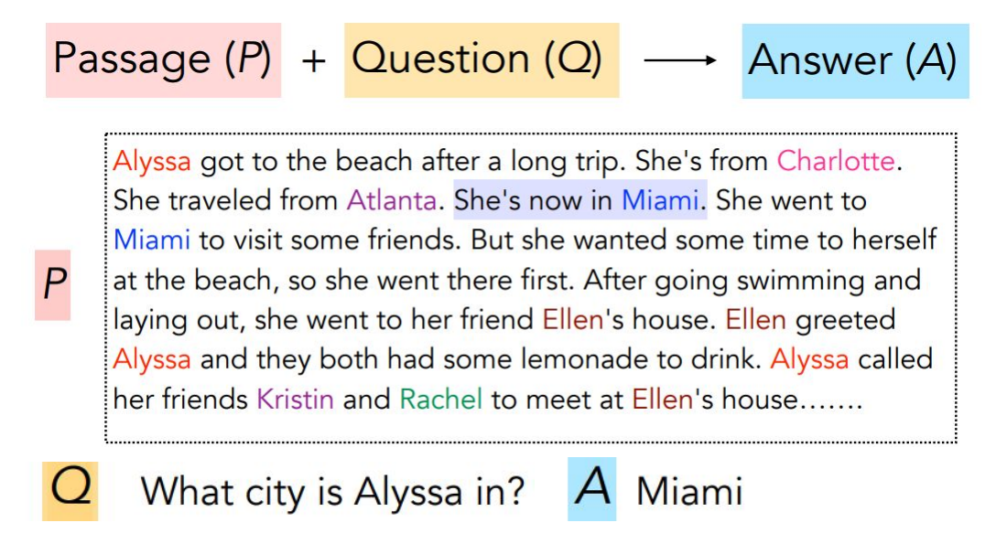
Problem Statement
Notes:
Given a Passage P and Question Q from the passage, we want to predict the answer for the question

Slide 3
Background
Machine Learning Approaches –
Sliding Window (Richardson et. Al, 2013)
Compute the unigram/bigram overlap between the sentence containing the candidate answer and the question.
Use TF-IDF based similarity to select the best candidate answer
Logistic Regression (Rajpurkar et. Al, 2013)
Extract several types of features for each candidate answer
Features
– Matching Word Frequencies
– Matching Bigram Frequencies
– Lengths
– Span POS Tags
Notes:
Machine comprehension has been a popular area of research in NLP and many approaches have been proposed over the years. Early methods involved the use of machine learning, For eg- sliding window method where the idea is to find similarity between answer and the question using overlapping k-grams and then use TFIDF to select best candidate answer.
In logistic regression method, several types of features for each candidate answer are extracted. Matching word and bigram frequencies feature help the model to pick the correct sentences and length and position of span guides the model towards the correct answer

Slide 4
Background
Deep Learning Approaches–
- RNN + Attention (2016)
Bi-directional Attention Flow (BiDAF) network
query-aware context representation
- Transformer Models (2019 - Present)
pretrained weights on a large-scale language modeling dataset
Dominates SQUAD 2.0 leaderboard
Bidirectional Encoder Representations from Transformers
BERT, ALBERT, RoBERTa etc.
Notes:
The recent approaches makes use of deep learning. One of the most popular approach, first released in 2016, is the use of Bi-directional Attention Flow network or otherwise known as BiDAF. This approach leverages query-aware context representation which makes easier for the model to make accurate prediction for the answer.
Since 2019, SQUAD leaderboard has been dominated by transformer based models. These models are based on self attention and are huge in size with hundreds of millions of parameters.
In this project, we have explored both these existing approaches and have tried to improve their performance further.

Slide 5
Dataset: Stanford Question Answering Dataset (SQuAD) V2.0
Reading Comprehension Dataset
SQUAD v1.0 - All questions answerable
High-quality wikipedia articles
Covers a diverse range of topics across a variety of domains
Answer to question is a segment of text, or span
SQUAD v2.0 - Question might be unanswerable
Type | Number of Questions | Number of Questions with No Answer
Train | 130319 | 43498 (33%)
Dev | 11873 | 5945 (50%)
Notes:
For this project we have used SQUAD dataset for our experiments. SQuAD is an abbreviation for Stanford Question Answering Dataset. It is a reading comprehension dataset, consisting of questions posed on a set of Wikipedia articles- These articles covers a diverse range of topics across a variety of domains, from music to sports to abstract concepts.
The answer to every question is a segment of text, or a span, from the corresponding reading passage. In Version 1 of SQUAD dataset All questions were answerable but in version 2 of squad, many questions are unanswerable also, i.e. there exists no answer for the question in the passage.
In squad2 dataset we have more than 130 thousand training samples and 11873 samples in the development dataset. In our project we have used this development dataset to evaluate our models’ performances

Slide 6
Experiments
Baseline Model
Transformer models
Data Augmentation
Proposed model
BiDAF
Models - BERT, ALBERT, RoBERTA, XLNet Variants - base / large, Distillation
Augment questions using back translation
Motivated from Human Reading Comprehension
Notes:
In this project, we first experiment with the baseline Bidirectional Attention Flow (BiDAF) model. Next, we focus on evaluating the performance of different pre-trained Language Models(PrLM). Finally, we try to improve the model performance by experimenting with data augmentation and a new model architecture inspired from the Human Reading Comprehension approach.

Slide 7
Experiments
Baseline Model
Transformer models
Data Augmentation
Proposed model
BiDAF
Models - BERT, ALBERT, RoBERTA, XLNet Variants - base / large, Distillation
Augment questions using back translation
Motivated from Human Reading Comprehension
Notes:
The first existing approach, which we tried was BiDAF model. We considered as our Baseline model

Slide 8
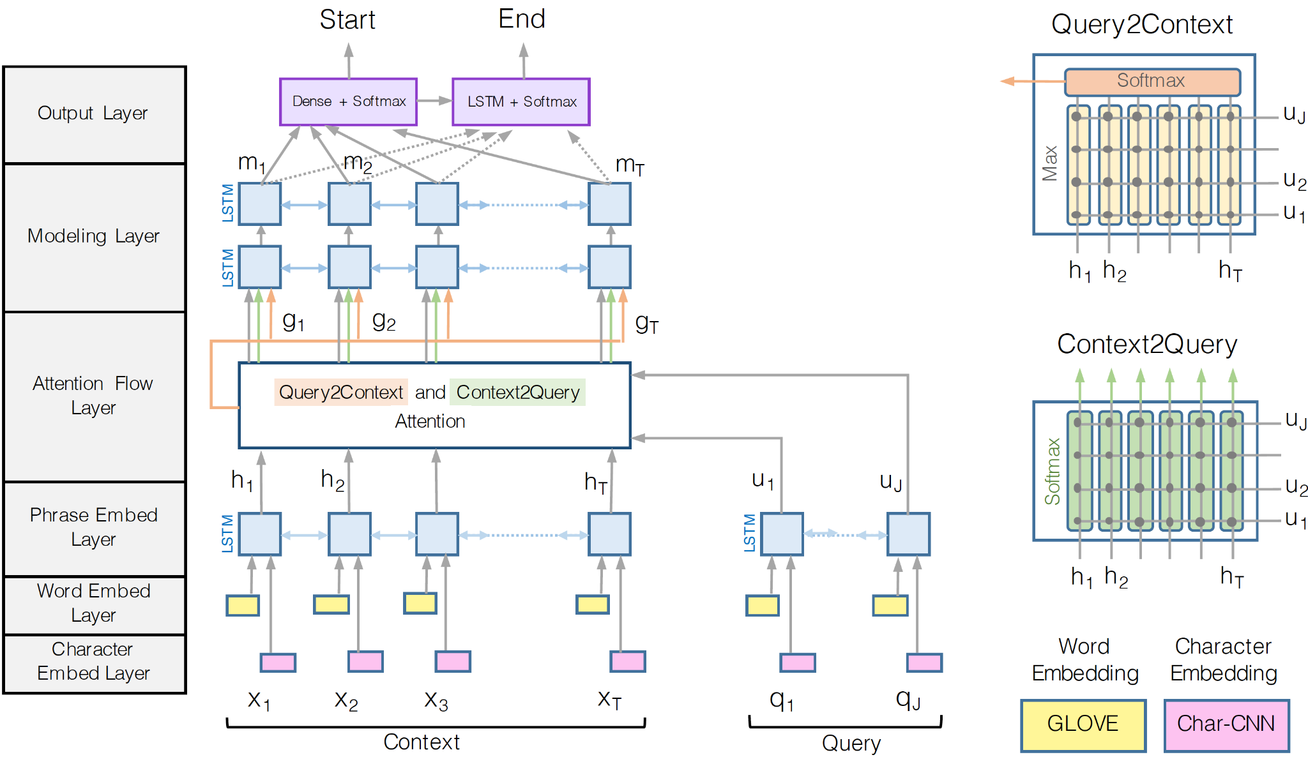
Baseline Model
1) Bi-directional Attention Flow (BiDAF)
Notes:
BiDAF model is improvement over regular attention based models
In a typical attention mechanism, a small portion of the context is taken and summarized with a fixed-size vector. That makes it difficult to model complex interactions between the context and the query. BIDAF network uses bi-directional attention flow to obtain a query-aware context representation
Bidaf Network has different types of layers-
1. Embedding Layers
BiDAF has 3 embedding layers whose function is to change the representation of words in the Query and the Context from strings into vectors of numbers.
2. Attention and Modeling Layers
These Query and Context representations then enter the attention and modeling layers. These layers use several matrix operations to fuse the information contained in the Query and the Context. The output of these steps is another representation of the Context that contains information from the Query. This output is referred to as the “Query-aware Context representation.”
3. Output Layer
This Query-aware Context representation is then passed into the output layer, which transforms it into the probability values which are used to determine the start and the end index of the answer

Slide 9
Experiments
Baseline Model
Transformer models
Data Augmentation
Proposed model
BiDAF
Models - BERT, ALBERT, RoBERTA, XLNet Variants - base / large, Distillation
Augment questions using back translation
Motivated from Human Reading Comprehension
Notes:
Next to improve on the baseline, we use state-of-the-art transformer based model architectures. These models are much bigger and larger than traditional RNN networks.

Slide 10
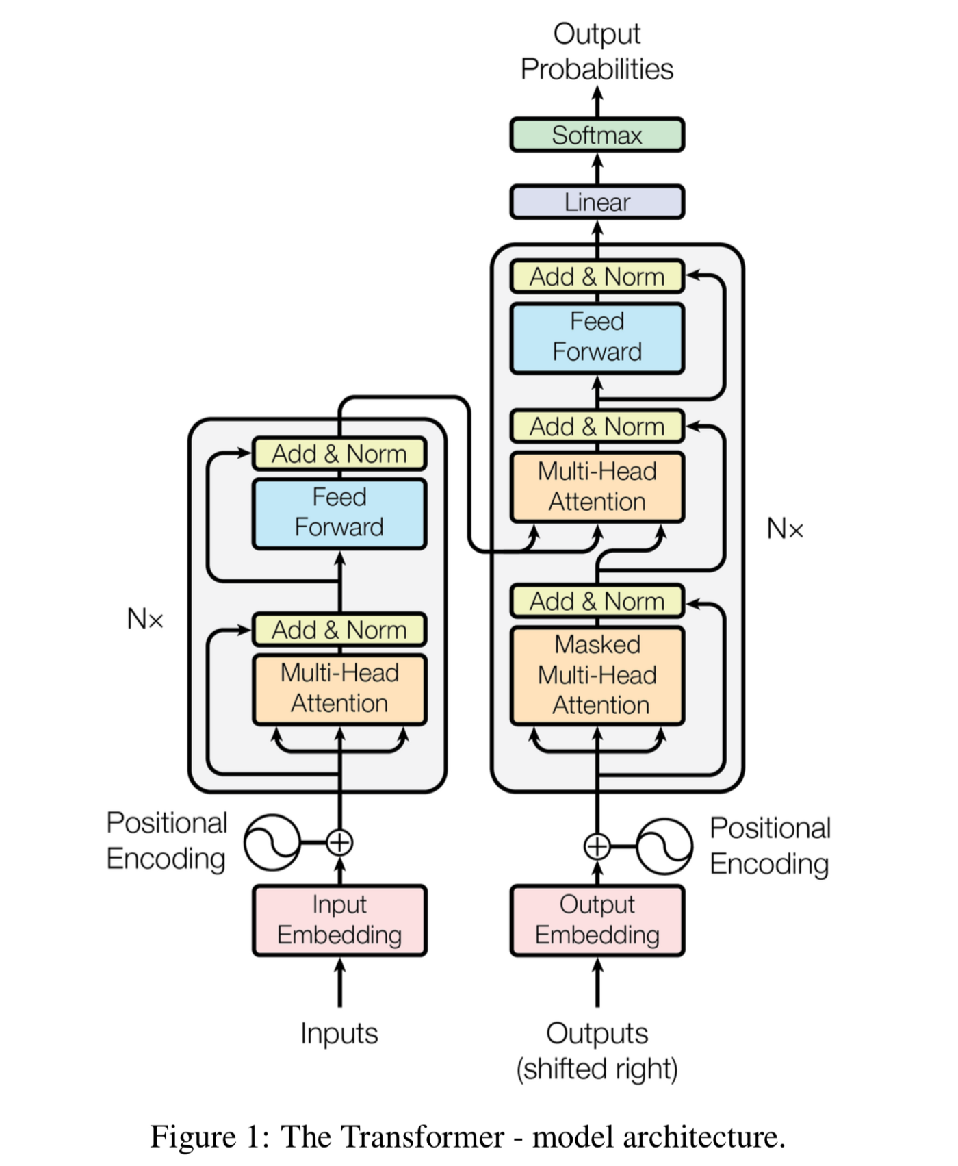
Transformer based models
Models:
BERT
ALBERT
RoBERTA
XLNet
Variants:
Base
Large
Distillation
https://huggingface.co/models
Notes:
Hugging face website provides multiple transformer based language models which are pre-trained on large corpus like Wikipedia, Book Corpus etc.
We fine-tuned many such models such as ** point ** to perform well on our squad dataset. For each of these models, we tried out their variants such as base and large, case and uncased, and distilled models which is smaller in size and has lesser number of parameters.

Slide 11
Experiments
Baseline Model
Transformer models
Data Augmentation
Proposed model
BiDAF
Models - BERT, ALBERT, RoBERTA, XLNet Variants - base / large, Distillation
Augment questions using back translation
Motivated from Human Reading Comprehension
Notes:
We also experimented by augmenting the questions using the process of Back Translation.

Slide 12


Data Augmentation using back translation
Original:
What magazine rated Beyonce as the most powerful female musician in 2015?
Translate to Danish
Danish
English
Hvilket magasin vurderede Beyonce som den mest magtfulde kvindelige musiker i 2015?
Augmented:
Which magazine named Beyonce the most powerful female musician in 2015?
English
Translate to English
Key idea: help the network generalize to the syntactic variance in the question
Notes:
Since the transformer models are large, they need extensive and diverse training data. For this purpose, we have used data augmentation using the given training data.
In this method, we translate the text data of the given questions to some intermediate language ** which is danish here ** and then translate it back to the original language. This will help us to generate textual data with different words while preserving its context. We used the library nlpaug to perform back translation.

Slide 13
Experiments
Baseline Model
Transformer models
Data Augmentation
Proposed model
BiDAF
Models - BERT, ALBERT, RoBERTA, XLNet Variants - base / large, Distillation
Augment questions using back translation
Motivated from Human Reading Comprehension
Notes:
In this work, we also propose and experimented with a new pipeline architecture motivated by how humans approach this problem.

Slide 14
Proposed Model
Motivation - Human Reading Comprehension
"Southern California, often abbreviated SoCal, is a geographic and cultural region that generally comprises California's southernmost 10 counties. The region is traditionally described as "eight counties", based on demographics and economic ties: Imperial, Los Angeles, Orange, Riverside, San Bernardino, San Diego, Santa Barbara, and Ventura. The more extensive 10-county definition, including Kern and San Luis Obispo counties, is also used based on historical political divisions. Southern California is a major economic center for the state of California and the United States."
Passage
“Southern California, often abbreviated SoCal, is a geographic and cultural region that generally comprises California's southernmost 10 counties.”
Relevant Context
"SoCal"
Exact Answer
"What is Southern California often abbreviated as?"
Question
Notes:
Inspired from the Retro reader we defined a new pipeline architecture which is mainly based on how humans tackle a reading comprehension problem.
As a natural practice, a reader quickly skims through the entire passage to find the part which is most relevant to the question. Then, the reader focuses on only the relevant part of the passage to extract the exact answer for the question.
Consider the example provided here, the passage provides information about Southern California -based on the geographic location and the political/economic standing. But given the question is framed around the name of the region, a reader can quickly judge that the answer lies in the first sentence. So, to extract the exact answer the reader just carefully examines the first sentence and arrives at the answer “SoCal”.

Slide 15
Proposed Model Architecture
Relevant Context Extraction Module
Exact Answer
Extraction Module
RoBERTa
RoBERTa
[CLS]
E_{CLS}
C
[CLS]
E_{CLS}
C
Tok 1
E₁
T₁
Tok 1
E₁
T₁
Question
Tok N
E_{N}
T_{N}
Tok N
E_{N}
T_{N}
[SEP]
E_{SEP}
T_{SEP}
[SEP]
E_{SEP}
T_{SEP}
Tok 1
E₁’
T₁’
Tok 1
E₁’
T₁’
Exact Answer
Start/End
Span
Start/End
Span
Relevant Context
Passage
Tok M
E_{M}’
T_{M}’
Tok M
E_{M}’
T_{M}’
Notes:
Inspired by this, we define a pipeline architecture with 2 distinct modules:
1. Relevant Context Extraction Module
2. Exact Answer Extraction Module
Both these modules use pre-trained RoBERTa base as the central model and change the context-answer span in the training set to train the two modules for their respective tasks. To generate the training data for the first module, input context is kept the same and for the answer we tokenize the original Context into sentences using spacy library and extract entire sentences that span the original answer.
For the second model, the answer in each training example is the original answer and the context is the answer predicted from the first model, which is supposed to capture only the relevant portion.
During inference, the first module takes as input the question and the entire passage and returns the start/end span of the context that contains the part most relevant to the question. The second module then takes this shrunken context to predict the actual answer.

Slide 16
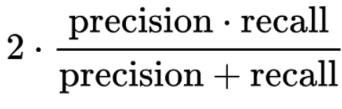
Evaluation Metrics
Exact Match (strict) If the characters of the model's prediction exactly match the characters of (one of) the True Answer(s), EM = 1, otherwise EM = 0.
F1 Score (lenient)
Question: Where on Earth is free oxygen found? True Answers: ['water', "in solution in the world's water bodies", "the world's water bodies"]
Prediction: water bodies
EM | F1
0 | 0.8
Overall EM and F1 scores are computed for a model by averaging over the individual example scores.
Notes:
To evaluate the performance of the models, we use the official metrics Exact Match and F1 score.
EXACT MATCH measures exactness of prediction with the ground truth. It is a strict measure which requires prediction to be 100% accurate for each character in the answer.
Second metric is the F1 score which is comparatively a looser measure, it averages all overlap values between the prediction and ground truth answer. Here is an example prediction and we can see that Exact Match is 0 while the F1 is 0.8

Slide 17
Results
Model | Variant | F1 | EM | No. of parameters
BiDAF | - | 60.86 | 57.44 | < 1M
BERT | base large | 80.3 83.9 | 77.3 80.8 | 108M 340M
ALBERT | base large | 79.1 82.1 | 76.1 79.0 | 11M 17M
ROBERTA | base Large augmented | 84.7 87.1 86.7 | 81.2 83.9 83.1 | 125M 355M 355M
XLNet | base large | 84.1 86.7 | 80.8 83.4 | 110M 340M
DistilBERT | base | 77.4 | 76.2 | 66M
Our Model | RoBERTa base | 79.6 | 76.3 | 250M
Notes:
Based on the metrics discussed before, we evaluate and compare all the models that we experimented with. The Best performing model here was roberta, followed by XLNet. Both these models have largest no of parameters when compared to others. Interestingly, we did not see improvement in the performance after data augmentation. One possible reason might be because the questions were collected from the crowdsourced workers and might already cover syntactic variations.

Slide 18
Pipeline Model Analysis
Model | F1 | EM
Relevant Context Extraction | 80.9 | 80
Exact Answer Extraction | 95.6 | 91.9
End to End Pipeline | 79.6 | 76.3
Notes:
As we can observe from the previous results, our pipeline model which is based on ‘RoBERTa base’ produces comparable results to the ALBERT model, but is not able to outperform the original RoBERTa model. The degrade in performance can be attributed to the sub par performance of the first model in extracting the relevant context from the passage. But as mentioned in this table, the Exact Answer Extraction Module gives EM: 91.9 and F1: 95.6 when tested independently using ground-truth dev set. This shows the potential in improving the overall performance, if the first model can be trained to correctly extract the relevant part of the context.

Slide 19
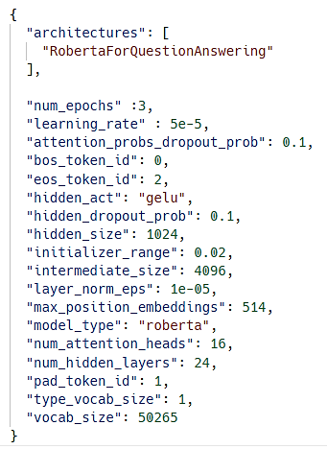
Details of the best performing model
Human performance
‘F1’ : 89.45
‘Exact’ : 86.83
Fine-tuned roberta large
'F1': 87.18
'Exact': 83.90
'HasAns_f1': 87.37
'HasAns_exact': 80.80
'NoAns_f1': 86.99
'NoAns_exact': 86.99
Model hyperparameters setting
24-layer, 1024-hidden, 16-heads, 355M parameters
Training time: > 1 day (batch_size=8)
GPU: NVIDIA A100 (xgpg0 cluster node)
Notes:
As we saw in the results, the best performing model is roberta-large. Which has f1 score ** and exact match of ** , this is very close to human performance of f1, em…
Here is the details of the hyperparameters of the best performing transformer based model.

Slide 20
Error Analysis
Common Non Matching Samples
Total : 3000 Samples
Roberta Large
Dependency Distance: 7.02
Proportion of “What” questions out of 339 samples: 0.63
Proportion of “Why” questions out of total “Why” samples in data: 0.38
Proportion of DESC answers out of 339 samples : 0.76
Dependency Distance: 6.33
Proportion of “What” questions not matching : 0.21
Proportion of “Why” questions not matching : 0.51
Proportion of DESC answers not matching : 0.256
Roberta Large
Non EM: 623
Non Exact Match common among all models : 339
Distilled Bert
Distilled Bert
Non EM: 1061
Proposed Pipeline
Dependency Distance: 6.5
Proportion of “What” questions not matching : 0.37
Proportion of “Why” questions not matching : 0.66
Proportion of DESC answers not matching : 0.42
Proposed Pipeline
Non EM : 817
Dependency Distance: 6.36
Proportion of “What” questions not matching : 0.28
Proportion of “Why” questions not matching : 0.55
Proportion of DESC answers not matching : 0.32
Notes:
Error analysis is a method used to document the errors that appear in model and determine whether those errors are systematic, and (if possible) explain what caused them. In this project we are performing error analysis using predictions provided by the Roberta Large, Distilled Bert and the proposed pipeline model. A sample of 3000 questions which had answers were extracted from the development dataset.
Analysis was performed on the question and answer types, and metrics such as dependency distances were calculated. It is observed that predictions which did not exactly match the ground truths had a higher mean dependency distance than for the exact matches. Dependency distance was calculated using the key question and answer tokens. Thus, on average, models found it harder to predict exact answers when the distance between the key tokens of the questions and answers were far apart.
Question and answer type analysis revealed that samples requiring descriptive answers were less likely to be extracted correctly. This behavior was observed across all the models. From these observations it was inferred that models were not able to perform as good on descriptive as compared to discrete type question answers.

Slide 21
Error Analysis Example
Context
Historically, Victoria has been the base for the manufacturing plants of the major car brands Ford, Toyota and Holden; however, closure announcements by all three companies in the 21st century will mean that Australia will no longer be a base for the global car industry, with Toyota's statement in February 2014 outlining a closure year of 2017. Holden's announcement occurred in May 2013, followed by Ford's decision in December of the same year (Ford's Victorian plants—in Broadmeadows and Geelong—will close in October 2016).
What type of manufacturing plant is Victoria soon losing?
Groundtruth
Roberta: base
Distilled Bert:
Proposed Pipeline:
Major car brands
Car
Question
Predictions
Notes:
Here is example for which none of the models could predict the correct answer. The question is of type “what” and the answer was of description type. The Roberta model was able to get a close prediction that Victoria might be losing a “base” however it was not able to correctly predict that it will be losing a base for car manufacturing. The other models failed to predict anything. Thus, the models fail to give correct answers in cases where a deeper language understanding is required which is common for descriptive answer types.

Slide 22
Conclusion
Transformer based models outperform the baseline BiDAF model.
RoBERTa and XLNet produce comparable results, with highest F1 and EM score for their large variants.
No improvement with Data Augmentation
Our pipeline model which is based on ‘RoBERTa base’ produces comparable results to the ALBERT model, but is not able to outperform the original RoBERTa model.
The F1 score of Exact Answer Extraction Module tested independently using ground-truth dev set is 95.6. This highlights potential in the pipeline architecture if first model can be improved.
Notes:
To summarize our work, we experimented with BiDAF, transformer based models and proposed a new pipeline architecture to tackle machine comprehension on Squad dataset. We saw that transformer based model specifically Roberta large perform the best. Also, our proposed pipeline architecture did not improve the performance of roberta base model, but based on the analysis it shows potential for improvement.

Slide 23
Future Work
Fine tune to improve the Relevant Context Extraction module of the pipeline architecture
Experiment with Linguistic post-processing
Ensemble different models
Hyperparameter tuning
Notes:
So, as future work, we would fine-tune and improve the Relevant Context Extraction module of the pipeline to see overall improvements in the pipeline architecture. Also, linguistic post-processing for the “when", “Where", “Whose", “Which" questions can be experimented with. Furthermore, ensembling different transformer models and hyper parameter tuning is another direction to look at.

Slide 24
Challenges
Relevant Context Extraction
Given the answer start, extracting relevant sentences from the context (tried nltk and spacy sentence tokenizer but it fails in some edge cases which were handled separately)
Data Augmentation
Back translation: Limited resources, paid conversion tools - Google translation API
Training time
CUDA out of memory
Notes:
We faced a few challenges while working on this project. First, extracting the relevant context sentences given the answer start from the context was quite a challenge. Even nltk and spacy library’s sentence tokenizer didnot perform very well in many cases which were handled by us in our code. Next, data augmentation using back translation was tricky as most of the translation tools are either paid or have limitations on the number of requests. The most pressing challenge however was the memory and time limitations. We could not fine tune our pipeline architecture as we were repeatedly getting CUDA out of memory error.

Slide 25
References
Bidirectional attention flow for machine comprehension, Min Joon Seo, Aniruddha Kembhavi, Ali Farhadi, and Hannaneh Hajishirzi.
Retrospective Reader for Machine Reading Comprehension, Zhuosheng Zhang and Junjie Yang and Hai Zhao, 2020
Attention is all you need}, 2017, Ashish Vaswani, Noam Shazeer, Niki Parmar, Jakob Uszkoreit, Llion Jones, Aidan N. Gomez,Lukasz Kaiser, and Illia Polosukhin.
Ensemble ALBERT on SQuAD 2.0, https://arxiv.org/pdf/2110.09665.pdf}{https://arxiv.org/pdf/2110.09665.pdf
Know What You Don't Know: Unanswerable Questions for SQuAD, https://arxiv.org/abs/1806.03822}{https://arxiv.org/abs/1806.03822
Ensemble BERT with Data Augmentation and Linguistic Knowledge on SQuAD 2.0
https://web.stanford.edu/class/archive/cs/cs224n/cs224n.1194/reports/default/15845024.pdf
Notes:
These are some of the resources we referenced for this project. Overall, the project helped us get a good understanding on current state-of-the-art question answering models and how to build, train and evaluate transformer based models for our own tasks.

