Slide 1
AI Powered Learning APP
Simran Singh
21d070073

Slide 2
Project Overview
I built a gamified learning platform where users:
Register/login via email
Watch educational YouTube videos
Get AI-generated summaries of videos
Take AI-generated quizzes from video transcripts
Earn XP, levels, and badges for engagement
Receive personalized recommendations
All user activity is tracked in Firestore

Slide 3
Key Features of the App
Firebase Authentication (email/password)
Firestore for clickstream tracking
YouTube Player API integration
OpenAI for summaries/quizzes (via external api)
Tailwind CSS for modern UI
Gamification (XP, badges, progress tracking)

Slide 4
Project Overview
I built a gamified learning platform where users:
Register/login via email
Watch educational YouTube videos
Get AI-generated summaries of videos
Take AI-generated quizzes from video transcripts
Earn XP, levels, and badges for engagement
Receive personalized recommendations
All user activity is tracked in Firestore

Slide 5
Tech Stack
Frontend | React + Vite
Styling | Tailwind CSS
Database | Firestore
Auth | Firebase Auth
Backend | Firebase
Hosting | Render
AI | OpenAI GPT
Version Control | Git

Slide 6
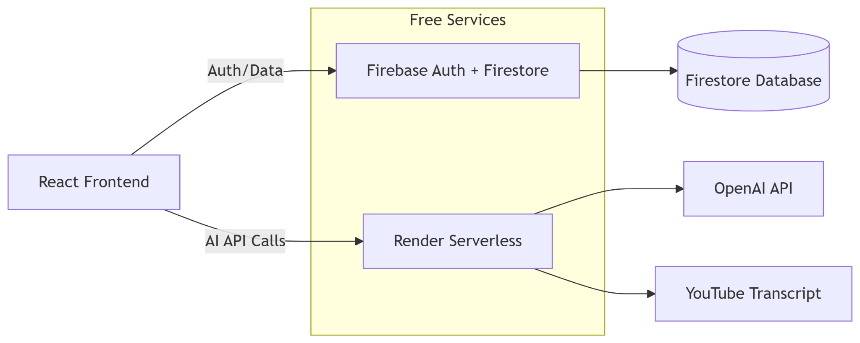

Slide 7
Project Demo
User registration
Video playback with AI summary
Quiz attempt + XP gain
Admin view of clickstream data

Slide 8
Challenges & Solutions
Challenge:
Firebase Cloud Functions require paid plan
Solution:
Used Render’s free tier for backend API

Slide 9
Future Improvements
Add more AI personalization features
Add leaderboard
Enhance recommendation system
Implement learning by teaching method

Slide 10
THANKS!

