Slide 1


Slide 2
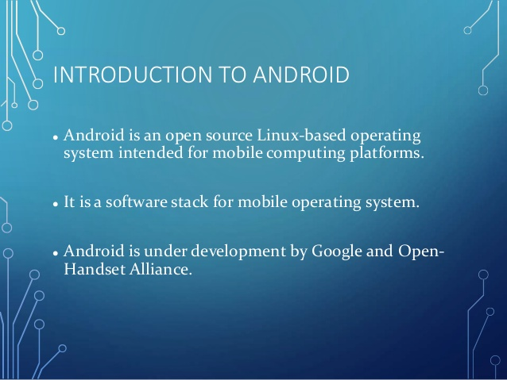

Slide 3
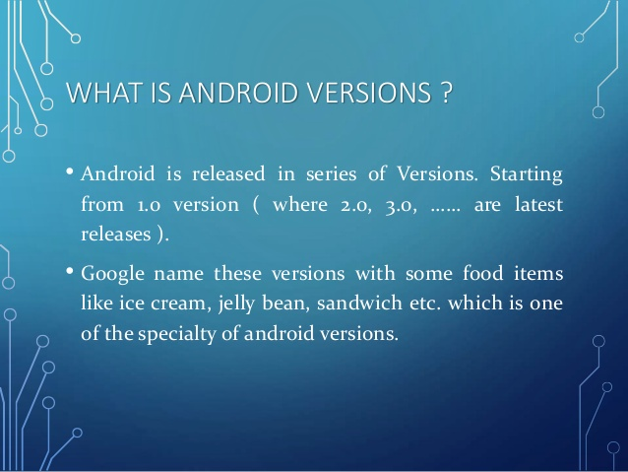

Slide 4
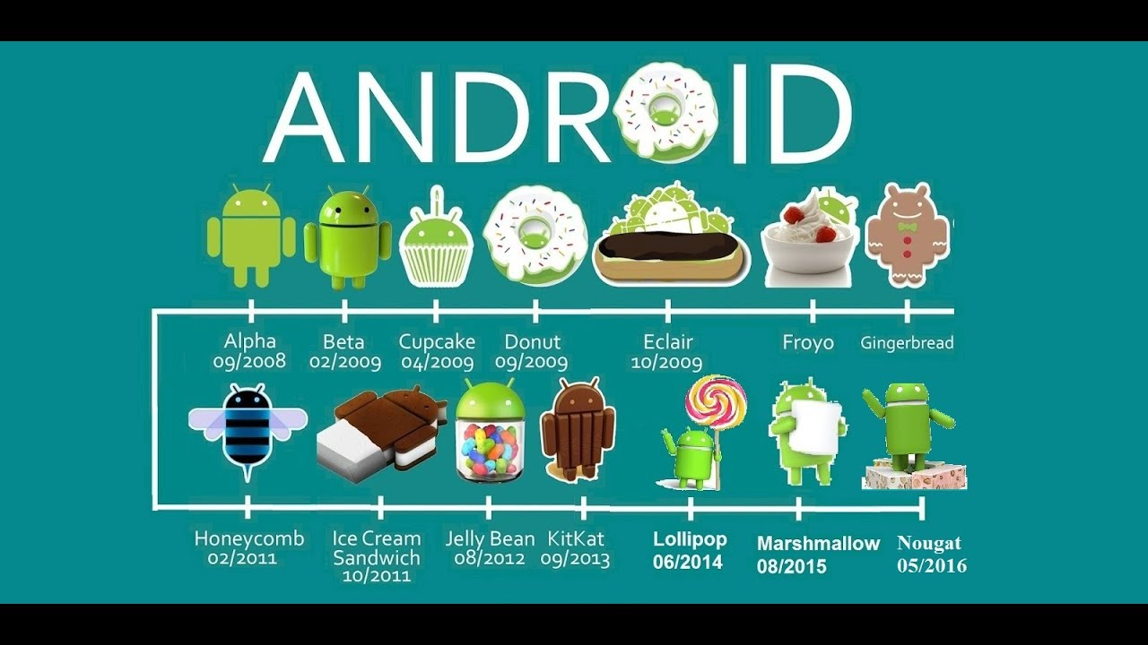

Slide 5
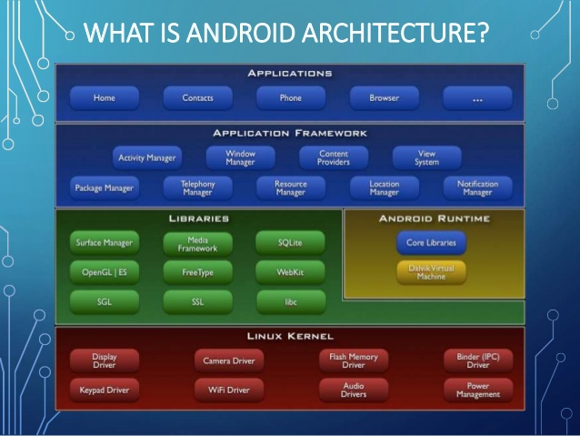

Slide 6
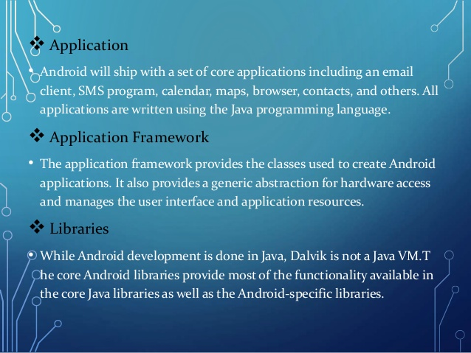

Slide 7
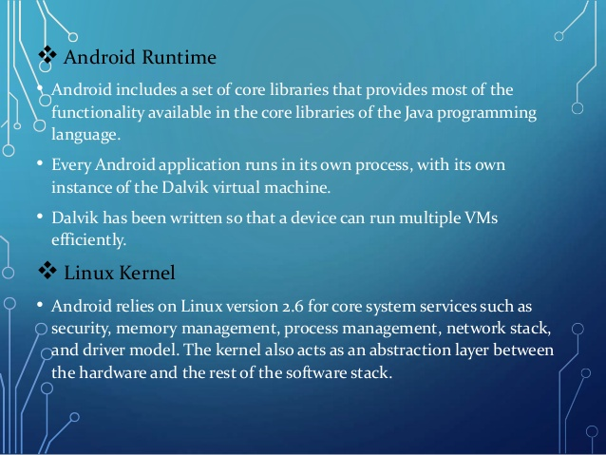

Slide 8
Exploring android studio
create a project
settings
clean vs build vs run a project
refactor vs rename
Gradle
Android SDK
Terminal, Log and Debugging
Basic unit of Android App - Activity

Slide 9
Android Project structure
Android manifest
entry for every activity
app permission and launcher
main -> java and res folder
activity comprises of UI (xml file) and backend code(java files)
dependencies in gradle.properties

Slide 10
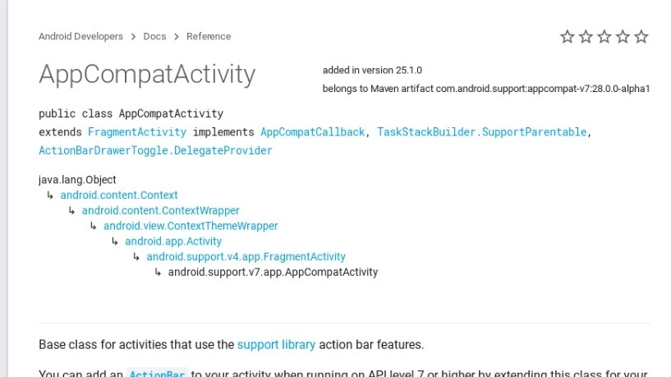
AppCompatActivity heirarchy

Slide 11
