Slide 1
Discussion from previous class
Static vs Instance methods
Statics methods belong to class, memory allocated once.
Can be accessed using class name, no need to create object.
Static methods are binded at compile time. (Objects are created at runtime)
Compile-time is the instance where the code you entered is converted to executable while Run-time is the instance where the executable is running.

Slide 2
Wrapper classes in Java
convert primitive data types into objects
The classes in java.util package and data structures in collection framework handles only objects .
Ex - Integer for int, Float for float , Double for double, etc.
char ch = ‘a’; Character a = ch; //autoboxing
Character ch = ‘a’; char a = ch; //unboxing

Slide 3
Input in java - Scanner Class
Scanner class ( java.util package) (easier)
BufferedReader (java.io package) (faster)

Slide 4
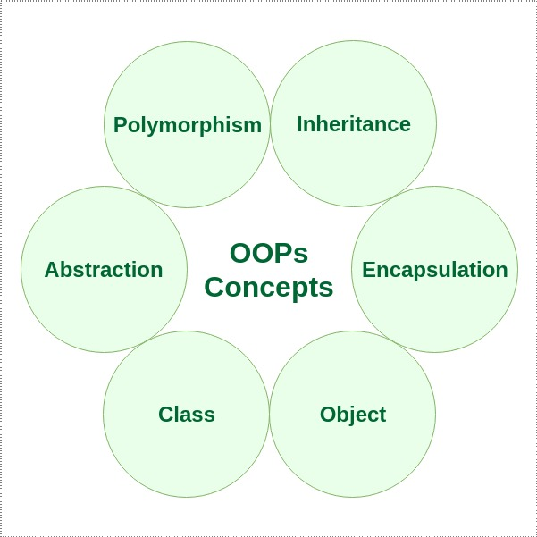
OOP(Object Oriented Programming)

Slide 5
Encapsulation
wrapping up of data under a single unit
the data in a class is hidden from other classes, so it is also known as data-hiding.
Encapsulation can be achieved by: Declaring all the variables in the class as private and writing public methods in the class to set and get the values of variables

Slide 6
Why are data members declared private?

Slide 7
Why are data members declared private ?
Prevent illegal change of data.
Control over data.

Slide 8
Inheritance
one class is allow to inherit the features(fields and methods) of another class.
Super Class/ Base Class/ Parent Class
Sub Class/ Derived Class/ Child Class
Object class is parent/ancestor to all classes
Reusability
Types Of Inheritance (isMultiple Inheritance allowed in java ? )

Slide 9
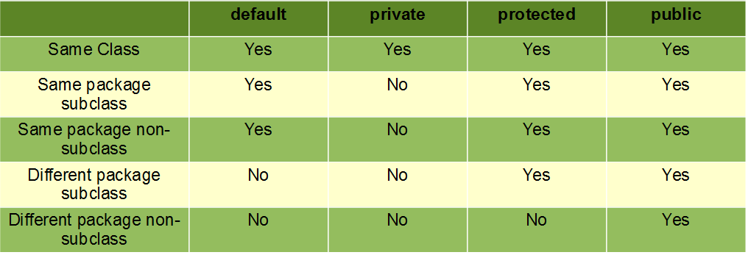
Access Modifiers

