Slide 1

Dev-Term Flashcards By Group - 12

Slide 2

Index
Problem Statement
Solution
Working (Method/Mind map)
Conclusion.

Slide 3
Problem Statement
Many beginners struggle to remember programming terms and definitions
Traditional notes are boring and not interactive
Students need a fun, quick, and engaging way to revise concepts

Slide 4
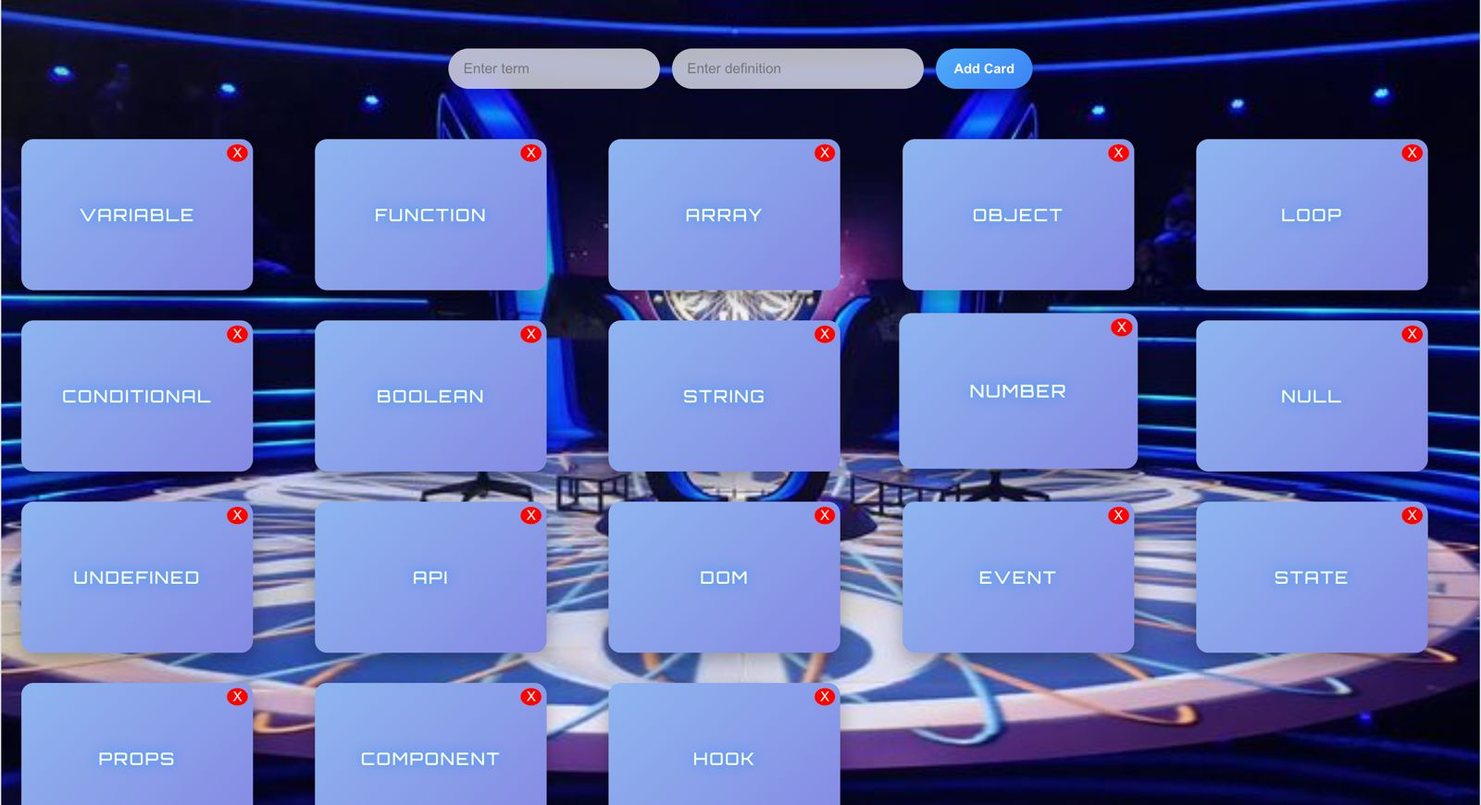
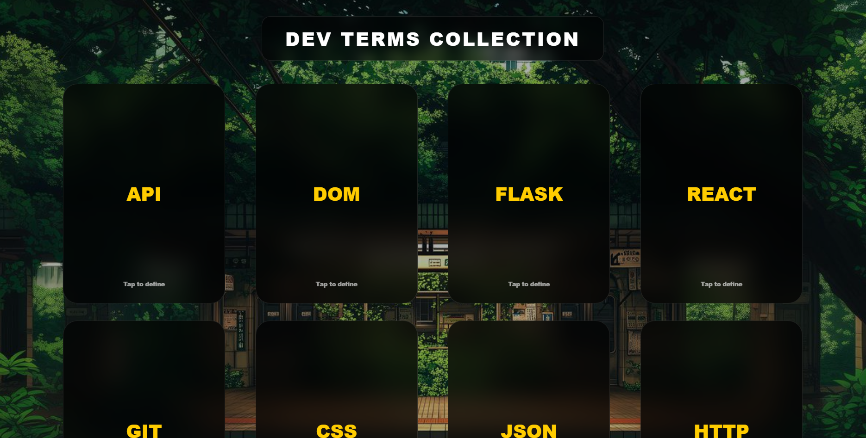
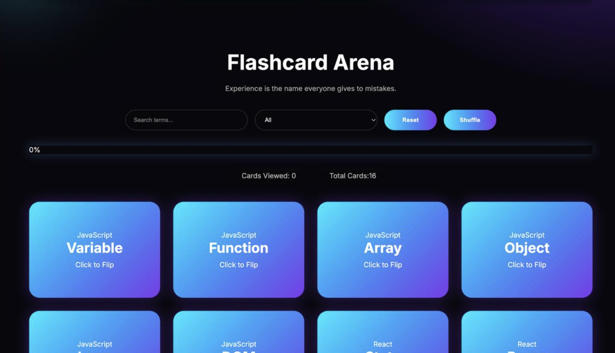
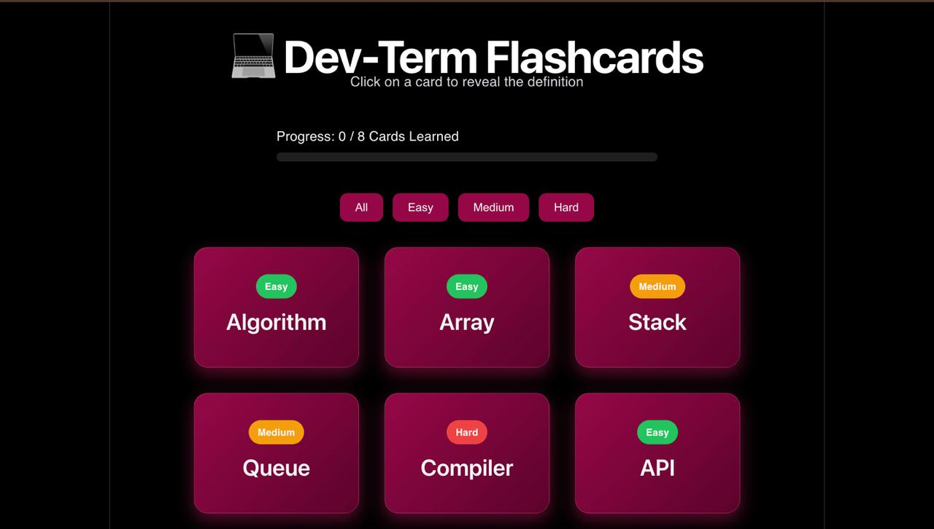
Solution
A React-based flashcard web app
Each card shows a programming term on the front
Clicking the card flips it using React state
Back side shows the definition
Helps in active learning + quick revision

Slide 5
Working
Mind Flow:
How it works:
Store terms & definitions in an array (JSON format)
Use React useState to track flip state
On click → toggle state → flip card
Conditional rendering shows front/back
Display Card
User Click
State Update
Flip Animation
Show Definition

Slide 6
Conclusion
Makes learning programming terms interactive and fun
Improves memory retention
Simple UI but highly useful for students
Can be extended with:
- Quiz mode
- Timer
- Score tracking

Slide 7
Thank You

