Slide 1
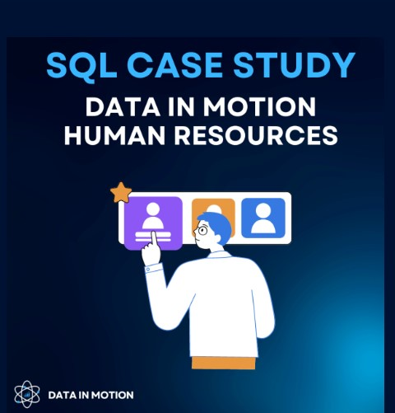
There are three tables in this dataset: "departments," "employees," and "projects." In this context, various SQL functions are employed, including:
Joins
order by clause
subquery
window function
The database server used for this dataset is PostgreSQL, a powerful and open-source relational database management system.

Slide 2
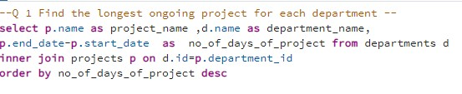
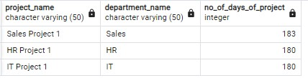

Slide 3
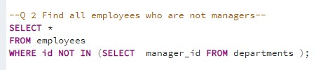
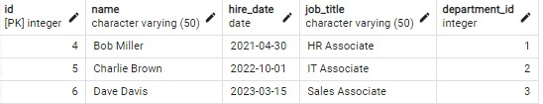

Slide 4
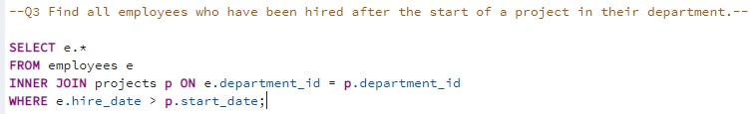


Slide 5
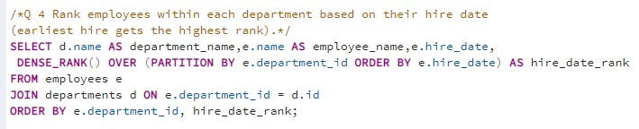
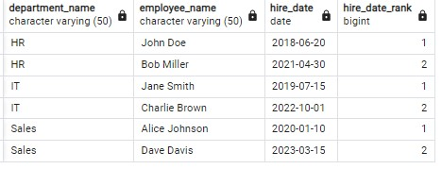

Slide 6
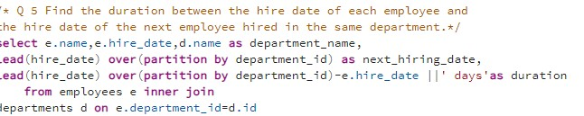
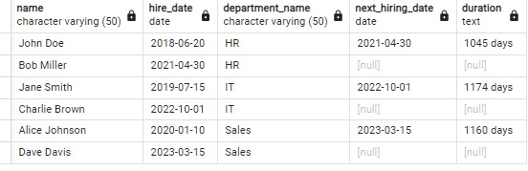

Slide 7

The Sales project, with a duration of 183 days, holds the record as the longest ongoing project in each department.
Among the employees, Bob Miller, Charlie Brown, and Dev Davis stand out as non-managers.
Dave Davis is the employee who was hired after the start of the Sales department's operations.
The time span between the hiring date in the HR department is 1045 days, in the IT department is 1174 days, and in the Sales department is 1160 days.
KEY
FINDINGS

