Slide 1
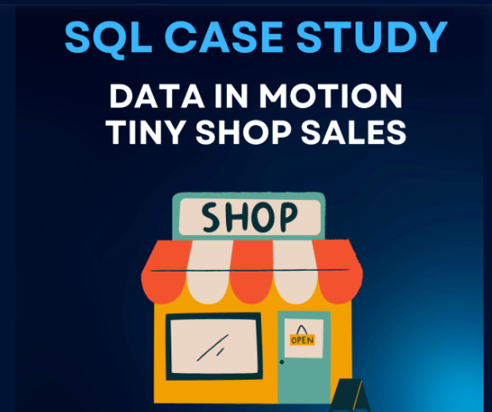
The case study comes with 4 tables: customers, orders, order items, and products, containing details about the Tiny Shop Sales. 📚 There are 10 questions to be answered which would require exposure to the below-mentioned topics: ➡ Basic aggregations ➡ CASE WHEN statements ➡ Window Functions(RANK, DENSE_RANK, and so on.) ➡ Joins ➡ LIMIT Clause ➡ CTEs ➡ ROUND, PARTITION BY functions ➡ GROUP BY & ORDER BY clause
Database Server used: PostgreSQL

Slide 2
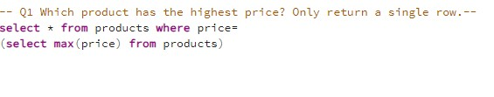

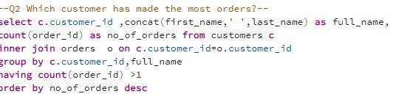
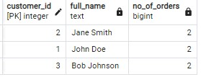

Slide 3
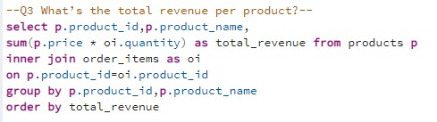
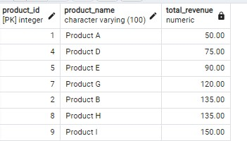
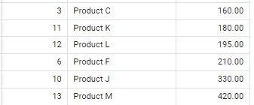

Slide 4
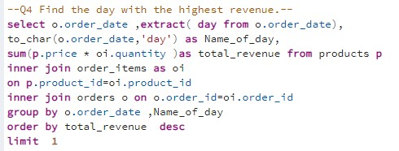


Slide 5
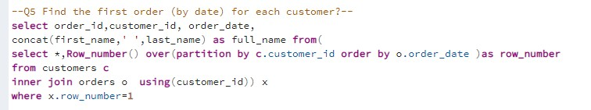
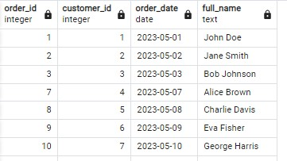
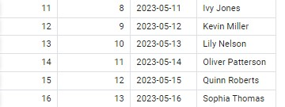

Slide 6
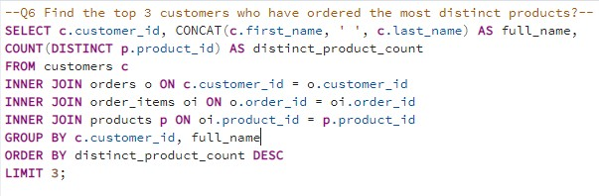
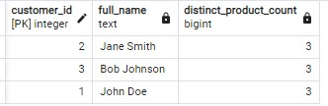
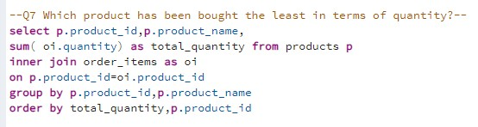
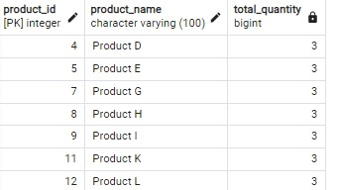

Slide 7
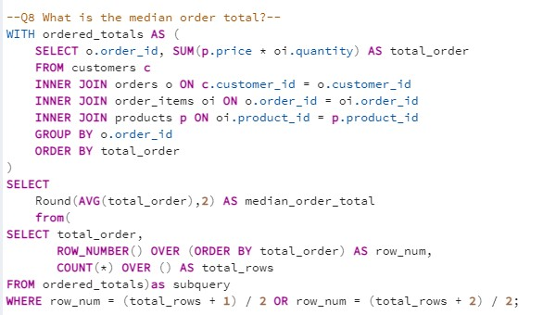


Slide 8
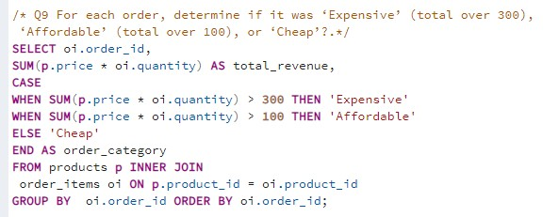
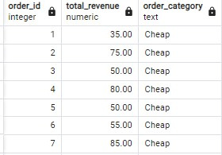
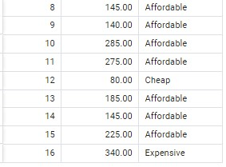

Slide 9
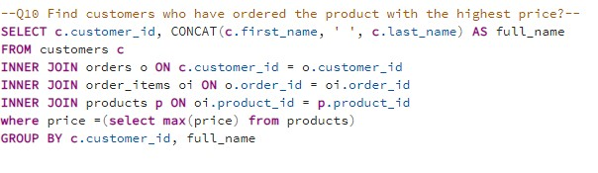


Slide 10
INSIGHTS
Product M is the most expensive, priced at $70.
John Doe, Bob Johnson, and Jane Smith are the top three customers with the highest number of orders, each having made 2 orders.
Tuesday is the day that generates the highest revenue.
Jane Smith, Bob Johnson, and John Doe are the top three customers who have ordered the most distinct products, with each of them ordering 3 different products.
Among the 7 products available, the one with a total quantity purchased of 3 has the lowest sales in terms of quantity.
The median order total is $112.50.
Ivy Jones and Sophia Thomas are the customers who have purchased the product with the highest price.

