Slide 1

Discussion on “Udaan”
A Special Industry Initiative (SII) for Jammu & Kashmir
2013

Slide 2
“Udaan” - a program to deliver skill and higher employment for the youth of Jammu and Kashmir has 3 key objectives
Bring about a sustainable change in the situation in Jammu and Kashmir by making a difference in the life’s of the educated youth
Provide exposure to the graduates and post graduates of Jammu and Kashmir to the best of corporate India – integrate them with the mainland!
Provide corporate India with exposure to the rich talent pool available in the state
1
2
3

Slide 3

Program is a unique partnership between industry and the youth of J&K through NSDC
UDAAN
Corporate partnerships
Associations
Program Implementation and funding support
Advocacy and support
Facilitation, Proposal evaluation and Monitoring
A corporate initiative focused on skilling and employability of 40,000 graduates and post graduates over a 5 year period

Slide 4
What it means for Corporates
You have a need for talent
Look beyond your traditional areas of recruitment, look at J&K – contribute to a national cause!
Screen and shortlist from the rich pool of talent available
Put them through your training process
If found suitable – hire them!
NSDC will help with the funding for this process

Slide 5
Evaluation and Approval Process for Corporate Proposals
Board
Roles And Responsibilities
Representatives of Key Stakeholders – Both Gov & Private Sector; Chairman & CEO-NSDC
For information to the Board
Proposal Approval Committee (AC)
Representation from the MHA, State Government; NSDC and 1 independent member
PAC approves or rejects the proposal
Proposal Evaluation Committee (PEC)
PEC forms a view on the evaluated proposals for discussion at the PAC
Due diligence partners
NSDC team
Proposal introduction and evaluation
NSDC evaluates and performs financial and technical due diligence on feasible proposals
Proposal to be submitted by filling the format available on the Udaan website

Slide 6
Participation in the Udaan process has been kept very simple
Process for approval of project……
…. And activities in the state
Connect with NSDC to understand details on program
Submit project proposal for due diligence at NSDC
Proposal gets discussed at PAC meeting
MOU with NSDC
Understand the talent pool in the state
Start screening candidates for selection
Submit list of shortlisted candidates for security clearance
Start training
Recruit or help in recruitment
1
2
1
2
3
3
4
4
5
Way forward: Both activities can happen in parallel

Slide 7
Nature of entities that can participate in Udaan SII
Any legal entity
If a corporate intends that the training be routed through a prestigious training provider or apex level industry association, it could be allowed to do so as an exception provided that the corporate is solidly behind such an association and the corresponding MoU is in place with funding and commitments for provision of employment of minimum 70% of the candidates trained.
The Public Sector Undertakings (PSUs) can also participate in the scheme. Total expenditure for implementation of the scheme however will be borne by the participating PSU under the (Corporate Social responsibility) CSR head.

Slide 8
Other Project Details
Location of training
It is proposed that the training be conducted outside the state of Jammu and Kashmir.
However, in select cases the training may be conducted within the state of Jammu and Kashmir as well.
Duration of training
Normally the training duration will be for 6 months which may be reduced to 3 months depending upon the requirement of corporates.
Target candidates
The Scheme will cover graduates, post graduates, professional degree holders and three year engineering diploma holders. Final year students can also be included.

Slide 9
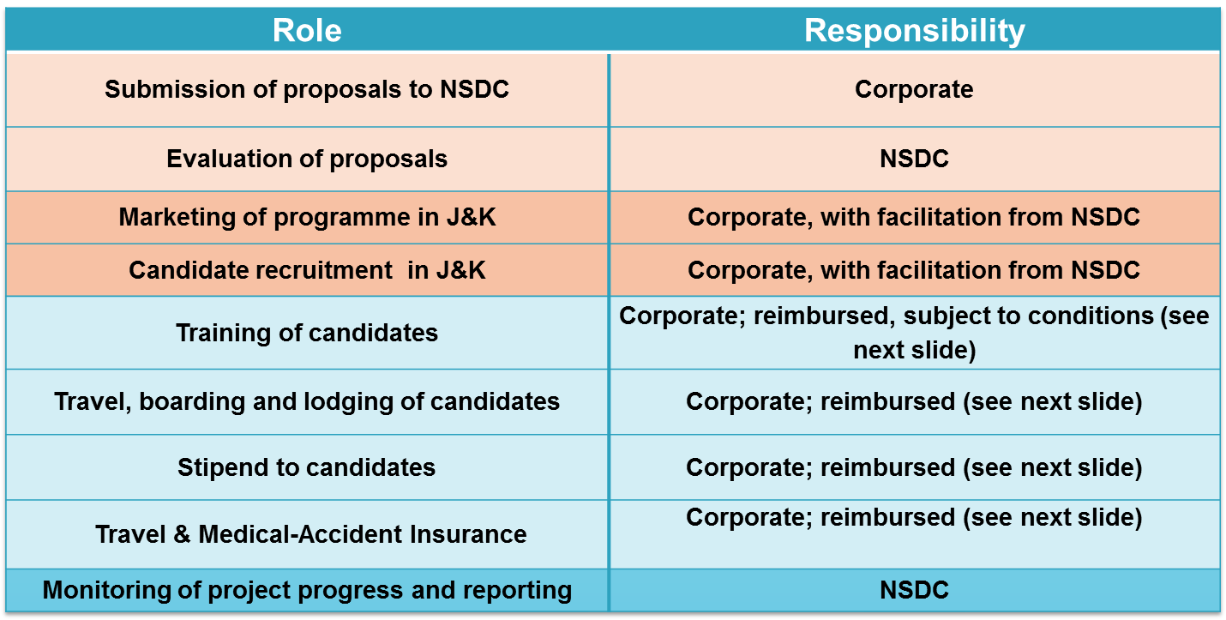
Roles and Responsibilities of NSDC and Corporates

Slide 10
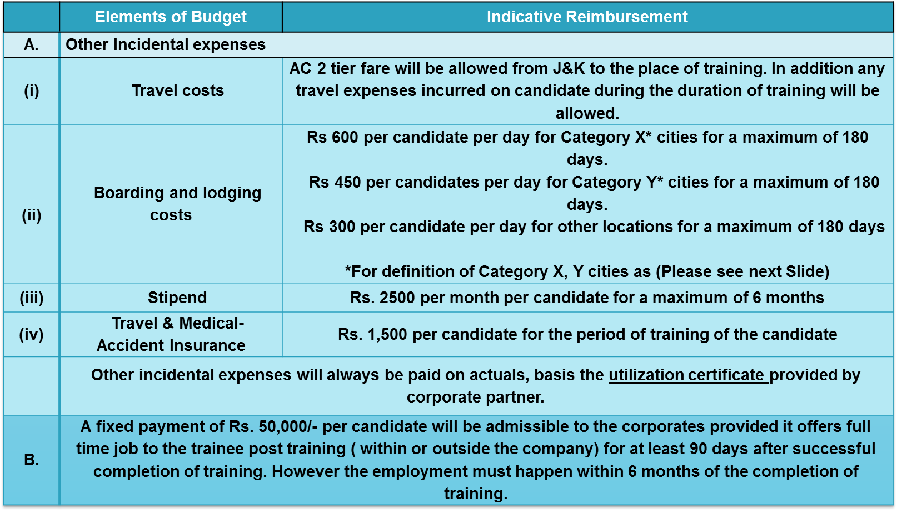
Budget for the program per candidate

Slide 11
Details of boarding and lodging costs-
Definition of Category X, Y cities:
Category ‘X’ cities | Category ‘Y’ cities
Delhi-NCR Greater Mumbai Chennai Kolkata Hyderabad Bengaluru | Andhra Pradesh: Vijayawada, Visakhapatnam, Warangal, Guntur Andaman and Nicobar: Port Blair Assam: Guwahati Bihar: Patna Chandigarh: Chandigarh Chhatisgarh: Durg-Bhilai Nagar, Raipur Goa: Goa Gujarat: Ahmedabad, Rajkot, Jamnagar, Vadodara, Surat J & K: Srinagar, Jammu Jharkhand: Jamshedpur, Dhanbad ,Ranchi Karnataka: Belgaum, Hubli, Dharwad, Mangalore, Mysore Kerala: Kozhikode, Kochi, Thiruvanathapuram Madhya Pradesh: Gwalior, Bhopal, Jabalpur, Indore | Maharashtra: Amravati, Nagpur, Aurangabad, Nashik, Bhiwandi, Pune, Solapur, Kolhapur Meghalaya : Shillong Orissa: Cuttack, Bhubaneswar Punjab: Amritsar, Jalandhar, Ludhiana Puducherry: Pondicherry Tamil Nadu: Salem, Tiruppur, Coimbatore, Tiruchirappalli, Madurai Rajasthan: Bikaner, Jodhpur, Kota, Jaipur Uttarakhand: Dehradun Uttar Pradesh: Moradabad, Meerut, Aligarh, Agra, Bareilly, Lucknow, Kanpur, Allahabad, Gorakhpur, Varanasi West Bengal: Asansol
Refer to the next slide for reimbursement schedule

Slide 12
Reimbursement Schedule for Approved Projects
 | 1st instalment | 2nd Instalment | 3rd Instalment
What? | 35% of annual approved other incidental expenses to be borne by NSDC. Note: This does not include reimbursement of Rs. 50,000 towards training cost. | 35% of annual approved other incidental expenses to be borne by NSDC. Note: This does not include reimbursement of Rs. 50,000 towards training cost. | 30% of annual approved other incidental expenses to be borne by NSDC. Note: This does not include reimbursement of Rs. 50,000 towards training cost.
When ? | After project approval and initiation of training. | Utilization 50% of the 1st instalment and achievement of corresponding physical target. | Utilization of 90% of the total available funds and achievement of 100% of corresponding physical target.
Conditions to be complied with | MoU between NSDC and the proposal owner signed. | Submission of utilization certificates certified by a CAG approved auditor for 50% of the total available funds. | Submission of utilization certificates certified by a CAG approved auditor for 90% of the total available funds.

Slide 13
Visit the Udaan website for details and connect with us
http://www.nsdcudaan.com
Connect with us :
Dilip Chenoy : dilip.chenoy@nsdcindia.org
Gouri Gupta : gouri.gupta@nsdcindia.org
Abhishek Hegde : abhishek.hegde@nsdcindia.org
Bint Abbas: bint.abbas@nsdcindia.org

