Slide 1
LEVERAGING BIG DATA IN TIME SENTIMENT ANALYSIS AND VOTER ANALYSIS

Slide 2
WHY VOTER SENTIMENT ANALYSIS IS CRUCIAL
Priyal
Gauge Public Opinion
Identify Trends
Improve Engagement
Understand voter concerns, preferences, and emotions for actionable feedback
Detect emerging issues and shifts in voter priorities over time and align strategies
Foster meaningful interactions between leaders and citizens
Notes:
"In today's hyper-connected world, elections aren't just about votes—they're about voices. How can we decode millions of digital conversations to understand voter sentiment and empower decision-makers?"Mention the latest election, highlighting its high voter engagement and the role of online platforms in shaping public opinion. "This project leverages cutting-edge technologies like HDFS and BERT to analyze Reddit data, offering insights into voter behavior and sentiment during the recent elections.“
Key stakeholders- Policymakers: Use sentiment insights to align policies with public priorities and address pressing concerns effectively.Political Campaign Teams: Tailor messaging, identify key voter issues, and optimize strategies based on real-time sentiment trends.Media Analysts: Track public discourse to shape election narratives and highlight emerging voter concerns.Voters: Benefit indirectly from improved campaigns and policies that reflect their true needs and opinions.Academia and Researchers: Leverage sentiment data for studies on political trends, public behavior, and electoral dynamics.Tech Providers: Ensure robust data collection, storage, and analytical tools for accurate and actionable sentiment analysis.

Slide 3
THE ISSUE IN FOCUS
01
02
03
04
Priyal
Unstructured Data Overload​
Scalability Challenge​
Vast Amount of Data
Difficulty in Manual Intepretation
Lack of Ability to Scale
Need of Automation
Real Time Sentiment Shifts​
Impact on Decision-Making​
Hinderance due to inaccurate insights
Ineffective alignment with voter
concerns
Traditional Analysis Slowness
Missed Opportunities
Notes:
This project focuses on using big data technologies to analyze voter sentiments effectively. By gathering data from various sources, such as social media, news articles, and public forums, we aim to understand the opinions and emotions of voters over time. The vast scale of data makes traditional storage and processing methods insufficient, leading us to leverage distributed systems for storage (HDFS) and advanced processing tools (Apache Spark). The ultimate goal is to predict sentiment trends and provide insights that could guide decisions in areas such as public policymaking and social engagement.

Slide 4
METHODOLOGY
Priyal
Step 1
Step 3
Step 5
Collection of Data from Reddit and Data Cleaning
Training Dataset for Sentiment Analysis
Evaluation and Insights
Step 2
Step 4
Configuring Hadoop Client and HDFS for Storage/Retrieval of Reddit Data
Testing the Naïve Bayes & BERT model on Reddit Dataset

Slide 5
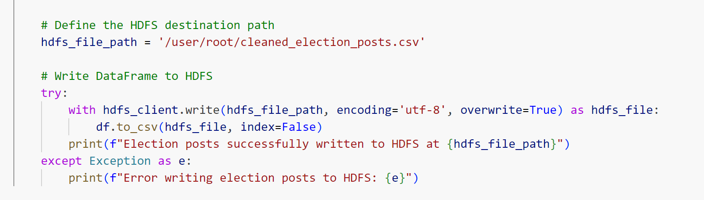
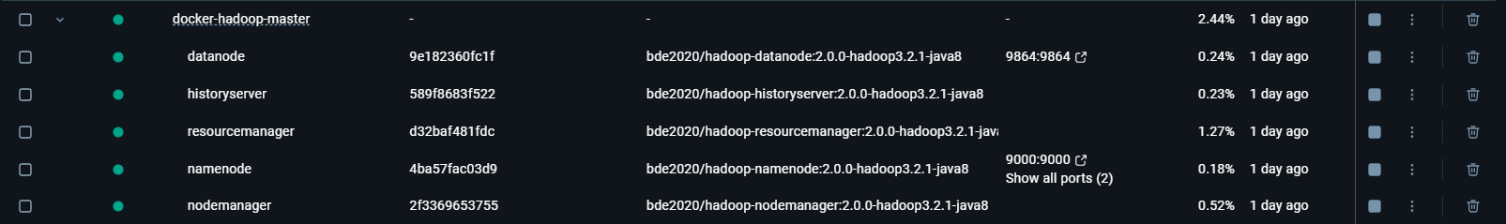
INTERACTION WITH HADOOP
Utsav

Slide 6
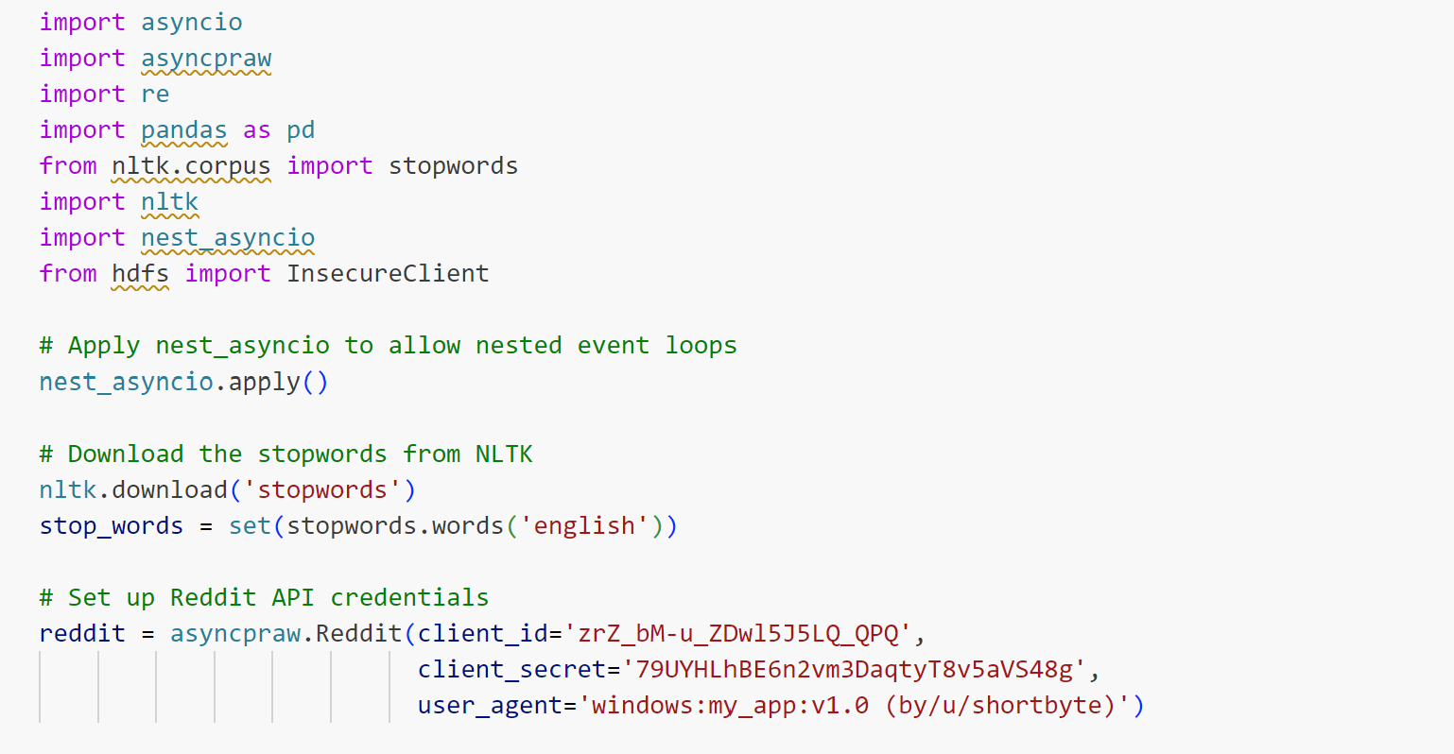
Leveraging HDFS for Sentiment Analysis
Utsav
asyncio & nest_asyncio: Enable asynchronous Reddit data fetching
asyncpraw: Access Reddit API for posts and comments
re: Clean text data (remove URLs, special characters)
pandas: Organize and analyze fetched data.
nltk: Preprocess text (tokenization, stopword removal).
hdfs.InsecureClient: Store and retrieve data in HDFS
Data Source: Reddit

Slide 7
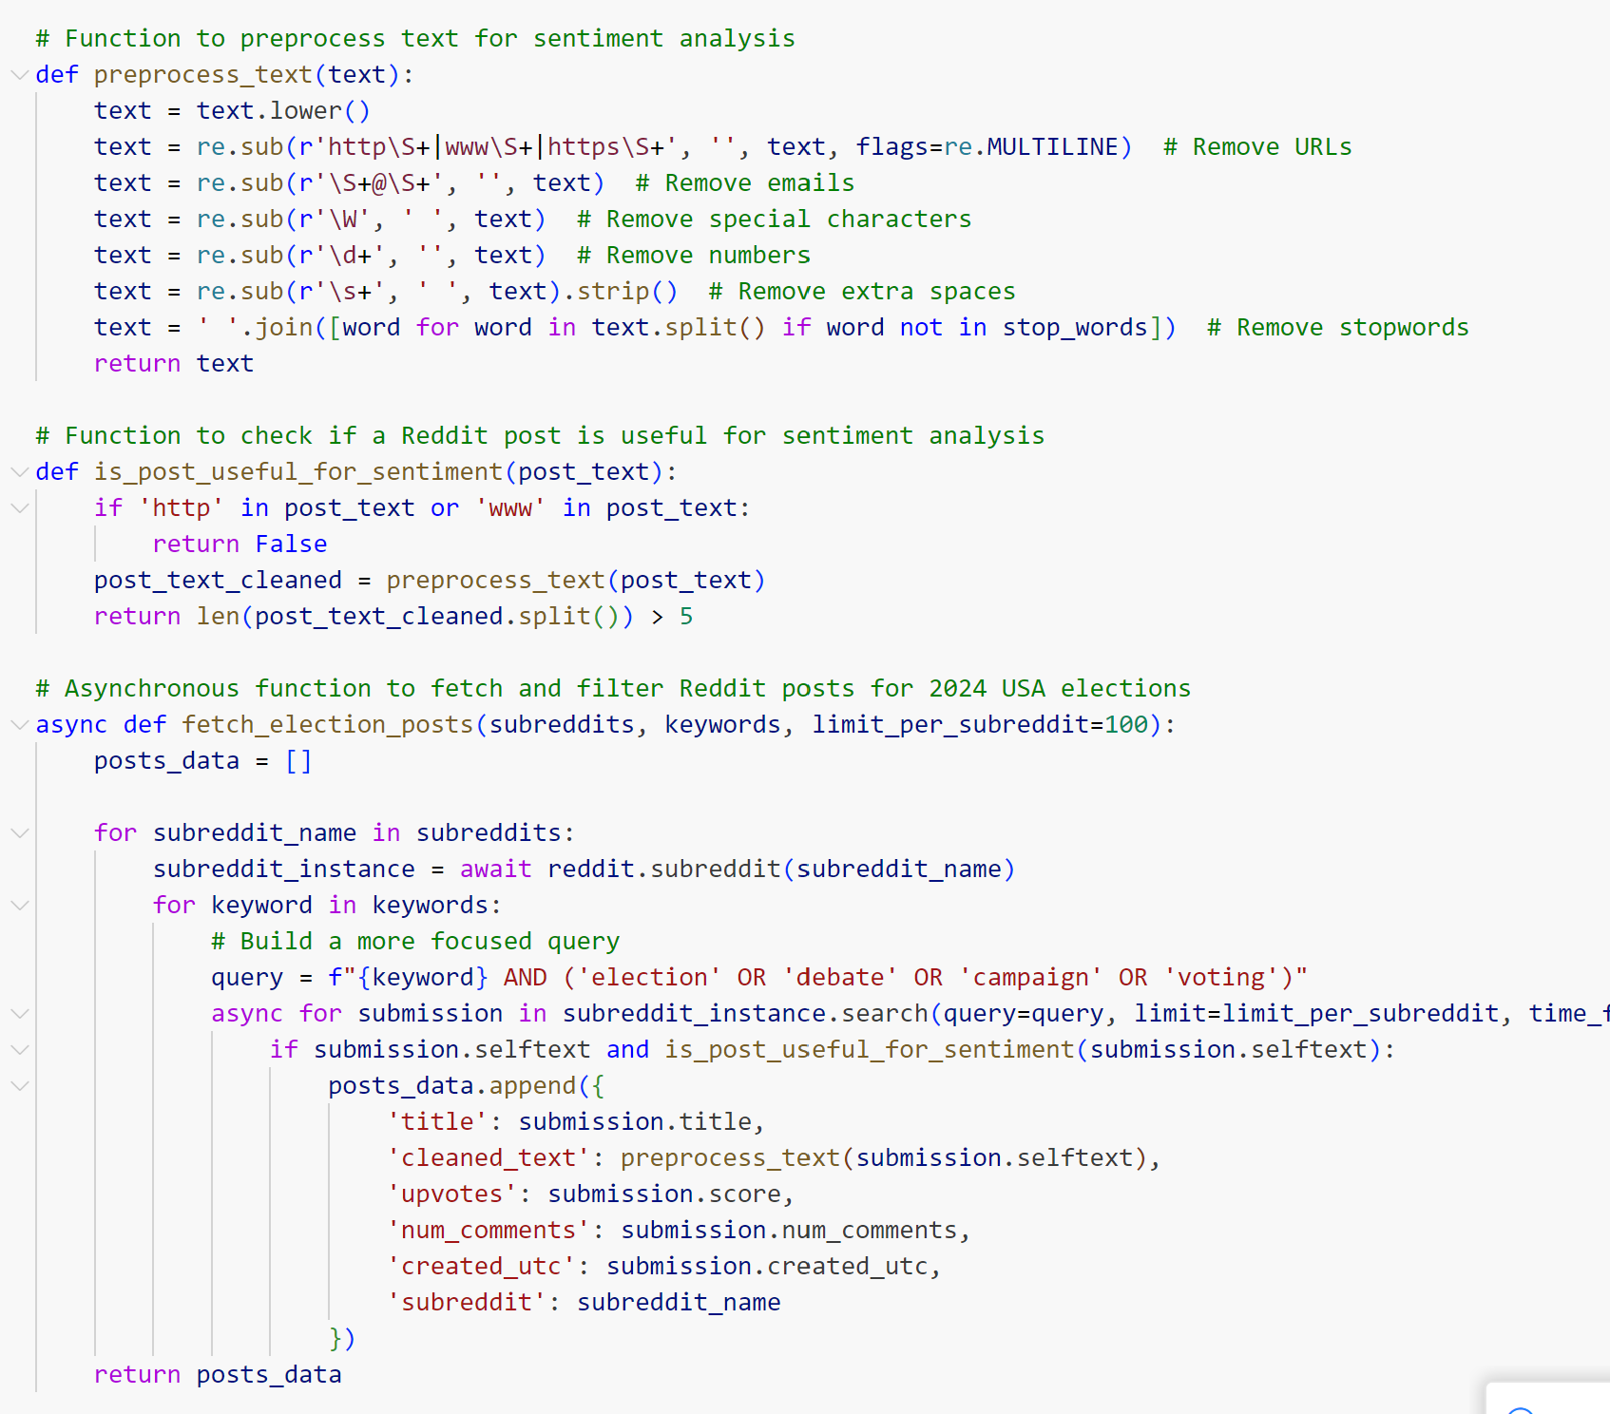
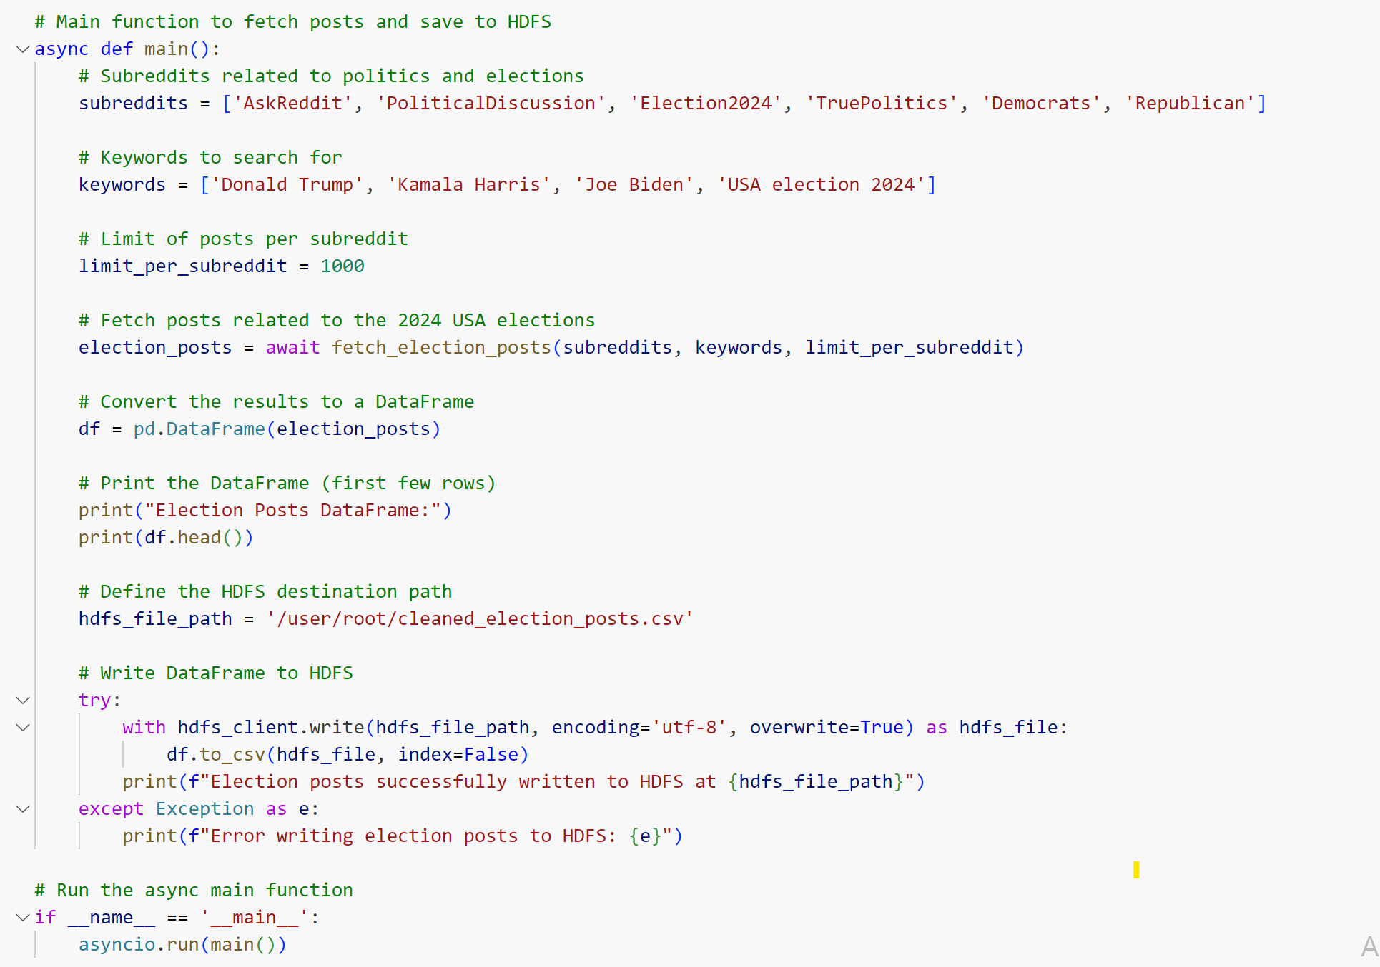
Data Collection & Preprocessing
Utsav

Slide 8
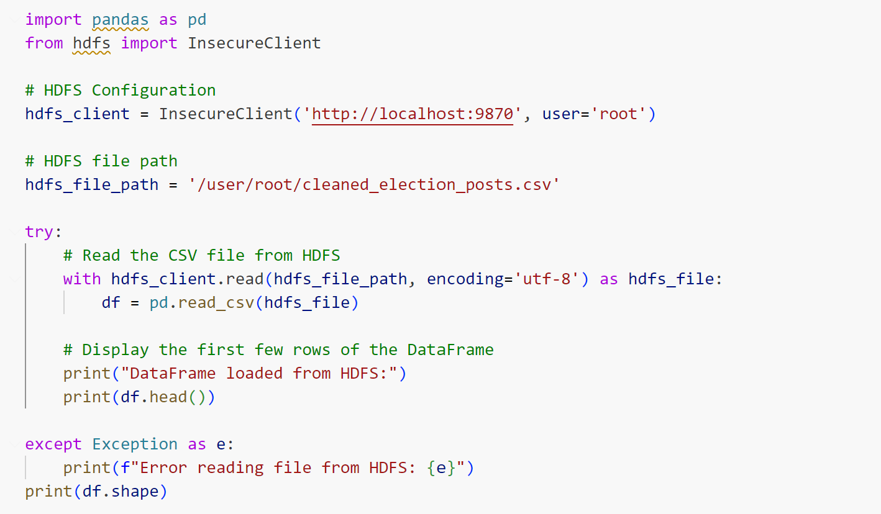
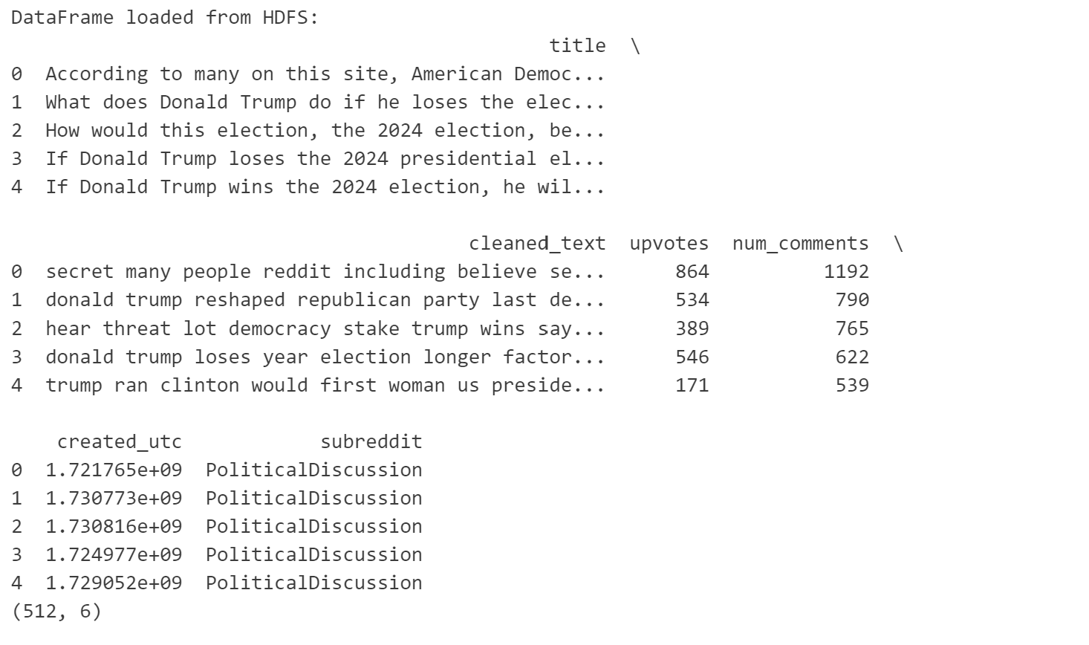
Leveraging HDFS for Sentiment Analysis
Utsav
Results

Slide 9
02
NAÏVE BAYES
Asmita
Text Classification Strength
Handles Sparse Data
Quick Training & Implementation
Scalable
Notes:
Efficient with Text Data: Handles Reddit's unstructured and text-heavy content effectively, even with large volumes of posts and comments
Adaptable to Sparse Features: Works well with the sparse nature of term-frequency representations in Reddit data Scalable for Big Data: Processes Reddit’s large datasets efficiently, aligning with HDFS storage capabilities.
Quick to Implement: Naïve Bayes enables fast training and prediction, ideal for dynamic and evolving Reddit discussions.
Proven NLP Accuracy: Excels in sentiment classification tasks, even when text includes diverse tones, slang, and varying vocabulary typical of Reddit posts.

Slide 10
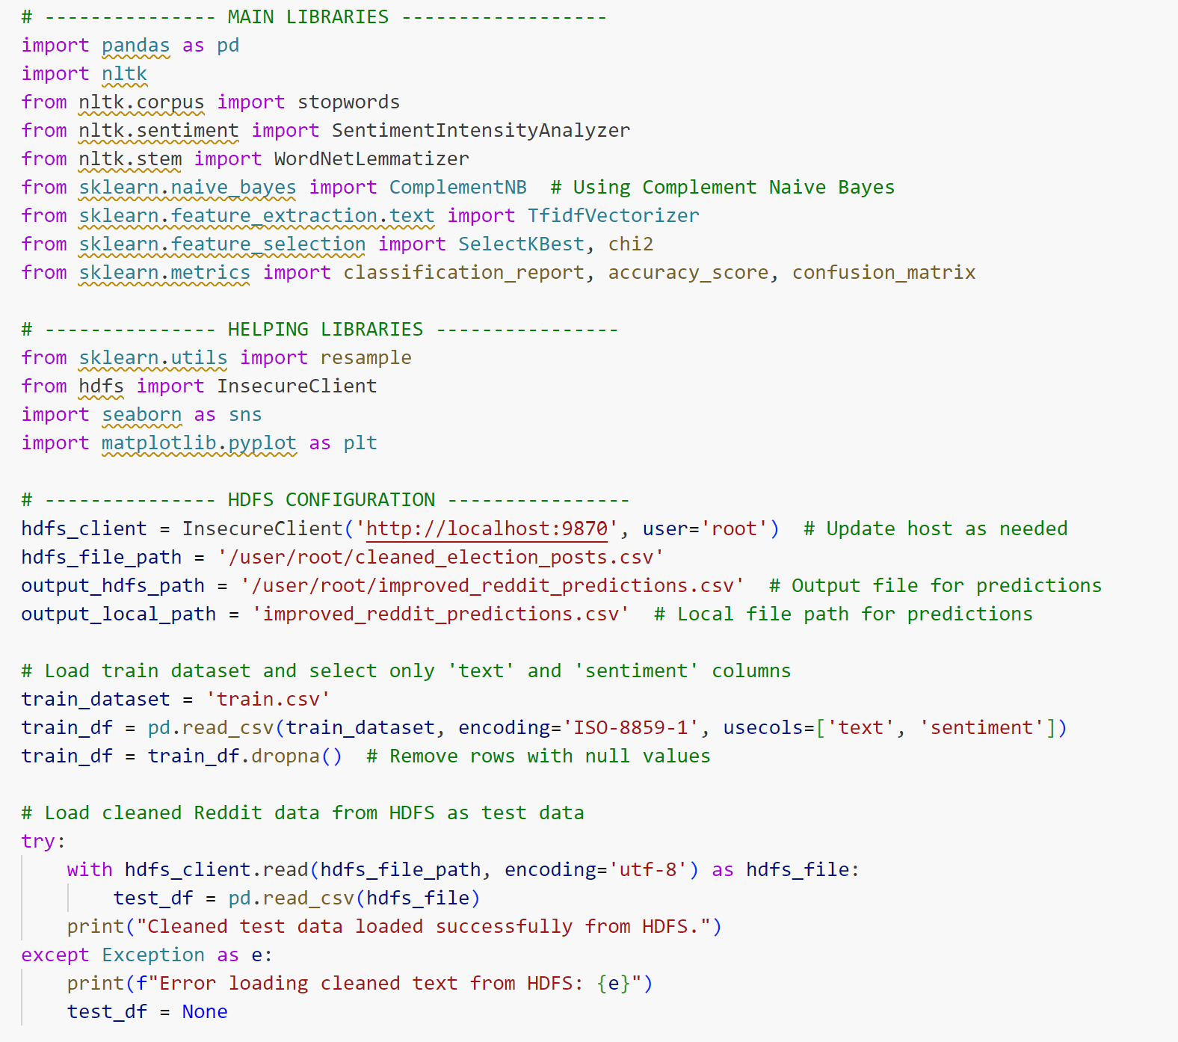
NAÏVE BAYES IMPLEMENTATION
Asmita
SentimentIntensityAnalyzer (NLTK): Detects positive, negative, and neutral sentiments in text
WordNetLemmatizer (NLTK): Reduces words to their root form for improved accuracy
TfidfVectorizer (Sklearn): Converts text to numerical data, capturing word importance
SelectKBest & chi2 (Sklearn): Optimizes feature selection for better performance
Notes:
SentimentIntensityAnalyzer (NLTK): Ideal for analyzing sentiment intensity in text, detects positive, negative, and neutral tones, especially useful for Reddit's diverse user language.
WordNetLemmatizer (NLTK): Reduces words to their root form, improving model accuracy by consolidating variations of words into a single token.
Complement Naive Bayes (Sklearn): Optimized for imbalanced data, which is typical in sentiment analysis tasks, providing better accuracy and performance on large datasets like Reddit posts.
TfidfVectorizer (Sklearn): Converts text data into numerical vectors based on term frequency and inverse document frequency, helping the model understand the importance of words in posts
.SelectKBest & chi2 (Sklearn): Feature selection techniques that optimize model performance by selecting the most relevant features for sentiment analysis
.Classification Metrics (Sklearn): Helps evaluate model performance using metrics like accuracy, confusion matrix, and classification report, ensuring the quality of sentiment predictions.

Slide 11
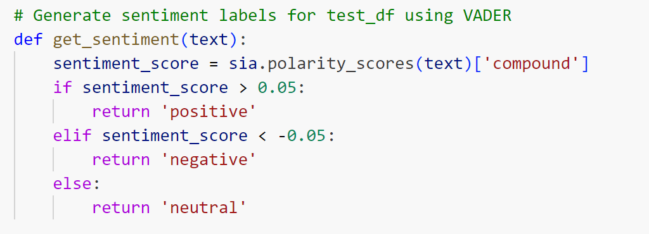
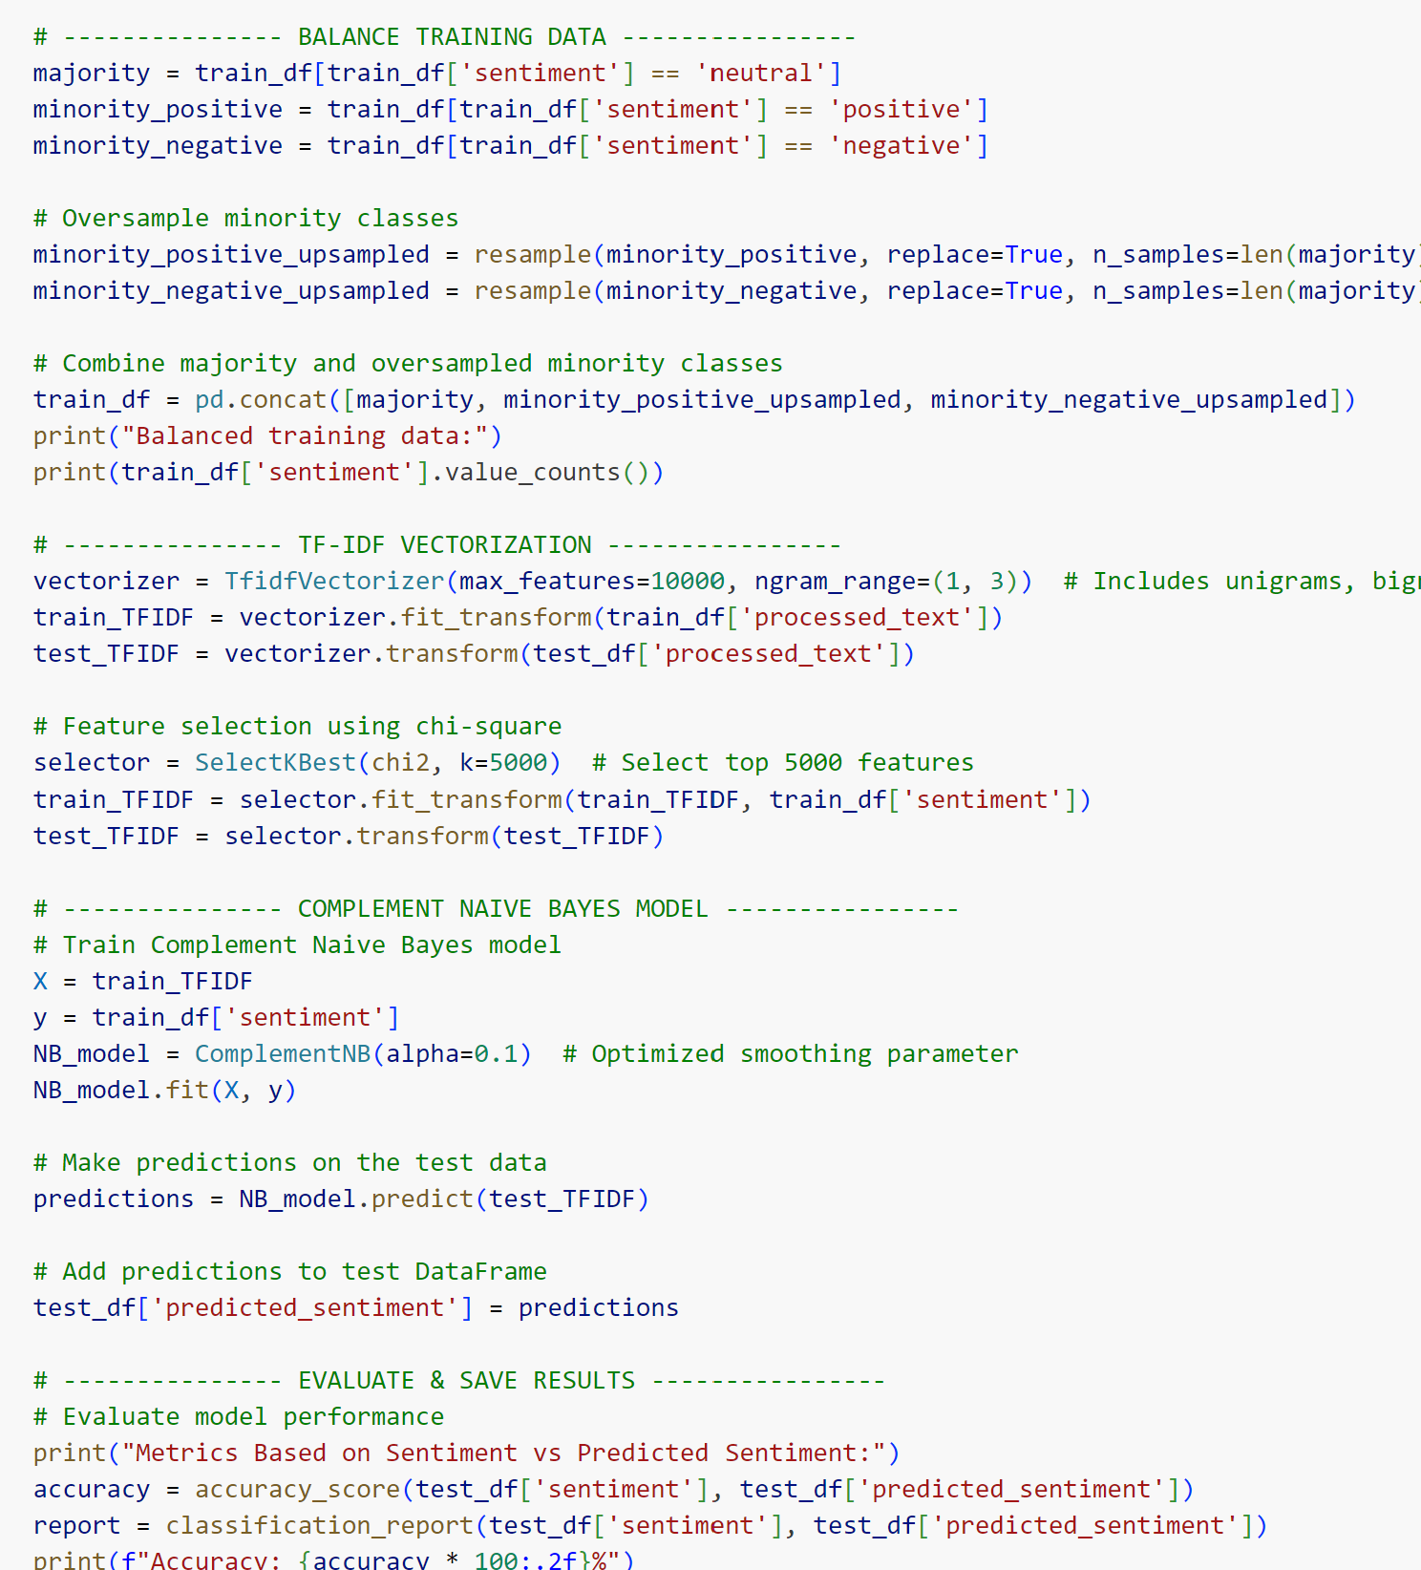
NAÏVE BAYES IMPLEMENTATION
Asmita
Sentiment Scoring with VADER: VADER assigns a compound score to text, ranging from -1 (most negative) to +1 (most positive), to quantify sentiment
Threshold-Based Classification: Text with a score > 0.05 is labeled as positive, < -0.05 as negative, and in between as neutral, ensuring clear sentiment categorization

Slide 12
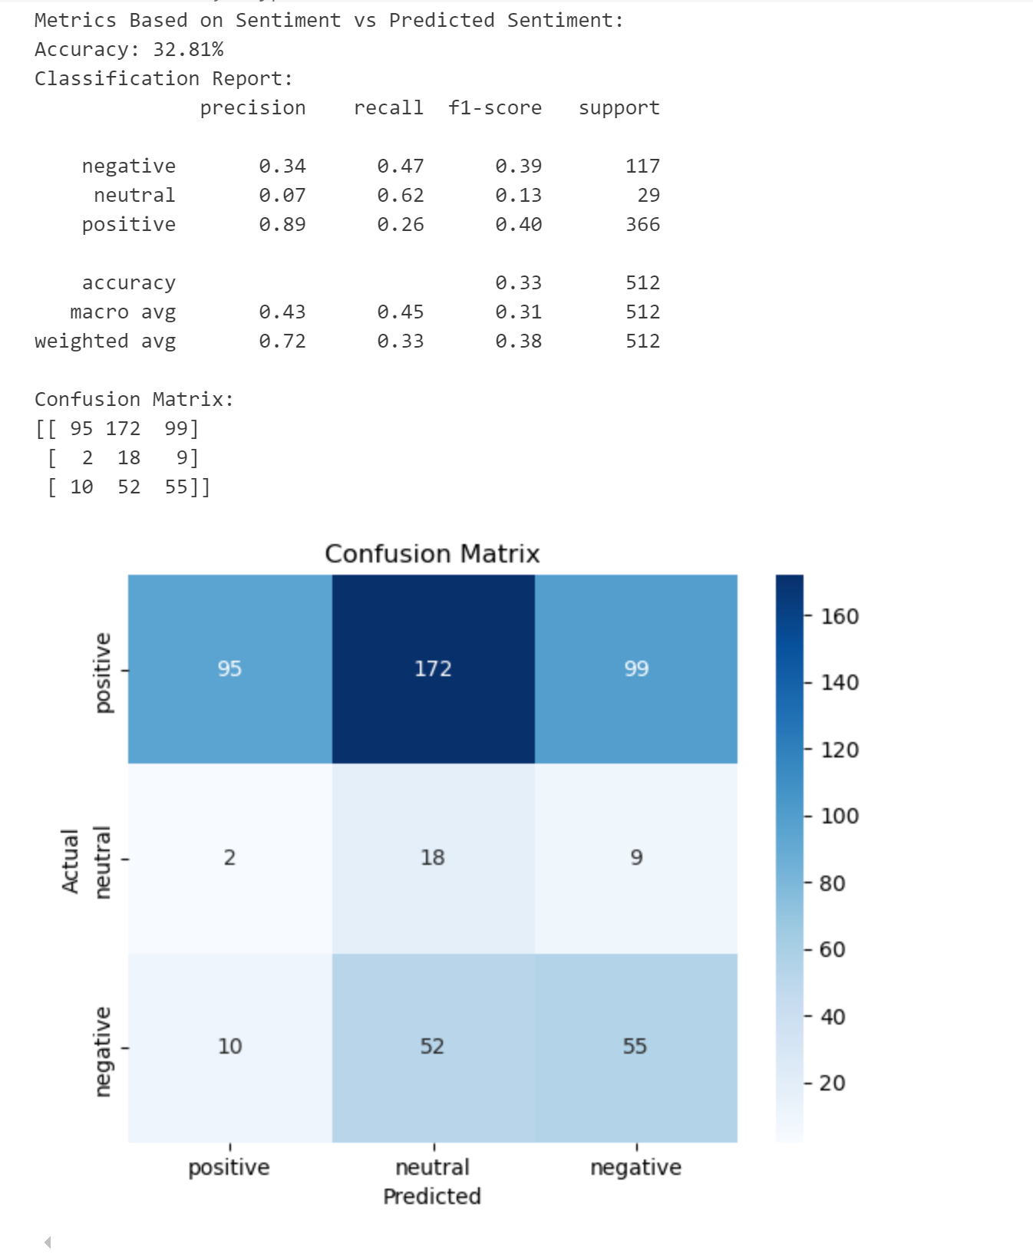
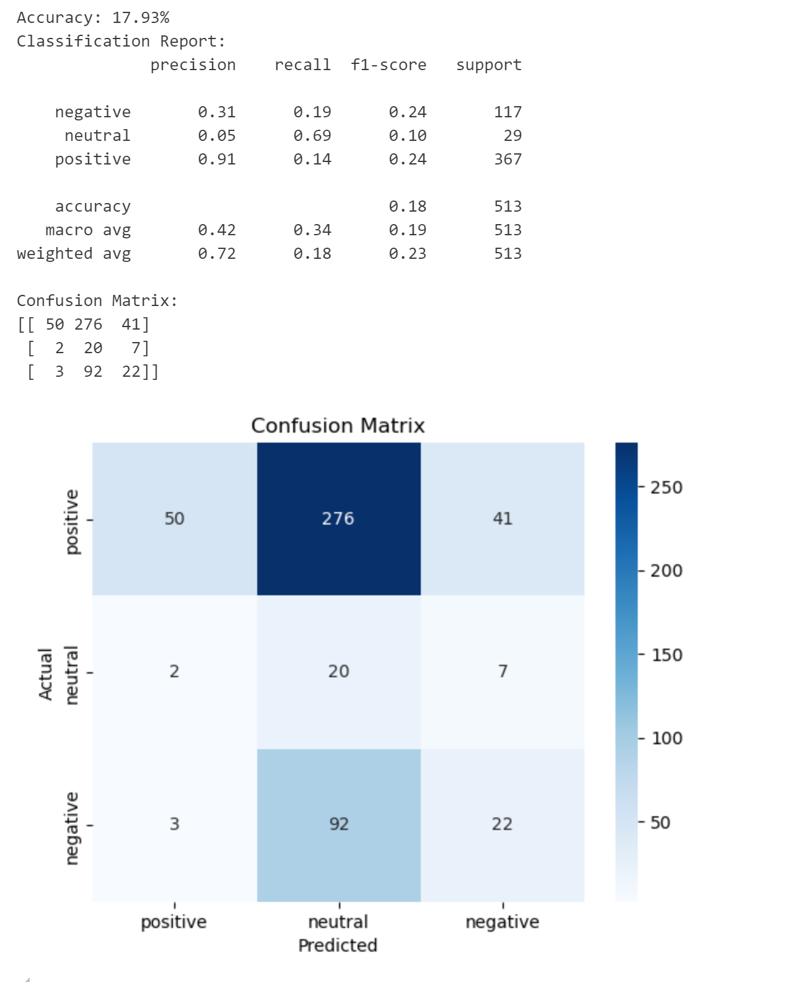
NAÏVE BAYES RESULTS
Asmita
After
Before
Brought Accuracy from 18% to ~33%
Feature Engineering
N-grams
TF-IDF Adjustments
Used Complement Naïve Bayes instead of MultinomialNB
Removed Noise and text normalization

Slide 13
03
BERT MODEL
Simran
Contextual Understanding
Pre-trained
Accurate Sentiment Detection
State-of-the-Art Performance
Notes:
Contextual Understanding: BERT captures the context of words in a sentence, which is crucial for accurately understanding nuanced sentiments in Reddit posts
Pre-trained on Large Datasets: BERT has been pre-trained on vast text data, making it highly effective for sentiment analysis tasks with minimal fine-tuning
Better Handling of Complex Sentiments: BERT can differentiate between positive, negative, and neutral sentiments, even in complex, context-dependent language often seen on Reddit
State-of-the-Art Performance: BERT provides cutting-edge accuracy in natural language processing tasks, making it suitable for precise sentiment prediction.

Slide 14
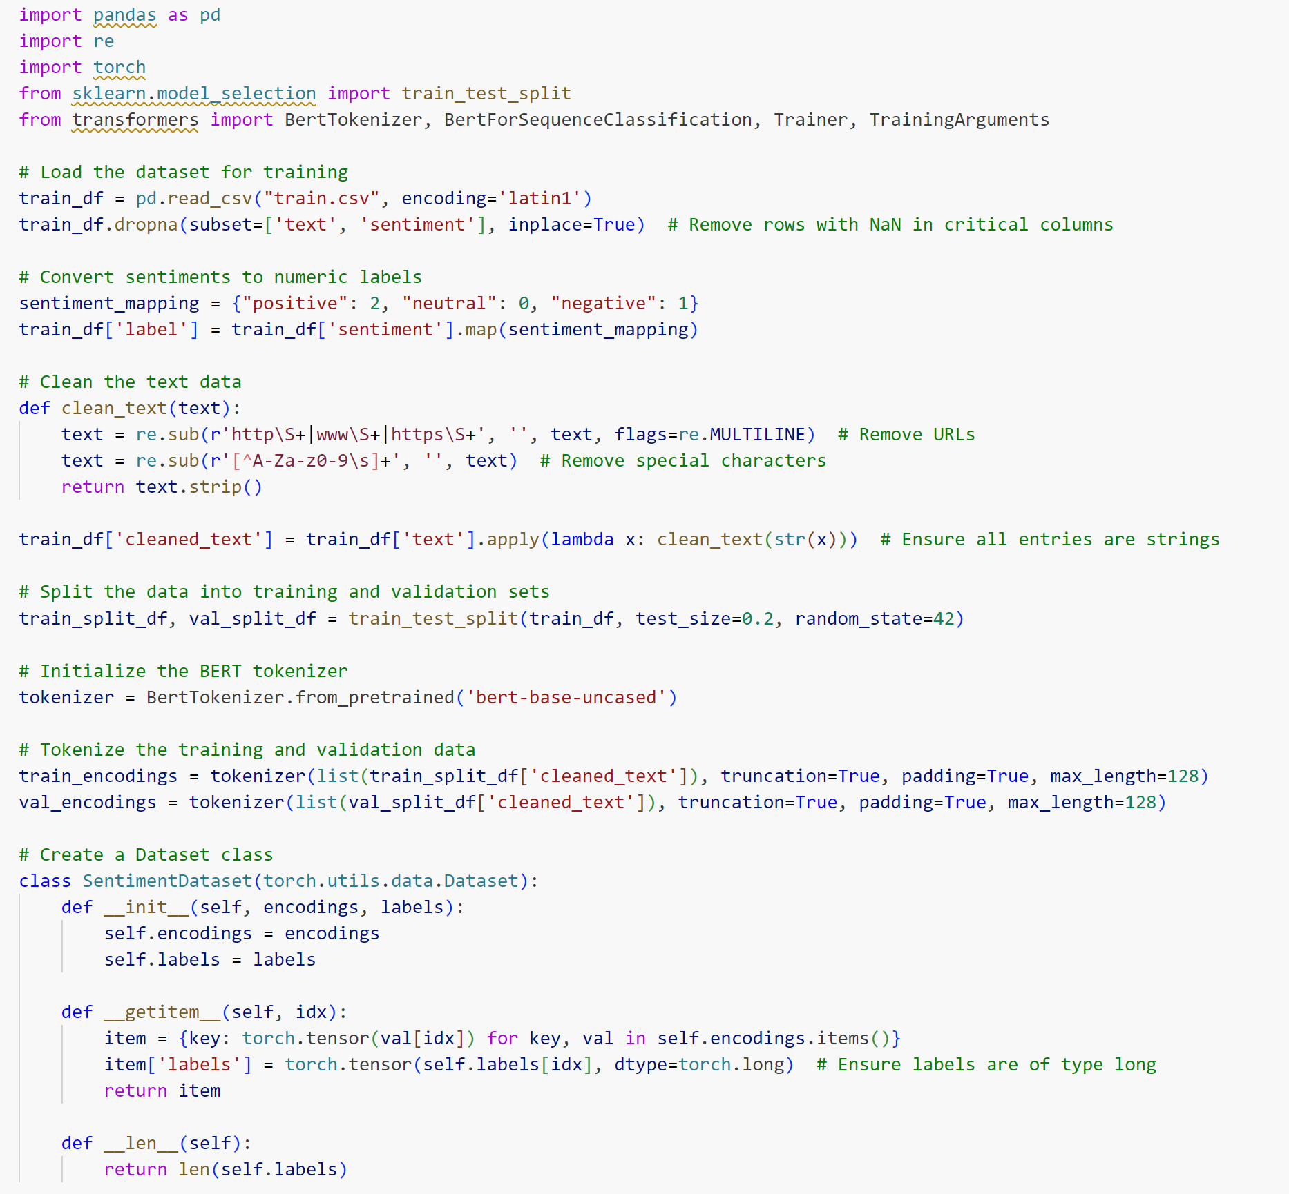
BERT MODEL IMPLEMENTATION
Simran
BERT Tokenizer (BertTokenizer)
Converts text into tokens for BERT model understanding
BERT Model (BertForSequenceClassification) Pre-trained model fine-tuned for sentiment classification
Trainer and Training Arguments
Manages training loops, evaluation, and hyperparameter tuning for improved model performance.
Notes:
Pandas (import pandas as pd): Used for data manipulation and preprocessing, such as handling and cleaning Reddit data.
Regular Expressions (import re): Utilized to clean text data (remove special characters, URLs) for better input into the model.
PyTorch (import torch): Framework for building and training the BERT model, enabling GPU acceleration for faster computations.
Train-Test Split (train_test_split): Splits the dataset into training and testing sets, ensuring model validation.
BERT Tokenizer (BertTokenizer): Converts text into tokens that the BERT model can understand.
BERT Model (BertForSequenceClassification): Pre-trained BERT model fine-tuned for sentiment classification, leveraging its language understanding for sentiment analysis.
Trainer and TrainingArguments: Simplify the training process by managing training loops, evaluation, and hyperparameter tuning for better model performance.

Slide 15
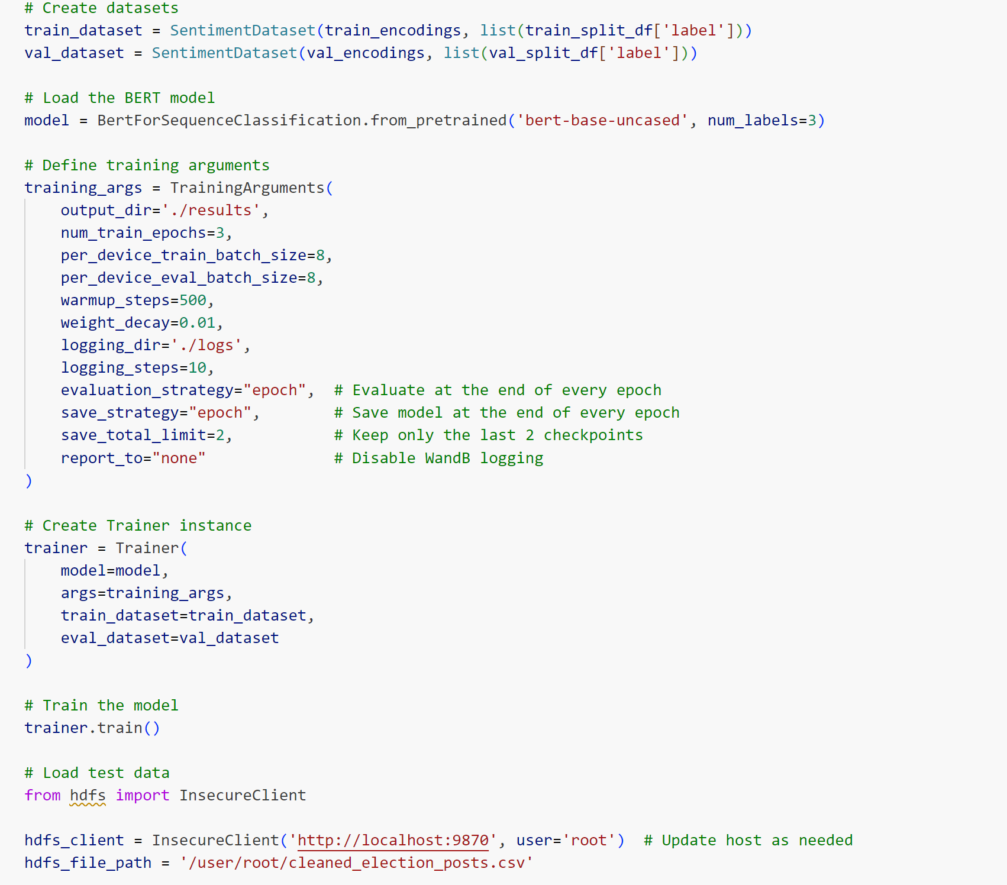
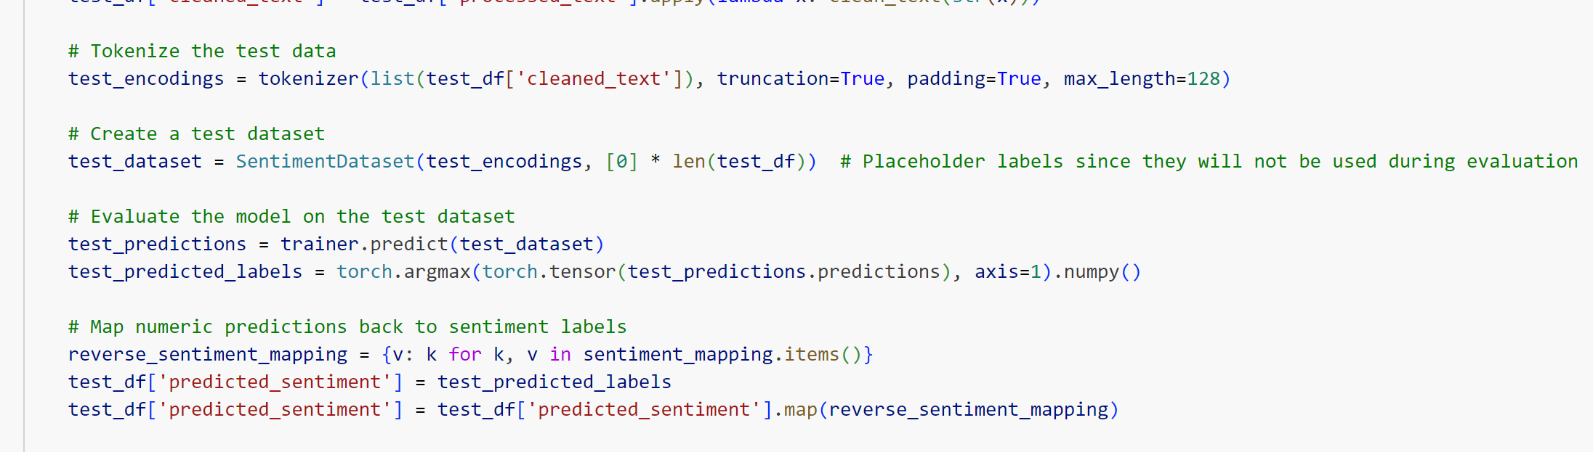
BERT MODEL IMPLEMENTATION
Simran
BERT Setup: Tokenized text using BERT tokenizer; created datasets for training and validation with sentiment labels.
Model Training: Fine-tuned a pre-trained BERT model for sentiment classification with defined training arguments, including saving checkpoints and evaluation strategies.
Test Data Handling: Retrieved and cleaned test data from HDFS; tokenized and prepared it for model prediction.
Prediction & Storage: Predicted sentiments using the trained BERT model, mapped numeric labels back to text sentiments, and saved results locally and on HDFS.

Slide 16
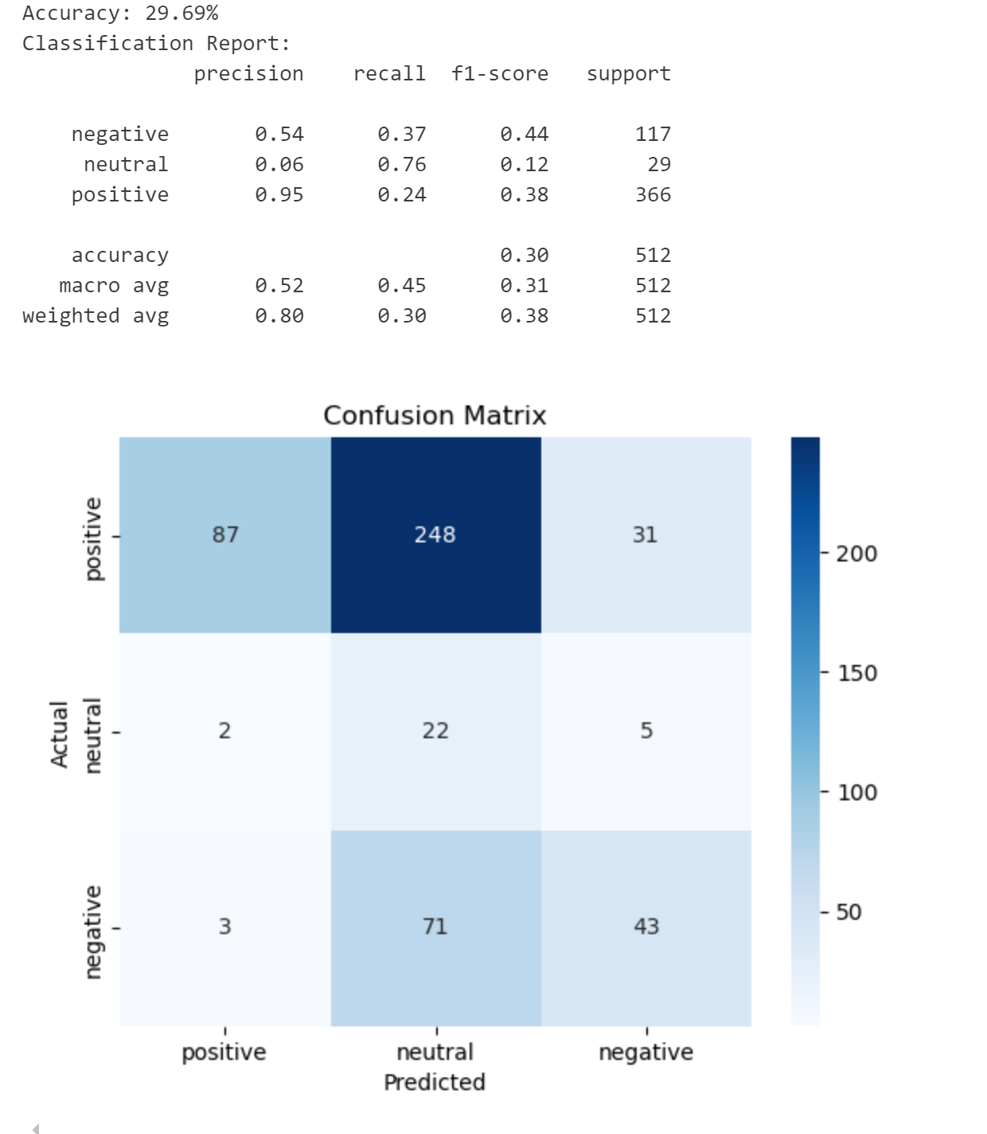
BERT MODEL RESULTS
Simran
Model Strengths: High precision in identifying positive sentiment
Model Weaknesses: Struggles with negative and neutral sentiments

Slide 17
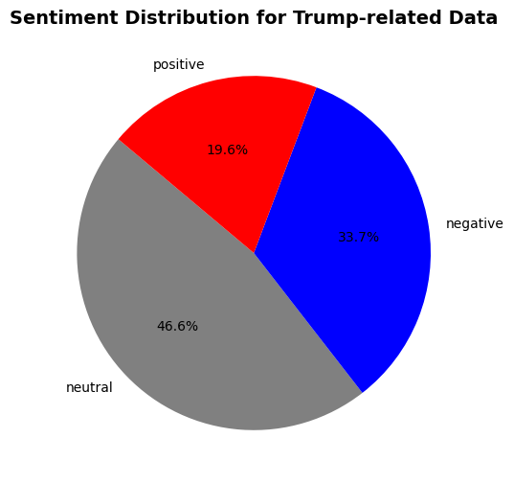
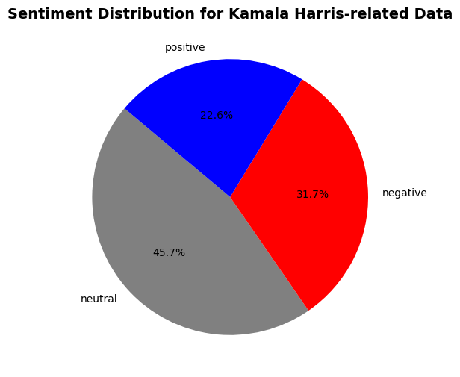
INSIGHT & ANALYSIS
Priyal
Notes:
Sentiment Distribution: The majority of Trump-related Reddit posts are neutral (46.6%), suggesting that discussions are primarily factual or non-polarizing.Negative Sentiment: A significant portion (33%) reflects dissatisfaction or criticism, which may highlight areas of concern among the public.Positive Sentiment: At 19.6%, the positive sentiment indicates support or approval but is relatively smaller compared to neutral and negative sentime
Balanced Conversations: The dominance of neutral posts suggests a diverse and balanced discussion environment on Reddit.Polarized Opinions: A combined 52.6% of posts are either positive or negative, showing considerable polarization in public opinion.Actionable Insights: Stakeholders can utilize this analysis to identify issues for strategic responses and further understand public concerns.

Slide 18
DIFFICULTIES & LIMITATIONS
01
04
02
05
03
06
Configuration and authorization issues with PRAW for Reddit data extraction
Training BERT on a new dataset or fine-tuning it is ​time-consuming. It took 5 hours to train and test the model
Permissions issues with the HDFS root user preventing service startup​
Docker environment complications led to user privilege issues affecting HDFS connectivity​
Training data set from Kaggle had sentiment label issues
Inability to start Hadoop services due to user privileges​ and localhost restrictions
​

Slide 19
DIFFICULTIES & LIMITATIONS
Priyal
Data Handling and Collection​
Configuration and authorization issues with PRAW for Reddit data extraction​
​
Hadoop Configuration​
Permissions issues with the HDFS root user preventing service startup​
Hadoop Service Management​
Inability to start Hadoop services due to user privileges​ and localhost restrictions
​
Execution Environment​
Docker environment complications led to user privilege issues affecting HDFS connectivity​
5. Long training and inference time with BERT​
Training BERT on a new dataset or fine-tuning it for sentiment analysis is ​
time-consuming. It took 5 hours to train and test the model
Notes:
hroughout our project, we encountered several technical challenges that required troubleshooting:
Data Handling and Collection: While using PRAW to extract Reddit data, we ran into configuration and authorization issues, which slowed down the data collection process.
Hadoop Configuration: HDFS posed problems with root user permissions, which prevented it from starting properly, requiring adjustments to user privileges.
Service Management: Starting Hadoop services was complicated due to user privilege conflicts and localhost restrictions, which required further debugging.
Execution Environment: Running Hadoop in a Docker container introduced additional challenges. User privilege conflicts in the environment disrupted connectivity with HDFS.
BERT Training: One major challenge was the time required to fine-tune BERT for sentiment analysis. The entire process, including training and testing, took 5 hours due to its computational demands.

Slide 20
THANK YOU!

