Slide 1


Slide 2
Group:-3
Muralidharan S 2529627
Arjunkumar X 2529223
Ajeydev X 2529090
Kirubashankar Marimuthu 2530299
Kampalli Naveena 2527276
V Arthi Nandhini 2529107
Gurram Anusha 2528059
Palakodeti Kavya 2529665
Simran Gill 2530735
Kovvuru Yashoda 2530031

Slide 3
Content:-
Abstract & Introduction
How can it help?
Objectives
Tools & Languages used
Key features & Modules
System Requirements
App Flow
Future scope & Improvement
Conclusion

Slide 4
Abstract
Hospital Management System is an organized computerized system designed and programmed to deal with day-to-day operations and management of hospital activities.
The program can look after inpatients, outpatients, records, database treatments, status illness.
The interface is very user-friendly. The data are well protected for personal use and makes the data processing very fast.

Slide 5
Introduction:-
Hospital Management System is a system enabling hospitals to manage information and data related to all aspects of healthcare.
Such as processes, providers, patients, and more, which in turn ensures that processes are completed swiftly and effectively.
It may be due to some sort of stress, changes in climates, work-overload (this is one of the major issues who work in the corporate world) or someone might hurt himself/herself. So we can help with this application.

Slide 6
How Can It Help?
There are several other reasons that a person needs medical assistance. And, to provide the best medical assistance, the management of the hospital must be disciplined, well-versed in its service-providing techniques. They should be able to keep track of the records of the doctors, patients, nurses, and other hospital staff.
Main aim is to minimize the paperwork of the hospital as minimum as possible, if not completely.

Slide 7
It is not very efficient, is not reliable, and is a very time-consuming process to maintain work on paper. In today’s highly technological era, it is not feasible not also technically but also economically. So, this is an automated system for keeping the track of all the activities and maintaining their records.

Slide 8
Objective:-
To computerize all details regarding patient details & hospital details
Scheduling the appointment of patient with doctors to make it convenient for both.
If the medical store issues medicines to patients, it should reduce the stock status of the medical store and vice-versa
Scheduling the services of specialized doctors and emergency properly so that facilities provided by hospital are fully utilized in effective and efficient manner.

Slide 9
Objective:-
It should be able to handle the test reports of patients conducted in the pathology lab of the hospital.
The inventory should be updated automatically whenever a transaction is made.
The information of the patients should be kept up to date and there record should be kept in the system for historical purposes.

Slide 10
Tools And Language Used:-
Back End
MySQL
Front End
1.Angular
2.Html
3.CSS
4.BOOTSTRAP
Junit & Postman API for testing
Spring tool suite
Hibernate

Slide 11
Back End
1.My SQL : MySQL is an open-source relational database management system. As with other relational databases, MySQL stores data in tables made up of rows and columns. Users can define, manipulate, control, and query data using Structured Query Language.
2.Hibernate : Hibernate is a Java framework that simplifies the development of Java application to interact with the database.
Hibernate implements the specifications of JPA (Java Persistence API) for data persistence.

Slide 12
Contd :
3.Spring tool suite :Spring Tool Suite is an IDE to develop Spring applications. It is an Eclipse-based development environment. It provides a ready-to-use environment to implement, run, deploy, and debug the application.
4.Junit & Postman :JUnit is a unit testing open-source framework for the Java programming language.
Postman is one of the most popular software testing tools which is used for API testing.

Slide 13
Front End
1.Angular :Angular is a JavaScript (actually a TypeScript based open-source full-stack web application) framework which makes you able to create reactive Single Page Applications (SPAs). Angular is completely based on components. It consists of several components which forms a tree structure with parent and child components.
2.Html :Hypertext Markup Language, is a markup language for the web that defines the structure of web pages .It is one of the most basic building blocks of every website.

Slide 14
Contd :
3.CSS :CSS stands for Cascading Style Sheets. It is a style sheet language which is used to describe the look and formatting of a document written in markup language. It is generally used with HTML to change the style of web pages and user interfaces.
4.Boot Strap :Bootstrap is the most popular HTML, CSS and JavaScript framework for developing a responsive and mobile friendly website.

Slide 15
Key Feature of Hospital Management System:-
Multi-user account system
Monitoring the whole hospital system
Management of all type of users’ account
Appointment Management
View Appointments

Slide 16
Key Feature of Hospital Management System:-
Medical History
Invoice Management
Medical Report Management
Internal Communication
Responsive User Interfaces

Slide 17
Modules:-
Admin Module
Patient Module
Doctor Module

Slide 18
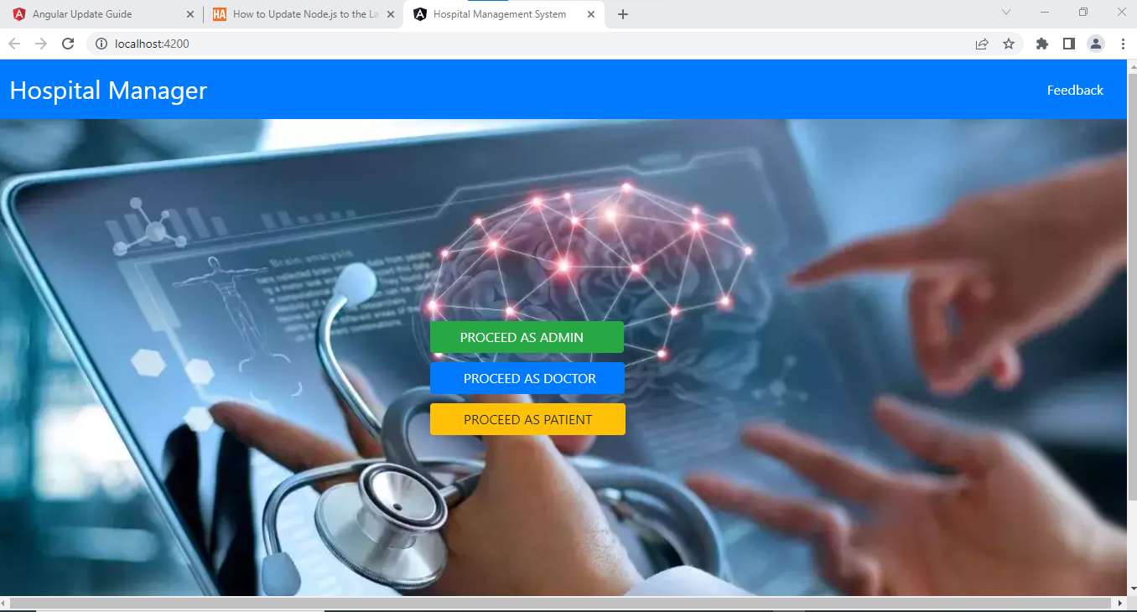
Home Page

Slide 19
ADMIN MODULE:-
In the Admin Module the Admin could login and signup.
The Admin can see the Doctor List, Patient List and Feedback List.
In the Doctor’s List the Admin can perform UPDATE and DELETE operation
In the Patient’s List the Admin can perform DELETE operation.

Slide 20
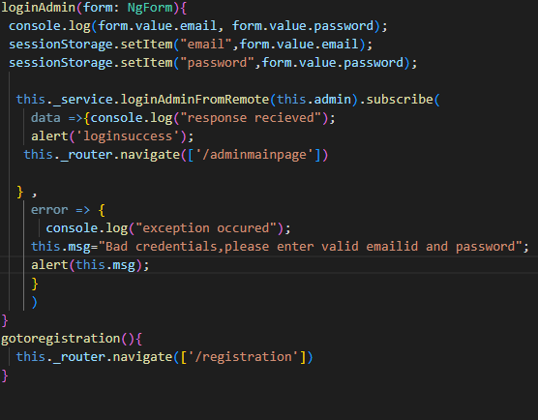
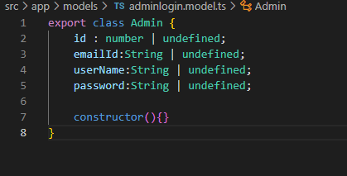
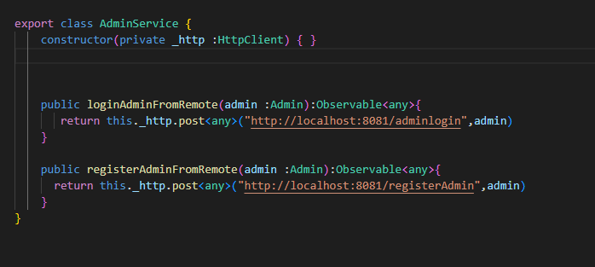
Frontend Code Snippets

Slide 21
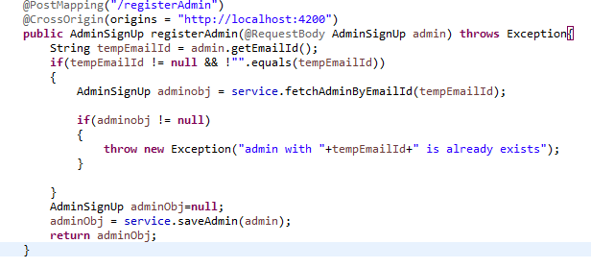
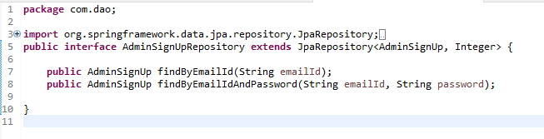
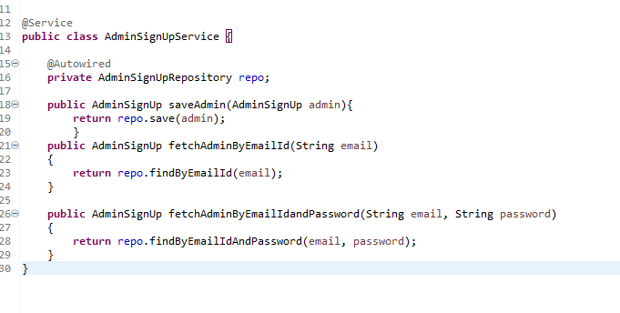
Backend Code Snippets

Slide 22
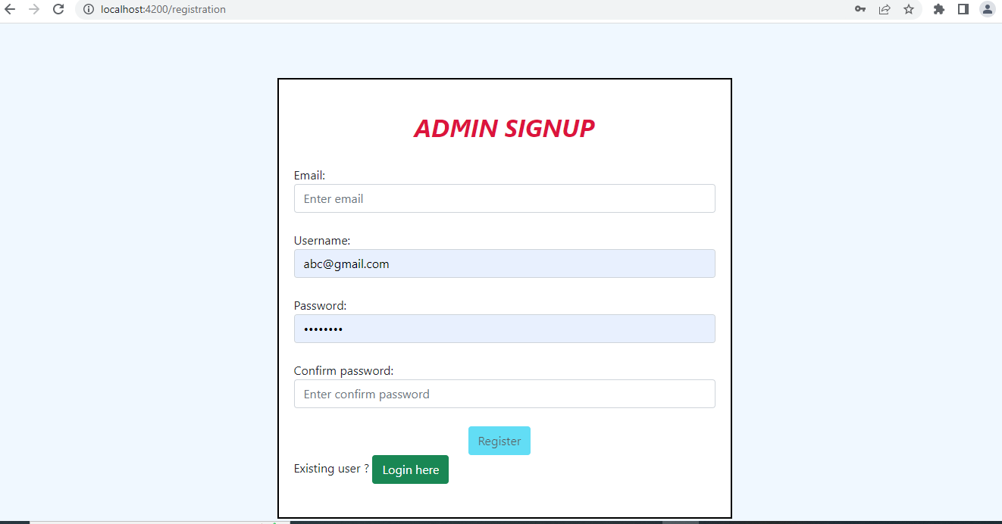
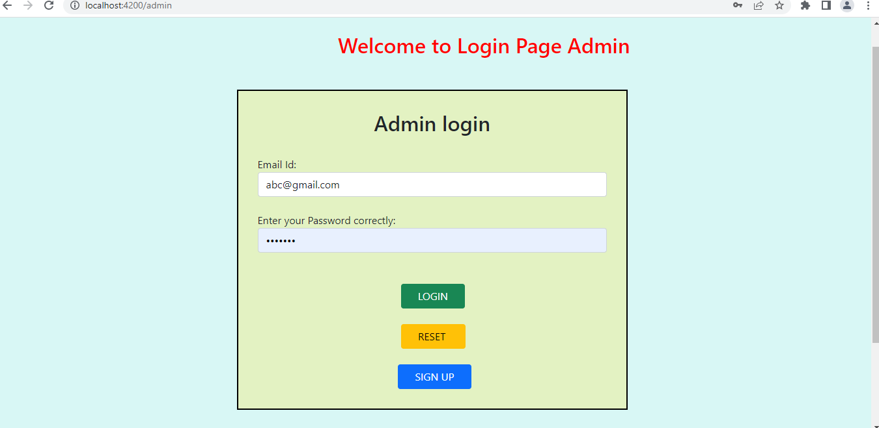
Admin signup & login

Slide 23
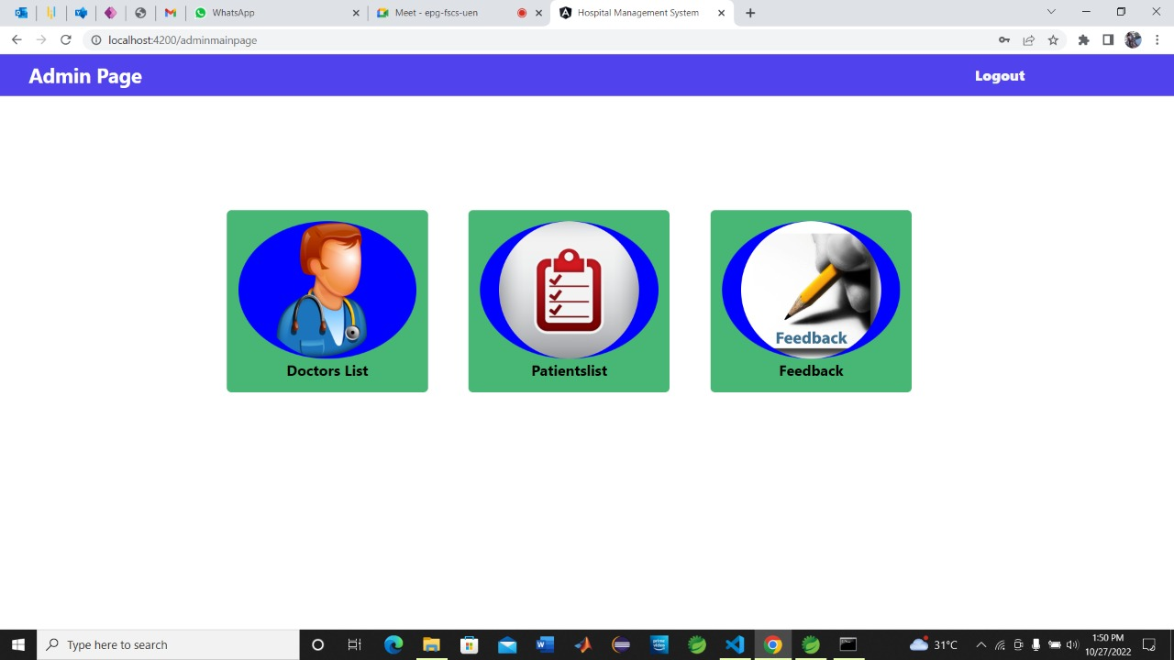
Admin Home Page

Slide 24
PATIENT MODULE
Patient can Login and SignUp
Patient can see the Doctor List
Patient can Register the Appointment.
Patient can fill the form of Discharge Appointment
Patient can give the Feedback to the Doctor

Slide 25
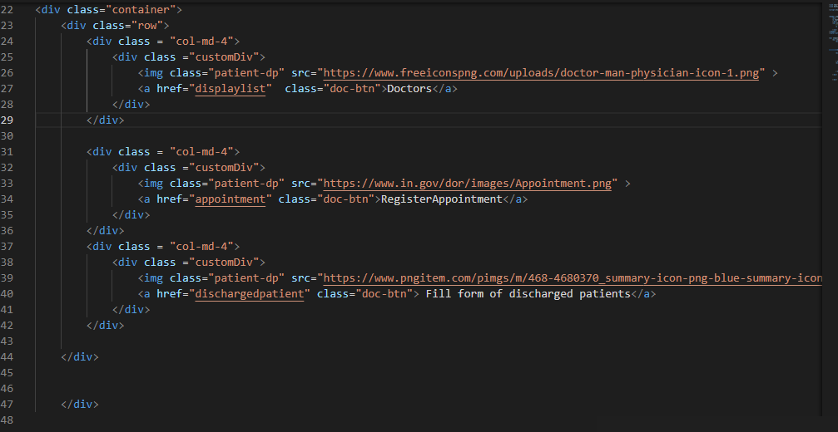
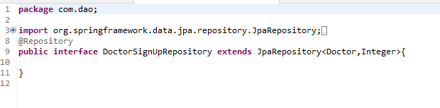

Code Snippets
Repository
Controller

Slide 26
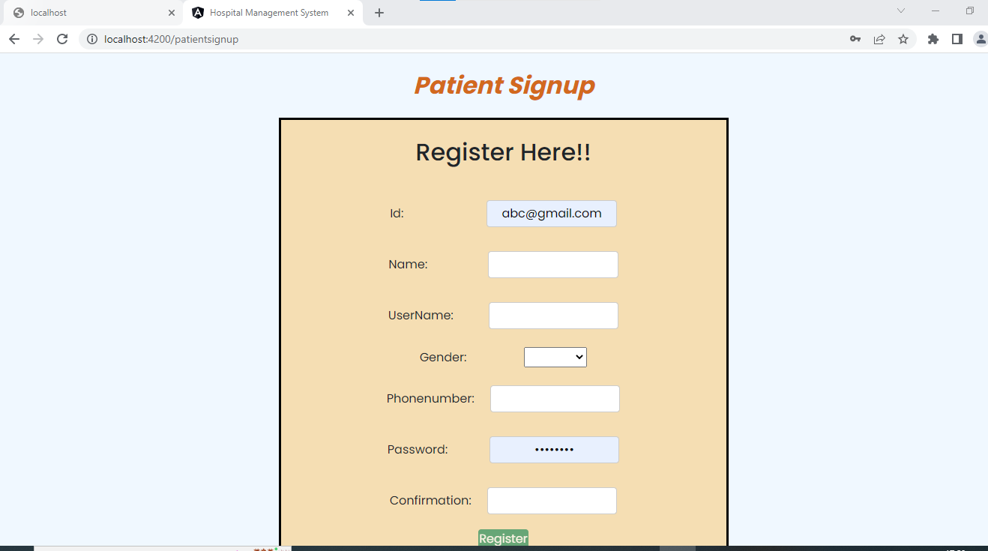
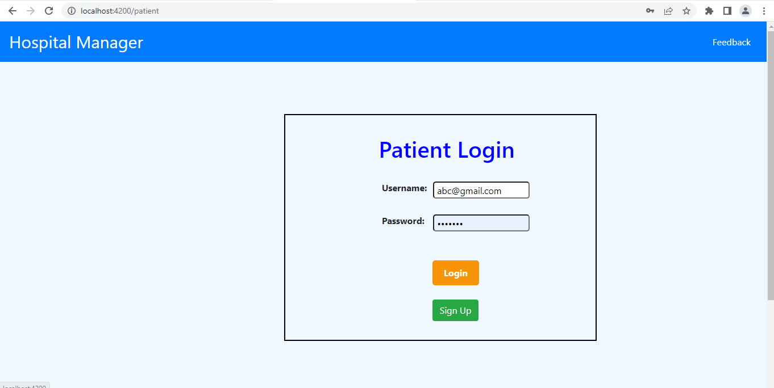
Patient signup & login:

Slide 27
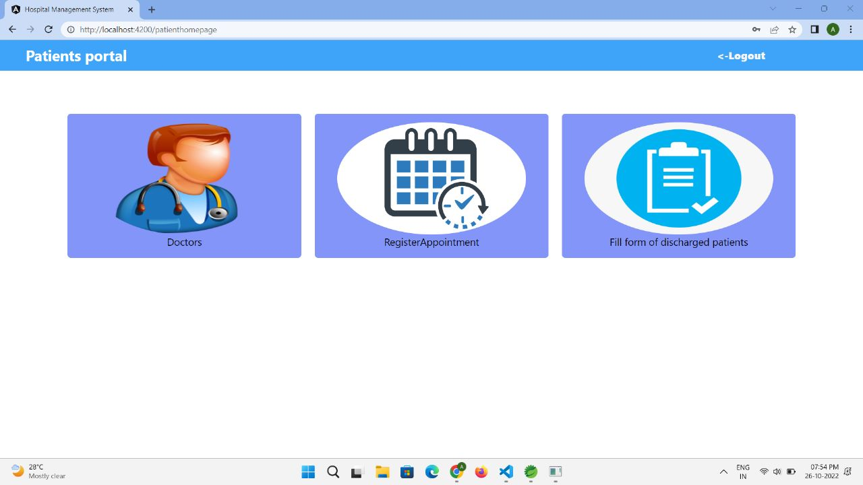
Patient Home Page

Slide 28
DOCTOR MODULE
Doctor can Login and SignUp
Doctor can see the Appointment List and Discharge List
Doctor can DELETE the Appointment

Slide 29
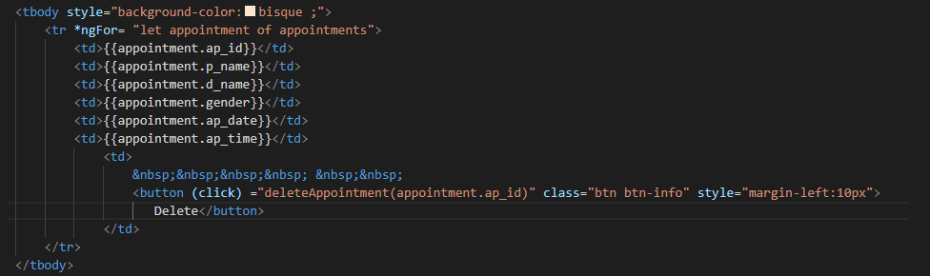
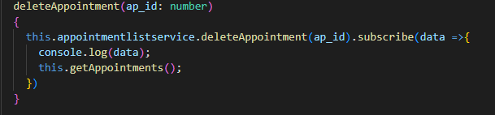
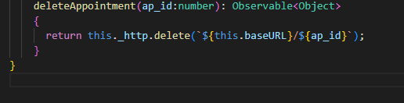
Code Snippets

Slide 30

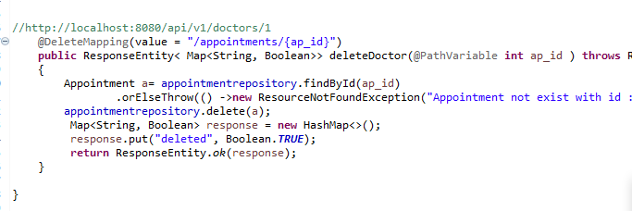
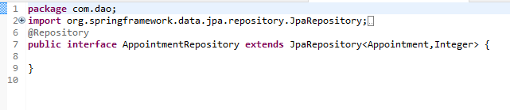
Backend Code Snippets
List all appointments(controller)
Delete appointments(controller)
Delete appointments(repository)

Slide 31
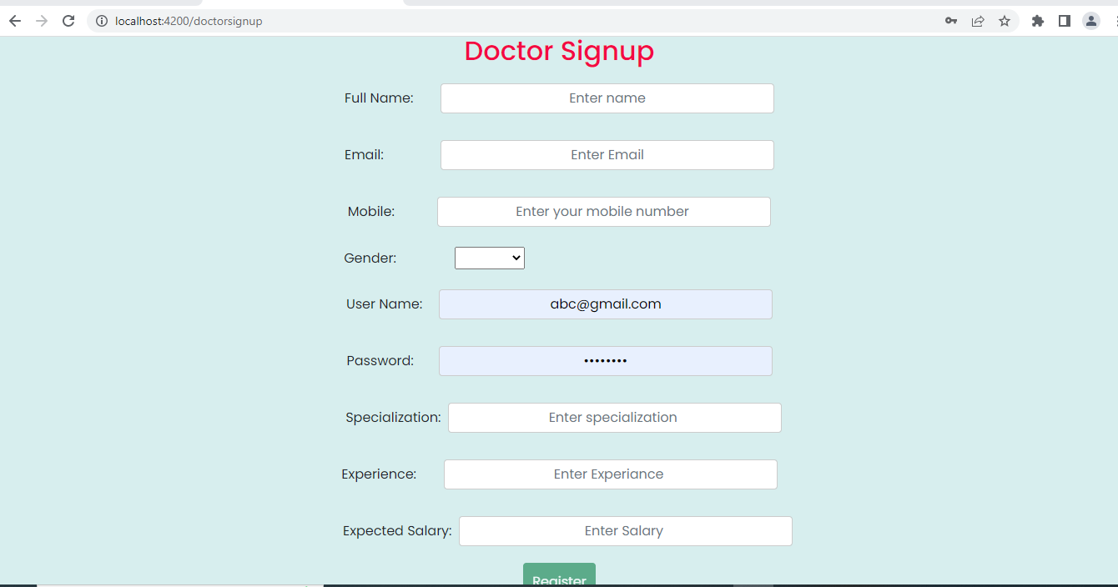
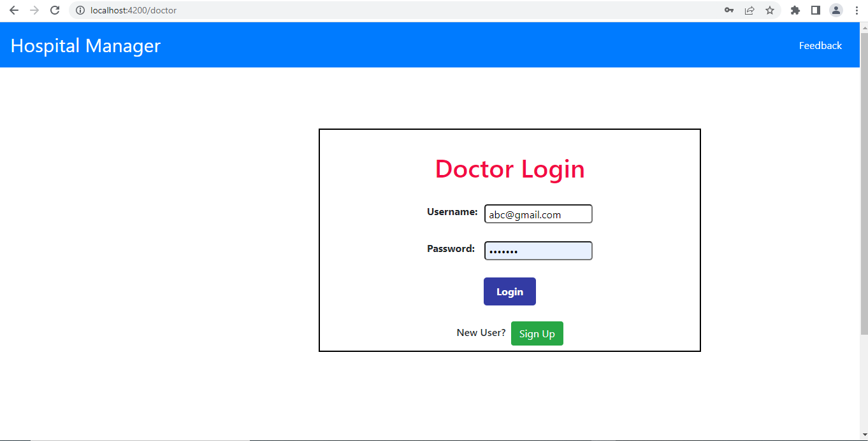
Doctor signup & login :

Slide 32
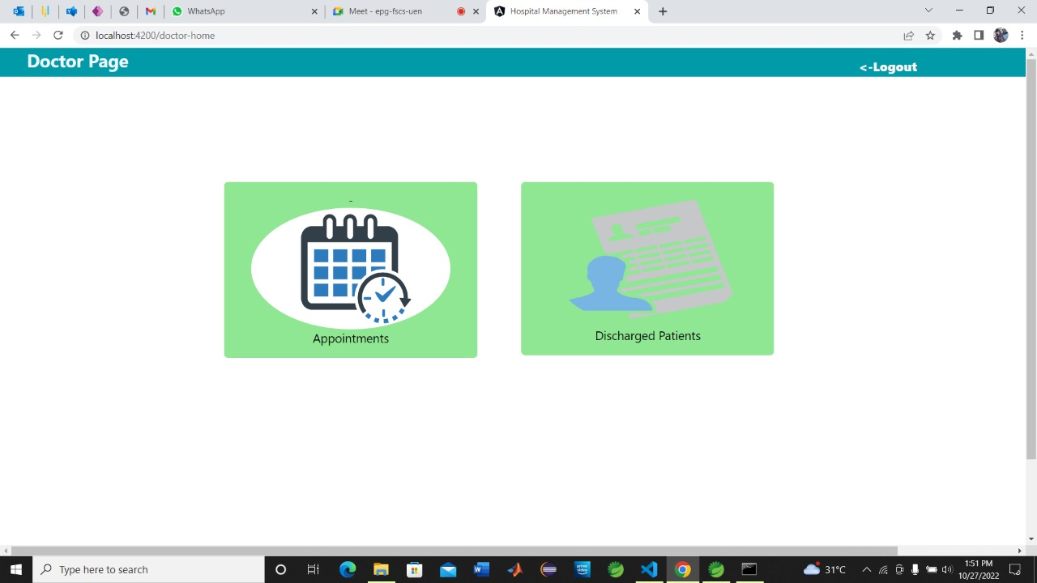
Doctor Home Page

Slide 33
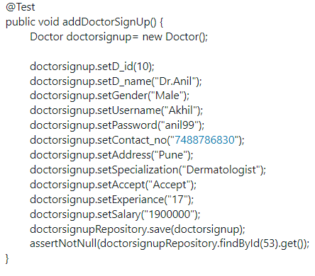
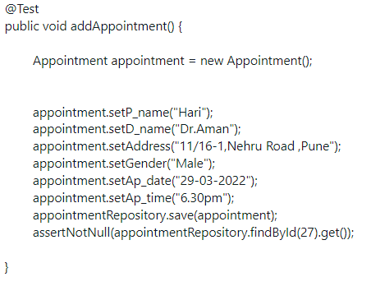
Testing-Code Snippets

Slide 34
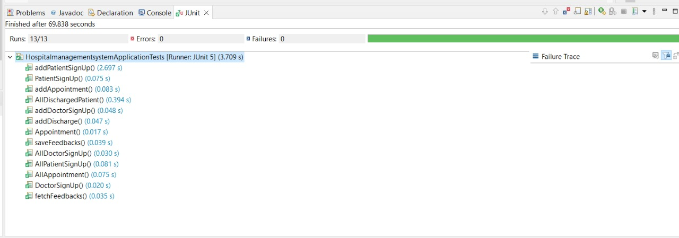
Testing Output

Slide 35
Advantage:-
Better revenue management
Improved Patient Care
Increased Data Security & Retrieve-ability
Improved clinical decision-making
Easy Access To Patient Data

Slide 36
Disadvantage:-
Lack of employment is another such thing. The chances of employment usually become less with the automation of the system.
It is more expensive for the hospital.
Software implementation in the process is very tough.

Slide 37
System Requirements
The Basic System Requirements for Running this project are listed below:
Visual studio, STS, Postman and MySql to be installed to the system
1 GB Random Access Memory
200 MB of Free Space on Hard Disk
Microsoft Windows 8,10,11 or Linux or Equivalent OS
Web Browser (Microsoft Edge, Google Chrome)

Slide 38
App Flow:-
Id
Doctor name
Gender
Contact no.
Address
Specialization
Experience
Status
Doctor
Admin
Email
Username
password
Patient id
Patient name
Gender
Phone number
Patient

Slide 39
Future scope & Improvements
The proposed system is Hospital Management System, the system include more facilities like pharmacy system for the stock details of medicines in the pharmacy.
They providing such features enable the users to include more comments into the system.

Slide 40
Conclusion
Hospital management systems allows us the ability to optimize and digitize all the processes within the institution.
It will help to improve customer service, reduce process costs, streamline the search of medical records, bills, patients, doctors, etc.
Hospital Management System will contributed enormously to better health and influenced the lives and well-being of billions of humans

Slide 41
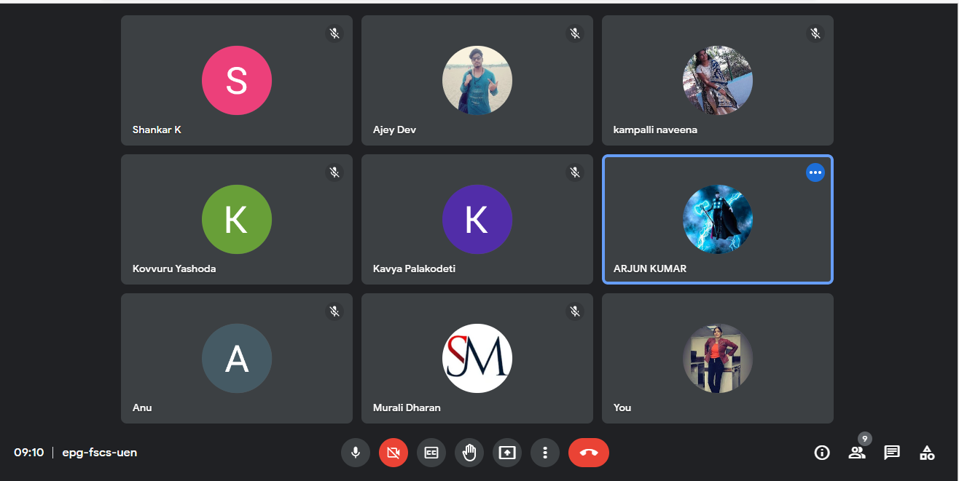
Meeting

Slide 42


