Slide 1


Fantasy Football
Simran Gaglani

Slide 2


Explain My Project
A team roster is built by choosing 15 football players from a larger pool of players with varying position types. The same player cannot be listed twice in one 15 player roster.
We want the most optimal players on our roster to maximize our fantasy score. Thus, create a team roster that yields the most points possible. (Maximize points earned)
Here’s the catch: each football player has a price associated with them, and the total budget cannot exceed $200 while choosing players for the roster.

Slide 3


Explain My Project
Team roster consists of a starting lineup and 6 bench slots
Starting Lineup:
1 Quarterback
3 Wide receivers
2 Running backs
1 Tight-end
1 Kicker
1 Defense
All starting lineup positions can only house a player of that position type. The players who do not make in your starting lineup will fill the bench slots.
The bench slots can house any player position type, but only generate half the points earned by the player

Slide 4
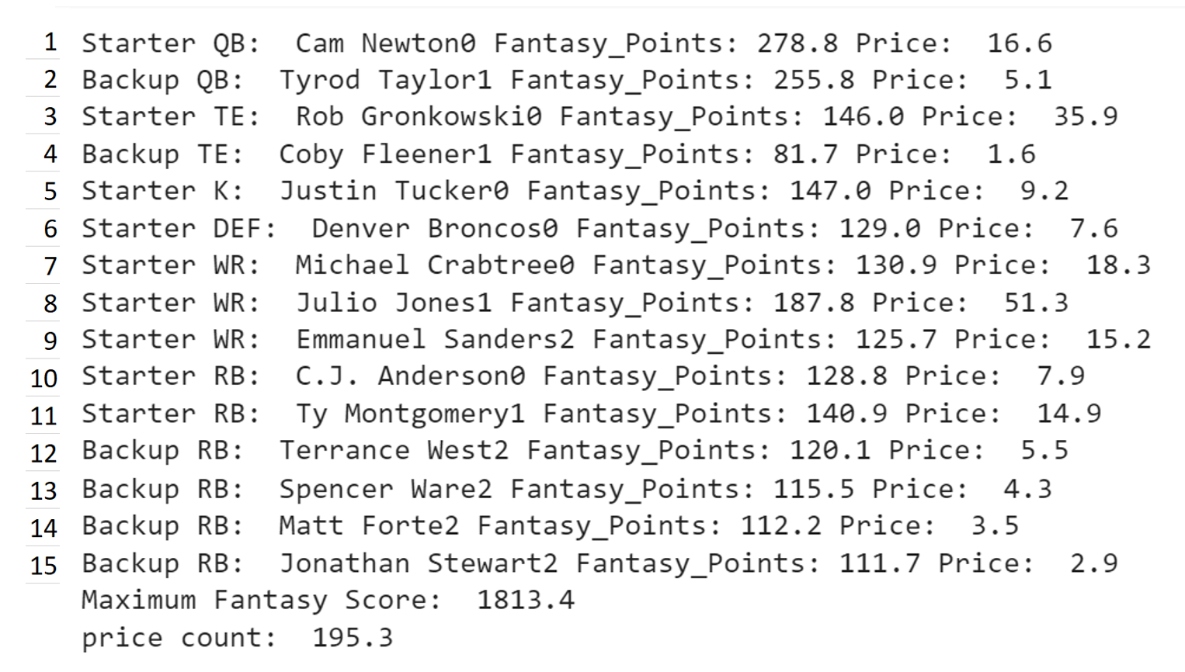
Explaining My Results
The results yielded from the code iterated through the lists and was able to create an optimal 15-player team roster with a starting lineup position (‘Starters’) and 6 bench slots (‘Backup’), with maximized points.
The code prints the fantasy points earned by each optimal player in the roster. Additionally, a count of price keeps track of the total money spent on each player (195.3), to yield a total fantasy football score of 1813.4
A1, A2, = ($A1 + A2 + ½ * A2)

Slide 5
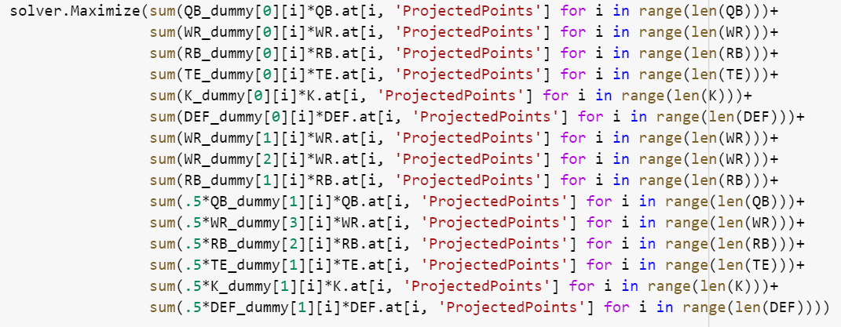
Maximizing Points

Slide 6
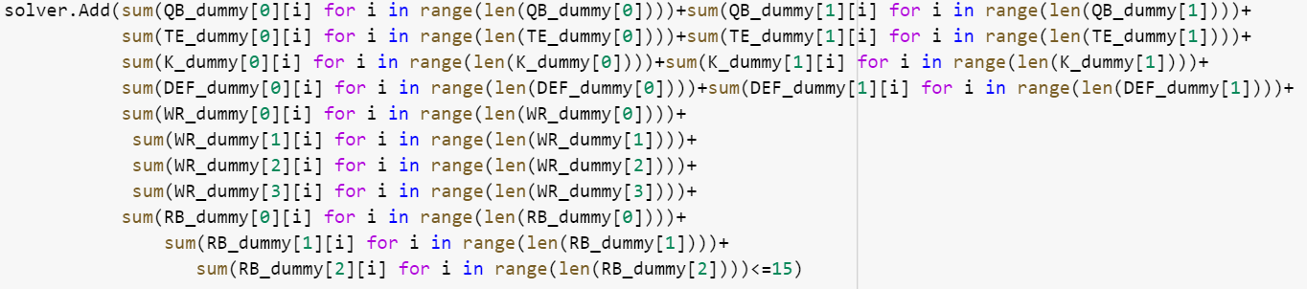
Constraints for 15 Players

Slide 7
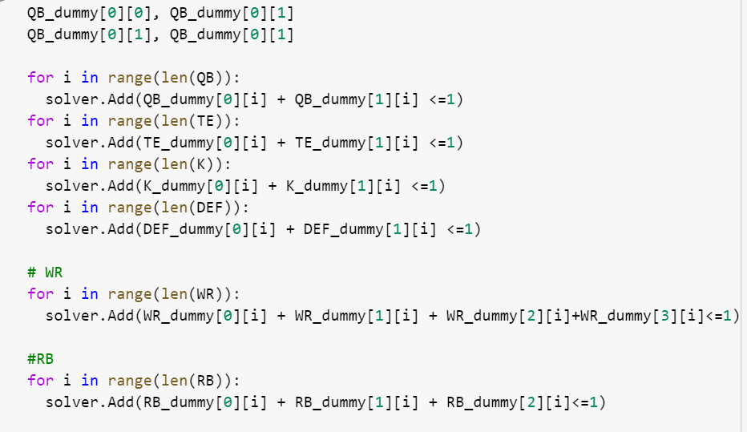
Constraints for Unique Players

Slide 8
