Slide 1

Walmart Predictions
Simran
Gaglaini

Slide 2
Introduction
Goal: Aimed to improve sales forecasting accuracy for a retail company. The goal was to develop a model that could accurately predict future sales quantities, enabling the company to optimize inventory management and meet customer demand effectively.
Objectives: Formatting, Preprocessing, Feature Engineering, Model, Predictions, Problems Faced, Comparing models

Slide 3
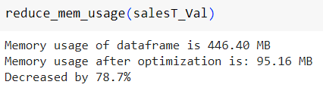
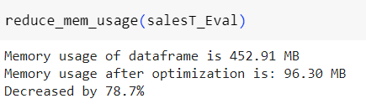
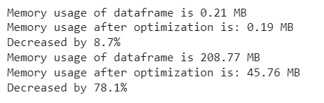
Memory Optimization
Sales_train_validation
Sales_train_evaluation
Calendar and Prices

Slide 4
Processing Calendar Data & Feature Engineering
Drop unnecessary columns: Remove columns such as 'weekday', 'wday', 'month', 'year', 'event_name_1', 'event_type_1', 'event_name_2', and 'event_type_2’.
Create additional features: a. Holidays:
Define a list of holidays based on the competition context, including events like 'NewYear', 'OrthodoxChristmas', 'MartinLutherKingDay', etc.
Implement a function called 'is_holiday(x)' that takes an event name as input and returns 1 if it is a holiday, or 0 otherwise.
Apply the 'is_holiday' function to the 'event_name_1' and 'event_name_2' columns using the 'apply' method.
Create a new column called 'is_holiday' by taking the maximum value between 'is_holiday_1' and 'is_holiday_2' using the 'max' function.
This process identifies whether a particular date is associated with a holiday.
b. Weekends:
Define a list of weekend days, such as 'Saturday' and 'Sunday'.
Implement a function called 'is_weekend(x)' that takes a weekday as input and returns 1 if it is a weekend, or 0 otherwise.
Apply the 'is_weekend' function to the 'weekday' column using the 'apply' method.
Create a new column called 'is_weekend' to store the results.
This process determines whether a specific date falls on a weekend.
These additional features of holidays and weekends provide valuable information for analyzing and forecasting sales data, as they capture potential patterns and variations in consumer behavior based on special events and weekends.

Slide 5
Data and Preprocessing Sales Evaluation Data
Transformation using the Melt Function
Utilize the melt function to reshape the data.
Purpose: Convert the wide format (each day as a separate column) to a long format (each day as a separate row).
The melt function allows us to gather multiple columns into a single column while preserving the identifying variables.
Reshaped Data Structure
The reshaped data structure consists of the following columns:
id: Unique identifier for each item and store combination.
item_id: Unique identifier for the item.
dept_id: Unique identifier for the item department.
cat_id: Unique identifier for the item category.
store_id: Unique identifier for the store.
state_id: Unique identifier for the state.
d: Day identifier (e.g., "d_1" represents the first day).
qty: Sales quantity for a specific item, store, and day.

Slide 6
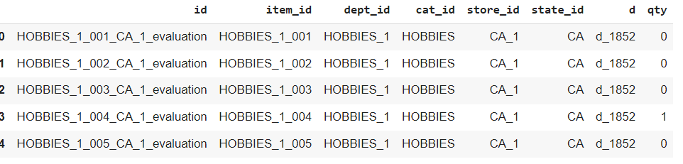
Data and Preprocessing Sales Evaluation Data
There is a change in data structure and the inclusion of the qty column representing sales quantities.
By using the melt function, the original wide-format data is converted into a long format, allowing for easier analysis and modeling.
The reshaped data retains important information such as item, store, and sales quantity, which are essential for forecasting.

Slide 7
Preprocessing Calendar, Sales, Price Data
The train_sales DataFrame is merged with the calendar DataFrame based on the common column 'd' (representing the day) using the pd.merge() function. This combines the sales data with the corresponding calendar information.
The sales data, which was previously transformed using the melt function, was merged with the prices data.
The merging was done based on three columns: "item_id," "wm_yr_wk" (week), and "store_id."
This allows us to align the sales data with the corresponding prices for each item, week, and store.
The merged dataset contains sales, calendar, and price information combined.
Each row corresponds to a specific item, week, and store combination.

Slide 8
Merging and Transforming
A specific subset of train sales data ('train_sales_test') is selected for further processing.
Rows from the original train_sales_test DataFrame are duplicated and appended to itself 28 times to accommodate the predictions for each of the 28 forecasted days.
'train_sales_test' is merged again with the calendar data based on the 'd' column using a left join.
'train_sales_test' is merged again with the prices data based on the 'item_id', 'wm_yr_wk', and 'store_id' columns using a left join.

Slide 9
Feature Engineering (Model 2)
Two lists, holiday and weekend, are created to identify holidays and weekends.
Two functions, is_holiday() and is_weekend(), are defined to assign binary values (1 or 0) indicating whether a particular event is a holiday or falls on a weekend.
The functions are applied to the event_name_1, event_name_2, and weekday columns of the calendar DataFrame to create additional columns (is_holiday_1, is_holiday_2, is_holiday, and is_weekend).
Creation of Dummy Variables: The train_sales and train_sales_test DataFrames are transformed using one-hot encoding to create dummy variables for categorical columns (dept_id, cat_id, store_id, state_id).
Dummy variables are created for each unique category value in the categorical columns, expanding the feature space.

Slide 10
Feature Engineering: Lags and Rolling Average (Model 1)
Adding lag features: Lag features are created by shifting the sales values for different time periods (specified by dayLags) within each id group. This is done using the .shift function.
Lag features capture the sales from previous days, allowing the model to learn temporal patterns.
Rolling mean features: Rolling mean features are created by calculating the mean of lagged sales values over a specified window size (specified by windows). This is done using the .rolling function with the mean aggregation.

Slide 11
LightGBM
LightGBM is a gradient boosting framework that uses tree-based learning algorithms. It is known for its efficiency, scalability, and accuracy.
The choice of LightGBM for this task suggests that it is suitable for handling the dataset's size and complexity.
LightGBM's boosting type is specified as 'gbdt', which stands for Gradient Boosting Decision Trees. This type of boosting algorithm builds an ensemble of decision trees to make predictions.
The 'rmse' metric (Root Mean Squared Error) is used to evaluate the performance of the model. RMSE measures the average difference between predicted and actual quantities, giving insight into the model's accuracy.
The objective is set to 'regression' since the task involves predicting quantity values
Parameters such as learning rate, bagging fraction, and colsample bytree are set to control the model's learning behavior and generalization capability. These parameters can be tuned to optimize the model's performance.

Slide 12
LightGBM
Chosen Parameters:
boosting_type: 'gbdt' (Gradient Boosting Decision Tree)
metric: 'rmse' (Root Mean Squared Error) - evaluation metric for regression
objective: 'regression' - regression task
n_jobs: -1 - utilizes all available CPU cores
seed: 236 - random seed for reproducibility learning_rate: 0.01 - step size shrinkage
bagging_fraction: 0.75 - randomly selects a subset of data for each tree
bagging_freq: 10 - performs bagging every 10 iterations
colsample_bytree: 0.75 - randomly selects a subset of features for each tree

Slide 13
Model Training
The dataset is split into training and testing sets using the train_test_split function. This allows for model evaluation on unseen data to assess its generalization ability.
The target variable ('qty') is separated from the features since it represents the value to be predicted by the model.
To train the model, the training data (features and target) is converted into numpy arrays, which is a commonly used format for machine learning models.
The lgb.train function is used to train the LightGBM model on the training data. It takes in the training data, model parameters, and the number of boosting rounds as inputs.
Early stopping is applied during training to prevent overfitting.
The training progress is displayed by setting verbose_eval to a non-zero value, which provides information about the model's performance at each specified evaluation interval.

Slide 14
Prediction
Applying the Trained Model:
The trained model is used to predict quantities (qty) in the test set (train_sales_test).
Reshaping and Reformatting: The prediction results are reshaped and reformatted to match the required submission format.
The predictions DataFrame is pivoted, dropping the second column (which represents the date) and renaming the columns to match the required format (F1 to F28).
The predictions_v DataFrame is created for the validation set by selecting the relevant columns and adjusting the id column values.

Slide 15
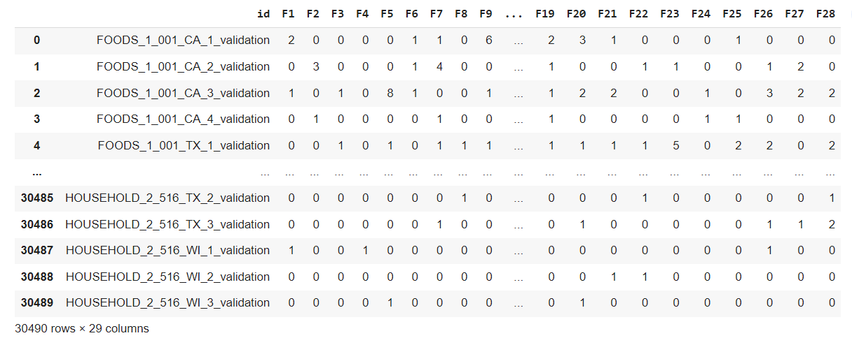
Prediction

Slide 16
Problems
Crashing
Reduce memory
Processing in chunks
Overfitting data
Chunking the Data:
The dataset (ds) is divided into chunks using the np.array_split function. Each chunk contains a subset of the original dataset and has a maximum size of chunk_size (set to 10,000 in this case).
The number of chunks is determined by dividing the length of the dataset by the chunk size and adding 1 to account for any remaining elements.
Processing Each Chunk: A loop is used to iterate over each chunk. For each chunk, specific operations are performed to process the data.
By chunking the data and processing it iteratively, crashing and memory limitations decreased.

Slide 17
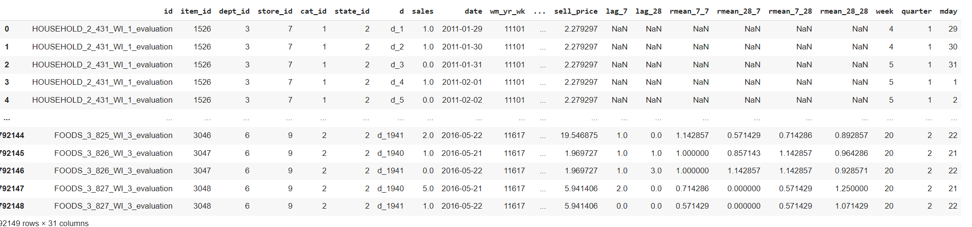
Comparison
First Model:
Merged dataset:

Slide 18
Comparison – Merging Model 1
The data types of specific columns in the "calendar" and "prices" datasets are defined using dictionaries. The "calendar" dataset contains columns such as "event_name_1," "event_type_1," "weekday," etc., which are assigned appropriate categorical data types. Similarly, the "prices" dataset contains columns like "store_id," "item_id," "wm_yr_wk," etc., with specific data types.
Conversion of Categorical Features: Categorical features in the "calendar" and "prices" datasets are transformed into integer codes using the cat.codes function. This conversion enables the models to work with categorical data more efficiently.
Merging Data Tables: The two data tables, "chunk" and "calendar," are merged using the merge function. The merge is performed on the common column "d," which represents the days of sales data. This step combines the sales data with the corresponding calendar information.
Merging Prices Data: The merged data from the previous step is further merged with the "prices" dataset based on the common columns "store_id," "item_id," and "wm_yr_wk." This step adds the price information to the existing merged dataset.

Slide 19
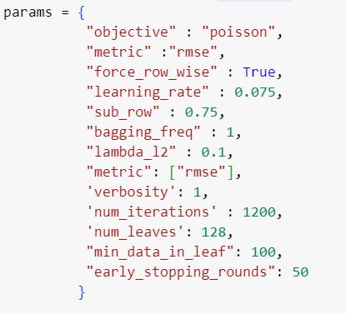
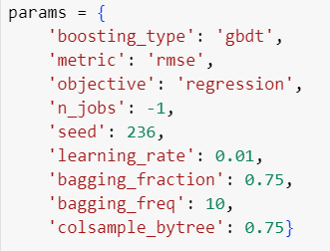
Comparison
1st Model
2nd Model

Slide 20
Comparison
1st Model
2nd Model
Applies memory function
Defines correct data types for calendar and sell_prices datasets
Categorical feature encoding - datasets are transformed into integers; cat.codes
Reads the "sales_train_evaluation.csv" file
Splits the dataset into chunks for processing
Merges in chunks: Melts the chunk dataframe to transform the dataset
Merges the chunk dataframe with calendar and prices dataset
Adds day lags, rolling means, and date features to the dataset
Defines the training and validation sets
Defines the LightGBM model parameters
Trains the LightGBM model
Creates a dataset for predictions
Creates features for the prediction dataset
Applies memory function
Performs data formatting for calendar data by defining holiday and weekend
Applies functions to determine if a day is a holiday or a weekend
Feature Engineering, but less than Model 1
Uses the melt function to transform the train_sales dataset
Merges train_sales and calendar datasets and prices datasets
Creates a test dataset by filtering train_sales for a specific day
Merges the processed test dataset with calendar and prices datasets
Performs one-hot encoding on train_sales and train_sales_test datasets
Splits the data into training and testing sets using sickit learn
Defines the model parameters for LightGBM
Trains the LightGBM model
Makes predictions on the test dataset
Formats the predictions into the desired format

Slide 21

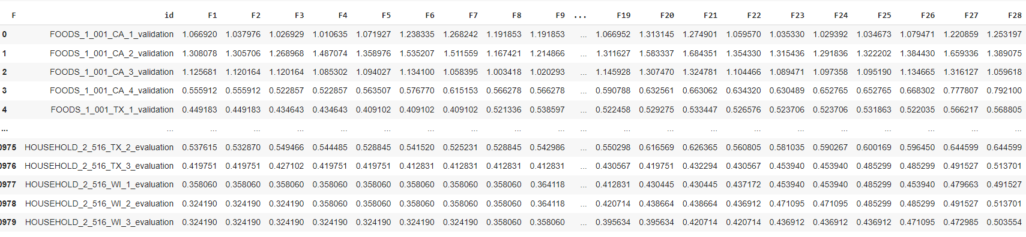
Comparison
First Model Results

Slide 22
Comparison – Conclusion
Both codes involve data preprocessing steps such as merging datasets and transforming categorical features.
Both codes use LightGBM for model training, but differ in their approach to data preprocessing and feature engineering.
Both codes involve feature engineering steps such as adding day lags and rolling mean features.
Model 2 has specific formatting steps for the calendar and train_sales datasets
Model 2 uses the melt function to transform the train_sales dataset, while Model 1 melts the dataset in chunks.
Model 2 merges train_sales with calendar and prices datasets separately, while Model 1 merges the chunk dataframe with calendar and prices datasets.
This could be the reason why model 1 was slower in merging and crashed more.
Poisson vs Regressoin – prediction values
Feature engineering: Lag days, and rolling average

Slide 23
LSTM

Slide 24
LSTM – Feature Scaling
The MinMaxScaler from the sklearn.preprocessing
A MinMaxScaler object named sc is created, which will scale the features between 0 and 1.
The train_sales DataFrame is scaled, excluding certain columns (id, item_id, d, date, wm_yr_wk).

Slide 25
LSTM – Data Prep
The timesteps variable is set to 14, representing the number of previous time steps to consider for each data point.
The startDay variable is set to 350, representing the starting day of the time series data.
A loop is executed from timesteps to 1941 - startDay (the length of the time series data). Within the loop: The previous timesteps data points are appended to X_train. The current data point's sales values for all items are appended to y_train.
Only the sales values are considered for predictions, even if additional features are present. The dt_scaled variable is deleted to free up memory. X_train and y_train are converted to numpy arrays.

Slide 26
LSTM - The RNN
An RNN model is initialized using the Sequential class, creating an empty model object named regressor.
Adding LSTM Layers with Dropout Regularization: The first LSTM layer is added to the model with layer_1_units and a dropout rate of 0.2.
Two more LSTM layers are added with layer_3_units units and a dropout rate of 0.2, both with return_sequences = True.
Dropout layers are added after each LSTM layer to regularize the model.
Adding the Output Layer: A dense layer is added with units = 29, representing the number of output units. The output layer will provide predictions for the next 28 days of sales.
Compiling the RNN: The RNN model is compiled by specifying the optimizer and loss function.
The loss function is set to 'mean_squared_error', which measures the mean squared difference between the predicted and actual values.

Slide 27
LSTM - Fitting
The RNN model is fitted to the training set using the fit method of the regressor object.
The X_train and y_train datasets are used as inputs.
The epochs parameter is set to epoch_no, representing the number of times the model will iterate over the entire dataset during training.
The batch_size parameter is set to batch_size_RNN, which determines the number of samples used in each gradient update. The model is trained to learn patterns in the data and minimize the mean squared error loss between the predicted and actual values.

