Slide 1
Alpha Net Technologies Pvt. Ltd. Chandigarh
Submitted By:
Vishal Gupta Simrandeep Singh
100903114 100903105

Slide 2
emailPLUS (Window Interface to email manager)

Slide 3
Preface & Abstract
emailPLUS is an window application which allows its users to connect with any mail server
Retrieves e-mails using POP3 protocol & sends through SMTP Protocol
Users will be able to configure any mail account with this application to access email accounts

Slide 4
Security is enhanced by the use of spam filter
Technology used
Front End: core Java (1.6), Java mail APIs (1.4.3)
Back End: MYSQL (5.5)

Slide 5
Need Of Project
Only registered users can use this application
To access more than one mail accounts using a single interface/platform
Maintain history of all the activities of users of this application

Slide 6
System Outline View
The Inputs required for this system are:
Login
User Information
Mail Server connection detail
The Outputs required for this system:
Retrieve & view emails from mail server.
Compose and send mail using email account on mail server.
Listing of user activities.
Listing of user details.
Details of data sent using emailPLUS.
User Maintenance
Reports.

Slide 7
System Modules
Login
User Maintenance
Mail Server Configuration
Mail Receiver
Mail Composer and Sender
Reports
a. All Users details
b. User Activities – Login and logout time of users.
c. Sent email details

Slide 8
Data Flow Diagrams

Slide 9
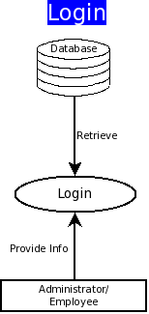

Slide 10
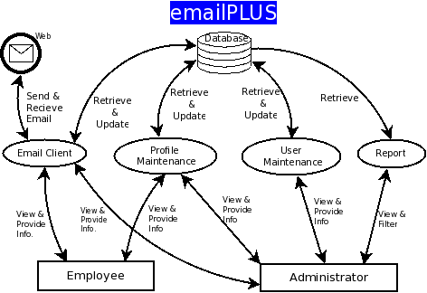

Slide 11
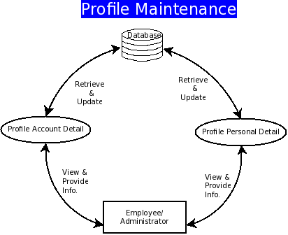

Slide 12
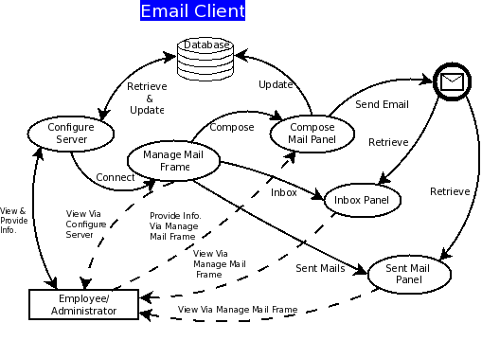

Slide 13
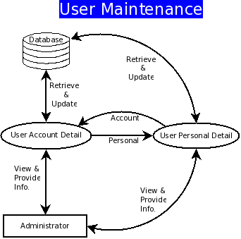

Slide 14
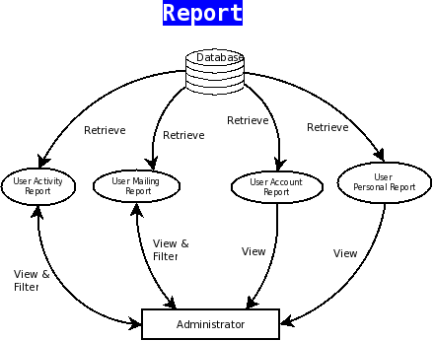

Slide 15
Snapshots

Slide 16
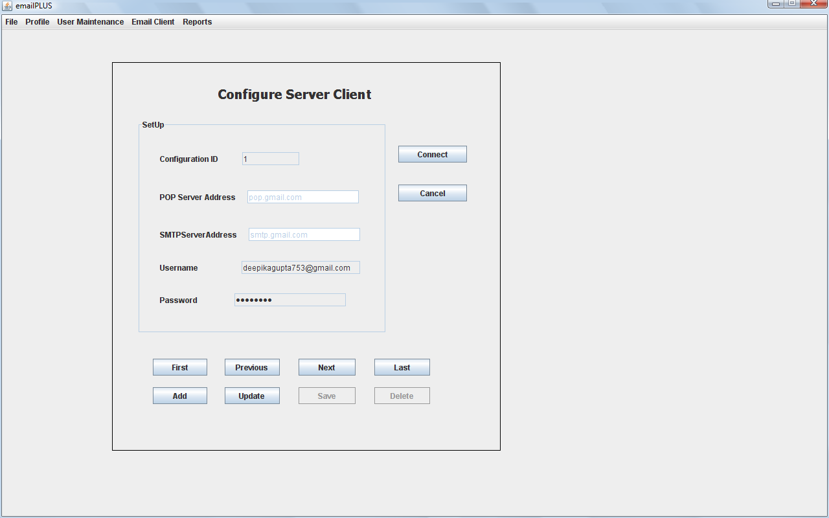
HOME SCREEN

Slide 17
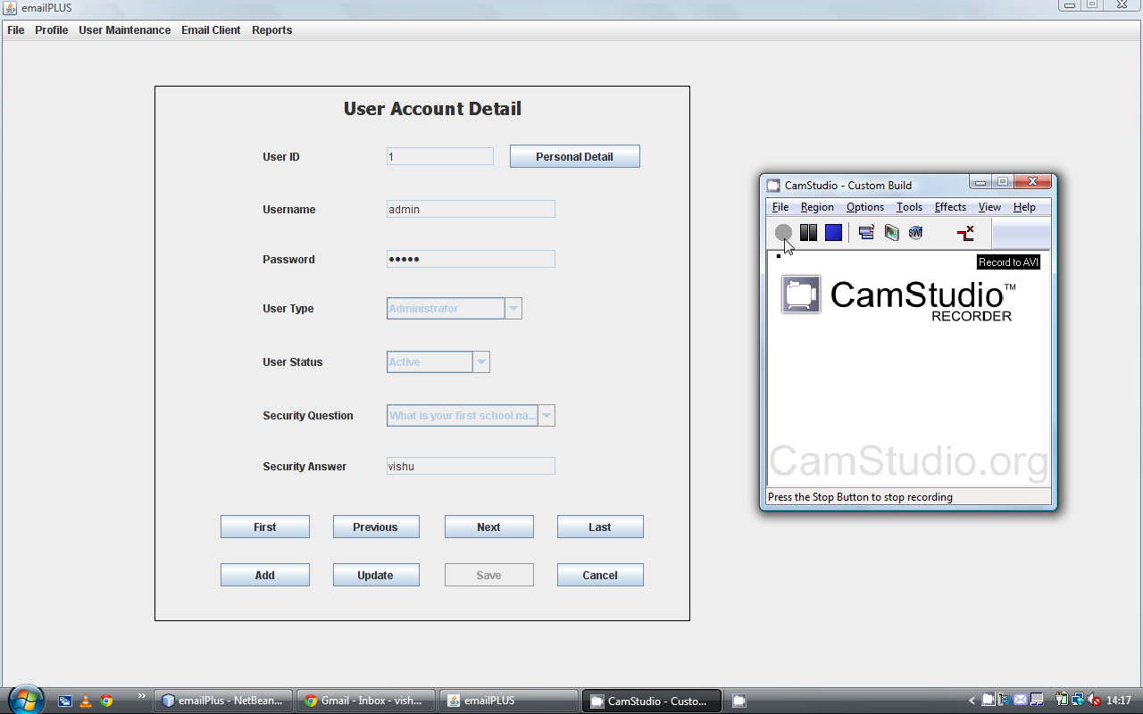

Slide 18
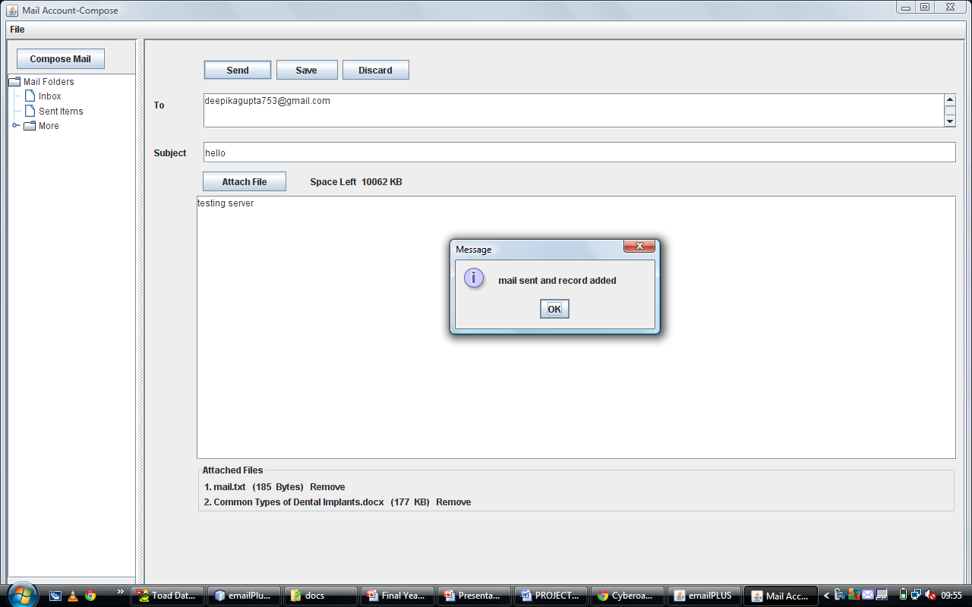
COMPOSE PANEL

Slide 19
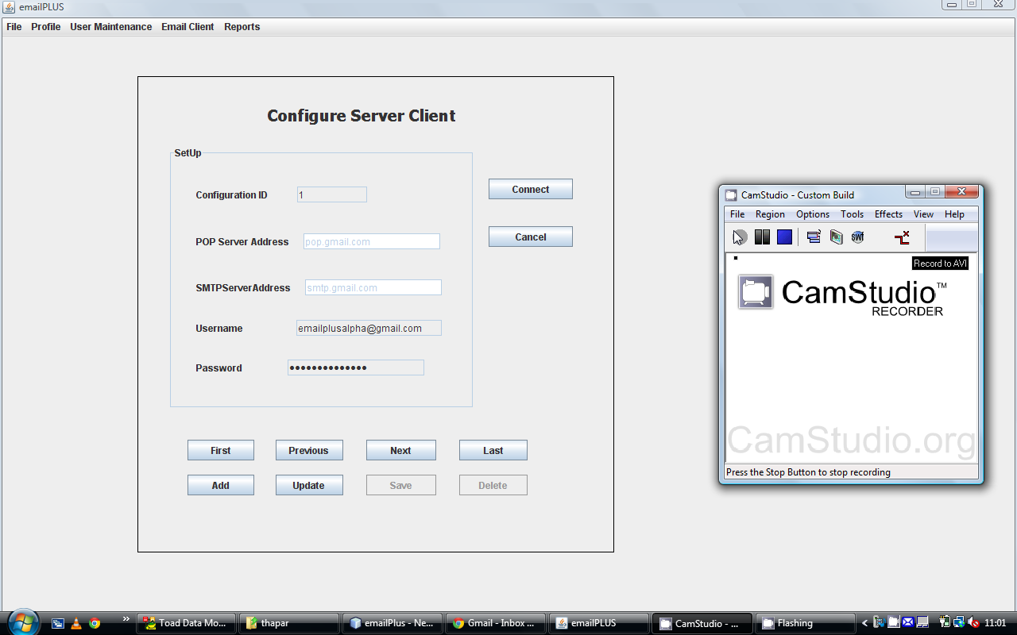

Slide 20
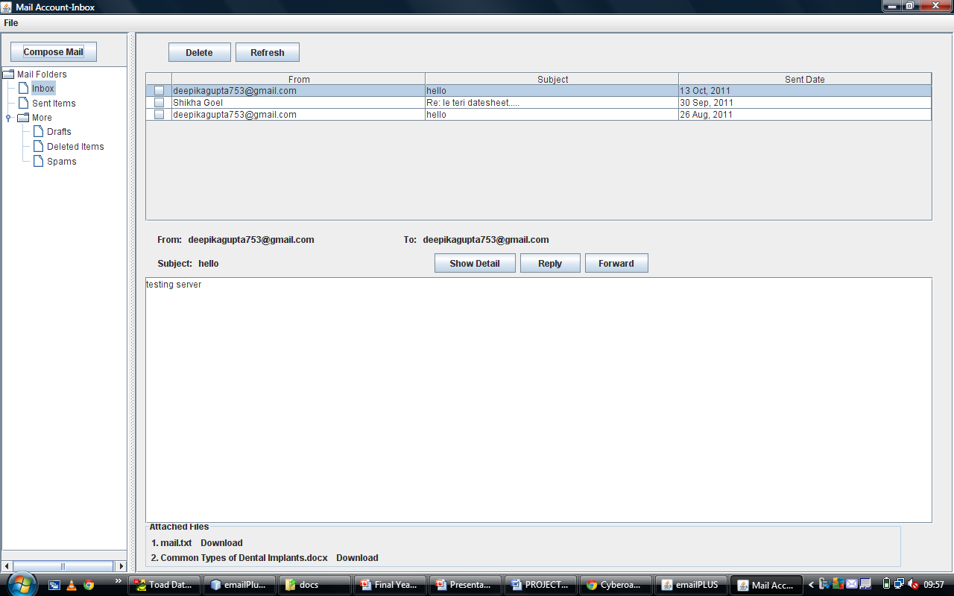
INBOX PANEL

Slide 21
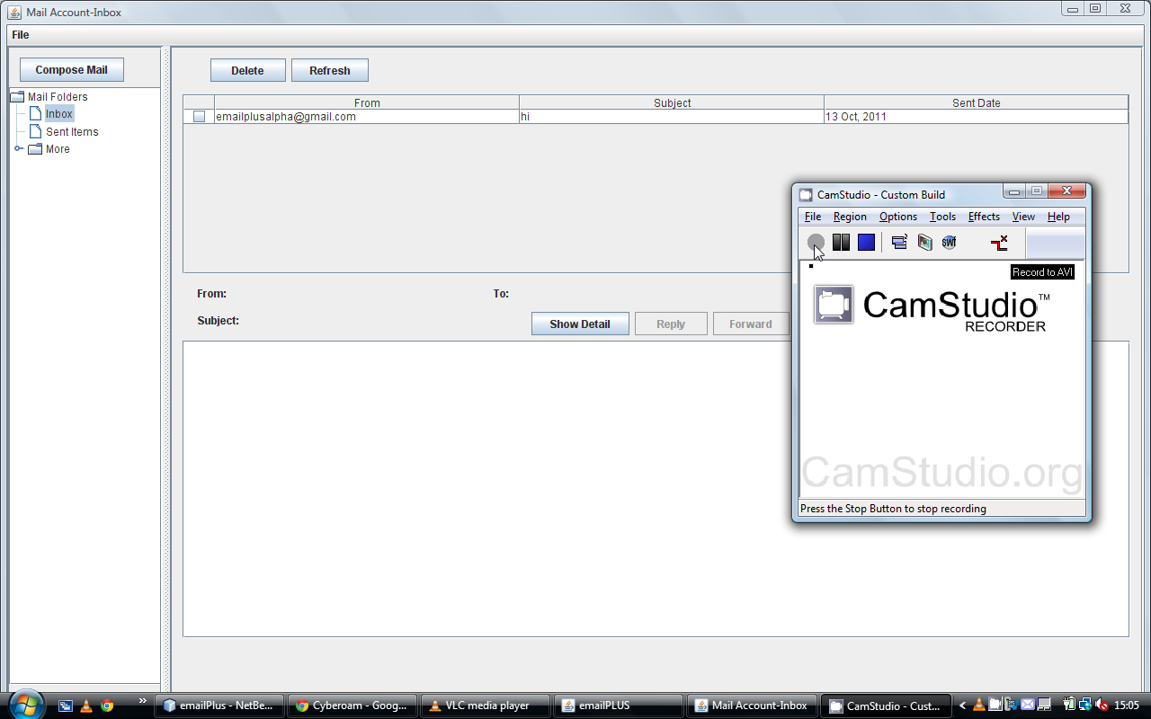

Slide 22
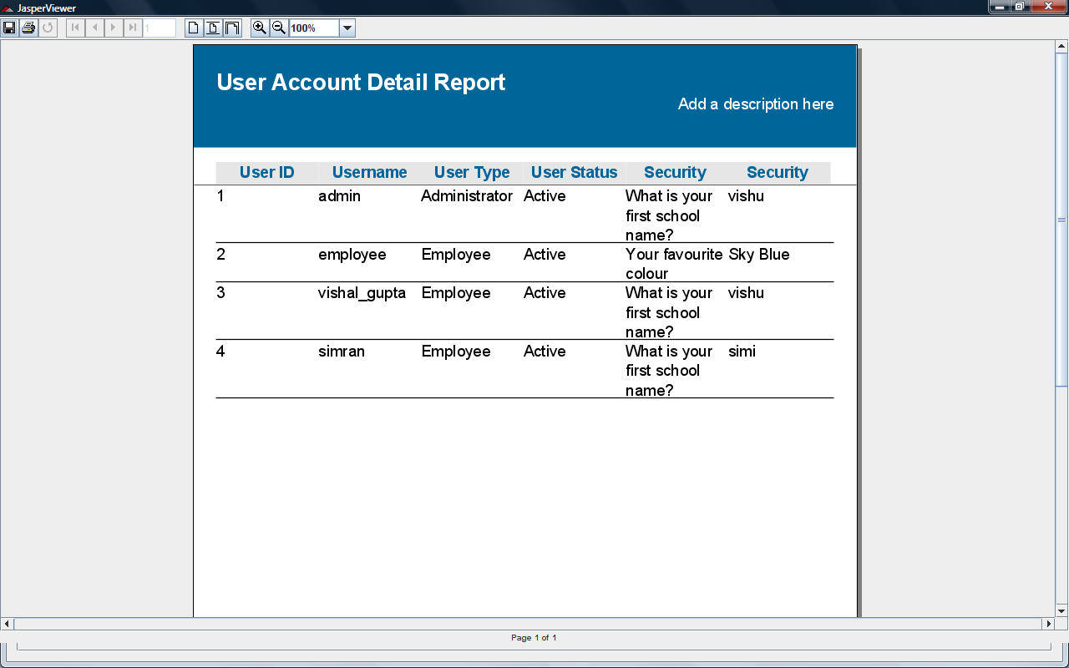
JASPER REPORT VIEW

Slide 23
THANK YOU

