Slide 1
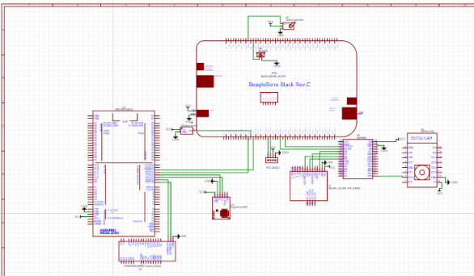
Schematic Design
Group: 2
Simran
C0765503

Slide 2
Why schematic design is Important?
Schematic captures defines the electrical circuits.
The user can easily understand the complex circuit with the help of schematic design
Like, which components are used, and which pins need to be connected, all these things are clearly defined by the schematic.

Slide 3
Why schematic design is Important?
Here, in the schematic capture, the lines represents the actual wiring and all the components used in the project is represented by the electrical symbol.
Schematic design help the user to understand the whole process in easy way

Slide 4
EASYEDA
It is an easier and powerful web-based Electronics Design Automation (EDA) tool that help the user to access it anywhere at anytime, so software installation is not mandatory. Like user can install it on their personal computers as it is compatible with LINUX, WINDOWS and MAC OS. For our project, we are using EASYEDA online.

Slide 5
EASYEDA
EASYEDA is a very user friendly and simple to use software. All the components are easily available in the Library, user can select the desired components, drag and place it.
EASYEDA official sites comes with the tutorials that help the new user to understand the software easily.

Slide 6
FEATURES OF EASYEDA
Simple, Easier, Friendly, and Powerful general drawing capabilities
Schematic Capture
PCB Layout
Working Anywhere, Anytime, Any Device
Real-time Team Cooperation
Sharing Online
Thousands of Open Source Projects
Direct Links to LCSC Components for Selection
Integrated PCB Fabrication
Import Altium/Kicad/Eagle,PNG,DXF
More Than 1 Million Free Libraries
Script Support

Slide 7
GETTING STARTED WITH EASY EDA
If the user is using the software online, so the initial steps user has to take is register to the site so that their work can be saved easily.
Once the user is register, for the next time user need to login, and user can see all their work.

Slide 8
EASYEDA
Once the user login through the registered account the main window will pop up on the screen.
Now the user can make anything they want to like schematic design, or PCB design.

Slide 9
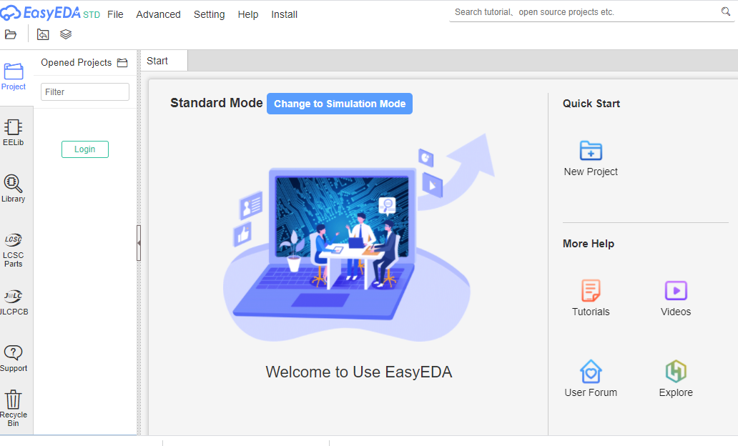
Show the existing projects.
Components that are already present can be accessed from here.
New components can be added from here. We need to search that particular element here.
This icon takes to a website from where we can order the components and PCB

Slide 10
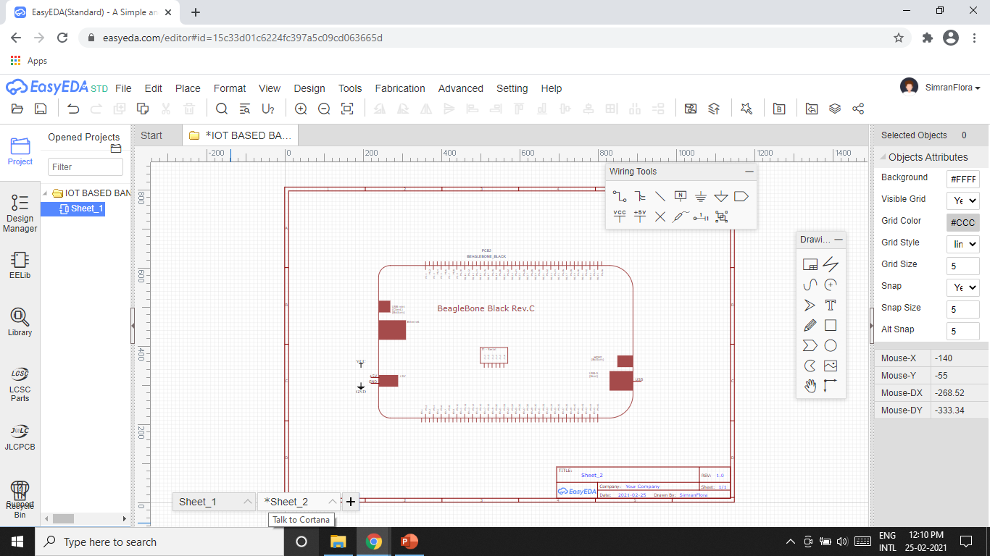
INITIAL WINDOW

Slide 11
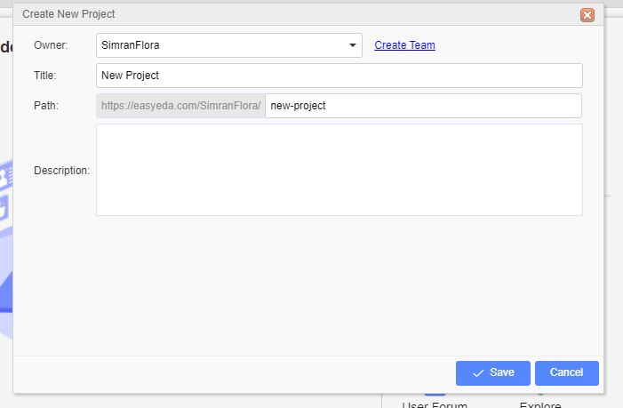
CREATING NEW PROJECT
Displays the name of the owner of the project
Name of the project is assigned here.
Information regarding the path of the project.
Details of the project can be added here
After filling all the information click on save option to store the details

Slide 12
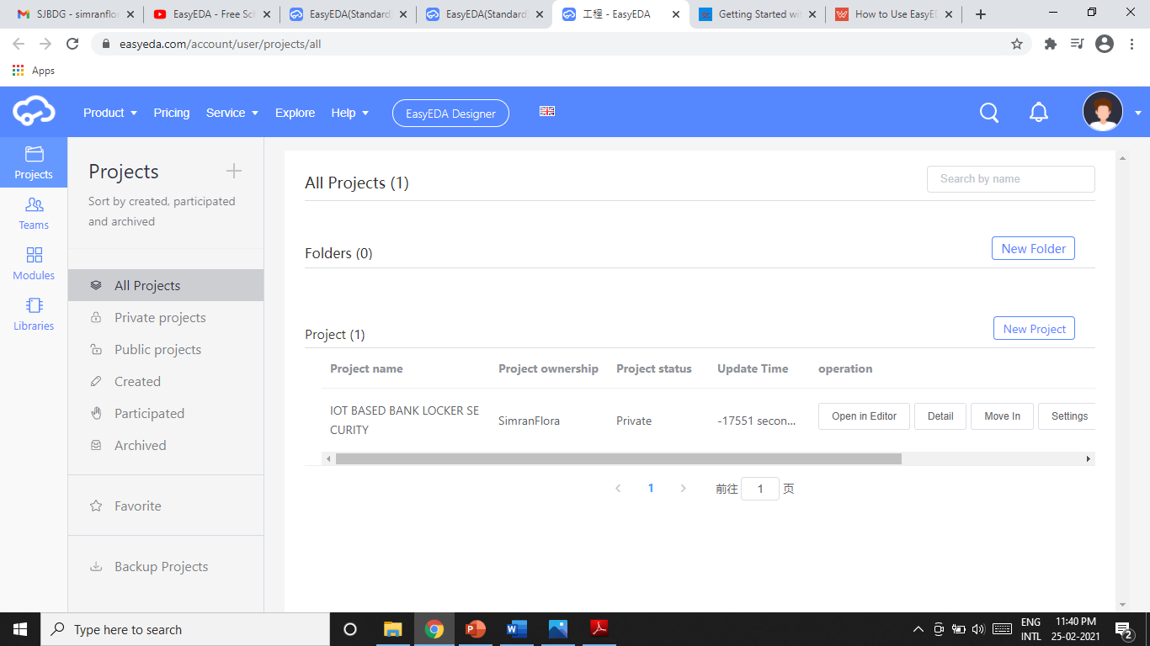
MY PERSONAL WORKSPACE IN EASYEDA

Slide 13
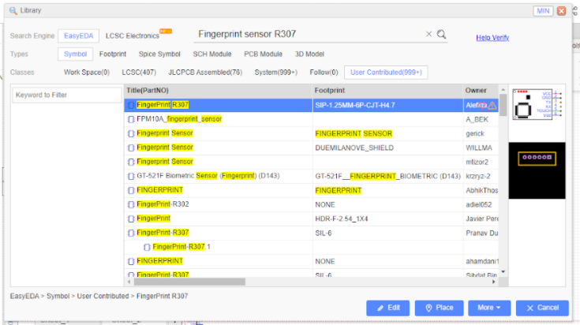
SEARCHING COMPONENTS
Search for the component you need.
Schematic design
PCB Design
Choose required component from the list that appears.

Slide 14
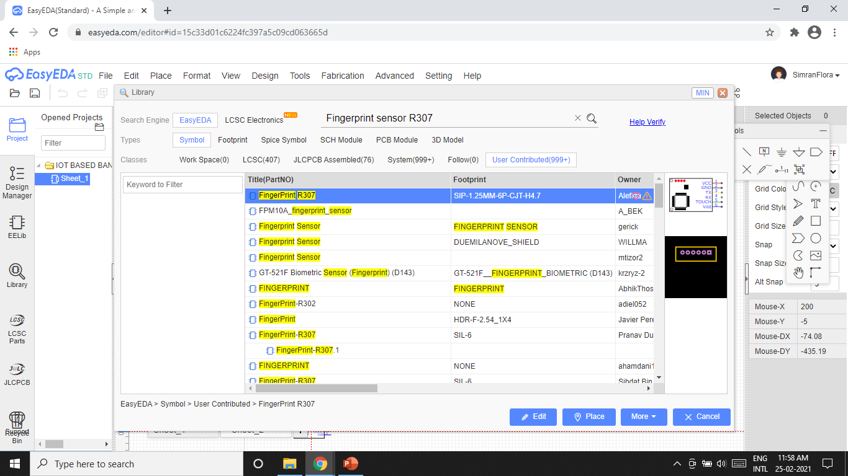
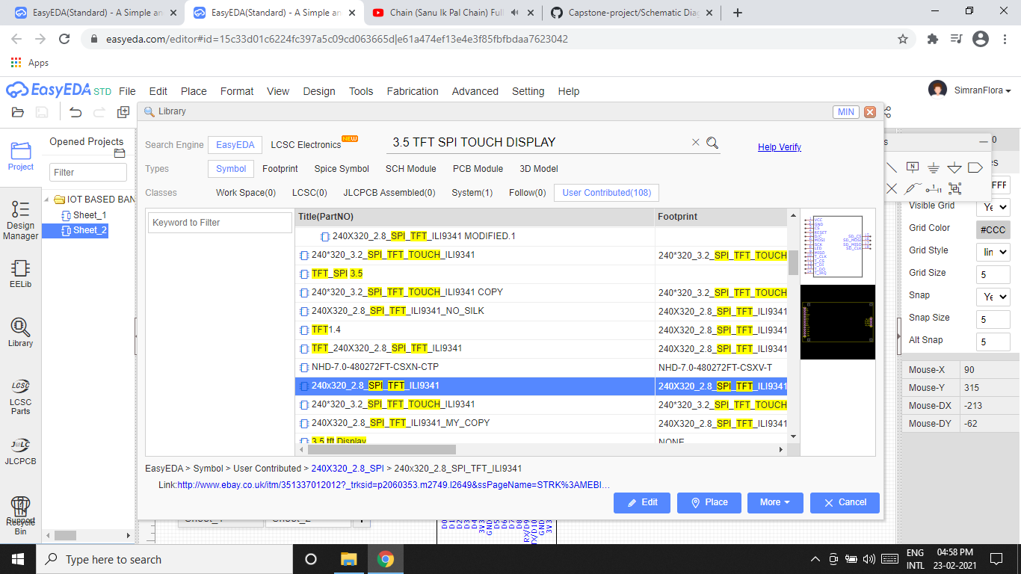
SOME OTHER EXAMPLES OF ADDING VARIOUS COMPONENTS

Slide 15
CONNECTION 1: SERVO MOTOR
Servo motor is connected directly to the beaglebone black.
We are using motor to open the locker.
Connections made with the help of GPOI pins.
Servo motor | Beaglebone Black
GND(BROWN) | P8.2
5V (RED) | P9.5
PWM(BROWN) | P8.10

Slide 16
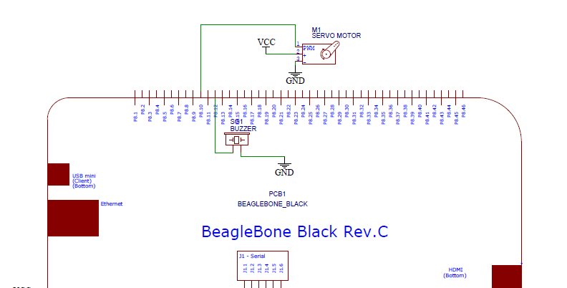

Slide 17
CONNECTION 2: BUZZER
Buzzer is directly connected to the beaglebone black with the help of GPIO pins.
Function of buzzer is to make sound when something wrong happens.
Buzzer | Pins of beaglebone
Red wire | P8.12
Black wire | GND

Slide 18
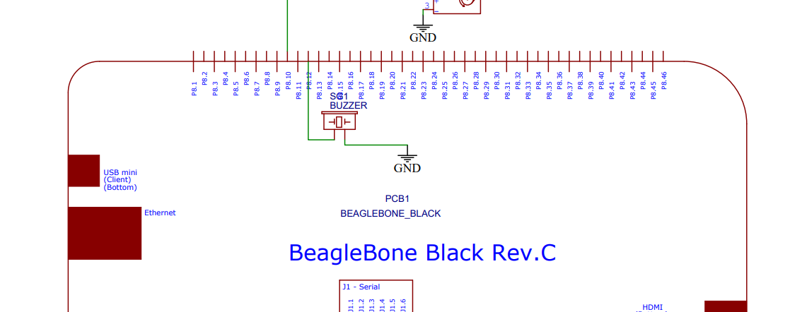

Slide 19
CONNECTION 3: REAL TIME CLOCK
Real time clock is connected using I2C communication protocol.
RTC is connected directly to the beagle bone to determine the real time on screen as BBB does not have inbuilt RTC.
RTC DS3231 | BEAGLEBONE BLACK
SCL | P9.19
SDA | P9.20
VCC | VCC
GND | GND

Slide 20
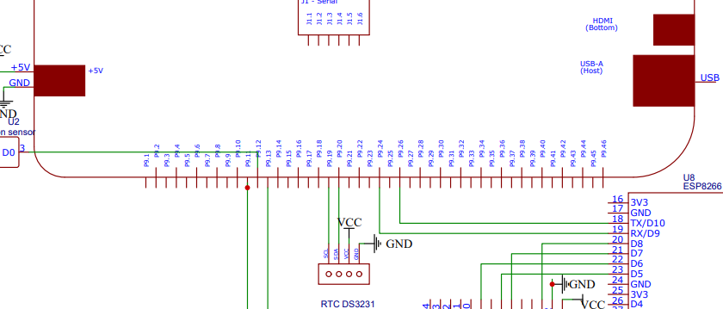

Slide 21
CONNECTION 4 : ARDUINO MEGA
Protocol used for communication is UART.
Pin 18 (Tx) is connected to Pin P9.11
Pin 19(Rx) is connected to Pin P9.13

Slide 22
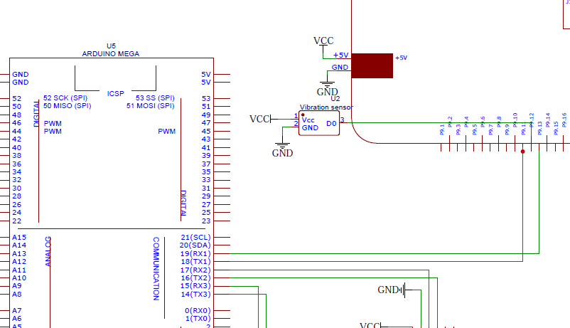

Slide 23
CONNECTION 5: GSM SIM900 WITH ARDUINO MEGA
We are using GSM SIM 900 Module for this project to send SMS, when something wrong happen an email will be send to the owner.
Protocol used for communication is UART.
GSM need 5V power supply that is supplied by the 5V adaptor.
Arduino mega | GSM MODULE
PIN 15 | SIM TX
PIN 14 | SIM RX
GND | GND

Slide 24
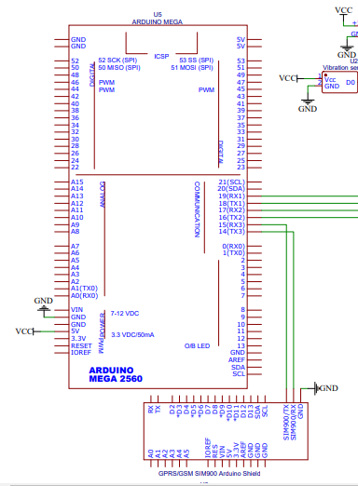

Slide 25
CONNECTION 6: ARDUINO WITH FINGERPRINT SENSOR
Fingerprint sensor model used is R307
Communication is used is UART.
This provides second layer of security by matching user finger scan.
Fingerprint sensor | Arduino Mega
Tx | Rx 2 (17)
Rx | Tx 2 (16)
VCC | VCC
GND | GND

Slide 26
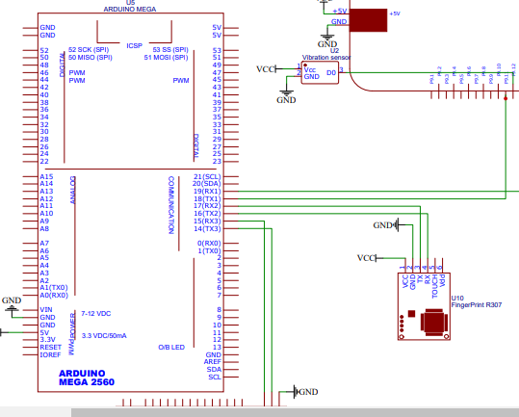

Slide 27
CONNECTION 7: VIBRATION SENSOR
Vibration sensor is connected directly to the beaglebone black with the help of GPIO pins.
This sensor is used to detect any unauthorized access by hammering the locker.
Vibration sensor | Beaglebone Black
D0 | P9.12
VCC | VCC
GND | GND

Slide 28
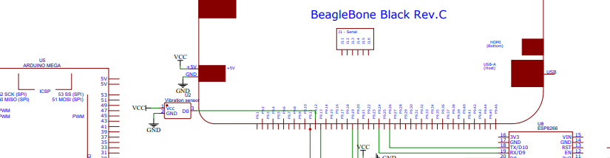

Slide 29
CONNECTION 8:ESP8266 WITH BEAGLEBONE
ESP8266 is communicating with beagle bone by UART communication.
We are using the ESP8266 in this project just for the interfacing of touch screen.
ESP8266 | Beaglebone
18 Tx | P9.26
19 Rx | P9.24
GND | GND

Slide 30
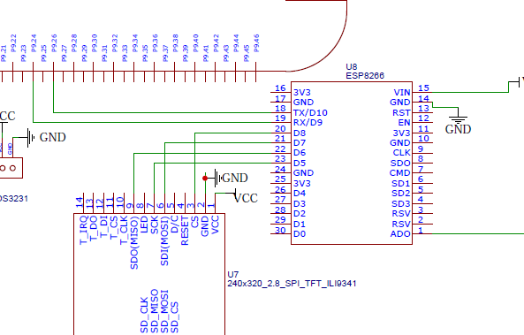

Slide 31
CONNECTION 9:ESP8266 WITH TOUCH SCREEN
We are using 3.5” TFT touch screen in this project as a first layer of security for the user.
The user needs to enter the password first using the touch screen to open the locker.
We are connecting the touch screen with esp8266 using the SPI communication protocol.
So, the ESP8266 is the master device to the touch screen and
ESP8266 acts as an bridge between the beagle bone black and the touch screen.

Slide 32
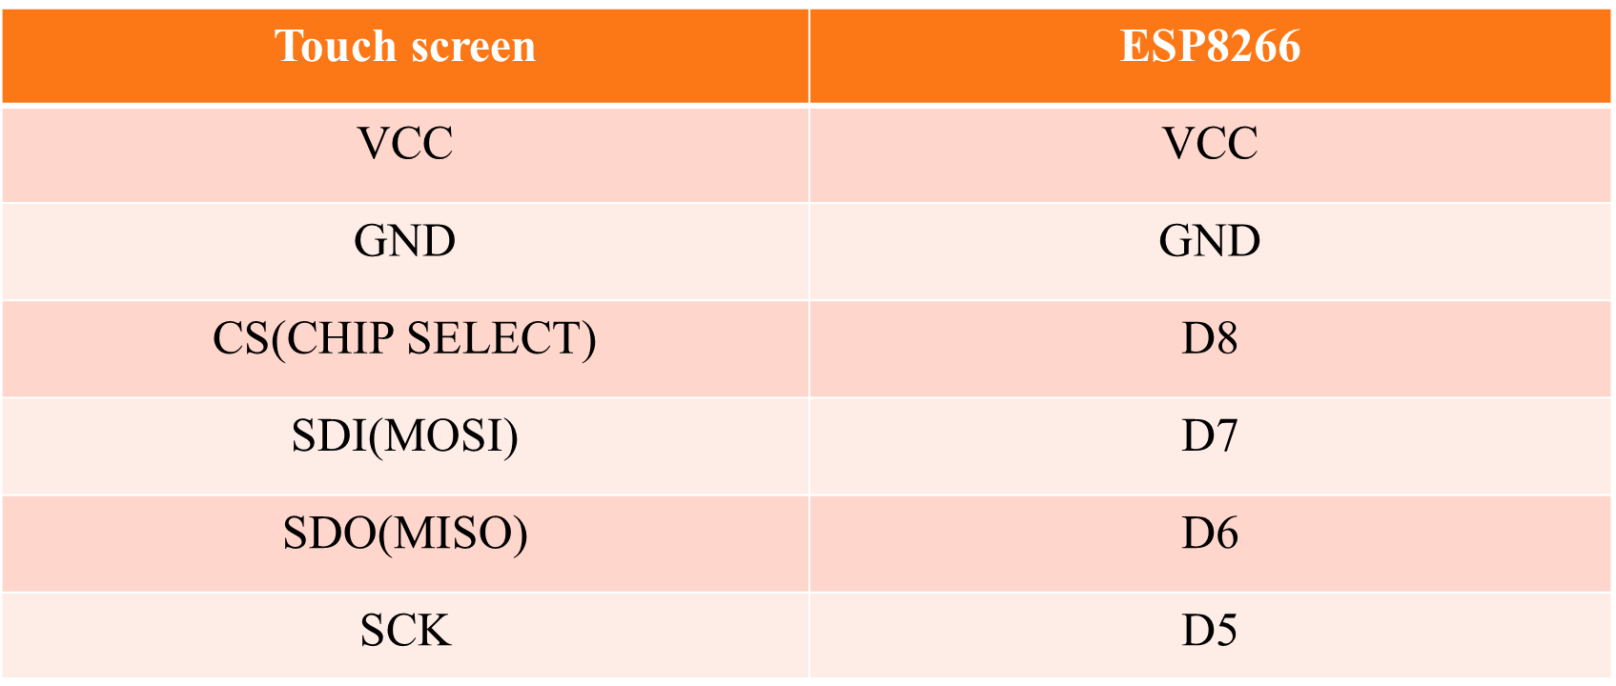
CONNECTION 9:ESP8266 WITH TOUCH SCREEN

Slide 33
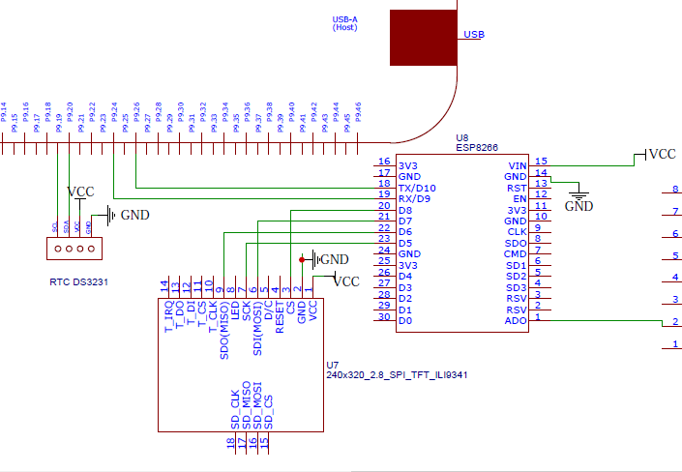

Slide 34
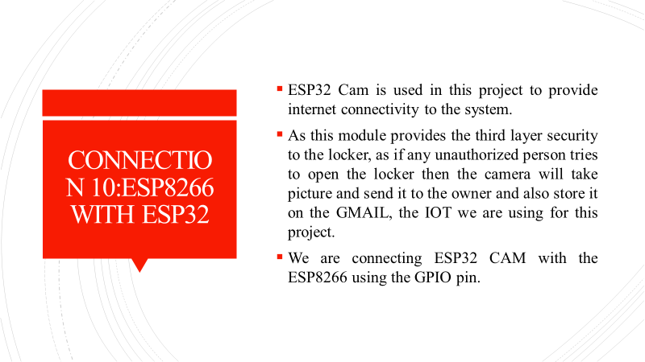

Slide 35
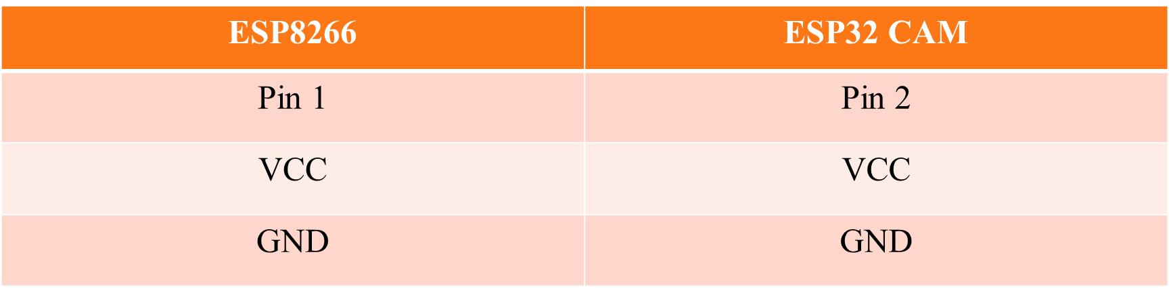
CONNECTION 10: ESP8266 WITH ESP32 CAM

Slide 36
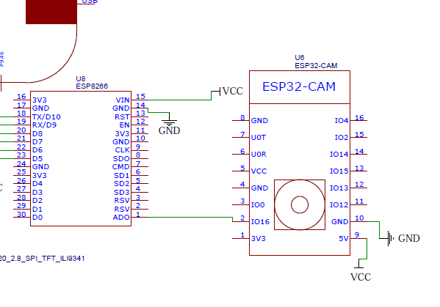
CONNECTION 10: ESP8266 WITH ESP32 CAM

Slide 37
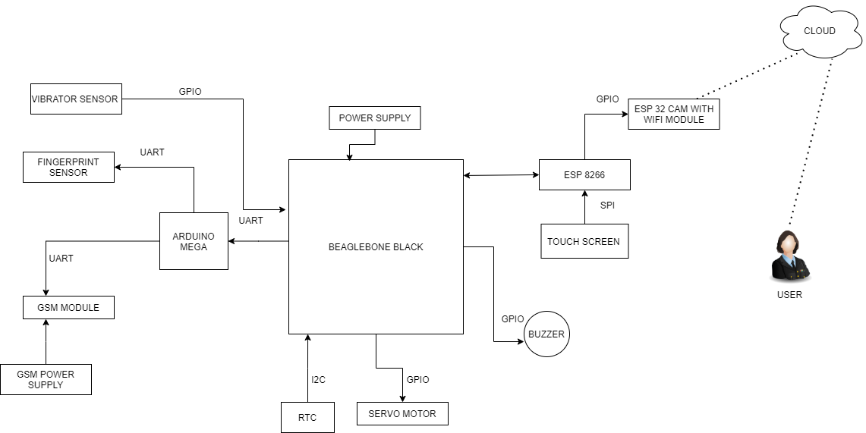
BLOCK DIAGRAM

Slide 38
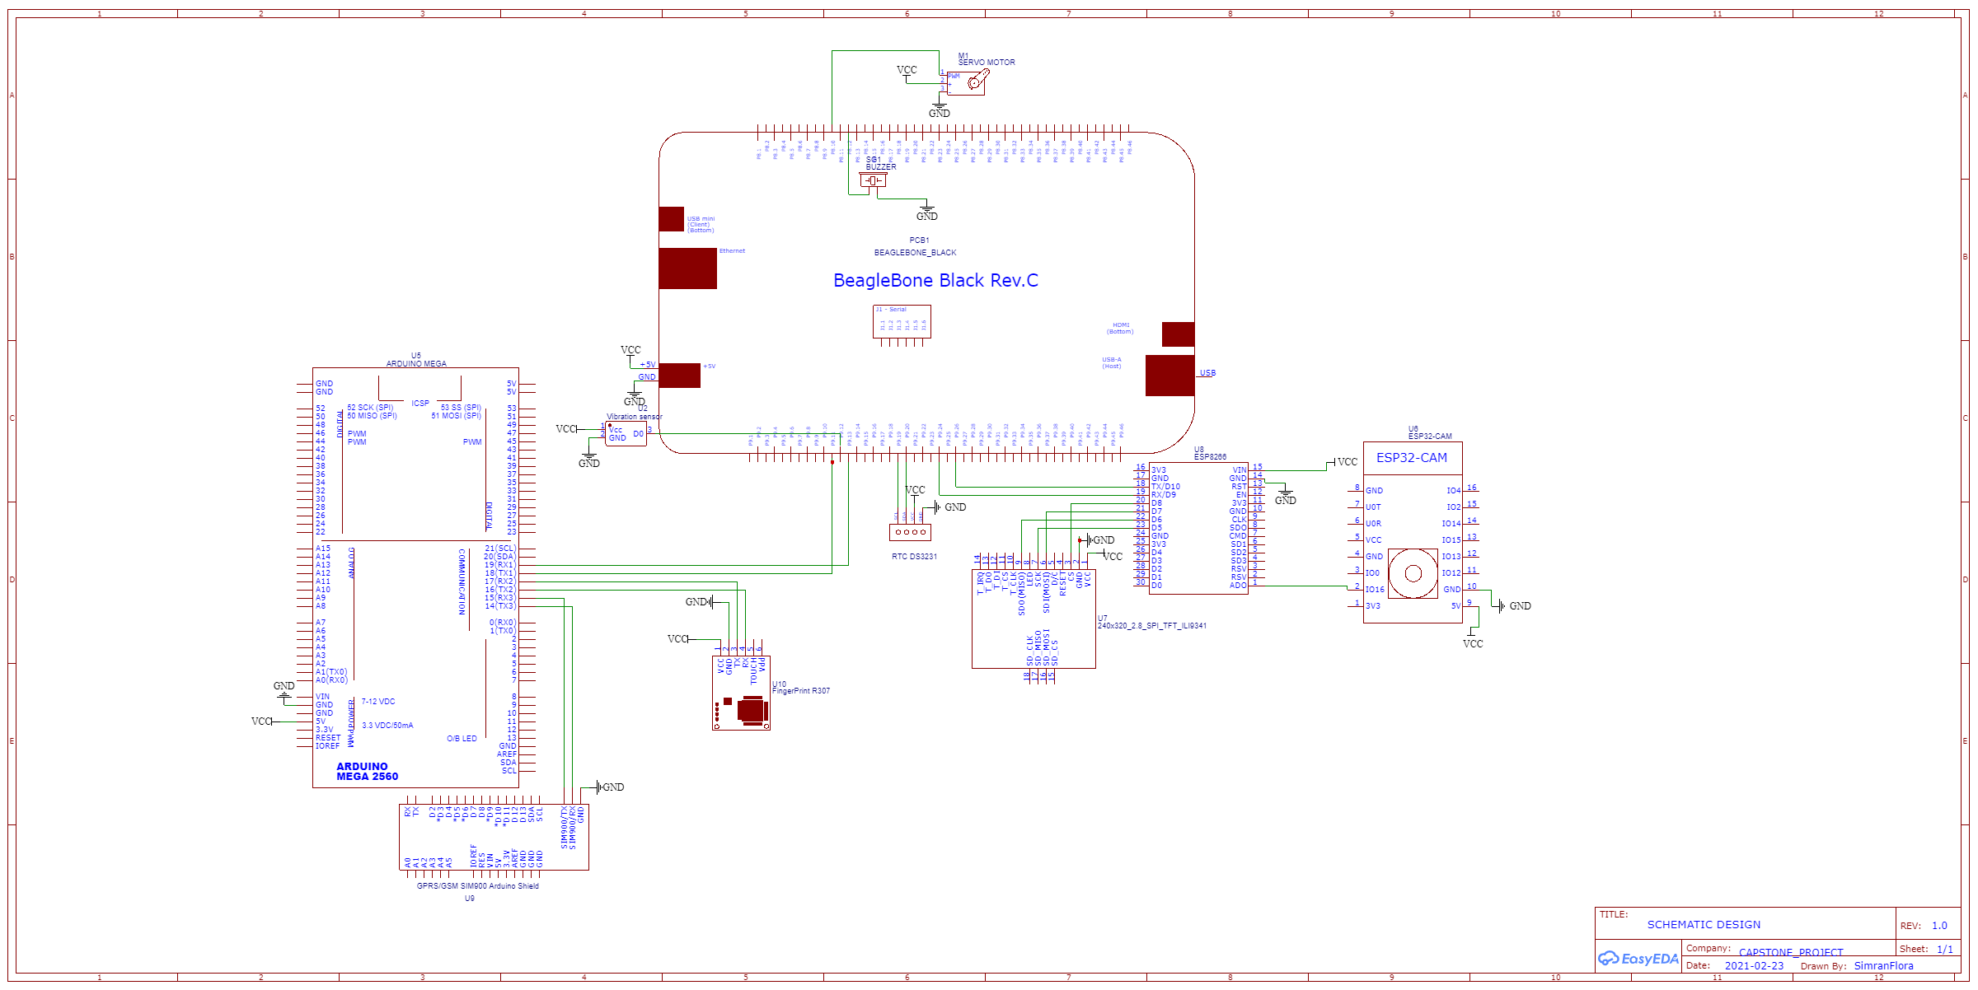
SCHEMATIC DESIGN

Slide 39
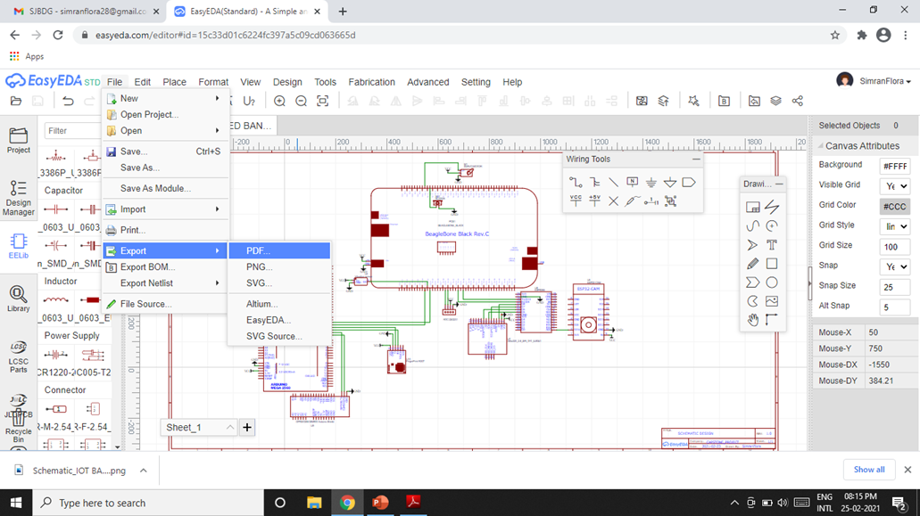
SAVING THE PROJECT

Slide 40
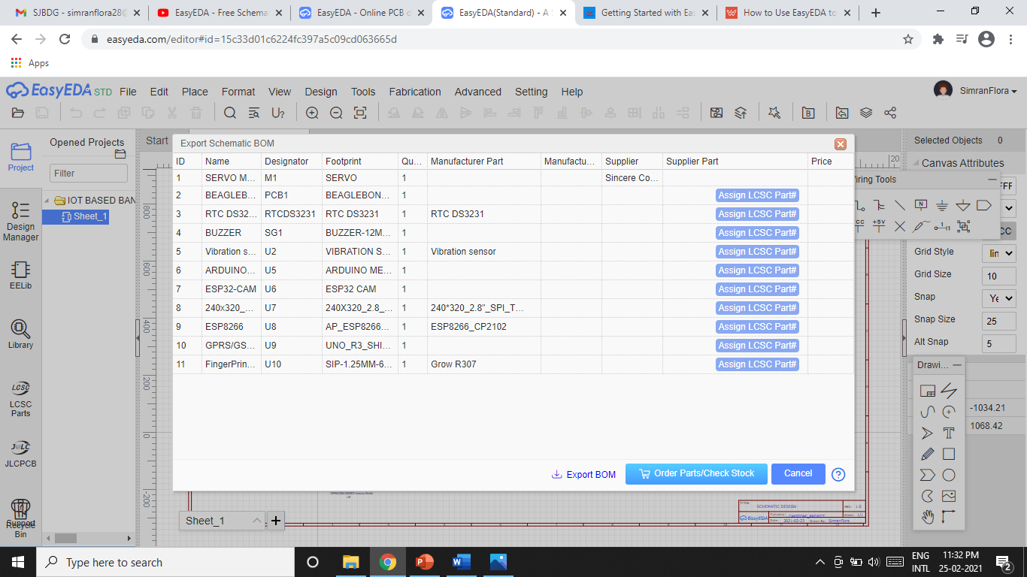
GENERATE THE BOM
With the help of EASYEDA, user can generate the BOM, the components we want to use for project.
Just go to the fabrication in the menu bar and the BOM option is available, click on it and all the components that we are using in this project will appear on the screen.

Slide 41
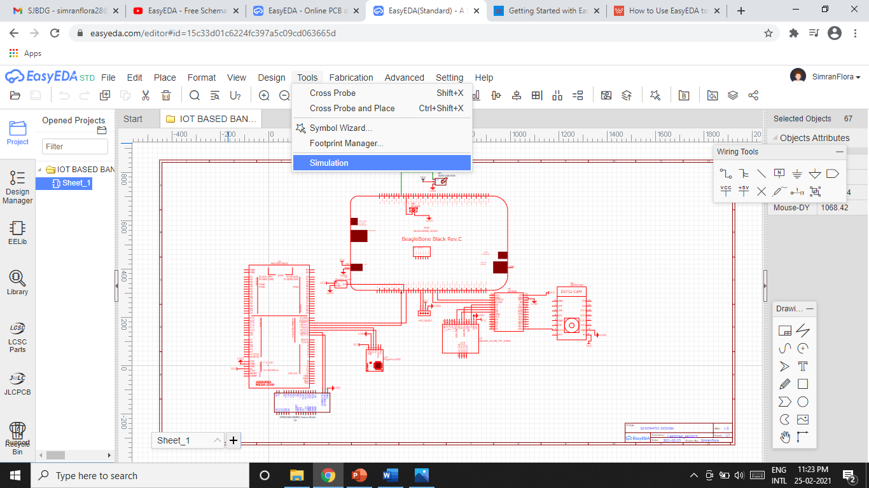
SIMULATION FOR EASYEDA

Slide 42
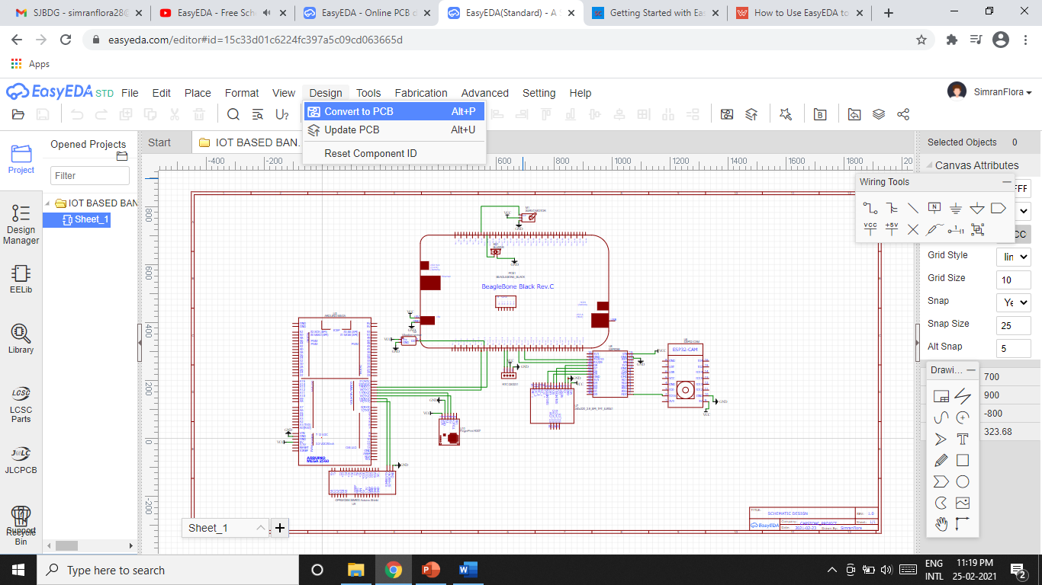
EASYEDA FOR PCB DESIGN

Slide 43
REFERENCES
Interfacing gsm module with Arduino mega: https://lastminuteengineers.com/sim900-gsm-shield-arduino-tutorial/ https://www.youtube.com/watch?v=wI-pQyG13ZM
Interfacing bbb with esp8266: https://v37e00e.blogspot.com/2015/12/beaglebone-black-bbb-uart2-with-esp8266.html
Interfacing of servo motor with BBB: Servo Motor Controlling with Beaglebone Black (Part 6/15) (engineersgarage.com)
Interfacing RTC with BBB: https://learn.adafruit.com/adding-a-real-time-clock-to-beaglebone-black/wiring-the-rtc
Interfacing fingerprint with Arduino mega: https://www.c-sharpcorner.com/article/fingerprint-lock-using-arduinomega2560/
EasyEda Editor: https://easyeda.com/editor

Slide 44
REFERENCES
Interfacing bbb with Arduino mega: How to Make a BeagleBone and an Arduino Communicate : 4 Steps – Instructables
EasyEda for pcb : https://www.wellpcb.com/easyeda.html
ESP8266 With touch screen: https://simple-circuit.com/esp8266-nodemcu-ili9341-tft-display/
EasyEda: https://easyeda.com/editor#id=15c33d01c6224fc397a5c09cd063665d
EasyEda: https://www.youtube.com/watch?v=30BYc0ikP6c
Interfacing ESP8266 With ESP32: https://www.instructables.com/Programming-ESP32-CAM-With-ESP8266/

