Slide 1

IOT BASED BANK LOCKER SECURITY SYSTEM

Slide 2
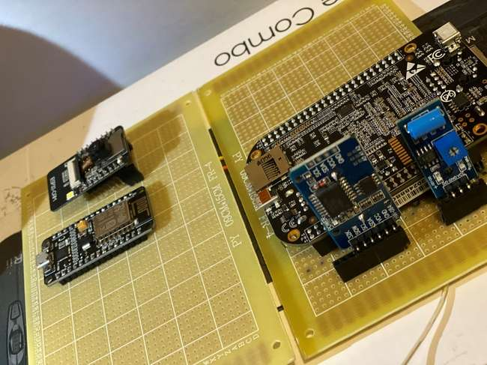
ZERO PCB IMPLEMENTATION
SUBMITTED BY: JASMEET SINGH(C0751797)
GROUP: 2

Slide 3
UNTIL NOW
Before starting the task, initially we will review what all we have done till now with respect to the project that we had proposed.
Till now, we are done with the interfacing of buzzer, Servo motor, Vibration sensor, Arduino mega, Fingerprint sensor, GSM SIM900 Module, ESP8266 Module, ESP32 Module, Touchscreen and RTC Module with beaglebone black.
In order to make interfacing possible we used various functions and features of C programming and various communication protocols are used such as UART, SPI, I2C and GPIO that required various libraries as to gain the control over GPIO pins we installed “iobb library.”
After the successful interfacing of all the components and desgin the PCB online; the next is Zero PCB Implementation.

Slide 4
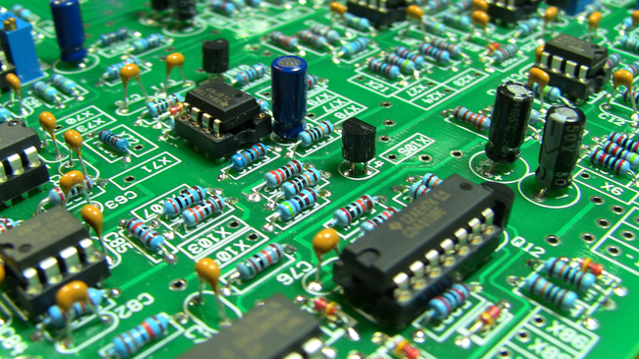
INTRODUCTION TO PCB
PCB(Printed Circuit Board), it is a printed circuit board which contains traces, lines and paths to electrically connect different components. It consists of substrate on which copper conducting material is laminated for creating a electrical connection between components.
This Photo by Unknown Author is licensed under CC BY-SA-NC

Slide 5
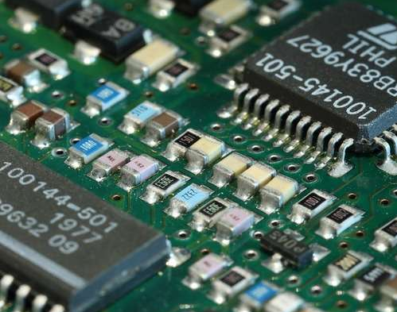
TYPES OF PCB
Following is the list of available PCBs in the market. You can choose any PCB based on your requirements related to project.
Single Sided PCBs
Double Sided PCBs
Multilayer PCBs
Rigid PCBs
Flex PCBs
Rigid-Flex PCBs
High Frequency PCBs
Aluminium Backed PCBs
Zero PCB

Slide 6
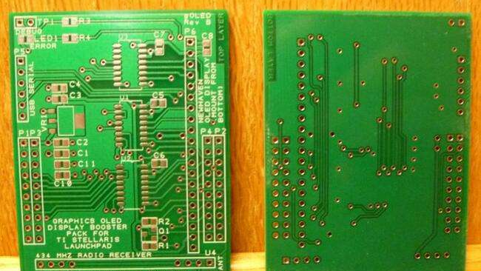
WHAT IS ZERO PCB ??
Zero PCB is basically a general-purpose printed circuit board (PCB), also known as perfboard or DOT PCB. It is a thin rigid copper sheet with holes pre-drilled at standard intervals across a grid with 2.54mm (0.1-inch) spacing between holes.
This Photo by Unknown Author is licensed under CC BY-SA

Slide 7
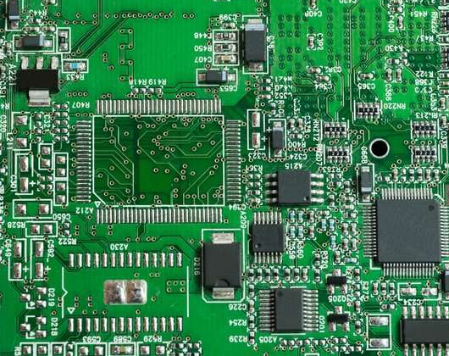
WHAT ARE THE FUNCTION OF HOLES ??
There are number of holes in the Zero PCB. Each hole is encircled by a round or square copper pad so that component lead can be inserted into the hole and soldered around the pad without short-circuiting the nearby pads and other leads. For connecting the lead of component with another lead, solder these together or join these using a suitable conducting wire.
This Photo by Unknown Author is licensed under CC BY-SA-NC

Slide 8
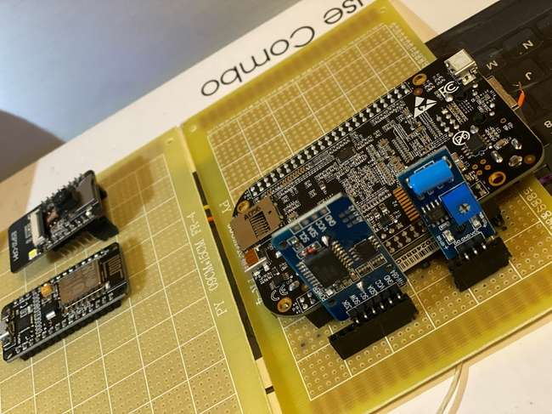
REQUIREMENTS
For the fulfilment of this task, there are various hardware requirements.

Slide 9
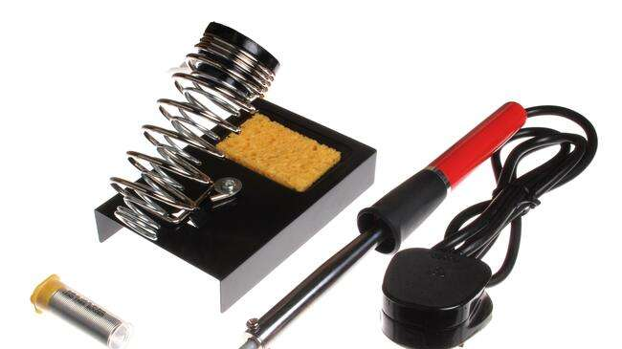
REQUIREMENTS
Soldering Iron
Soldering Wire
Zero PCB
Headers
Jumper Wires
Multimeter
This Photo by Unknown Author is licensed under CC BY-SA

Slide 10
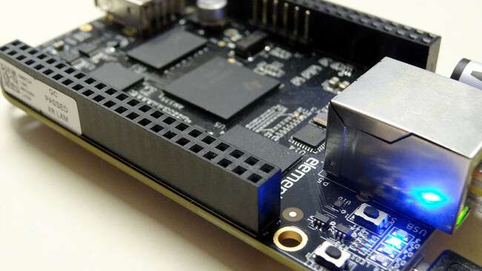
REQUIREMENTS
Beaglebone Black
ESP32 CAM Module
ESP8266 Module
RTC Module
Vibrator Sensor
This Photo by Unknown Author is licensed under CC BY-NC

Slide 11
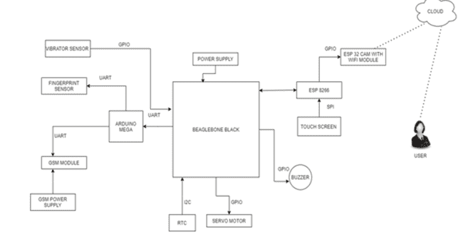
PROJECT OVERVIEW

Slide 12
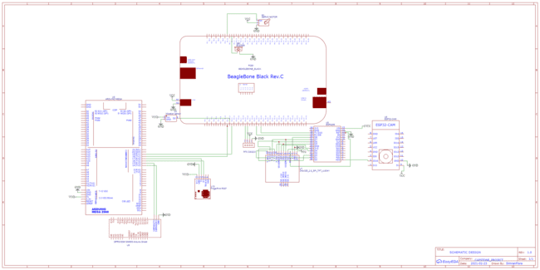
SCHEMATIC DIAGRAM

Slide 13
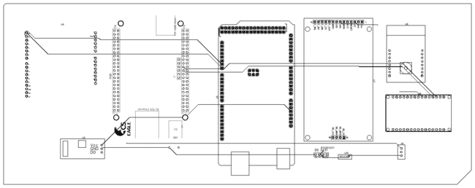
PCB DESIGNING ONLINE

Slide 14
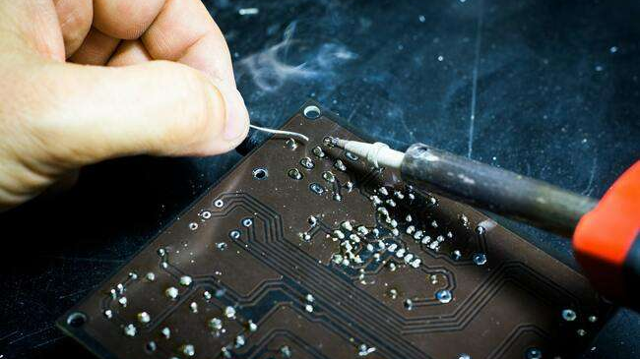
INTRODUCTION TO SOLDERING
Soldering is one of the most fundamental skills needed to dabble in the world of electronics. The two go together like peas and carrots. And, although it is possible to learn about and build electronics without needing to pick up a soldering iron, you’ll soon discover that a whole new world is opened with this one simple skill. Soldering is the only permanent way to ‘fix’ components to a circuit.

Slide 15
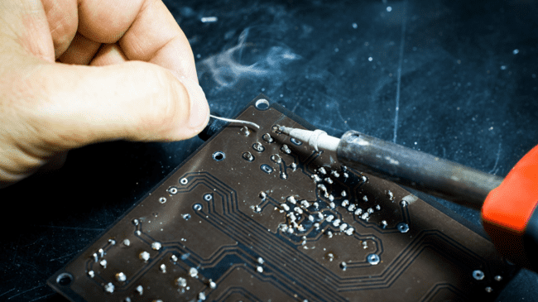
STEPS FOR SOLDERING
Collecting Materials for Soldering
Preparing to Solder
Soldering a PCB

Slide 16
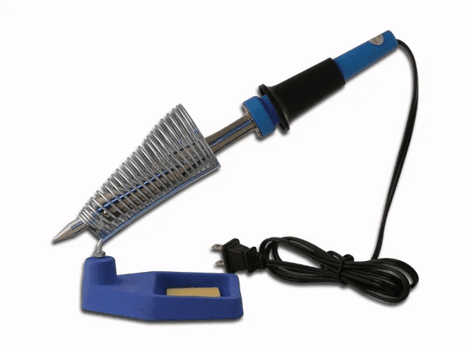
COLLECTING MATERIAL FOR SOLDERING
Soldering Irons
Here are the basic parts that make up a soldering iron:
Tip - The tip is the part of the iron that heats up and allows solder to flow around the two components being joined. The tip transfers heat, raising the temperature of the metal components to the melting point of the solder, and the solder melts accordingly. Most irons give you the option to change your tip, should you need to replace an old tip or if you need to switch to a different style of tip. Tips come in a variety of sizes and shapes to accommodate any component.
Wand - The wand is the part of the iron that holds the tip. This is also the part that is handled by the user. Wands are usually made of a variety of insulating materials (such as rubber) to prevent the heat of the tip from transferring to the outside of the wand.

Slide 17
PREPARING TO SOLDER
Step 1: Warm Up The Iron:
Warm up the soldering iron or gun thoroughly. Make sure that it has fully come to temperature because you are about to melt a lot of solder on it. This is especially important if the iron is new because it may have been packed with coating to prevent corrosion.
Step 2: Prepare A Little Space:
While the soldering iron is warming up, prepare a little space to work. Moisten a little sponge and place it in the base of your soldering iron stand or in a dish close by. Lay down a piece of cardboard in case you drip solder (you probably will) and make sure you have room to work comfortably.

Slide 18
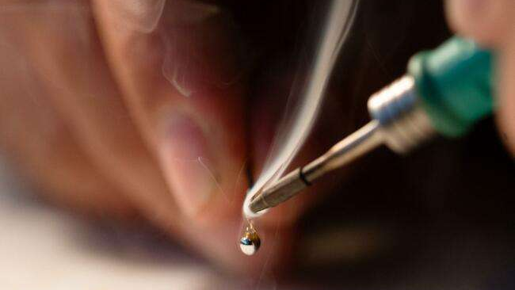
PREPARING TO SOLDER
Step 3: Thoroughly Coat The Tip In Solder:
Thoroughly coat the soldering tip in solder. It is very important to cover the entire tip. You will use a considerable amount of solder during this process, and it will drip, so be ready.
Step 4: Clean The Soldering Tip:
After you are certain that the tip is totally coated in solder, wipe the tip off on the wet sponge to remove all the flux residue. Do this immediately so there is no time for the flux to dry out and solidify.
Step 5: You're Done!:
You have just tinned your soldering tip. This must be done anytime you replace the tip or clean it so that the iron maintains good heat transfer.

Slide 19
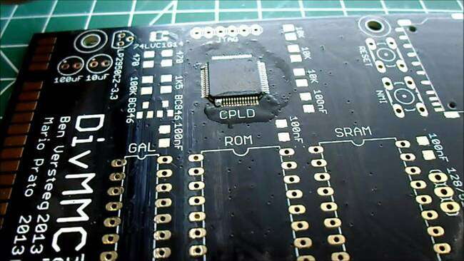
SOLDERING A PCB
Step 1: Surface Preparation:
A clean surface is very important if you want a strong, low resistance solder joint. All surfaces to be soldered should be cleaned well.
This Photo by Unknown Author is licensed under CC BY-SA

Slide 20
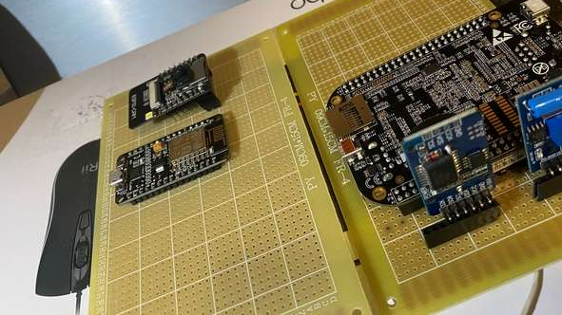
SOLDERING A PCB
Step 2: Component Placement:
After the component and board have been cleaned, you are ready to place the components onto the board.
Therefore, we are placing the following components on the Zero PCB board:
Beaglebone Black
ESP32 CAM Module
ESP8266 Module
RTC Module
Vibrator Sensor

Slide 21
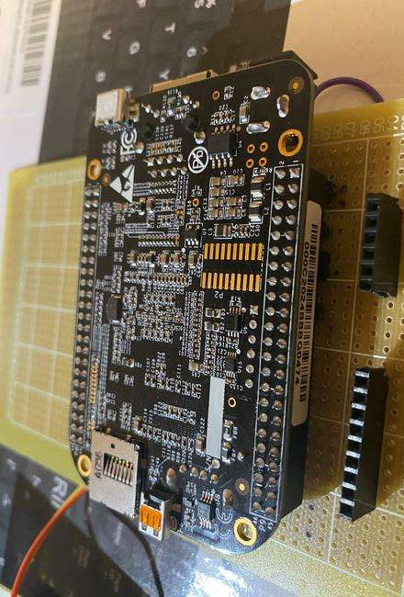
COMPONENT PLACEMENT
Soldering the Beaglebone Black on Zero PCB
For the zero PCB Implementation(Part-1) we are soldering the header 9 of the beaglebone black only as shown.

Slide 22
CONNECTIONS
RTC MODULE | BEAGLEBONE BLACK
SCL | P9.19
SDA | P9.20
Vcc | Vcc
GND | GND
Connecting the RTC(Real-time Clock) with the Beaglebone Black:
Real time clock is connected using I2C communication protocol.
RTC is connected directly to the beagle bone to determine the real time on screen as BBB does not have inbuilt RTC.

Slide 23
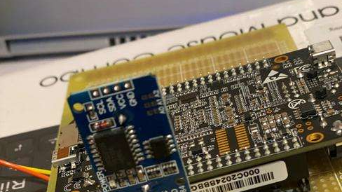
CONNECTIONS OF RTC WITH BEAGLEBONE BLACK

Slide 24
CONNECTIONS
Connecting the Vibrator Sensor with the Beaglebone Black:
Vibration sensor is connected directly to the beaglebone black with the help of GPIO pins.
This sensor is used to detect any unauthorized access by hammering the locker.
We are connecting the D0 pin of Vibrator sensor to the header 9 of beagle black to pin 12.

Slide 25
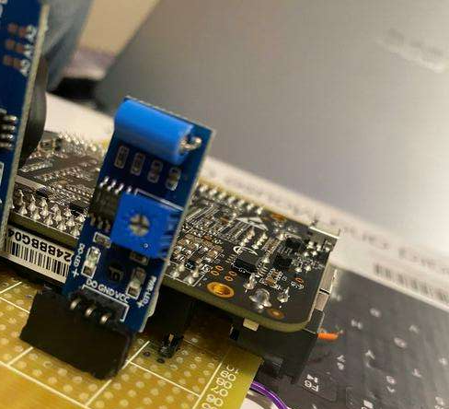
CONNECTIONS OF VIBRATION SENSOR WITH BEAGLEBONE BLACK

Slide 26
CONNECTIONS OF ESP8266 MODULE WITH BEAGLEBONE BLACK
ESP8266 is communicating with beagle bone by UART communication.
We are using the ESP8266 in this project just for the interfacing of touch screen.
ESP8266 MODULE | BEAGLEBONE BLACK
P9.24 | P19 Rx
P9.26 | P18 Tx

Slide 27
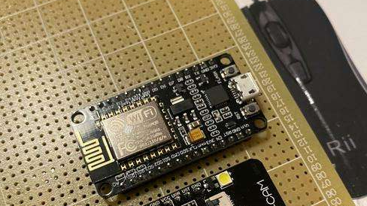
CONNECTIONS

Slide 28
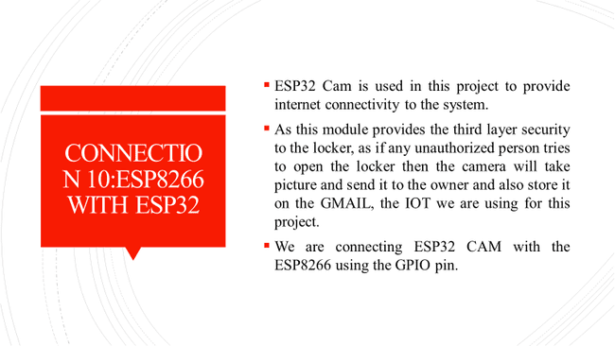
CONNECTIONS OF ESP32 CAM MODULE TO ESP8266 MODULE

Slide 29
SOLDERING A PCB
Step 3: Apply Heat:
Apply a very small amount of solder to the tip of the iron. This helps conduct the heat to the component and board, but it is not the solder that will make up the joint. To heat the joint, you will lay the tip of the iron so that it rests against both the component lead and the board.

Slide 30
SOLDERING A PCB
Step 4: Apply Solder To The Joint:
Once the component lead and solder pad has heated up, you are ready to apply solder. Touch the tip of the strand of solder to the component lead and solder pad, but not the tip of the iron. If everything is hot enough, the solder should flow freely around the lead and pad.
Step 5: Inspect The Joint and Cleanup:
Once the joint is made you should inspect it. Check for cold joints (described a little above and at length below), shorts with adjacent pads or poor flow. If the joint checks out, move on to the next. To trim the lead, use a small set of side cutters and cut at the top of the solder joint. After you have made all the solder joints, it is good practice to clean all the excess flux residue from the board.

Slide 31
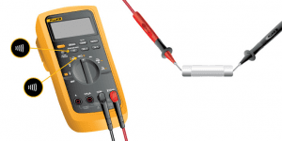
TESTING WITH MULTIMETER
You can also use the continuity function on your multimeter to test a solder joint. First, set your multimeter to continuity mode (looks like sound waves going out left to right in a cone shape). Touch the leads together and make sure the multimeter beeps.
Now, touch the leads to two points on opposite sides of your solder joint. The multimeter will beep if there is continuity detected. This means that conductive material (i.e. your solder joint) is connecting the points between your leads and that the solder joint is good from a continuity standpoint. If the multimeter does not beep, you do not have continuity.

Slide 32
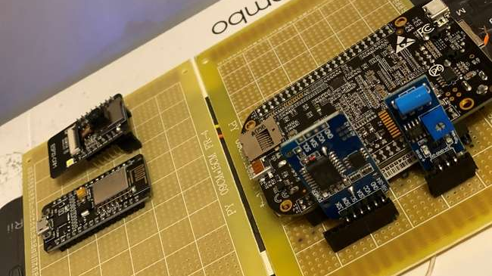
OUTPUT(TOP VIEW)

Slide 33
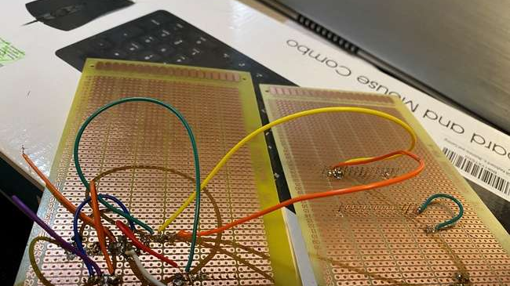
OUTPUT(BOTTOM VIEW)

Slide 34
REFERENCES
INTRODUCTION TO PCB: https://www.electronicsforu.com/technology-trends/learn-electronics/veroboard-zero-pcb-difference
STEPS FOR ZERO PCB DESIGNING: https://www.instructables.com/Simple-PCB-soldering/
TYPES OF ZERO PCB: https://www.theengineeringprojects.com/2018/03/different-types-of-pcb-printed-circuit-board.html
TESTING WITH MULTIMETER: https://multimeterexpert.com/use-multimeter-test-solder-joint/
YOUTUBE: https://www.youtube.com/watch?v=-JI3spJFX5w

Slide 35
THANK YOU

