Slide 1

A SEMINAR REPORT ON “LI-FI Technology” Submitted to the Gondwana University , Gadchiroli. As partial fulfillment of MCA – 2 nd( Sem -IV) Submitted by MR. Nilesh M. Urkude Guided by Asst. Prof. Leena Nasre Department of Computer Studies & Research Sardar Patel Mahavidyalaya , Chandrapur Session 2022-23

Slide 2

Presented by : Nilesh Madhav Urkude

Slide 3
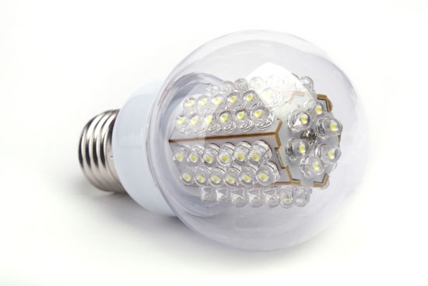
WHAT IS LI – FI ?
LI-FI is transmission of data through illumination, sending data through a LED light bulb that varies in intensity faster than human eye can follow

Slide 4
INTRODUCTION OF LI-FI
Li-Fi stands for ‘Light Fidelity’.
It is a VLC(Visible Light Communication), technology developed by team of scientists including Dr. Gorden Povey, Prof. Harald Hass and Dr. Mostafa Afgani at University of Edinburgh
Li Fi is now part of Visible Light Communication(VLC) PAN IEEE 802.15.7 Standard.”Li-Fi is typically implemented using white LED light bulbs”.
These device are normally used for illumination by Appling a constant current through the LED
Li-Fi is the term have been used to label the fast and cheap wireless communication system, which is the optical version of Wi –Fi .
Li-Fi is light based Wi-Fi that is, it uses light instead of radio waves to transmit information

Slide 5
IMPORTANT ABOUT LI-FI
Instead of Wi-Fi modems, Li-Fi would use transceivers-fitted LED lamps that can light a room as well as transmit and receive information
This technology uses a part of the electromagnetic spectrum that is still not greatly utilized- The Visible Spectrum.
Li-Fi , as it has been dubbed , has already achieved high speeds in the lab. Researchers at the Heinrich Hertz Institute in Berlin,germany, have reached data rates over 500 megabytes per second using a standard white-light LED.
It is capable of transmitting data at 100 MB/s

Slide 6
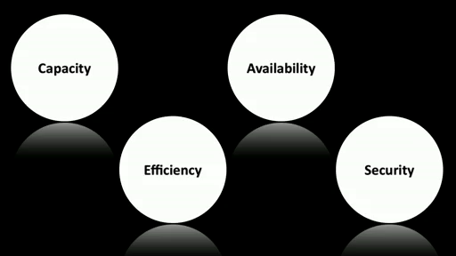
Issues Regarding Radio-spectrum

Slide 7
Capacity
Radio waves
Cost and Expensive
Less Bandwidth compared to other spectrums
Insufficient spectrum for increasing data

Slide 8
Efficiency
Millions of base stations consume huge amount of energy for
1.Transmitting the radio waves
2.To cool the base station cabins
5% Efficiency

Slide 9
Availability
Available within the range of Base stations
Limited availabity
Unavailable in aircrafts
Security:
Less secure(passes through the walls)

Slide 10
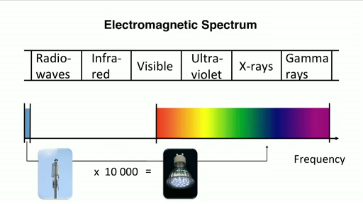

Slide 11
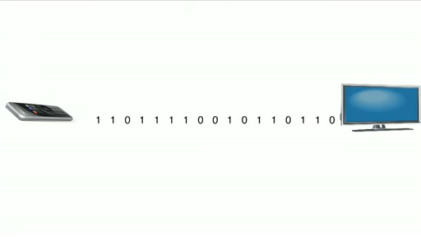
Infrared rays in Remote control
Single data stream
20000 bits per second
Not usable for video streaming

Slide 12
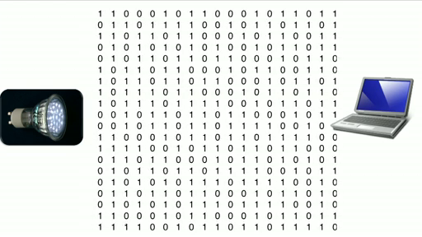
LI-FI

Slide 13
Working of Li- Fi
The brilliant idea was first showcased by Prof. Harald Hass in his TED Global Talk on VLC.
He explained ,”very simple, if the LED is on, you transmit a 1 and when LED off transmit a 0.The LED can be switched on and off very quickly, which gives nice opportunities for transmitting data.”
Further enhancements can be made in this method, like using an array of LEDs for parallel data transmission, or using mixtures of red, green and blue LEDs to alter the light’s frequency encoding a different data channel.

Slide 14
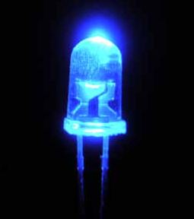

Transmitting element
LED
Fluorescent Lamp

Slide 15
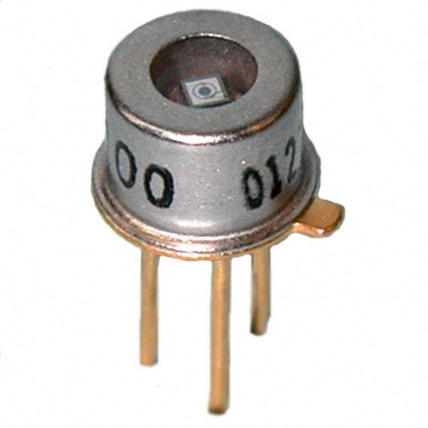
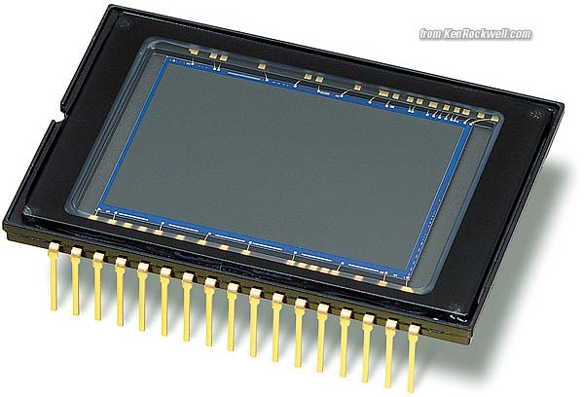
Receiving element (Detector)
Avalanche Photo Diode
Image Sensors

Slide 16
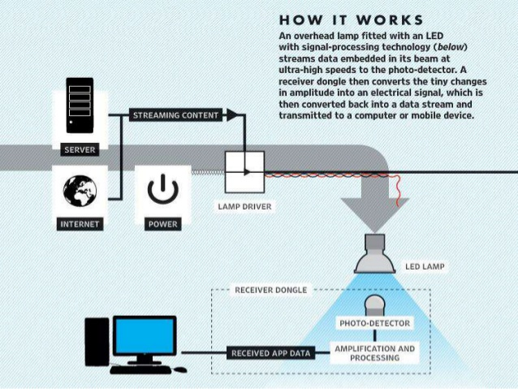
Working process

Slide 17
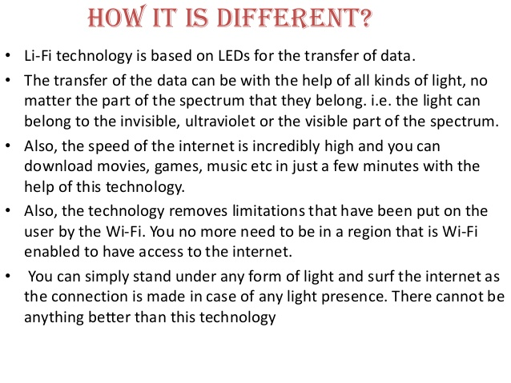

Slide 18
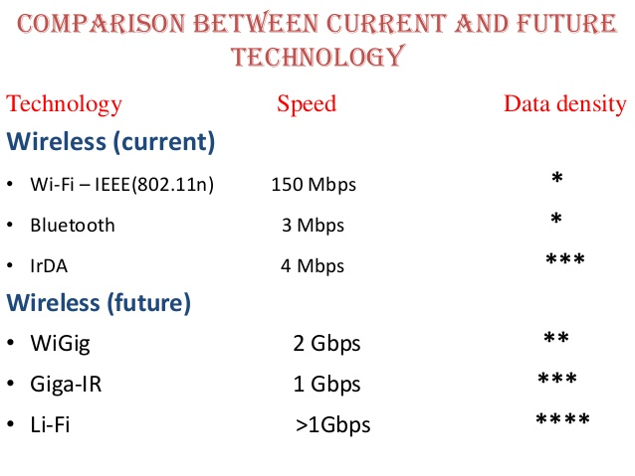

Slide 19
Advantages and Disadvantages
Advantages
Larger bandwidth (10,000 times the radio bandwidth)
High efficiency
More availability
Highly secure

Slide 20
Disadvantages
Presence of Light is essential
There will be interference from sunlight
You need special LEDs

Slide 21
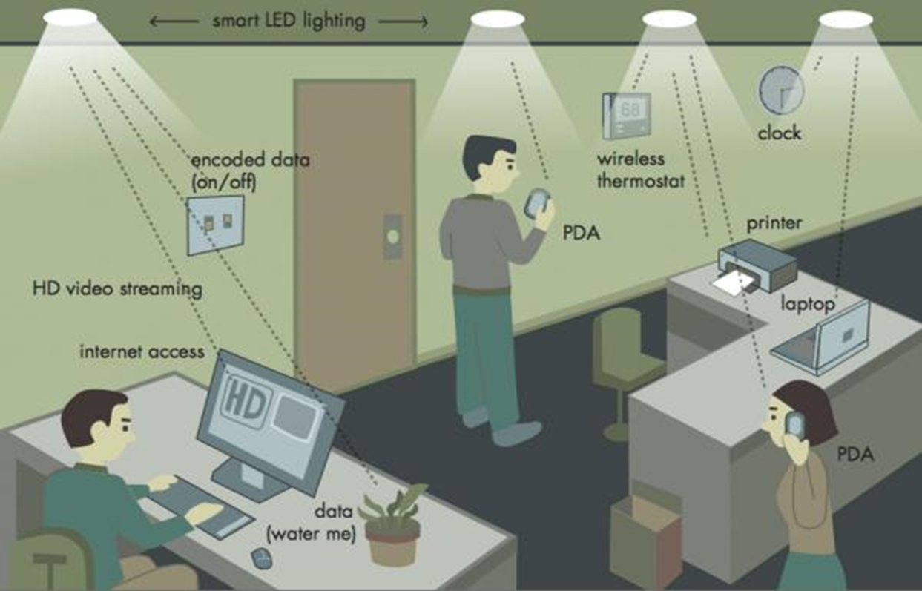
In Offices and Home as smart LED Lightings

Slide 22
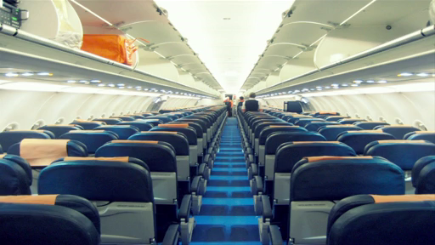
In Aircraft cabins

Slide 23

In RF restricted Environments

Slide 24
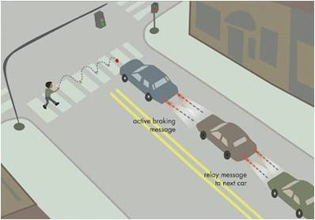
In Traffic lighting

Slide 25
Conclusion
Overcomes the limitations of radio spectrum
High speed of 10 Gbps can be achieved
Li-fi can solve the for essential problems of wireless communications these days

Slide 26


