Slide 1
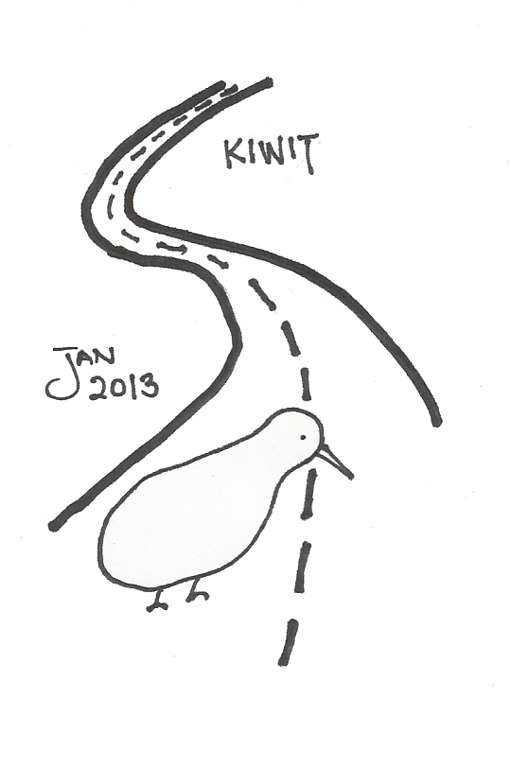
Misfitbrew.org/recipes/kiwit
Misfitbrew.org/recipes/kiwit
KiWit
Misfit.open.source.brew
Malts
1/2 lb torrified wheat
1 lb honey malt
1/4 lb Victory!
1/4 lb carapils
Steep at 160 for 45min
Add 5lb liquid wheat malt extract (half now, half with 10 min to go)
Hops
1 oz Tettnanger 60 min
1/2 oz Willamette 10 min
Additions
whirlfloc tablet 10 min
1/2-1oz coriander seed 10 min
4 lbs diced Kiwis skin on 10 min
(Optional) 1/2 - 1lb honey. Flame out.
Yeast
Belgian witbier 3944
Secondary
If you like, 4-8 oz Matcha
Kiwi Honey Wit
KiWit
Misfit.open.source.brew
Malts
1/2 lb torrified wheat
1 lb honey malt
1/4 lb Victory!
1/4 lb carapils
Steep at 160 for 45min
Add 5lb liquid wheat malt extract (half now, half with 10 min to go)
Hops
1 oz Tettnanger 60 min
1/2 oz Willamette 10 min
Additions
whirlfloc tablet 10 min
1/2-1oz coriander seed 10 min
4 lbs diced Kiwis skin on 10 min
(Optional) 1/2 - 1lb honey. Flame out.
Yeast
Belgian witbier 3944
Secondary
If you like, 4-8 oz Matcha
Kiwi Honey Wit

