Slide 1
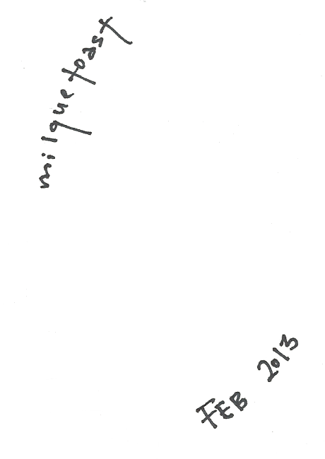

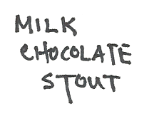
Misfitbrew.com/recipes/milquetoast
Misfitbrew.com/recipes/milquetoast
Milquetoast
A chocolate milk stout
Misfit.open.source.brew
Malts
1 lb chocolate malt
1 lb german chocolate wheat malt
1 lb roast barley
8 oz carafa (dehusked)
½ lb medium british crystal 60
½ lb victory
¾ lb British malted oats
Steep at 165 for 45min
7lbs Light liquid malt extract.
Half 60 min, the rest 5 min
Hops
1 oz Northern Brewer 60 min
1 oz Mt Hood 15 min
Additions
1 lb lactose 5 min
8oz cacao nibs in hops bag 5 min leave bag in fermenter
whirlfloc tablet 5 min
Yeast
Wyeast 1084
Milquetoast
A chocolate milk stout
Misfit.open.source.brew
Malts
1 lb chocolate malt
1 lb german chocolate wheat malt
1 lb roast barley
8 oz carafa (dehusked)
½ lb medium british crystal 60
½ lb victory
¾ lb British malted oats
Steep at 165 for 45min
7lbs Light liquid malt extract.
Half 60 min, the rest 5 min
Hops
1 oz Northern Brewer 60 min
1 oz Mt Hood 15 min
Additions
1 lb lactose 5 min
8oz cacao nibs in hops bag 5 min leave bag in fermenter
whirlfloc tablet 5 min
Yeast
Wyeast 1084

