Slide 1
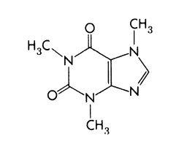
Misfitbrew.org/recipes/xpstumpy
Misfitbrew.org/recipes/xpstumpy
XP.STUMPY
Misfit.open.source.brew
Malts
1lb crystal 60
1lb honey malt
1/2lb Victory!
1lb US chocolate
4oz Carafa II
4oz light roast barley
1/2lb choc wheat
1/2lb pale choc
Steep at 160 for 45min
Add 7lb light liquid malt extract (half now, half with 10 min to go)
Hops
1 oz Northern Brewer 60 min
1 oz Kent Goldings 15 min
Additions
whirlfloc tablet 5 min
1 lb cold-brewed Stumptown coffee. Add to primary fermenter after 3 days.
Yeast
A clean-burning ale yeast like S05, Wyeast 1084 or WLP English
Xanthine.porter.series
XP.STUMPY
Misfit.open.source.brew
Malts
1lb crystal 60
1lb honey malt
1/2lb Victory!
1lb US chocolate
4oz Carafa II
4oz light roast barley
1/2lb choc wheat
1/2lb pale choc
Steep at 160 for 45min
Add 7lb light liquid malt extract (half now, half with 10 min to go)
Hops
1 oz Northern Brewer 60 min
1 oz Kent Goldings 15 min
Additions
whirlfloc tablet 5 min
1 lb cold-brewed Stumptown coffee. Add to primary fermenter after 3 days.
Yeast
A clean-burning ale yeast like S05, Wyeast 1084 or WLP English
Xanthine.porter.
series

