Slide 1
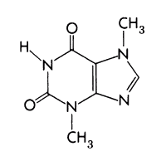
Misfitbrew.org/recipes/xpTHEO
Misfitbrew.org/recipes/xpTHEO
XP.Theo
Misfit.open.source.brew
Malts
1lb crystal 60
1lb honey malt
1/2lb victory
1/2lb US chocolate
4oz Carafa II
4oz light roast barley
1/2lb pale choc
Steep at 165 for 45min
Add 7lb light liquid malt extract (half now, half with 10 min to go)
Hops
1 oz Northern Brewer 60 min
1 oz Kent Goldings 15 min
Additions
whirlfloc tablet 5 min
¼ to 1/2 lb cacao nibs in hops bag. Add at 10 min. After boil, fish out & put into primary.
Yeast
Wyeast 1084
Xanthine.porter.series
XP.Theo
Misfit.open.source.brew
Malts
1lb crystal 60
1lb honey malt
1/2lb victory
1/2lb US chocolate
4oz Carafa II
4oz light roast barley
1/2lb pale choc
Steep at 165 for 45min
Add 7lb light liquid malt extract (half now, half with 10 min to go)
Hops
1 oz Northern Brewer 60 min
1 oz Kent Goldings 15 min
Additions
whirlfloc tablet 5 min
¼ to 1/2 lb cacao nibs in hops bag. Add at 10 min. After boil, fish out & put into primary.
Yeast
Wyeast 1084
Xanthine.porter.series

